Slide 1
CS 309A- Database Management Systems
Introduction to relational model

Slide 2

Basics of The Relational Model
Foundation: relation (also called table)
is a matrix composed of intersection rows and columns.
Each row in a relation is called a tuple.
Each column represents an attribute.
The relational data model is implemented through relational database management system (RDBMS).
The most important advantage of the RDBMS is to hide the complexities of the relational model from the user.
attribute
tuple

Slide 3
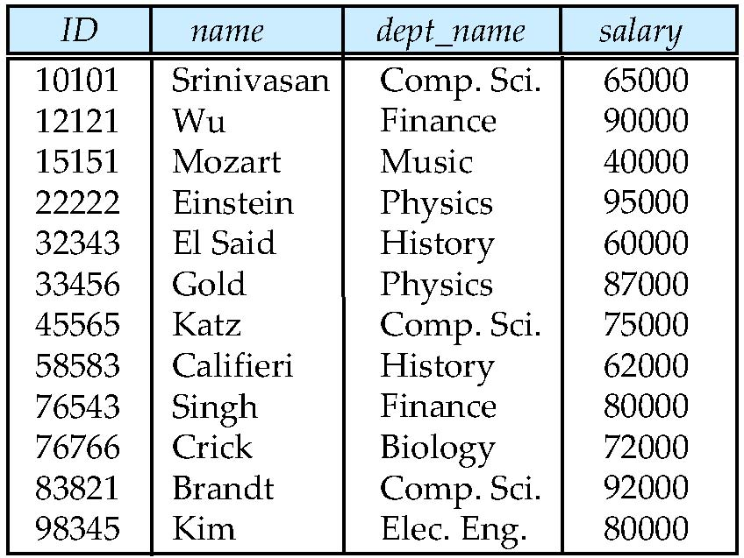
Another example of a Relation
attributes
(or columns)
tuples
(or rows)

Slide 4
Attribute Types
The set of allowed values for each attribute is called the domain of the attribute
Attribute values are (normally) required to be atomic; that is, indivisible
The special value null is a member of every domain. Indicated that the value is “unknown”
The null value causes complications in the definition of many operations

Slide 5
Relation Schema and Instance
A₁, A₂, …, A_{n} are attributes
R = (A₁, A₂, …, A_{n} ) is a relation schema
Example: instructor = (ID, name, dept_name, salary)
Formally, given sets D₁, D₂, …. D_{n} , a relation r is a subset of D₁ x D₂ x … x D_{n .}Thus, a relation is a set of n-tuples (a₁, a₂, …, a_{n}) where each a_{i} ∈ D_{i}
The current values (relation instance) of a relation are specified by a table
An element t of r is a tuple, represented by a row in a table

Slide 6
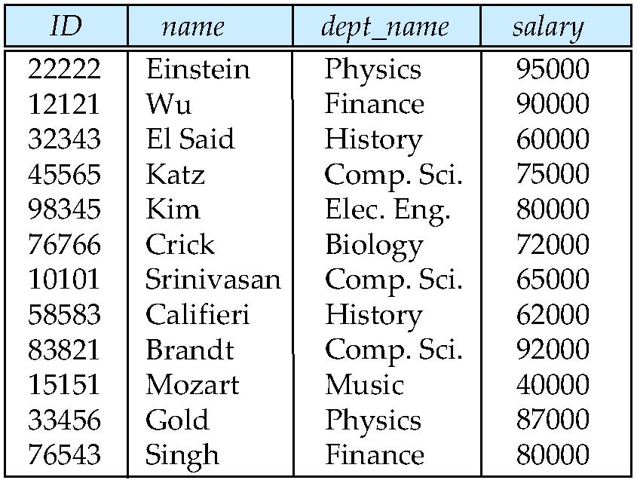
Relations are Unordered
Order of tuples is irrelevant (tuples may be stored in an arbitrary order)
Example: instructor relation with unordered tuples

Slide 7
keys
In the relational model, keys are used to:
Ensure that each row in a table is uniquely identifiable
Establish relationships among tables
Ensure the integrity of the data
A key consists of one or more attributes that determines other attributes.

Slide 8
Some concepts
Determination: a state that knowing the value of one attribute makes it possible to know the value of another.
total_price = unit_price * count
Functional dependence: the value of one or more attributes determines the value of one or more other attributes.
STU_NUM → STU_LNAME
determinant (key)
dependent
STU_NUM → (STU_LNAME, STU_FNAME, STU_GPA)
(STU_FNAME, STU_LNAME, STU_INIT, STU_PHONE) → (STU_DOB, STU_HRS, STU_GPA)

Slide 9
Some concepts
Full functional dependence: the entire collection of attributes in the determinant is necessary for the relationship.
Which one is full functional dependence?
1) STU_NUM → STU_GPA
2) (STU_NUM, STU_LNAME) → STU_GPA

Slide 10
Types of Keys
Composite key: composed of more than one attribute
STU_NUM -> GPA (Is not a composite key)
(STU_LNAME, STU_FNAME, STU_INIT, STU_PHONE) → STU_HRS (Is a composite key)
Superkey: can uniquely identify any row in the table
a superkey functionally determines every attribute in the row
STU_NUM, (STU_NUM, STU_LNAME), (STU_LNAME, STU_FNAME, STU_INIT)
Candidate key: a minimal superkey; a superkey without any unnecessary attributes
In the above superkeys, which are candidate keys?
A table can have many different candidate keys.

Slide 11
Types of Keys: primary key
The primary key is a candidate key chosen to ensure entity integrity.
Entity integrity: each row in the table has its own unique identity
To ensure entity integrity, the primary key has two requirements:
All of the values must be unique
No key attribute can contain a null
Another role that the primary key plays is to build relationships between tables.
The absence of any data value.
Nulls should be avoided in the database.

Slide 12
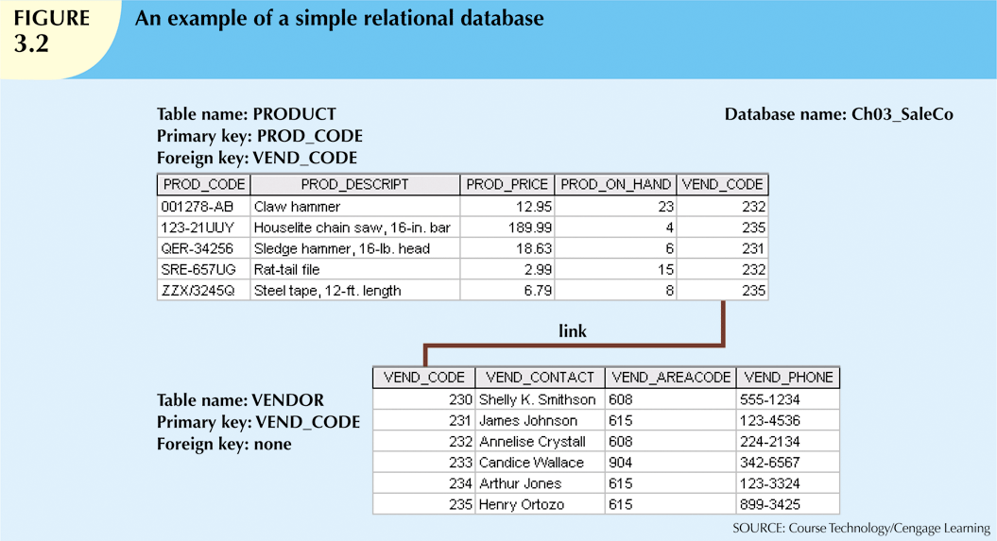
The relational model uses common attributes to link tables.

Slide 13
Types of Keys: foreign key
A Foreign key is the primary key of one table that has been placed into another table to create a common attribute, which are used to ensure referential integrity.
Referential integrity: every reference to an entity occurrence (instance) by another entity occurrence (instance) is valid.
Every foreign key entry must either be null or a valid value in the primary key of the related table.

Slide 14
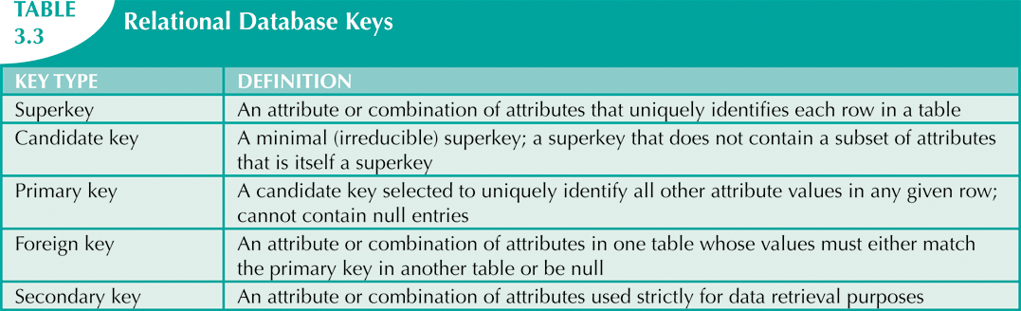
Types of Keys
Secondary key: a key used for data retrieval purpose.
May not yield a unique identify

Slide 15
Integrity Rules
Very important to good database design
RDBMS enforce integrity rules automatically
Safer to ensure that application design conforms to the entity and referential rules

Slide 16
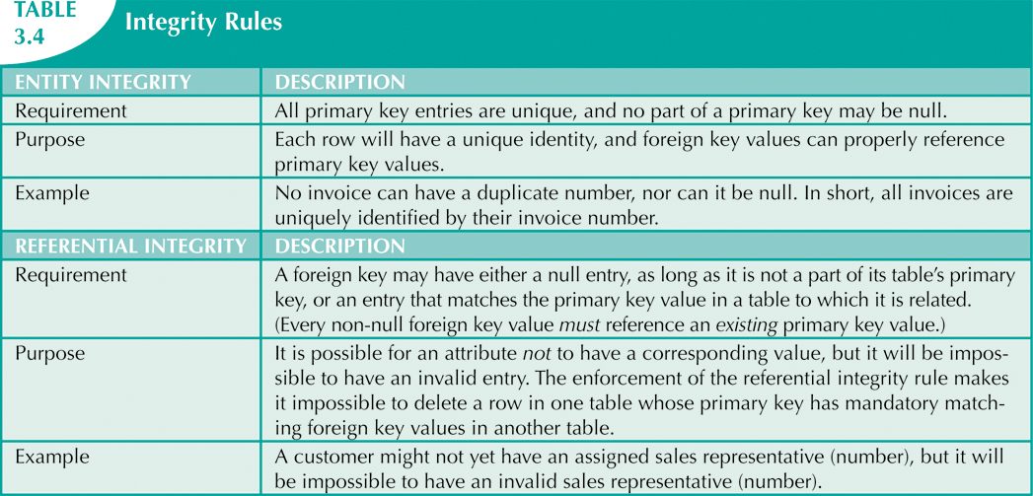
Integrity Rules

Slide 17
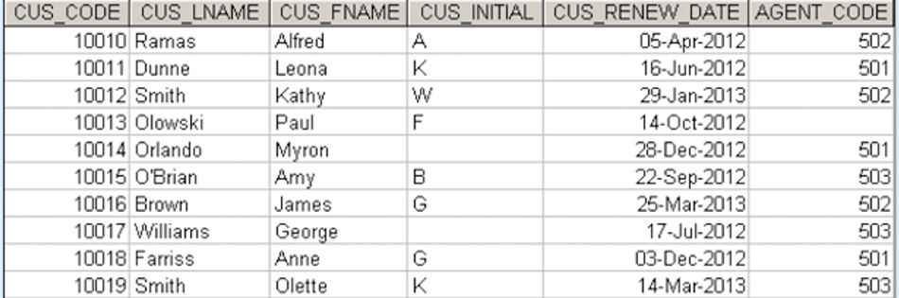
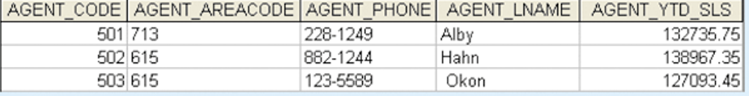
Customer Table and Agent table

Slide 18
Answer the following questions:
What is the primary key in the CUSTOMER table? How does it ensure the entity integrity?
What is the foreign key in the CUSTOMER table? How does it ensure the referential integrity?

Slide 19
Another Example
Consider the following two tables : Enrolled and Students
What is the primary key in the Students table? How does it ensure the entity integrity?
What is the foreign key in the Enrolled table? How does it ensure the referential integrity?
Enrolled
Students
sid
cid
grade
53666
Carnatic101
C
sid
name
login
age
gpa
53666
Reggae203
B
53666
Jones
jones@cs
18
3.4
53650
Topology112
A
53688
Smith
smith@eecs
18
3.2
53666
History105
B
53650
Smith
smith@math
19
3.8
FOREIGN Key
PRIMARY Key

Slide 20
Relational Query Languages
Procedural vs .non-procedural, or declarative
“Pure” languages:
Relational algebra
Tuple relational calculus
Domain relational calculus
The above 3 pure languages are equivalent in computing power
We will concentrate on relational algebra
Not turning-machine equivalent

Slide 21
Relational Algebra
The data in relational tables has limited value.
However, we can use relational algebra to manipulate data to get more useful information.
The relational operators have the property of closure, that is, the use of relational algebra operators on existing relations (tables) produces new relations (tables).

Slide 22
Example Instances
R1
Boats
S1
S2

Slide 23
Selection (σ)
Selects rows that satisfy selection condition.
Gives a subset of the tuples that match a specified criterion.
Result is a relation.
sid
sname
rating
age
28
yuppy
9
35.0
sname
rating
31
lubber
8
55.5
yuppy
9
44
guppy
5
35.0
rusty
10
58
rusty
10
35.0

Slide 24
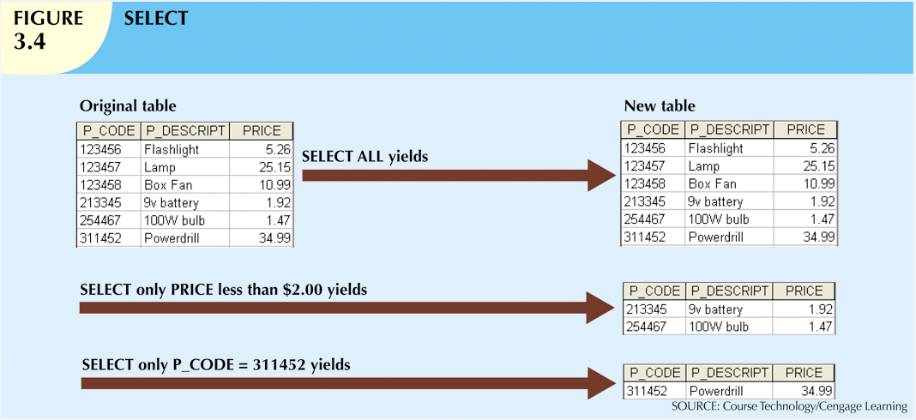
Examples on SELECT: σ

Slide 25
Projection (π)
sname
rating
Gives a subset of the attributes that match a specified criterion.
yuppy
9
lubber
8
guppy
5
rusty
10
S2

Slide 26
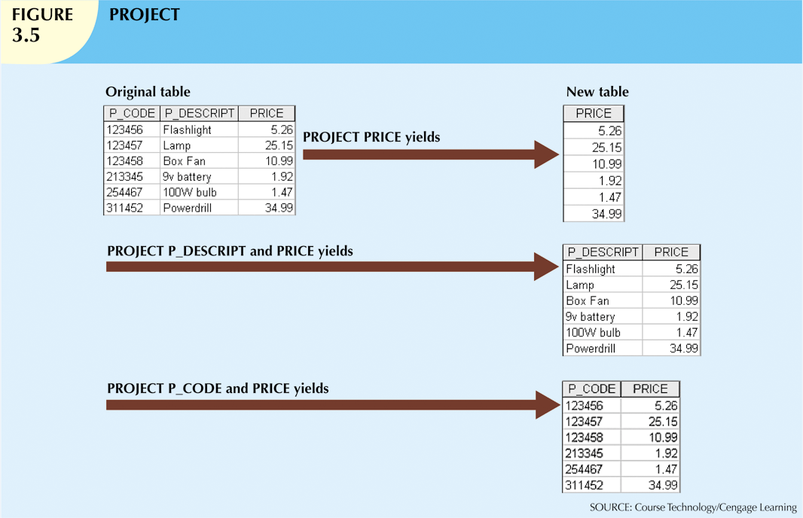
Examples on PROJECT

Slide 27
Union and Set-Difference
Both of these operations take two input relations that are union compatible. Two relations are union compatible if
they have the same number of attributes
the domain of each attribute in column order is the same in both R and S. `Corresponding’ attributes have the same type.

Slide 28
UNION Operation
Consider two relations R and S:
UNION of R and S the union of two relations is a relation that includes all the tuples that are either in R or in S or in both R and S. Duplicate tuples are eliminated.

Slide 29
Union
S1
S2

Slide 30
SET DIFFERENCE Operation
Consider two relations R and S:
DIFFERENCE of R and S the difference of R and S is the relation that contains all the tuples that are in R but that are not in S.
Yields all rows in one table that are not in the other table.
The tables must be union-compatible.

Slide 31
Set Difference
S1
S2 – S1
S2

Slide 32
Cross-Product ((Cartesian Product))
S1 × R1: Each row of S1 paired with each row of R1.
Q: How many rows in the result?
Result schema has one attribute per attribute of S1 and R1, with attribute names `inherited’ if possible.
May have a naming conflict: Both S1 and R1 have a field with the same name.
In this case, can use the renaming operator:

Slide 33
Cross Product Example
R1
S1
S1 x R1 =

Slide 34
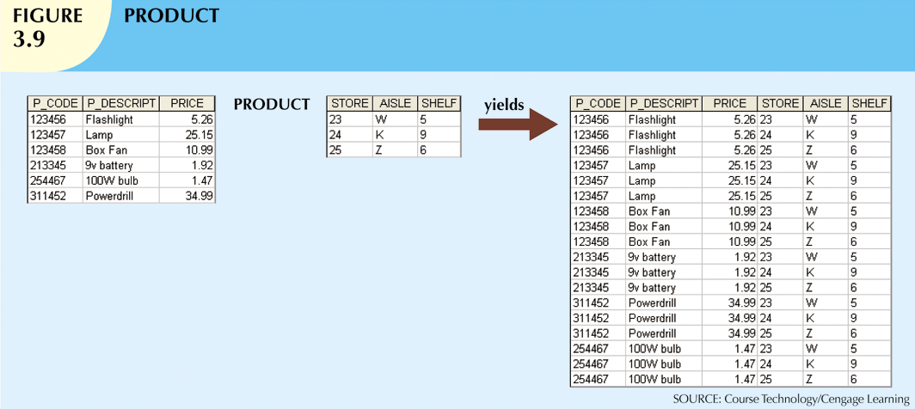

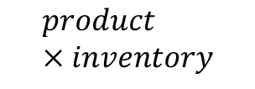
Cross Product (Cartesian Product): $×$
Yields all possible pairs of rows from two tables.
$$product×inventory$$
inventory
product

Slide 35
Relational Algebra: 5 Basic Operations
Selection ( σ ) Selects a subset of rows from relation (horizontal).
Projection ( π ) Retains only wanted columns from relation (vertical).
Cross-product ( × ) Allows us to combine two relations.
Set-difference ( — ) Tuples in r1, but not in r2.
Union ( ∪ ) Tuples in r1 or in r2.
Since each operation returns a relation, operations can be composed! (Algebra is “closed”.)

Slide 36
Compound Operator: Intersection
In addition to the 5 basic operators, there are several additional “Compound Operators”
These add no computational power to the language, but are useful shorthands.
Can be expressed solely with the basic ops.
Intersection takes two input relations, which must be union-compatible.
Q: How to express it using basic operators?
R ∩ S = R − (R − S)

Slide 37
Intersection
S1
S2

Slide 38

JOIN: $⋈$
Combines information from two or more tables.
Is the real power behind the relational database.
Its simplest form is cross product of the two relations.
As the join becomes more complex, tuples are removed within the cross product to make the result of the join more meaningful.
JOIN allows you to evaluate a join condition between the attributes of the relations on which the join is undertaken.

Slide 39
Compound Operator: Join
Joins are compound operators involving cross product, selection, and (sometimes) projection.
Most common type of join is a “natural join” (often just called “join”).
A natural join links tables by selecting only the rows with common values in their common attributes.

Slide 40
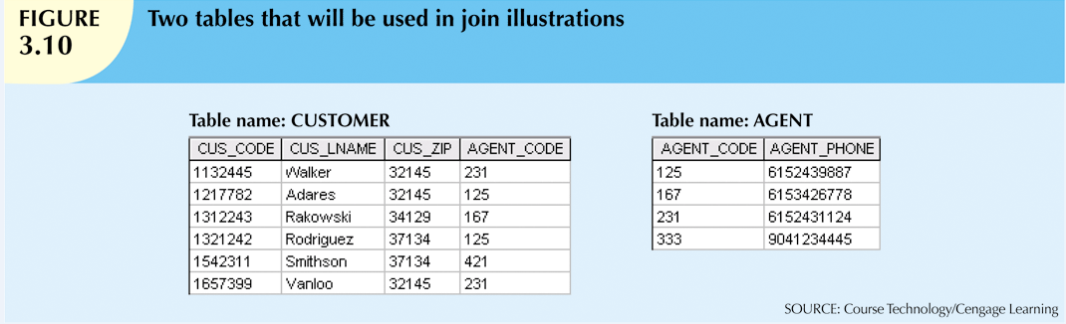

JOIN: natural join
CUSTOMER $⋈$ AGENT
A natural join is the result of a three-stage process.

Slide 41
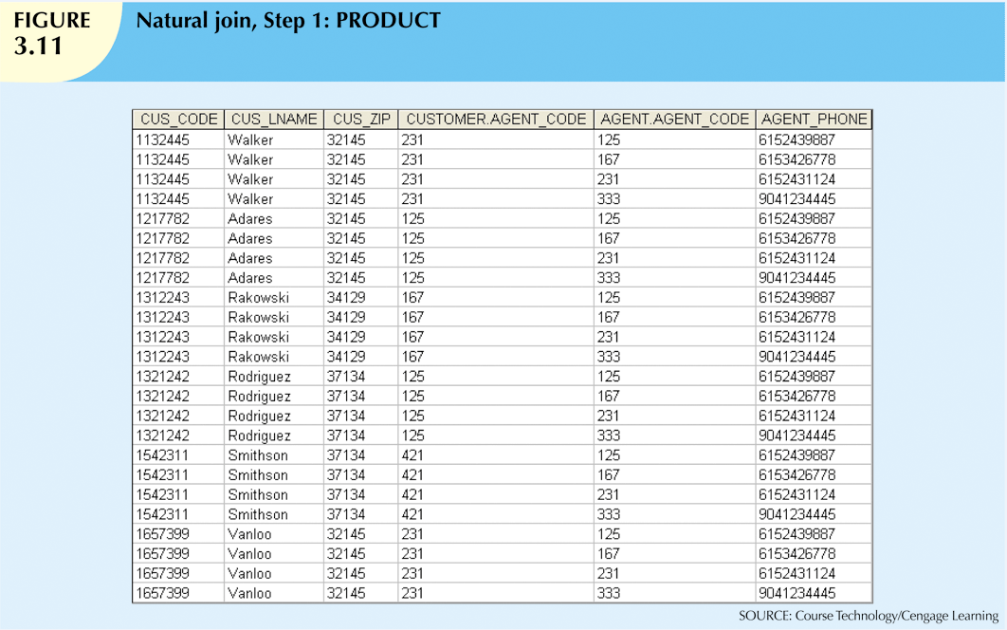
1. Create a PRODUCT of the tables

Slide 42
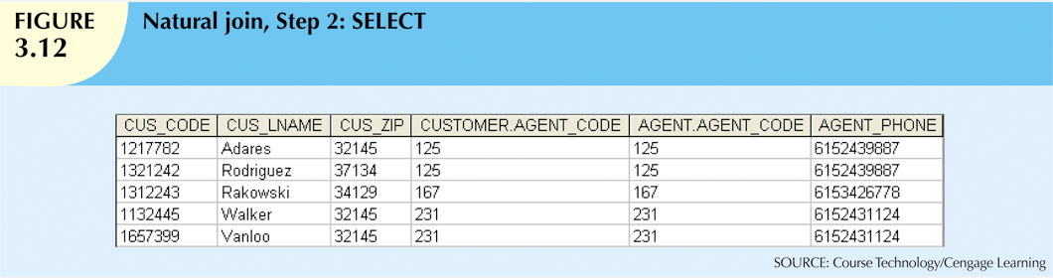
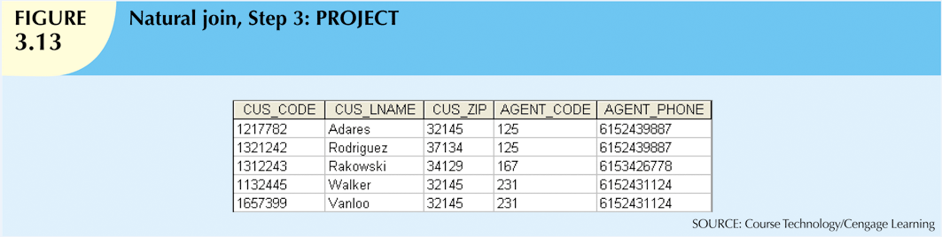
2. Use a SELECT to yield the rows that the join columns (AGENT_CODE) values are equal.
3. Perform a PROJECT to yield a single copy of each attribute (remove duplicate columns).

Slide 43
Natural Join Example
R1
S1
S1 R1 =

Slide 44
JOIN: inner join
An inner join only returns matched records from the tables that are being joined.
Natural join
Equijoin: links tables on the basis of an equality (==) condition that compares specified columns of each table
Theta join: links tables on the basis of any other comparison operator that compares specified columns of each table

Slide 45
JOIN: outer join
In an outer join, the matched pairs would be retained, and any unmatched values in the other table would be left null.
Think of an outer join as an “inner join plus”.
There are three forms of the outer join, depending on which data is to be kept.
LEFT OUTER JOIN - keep data from the left-hand table
RIGHT OUTER JOIN - keep data from the right-hand table
FULL OUTER JOIN - keep data from both tables

Slide 46
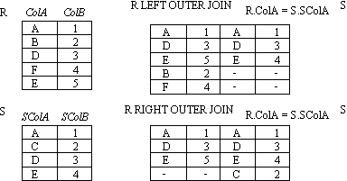
JOIN: outer join example 1

Slide 47
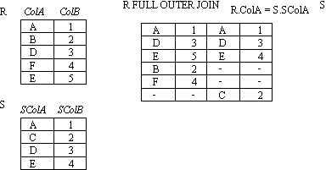
JOIN: outer join example 2

Slide 48
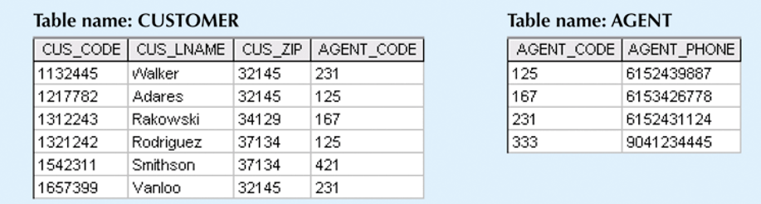

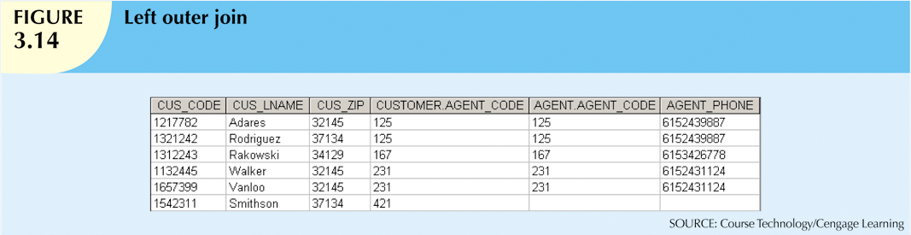
Left outer join: yields all of the rows in the CUSTOMER table
CUSTOMER AGENT

Slide 49

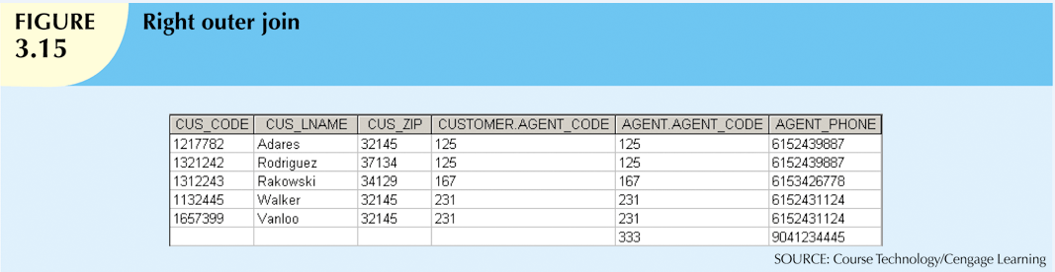
Right outer join: yields all of the rows in the AGENT table
CUSTOMER AGENT

Slide 50
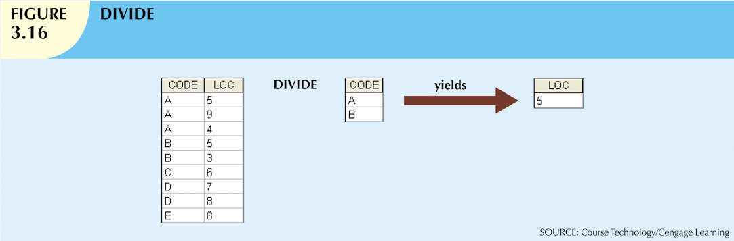


DIVIDE: $÷$
Uses one 2-column table as the dividend and one single-column table as the divisor.
The tables must have a common column.
Outputs a single column that contains all values from the second column of the dividend that are associated with every row in the divisor
Table_1
table_2
$$table_1÷table_2$$

Slide 51

Thank you & Questions

