Slide 1
CS 309A- Database Management Systems

Slide 2
Introduction to SQL
Structured query language (SQL)
Standard query language for relational databases
American National Standards Institute (ANSI) prescribes a standard SQL
Several SQL dialects exist
Enables users to create database objects and manipulate and view data
Basic command set has vocabulary of fewer than 100 words
Basic categories for SQL commands
Data definition language (DDL)
Data manipulation language (DML)
Reserved words
SQL command words

Slide 3
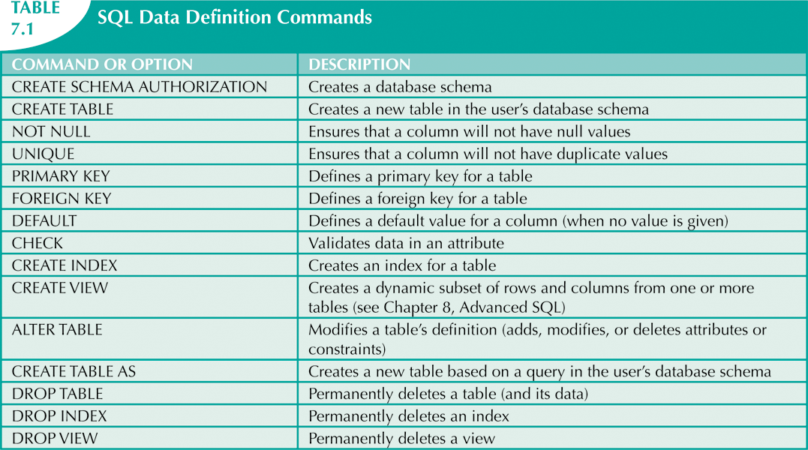
Data Definition Commands

Slide 4
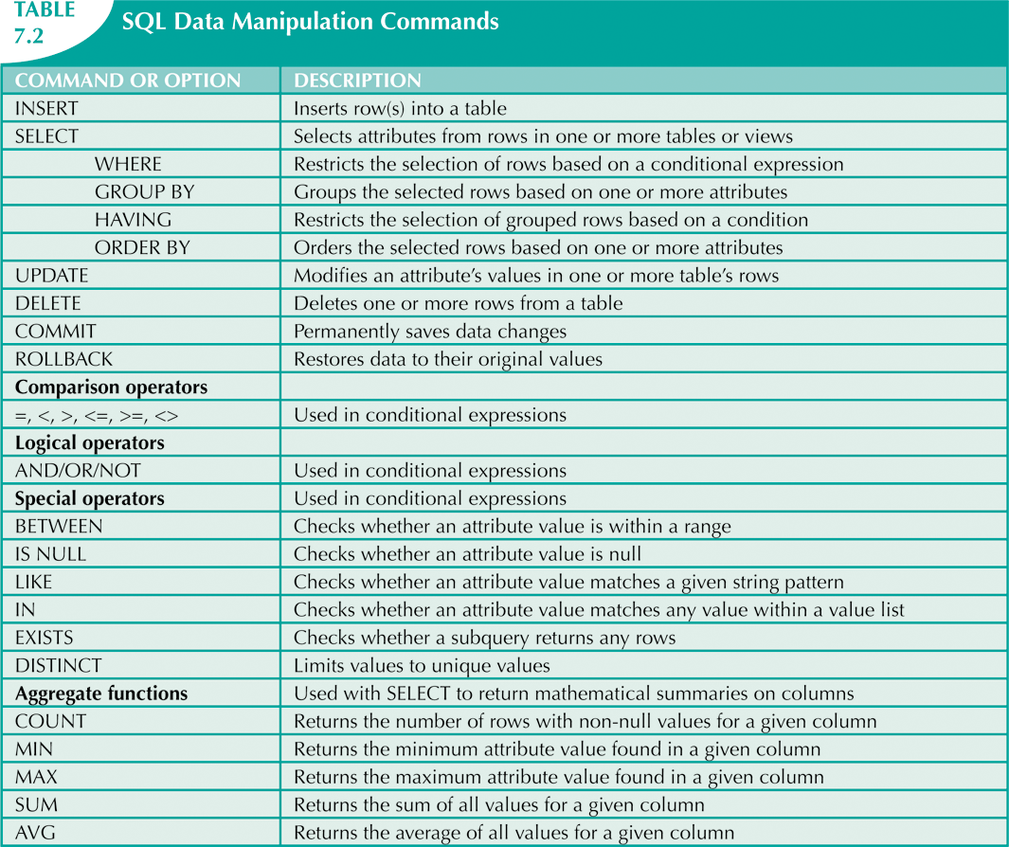
Data Manipulation Commands

Slide 5
Data Types
Data type
Specifies kind of data that column stores
Provides means for error checking
Enable DBMS to use storage space more efficiently
Basic types
String Types
Numeric Types
Date and Time Types

Slide 6
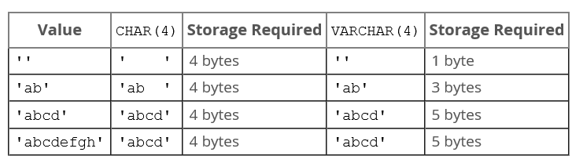
String Types
VARCHAR
Variable-length character data
columnname VARCHAR(maximum_size)
CHAR
Fixed-length character data
columnname CHAR(maximum_size)
VARCHAR values are stored as a 1-byte or 2-byte length prefix plus data.
More detail: https://dev.mysql.com/doc/refman/5.7/en/char.html

Slide 7
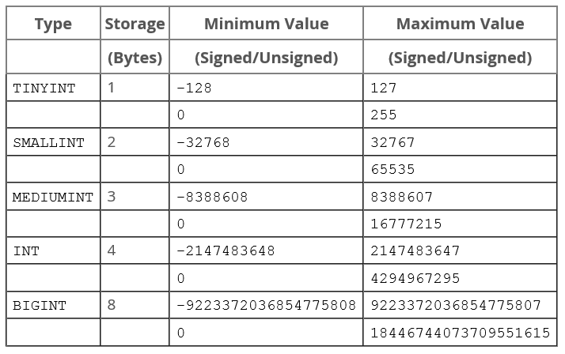
Numeric Types
Integer Types (Exact Value)
columnname INT

Slide 8
Numeric Types
Fixed-Point Type (Exact Value)
DECIMAL/NUMERIC
columnname DECIMAL (precision, scale)
columnname NUMERIC (precision, scale)
Precision--the number of significant digits that are stored for values
Scale--the number of digits that can be stored following the decimal point
For example, the number 123.45 has a precision of 5 and a scale of 2.
These types are used when it is important to preserve exact precision, for example with monetary data.

Slide 9
Numeric Types
Floating-Point Types (Approximate Value)
FLOAT (4 bytes)
DOUBLE PRECISION (8 bytes)
columnname FLOAT (precision, scale)
columnname DOUBLE PRECISION (precision, scale)

Slide 10
Date and Time Data Types
DATE
Used for values with a date part but no time part
‘YYYY-MM-DD’
DATETIME
Used for values that contain both date and time parts
‘YYYY-MM-DD HH:MM:SS’
TIMESTAMP
Used for values that contain both date and time parts
Automatic initialization and updating to the current date and time
TIME
Used for time value
‘HHH:MM:SS’
The hours part may be so large because it can be used to represent elapsed time or a time interval between two events.
YEAR
Used for year value
‘YYYY’

Slide 11
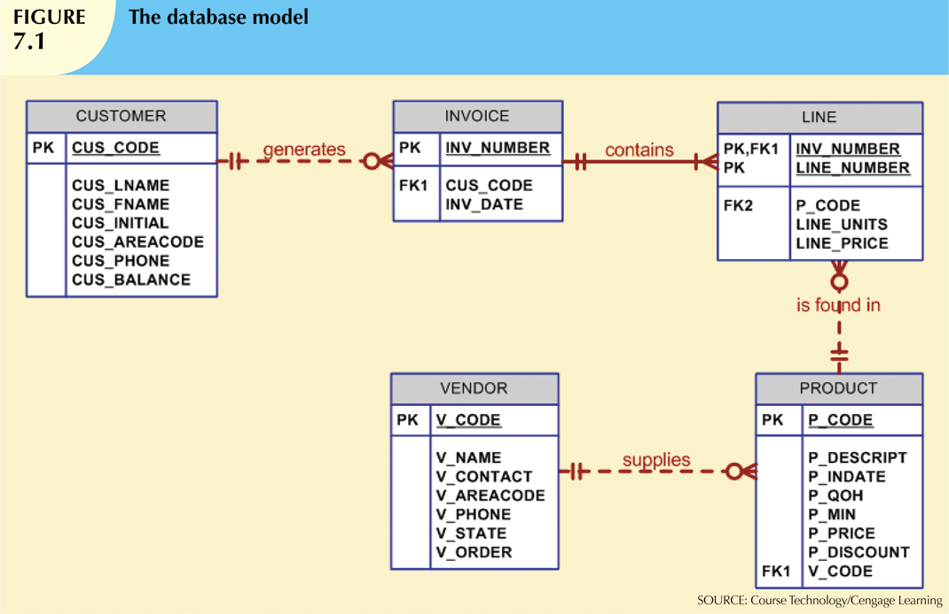
Database model
We will use a simple database (sale) with the following tables to illustrate commands:
CUSTOMER
INVOICE
LINE
PRODUCT
VENDOR

Slide 12
Connecting and Disconnecting to the MySQL
Authentication
DBMS verifies that only registered users are able to access database
Log on to RDBMS using user ID and password created by database administrator
To connect to the MySQL server:
mysql –h hostname –u username -p
hostname: where the MySQL server is running
username: MySQL account
-h: specifies that you are giving the host name of MySQL server
-u: specifies that you are giving a login
-p: specifies that you login requires a password
To disconnect MySQL: quit

Slide 13
Basic MySQL command
MySQL command is case insensitive
Most MySQL commands end with semicolon (;). If you do not end your command with a semicolon (;), MySQL assumes you want to keep typing.

Slide 14
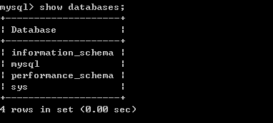
List all databases
SHOW DATABASES;

Slide 15
Create a database
Two tasks must be completed:
Create database structure – data dictionary
Create tables that will hold end-user data
Schema
A logical group of database objects that are related to each other
the schema belongs to a single user or application

Slide 16
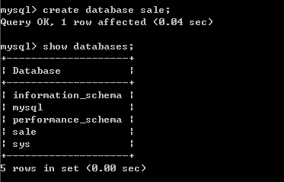
Create a database
CREATE DATABASE database_name;

Slide 17

Select a database
USE database_name

Slide 18
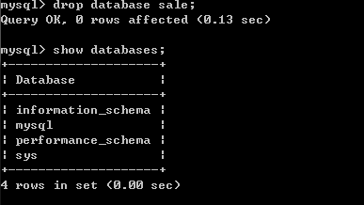
Delete a database
DROP DATABASE database_name;

Slide 19

Tables
List all tables in the selected database:
SHOW TABLES;
Create a table
CREATE TABLE table_name
(column_name1 data_type,
Column_name2 data_type, …);

Slide 20
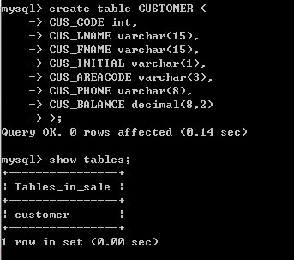
Examples

Slide 21
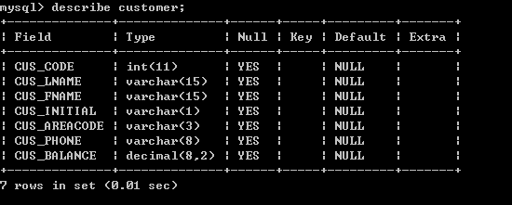
View information about the table
DESCRIBE tablename;

Slide 22

Delete and Rename an existing table
Delete an existing table
DROP TABLE tablename;
Rename an existing table
RENAME TABLE old_tablename TO new_tablename;

Slide 23
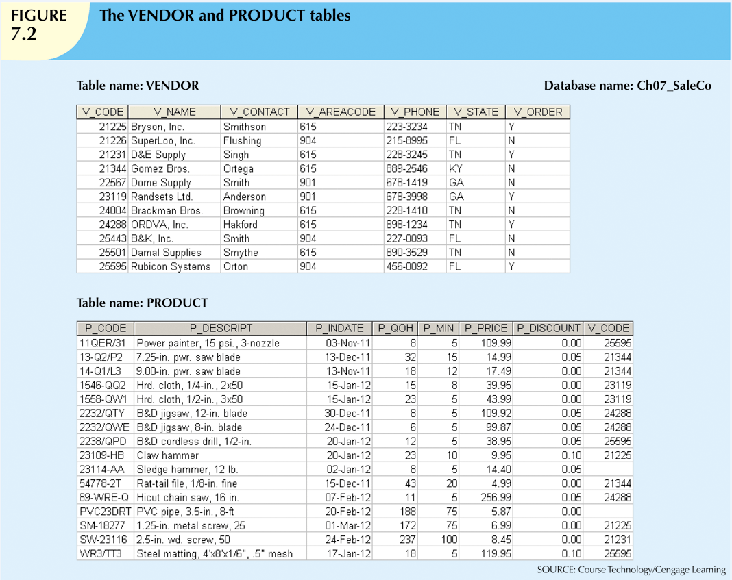
Continue creating tables: VENDOR & PRODUCT
Why VENDOR must be created before PRODUCT?

Slide 24
Table VENDOR
V_CODE
V_NAME
V_CONTACT
V_AREACODE
V_PHONE
V_STATE
V_ORDER
NUMBER? VARCHAR?
VARCHAR(35)
Recall data types we introduced:
String
VARCHAR(size)
CHAR(size)
Numeric
INT/SMALLINT/BIGINT
DECIMAL/NUMERIC(dig_len, deci_len)
FLOAT/DOUBLE(dig_len, deci_len)
Date/time
DATE/DATETIME/TIMESTAMP
TIME
YEAR
VARCHAR(25)
NUMBER? CHAR?
CHAR(8)
CHAR(2)
CHAR(1)

Slide 25
Choose Character type or Number type?
General Principle: if you want to do arithmetic operations on this attribute, choose Numeric type. Otherwise, choose String type.
V_CODE
If you want the computer to generate new vendor codes by adding 1 to the existing largest vendor code, use INT
If you do not want to perform arithmetic operations on V_CODE, use VARCHAR
V_AREACODE
Arithmetic operations on area codes does not yield meaningful results, use CHAR(3)

Slide 26
Table VENDOR Table PRODUCT
V_CODE
V_NAME
V_CONTACT
V_AREACODE
V_PHONE
V_STATE
V_ORDER
INT
VARCHAR(10)
P_CODE
P_DESCRIPT
P_INDATE
P_QOH
P_MIN
P_PRICE
P_DISCOUNT
V_CODE
VARCHAR(35)
VARCHAR(35)
DATE
VARCHAR(25)
INT
CHAR(3)
INT
CHAR(8)
DECIMAL(8,2)
CHAR(2)
DECIMAL(5,2)
INT
CHAR(1)

Slide 27
Constraints
Rules that restrict data values that can be entered into column.
Types of constraints:
Integrity constraints
Value constraints
Another classification:
Table constraint
Restricts data value with respect to all other values in table
Column constraint
Limits value that can be placed in specific column
Irrespective of values that exist in other table rows
Constraint definitions should be placed either:
At end of CREATE TABLE command after table columns declared
Within each column definition

Slide 28
Integrity constraints: set Primary Key
Primary key
Table constraint
Syntax (within column definition)
PRIMARY KEY
Syntax (at the end of table definition)
PRIMARY KEY (columnname1,[columnname2,…])
CREATE TABLE VENDOR (
V_CODE int PRIMARY KEY,
V_NAME varchar(35),
V_CONTACT varchar(25),
V_AREACODE char(3),
V_PHONE char(8),
V_STATE char(2),
V_ORDER char(1)
);
CREATE TABLE CUSTOMER (
CUS_CODE int,
CUS_LNAME varchar(15),
CUS_FNAME varchar(15),
CUS_INITIAL varchar(1),
CUS_AREACODE varchar(3),
CUS_PHONE varchar(8),
CUS_BALANCE decimal(8,2),
PRIMARY KEY (CUS_CODE)
);

Slide 29
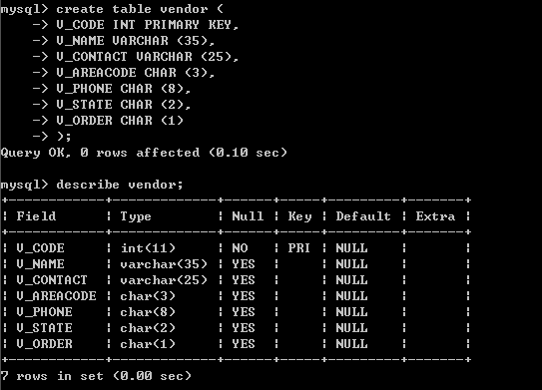
Example

Slide 30
Integrity constraints: set Foreign Keys
Foreign key
Column constraint
Specifies that value user inserts in column must exist as primary key in referenced table
Syntax (placed at end of table definition)
[CONSTRAINT constraint_name]
FOREIGN KEY (columnname)
REFERENCES primary_key_tablename (primary_key_columnname)

Slide 31
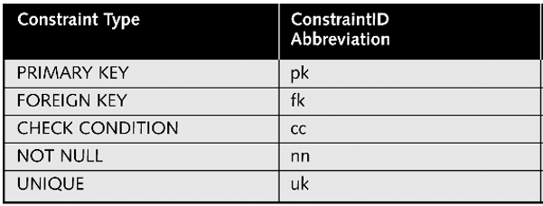
Constraint name
Constraint naming convention
tablename_columnname_constraintid
constraintid

Slide 32
Integrity constraints: set Foreign Keys
CREATE TABLE PRODUCT (
P_CODE varchar(10),
P_DISCRIPT varchar(35),
P_INDATE date,
P_QOH int,
P_MIN int,
P_PRICE decimal(8,2),
P_DISCOUNT decimal(5,2),
V_CODE int,
PRIMARY KEY (P_CODE),
CONSTRAINT PRODUCT_V_CODE_FK
FOREIGN KEY (V_CODE)
REFERENCES VENDOR (V_CODE)
);
The foreign key constraint definition ensures that:
You cannot insert a product with a invalid vendor code.
You cannot delete a vendor from the VENDOR table if at least product row references that vendor.

Slide 33
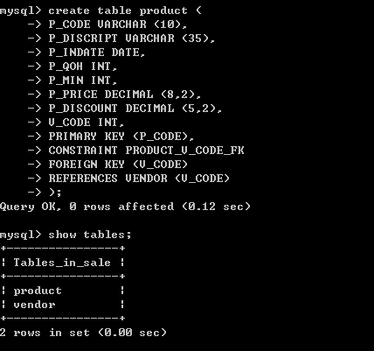
Example

Slide 34
Value constraints
Column-level constraints
Restrict data values that users can enter
Commonly used value constraints
CHECK conditions
it checks to see a specified condition exists
i.e., the minimum order value must be at least $75.00 for free shipping
NOT NULL constraint
a column does not accept nulls
DEFAULT constraint
assigns a value to an attribute when a new row is added to a table
UNIQUE constraint
all values in a column are unique

Slide 35
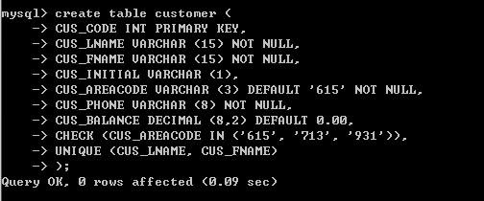
Table CUSTOMER

Slide 36
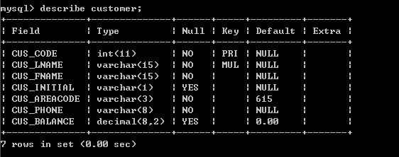
Table CUSTOMER

Slide 37
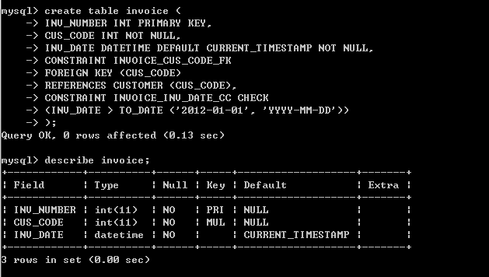
Table INVOICE

Slide 38
Table INVOICE
You can give a name to a value constraint:
CONSTRAINT INVOICE_INV_DATE_CC CHECK
(INV_DATE > TO_DATE('2012-01-01','YYYY-MM-DD'))
If you want to set the default value for date type column as system time:
You cannot set the default for a DATE column to be the value of a function such as NOW() or CURRENT_DATE.
You can specify CURRENT_TIMESTAMP as the default for TIMESTAMP and DATETIME columns.

Slide 39
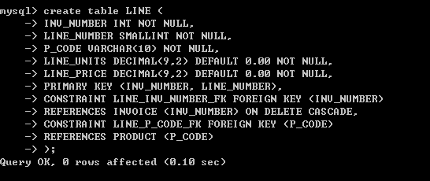
Table LINE
The ON DELETE CASCADE is recommended for weak entities to ensure that the deletion of a row in the strong entity automatically triggers the deletion of the corresponding rows in the dependent weak entity.

Slide 40

Thank you & Questions

