Slide 1
CS 309A- Database Management Systems

Slide 2
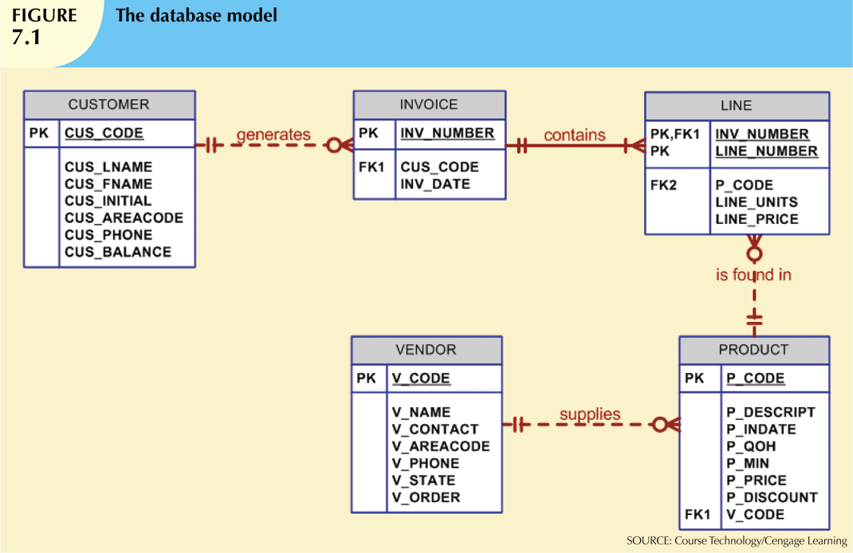
Database model
We will use a simple database (sale) with the following tables to illustrate commands:
CUSTOMER
INVOICE
LINE
PRODUCT
VENDOR

Slide 3
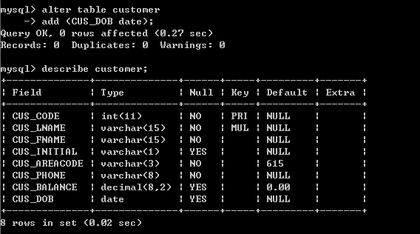
Add columns
Add new column to table
Syntax
ALTER TABLE tablename
ADD(columnname data_type [constraints]);

Slide 4
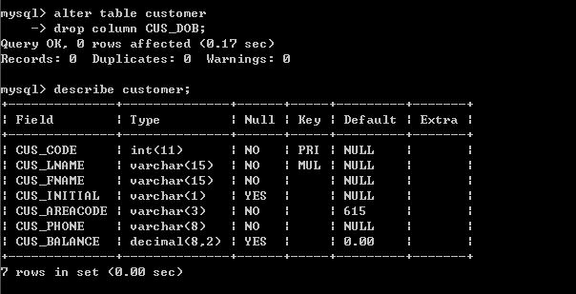
Delete columns
Delete a column from table
Data stored in deleted column removed from database
Syntax
ALTER TABLE tablename
DROP COLUMN columnname;

Slide 5
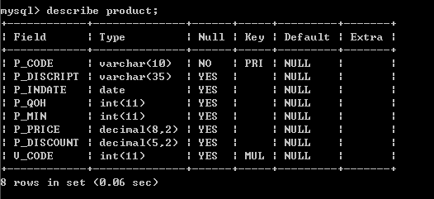
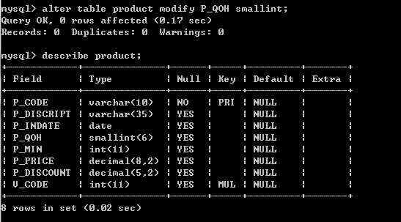
Modifying columns
Modify existing column’s data type
Syntax
ALTER TABLE tablename
MODIFY(columnname new_data_type);

Slide 6
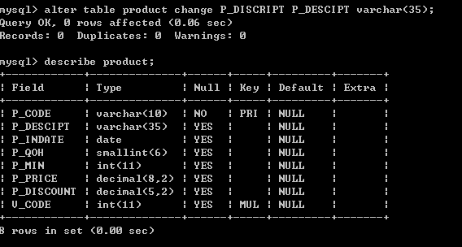
Modifying columns
Renaming a column
Syntax
ALTER TABLE tablename
CHANGE old_columnname new_columnname data_type;

Slide 7
Other ALTER TABLE commands
Reference:
http://dev.mysql.com/doc/refman/5.7/en/alter-table.html

Slide 8
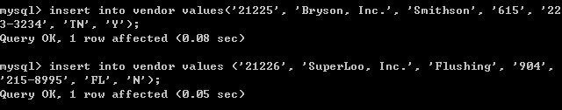
Add table rows
INSERT
Used to enter data into table
Syntax:
INSERT INTO tablename VALUES (value1, value2, … , valueN);
A value is required for each column

Slide 9
Add table rows
When entering values, notice that:
Row contents are entered between parentheses
Character and date values are entered between apostrophes
Attribute entries are separated by commas
A value is required for each column
Use NULL for unknown values
Attention: the NULL entry is accepted only when the attribute does not have NOT NULL constraint.

Slide 10
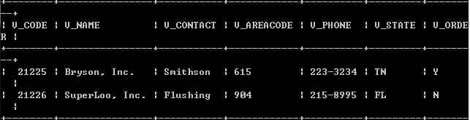
Practice
Create a table vendor with the following information.

Slide 11
List table rows
SELECT
Used to list contents of table
Syntax:
SELECT columnlist
FROM tablename;
Columnlist represents one or more attributes, separated by commas
SELECT V_CODE, V_NAME FROM VENDOR;
Asterisk can be used as wildcard character to list all attributes
SELECT * FROM VENDOR;

Slide 12
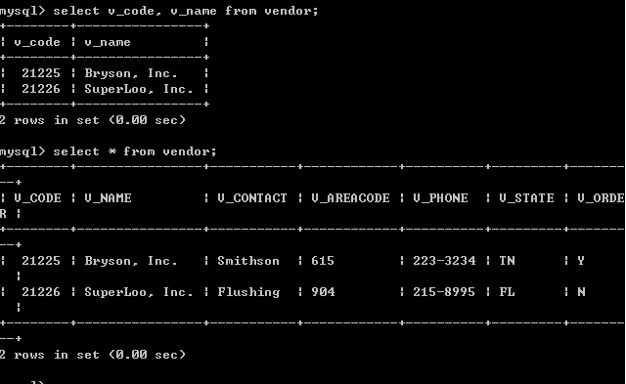
List table rows

Slide 13
Delete table rows
DELETE
Deletes a table row
Syntax:
DELETE FROM tablename [WHERE conditionlist ];
WHERE condition is optional
If WHERE condition is not specified, all rows from specified table will be deleted
Delete the vendor 21225 from the table vendor
DELETE FROM VENDOR
WHERE V_CODE = ‘21225’;
Delete all vendors from the table vendor
DELETE FROM VENDOR;

Slide 14
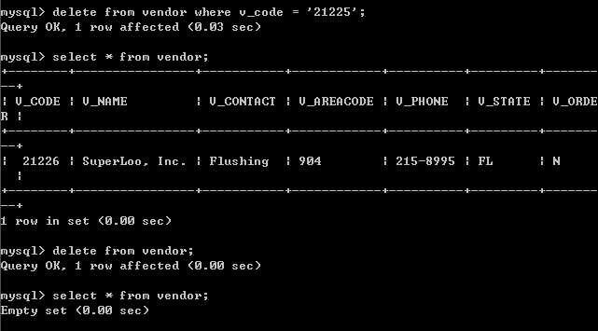

Slide 15
Execute a script file in MySQL
You can put all SQL commands in a file with extension .sql (called script file) and then tell MySQL to read its input from that file.
You can execute a script file with the SOURCE command.
SOURCE script_file

Slide 16
Practice
Create a database called Sale from the script sale_data.sql in my public folder.

Slide 17
Update table rows
UPDATE
Modify data in a table
Syntax:
UPDATE tablename SET columnname = expression [, columnname = expression] [WHERE conditionlist];
If more than one attribute is to be updated in row, separate corrections with commas

Slide 18
Update table rows
UPDATE PRODUCT
SET P_PRICE = 15
WHERE P_CODE = ’13-Q2/P2’;
UPDATE PRODUCT
SET P_PRICE = 17.99, P_MIN = 10
WHERE P_CODE = ’13-Q2/P2’;
If you do not specify a WHERE condition, the UPDATE command will apply the changes to all rows in the table.

Slide 19
SELECT queries
Get data from table
SELECT command
syntax
SELECT column_list
FROM table_list
[WHERE search_condition]
The above SELECT statement retrieves all rows that match the specified condition(s) you specified in the WHERE clause.

Slide 20
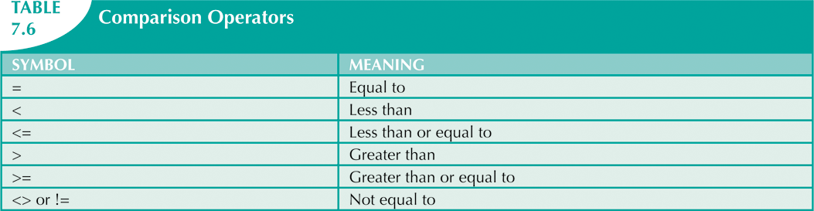
Using comparison operator

Slide 21
Example
Find all the products provided by vendor 21344
SELECT *
FROM PRODUCT
WHERE V_CODE = 21344;

Slide 22
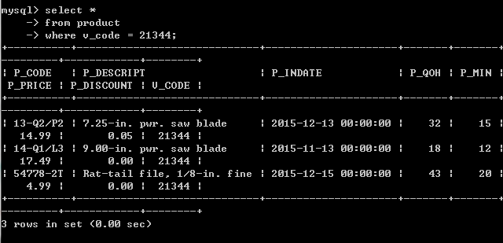
Example

Slide 23
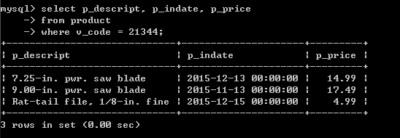
Example
List the products’ descriptions (P_DESCRIPT), stocking dates (P_INDATE), price (P_PRICE) provided by vendor 21344
SELECT P_DESCRIPT, P_INDATE, P_PRICE
FROM PRODUCT
WHERE V_CODE = 21344;

Slide 24
For the products which are NOT provided by vendor 21344, list their descriptions (P_DESCRIPT), stocking dates (P_INDATE), price (P_PRICE), and vendor code
SELECT P_DESCRIPT, P_INDATE, P_PRICE, V_CODE
FROM PRODUCT
WHERE V_CODE <> 21344;

Slide 25
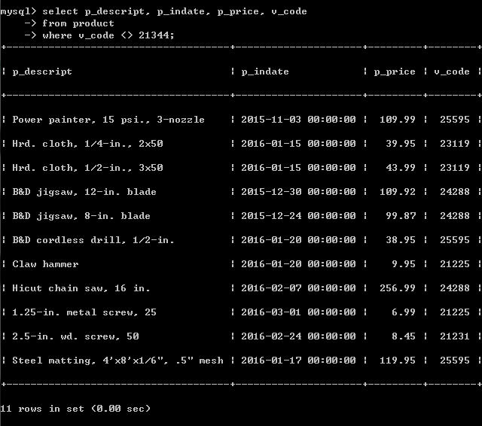
Example

Slide 26
SELECT Practice
Use SELECT queries to answer the following questions:
List all customers who live in 615 area
List names, contacts and phones of vendors in Tennessee (TN)
List products’ descriptions, units available (QOH) and vendor codes that the prices are under $100.
syntax
SELECT column_list
FROM table_list
[WHERE search_condition]

Slide 27
Comparison
You can compare characters
SELECT P_CODE, P_DESCRIPT, P_QOH, P_MIN, P_PRICE
FROM PRODUCT
WHERE P_CODE < ‘1558-QW1’;
String comparisons are made from left to right.
‘Apple’ > ‘Anna’
‘Apple’ < ‘Boy’
‘34’ < ‘6’

Slide 28
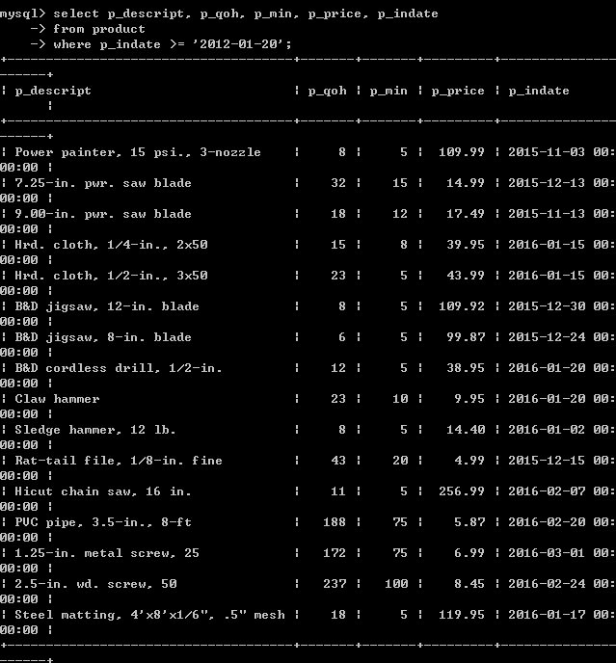
Comparison
You can also compare dates
SELECT P_DESCRIPT, P_QOH, P_MIN, P_PRICE, P_INDATE
FROM PRODUCT
WHERE P_INDATE >= ‘2012-01-20’;

Slide 29
Using computed columns and column aliases
If we want to know the total value of each product in inventory
We need to multiply of each product’s quantity by its current price
SELECT P_DESCRIPT, P_QOH, P_PRICE, P_QOH*P_PRICE
FROM PRODUCT;

Slide 30
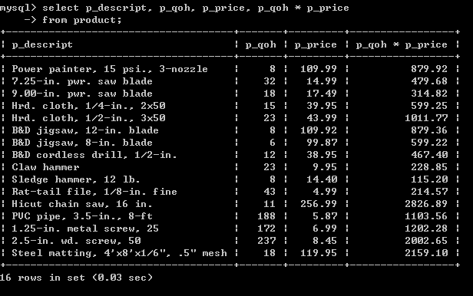

Slide 31
To make the output more readable, you can set an alias to a column or table in any SQL statement.
SELECT P_DESCRIPT, P_QOH, P_PRICE,
P_QOH*P_PRICE AS TOTALVALUE
FROM PRODUCT;

Slide 32
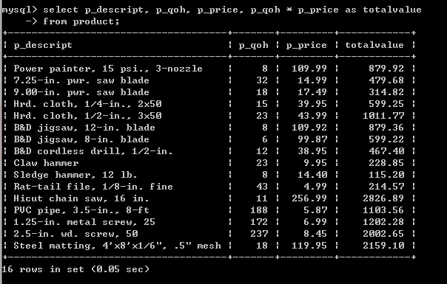

Slide 33
If we want to get a list of out-of-warranty products that have stored more than 90 days.
In that case, the P_INDATE is at least 90 days earlier than the current date
SELECT P_CODE, P_INDATE,
DATE_ADD(P_INDATE, INTERVAL 90 DAY) as EXPDATE
FROM PRODUCT
WHERE DATE_ADD(P_INDATE, INTERVAL 90 DAY) < CURDATE();
Function DATE_ADD(start_date, intervals):
add time values (intervals) to a date value
Function CURDATE():
return the current date
References to Date and Time functions in MySQL: https://dev.mysql.com/doc/refman/5.5/en/date-and-time-functions.html

Slide 34
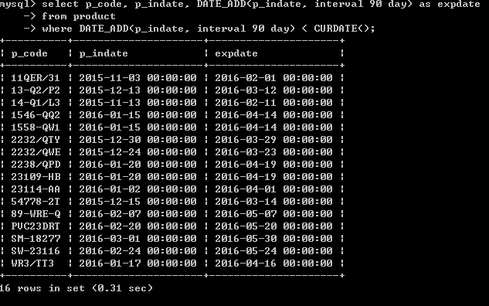

Slide 35
SELECT Practice
Get the total product value from vendor 21225
Assume the invoice which has been generated over 180 days cannot be used for return. Get a list of such invoices.

Slide 36

Thank you & Questions

