Slide 1
CS 309A- Database Management Systems

Slide 2
Aggregate functions
SQL can perform some statistics for you
Counting the number of rows
Finding the minimum/maximum values
Summing the values in a specified column
Average the values in a specified column
MySQL aggregate functions:
http://dev.mysql.com/doc/refman/5.7/en/group-by-functions.html

Slide 3
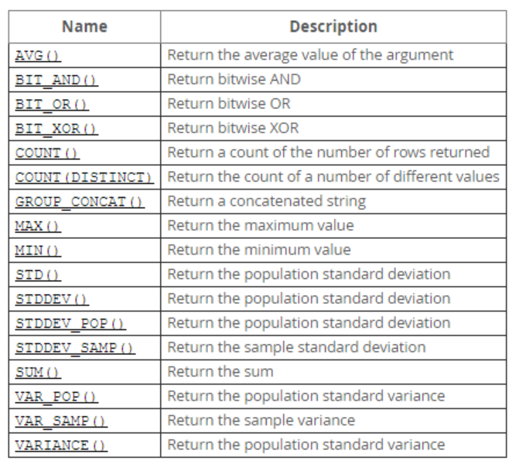
MySQL aggregate functions

Slide 4
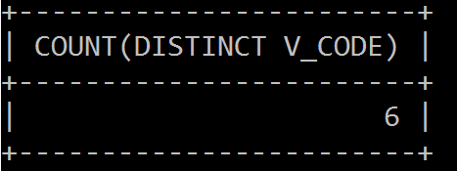
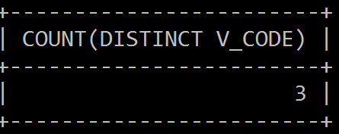
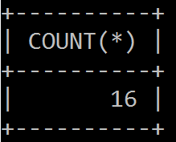
COUNT
COUNT always returns the number of non-null values in the given column.
How many vendors are providing products now?
SELECT COUNT(DISTINCT V_CODE)
FROM PRODUCT;
How many vendors are providing products with prices that are no more than $10?
SELECT COUNT(DISTINCT V_CODE)
FROM PRODUCT
WHERE P_PRICE <= 10;
How many products in the system?
SELECT COUNT(*)
FROM PRODUCT;

Slide 5
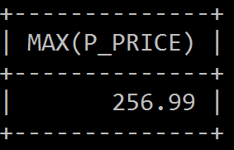
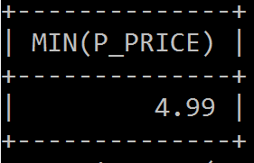
MAX and MIN
What is the price of the most expensive product?
What is the price of the cheapest product?
SELECT MAX(P_PRICE)
FROM PRODUCT;
SELECT MIN(P_PRICE)
FROM PRODUCT;
ATTENTION: the numeric functions yield only one value based on all the values found in the table: a single maximum value, a single minimum value, a single count, or a single average value.

Slide 6

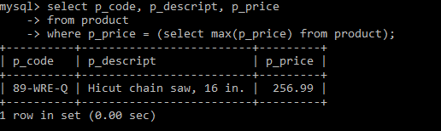
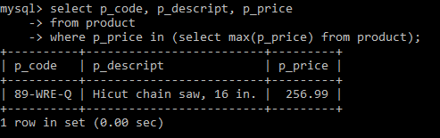
MAX and MIN
What is the most expensive product? Suppose we want to know its code, description and price.
SELECT P_CODE, P_DESCRIPT, P_PRICE
FROM PRODUCT
WHERE P_PRICE = MAX(P_PRICE);
Error!
MAX/MIN(columnname) can be used only with a SELECT statement
SELECT P_CODE, P_DESCRIPT, P_PRICE
FROM PRODUCT
WHERE P_PRICE = (SELECT MAX(P_PRICE)
FROM PRODUCT);
Correct!

Slide 7
Practice 5
Which product has the oldest date?
What is the most recent product?
What product has the highest inventory value?
Inventory value can be calculated by P_QOH * P_PRICE

Slide 8
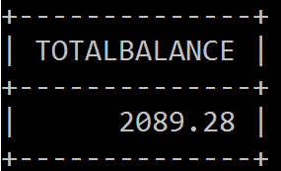
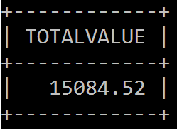
SUM
The SUM function computes the total sum for any specified attributes.
What is the total amount owned by customers?
What is the total value of all products in inventory?
SELECT SUM(CUS_BALANCE) AS TOTALBALANCE
FROM CUSTOMER;
SELECT SUM(P_QOH * P_PRICE) AS TOTALVALUE
FROM PRODUCT;

Slide 9
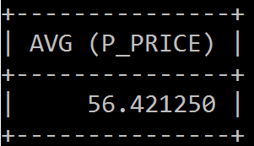
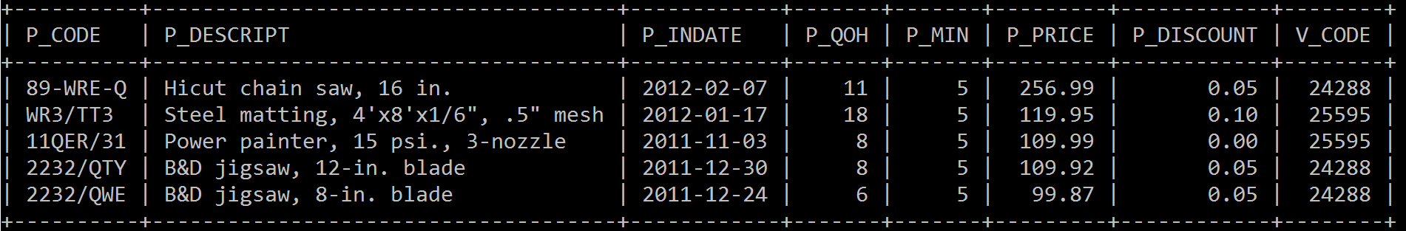
AVG
What is the average price of products?
Find the products which have prices over the average product price. The products are listed by price in descending
Similar to MAX/MIN, AVG can be used only with a SELECT statement
SELECT AVG (P_PRICE)
FROM PRODUCT;
SELECT *
FROM PRODUCT
WHERE P_PRICE > ( SELECT AVG(P_PRICE) FROM PRODUCT )
ORDER BY P_PRICE DESC;

Slide 10
Practice 6:
How many products in inventory are from vendor 24288?
What is the average balance of customers who live in area ‘615’?
Find the customers who live in area ‘615’ and have the balance lower than their local average. List customers by their balance in descending.

Slide 11

Thank you & Questions

