Slide 1
CS 309A- Database Management Systems

Slide 2
Recap of the last time
Modify table
ALTER TABLE tablename
--ADD(columnname data_declaration constraints);
--DROP COLUMN columnname;
--MODIFY(columnname new_data_type);
--CHANGE old_columnname new_columnname data_type;
References: ALTER TABLE syntax
http://dev.mysql.com/doc/refman/5.7/en/alter-table.html

Slide 3
Recall for the SELECT queries
Get data from table
SELECT command
syntax
SELECT columnlist
FROM tablelist
[WHERE conditionlist];
The above SELECT statement retrieves all rows that match the specified condition(s) you specified in the WHERE clause.

Slide 4
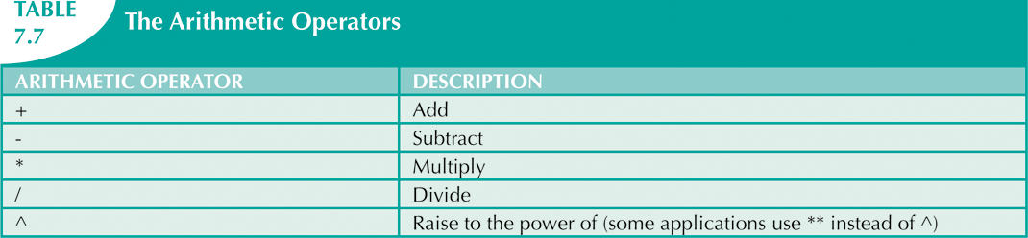
Arithmetic operators: rule of precedence
You can use arithmetic operators with table attributes in a column list or in a conditional expression.
Perform operations within parentheses
Perform power operations
Perform multiplications and divisions
Perform additions and subtractions

Slide 5
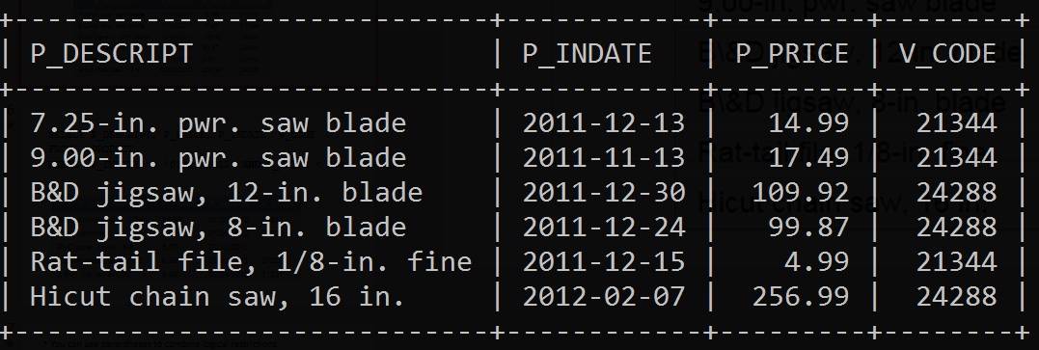
Logical operators: OR, AND
You can use logical operators to involve multiple conditions in queries
SELECT P_DESCRIPT, P_INDATE, P_PRICE, V_CODE
FROM PRODUCT
WHERE V_CODE = 21344 OR V_CODE = 24288;

Slide 6
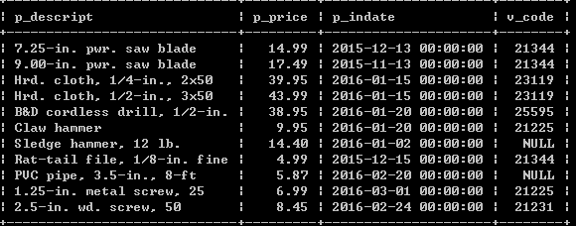
SELECT P_DESCRIPT, P_PRICE, P_INDATE, V_CODE
FROM PRODUCT
WHERE P_INDATE >= ‘2012-01-20’ AND P_PRICE < 50;

Slide 7
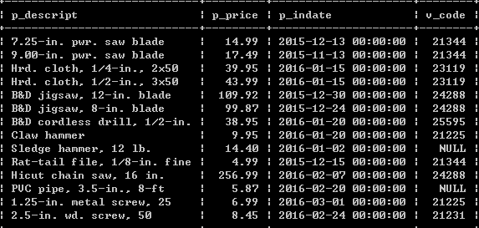
You can use parentheses to combine logical restrictions.
SELECT P_DESCRIPT, P_PRICE, P_INDATE, V_CODE
FROM PRODUCT
WHERE (P_PRICE < 50 AND P_INDATE >= ‘2012-01-20’)
OR V_CODE = 24288;

Slide 8
Practice 1:
List vendors information (name, contact and phone) that are in the area ‘615’ and have previous order
List customers name (last name, first name and middle initial) who live in the area ‘615’ or have zero balance
List products (all attributes) that either have excess inventory (units available (QOH) is at least 50 more than minimum units) or have discount and stocking date was before 01/01/2018.

Slide 9
Logical operators: NOT
The NOT logical operator is used to find the rows that do not match a certain condition.
SELECT *
FROM PRODUCT
WHERE NOT (V_CODE = 21344);
The above WHERE clause equals to
WHERE V_CODE <> 21344;
WHERE V_CODE != 21344;

Slide 10
Special operators
BETWEEN: checks whether attribute value is within a range
IS NULL: checks whether attribute value is null
LIKE: checks whether attribute value matches given string pattern
IN: checks whether attribute value matches any value within a value list
EXISTS: checks if subquery returns any rows

Slide 11
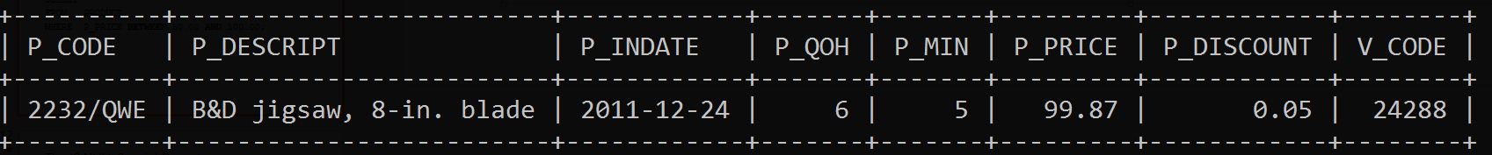
The BETWEEN special operator
List all products whose prices are between $50 and $100
SELECT *
FROM PRODUCT
WHERE P_PRICE BETWEEN 50.00 AND 100.00;

Slide 12
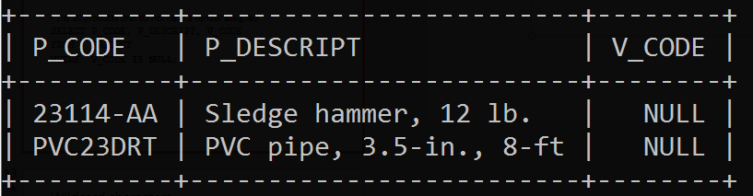
The IS NULL Special Operator
List all products that do not have a vendor assigned
SELECT P_CODE, P_DESCRIPT, V_CODE
FROM PRODUCT
WHERE V_CODE IS NULL;

Slide 13
Wildcard characters
String pattern is given by the characters and wildcards.
Wildcards:
%: means any and all following or preceding characters are eligible
‘J%’ includes all the strings beginning with ‘J’
i.e., ‘Johnson’, ‘July’, ‘Jack’
‘%n’ includes all the strings ending with ‘n’
i.e., ‘Johnson’, ‘Garden’, ‘Kevin’
_: means any one character may be substituted for the underscore
‘_23-456’ includes the strings such as ‘123-456’ and ‘823-456’
‘_o_es’ includes the string s such as ‘Jones’ and ‘Cokes’

Slide 14
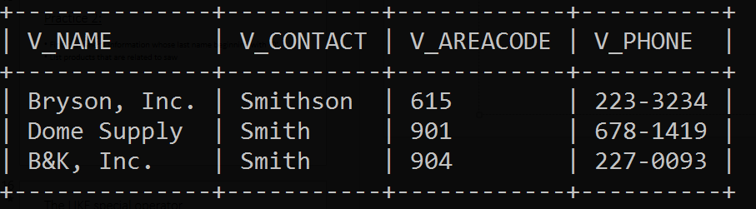
The LIKE special operator
Find all VENDOR rows that contacts’ last names begin with Smith
SELECT V_NAME, V_CONTACT, V_AREACODE, V_PHONE
FROM VENDOR
WHERE V_CONTACT LIKE 'Smith%’;

Slide 15
Practice 2:
Find customer’s information whose last name beginning with ‘O’
List products that are related to saw
Suppose that you want to find a vendor’s information, but you cannot remember that the contact’s name is spelled ‘Orton’ or ‘Orten’. How can you do it?

Slide 16
The IN special operator
List products provided by vendor 21344 or vendor 24288
SELECT *
FROM PRODUCT
WHERE V_CODE IN (21344, 24288);
The IN operator uses a value list
All of the values in the list must have the same data type.

Slide 17
The IN operator can be used with subqueries.
Suppose that you want to list the V_CODE and V_NAME of only those vendors who provide products.
Step 1: Find the vendors who provide products in table PRODUCT
SELECT V_CODE FROM PRODUCT;
Step 2: Based on the returned set of V_CODE, find their corresponding names in table VENDOR
SELECT V_CODE, V_NAME
FROM VENDOR
WHERE V_CODE IN (SELECT V_CODE FROM PRODUCT);

Slide 18
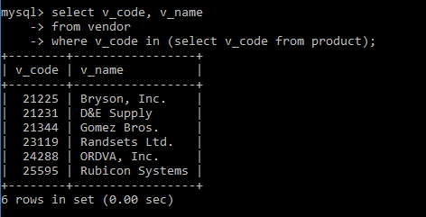

Slide 19
Practice 3:
Find customers who have generated invoices, list their last name, first name and middle initial

Slide 20
The EXISTS special operator
EXISTS is used with subquery
If a subquery returns any rows, run the main query; otherwise, do not.
List all vendors, only when there are products with the available quantity no more than the minimum quantity.
Step 1: Using a subquery to check whether there are products the available quantity no more than the minimum quantity.
SELECT * FROM PRODUCT WHERE P_QOH <= P_MIN
Step 2: If the subquery returns some rows, list all vendors.
SELECT *
FROM VENDOR
WHERE EXISTS (SELECT * FROM PRODUCT WHERE P_QOH <= P_MIN);

Slide 21
Consider another query
List vendors that they have products with the available quantity less than double the minimum quantity.
Use EXISTS again?
SELECT *
FROM VENDOR
WHERE EXISTS(SELECT V_CODE FROM PRODUCT WHERE P_QOH <= 2 * P_MIN);
No, should use IN
SELECT *
FROM VENDOR
WHERE V_CODE IN(SELECT V_CODE FROM PRODUCT WHERE P_QOH <= 2 * P_MIN);
List ALL vendors only when some vendors have products with the available quantity less than double the minimum quantity.

Slide 22
Ordering a listing
ORDER BY clause is useful when listing order is important
Syntax:
SELECT columnlist
FROM tablelist
[WHERE conditionlist]
[ORDER BY columnlist [ASC | DESC]];
Ascending order by default

Slide 23
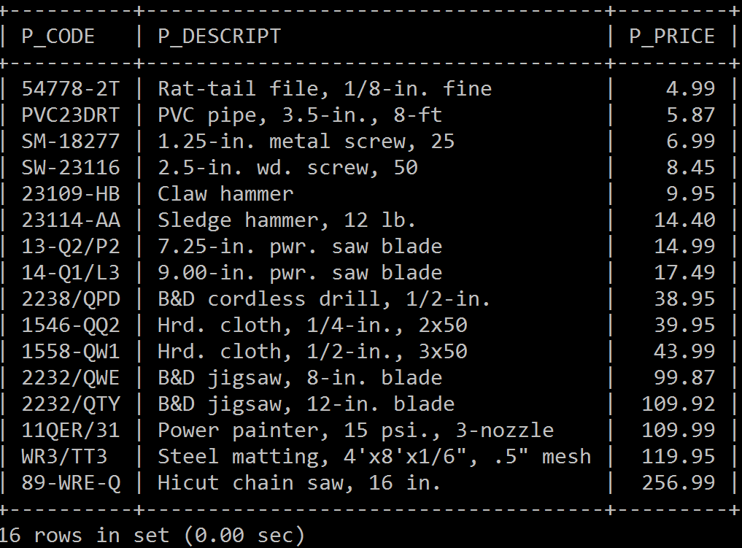
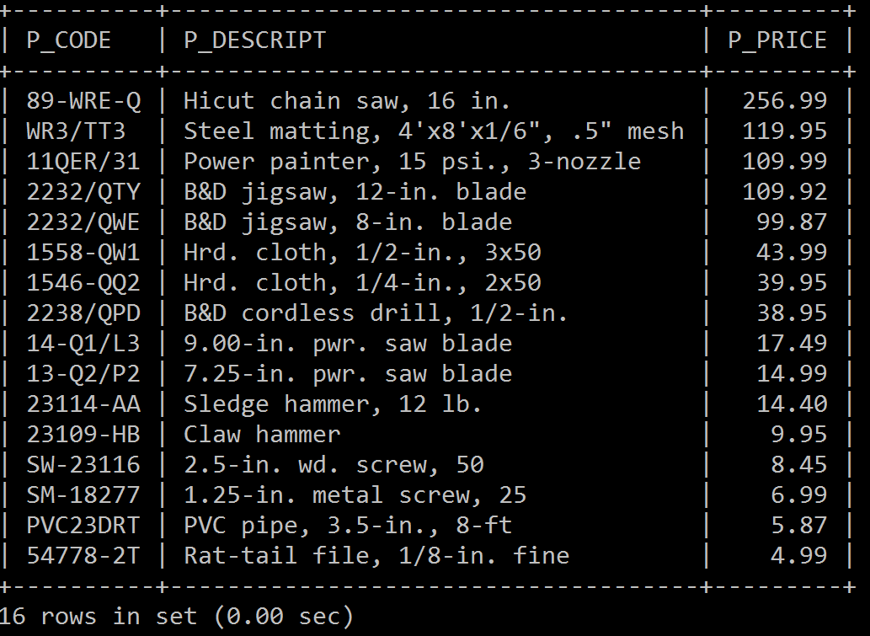
Example: list all products (code, description,
price) by their price in ascending
Example: list all products (code, description,
price) by their price in descending
SELECT P_CODE, P_DESCRIPT, P_PRICE
FROM PRODUCT
ORDER BY P_PRICE;
SELECT P_CODE, P_DESCRIPT, P_PRICE
FROM PRODUCT
ORDER BY P_PRICE DESC;

Slide 24
List customers using the following cascading order sequence:
ORDER BY last name ascending
Within the last names, ORDER BY first name ascending
Within the first and last names, ORDER BY middle initial
Order from left to right
SELECT *
FROM CUSTOMER
ORDER BY CUS_LNAME, CUS_FNAME, CUS_INITIAL;

Slide 25
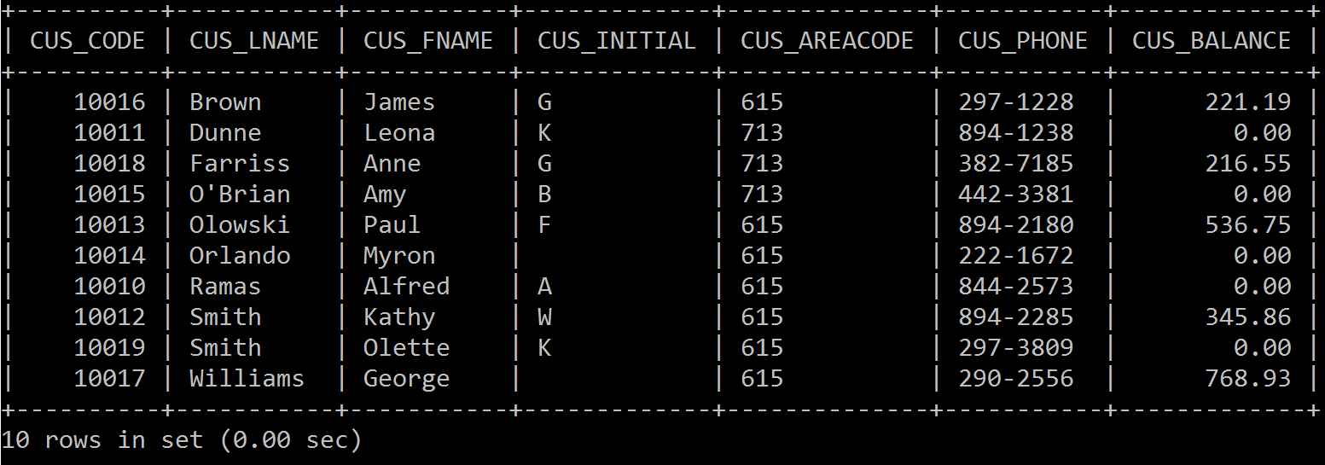

Slide 26
Practice 4
List the most recent invoices.
List the invoices by INV_DATE in descending
Find the products (description, vendor code, stocking date, price) which were stocked before 2018-01-01 and have prices no more than $50.00. The contents should be listed first by vendor code in ascending, and then by price in descending within the vendor code.

Slide 27
Listing unique values
If we want to know how many vendors are providing products now
Query on VENDOR table is not correct because some vendors may not provide any products right now
Query on PRODUCT table and listing V_CODE is not very useful because one vendor may provide many different types of products, which results many duplicate records. You have to filter manually.
Use DISTINCT to produce a list of values that are different from one another.

Slide 28
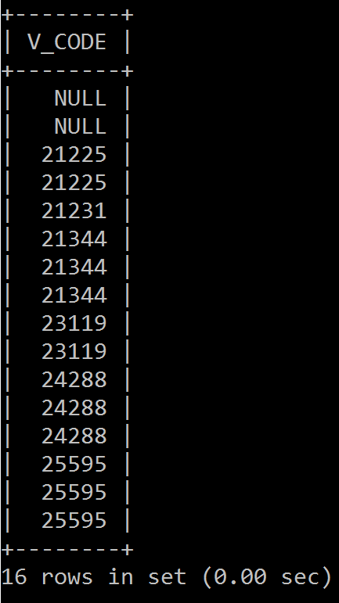
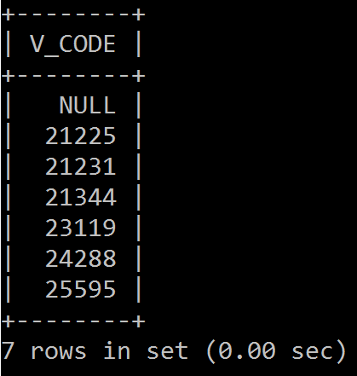
Listing unique values
SELECT V_CODE
FROM PRODUCT;
SELECT DISTINCT V_CODE
FROM PRODUCT;
If we have a thousands of rows in the list, do we need to count manually?

Slide 29

Thank you & Questions

