Slide 1
CS 309A- Database Management Systems

Slide 2
GROUP BY
If you want to group table rows, you could use GROUP BY clause.
Syntax:
SELECT columnlist
FROM tablelist
[WHERE conditionlist]
[GROUP BY columnlist]
[HAVING conditionlist]
[ORDER BY columnlist [ASC | DESC]];
GROUP BY is generally used when you have columns combined with aggregate functions in the SELECT statement.

Slide 3
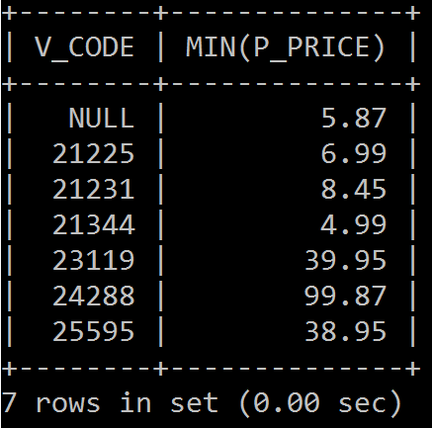
GROUP BY
What is the price of cheapest product from each vendor?
SELECT V_CODE, MIN(P_PRICE)
FROM PRODUCT
GROUP BY V_CODE
ORDER BY V_CODE;

Slide 4
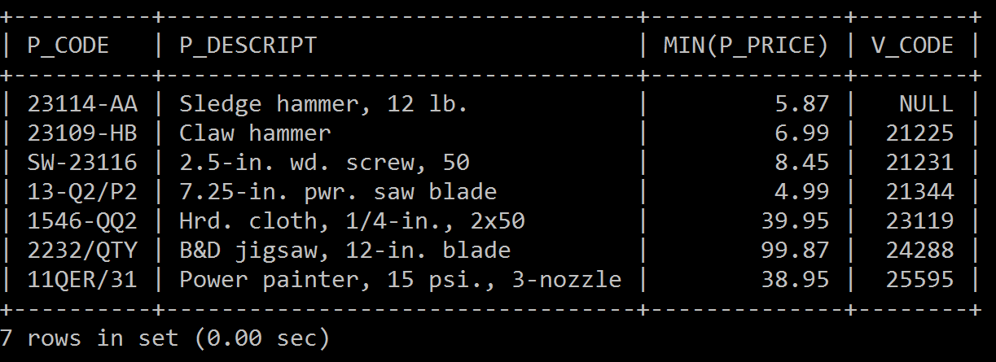
GROUP BY
What is the cheapest product from each vendor? Suppose we want to know product code, description, price and its vendor (code).
SELECT P_CODE, P_DESCRIPT, MIN(P_PRICE), V_CODE
FROM PRODUCT
GROUP BY V_CODE;

Slide 5
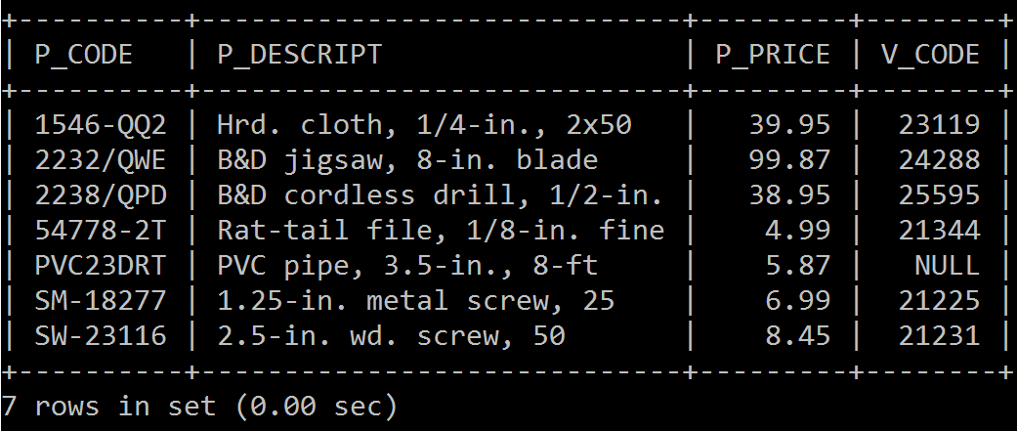
GROUP BY
Another way to get the cheapest product from each vendor?
SELECT P_CODE, P_DESCRIPT, P_PRICE, V_CODE
FROM PRODUCT
WHERE P_PRICE IN ( SELECT MIN(P_PRICE) FROM PRODUCT GROUP BY V_CODE );

Slide 6
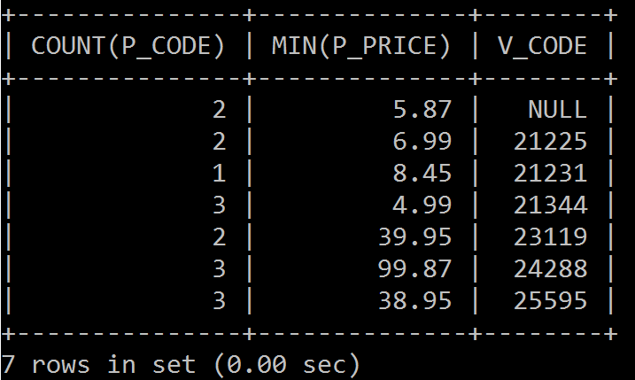
GROUP BY
Suppose we want to know the number of products supplied by each vendor and the price of cheapest product from each vendor.
SELECT COUNT(P_CODE), MIN(P_PRICE), V_CODE
FROM PRODUCT
GROUP BY V_CODE;

Slide 7
Practice 7:
What is the average price of products from each vendor?
Find how many invoices each customer have?
What is the total number of available quantity of products for each vendor?

Slide 8
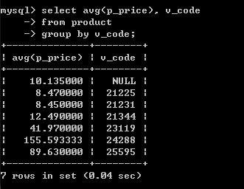
What is the average price of products from each vendor?

Slide 9
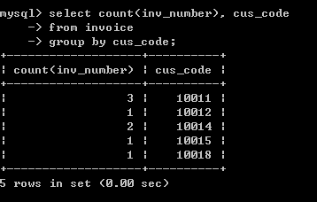
Find how many invoices each customer have?

Slide 10
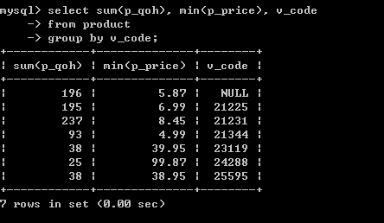
What is the total number of available quantity of products for each vendor?

Slide 11
HAVING
Operates like the WHERE clause.
The WHERE applies to columns and expressions for individual rows, while the HAVING is applied to the output of a GROUP BY operation.
If we want to get the number of products supplied by each vendor whose prices average less than $10.

Slide 12
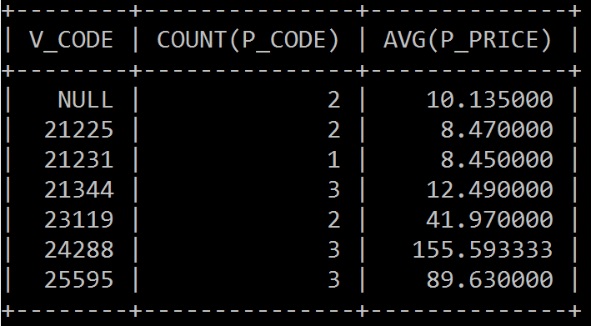
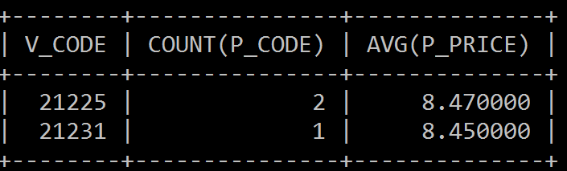
HAVING
Step 1: Get the number products supplied by each vendor and their average
Step 2: Select rows which have average price less than 10
SELECT V_CODE, COUNT(P_CODE), AVG(P_PRICE)
FROM PRODUCT
GROUP BY V_CODE;
SELECT V_CODE, COUNT(P_CODE), AVG(P_PRICE)
FROM PRODUCT
GROUP BY V_CODE
HAVING AVG(P_PRICE) < 10;

Slide 13
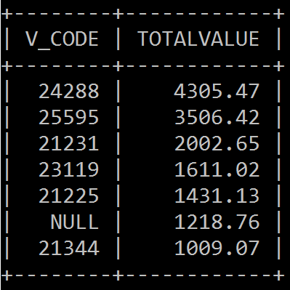
Another example
Suppose we want to get the total value of the products in inventory supplied by each vendor which are over $500. List the contents by total value in descending.
SELECT V_CODE, SUM(P_QOH*P_PRICE) AS TOTALVALUE
FROM PRODUCT
GROUP BY V_CODE
HAVING (SUM(P_QOH*P_PRICE) > 500)
ORDER BY SUM(P_QOH*P_PRICE) DESC;

Slide 14
Practice 8:
Find the invoices which have total purchase amount over $100. Show the invoice number and its total purchase amount. List the contents by total purchase amount in ascending.
SELECT from LINE
LINE_UNITS*LINE_PRICE gives the purchase amount of one product in one invoice
Use SUM to get the total purchase amount

Slide 15
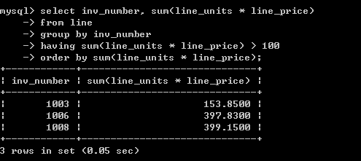
Find the invoices which have total purchase amount over $100. Show the invoice number and its total purchase amount. List the contents by total purchase amount in ascending.

Slide 16
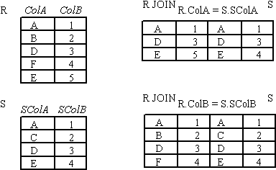
Join database tables
Recall join:
Combines information from two or more tables.
A natural join links tables by selecting only the rows with common values in their common attributes.
Create a PRODUCT of the tables
Yield the rows that the join columns values are equal.
Remove duplicate columns.

Slide 17
How to use SQL to join tables
Create the Cartesian product
-- List the tables in the FROM clause
Select only the rows in which the common attribute values match
-- Use the WHERE clause to indicate the join condition
-- The join condition is generally an equality comparison between the foreign key and the primary key of the related tables.

Slide 18
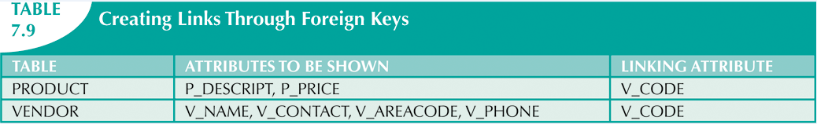
How to use SQL to join tables
How to get all the products with their vendors information?
Join VENDOR and PRODUCT
Common attributes: V_CODE
SELECT P_DESCRIPT, P_PRICE, V_NAME, V_CONTACT, V_AREACODE, V_PHONE
FROM PRODUCT, VENDOR
WHERE PRODUCT.V_CODE = VENDOR.V_CODE;

Slide 19
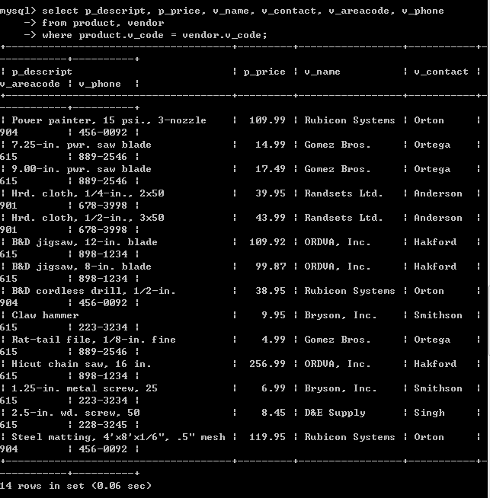

Slide 20
How to use SQL to join tables
You can also use other SQL commands on the joined tables.
List the products that were stocked after 2016-01-15 and their vendors information by their price in ascending.
SELECT P_DESCRIPT, P_PRICE, P_INDATE, V_NAME, V_CONTACT, V_PHONE
FROM PRODUCT, VENDOR
WHERE PRODUCT.V_CODE = VENDOR.V_CODE
AND P_INDATE > ’2016-01-15’
ORDER BY P_PRICE;

Slide 21
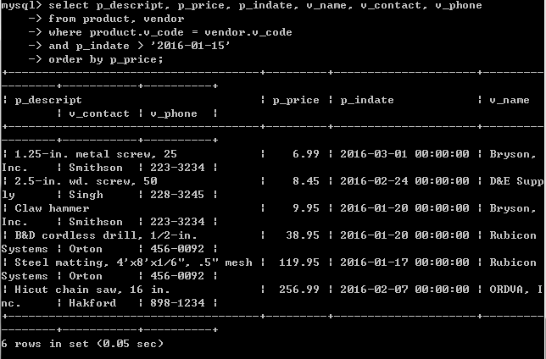

Slide 22
Practice 9
List customers and the date they generated invoices.
For the customers who live in area ‘615’, find out their information and the date they generated invoices. Show same attributes as the above query. List the records by their balance in descending.
TABLE | ATTRIBUTES TO BE SHOWN | LINKING ATTRIBUTE
CUSTOMER | CUS_LNAME, CUS_FNAME, CUS_INITIAL, CUS_AREACODE, CUS_BALANCE | CUS_CODE
INVOICE | INV_NUMBER, INV_DATE | CUS_CODE

Slide 23
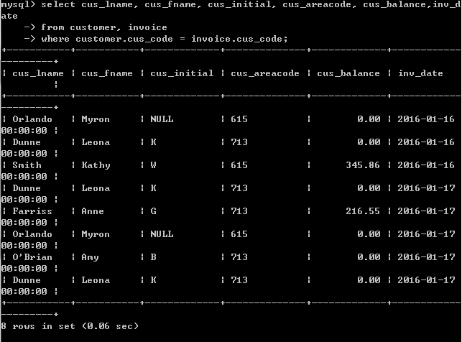
List customers and the date they generated invoices.

Slide 24
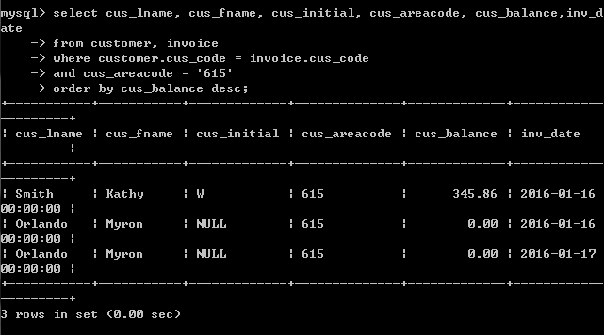
For the customers who live in area ‘615’, find out their information and the date they generated invoices. Show same attributes as the above query. List the records by their balance in descending.

Slide 25
Join more tables
When join three or more tables, you need to specify a join condition for each pair of the tables.
The number of join condition will be (# tables for join – 1)
3 tables should give 2 conditions
5 tables should give 4 conditions
Example:
List the CUS_LNAME, INV_NUMBER, INV_DATE, P_DESCRIPT for all invoices of customer 10014
--How many tables are needed for join?
--What are the attributes to link each pair of tables?

Slide 26
TABLE | ATTRIBUTES TO BE SHOWN | LINKING ATTRIBUTE
CUSTOMER | CUS_LNAME | CUS_CODE
INVOICE | INV_NUMBER, INV_DATE | CUS_CODE, INV_NUMBER
LINE |  | INV_NUMBER, P_CODE
PRODUCT | P_DESCRIPT | P_CODE
SELECT CUS_LNAME, INV_NUMBER, INV_DATE, P_DESCRIPT
FROM CUSTOMER, INVOICE, LINE, PRODUCT
WHERE CUSTOMER.CUS_CODE = INVOICE.CUS_CODE
AND INVOICE.INV_NUMBER = LINE.INV_NUMBER
AND LINE.P_CODE = PRODUCT.P_CODE
AND CUS_CODE = ‘10014’
ORDER BY INV_NUMBER;
SQL interpreter feels confused of the source of columns INV_NUMBER and CUS_CODE

Slide 27
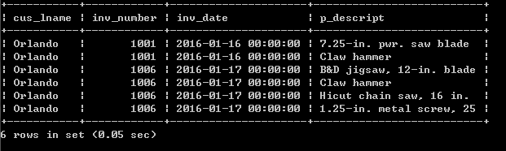
Join more tables
SELECT CUS_LNAME, INVOICE.INV_NUMBER, INV_DATE, P_DESCRIPT
FROM CUSTOMER, INVOICE, LINE, PRODUCT
WHERE CUSTOMER.CUS_CODE = INVOICE.CUS_CODE
AND INVOICE.INV_NUMBER = LINE.INV_NUMBER
AND LINE.P_CODE = PRODUCT.P_CODE
AND CUSTOMER.CUS_CODE = ‘10014’
ORDER BY INV_NUMBER;

Slide 28
Practice 10
Find the customers who ordered “saw” after ‘2016-01-15’. List the customer last name, customer first name, invoice number, invoice date and product description.
How many tables are needed for join?
CUSTOMER, PRODUCT, INVOICE, LINE
What are the attributes to link each pair of tables?
TABLE | ATTRIBUTES TO BE SHOWN | LINKING ATTRIBUTE
CUSTOMER | CUS_LNAME, CUS_FNAME | CUS_CODE
INVOICE | INV_NUMBER, INV_DATE | CUS_CODE, INV_NUMBER
LINE |  | INV_NUMBER, P_CODE
PRODUCT | P_DESCRIPT | P_CODE

Slide 29
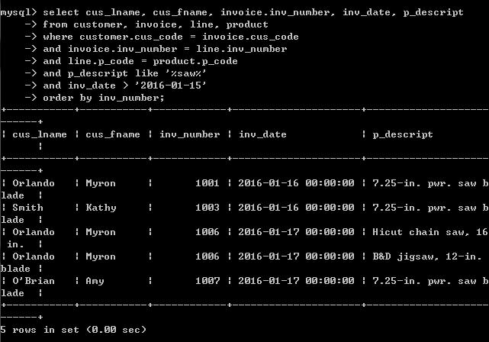
Find the customers who ordered “saw” after ‘01/15/2016’. List the customer last name, customer first name, invoice number, invoice date and product description.

Slide 30

Thank you & Questions

