Slide 1
CS 309A- Database Management Systems

Slide 2
GROUP BY
If you want to group table rows, you could use GROUP BY clause.
Syntax:
SELECT columnlist
FROM tablelist
[WHERE conditionlist]
[GROUP BY columnlist]
[HAVING conditionlist]
[ORDER BY columnlist [ASC | DESC]];
GROUP BY is generally used when you have columns combined with aggregate functions in the SELECT statement.

Slide 3
How to use SQL to join tables
Create the Cartesian product
-- List the tables in the FROM clause
Select only the rows in which the common attribute values match
-- Use the WHERE clause to indicate the join condition
-- The join condition is generally an equality comparison between the foreign key and the primary key of the related tables.

Slide 4
Join tables with an alias
You can use an alias to identify the source table that the data are taken.
SELECT P_DESCRIPT, P_PRICE, V_NAME, V_CONTACT, V_AREACODE, V_PHONE
FROM PRODUCT P, VENDOR V
WHERE P.V_CODE = V.V_CODE
ORDER BY P_PRICE;
An alias is especially useful for recursive join.

Slide 5
Recursive join
Recursive join: A table joins to itself
Example: table EMPLOYEE

Slide 6
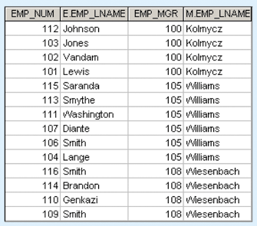
Recursive join
If you want to get a list of all employees with their managers’ names, you need to join EMPLOYEE table to itself.
How to different two tables?
-- use alias
SELECT E.EMP_MGR, M.EMP_LNAME, E.EMP_NUMBER, E.EMP_LNAME
FROM EMPLOYEE E, EMPLOYEE M
WHERE E.EMP_MGR = M.EMP_NUM
ORDER BY E.EMP_MGR;

Slide 7
Subqueries and correlated queries
What is subquery?
Use SELECT statement to return one or more values to another query
Examples:
Generate a list of vendors who do not provide products.
SELECT V_CODE, V_NAME FROM VENDOR
WHERE V_CODE NOT IN (SELECT V_CODE FROM PRODUCT);
Generate a list of products with a price greater than the average product price.
SELECT P_CODE, P_PRICE FROM PRODUCT
WHERE P_PRICE >= (SELECT AVG(P_PRICE) FROM PRODUCT);

Slide 8
WHERE subqueries
Use time:
In the WHERE clause, you need to compare one value to another value that comes from another query.
Generate a list of products with a price greater than the average product price.
SELECT P_CODE, P_PRICE FROM PRODUCT
WHERE P_PRICE >= (SELECT AVG(P_PRICE) FROM PRODUCT);

Slide 9
IN subqueries
Use time:
In the WHERE clause, you need to compare one value to a list of value that comes from another query.
Generate a list of vendors who do not provide products.
SELECT V_CODE, V_NAME FROM VENDOR
WHERE V_CODE NOT IN (SELECT V_CODE FROM PRODUCT);
Return a list of value, not one

Slide 10
Find all customers who purchased a hammer or any kind of saw or hammer.
Thinking:
Need to join CUSTOMER, INVOICE, LINE, PRODUCT
Besides natural join conditions, another condition is P_CODE should come from any of “hammer” or “saw” like products’ code
Use a subquery to get the P_CODE list of “hammer” or “saw” like products
Use IN operator to set up the condition because we need to compare a list of value

Slide 11
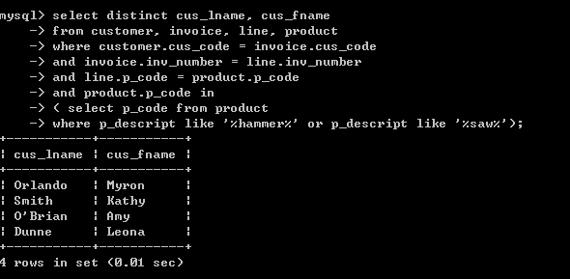
Why we need to use “distinct”?

Slide 12

Practice 11
Find the customers who bought products that have price are over 100.
You should get the query results like:

Slide 13
HAVING subqueries
Use time:
The HAVING clause is used to restrict the output of a GROUP BY query.
List all products (P_CODE) with a total quantity sold greater than the average quantity sold.
Thinking:
The quantity sold information is in table LINE
Needs to GROUP BY P_CODE to find the quantity sold by each product
Use a subquery to get the average quantity sold

Slide 14
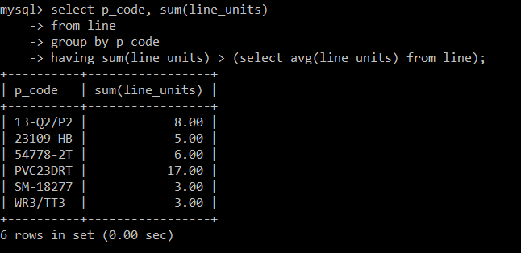
SELECT P_CODE, SUM(LINE_UNITS)
FROM LINE
GROUP BY P_CODE
HAVING SUM(LINE_UNITS) > (SELECT AVG (LINE_UNITS) FROM LINE);

Slide 15
HAVING subqueries
List all vendors (V_CODE, V_NAME) who have products with a total quality sold greater than the average quantity sold.
Thinking:
Need to use JOIN on PRODUCT and VENDOR
Need to use the previous query results (as subquery)
Since the previous query returns a list of value, need to use IN operator

Slide 16
To avoid ambiguous v_code
Join table PRODUCT and table VENDOR
SELECT VENDOR.V_CODE, V_NAME
FROM PRODUCT, VENDOR
WHERE PRODUCT.V_CODE = VENDOR.V_CODE
AND P_CODE IN (
SELECT P_CODE
FROM LINE
GROUP BY P_CODE
HAVING SUM(LINE_UNITS) >
( SELECT AVG(LINE_UNITS)
FROM LINE )
);

Slide 17
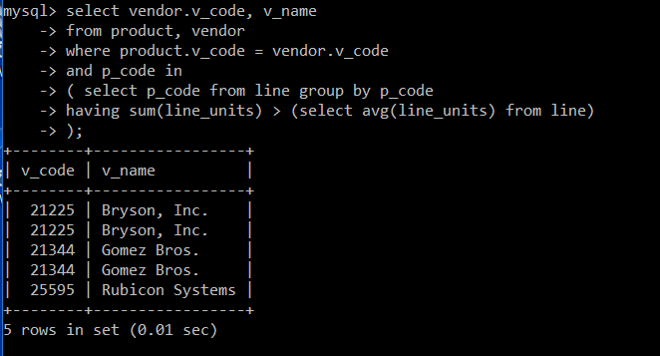

Slide 18
Practice 12
List all vendors (V_CODE) who have more than 2 products.
For the vendors who have more than 2 products, list its code, name and products description order by vendor code in ascending.

Slide 19
ALL and ANY subqueries
The IN operator uses an equality operator to compare a value to a list of values returned from the subquery.
If you want to make an inequality comparison (> or <) of one value to a list of values, we need to use ALL or ANY.
WHERE C1 > ALL (subquery)
select the rows whose C1’s value greater than ALL values returned from the subquery
other comparison operator such as >=, <, <= are allowed
WHERE C1 > ANY (subquery)
select the rows whose C1’s value greater than ANY values returned from the subquery
other comparison operator such as >=, <, <= are allowed

Slide 20
ALL and ANY subqueries
Find the product with the highest value.
Product value = unit’s price * quantity (P_PRICE * P_QOH)
Thinking:
Use a subquery to list the value of every product
sqA: SELECT P_PRICE * P_QOH FROM PRODUCT
Find out the product which has the highest value
SELECT P_CODE, P_PRICE*P_QOH
FROM PRODUCT
WHERE P_PRICE*P_QOH >= ALL (sqA)
ALL operator is to compare a single value (P_QOH*P_PRICE) with a list values return by the subquery sqA

Slide 21
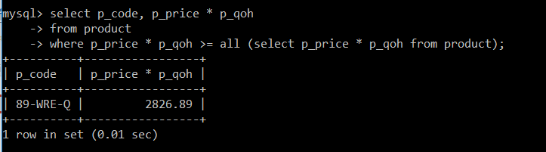
How can you do it with Max()?

Slide 22
ALL and ANY subqueries
Find which vendor provides the product with the highest value.
Thinking:
Use ALL to find the product with highest value
Use JOIN to find its vendor’s information
SELECT PRODUCT.P_CODE, P_PRICE*P_QOH AS VALUE, V_NAME, V_STATE
FROM PRODUCT, VENDOR
WHERE P_PRICE*P_QOH >= ALL (SELECT P_PRICE * P_QOH
FROM PRODUCT)
AND PRODUCT.V_CODE = VENDOR.V_CODE;

Slide 23
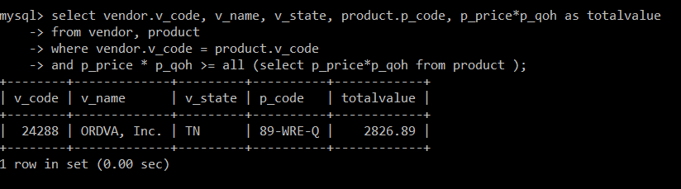

Slide 24
ALL and ANY subqueries
Find the products with the value that are higher than all products provided by vendors from Florida. Give their code and value.
Thinking
Find the vendors from Florida
sqA: SELECT V_CODE FROM VENDOR WHERE V_STATE = ‘FL’
2. Find the value list of products provided by vendors from Florida
sqB: SELECT P_PRICE * P_QOH FROM PRODUCT
WHERE V_CODE IN(sqA)
Find the products with higher value than the value list of products provided by vendors from Florida
SELECT P_PRICE*P_QOH, P_CODE FROM PRODUCT
WHERE P_PRICE*P_QOH > ALL(sqB)

Slide 25
ALL and ANY subqueries
Find the products with the value that are higher than all products provided by vendors from Florida. Give their code and value.
SELECT P_PRICE*P_QOH, P_CODE FROM PRODUCT
WHERE P_PRICE*P_QOH > ALL (SELECT P_PRICE * P_QOH
FROM PRODUCT
WHERE V_CODE IN ( SELECT V_CODE
FROM VENDOR
WHERE V_STATE = ‘FL’) )

Slide 26
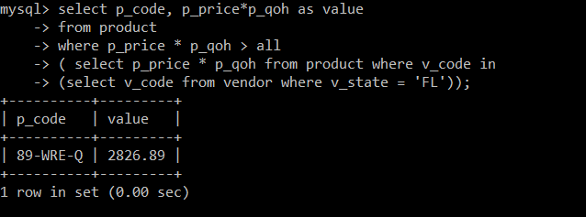

Slide 27
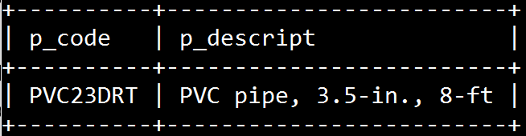
Practice 13
Find what is the most popular product (the product with largest-selling). List its product code and description.

Slide 28

Thank you & Questions

