Slide 1
CS 309A- Database Management Systems

Slide 2
Old-style Join
SELECT statement in conjunction with WHERE clause to join two or more tables.
SELECT p_code, p_descript, p_price, v_name
FROM product, vendor
WHERE product.v_code = vendor.v_code;
Old-style Join

Slide 3
SQL Join Operators
Relational join operation merges rows from two tables and returns rows with one of the following:
Natural join - common values in common columns
Equality or inequality - meet a given join condition
Outer join – common values in common columns or no matching values
Inner join: Rows that meet a given criterion are selected
Equality condition (natural join or equijoin) or inequality condition (theta join)
Outer join: Returns matching rows and rows with unmatched attribute values for one or both joined tables

Slide 4
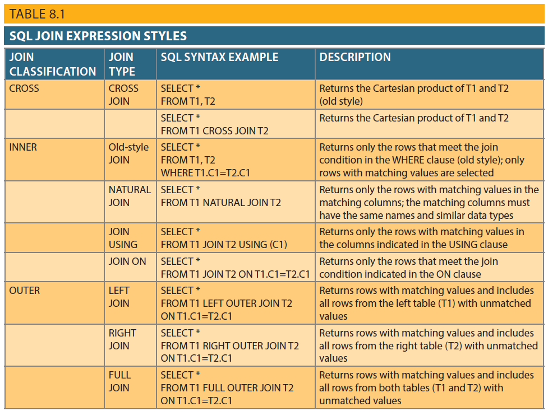
Table 8.1 -SQL Join Expression Styles

Slide 5
Cross Join
If you want to get a relational product (Cartesian product) of two tables.
Syntax:
SELECT columnlist
FROM table1 cross Join table2
Example:
SELECT * FROM invoice CROSS JOIN line;
How many rows you will get?

Slide 6
Natural Join
If you want to get all rows with matching values in the matching columns and eliminates duplicate columns.
Syntax:
SELECT columnlist
FROM table1 natural Join table2
Example:
SELECT cus_code, cus_lname, inv_number, inv_date
FROM customer NATURAL JOIN invoice;

Slide 7
Practice 1
List the customer code, last name, invoice number, invoice date using natural join according to the order of customer code.
List the invoice number, product code, product description, line units, line price using natural join. The line price should be greater than 50.

Slide 8
Join using
If you want to get only the rows with matching values in the column indicated in the USING clause – and that column must exist in both tables.
Syntax:
SELECT columnlist
FROM table1 Join table2
USING common-column
Example:
SELECT inv_number, p_code, p_descript, line_units, line_price
FROM invoice join line USING (inv_number) join product USING (p_code);

Slide 9
Join On
Express a join when the tables have no common attribute names
Join condition: equality comparison, not the same name but comparable data types
Syntax:
SELECT columnlist
FROM table1 Join table2
ON join-condition

Slide 10
Practice 2:
List invoice number, the customer code, the customer last and first name, the invoice date, and customer balance for all customers with a customer balance of $500 or more using join on.

Slide 11
Outer Join
Rows matching the join condition + rows with unmatched values
Syntax:
SELECT columnlist
FROM table1 LEFT [OUTTER]Join table2
ON join-condition
SELECT columnlist
FROM table1 RIGHT[OUTTER]Join table2
ON join-condition

Slide 12
FROM and Attribute List Subqueries
SELECT statement use subqueries within WHERE, HAVING,IN, or ANY and ALL for multi-row subqueries.
In the above case, subqueries was part of a conditional expression, and always on the right side of the expression
The output of a SELECT statement is another table (“virtual” table)
FROM clause:
Specifies the tables from which the data will be drawn
Can use SELECT subquery

Slide 13
From subqueries
Find all customers who have purchased products ’13-Q2/P2’ and ‘23109-HB’.
Thinking:
All product purchases are stored in LINE table
Easy to find out who purchased any given product by searching the p_code in LINE table
3. How to find all customers who purchases both products?

Slide 14
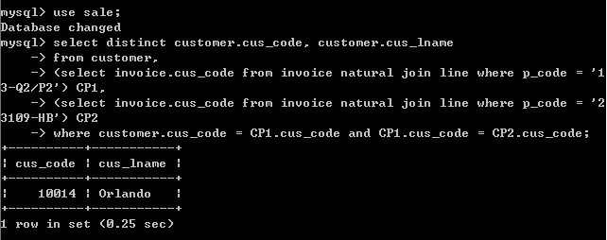
Find all customers who have purchased products ’13-Q2/P2’ and ‘23109-HB’.

Slide 15
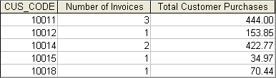
Practice 3
Write a query to produce the number of invoices and the total purchase amounts by customer.

Slide 16
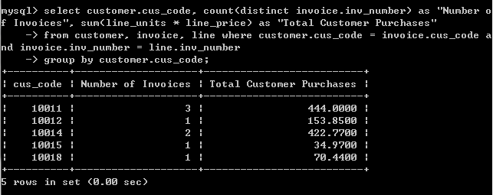
Solution 1:

Slide 17
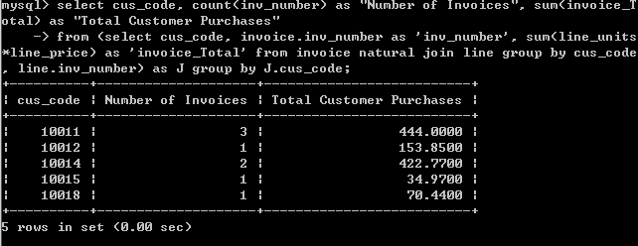
Solution 2:

Slide 18
Attribute List Subqueries
SELECT statement uses attribute list to indicate what columns to project in the resulting set
Inline subquery
Subquery expression included in the attribute list that must return one value
Column alias cannot be used in attribute list computation if alias is defined in the same attribute list

Slide 19
List product code, product price, average price and the difference between each product’s price and the average price.
Select p_code, p_price,
(select avg(p_price) from product) as average,
p_price - (select avg(p_price) from product) as DIFF
From product;
Column alias is not used

Slide 20
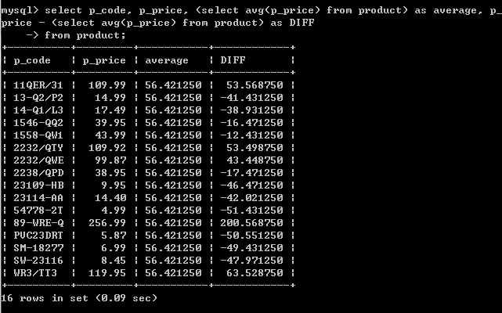
The inline query output returns one value

Slide 21
Practice 4
Write a query to get the product code, the total sales by product, and the contribution by employee of each product’s sales.

Slide 22
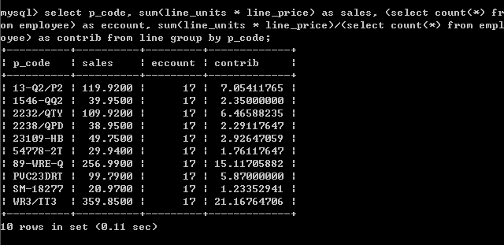
Solution:

Slide 23
Correlated Subqueries
All subqueries you have learned execute independently
Inner subquery executes first; its output is used by the outer query, which then executes until the last outer query finishes
Correlated subquery executes once for each row in the outer query
The process is similar to nested loop in programming
Inner query references a column of the outer subquery
Can be used with the EXISTS special operator

Slide 24
Write a query to get all product sales in which the units sold value is greater than the average units sold value for that product (as oppose to the average for all products).
Thinking:
1. compute the average units sold for a product
2. compare the average computed in step 1 to the units sold in each sale row
SELECT inv_number, p_code, line_units
FROM line LS
WHERE LS.line_units > (SELECT AVG(line_units) from line LA
WHERE LA.p_code = LS.p_code);
Line table is used more than once, must use aliases.

Slide 25
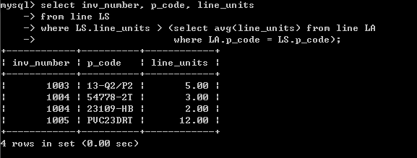

Slide 26
Practice 5
List vendor code and vendor name for products with a quantity on hand that is less than double the minimum quantity.
List customer code, customer last name, and customer first name who have placed an order. In other words, the corresponding customer code exists in invoice table.

Slide 27
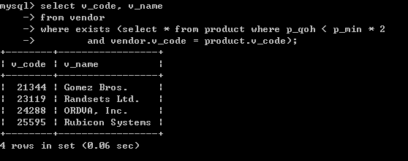
List vendor code and vendor name for products with a quantity on hand that is less than double the minimum quantity.

Slide 28
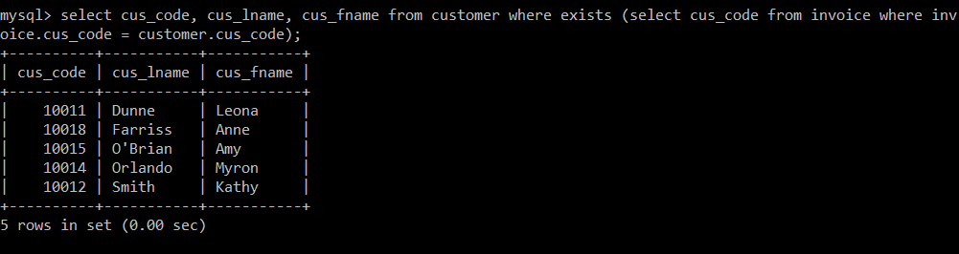
List customer code, customer last name, and customer first name who have placed an order. In other words, the corresponding customer code exists in invoice table.

Slide 29

Thank you & Questions

