Slide 1
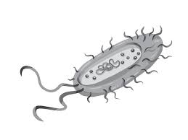

Association Rule Mining for AMR analysis

Slide 2
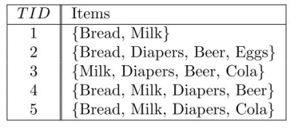

Background On The Method
Association rule mining has historically been used for market basket analysis (i.e., what products are purchased together?)

Slide 3
Background On The Method
This is done in two general steps:
1) Find which itemsets frequently occur in the data
2) Generate rules from the frequent itemsets

Slide 4

Background On The Method
How are frequent itemsets found?

Slide 5
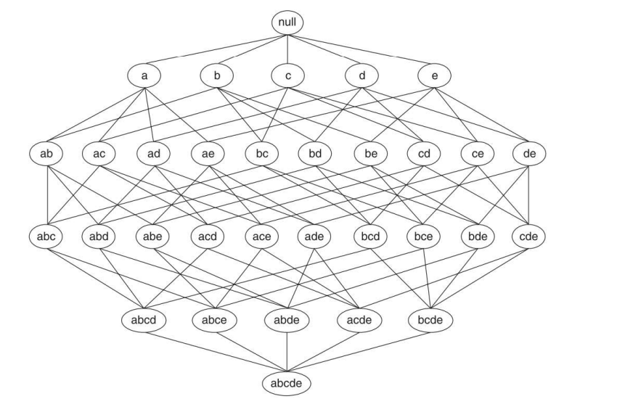
Background On The Method
Problem:
Computationally expensive to do this for all possible itemsets.

Slide 6
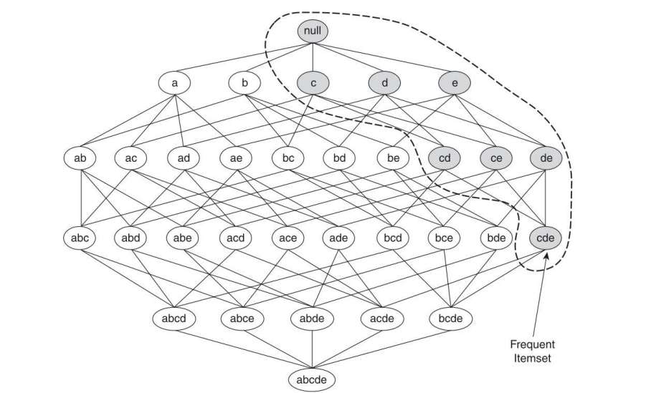
Background On The Method
Solution:
The Apriori Principle.

Slide 7
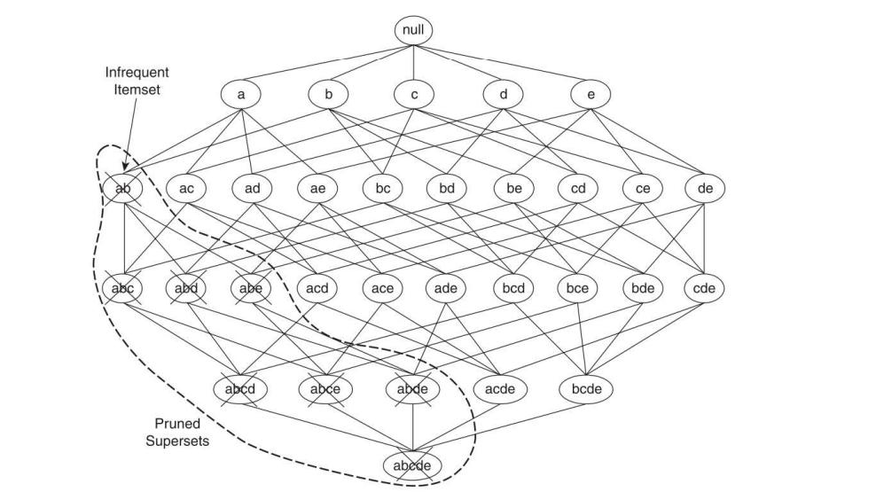
Background On The Method
Solution:
The Apriori Principle.

Slide 8
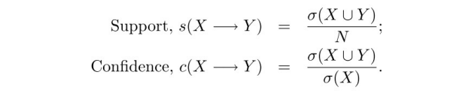
Background On The Method
Once the frequent itemsets are found, rules are generated from them.
Rules are pruned using a variety of measures.

Slide 9
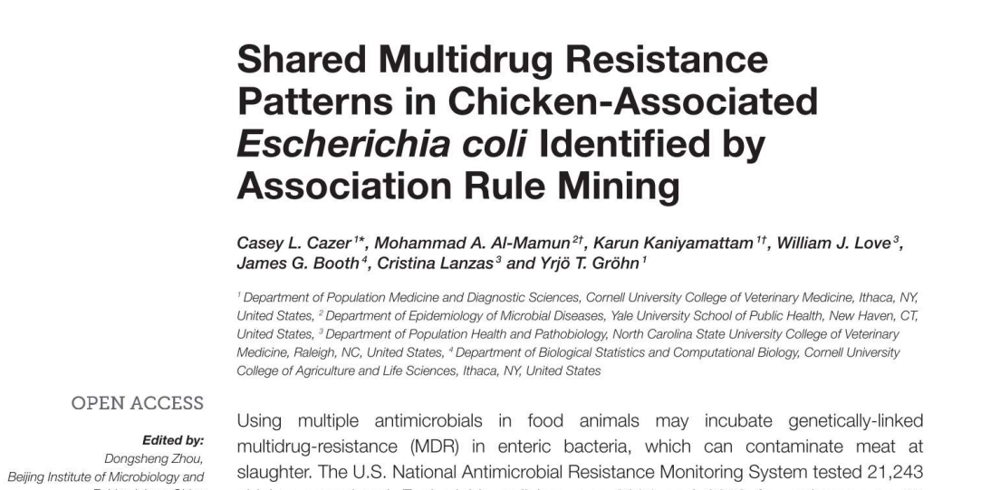
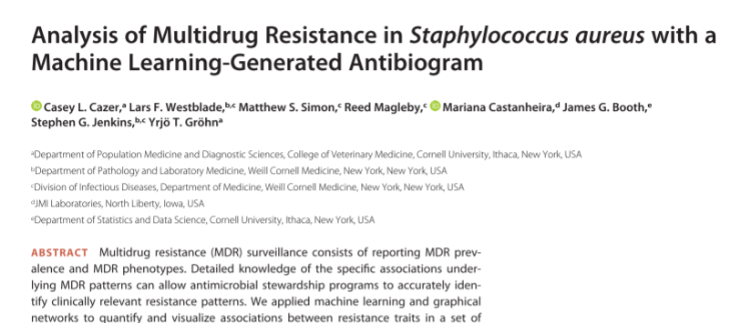
Previous Work
Items are resistances to antimicrobials.
A transaction is the resistance pattern present in one isolate.
Rules/frequent itemsets represent which resistances are likely to occur alongside other resistances.

Slide 10
The Current Work
Seeks to extend previous work
Look at patterns of multi-drug resistance across the food chain and across time
Incorporate both phenotypic and genotypic data
EXAMPLE
Genotype rule: {strA, strB} → {blaCMY-2-3}
Phenotype rule: {Gentamicin, Streptomycin} → {Amoxicillin–Clavulanic Acid}
Class Based rule: {Aminoglycosides} → {Beta lactams}

Slide 11
Preliminary Results
Using NARMS Retail Meats dataset
Focused on E. coli associated with cattle
Data from 2002-2019 (mined separately)

Slide 12
Preliminary Results
Three analysis decisions to make:
How many rules do we need to thoroughly describe the sample?
What quality measures should be used to prune rules?
What thresholds should be used for the quality measures?

Slide 13
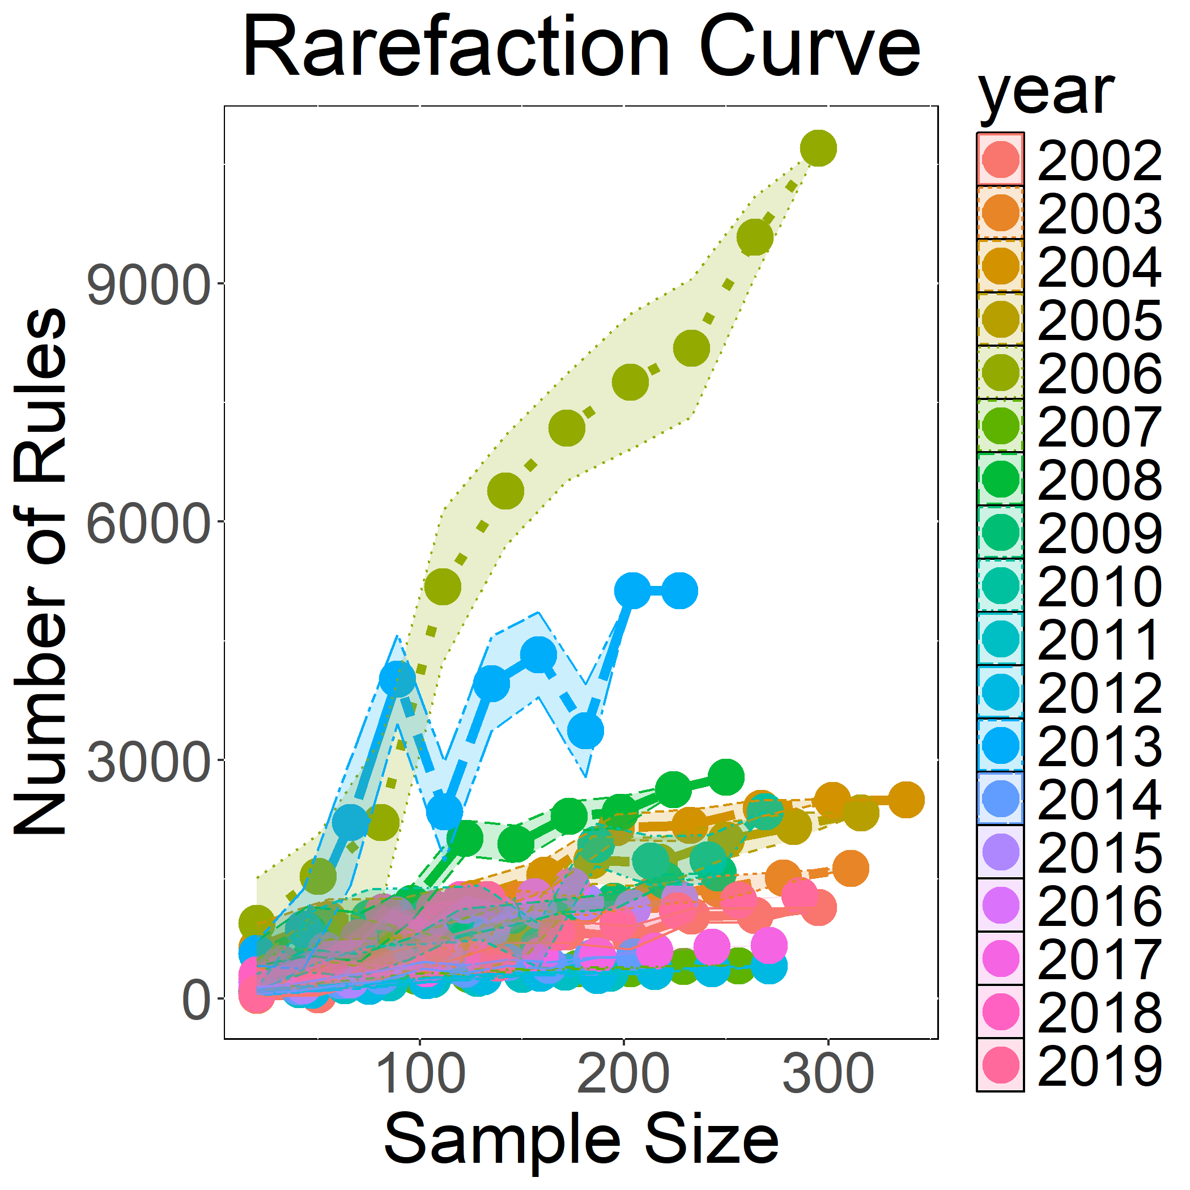
How Many Rules Do We Need?

Slide 14
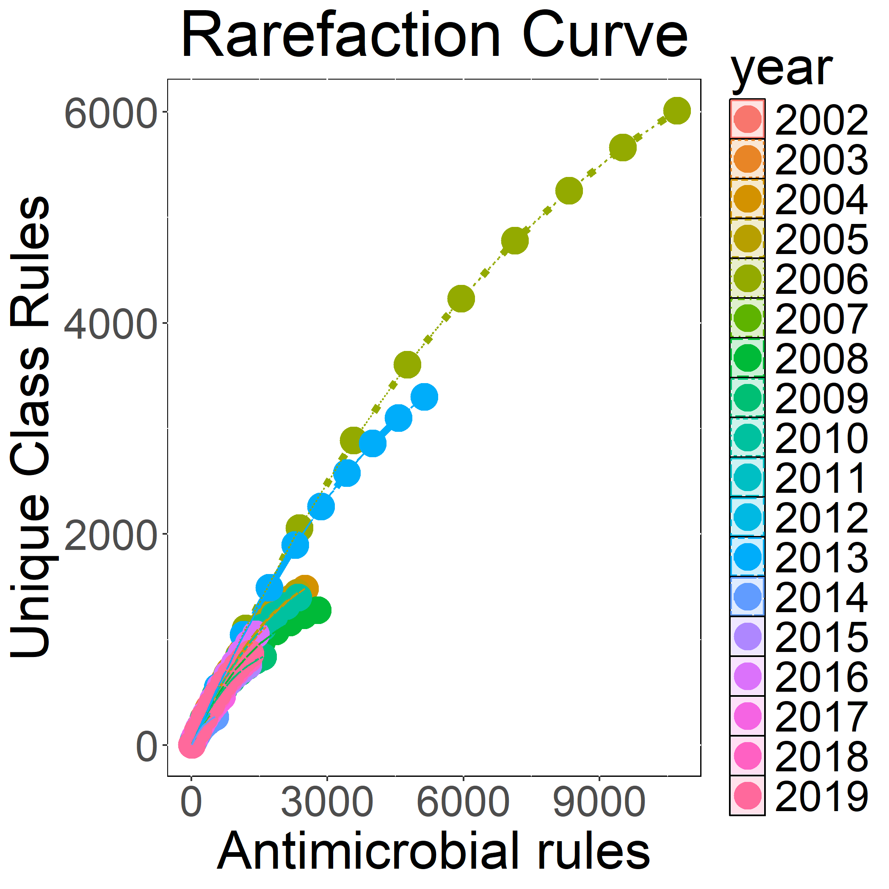
How Many Rules Do We Need?

Slide 15
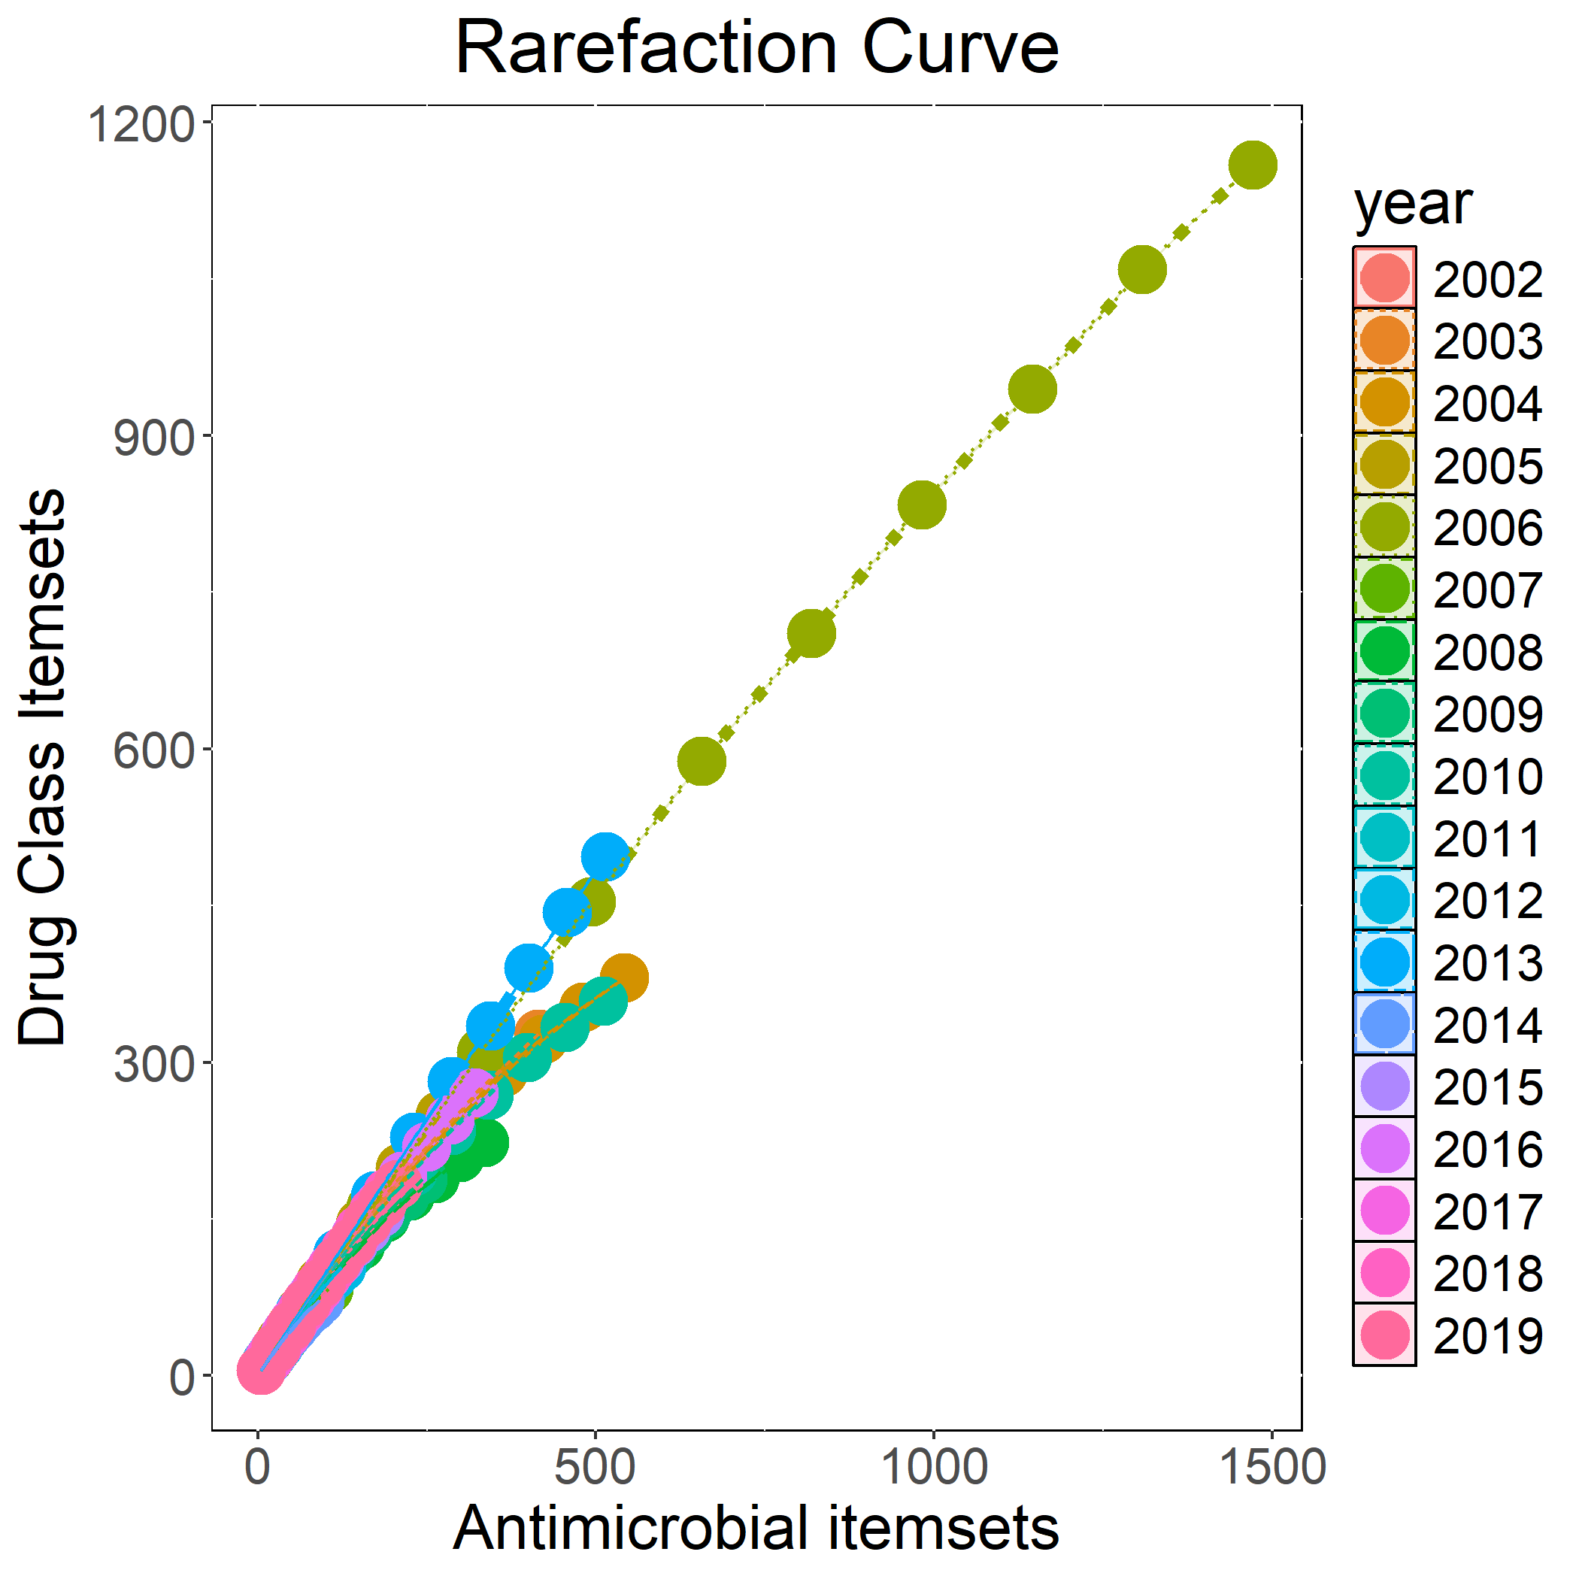
How Many Rules Do We Need?

Slide 16
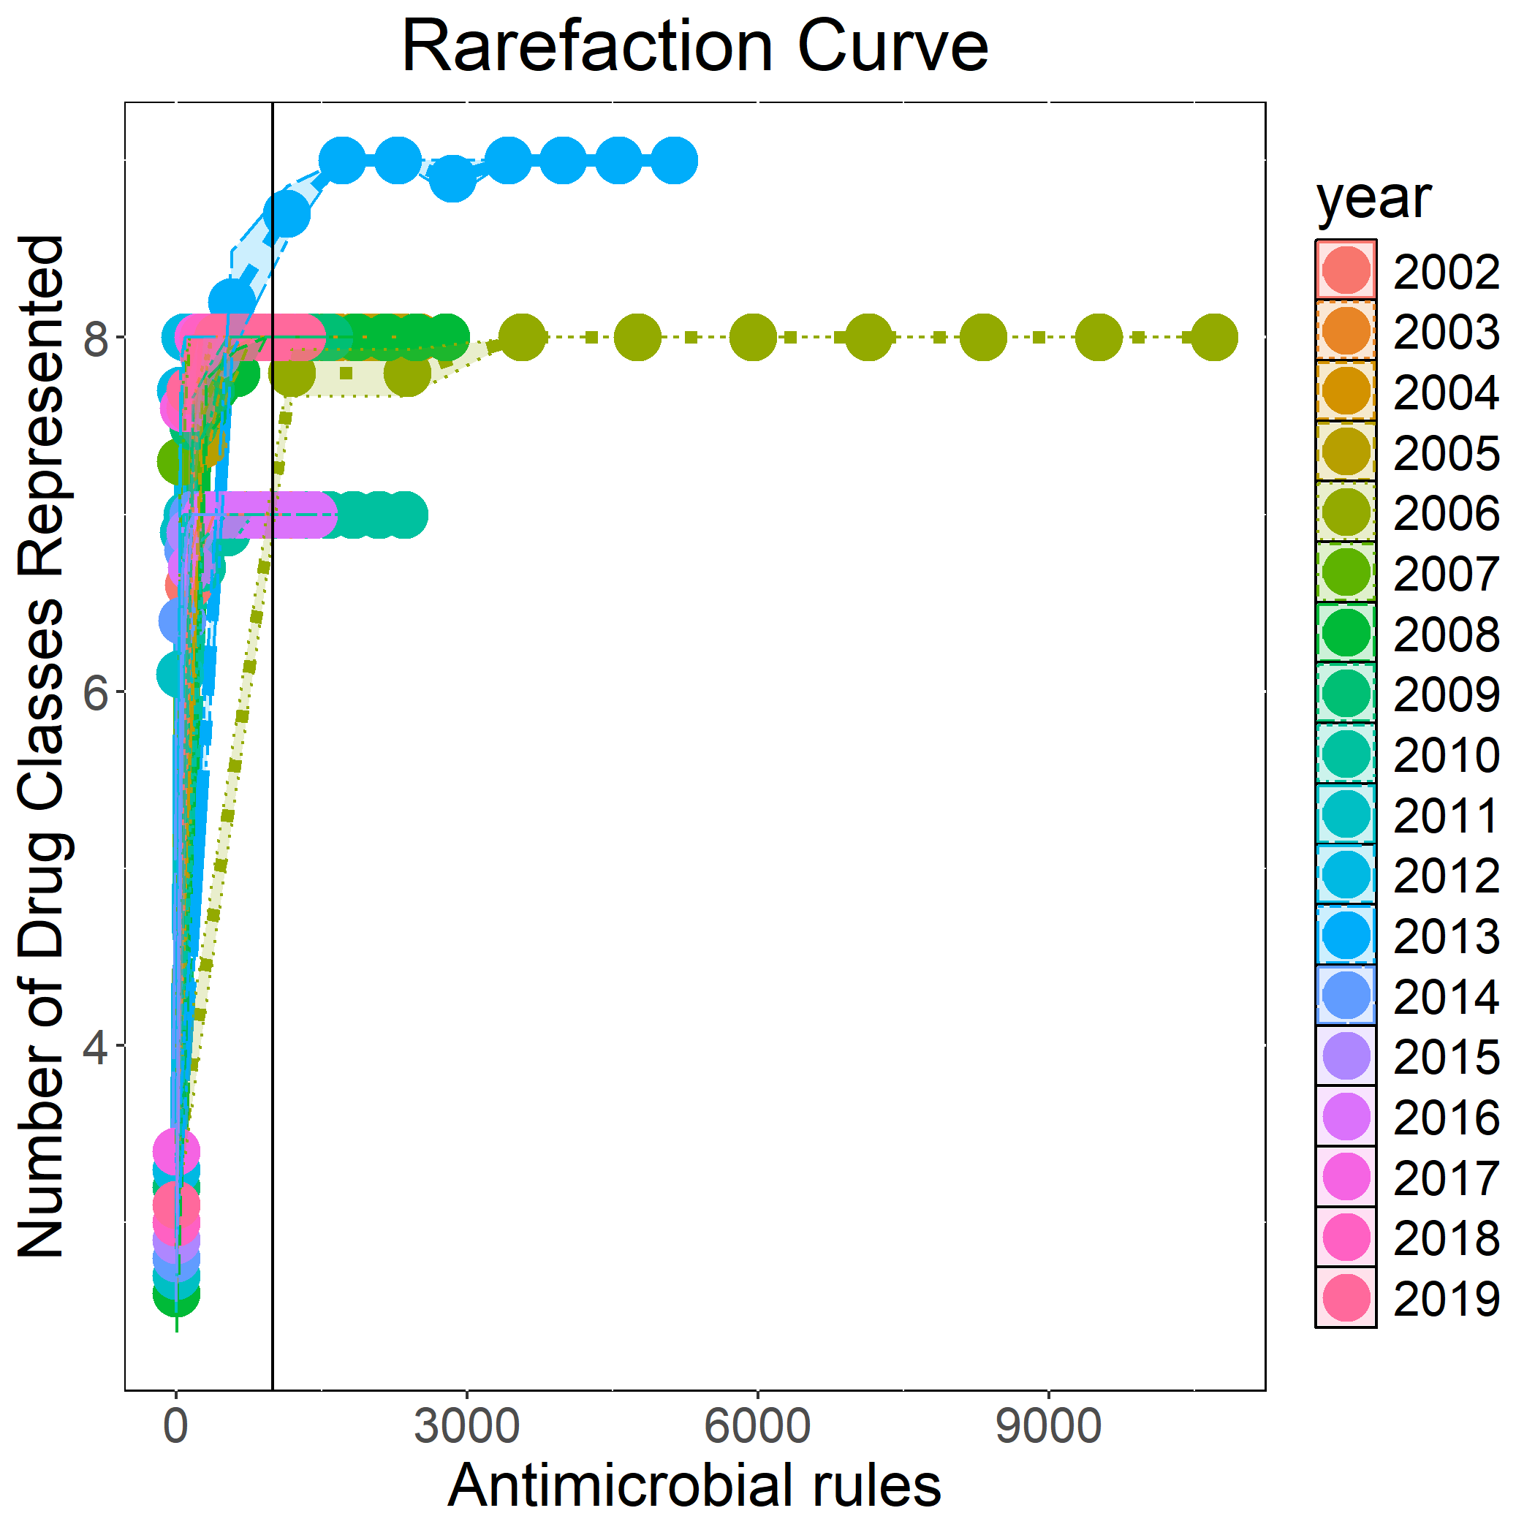
How Many Rules Do We Need?

Slide 17
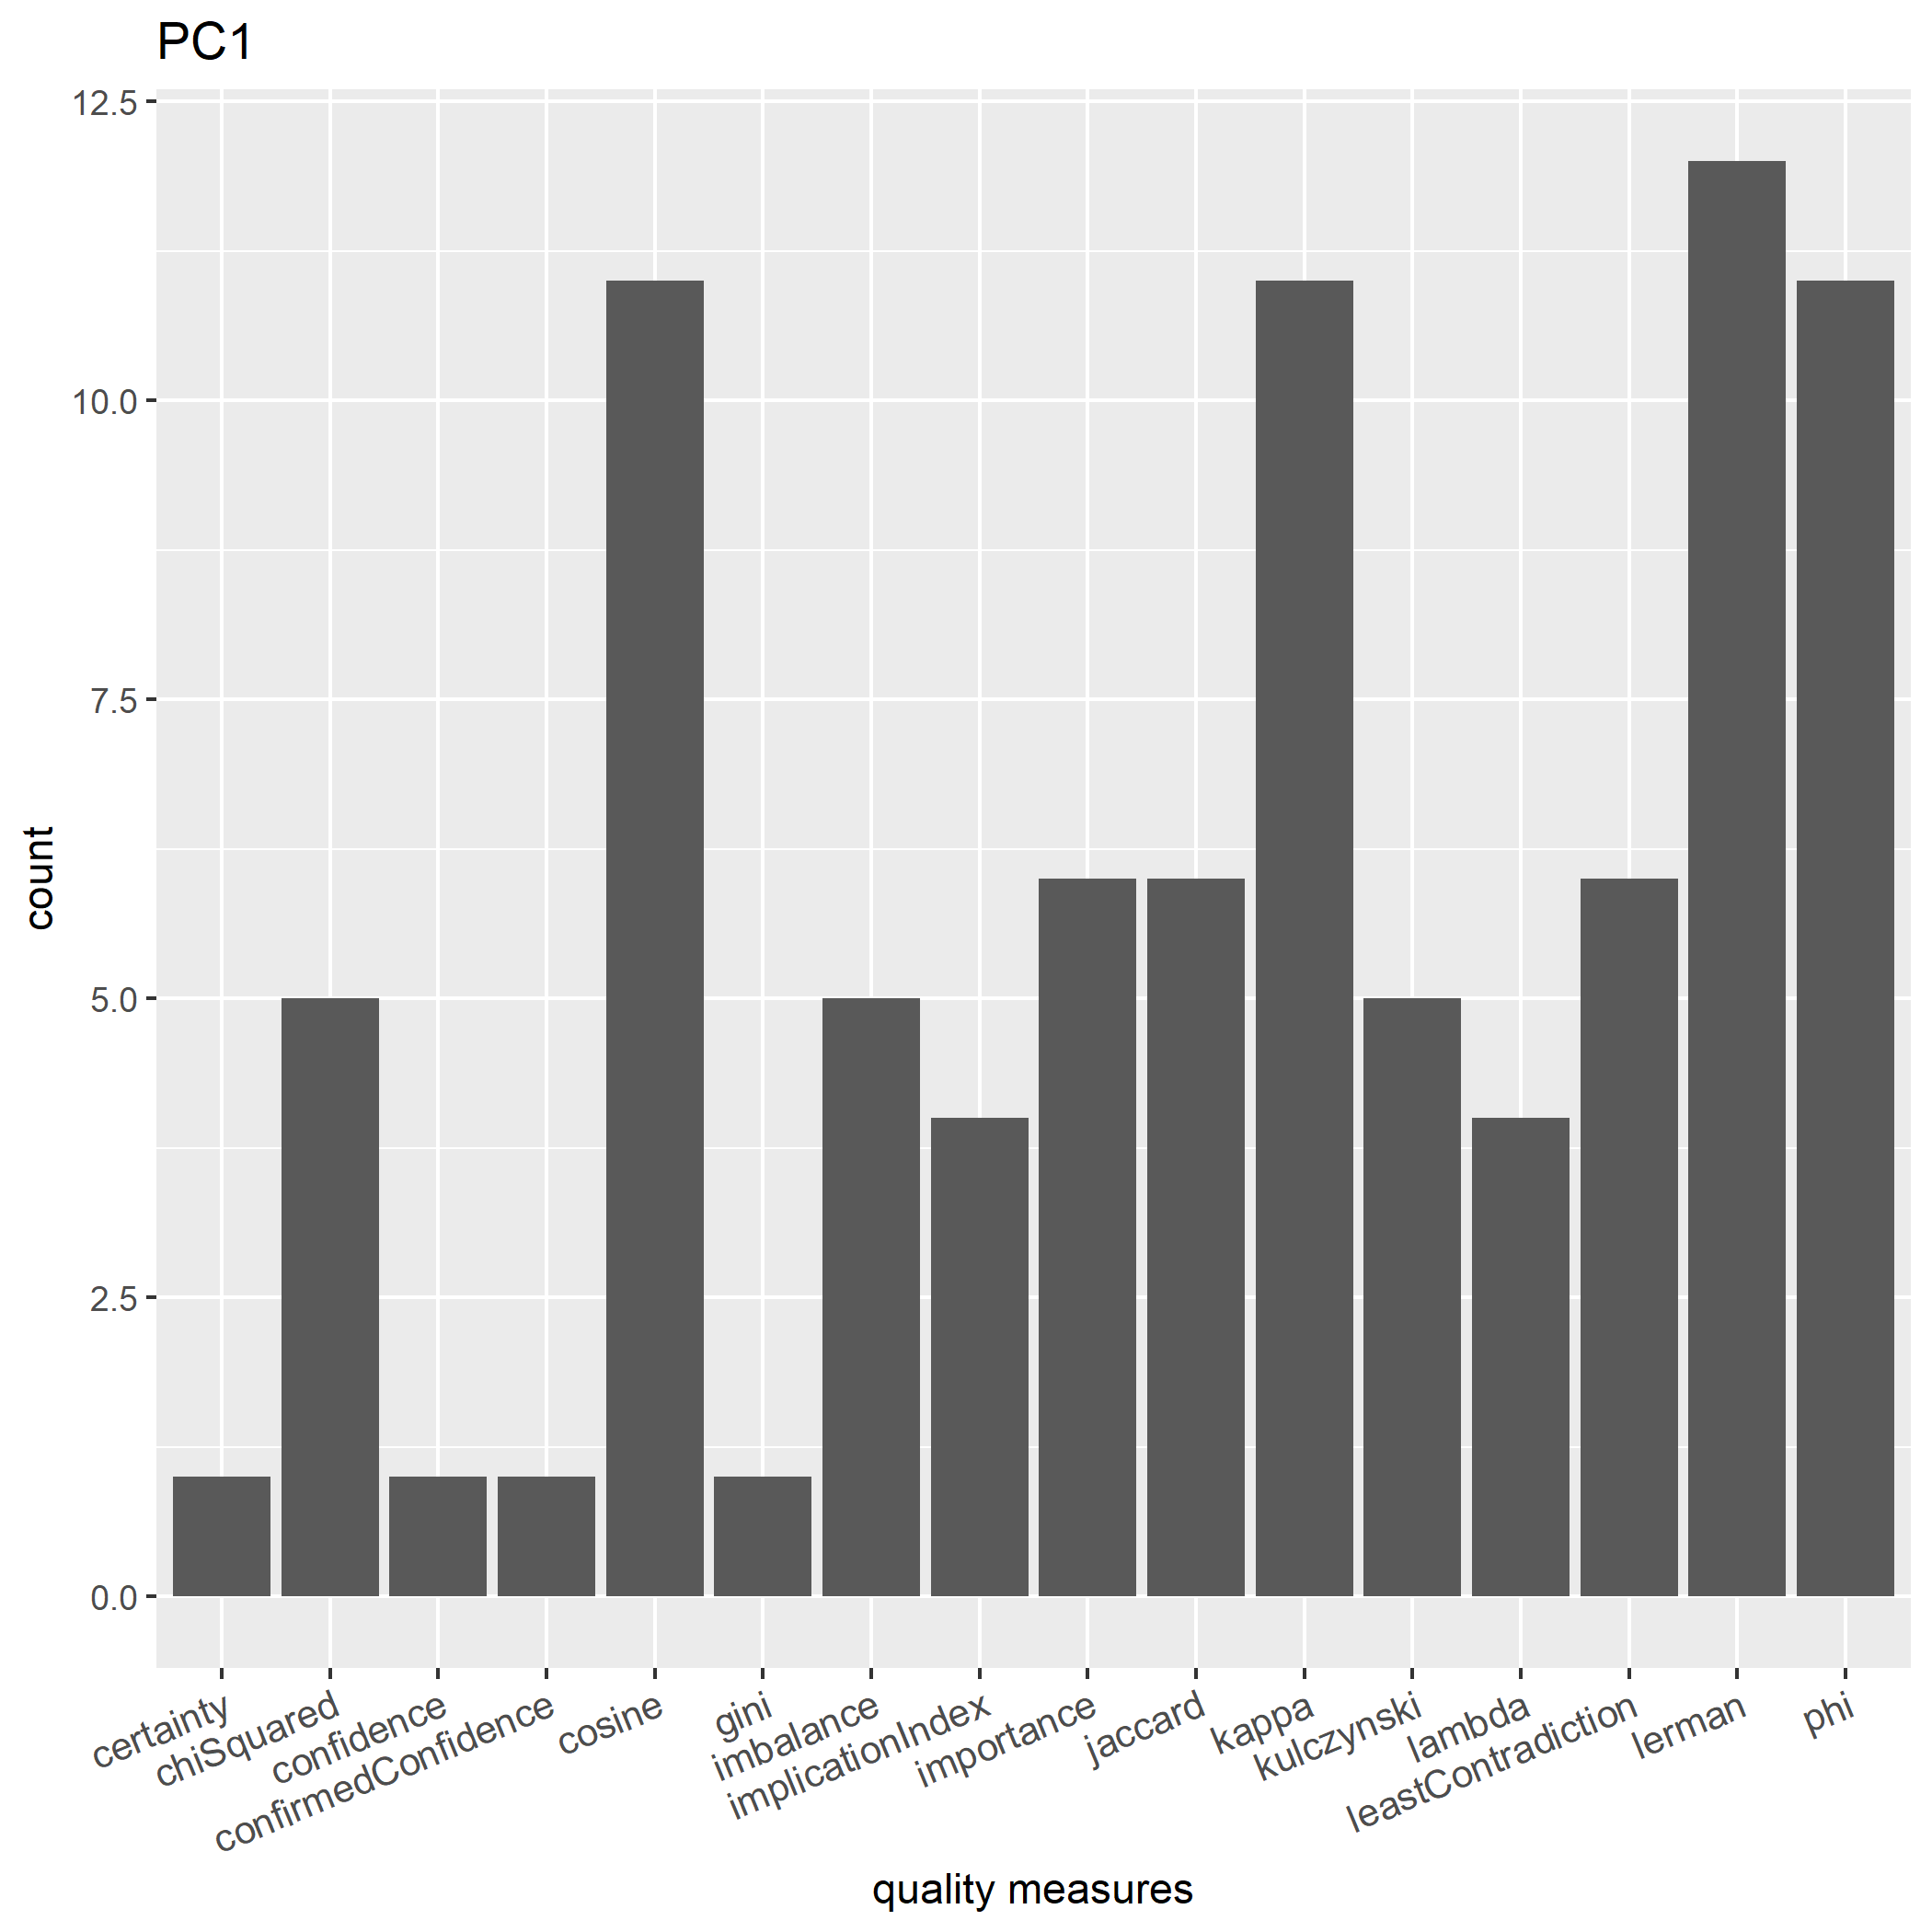
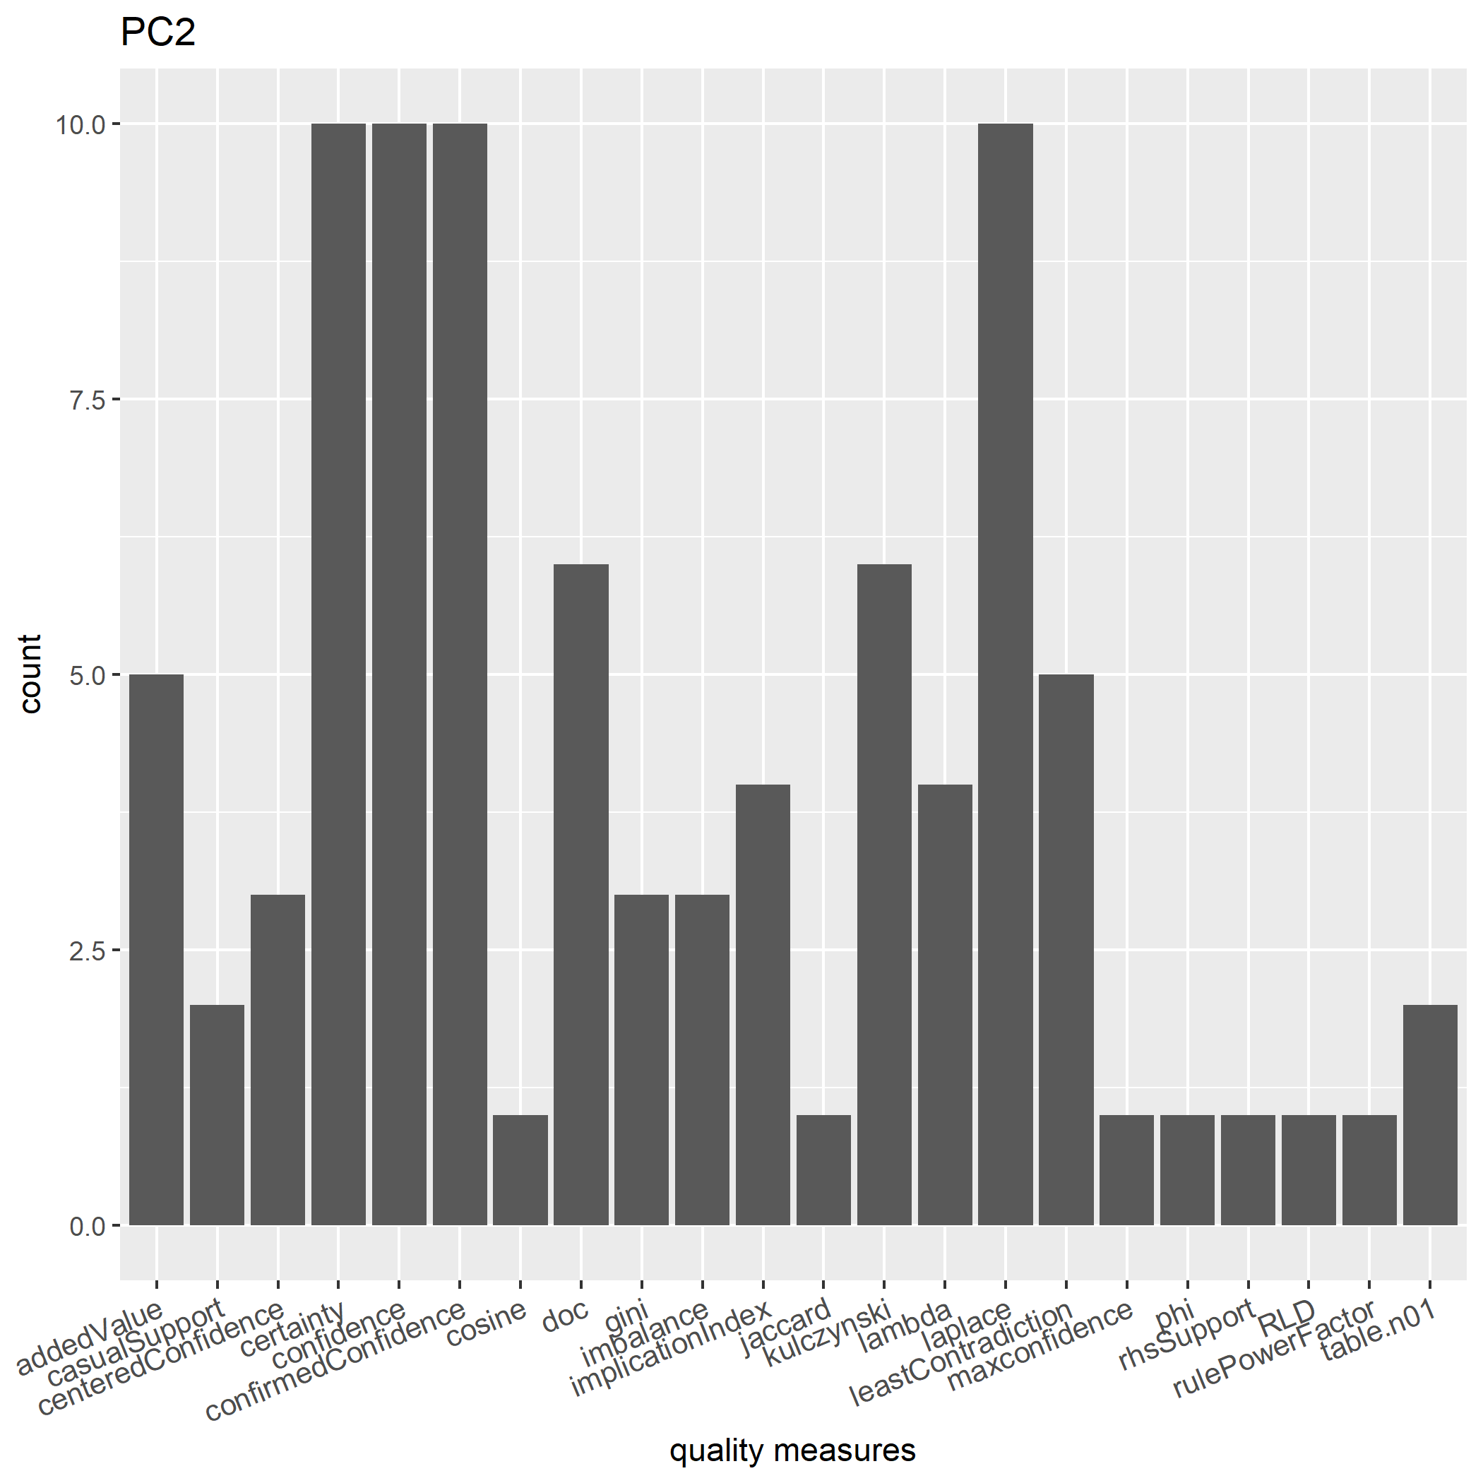
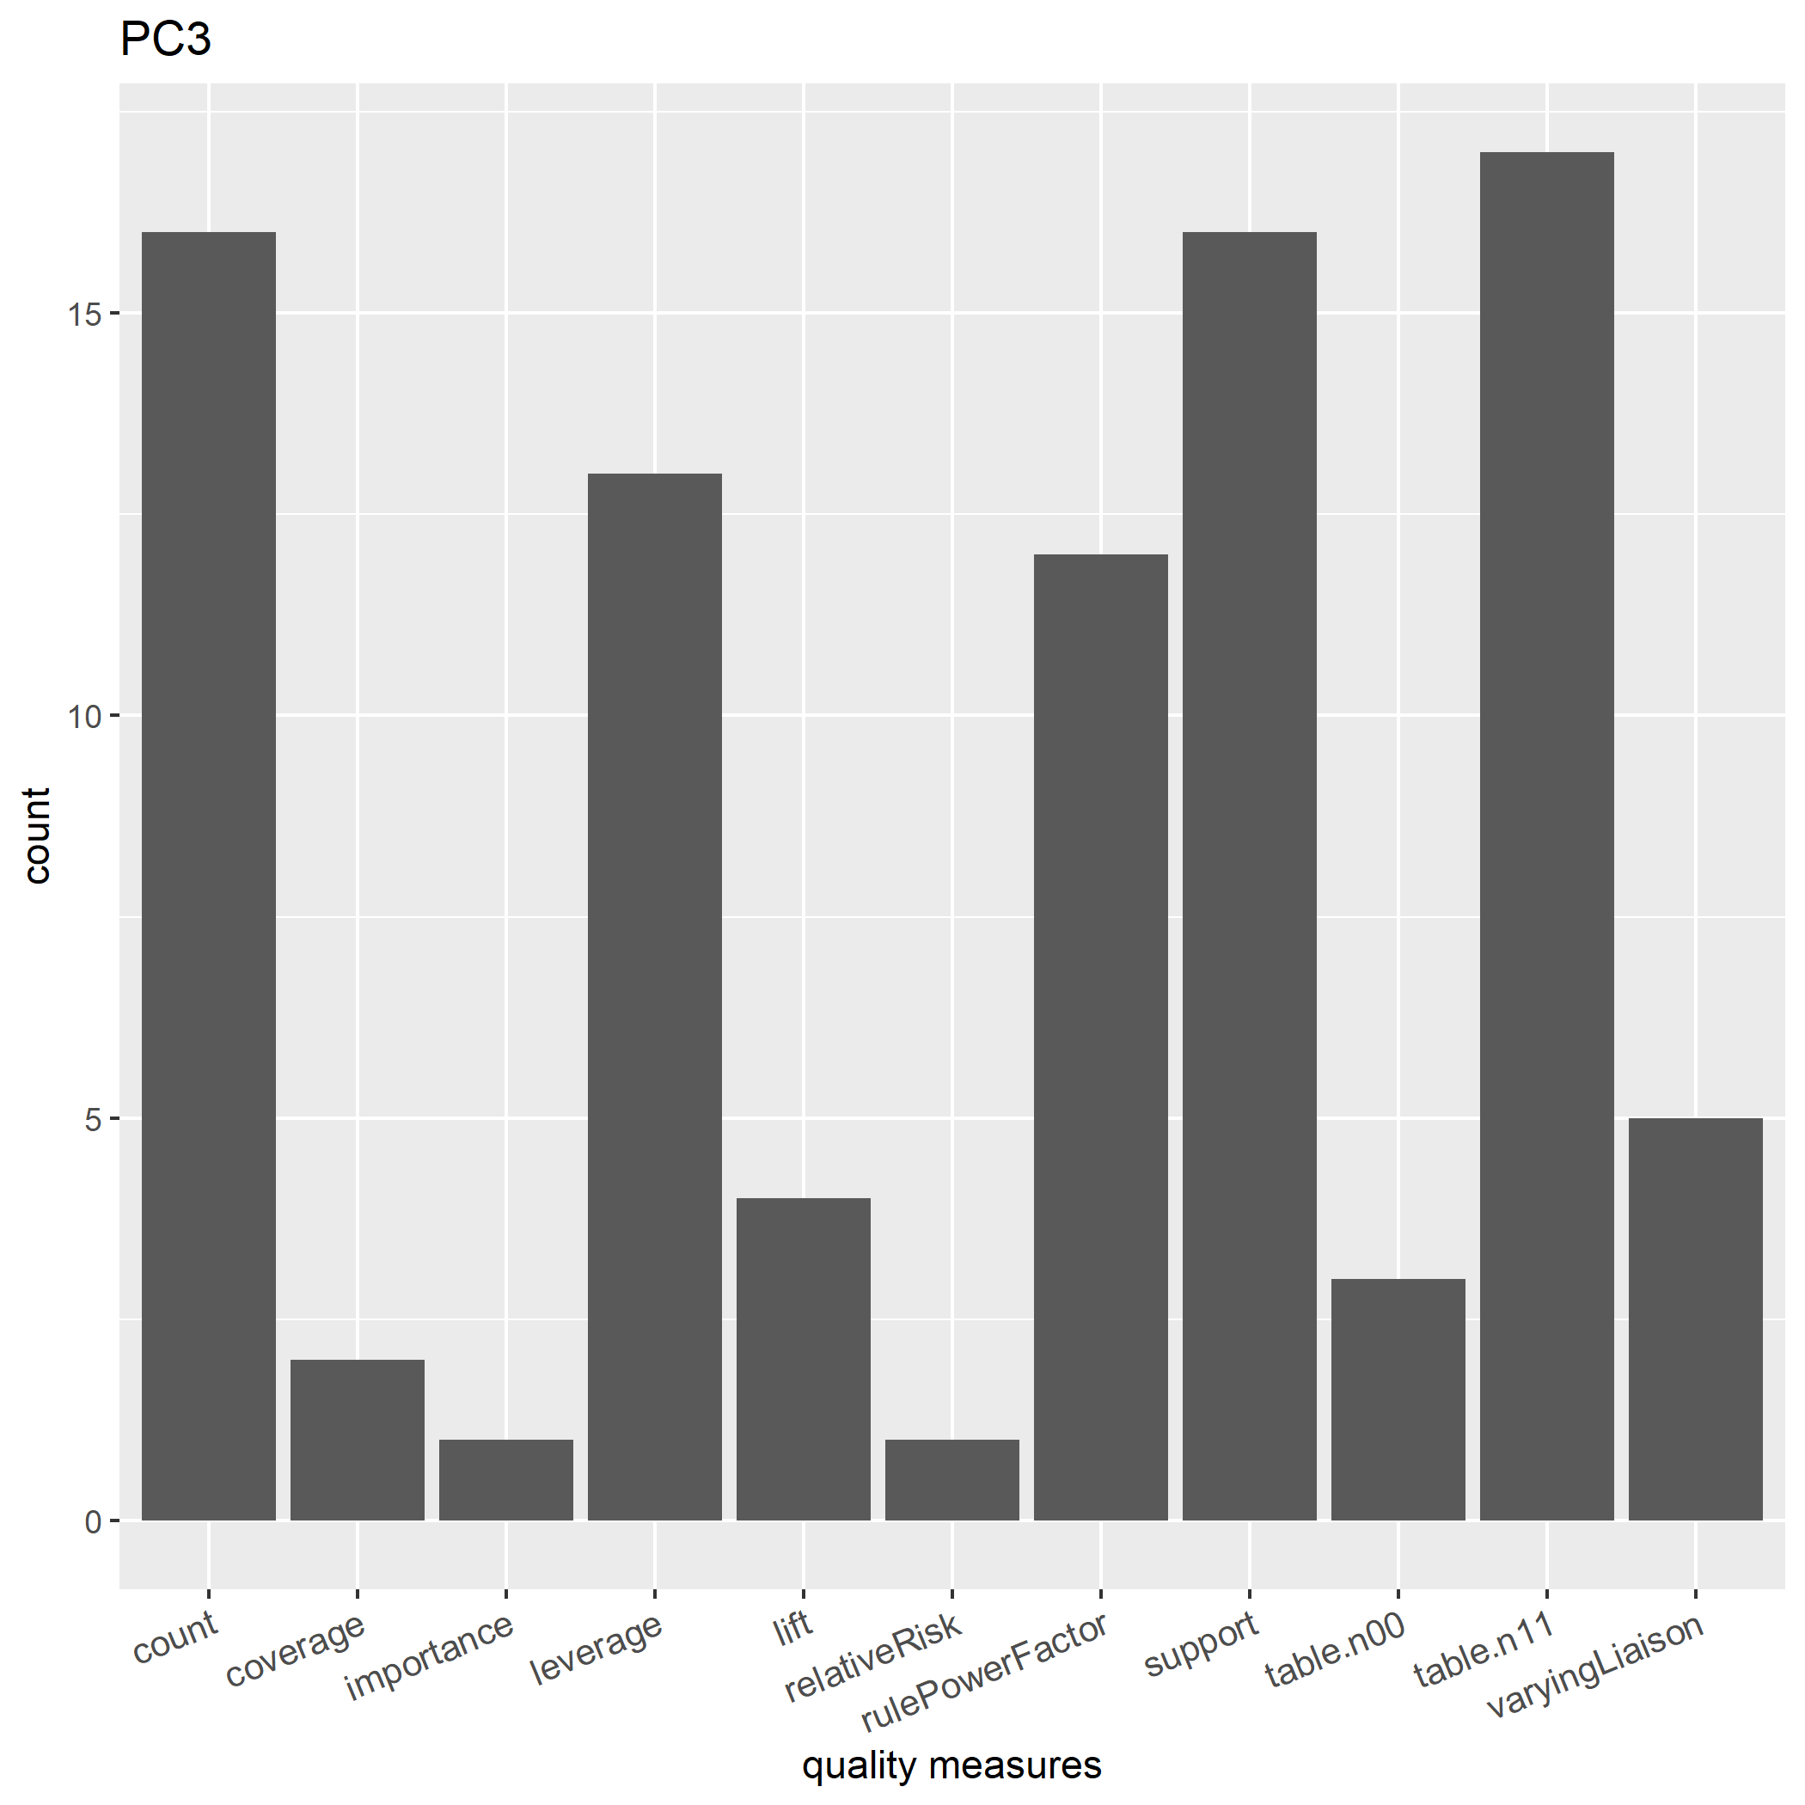
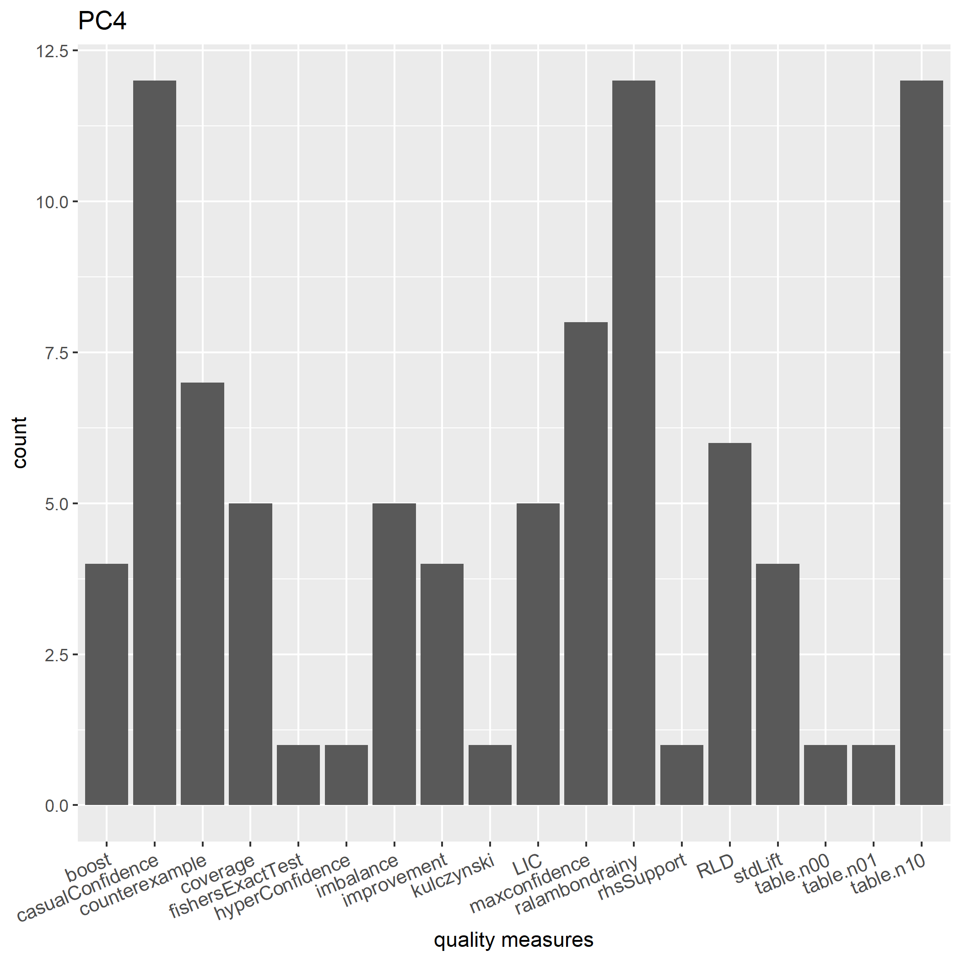
What Quality Measures Should We Use?

Slide 18
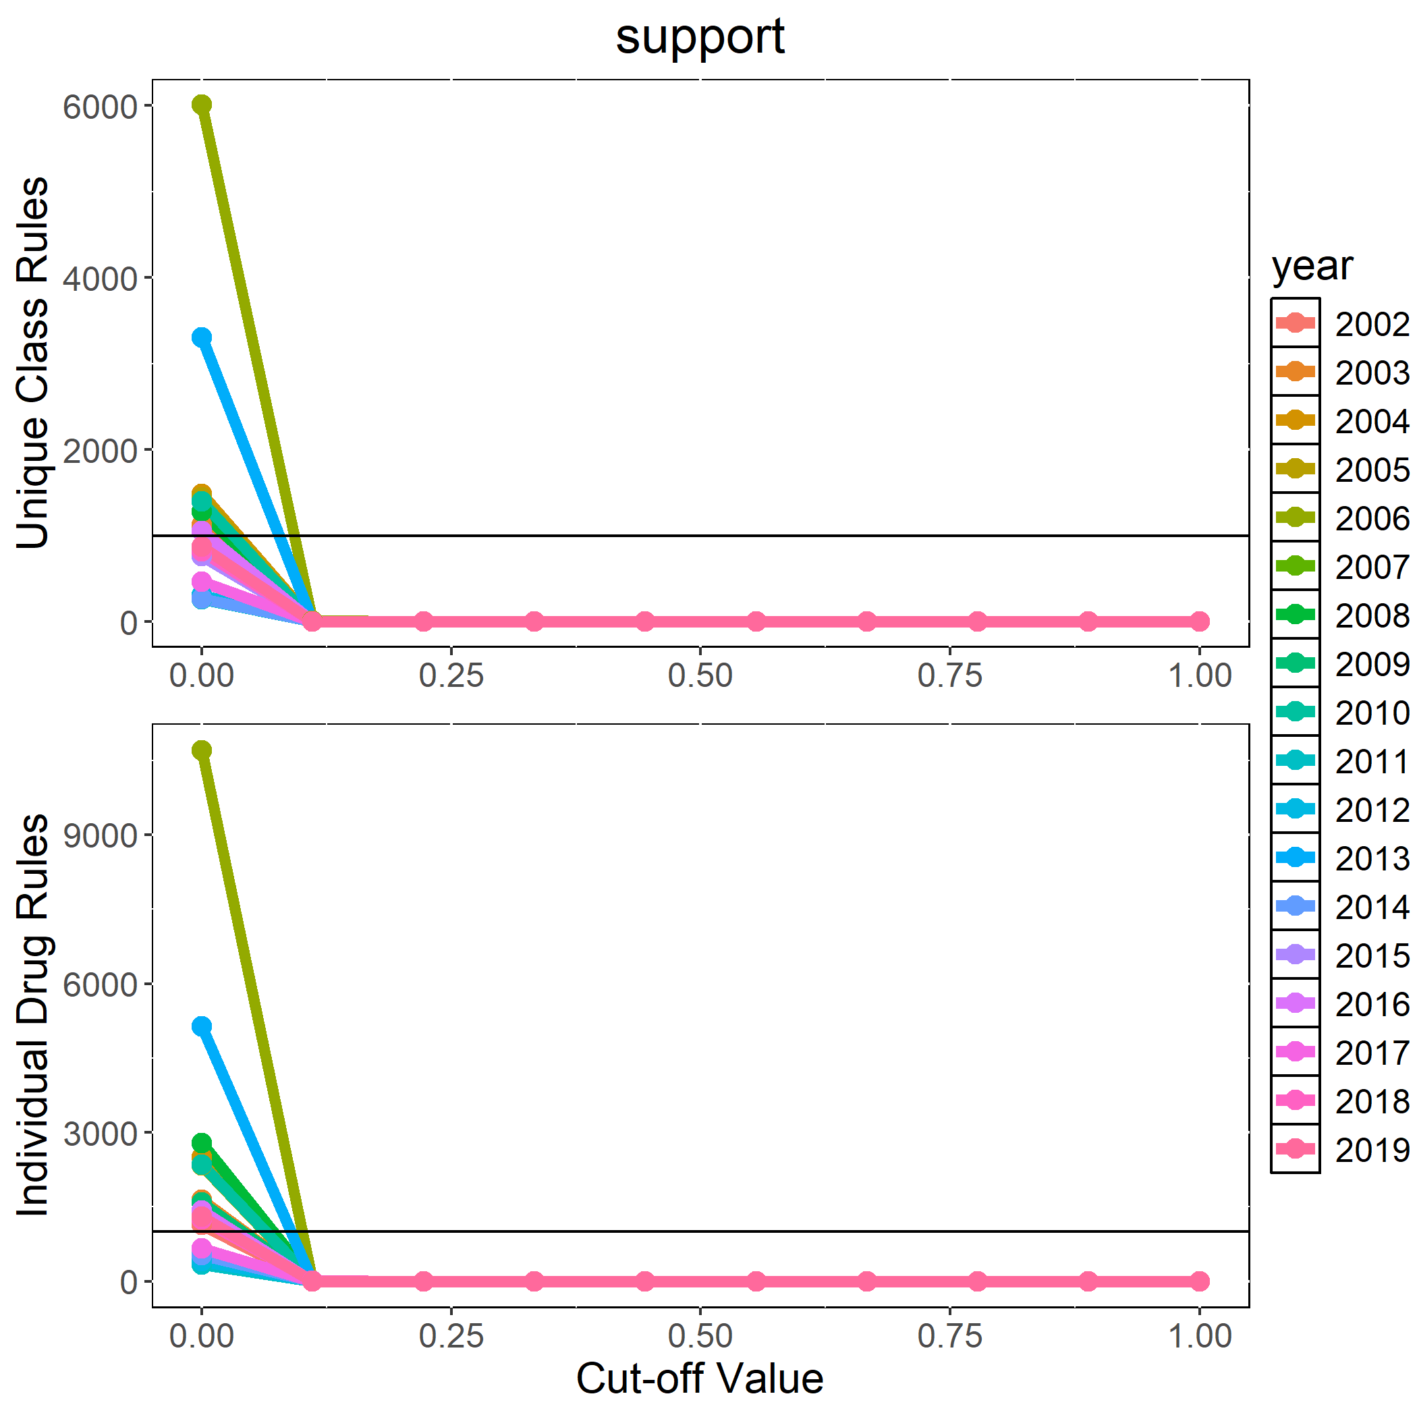
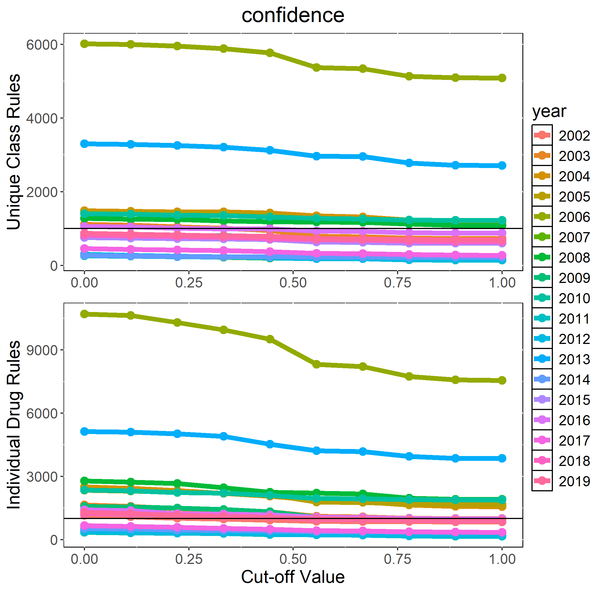
What Thresholds Should We Use?

Slide 19
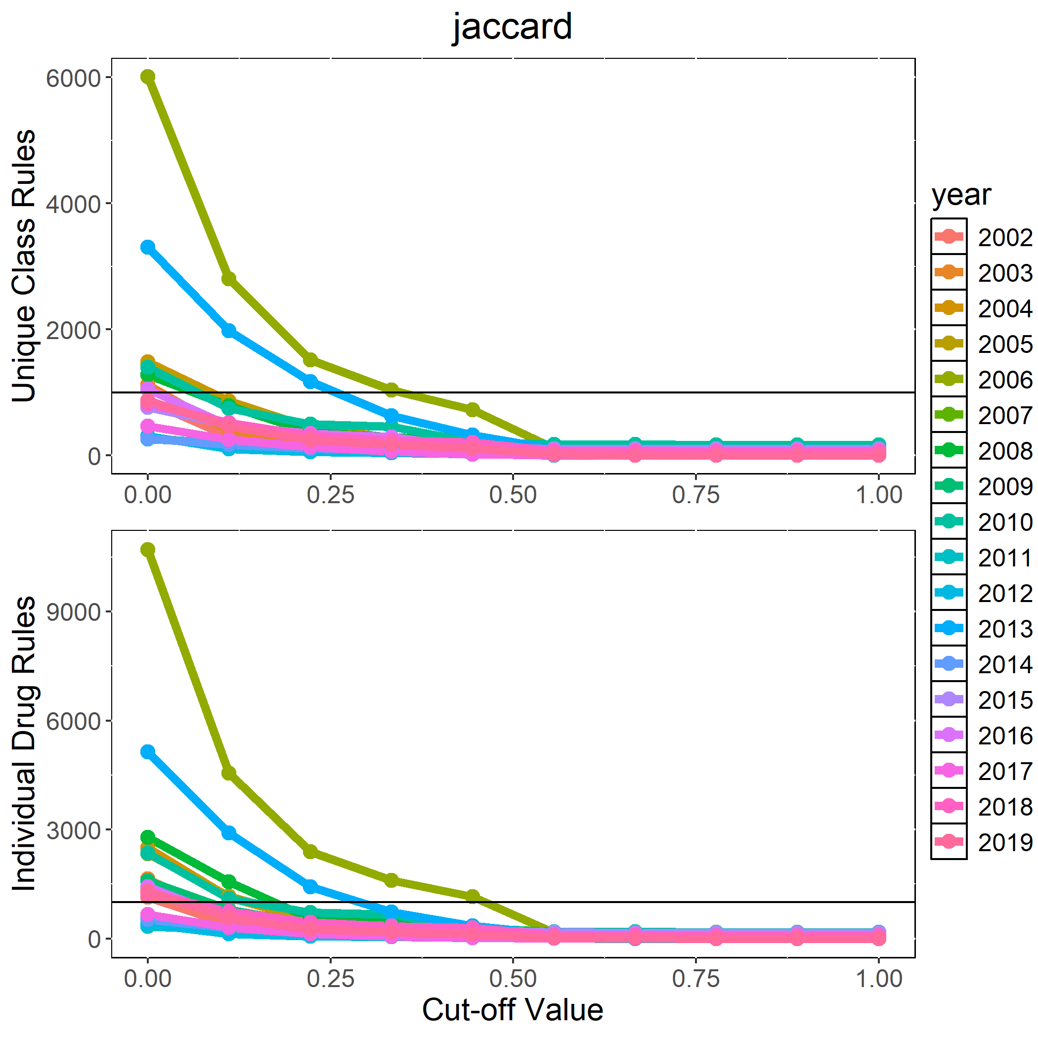
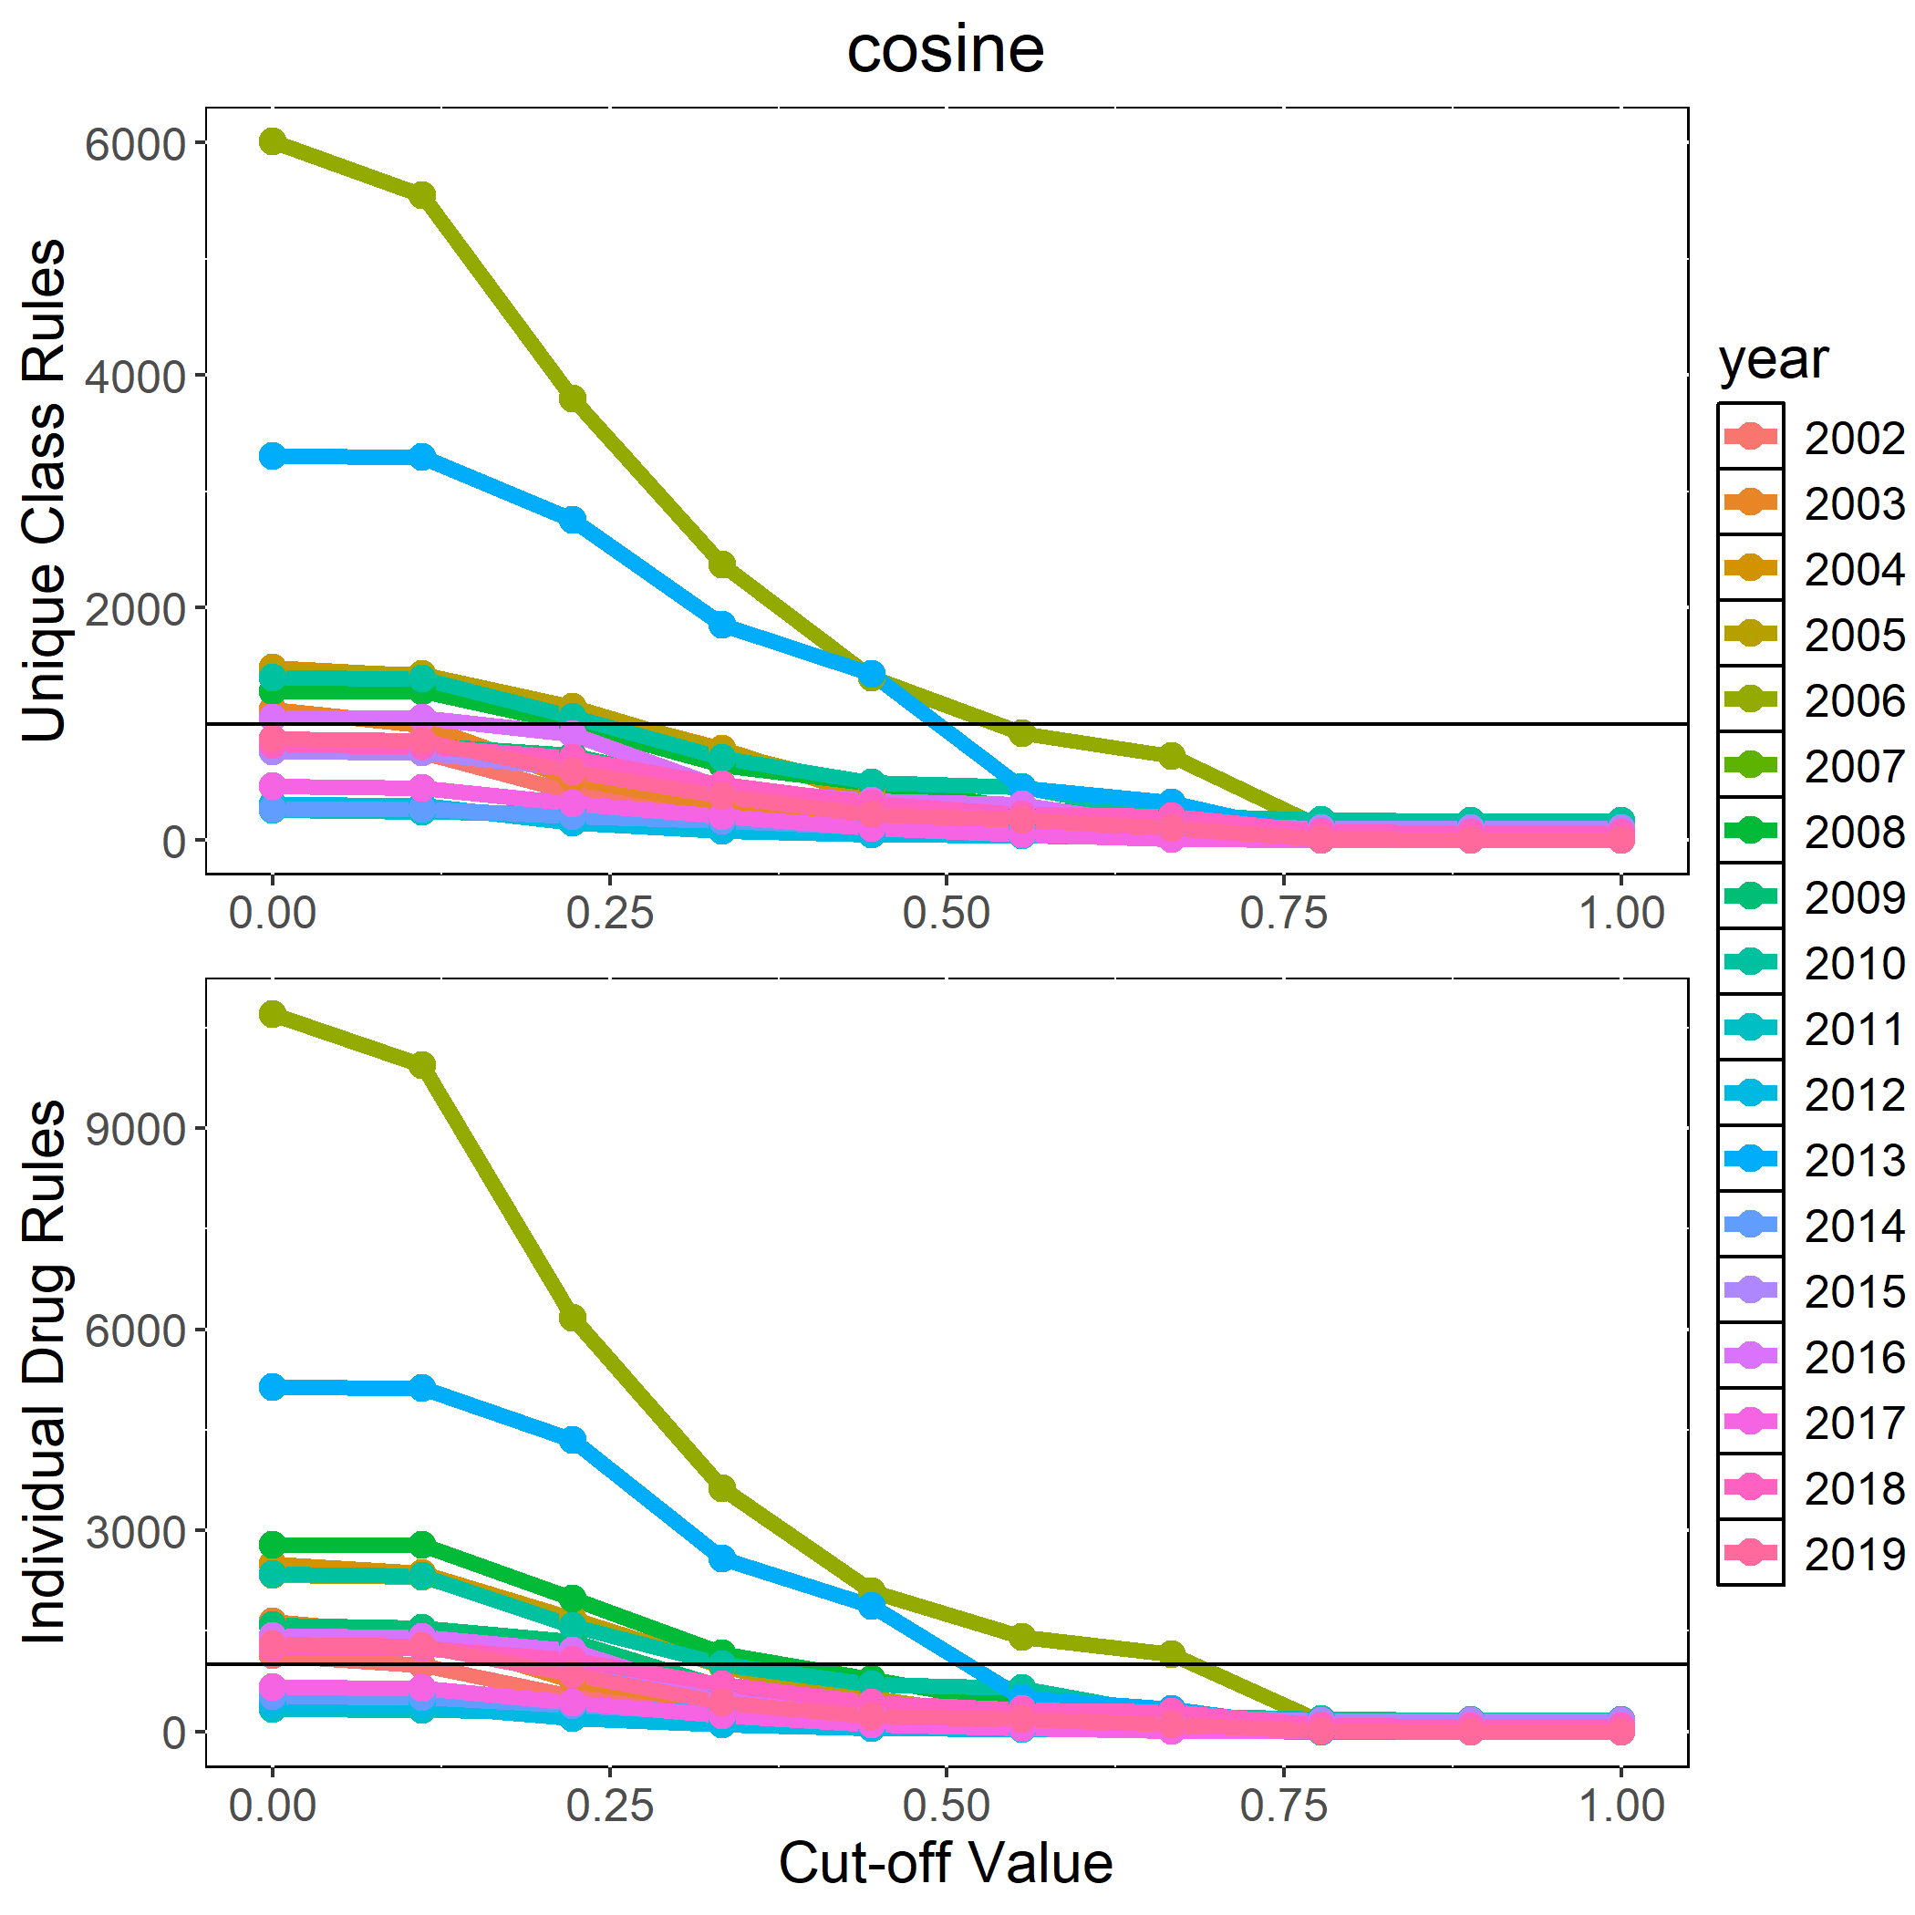
What Thresholds Should We Use?

Slide 20
Next Steps
Perform some tests of statistical significance via a resampling procedure.
Perform graphical analysis on network decompositions of rules in order to pull more interpretable insights out.
Include sample source variable to the analysis in order compare across food chain.
Include genotype and translate genotype and phenotype rules into class level rules for comparison.

Slide 21
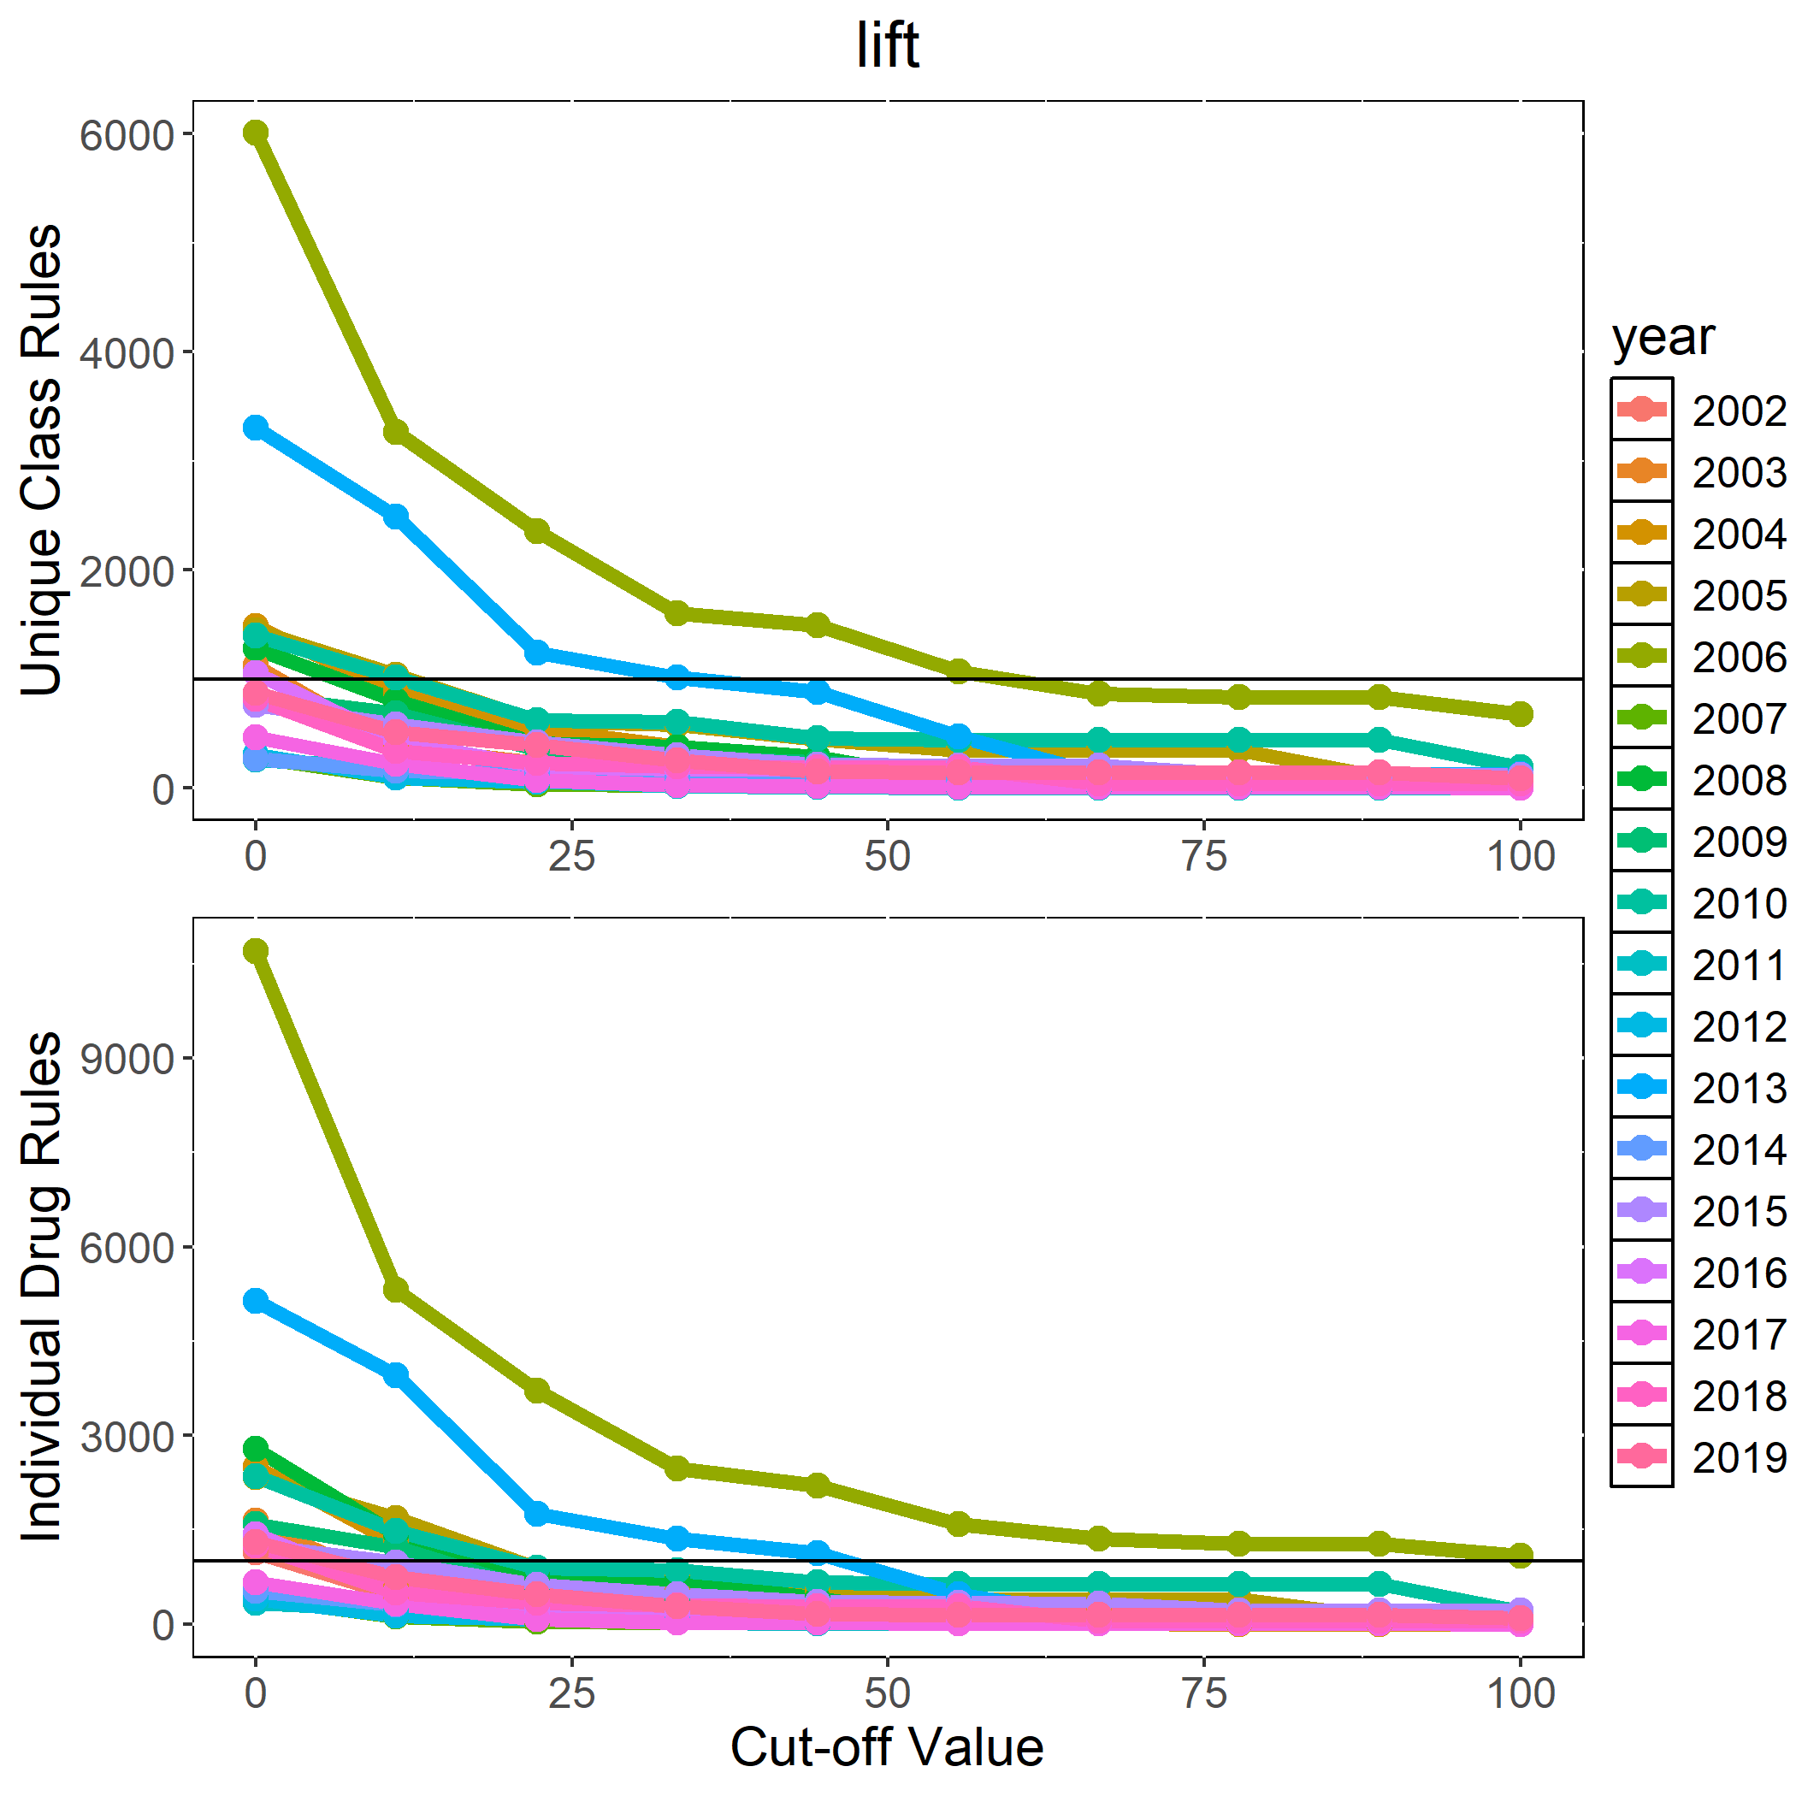

Slide 22
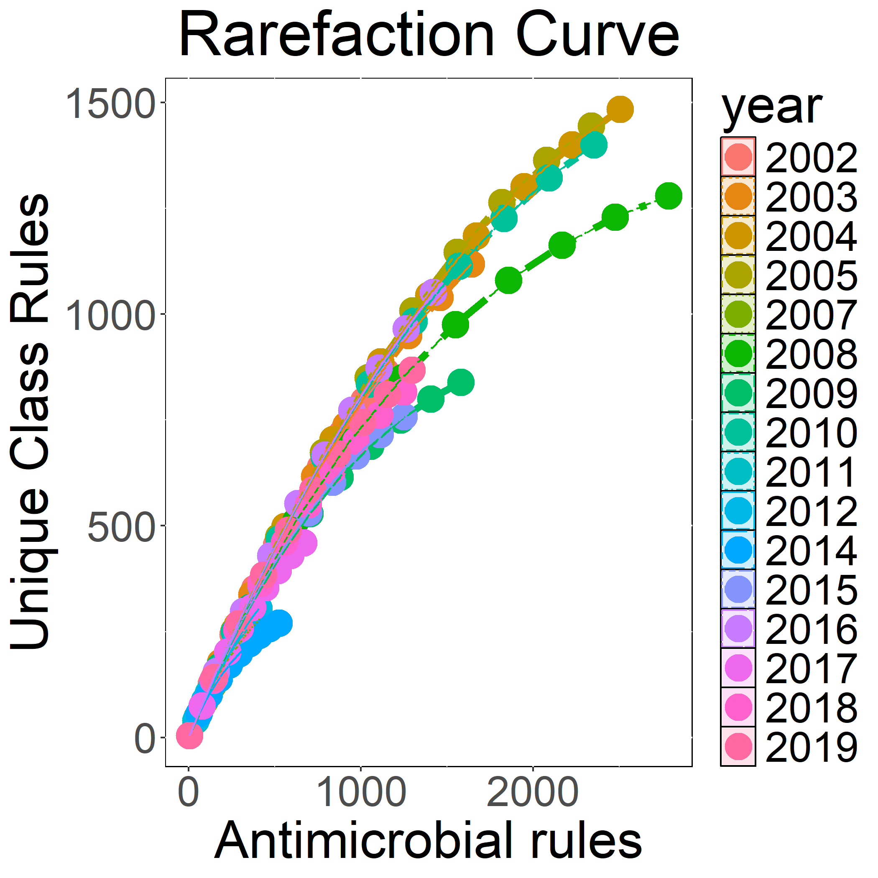

Slide 23
