Slide 1
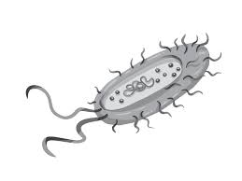

Association Rule Mining for AMR analysis

Slide 2
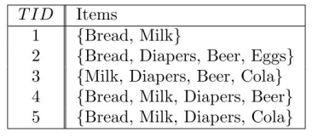

Background On The Method
Association rule mining has historically been used for market basket analysis (i.e., what products are purchased together?)

Slide 3
Background On The Method
This is done in two general steps:
1) Find which itemsets frequently occur in the data
2) Generate rules from the frequent itemsets

Slide 4

Background On The Method
How are frequent itemsets found?

Slide 5
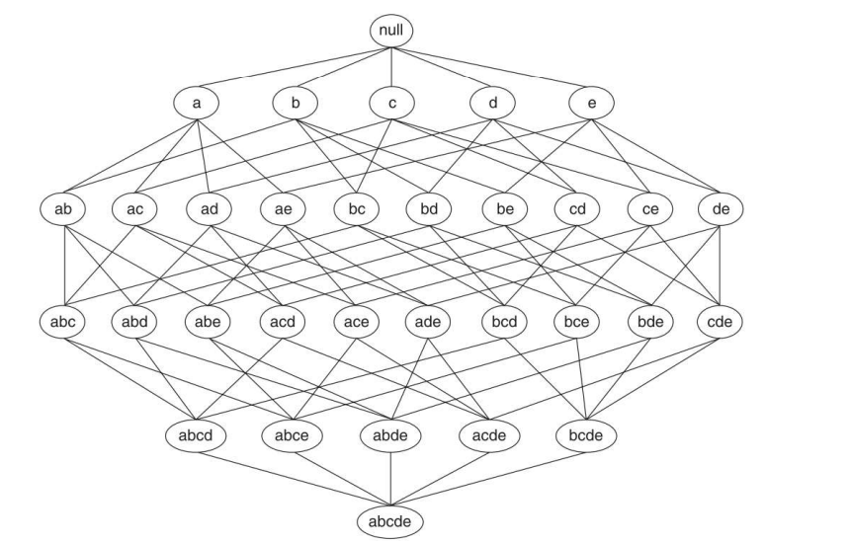
Background On The Method
Problem:
Computationally expensive to do this for all possible itemsets.

Slide 6
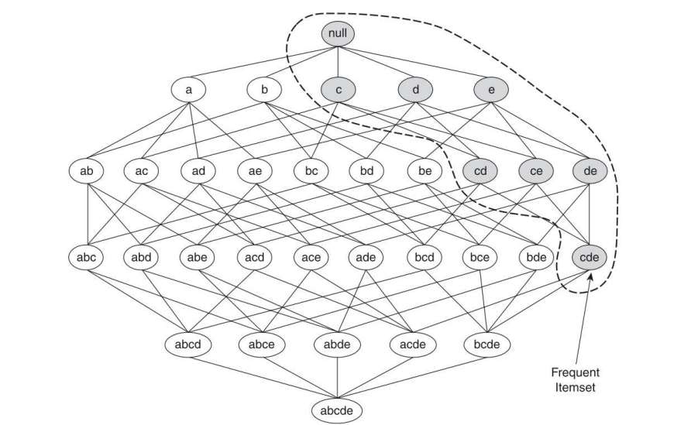
Background On The Method
Solution:
The Apriori Principle.

Slide 7
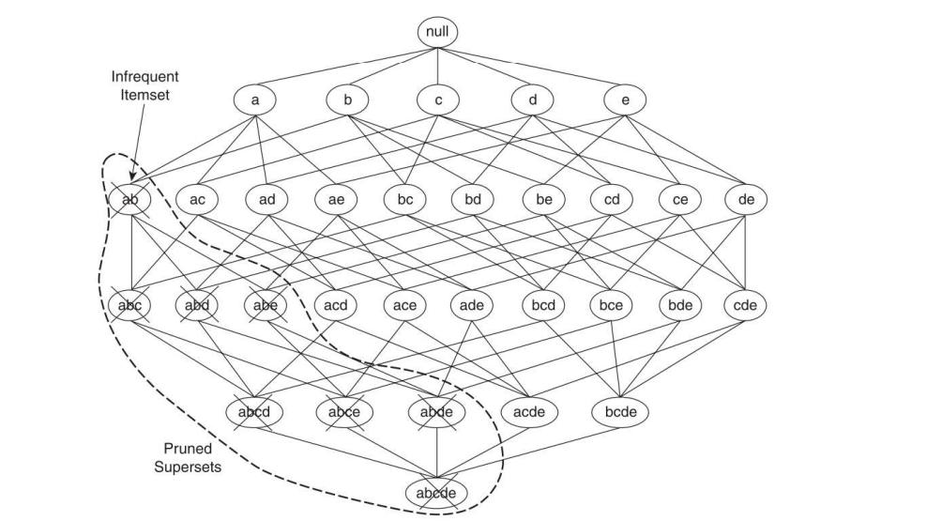
Background On The Method
Solution:
The Apriori Principle.

Slide 8
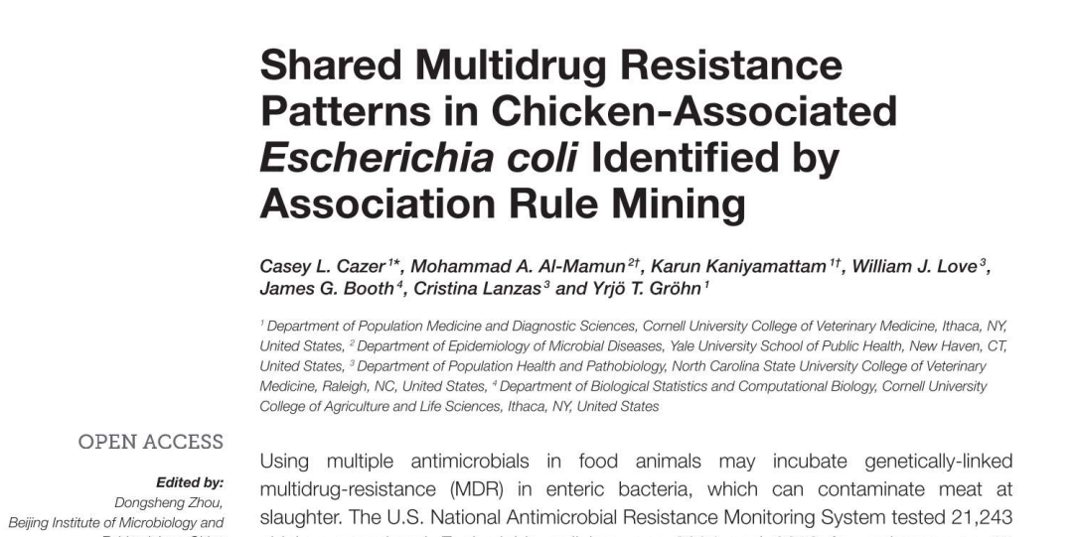
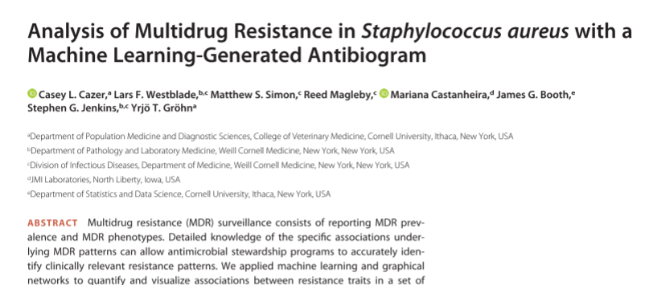
Previous Work
Items are resistances to antimicrobials.
A transaction is the resistance pattern present in one isolate.
Rules/frequent itemsets represent which resistances are likely to occur alongside other resistances.

Slide 9
The Current Work
Seeks to extend previous work
Look at patterns of multi-drug resistance across the food chain and across time
Incorporate both phenotypic and genotypic data
Three goals:
Determine how association rule sets change over time
Determine how association rule sets change across the food chain
Determine how genotypic rules compare to corresponding phenotypic rules
EXAMPLE
Genotype rule: {strA, strB} → {blaCMY-2-3}
Phenotype rule: {Gentamicin, Streptomycin} → {Amoxicillin–Clavulanic Acid}
Class Based rule: {Aminoglycosides} → {Beta lactams}

Slide 10
Data Preparation
Three data sources:
NARMS data from retail meats samples
Phenotypic data available from 2002 to 2019
Genotypic data available from 2017 to 2019
NARMS data from cecal (slaughterhouse) samples
Phenotypic data available from 2013 to 2021
Genotypic data available from 2017 to 2021
NAHLN data
Phenotypic data available from 2018 to 2022
Genotypic data available from 2018 to 2022
NARMS = National Antimicrobial Monitoring System
NAHLN = National Animal Health Laboratory Network

Slide 11
Class | Drug | Abbreviation | Resistant Breakpoint | In Dataset
AMINOGLYCOSIDE | Gentamicin | GEN | >=16 | Retail Meats; Cecal; NAHLN
 | Streptomycin | STR | >=32 | Retail Meats; Cecal
 | Neomycin | NEO | >8* | NAHLN
 | Spectinomycin | SPE | >64* | NAHLN
BETA-LACTAM | Amoxicillin–Clavulanic Acid | AMC | >=32 | Retail Meats; Cecal
 | Meropenem | MER | >=4 | Retail Meats; Cecal
 | Cefoxitin | FOX | >=32 | Retail Meats; Cecal
 | Ceftriaxone | AXO | >=4 | Retail Meats; Cecal
 | Ampicillin | AMP | >=32 | Retail Meats; Cecal; NAHLN
 | Ceftiofur | TIO | >=8 | NAHLN
 | Penicillin | PEN | NA | NAHLN
FOLATE-PATHWAY-INHIBITOR | Sulfisoxazole | FIS | >256 | Retail Meats; Cecal
 | Sulfamethoxazole | SMX | >256 | Retail Meats; Cecal
 | Trimethoprim/sulfamethoxazole | COT | >=4 | Retail Meats; Cecal; NAHLN
 | Sulphadimethoxine | SUL | NA | NAHLN
LINCOSAMIDE | Clindamycin | CLI | NA | NAHLN
MACROLIDE | Azithromycin | AZI | >=32 | Retail Meats; Cecal
 | Gamithromycin | GAM | NA | NAHLN
 | Tildipirosin | DIP | NA | NAHLN
 | Tilmicosin | TIL | NA | NAHLN
 | Tulathromycin | TUL | NA | NAHLN
 | Tylosin | TYL | NA | NAHLN
PHENICOL | Chloramphenicol | CHL | >=32 | Retail Meats; Cecal
 | Florfenicol | FFN | >16* | NAHLN
PLEUROMUTILIN | Tiamulin | TIA | NA | NAHLN
QUINOLONE | Ciprofloxacin | CIP | >=1 | Retail Meats; Cecal
 | Nalidixic acid | NAL | >=32 | Retail Meats; Cecal
 | Danofloxacin | DAN | NA | NAHLN
 | Enrofloxacin | ENR | >0.125* | NAHLN
TETRACYCLINE | Tetracycline | TET | >=16 | Retail Meats; Cecal; NAHLN
 | Chlortetracycline | LOR | NA | NAHLN
 | Oxytetracycline | OXY | NA | NAHLN

Slide 12
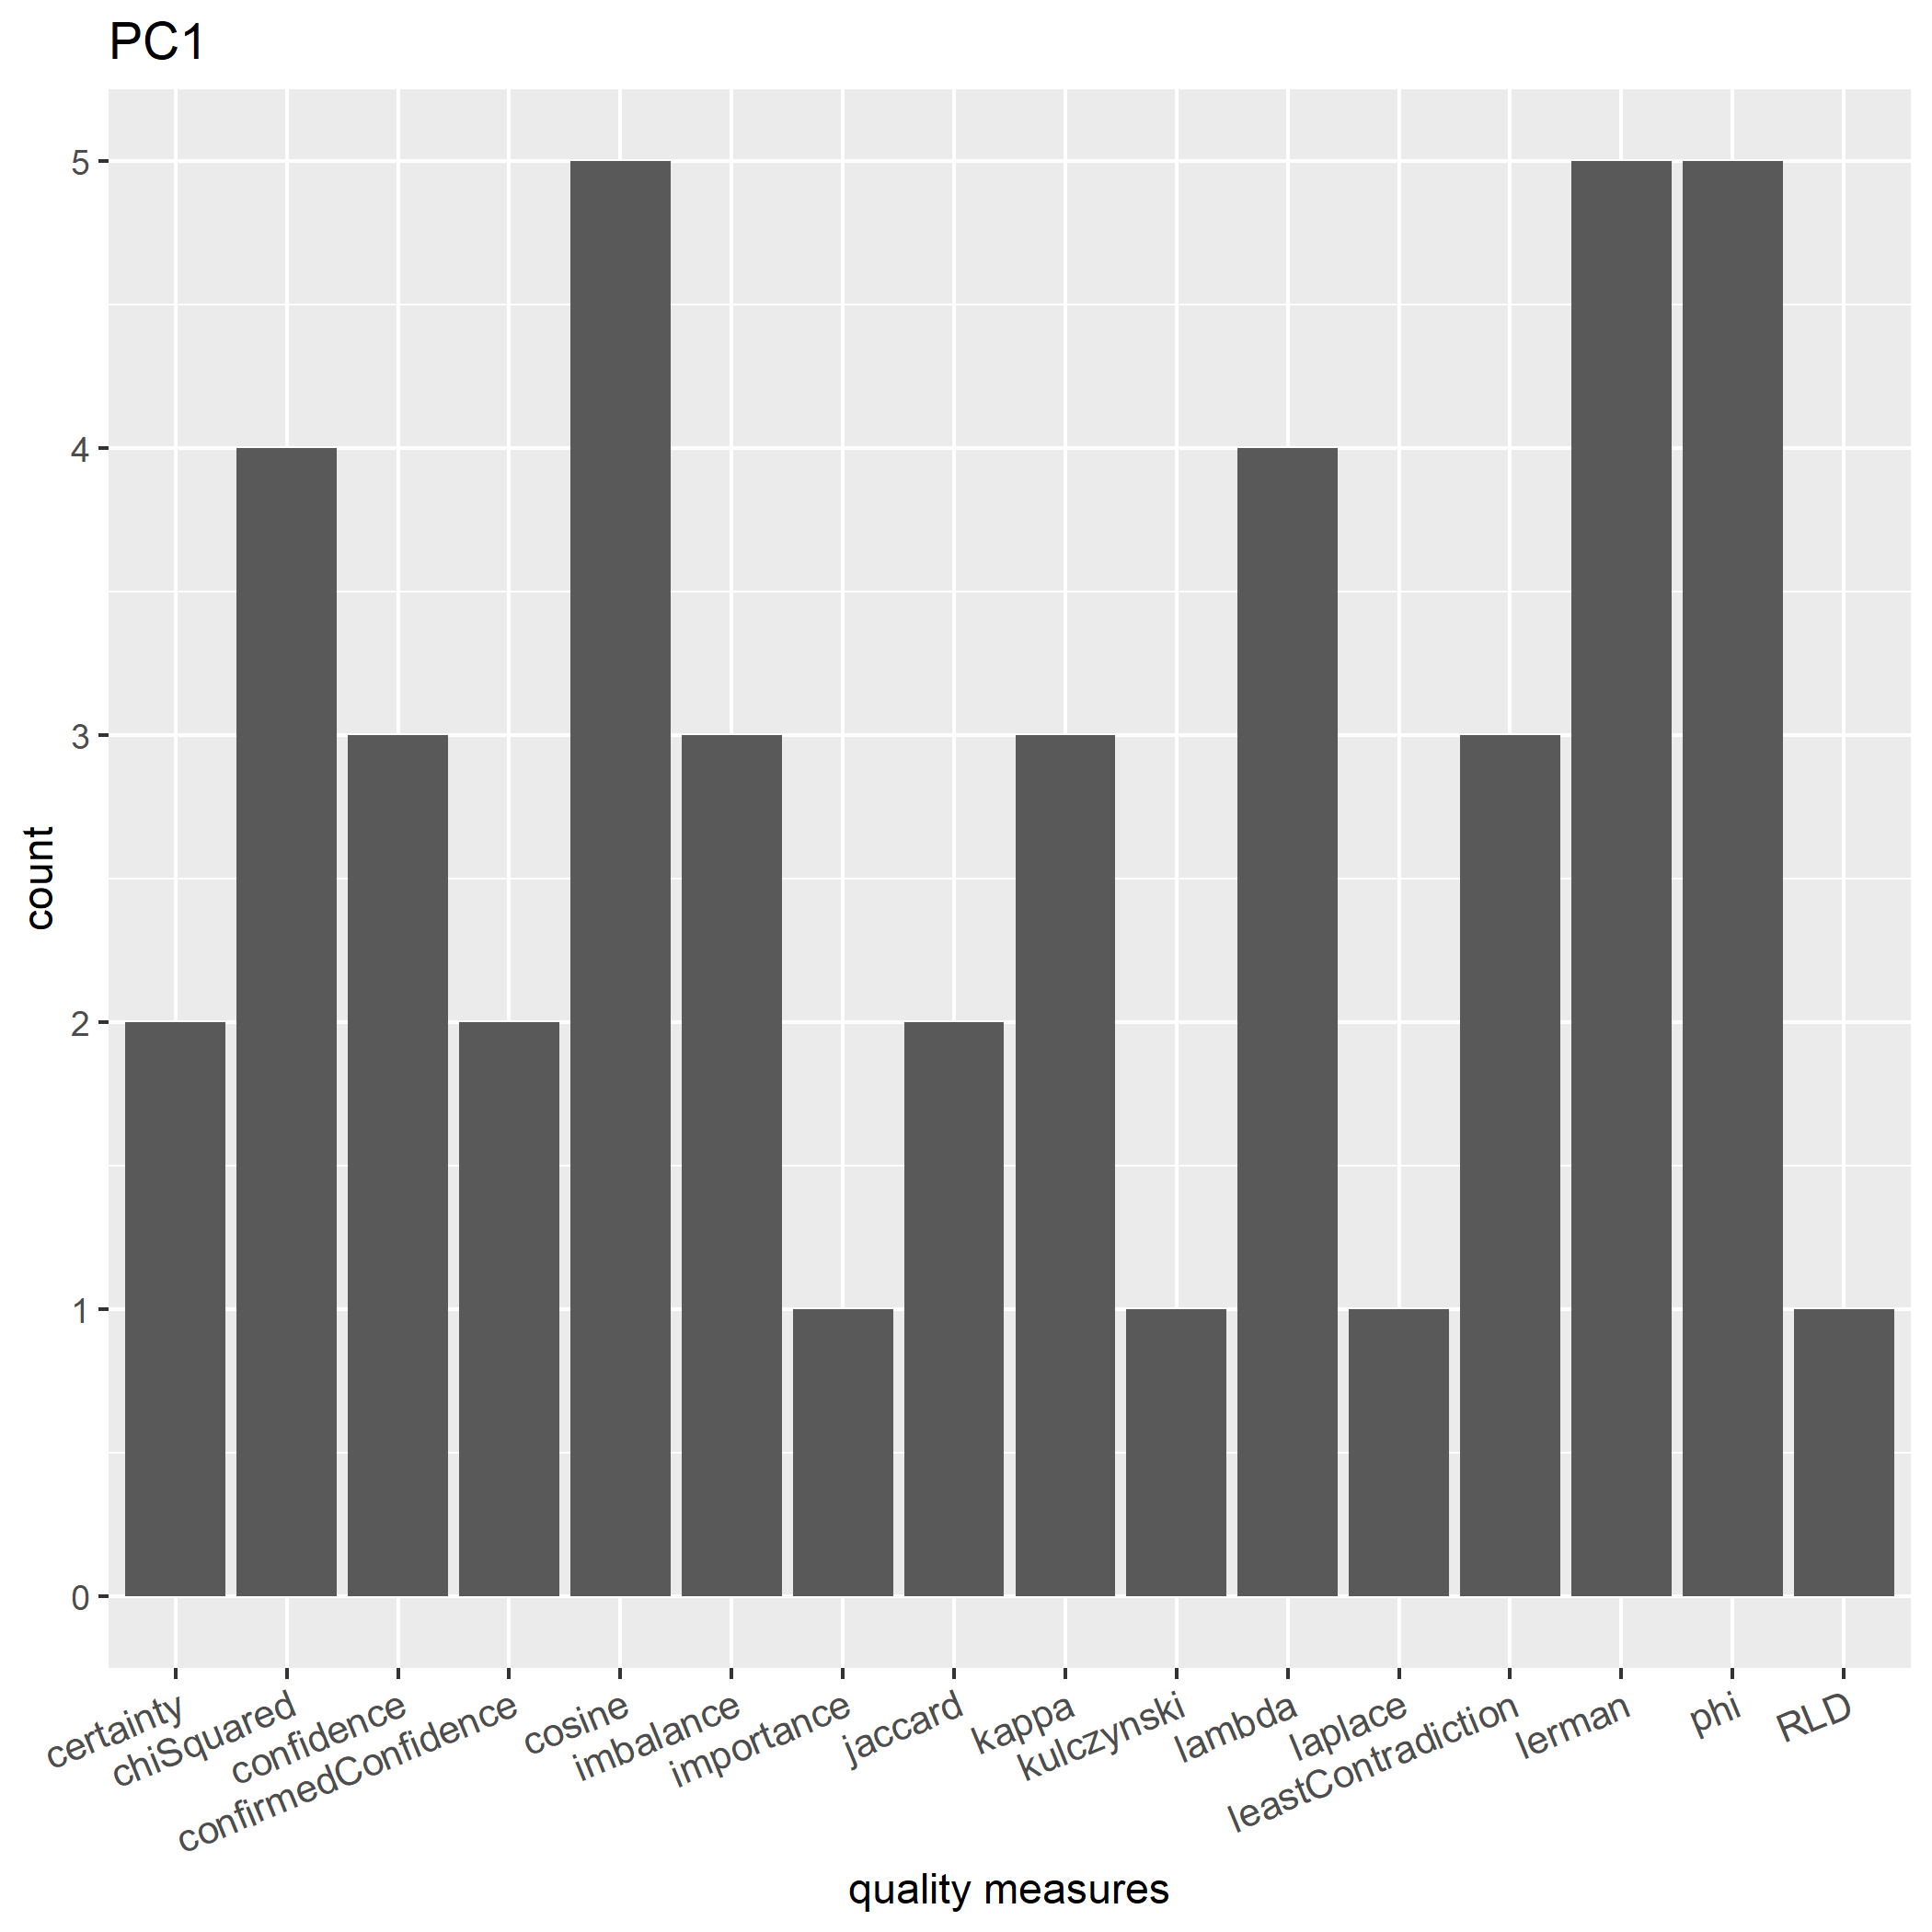
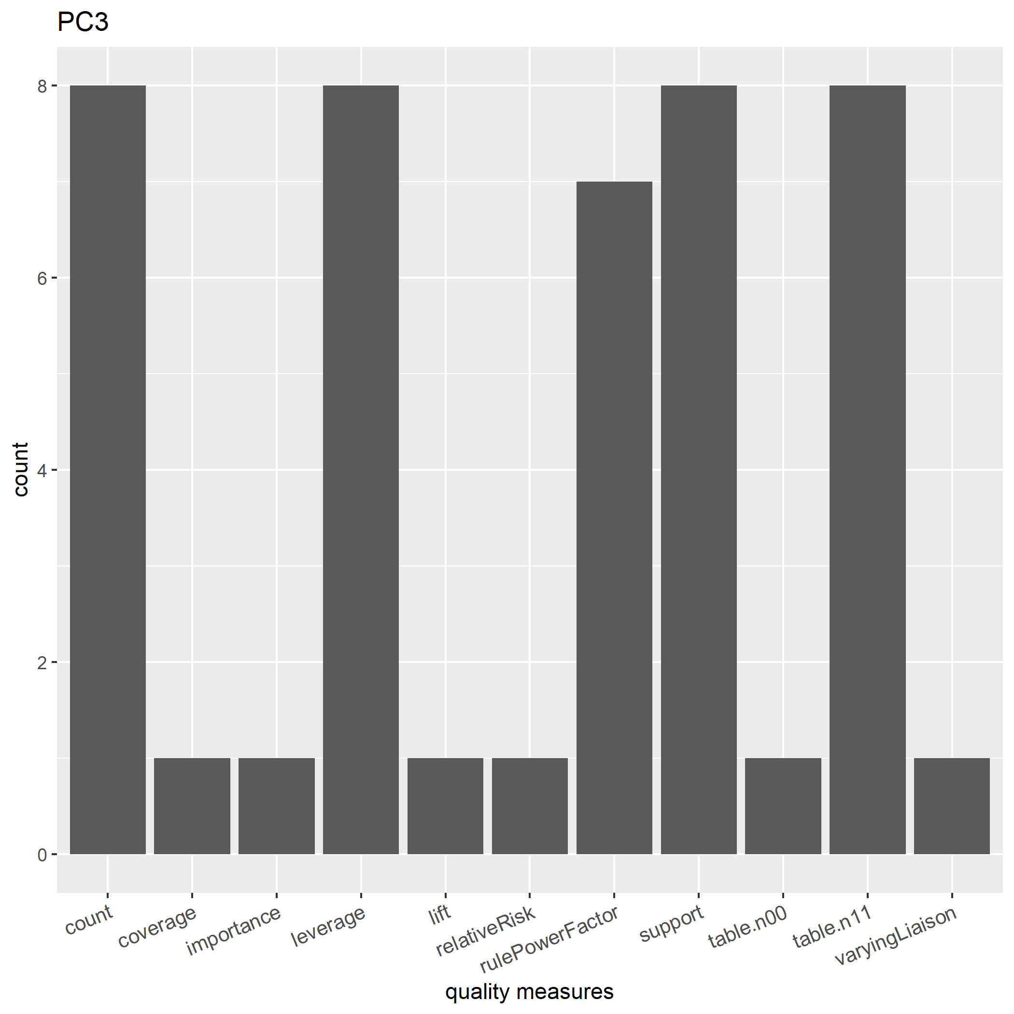
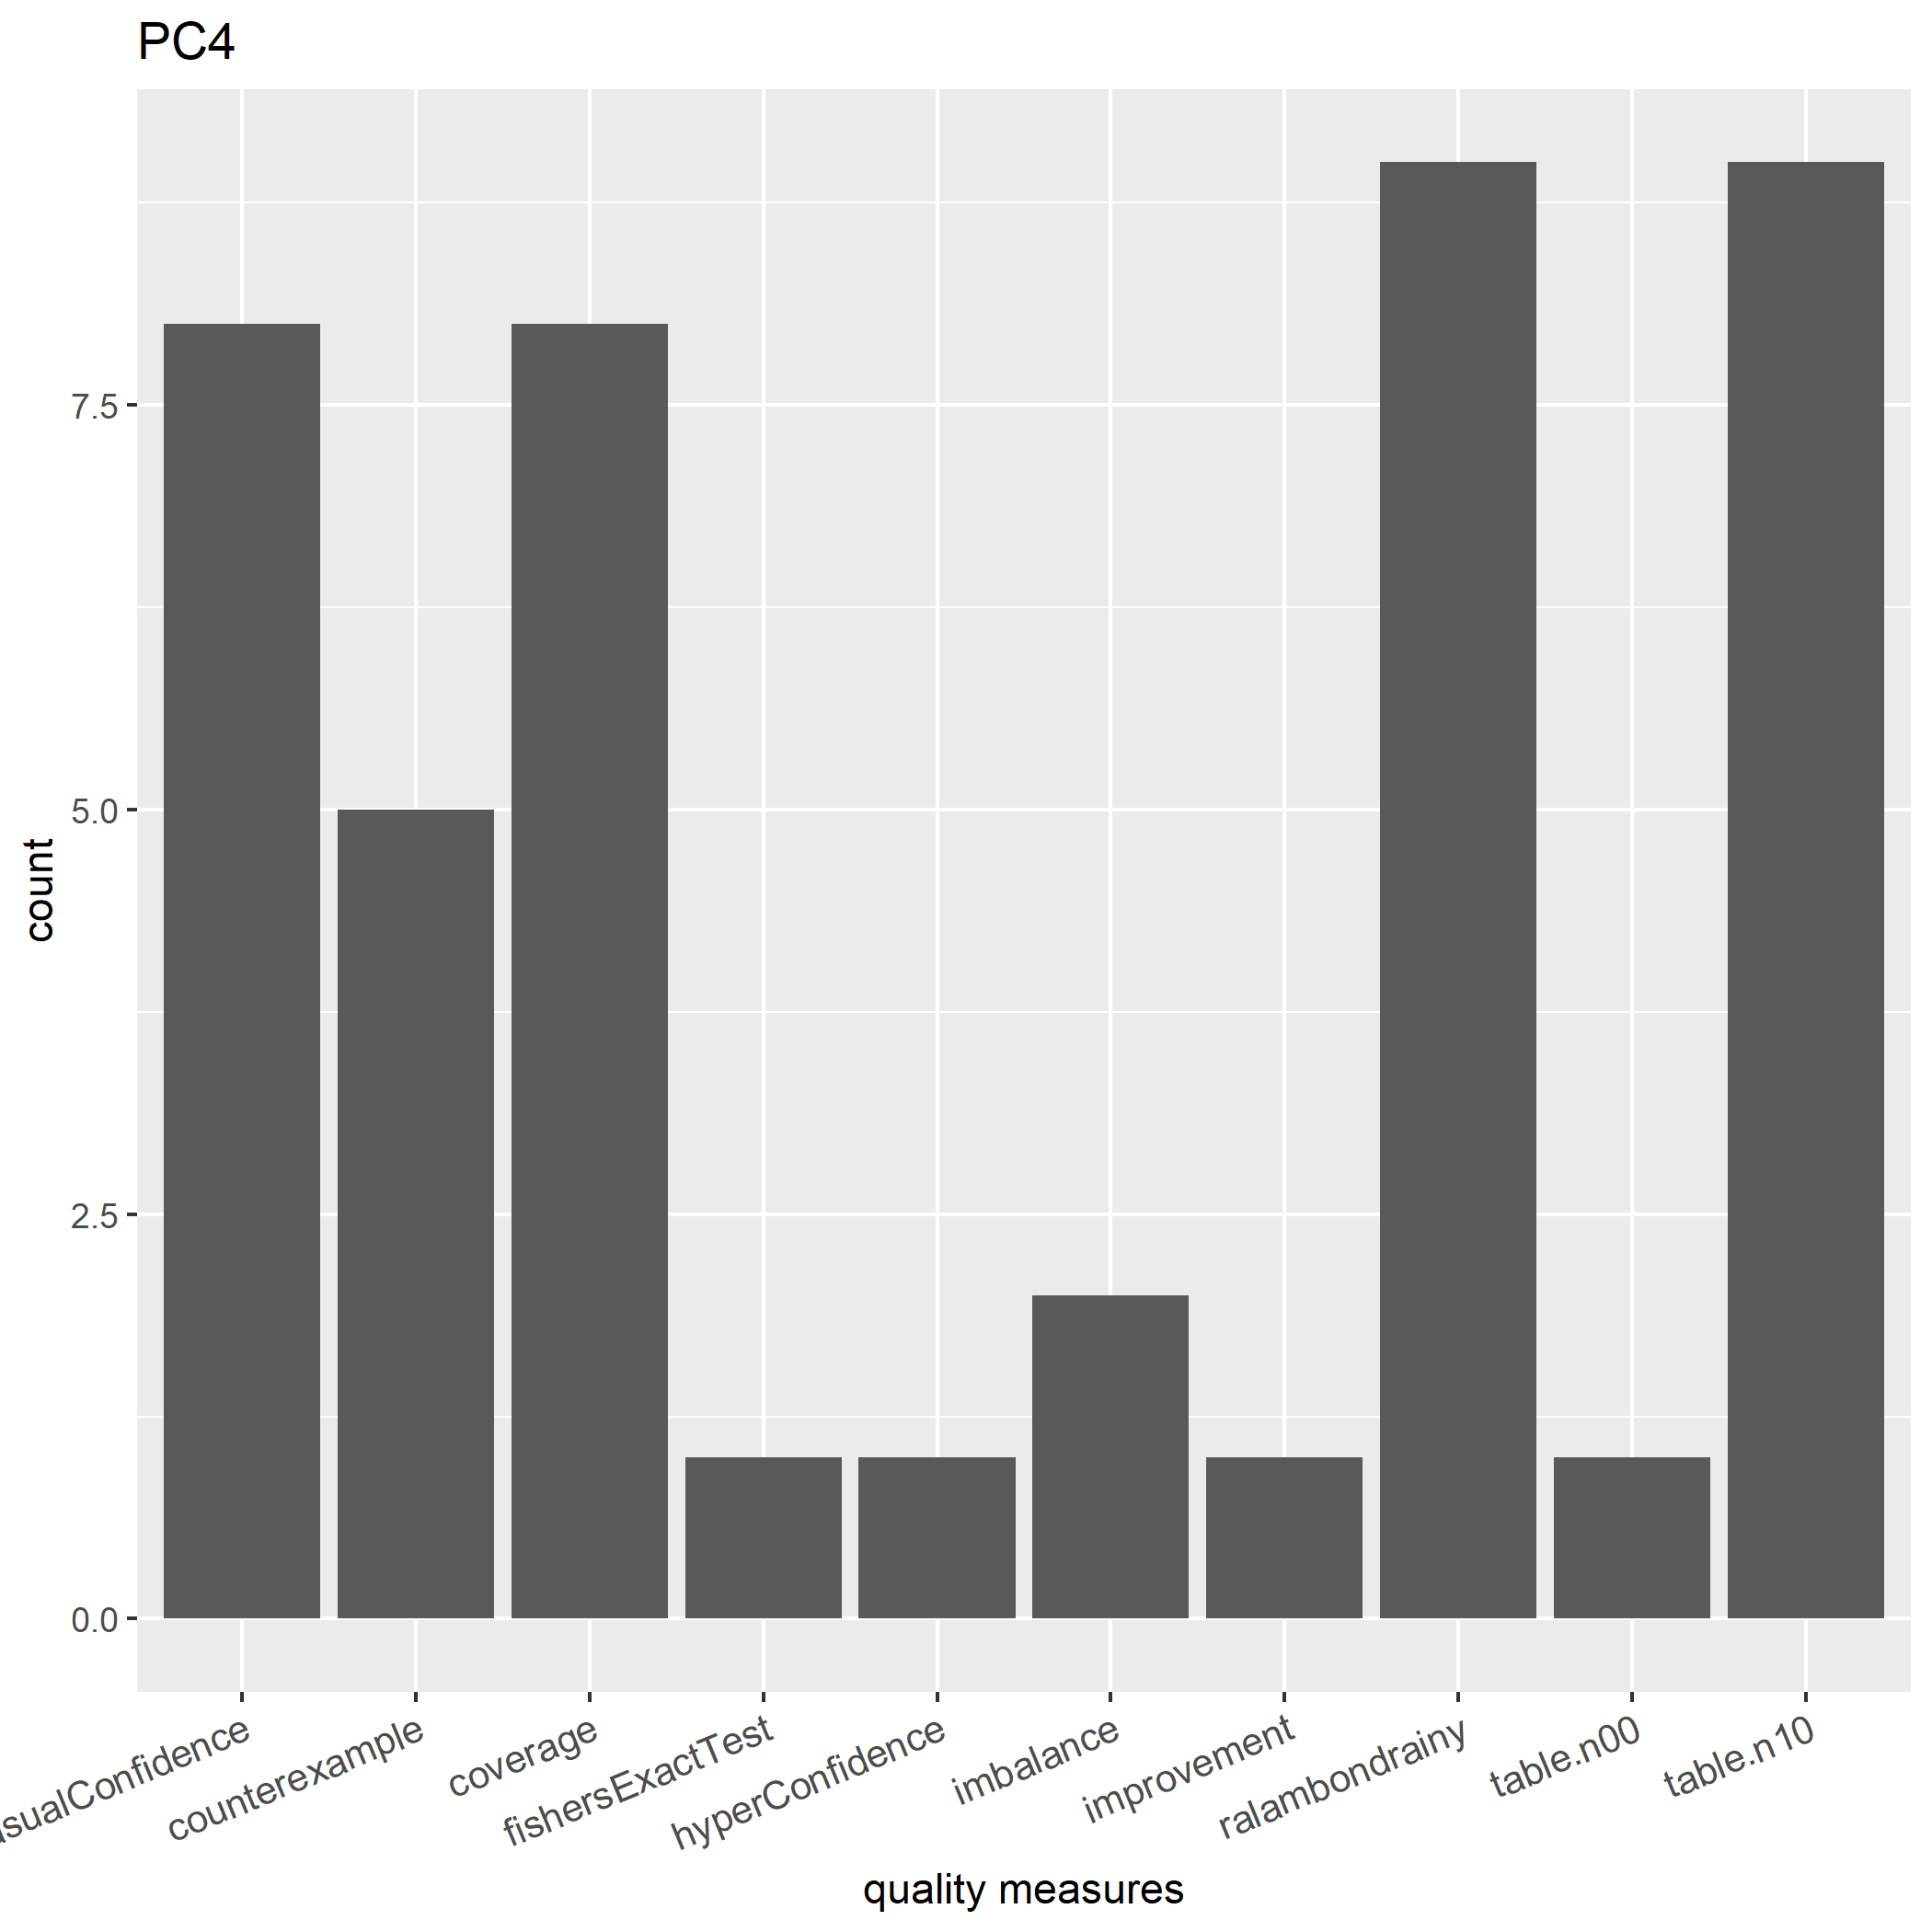
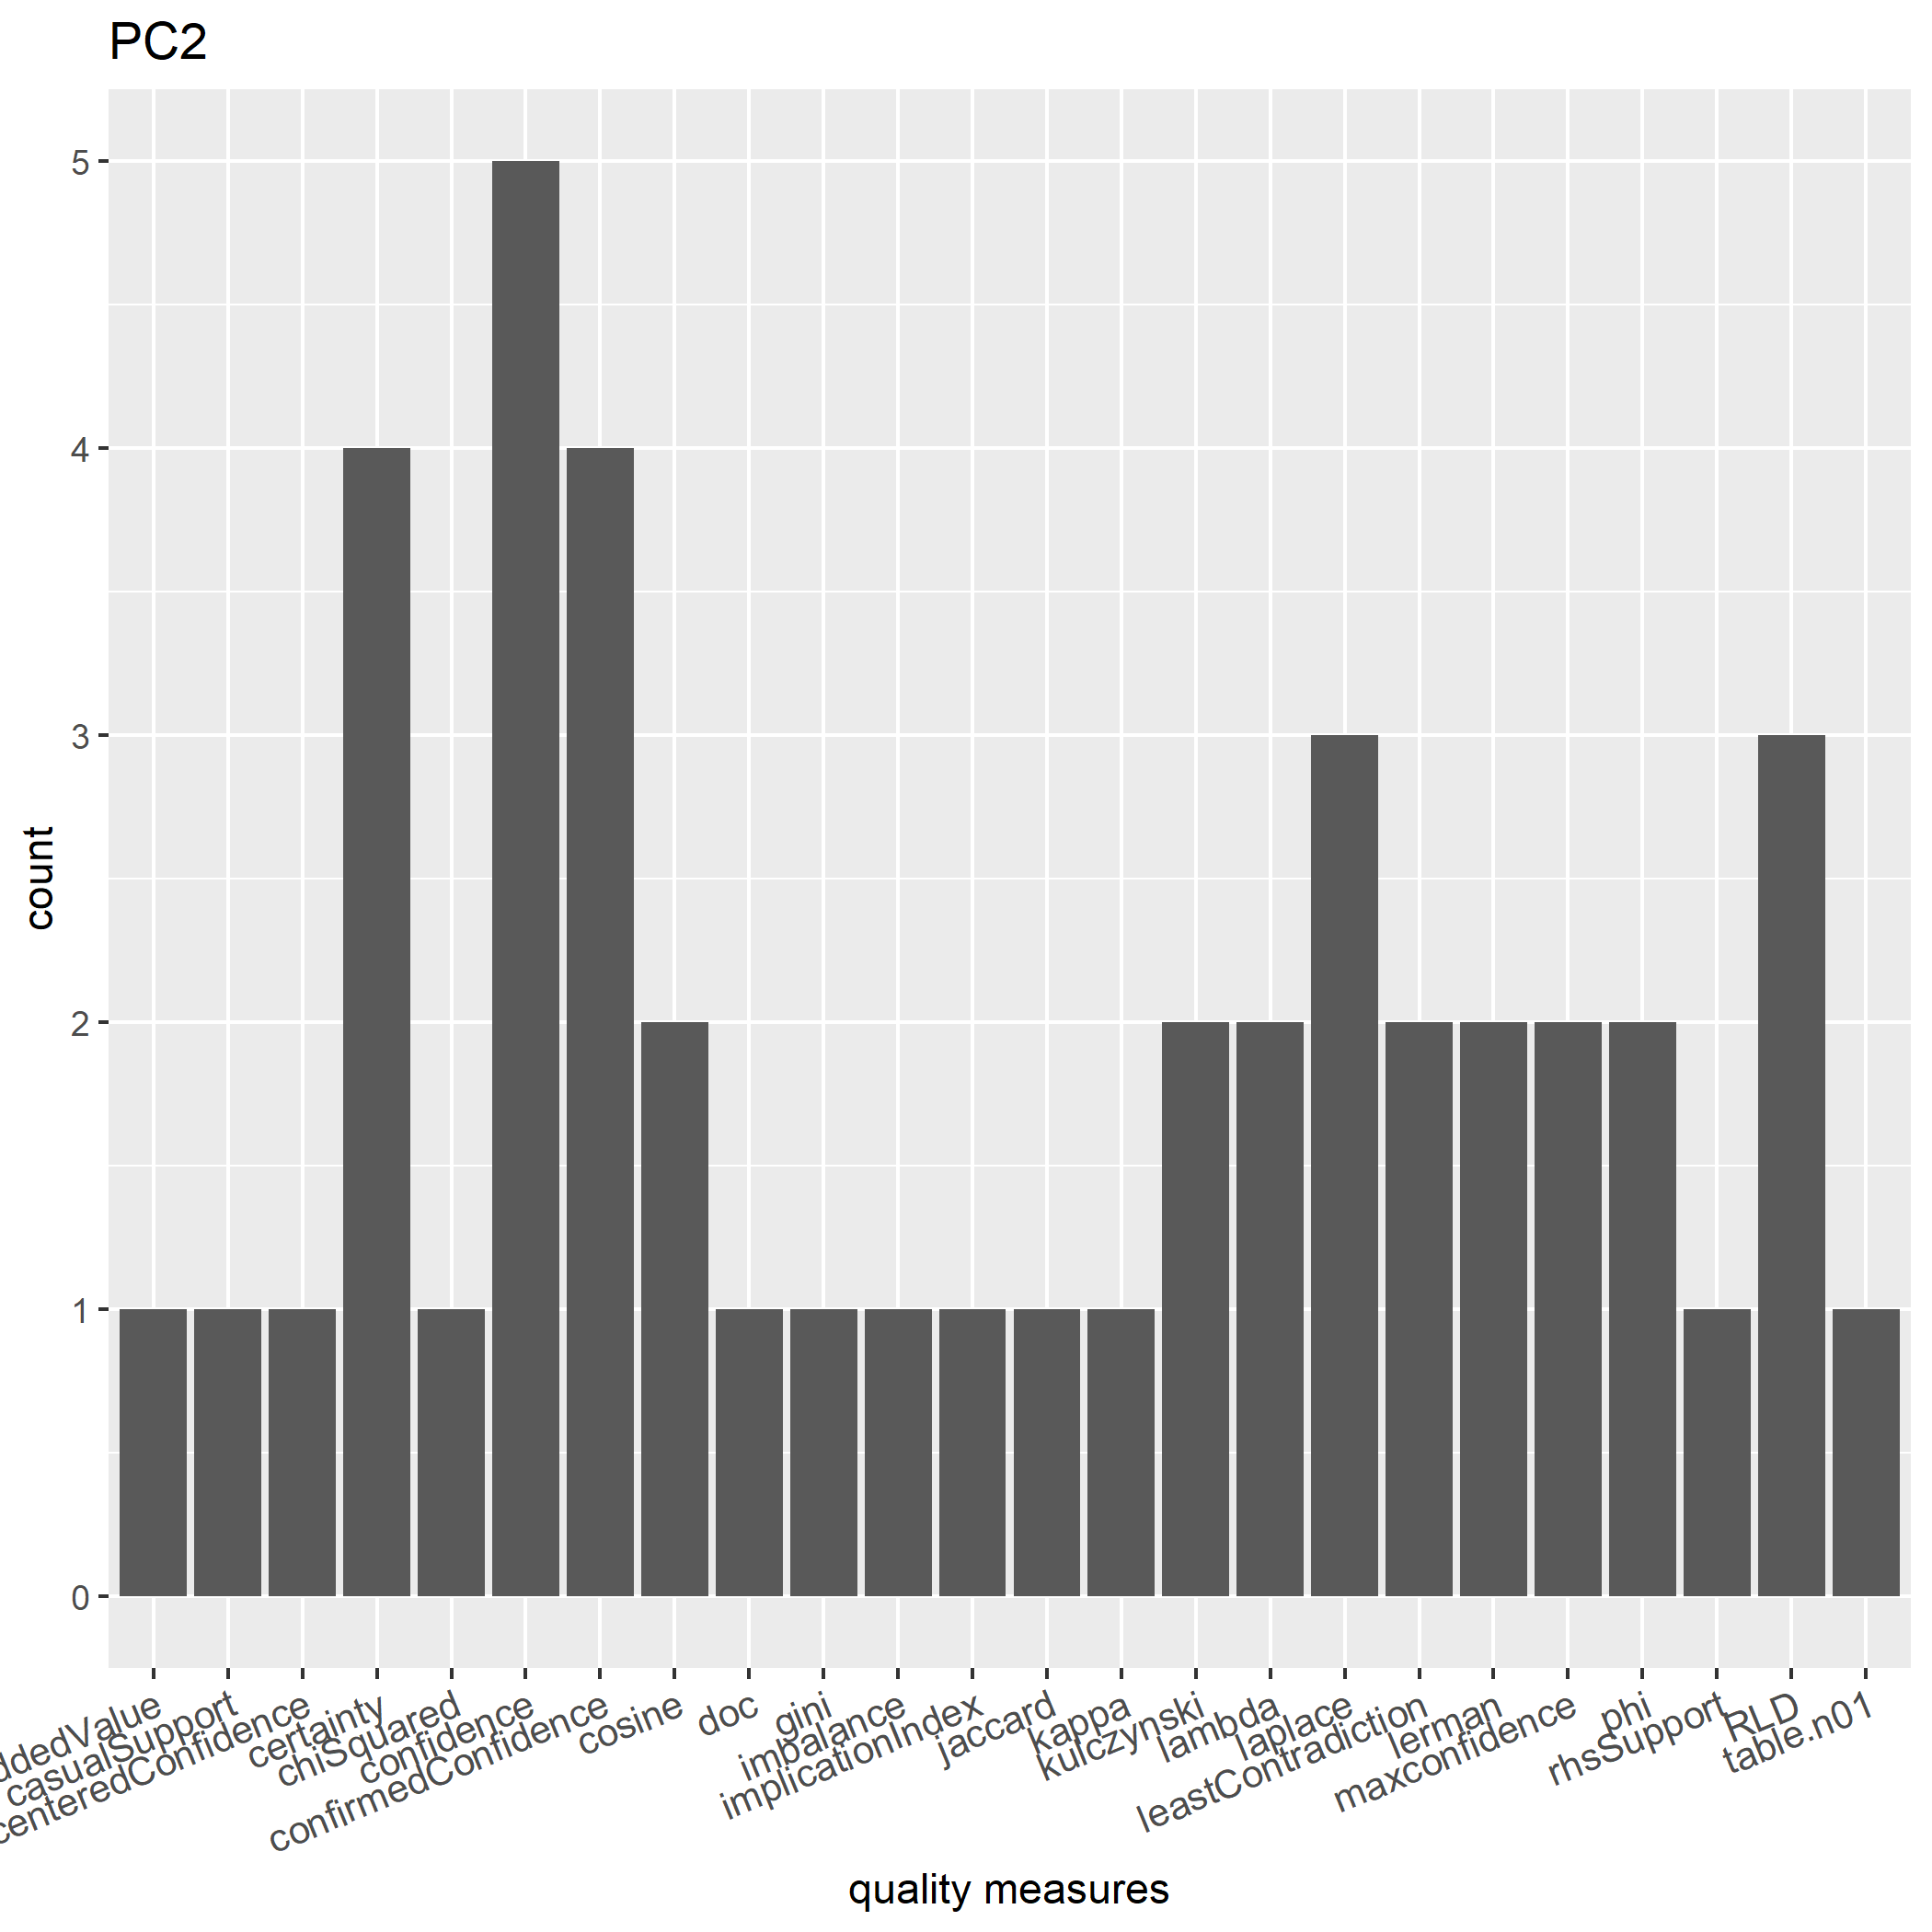
Quality Measure Selection
It is important to be able to prune rules based on their quality (i.e., how interesting they are).
There are various potential quality measures available.

