Slide 1
Capstone Project Foundations of Data Science
Craig Calder
March 2016

Slide 2
Overview
Problem statement
Data sources
Data challenges and preparation
Exploratory analysis
Top models
Summary

Slide 3
Problem Statement
Create a model that a lending organization could use to evaluate a potential customer's likelihood of being a good candidate for a medium term (36 or 60 month) loan based on a modest number of inputs such as annual income, loan amount, term, revolving line utilization rate, etc.

Slide 4
DatA sOURCES
Data: https://www.lendingclub.com/info/download-data.action/loan.csv Contains 163,987 observations with 15 variables. The variable we want to predict is bad_loans. The dataset is split between these observations:
Good Loans (bad_loan = 0): 133,971 observations (82%)
Bad Loans (bad_loan = 1): 30,016 observations (18%)

Slide 5
Data Preparation
Wrangling
Imputed Missing Values using MICE package
Created Dummy Variables from Categorical Variables
Identified and Excluded Outliers (Annual Income > $1M)
Balance and Split Training/Test Data using SMOTE

Slide 6
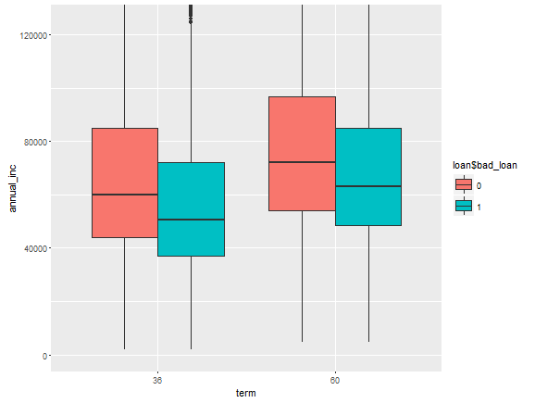
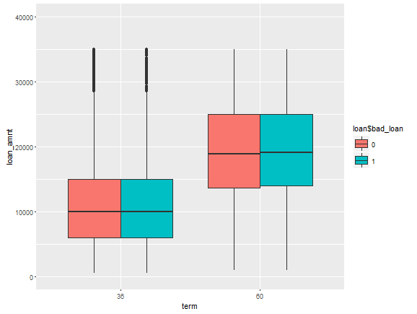
Exploratory Data Analysis
Unsurprisingly mean annual income is distinctly lower for a bad loan state…
and while loan amounts increase for longer terms, but the means are comparable

Slide 7
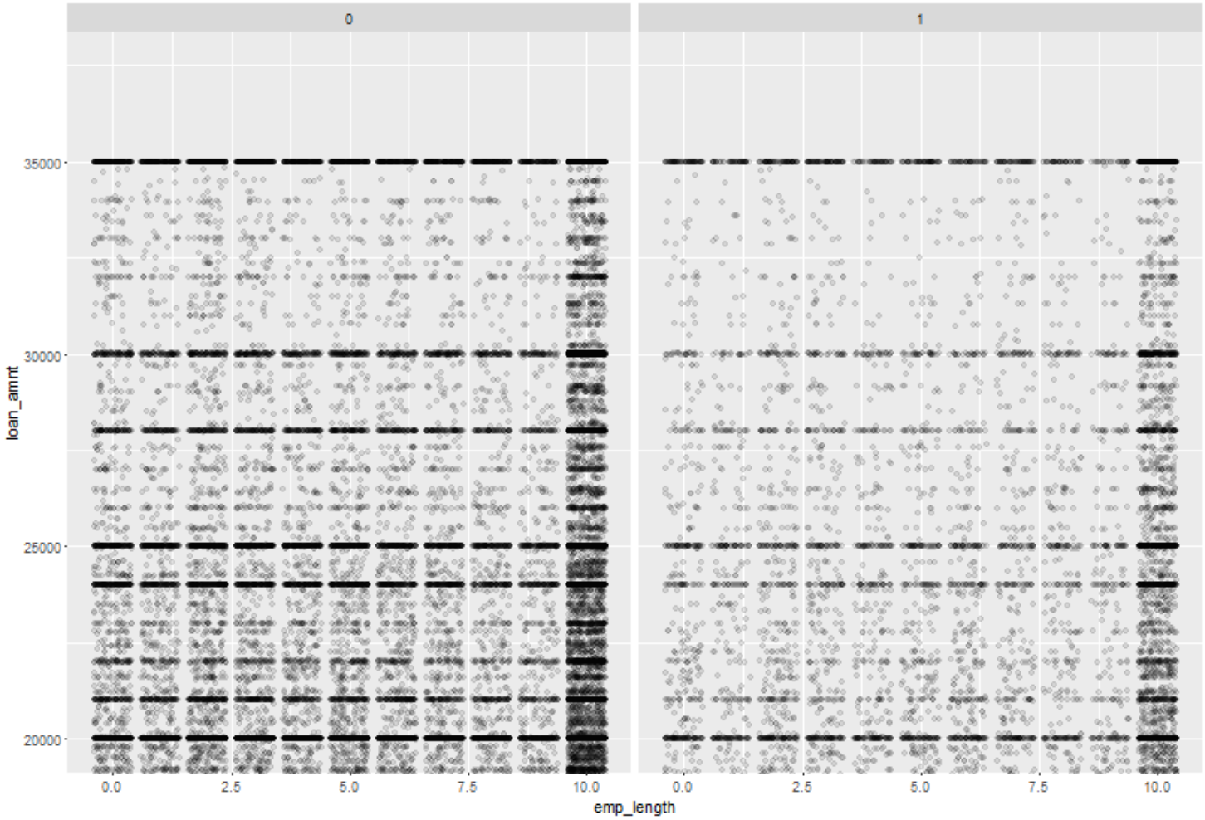
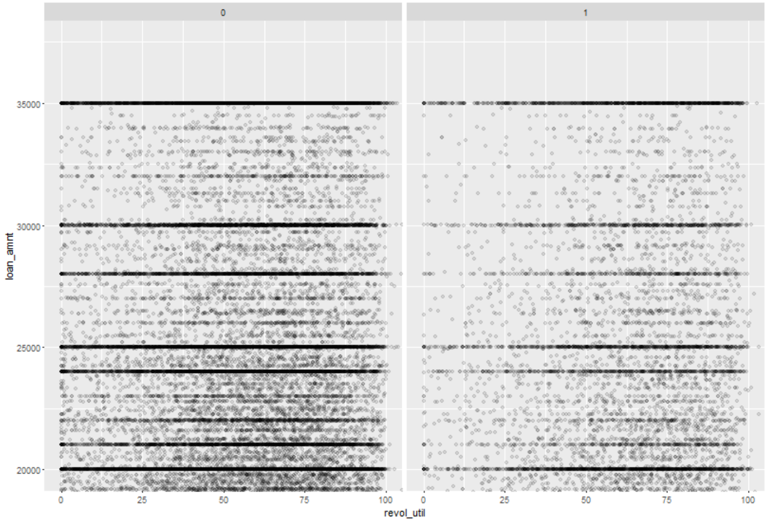
Exploratory Data Analysis Cont…
Most loans are for similar amounts across all employment lengths. Comparing Good Loans (0) to Bad Loans (1), employment length doesn’t appear to be a factor in whether or not a loan will be bad.
Revolving Line Utilization does appear to be a predicative variable of if a loan will be bad as one can see bad loans (1) increases as revol_util increases.

Slide 8
Model: Logistic Regression
The table on the right displays the logistic regression models output. From this we see employment length, annual income, total accounts, credit length, living in a low or medium average bankruptcy state and having a mortgage are all inversely related to bad loans.
Below we see the effect of different threshold values on the confusion matrices. It seems t=.55 provides balances the desire maximize true positives and true negatives while managing false positives and false negatives.
Variable | Coefficient | P-Value | Significance
Loan_amount | 1.84E-05 | 1.35E-55 | ***
emp_length | -0.00182616 | 0.485009021
annual_inc | -5.39E-06 | 5.49E-104 | ***
dti | 0.035582836 | 1.32E-177 | ***
delinq_2yrs | 0.056976745 | 3.57E-05 | ***
revol_util | 0.011514081 | 2.61E-195 | ***
total_acc | -0.00902606 | 4.00E-28 | ***
longest_credit_length | -0.00746845 | 3.89E-08 | ***
bankrpc_state_low (dummy) | -0.09342886 | 4.57E-05 | ***
bankrpc_state_med (dummy) | -0.04470727 | 0.032735737 | *
bankrpc_state_medhigh (dummy) | 0.059659539 | 0.003381705 | **
bankrpc_state_high (dummy) | 0.096607377 | 0.000106993 | ***
homeown_other (dummy) | 0.060802301 | 0.072699274 | .
homeown_mort (dummy) | -0.26221461 | 1.30E-43 | ***
homeown_rent (dummy) | 0.244811429 | 5.09E-38 | ***
term (factor) |  | 1.64E-297 | ***
purpose (factor) |  | 3.41E-16 | ***
vstatus_verified (factor) |  | 1.54E-67 | ***
Threshold | TP | FP | TN | FN
t > .70 | 106,393 | 6,505 | 998 | 4,995
t > .65 | 101,629 | 5,867 | 1,636 | 9,759
t > .60 | 94,395 | 5,036 | 2,467 | 16,993
t > .55 | 83,695 | 4,056 | 3,447 | 27,693
t > .50 | 69,625 | 2,919 | 4,584 | 41,763
t > .45 | 53,333 | 1,911 | 5,592 | 58,055
Signif. codes: 0 ‘***’ 0.001 ‘**’ 0.01 ‘*’ 0.05 ‘.’ 0.1 ‘ ’ 1

Slide 9
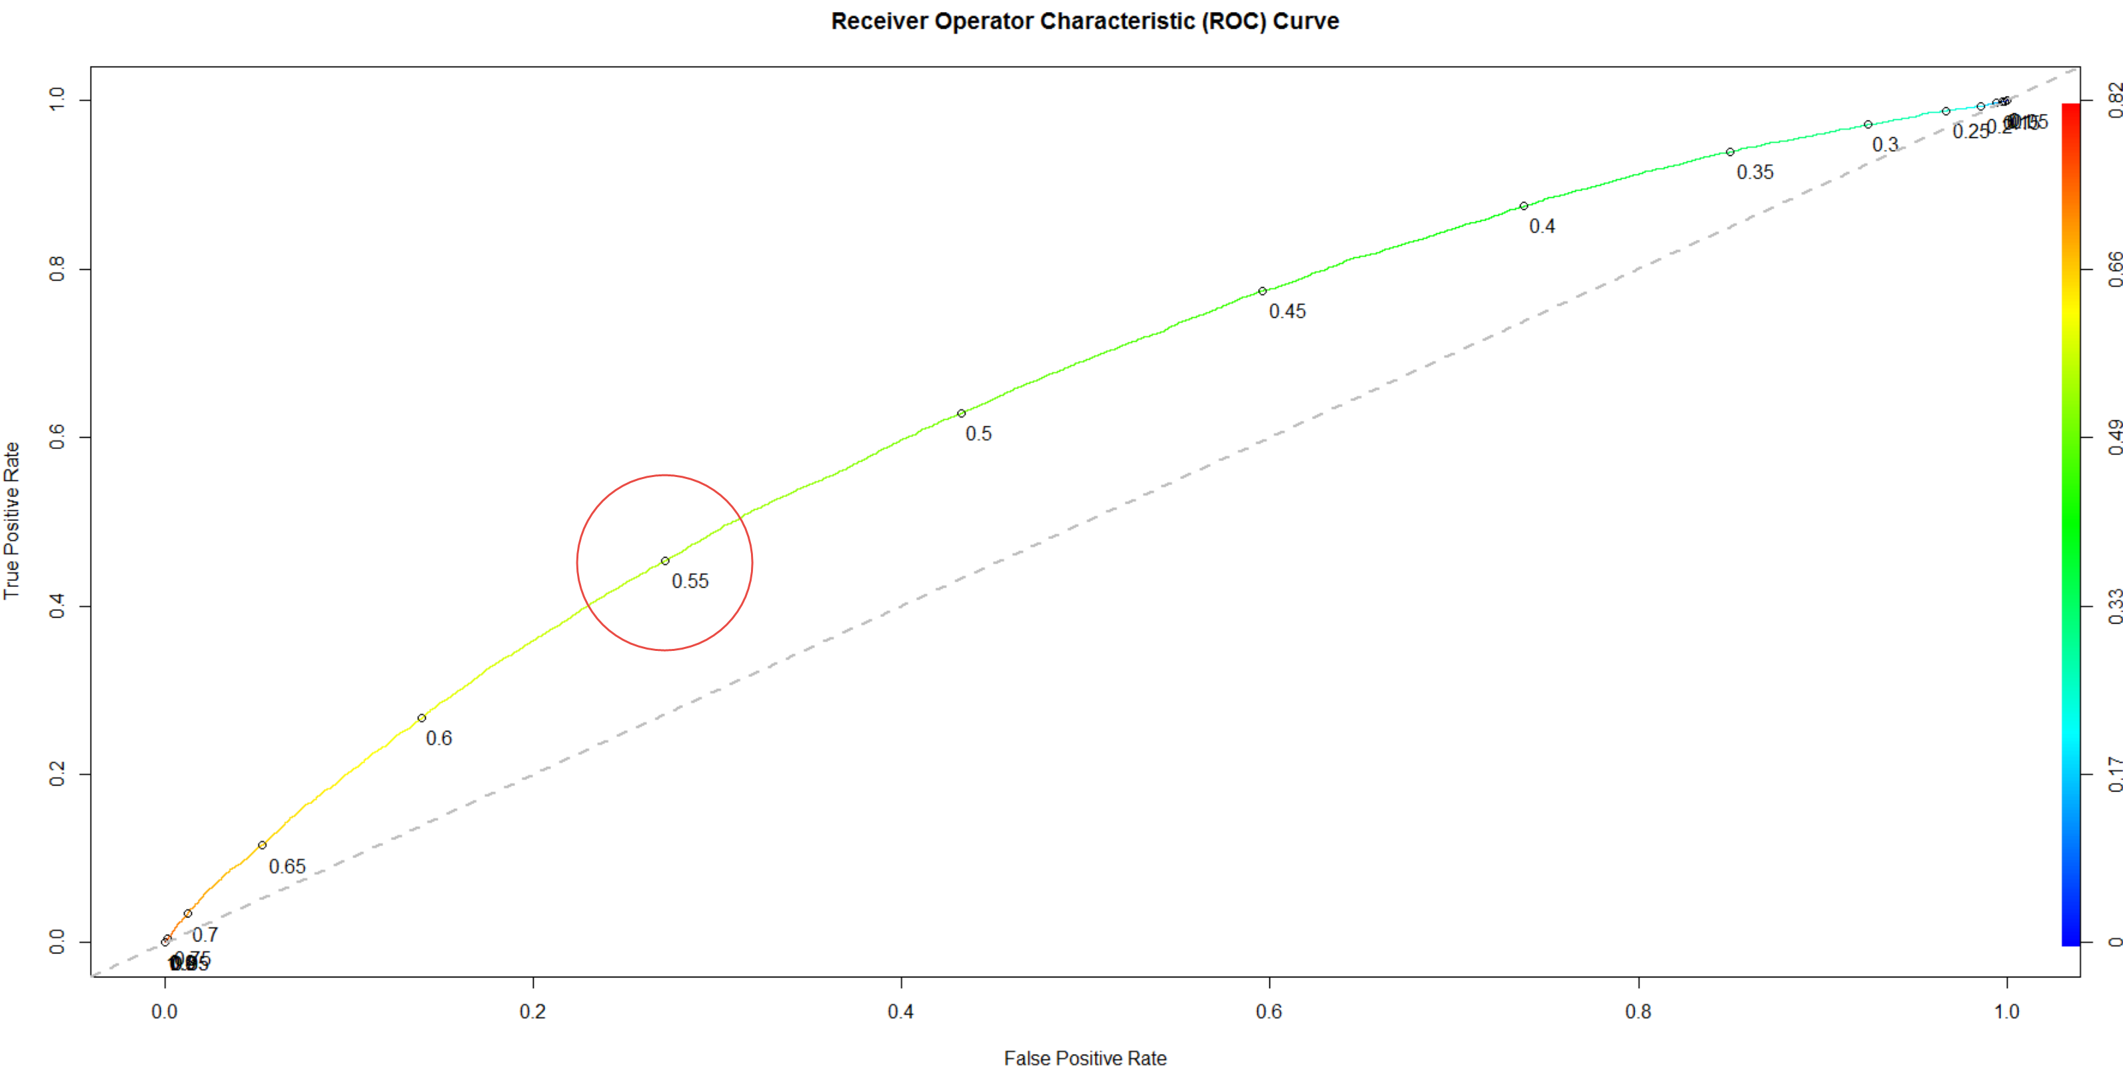
Model Validation - ROCR
Area Under the Curve (AUC) = 0.6618582. The ROC curve shows the tradeoff between sensitivity and specificity.
The table below highlights the exact values at select thresholds, where a threshold of .55 balances the True Positive Rate well against False Positive Rate.
Threshold | Sensitivity | Specificity
t > .70 | 0.9552 | 0.1330
t > .65 | 0.9124 | 0.2180
t > .60 | 0.8474 | 0.3288
t > .55 | 0.7514 | 0.4594
t > .50 | 0.6251 | 0.6110
t > .45 | 0.4788 | 0.7453

Slide 10
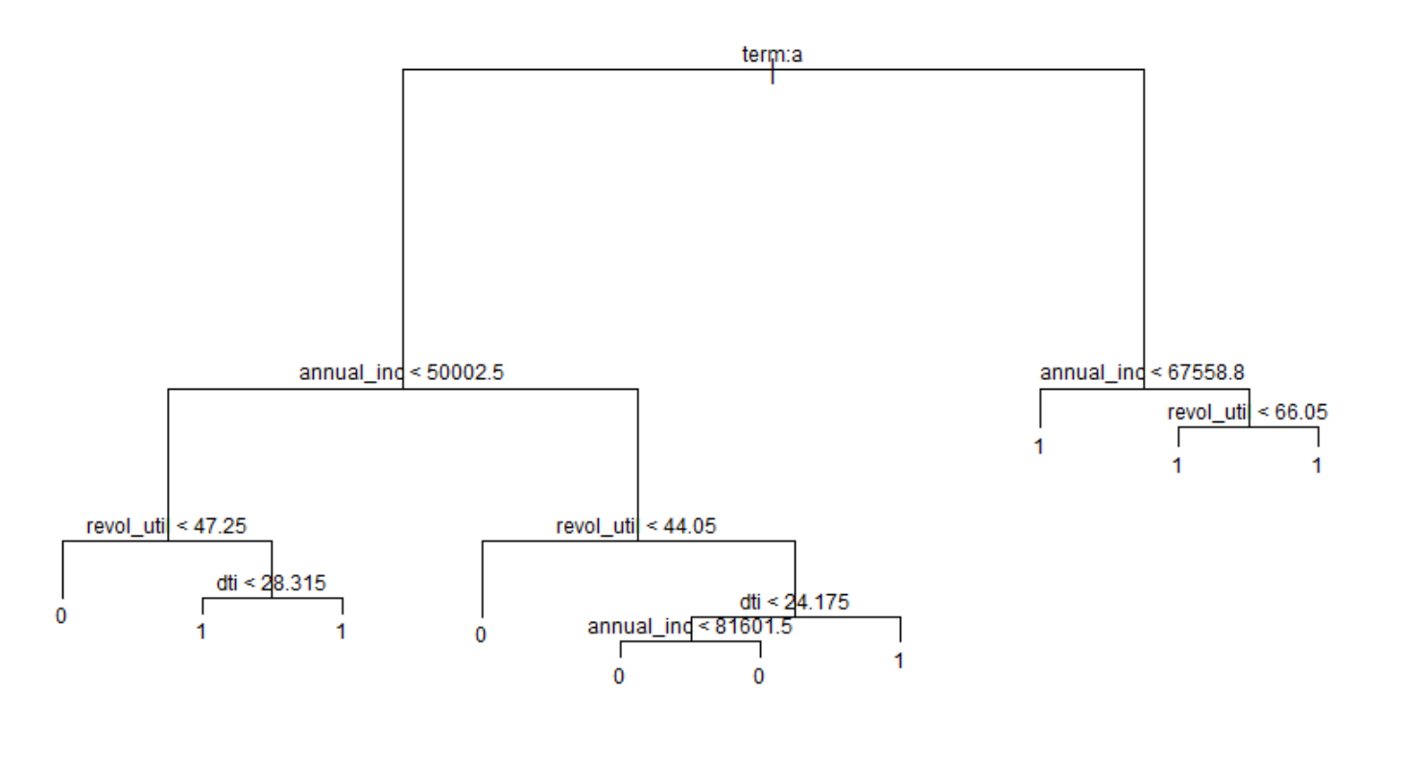
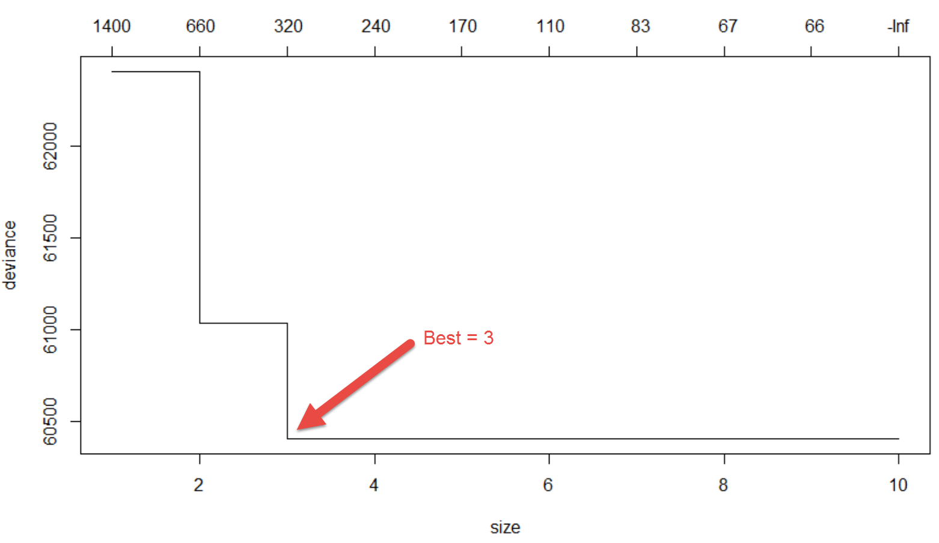
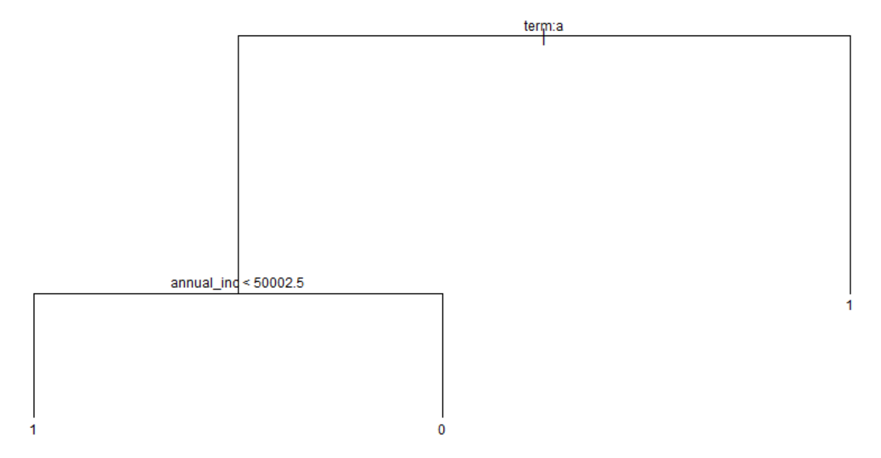
MODEL: Classification Tree
Do K-fold cross-validation to find the best number of nodes for the tree that minimizes overfitting.
The classification model run with all variables. Number of terminal nodes: 10
Residual mean deviance: 1.318
Misclassification error rate: 0.3888
Revised model using 3 as the number of terminal nodes:
Residual mean deviance: 1.341
Misclassification error rate: 0.4047

Slide 11
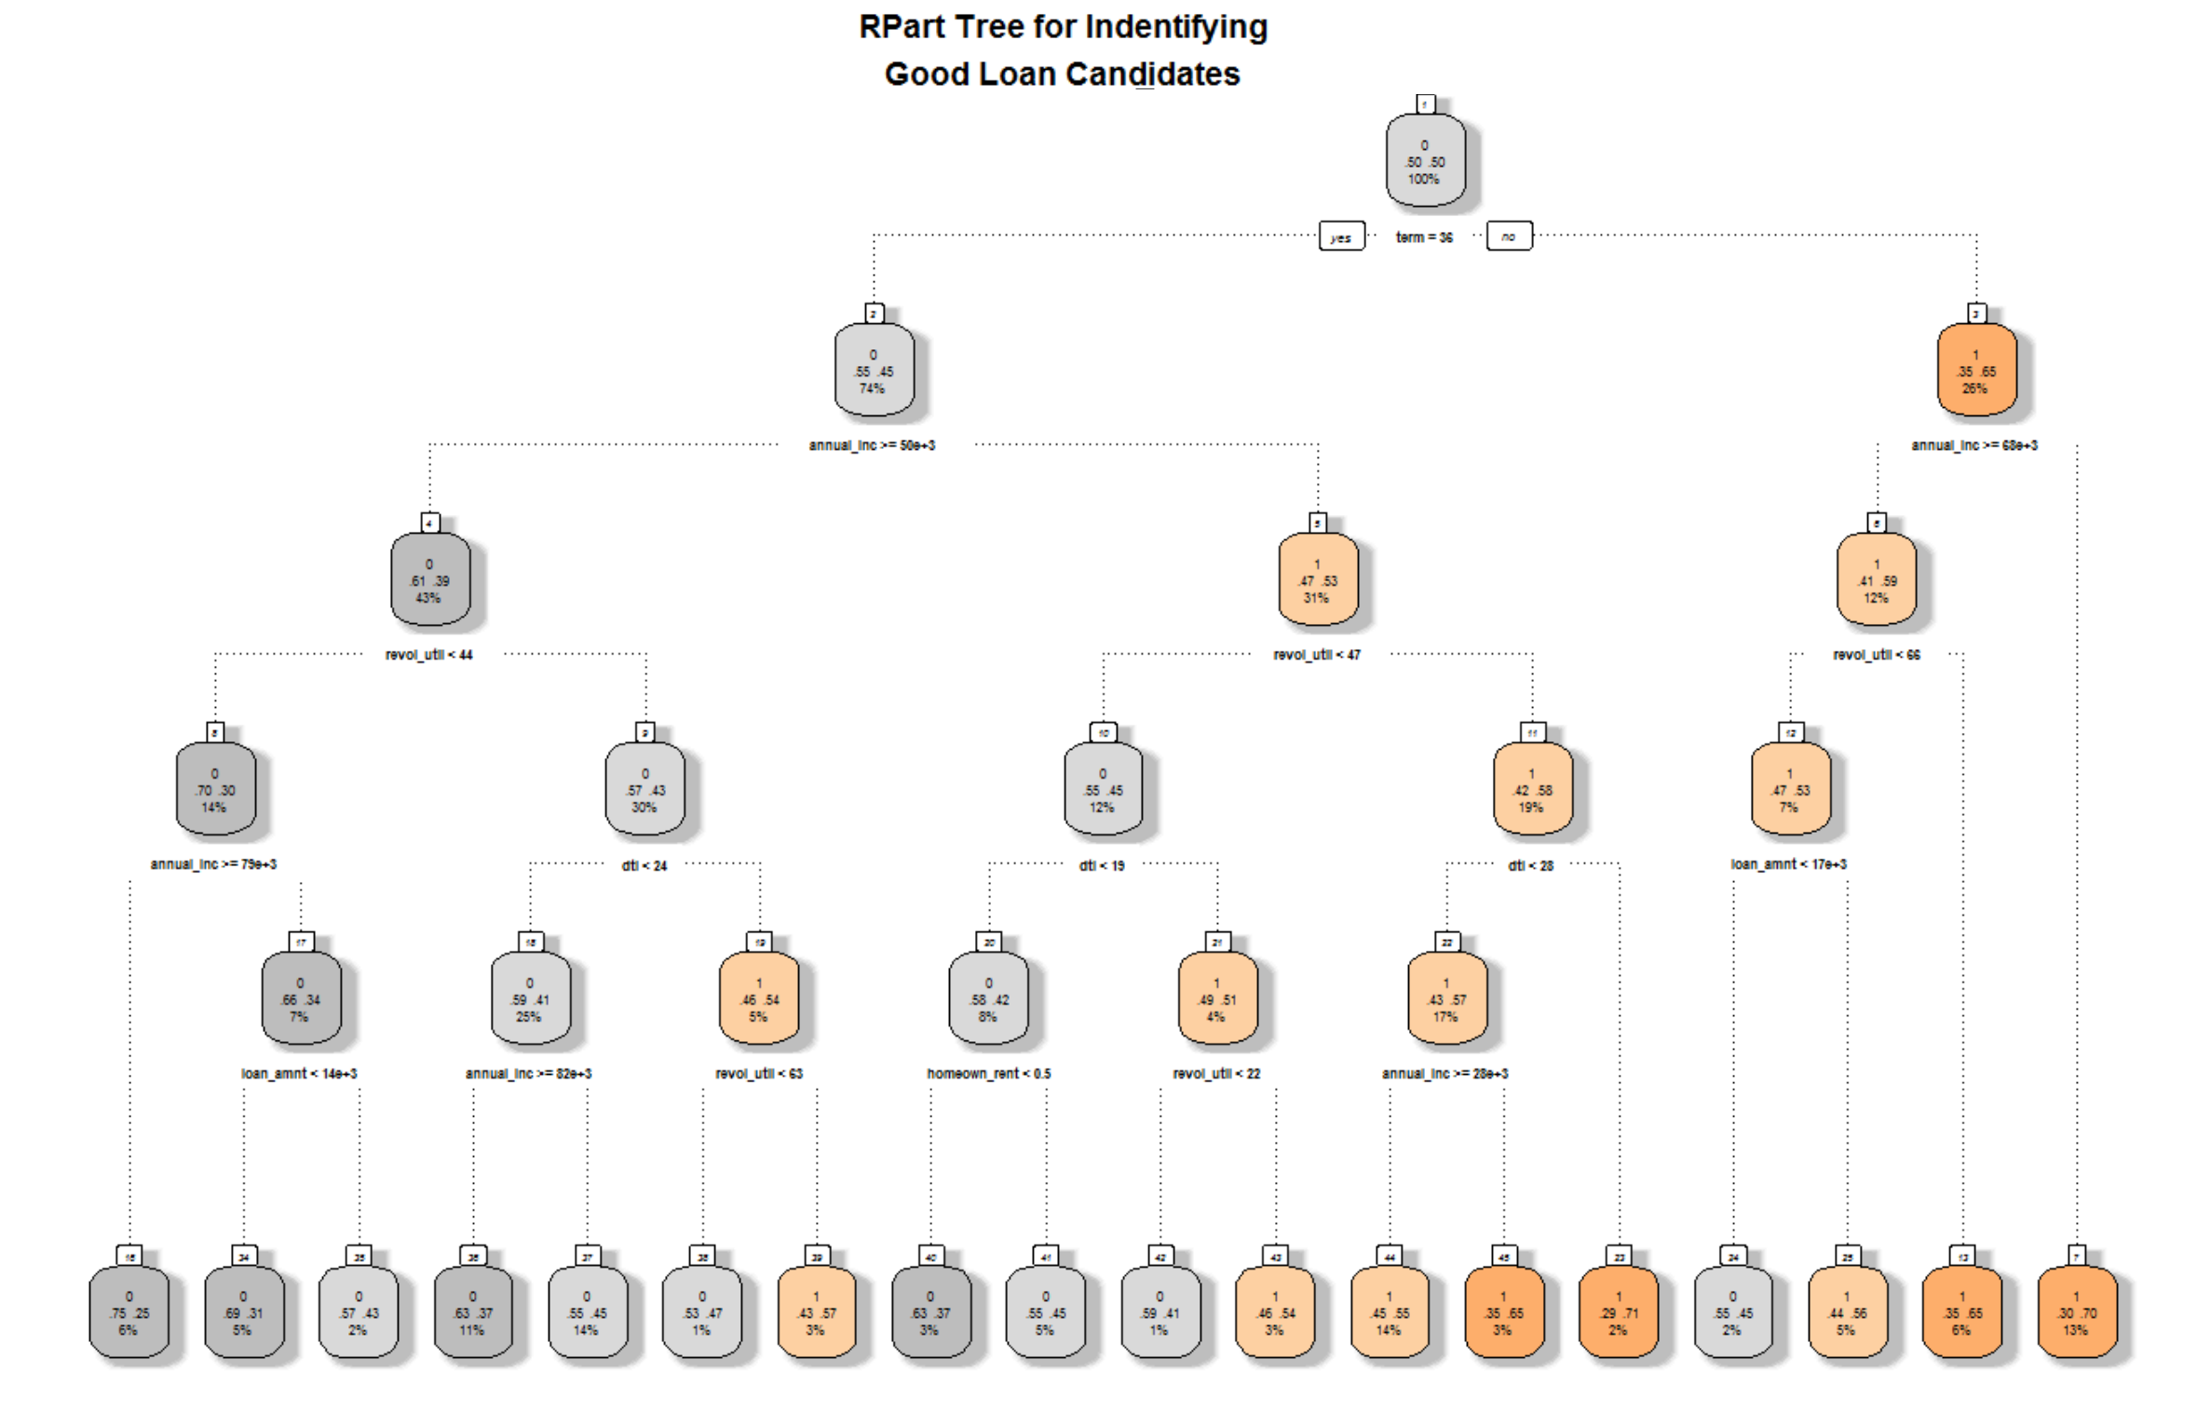
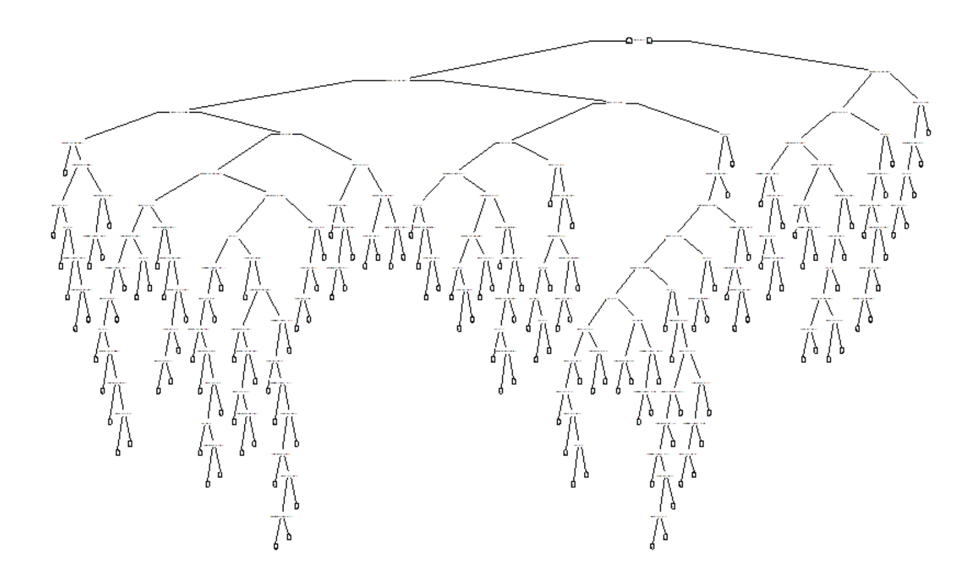
Model: RTree
The Rtree model, shown below using default values, creates an overfitted tree. But by increasing the number of observations assigned to a minimum split, or by controlling the maximum depth, we can reduce the model down to a meaningful number of nodes.

Slide 12
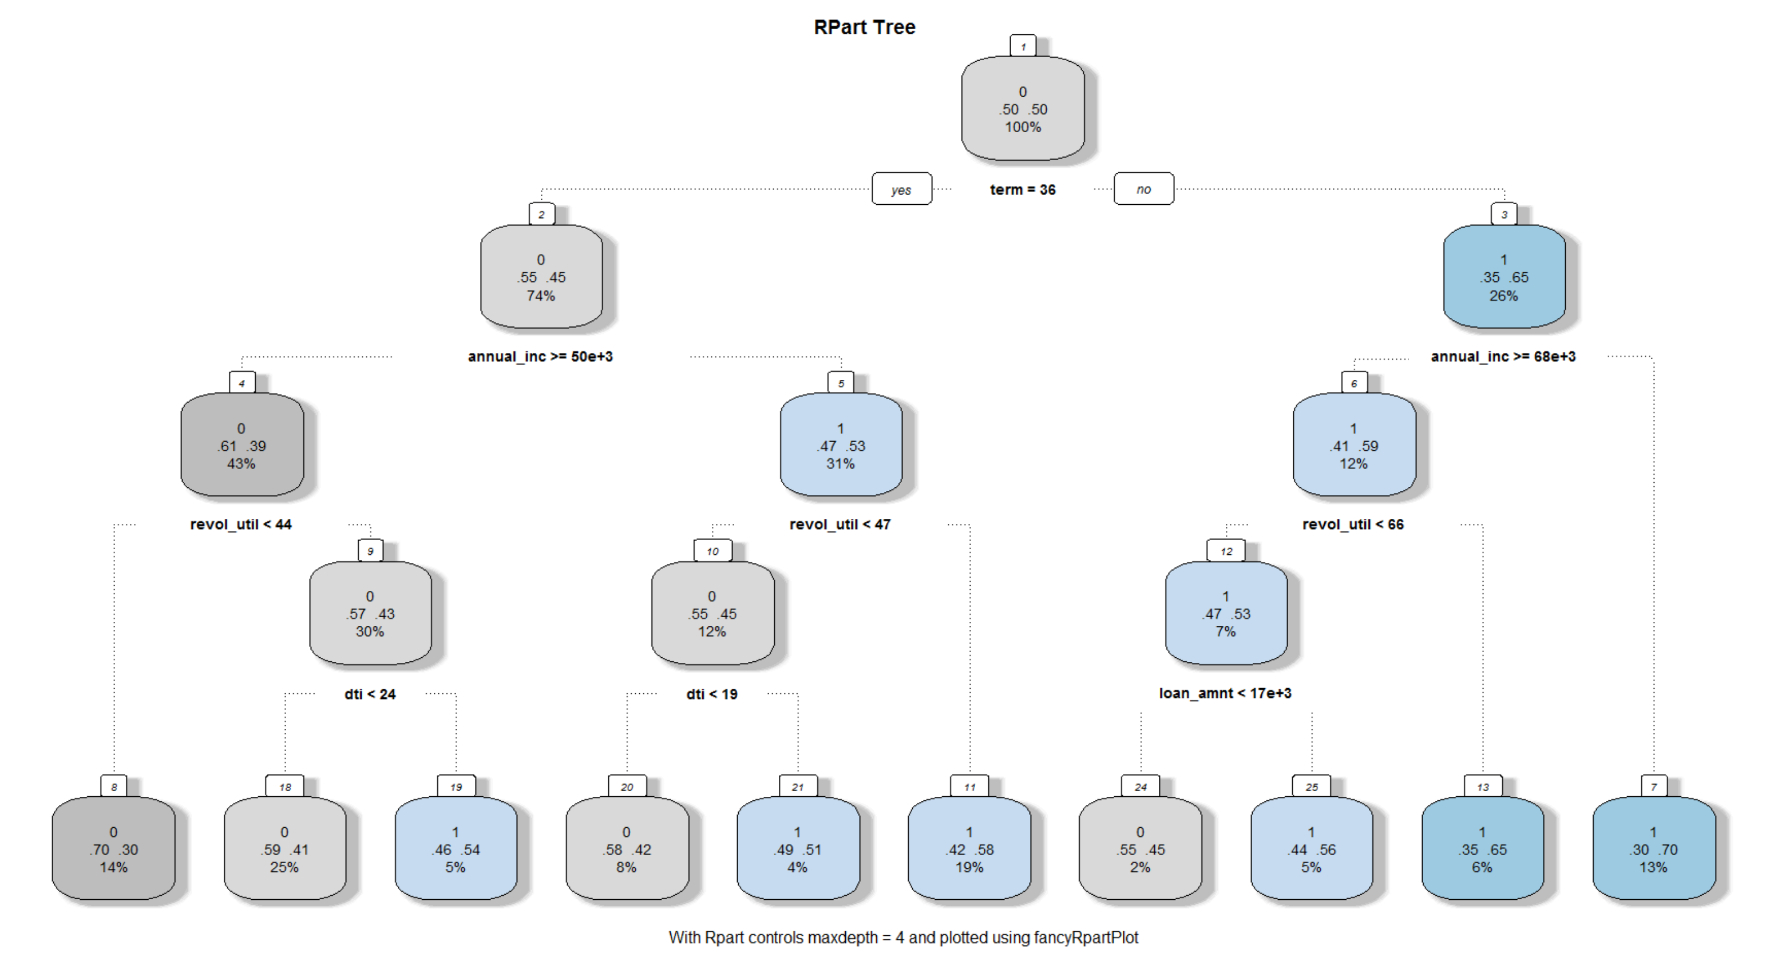
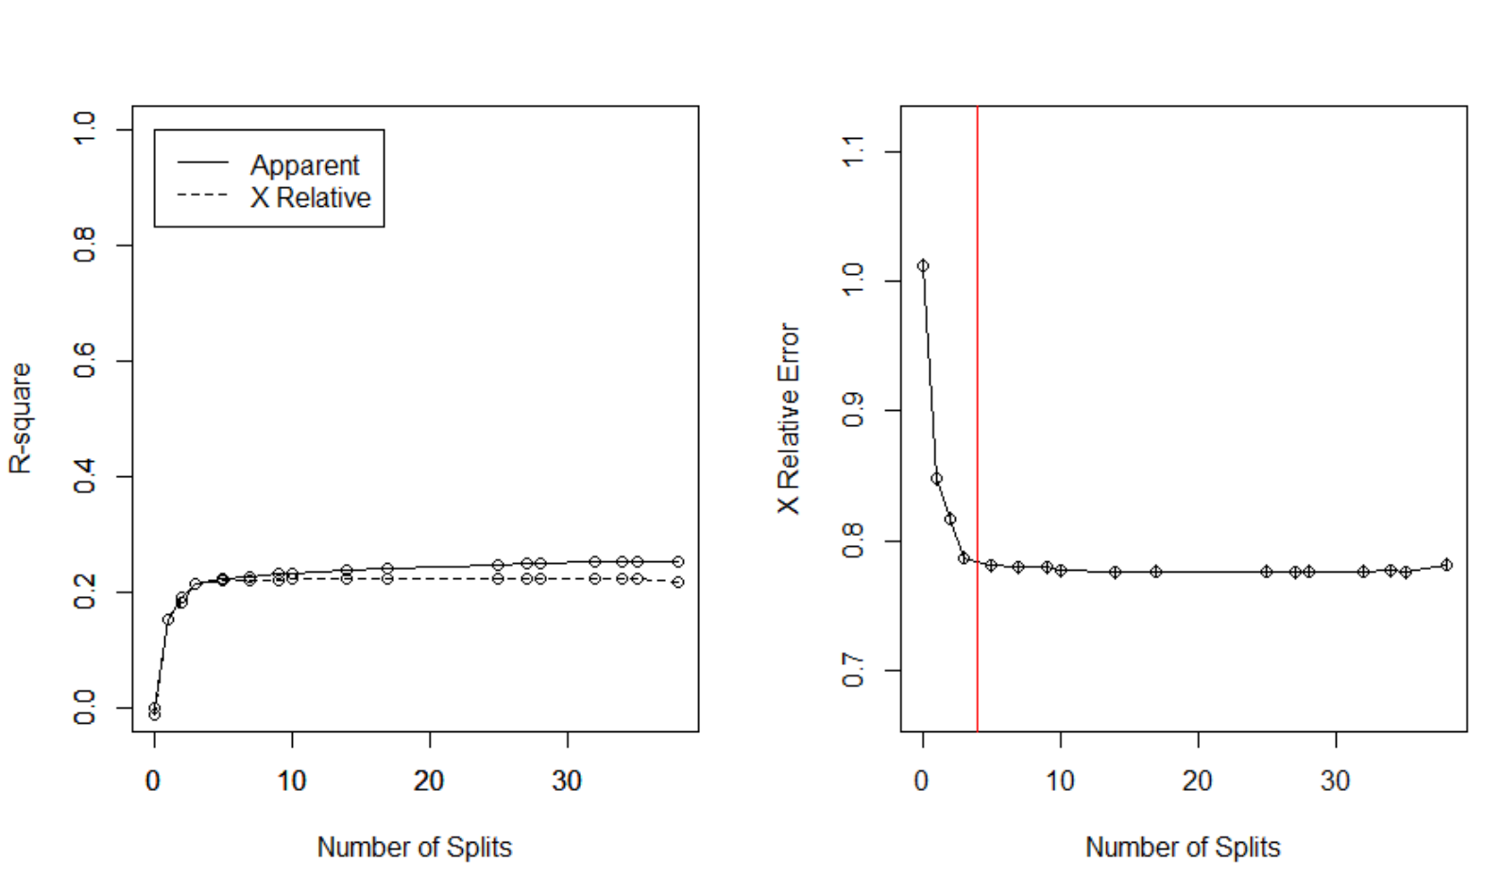
Model: Rtree Validation
Analyzing for the optimal depth that minimizes overfitting. The analysis below suggests that either three or four splits are the optimal. In trying both, four resulted in a more compelling tree and is shown on the right.
Variable definitions: revol_util = Revolving line utilization rate, or the amount of credit the borrower is using relative to all available revolving credit. dti = A ratio calculated using the borrower's total monthly debt payments on the total debt obligations, divided by the borrower's self-reported monthly income.

Slide 13
Summary
AUC = Area Under Curve. See Section 6.
Model | Technique | Variable.Imp | AUC
1 | Logistic | term, annual_inc, loan_amnt, dti, delinq_2yrs, revol_util, total_acc, longest_credit_length, bankrpc_state_low, bankrpc_state_high, homeown_mort, homeown_rent, purpose, vstatus_verified | 66.186%
2 | Decision Tree (Tree) | term, annual_inc | 63.492%
3 | Decision Tree (RTree) | term, annual_inc, revol_util, dti, loan_amnt | 65.718%
Best
Runner Up

Slide 14
Appendix: Original Variable Definitions
# | Variable Name | Description
1 | loan_amnt | The listed amount of the loan applied for by the borrower. If at some point in time, the credit department reduces the loan amount, then it will be reflected in this value. Loan amount ranges from 500 to 35,000.
2 | term | The number of months to pay the loan. Values are either 36 or 60 months (character type)
3 | int_rate | Ranging from 5.42 the best candidate (e.g. lowest risk) to 26.06 for high risk customers. (dependent variable)
4 | emp_length | Employment length in years.
5 | home_ownership | The home ownership status provided by the borrower during registration. Our values are: RENT, OWN, MORTGAGE, OTHER (character type).
6 | annual_inc | The self-reported annual income provided by the borrower during registration.
7 | purpose | A category provided by the borrower for the loan request.
8 | addr_state | The state provided by the borrower in the loan application
9 | dti | A ratio calculated using the borrower's total monthly debt payments on the total debt obligations, excluding mortgage and the requested LC loan, divided by the borrower's self-reported monthly income.
10 | delinq_2yrs | The number of 30+ days past-due incidences of delinquency in the borrower's credit file for the past 2 years
11 | revol_util | Revolving line utilization rate, or the amount of credit the borrower is using relative to all available revolving credit.
12 | total_acc | Total number of accounts
13 | bad_loan | Numeric: 1 = Bad Loan, 0 = Good loan. Captures if the consumer was either a good or bad loan.
14 | longest_credit_length | In months.
15 | verification_status | Based on the state of the loan application

Slide 15
Appendix: added variables definitions
New Variables | Description
bankrpc_state_high | States, grouped into four categories, based on bankruptcy filings by State: http://www.valuepenguin.com/bankruptcy-filings-state
bankrpc_state_medhigh
bankrpc_state_med
bankrpc_state_low
vstatus_verified | Loan status Verified = 1, Not Verified = 0
homeown_other | Collapsed the homeownership value into categories other, mortgage, or rent.
homeown_mort
homeown_rent

