Slide 1
Capstone Project Foundations of Data Science
Craig Calder
March 2016

Slide 2
Overview
Problem statement
Data sources
Data challenges and preparation
Exploratory analysis
Top models
Summary

Slide 3
Problem Statement
Create a model that a lending organization could use to evaluate a potential customer's likelihood of being a good candidate for a medium term (36 or 60 month) loan based on a modest number of inputs such as annual income, loan amount, term, revolving line utilization rate, etc.

Slide 4
DatA sOURCES
Data: https://www.lendingclub.com/info/download-data.action/loan.csv Contains 163,987 observations with 15 variables. The variable we want to predict is bad_loans. The dataset is split between these observations:
Good Loans (bad_loan = 0): 133,971 observations (82%)
Bad Loans (bad_loan = 1): 30,016 observations (18%)

Slide 5
Data Preparation
Wrangling
Impute Missing Values
Convert to Factors and Create Dummy Variables
Eliminate Outliers
Balance and Split Training/Test Data

Slide 6
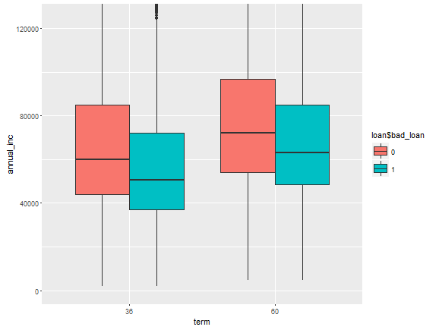
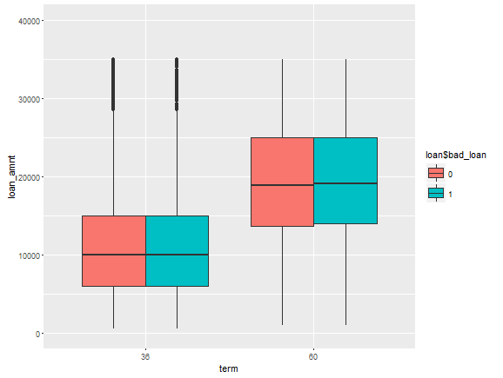
Exploratory Data Analysis
Unsurprisingly mean annual income is distinctly lower for a bad loan state…. and while loan amounts increase for longer terms, but the means are comparable

Slide 7
Model: Logistic Regression
The table on the right displays the logistic regression models output. From this we see employment length, annual income, total accounts, credit length, living in a low or medium average bankruptcy state and having a mortgage are all inversely related to bad loans.
Below we see the effect of different threshold values on the confusion matrices. It seems t=.55 provides balances the desire maximize true positives and true negatives while managing false positives and false negatives.
Variable | Coefficient | P-Value | Significance
Loan_amount | 1.84E-05 | 1.35E-55 | ***
emp_length | -0.00182616 | 0.485009021
annual_inc | -5.39E-06 | 5.49E-104 | ***
dti | 0.035582836 | 1.32E-177 | ***
delinq_2yrs | 0.056976745 | 3.57E-05 | ***
revol_util | 0.011514081 | 2.61E-195 | ***
total_acc | -0.00902606 | 4.00E-28 | ***
longest_credit_length | -0.00746845 | 3.89E-08 | ***
bankrpc_state_low (dummy) | -0.09342886 | 4.57E-05 | ***
bankrpc_state_med (dummy) | -0.04470727 | 0.032735737 | *
bankrpc_state_medhigh (dummy) | 0.059659539 | 0.003381705 | **
bankrpc_state_high (dummy) | 0.096607377 | 0.000106993 | ***
homeown_other (dummy) | 0.060802301 | 0.072699274 | .
homeown_mort (dummy) | -0.26221461 | 1.30E-43 | ***
homeown_rent (dummy) | 0.244811429 | 5.09E-38 | ***
term (factor) |  | 1.64E-297 | ***
purpose (factor) |  | 3.41E-16 | ***
vstatus_verified (factor) |  | 1.54E-67 | ***
Threshold | TP | FP | TN | FN
t > .70 | 106,393 | 6,505 | 998 | 4,995
t > .65 | 101,629 | 5,867 | 1,636 | 9,759
t > .60 | 94,395 | 5,036 | 2,467 | 16,993
t > .55 | 83,695 | 4,056 | 3,447 | 27,693
t > .50 | 69,625 | 2,919 | 4,584 | 41,763
t > .45 | 53,333 | 1,911 | 5,592 | 58,055
Signif. codes: 0 ‘***’ 0.001 ‘**’ 0.01 ‘*’ 0.05 ‘.’ 0.1 ‘ ’ 1

Slide 8
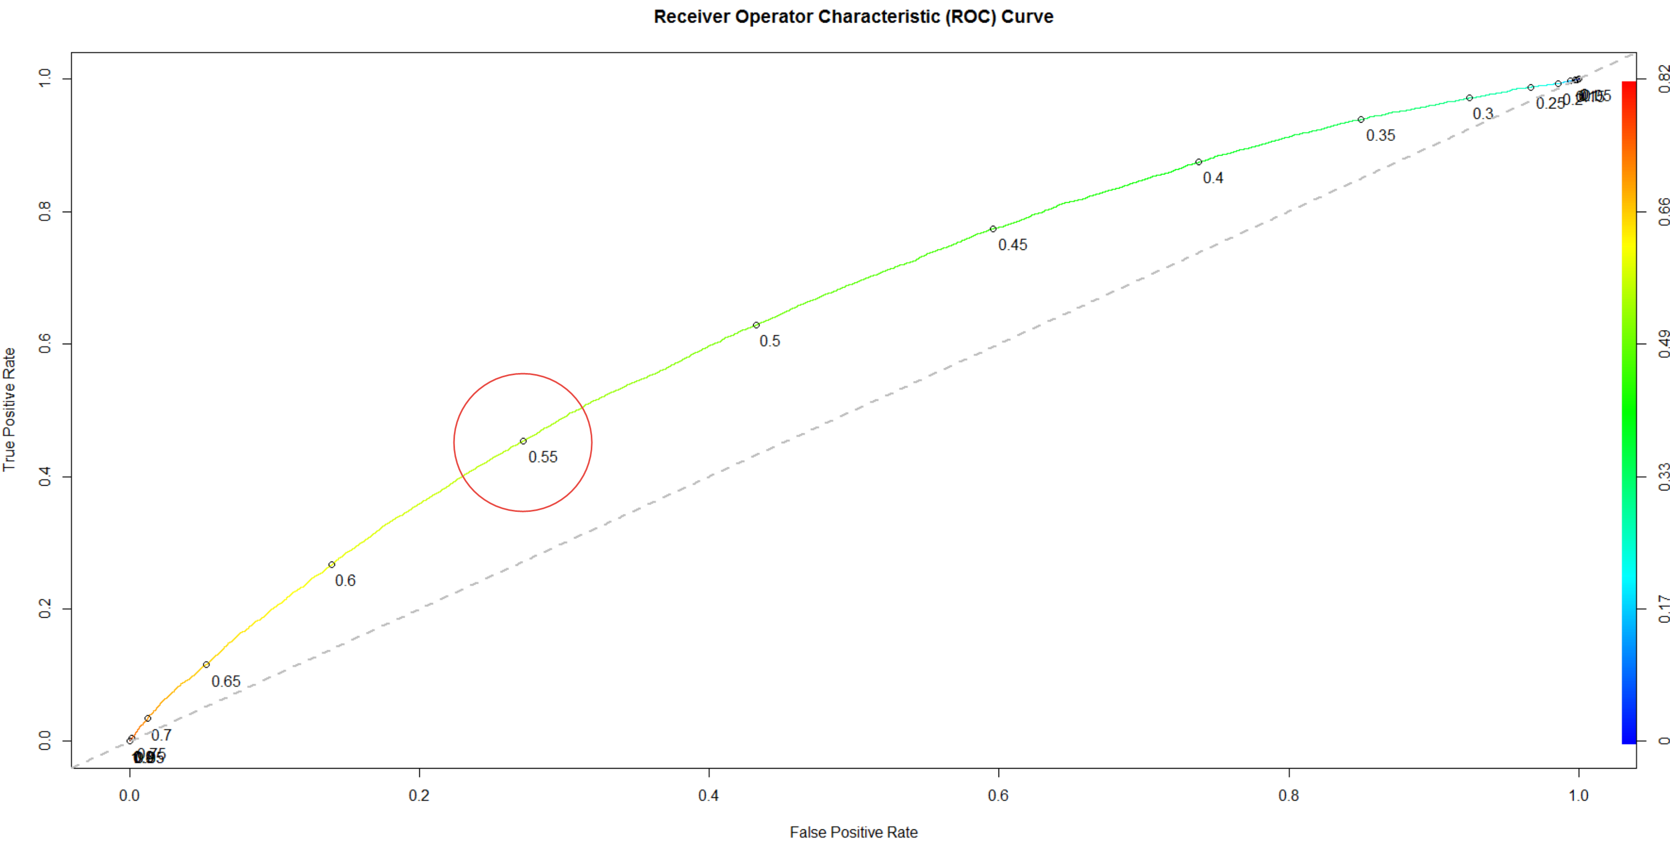
Model Validation - ROCR
Area Under the Curve (AUC) = 0.6618582. The ROC curve shows the tradeoff between sensitivity and specificity.
The table below highlights the exact values at select thresholds, where a threshold of .55 balances the True Positive Rate well against False Positive Rate.
Threshold | Sensitivity | Specificity
t > .70 | 0.9552 | 0.1330
t > .65 | 0.9124 | 0.2180
t > .60 | 0.8474 | 0.3288
t > .55 | 0.7514 | 0.4594
t > .50 | 0.6251 | 0.6110
t > .45 | 0.4788 | 0.7453

Slide 9
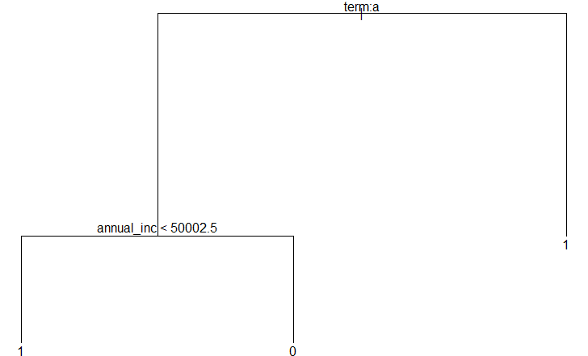
MODEL: Classification Tree
Interestingly a classification tree model only identified two predictive variables: Term and annual income.
Creating a general linear model with just these two variables results in a model with an AUC = 0.63492

Slide 10
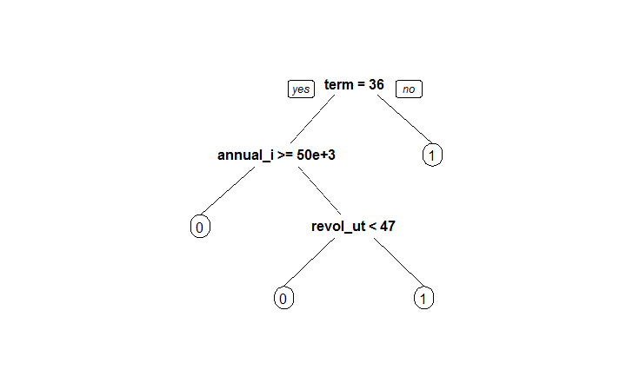
Model: RTree
Interestingly a rtree model identified only three significant variables: Term, annual income, revoling util*
Creating a general linear model with just these three variables results in a model with an AUC = 0.64859
* Revolving line utilization rate, or the amount of credit the borrower is using relative to all available revolving credit.

Slide 11
Summary
AUC = Area Under Curve. See Section 6.
Model | AUC
LoanModel00 = glm (bad_loan ~ loan_amnt + annual_inc + dti + delinq_2yrs + revol_util + total_acc + longest_credit_length + bankrpc_state_low + bankrpc_state_high + homeown_mort + homeown_rent + term + purpose + vstatus_verified, data=loan_train, family="binomial") | 66.186%
LoanModel03b = glm (bad_loan ~ annual_inc + term, data=loan_train, family="binomial") | 63.492%

