Slide 1
Intro to Data Science Capstone 2016
Identifying good loan candidates
Craig Calder
March 2016

Slide 2
Objective
Create a model that predicts whether a person is a good or bad candidate for a medium term (36 or 60 month) loan based on available attributes.
A client of this model would be an institution needing to provide an agent the capability to evaluate a potential customer's likelihood of being a good candidate for a loan based on a modest number of inputs.

Slide 3
Summary
AUC = Area Under Curve. See Section 6.
Model | AUC
LoanModel00 = glm (bad_loan ~ loan_amnt + annual_inc + dti + delinq_2yrs + revol_util + total_acc + longest_credit_length + bankrpc_state_low + bankrpc_state_high + homeown_mort + homeown_rent + term + purpose + vstatus_verified, data=loan_train, family="binomial") | 66.186%
LoanModel03b = glm (bad_loan ~ annual_inc + term, data=loan_train, family="binomial") | 63.492%

Slide 4
1. DataSet
The data source is available at: https://www.lendingclub.com/info/download-data.action
Loan.csv contains 163,987 observations with 15 variables. The dependent variables of interest, bad_loans, is split between good and bad loans:
Good Loans (bad_loan = 0): 133,971 observations (82%)
Bad Loans (bad_loan = 1): 30,016 observations (18%)

Slide 5
2. Wrangle: Impute Missing
Some observations are missing values. Specifically, emp_length (580 or 3.5%), annual_inc (4 or 0.002%), and delinq_2yrs (29), total_acc (2), revol_util (193), longest_credit_length (29 or 0.017%)
A "safe" maximum threshold of missing values is 5% of the total for large datasets, so using the “mice” function, we will impute the missing values rather than exclude those observations from the analysis: mice(loan,m=1,maxit=25,meth='pmm',seed=500)

Slide 6
2. Wrangling – Factors and Dummies
Factor values should be used for categorical data. Several variables that needed to be converted to factors and in some cases further broken down into dummy variables. Specifically bad_loan, term, add_state, purpose, verified, home_ownership
bad_loan: converted to a factor (e.g. a categorical variable that can only take on two values, 1 or 0)
add_state was initially organized into five regions of the country (e.g. West, South, Midwest, Northeast, East), however, it was later determined that four groups based on the prevalence of bankruptcies in the state produced more meaningful models (source http://www.valuepenguin.com/bankruptcy-filings-state).
purpose, verified, and home_ownership were factored into a small number of factors and then simplified into dummy variables. https://en.wikipedia.org/wiki/Dummy_variable_(statistics). A dummy variable is one that takes the value 0 or 1 to indicate the absence or presence of some categorical effect that may be expected to shift the outcome.

Slide 7
2. Wrangling - Outliers
Outliers were identified and removed. In particular, some of the observations had very high annual incomes. Therefore, the 27 observations exceeded $1,000,000 per year were excluded from the model.
This seems reasonable since these high income customers would likely receive special treatment and may not reflect the model well.

Slide 8
4. Balancing and Splitting
Instead of a training set reflect the 82 / 18% split of good to “bad” loan observations, the training set was first balanced
75% of bad_loans = 1 observations (22,512) were matched up with 22,512 random “good” loan observations (i.e. bad_loans = 0) observations.

Slide 9
5. Model #1: Logistic Regression
Build Bivariate models to identify which of our variables are useful in predicting a particular outcome (e.g. models that predict the outcome using a single independent variable.) An independent variable shall be considered significant if there is at least one star at the end of the coefficients row for that variable (e.g. the probability column having a value smaller than 0.05)

Slide 10
5. Model #1: Testing for Significance
Signif. codes: 0 ‘***’ 0.001 ‘**’ 0.01 ‘*’ 0.05 ‘.’ 0.1 ‘ ’ 1
 | Variable | P-Value | significance
1 | Loan_amount | 1.35E-55 | ***
2 | emp_length | 0.485009021
3 | annual_inc | 5.49E-104 | ***
4 | Dti | 1.32E-177 | ***
5 | delinq_2yrs | 3.57E-05 | ***
6 | revol_util | 2.61E-195 | ***
7 | total_acc | 4.00E-28 | ***
8 | longest_credit_length | 3.89E-08 | ***
9 | bankrpc_state_low (dummy) | 4.57E-05 | ***
10 | bankrpc_state_med (dummy) | 0.032735737 | *
11 | bankrpc_state_medhigh (dummy) | 0.003381705 | **
12 | bankrpc_state_high (dummy) | 0.000106993 | ***
13 | homeown_other (dummy) | 0.072699274 | .
14 | homeown_mort (dummy) | 1.30E-43 | ***
15 | homeown_rent (dummy) | 5.09E-38 | ***
16 | term (factor) | 1.64E-297 | ***
17 | purpose (factor) | 3.41E-16 | ***
18 | vstatus_verified (factor) | 1.54E-67 | ***

Slide 11
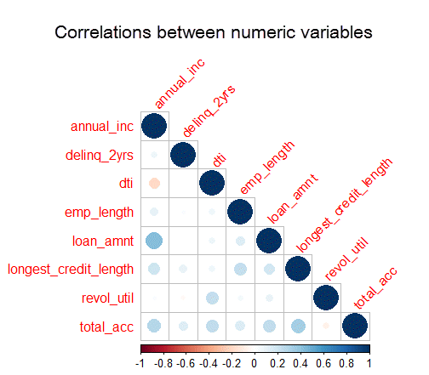
5. Check for Multivariance
Correlations displayed graphically:
Positive correlations are displayed in blue and negative correlations in red color.
Color intensity and the size of the circle are proportional to the correlation coefficients.
Conclusion: None of the numeric variables are excessively correlated and thus require additional management prior to building a candidate model:

Slide 12
Model #1
LoanModel00 = glm (bad_loan ~ loan_amnt + annual_inc + dti + delinq_2yrs + revol_util + total_acc + longest_credit_length + bankrpc_state_low + bankrpc_state_high + homeown_mort + homeown_rent + term + purpose + vstatus_verified, data=loan_train, family="binomial")

Slide 13
Logistic Model Validation
With a bank deciding on loan candidates, choosing someone who is a bad loan candidate can be compensated for by charging a higher interest rate, so we will try to minimize the number of times we turn away a good customer by aiming for a high sensitivity.
Threshold | TP | FP | TN | FN | Sensitivity | Specificity
t > .70 | 106,393 | 6,505 | 998 | 4,995 | 0.9552 | 0.1330
t > .65 | 101,629 | 5,867 | 1,636 | 9,759 | 0.9124 | 0.2180
t > .60 | 94,395 | 5,036 | 2,467 | 16,993 | 0.8474 | 0.3288
t > .55 | 83,695 | 4,056 | 3,447 | 27,693 | 0.7514 | 0.4594
t > .50 | 69,625 | 2,919 | 4,584 | 41,763 | 0.6251 | 0.6110
t > .45 | 53,333 | 1,911 | 5,592 | 58,055 | 0.4788 | 0.7453

Slide 14
Validation Concerns
One potential problem with the remaining test dataset is that it is now heavily skewed in favor of bad_loans = 0 (i.e. “good” loans). This supplementary analysis explores the impact of the skewed nature of the data set affects the threshold determination. table (loan_test$bad_loan) 0 (good) 1(bad) 111,459 7,504
After constructing a balanced test dataset that balances the number of good loans with 7504 bad loans: table (loan_test$bad_loan) 0 (good) 1(bad) 7,504 7,504

Slide 15
Results
Threshold Value | TP | FP | TN | FN | Sensitivity | Specificity
t > .70 | 7,169 | 6,505 | 998 | 334 | 0.9555 | 0.133
t > .65 | 6,848 | 5,867 | 1,636 | 655 | 0.9127 | 0.218
t > .60 | 6,336 | 5,036 | 2,467 | 1,167 | 0.8445 | 0.3288
t > .55 | 5,588 | 4,056 | 3,447 | 1,915 | 0.7448 | 0.4594
t > .50 | 4,629 | 2,919 | 4,584 | 2,874 | 0.617 | 0.611
t > .45 | 3,573 | 1,911 | 5,592 | 3,930 | 0.4762 | 0.7453
Given the above, it seems our model works best in a universe where the good loan candidates largely outweigh the number of bad candidates in similar proportions to the data set used to construct the model (e.g. Good Loans (0): 82%, Bad Loans (1): 18%).

Slide 16
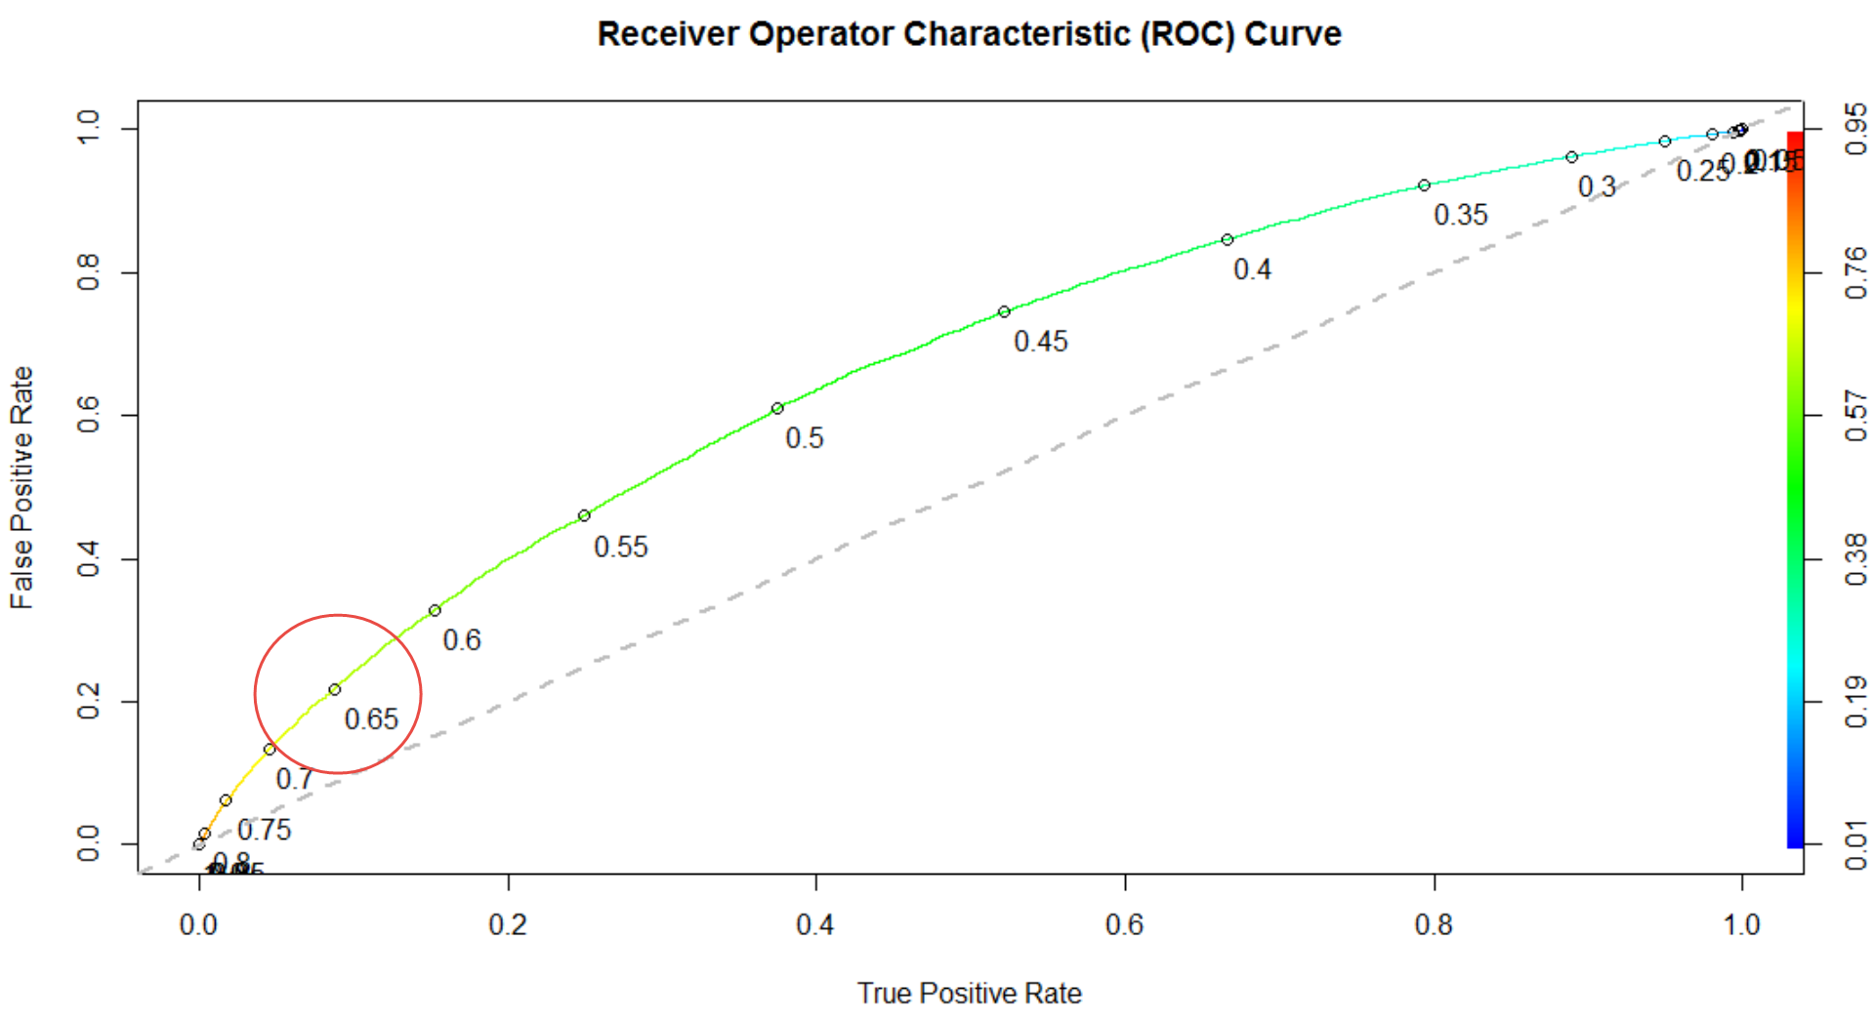
Model 1 Validation - ROCR

Slide 17
Area under the curve (AUC)
Area Under the Curve (AUC). The area under the ROC curve is often used as a measure of quality of the classification model - random model has an area under the curve equal to .5, a perfect classifier is equal to 1. Above .7 is highly desirable.
aucROCR = as.numeric(performance(ROCRpred, "auc")@y.values) = 0.6618582

Slide 18
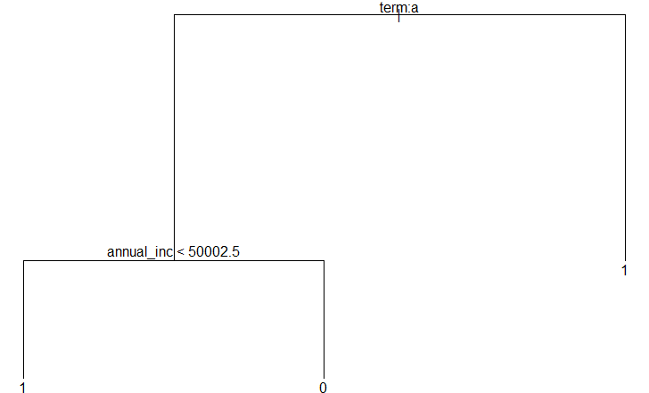
Classification Tree

Slide 19
Summary
AUC = Area Under Curve. See Section 6.
Model | AUC
LoanModel00 = glm (bad_loan ~ loan_amnt + annual_inc + dti + delinq_2yrs + revol_util + total_acc + longest_credit_length + bankrpc_state_low + bankrpc_state_high + homeown_mort + homeown_rent + term + purpose + vstatus_verified, data=loan_train, family="binomial") | 66.186%
LoanModel03b = glm (bad_loan ~ annual_inc + term, data=loan_train, family="binomial") | 63.492%

