Slide 1
Computer Architecture
Basic Processor Design:
Physics, transistors, gates
Slides developed by Dr. Gary Tyson

Slide 2
Levels of abstraction
Quantum level, solid state physics
Conductors, Insulators, Semiconductors.
Doping silicon to make diodes and transistors.
Building simple gates, boolean logic, and truth tables
Combinational logic: muxes, decoders
Clocks
Sequential logic: latches, memory
State machines
Processor Control: Machine instructions
Computer Architecture: Defining a set of instructions

Slide 3
Start with the materials: Conductors and Insulators
Conductor: a material that permits electrical current to flow easily. (low resistance to current flow)‏
  Lattice of atoms with free electrons
Insulator: a material that is a poor conductor of electrical current (High resistance to current flow)‏
  Lattice of atoms with strongly held electrons
Semi-conductor: a material that can act like a conductor or an insulator depending on conditions. (variable resistance to current flow)‏

Slide 4

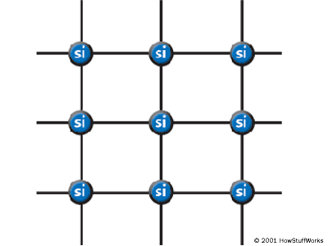
Making a semiconductor using silicon
e
e
e
e
e
e
e
e
e
e
e
e
e
e
e
e
e
e
e
e
What is a pure silicon lattice?
A. Conductor
B. Insulator
C. Semi conductor

Slide 5
N-type Doping
We can increase the conductivity by adding atoms of phosphorus or arsenic to the silicon lattice.
  They have more electrons (1 more) which is free to wander…
  This is called n-type doping since we add some free (negatively charged) electrons

Slide 6
Making a semiconductor using silicon
This electron is easily
moved from here
e
e
e
e
e
e
e
e
e
e
e
e
e
e
P
e
e
e
e
e
e
e
What is a n-doped silicon lattice?
A. Conductor
B. Insulator
C. Semi-conductor

Slide 7
P-type Doping
Interestingly, we can also improve the conductivity by adding atoms of gallium or boron to the silicon lattice.
  They have fewer electrons (1 fewer) which creates a hole. Holes also conduct current by stealing electrons from their neighbor (thus moving the hole).
  This is called p-type doping since we have fewer (negatively charged) electrons in the bond holding the atoms together.

Slide 8
Making a semiconductor using silicon
e
e
e
e
e
e
e
e
e
e
e
e
e
Ga
e
e
?
e
e
e
e
This atom will accept an electron even
though it is one too many since it fills the
eighth electron position in this shell. Again
this lets current flow since the electron must
come from somewhere to fill this position.

Slide 9
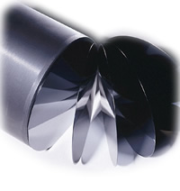
Making Silicon into Processors
Start with a very pure ingot of silicon
Carefully add:
  Phosphorus or Arsenic
  Gallium or Boron
  Metal wires

Slide 10
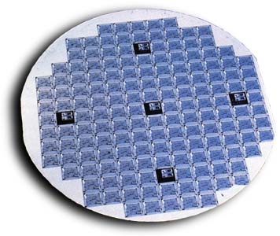
Getting Chips out of Wafers

Slide 11
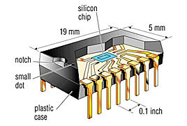
Packaging Chips

Slide 12
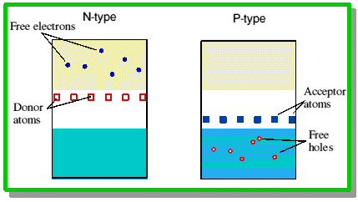
Using doped silicon to make a junction diode
A junction diode allows current to flow in one direction and blocks it in the other.

Slide 13
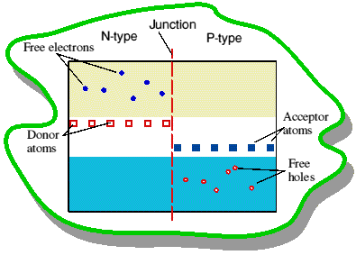
Using doped silicon to make a junction diode
A junction diode allows current to flow in one direction and blocks it in the other.

Slide 14
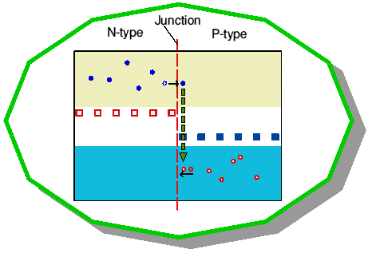
Using doped silicon to make a junction diode
Free Electrons (Ntype) fill Holes (Ptype)‏

Slide 15
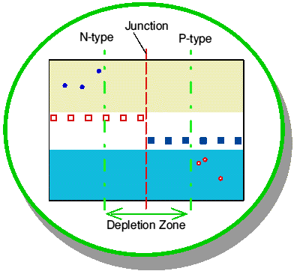
Using doped silicon to make a junction diode
A depletion zone is made with atoms with completed outer shells (and with a charge)‏

Slide 16
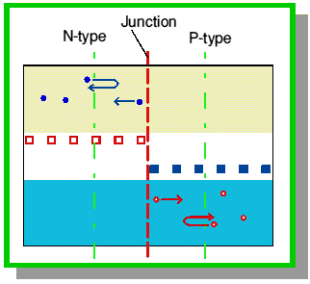
Using doped silicon to make a junction diode
With no current, equilibrium occurs with the depletion zone acting as an insulator

Slide 17
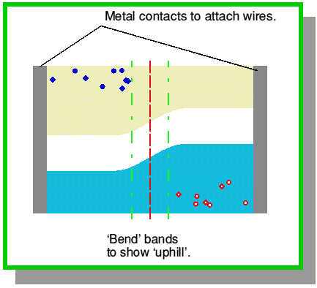
Using doped silicon to make a junction diode
Connect N-type to native; ptype to positive and the depletion zone shrinks and current flows

Slide 18
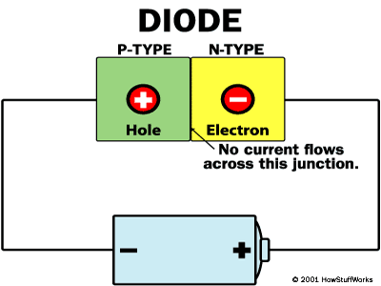
Making a transistor
Our first level of abstraction is the transistor. (basically 2 diodes sitting back-to-back)‏
Gate
P-type

Slide 19
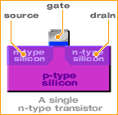
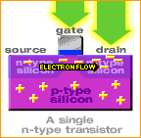
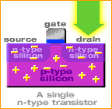
Making a transistor
Transistors are electronic switches connecting the source to the drain if the gate is “on”.
Vcc
Vcc
Vcc
http://www.intel.com/education/transworks/INDEX.HTM

Slide 20
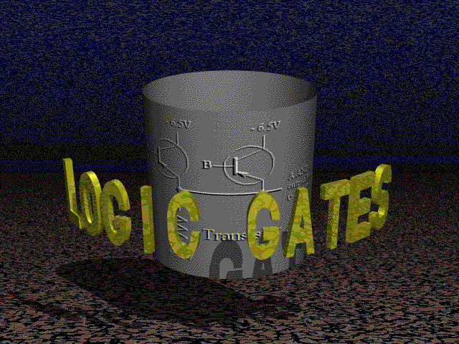

Slide 21
Abstractions in CS (gates)‏
Basic Gate: Inverter
Truth Table
I
O
I
O
0
1
1
0
GND
I
O
Resister (limits conductivity)‏
Vcc

Slide 22
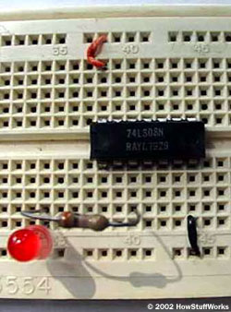
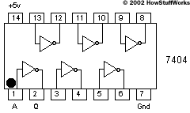
Abstractions in CS (gates)‏
Truth Table
I
O
I
O
0
1
1
0

Slide 23
Abstractions in CS (gates)‏
Basic Gate: Nand (Negated AND)‏
Truth Table
A
B
A
B
Y
Y
0
0
1
1
0
1
0
1
1
1
1
0
GND
A
B
Y
Vcc

Slide 24
Abstractions in CS (gates)‏
Basic Gate: And
Truth Table
A
B
Y
0
0
1
1
0
1
0
1
0
0
0
1
A
B
Y

Slide 25
Abstractions in CS (gates)‏
Other Basic Gates: Or gate
Truth Table
A
B
Y
0
0
1
1
0
1
0
1
0
1
1
1
A
B
Y

Slide 26
Abstractions in CS (gates)‏
Other Basic Gates: Xor gate
Truth Table
A
B
Y
0
0
1
1
0
1
0
1
0
1
1
0
A
B
Y

Slide 27
All 2 input 1 output gates (1-8)‏
Truth Table
Truth Table
Truth Table
Truth Table
A
B
Y
A
B
Y
A
B
Y
A
B
Y
0
0
1
1
0
1
0
1
0
0
0
0
0
0
1
1
0
1
0
1
0
0
0
1
0
0
1
1
0
1
0
1
0
0
1
0
0
0
1
1
0
1
0
1
0
0
1
1
Truth Table
Truth Table
Truth Table
Truth Table
A
B
Y
A
B
Y
A
B
Y
A
B
Y
0
0
1
1
0
1
0
1
0
1
0
0
0
0
1
1
0
1
0
1
0
1
0
1
0
0
1
1
0
1
0
1
0
1
1
0
0
0
1
1
0
1
0
1
0
1
1
1

Slide 28
All 2 input 1 output gates (9-16)‏
Truth Table
Truth Table
Truth Table
Truth Table
A
B
Y
A
B
Y
A
B
Y
A
B
Y
0
0
1
1
0
1
0
1
1
0
0
0
0
0
1
1
0
1
0
1
1
0
0
1
0
0
1
1
0
1
0
1
1
0
1
0
0
0
1
1
0
1
0
1
1
0
1
1
Truth Table
Truth Table
Truth Table
Truth Table
A
B
Y
A
B
Y
A
B
Y
A
B
Y
0
0
1
1
0
1
0
1
1
1
0
0
0
0
1
1
0
1
0
1
1
1
0
1
0
0
1
1
0
1
0
1
1
1
1
0
0
0
1
1
0
1
0
1
1
1
1
1

Slide 29
Levels of abstraction
Quantum level, solid state physics
Conductors, Insulators, Semiconductors.
Doping silicon to make diodes and transistors.
Building simple gates, boolean logic, and truth tables
Combinational logic: adders, muxes, decoders
Clocks
Sequential logic: latches, memory
State machines
Processor Control: Machine instructions
Computer Architecture: Defining a set of instructions

Slide 30
Abstractions in CS (gates)‏
Basic Gate: Inverter
Truth Table
I
O
I
O
0
1
1
0
GND
I
O
Resister (limits conductivity)‏
Vcc
http://www.howstuffworks.com/boolean.htm
Textbook: See Appendix B

Slide 31
Abstractions in CS (gates)‏
Basic Gate: Nand (Negated AND)‏
Truth Table
A
B
A
B
Y
Y
0
0
1
1
0
1
0
1
1
1
1
0
GND
A
B
Y
Vcc

Slide 32
Abstractions in CS (gates)‏
Basic Gate: And
Truth Table
A
B
Y
0
0
1
1
0
1
0
1
0
0
0
1
A
B
Y

Slide 33
Abstractions in CS (gates)‏
Other Basic Gates: Or gate
Truth Table
A
B
Y
0
0
1
1
0
1
0
1
0
1
1
1
A
B
Y

Slide 34
Abstractions in CS (gates)‏
Other Basic Gates: Xor gate
Truth Table
A
B
Y
0
0
1
1
0
1
0
1
0
1
1
0
A
B
Y

Slide 35
A little math
Grade School
125
5 × 10⁰
+ 2 × 10¹
+ 1 × 10²
binary numbers
10110
0 × 2⁰
+ 1 × 2¹
+ 1 × 2²
+ 0 × 2³
+ 1 × 2⁴

Slide 36
Adding numbers
Decimal Addition
125
+ 237
Binary Addition
1011
+ 0001
1
1
1
3
2
6
1
0
1
0

Slide 37
Building an adder
Half Adder: Carry bit (C)can use an AND gate Sum bit (S) can use an XOR gate
Half Adder
Half Adder
Add 2 1-bit numbers
A
A
B
S
C
S
0
0
1
1
0
1
0
1
0
1
1
0
0
0
0
1
B
C

Slide 38
Combinational Circuits
Implement Boolean expressions
  Output is determined exclusively by the input
  No memory: Output is valid only as long as input is
Half Adder
Decoder
MUX
Add 2 1-bit numbers
Select one of multiple
Input line to pass to the output
Select a single line
given an index
A
B
S
C
A₀ A₁ Out ₀₋₃
0 0 1000
1 0 0100
0 1 0010
1 1 0001
A B S C
a b 0 a
a b 1 b
0
0
1
1
0
1
0
1
0
1
1
0
0
0
0
1

Slide 39
Building a Decoder Circuit
A₀
A₁
Out₃
0
1
0
1
0
0
1
1
0
0
0
1
Out₃ is just an AND gate
A₀
A₁
Out₂
0
1
0
1
0
0
1
1
0
0
1
0
Out₂ would be an AND gate if A₀ was inverted
Decoder
Decoder
A₀
A₁
Out₁
0
1
0
1
0
0
1
1
0
1
0
0
Invert A₁
Select a single line
given an index
A₀ A₁ Out ₀₋₃
0 0 1000
1 0 0100
0 1 0010
1 1 0001
A₀
Out₀
A₁
A₀
A₁
Out₀
0
1
0
1
0
0
1
1
1
0
0
0
Invert A₁ and A₂
Out₁
Out₂
Out₃

Slide 40
Building a Mux
Multiplexor: Input S selects either input A or input B
This is called a 2x1 MUX since it has 2 inputs and 1 output.
How would you build a 4x1 MUX?
MUX
MUX
Is A if S is 0
Is 0 if S is 1
Select one of multiple
Input line to pass to the output
A
S
C
Is A if S is 0
Is B if S is 1
A B S C
a b 0 a
a b 1 b
B
Is 0 if S is 0
Is B if S is 1

Slide 41
Combinational Circuits
Adder is the basic gate of the ALU
Decoder is the basic gate of indexing
Mux is the basic gate controlling data movement
Half Adder
Decoder
MUX
A₀
Out₀
A₁
A
Out₁
S
C
Out₂
B
Out₃

Slide 42
Propagation through Combinational Gates
Gate outputs do not change exactly when inputs do.
  Transmission time over wires (~speed of light)‏
  Saturation time to make transistor gate switch
  Every combinatorial circuit
  has a propagation delay
  (time between input and
  output stabilization)‏
Electron saturation of
p-type silicon at gate

Slide 43
Timing in Combinational Circuits
d_{G2}
d_{G3}
d_{G1}
d_{G3}
Delay of gate G2
A
MUX
S
A
G1
X
B
S
C
B
G2
G3
X
Y
Y
C
time
What is the input/output delay (or simply, delay) of the MUX?

Slide 44
How about this Circuit?
A
B
G1
G3
G5
F
C
D
G2
G4
E

Slide 45
Levels of abstraction
Quantum level, solid state physics
Conductors, Insulators, Semiconductors.
Doping silicon to make diodes and transistors.
Building simple gates, Boolean logic, and truth tables
Combinatorial logic: muxes, decoders, adders
Clocks
Sequential logic: latches, memory
State machines
Processor Control: Machine instructions
Computer Architecture: Defining a set of instructions

Slide 46
What is storage in a computer?
Disk Storage: long term non-volatile
Various other optical or magnetic media
  CD, DVD, magnetic tape
Memory: short term volatile & non-volatile
  DRAM, SRAM, FlashRam, etc.
Cache: fast (temporary) memory volatile
Register: very fast small memory volatile

Slide 47
How can silicon remember anything?
What does it mean to remember?
  Storage cell (We will design this)‏
  Operations performed
    Reset value to 0
    Set value to 1
  Ability to read current value
    Was the last command to set or reset
R S Q
0 0 ?
0 1 1
1 0 0
1 1 ?

Slide 48
Feedback in a circuit
I
O

Slide 49
Let’s design a “flip flop”
Truth Table (NOR)‏
A
B
Y
0
0
1
1
0
1
0
1
1
0
0
0
A
B
Y
Start with a NOR gate

Slide 50
2 NOR gates + feedback makes an RS Flipflop
0
1
S
Truth Table (NOR)‏
Q
A
B
Y
0
0
1
1
0
1
0
1
1
0
0
0
1
0
Q
R
S R Q Q
0 0
0 1 0 1
0
1 1

Slide 51
RS Flipflop (set)‏
1
0
S
Truth Table (NOR)‏
Q
A
B
Y
0
0
1
1
0
1
0
1
1
0
0
0
0
1
Q
R
S R Q Q
0 0
0 1 0 1
0 1 0
1 1

Slide 52
RS Flipflop (retain value 1)‏
0
0
S
Truth Table (NOR)‏
Q
A
B
Y
0
0
1
1
0
1
0
1
1
0
0
0
0
1
Q
R
S R Q Q
0 0 Q Q
0 1 0 1
0 1 0
1 1

Slide 53
RS Flipflop (retain value 0)‏
0
1
S
Truth Table (NOR)‏
Q
A
B
Y
0
0
1
1
0
1
0
1
1
0
0
0
0
0
Q
R
S R Q Q
0 0 Q Q
0 1 0 1
0 1 0
1 1

Slide 54
RS Flipflop (don’t do this)‏
1
S
Truth Table (NOR)‏
Q
A
B
Y
0
0
1
1
0
1
0
1
1
0
0
0
1
Q
R
S R Q Q
0 0 Q Q
0 1 0 1
0 1 0
1 1 ? ?
What does it mean?

Slide 55
Transparent D Flipflop
D
S
Q
Q
Gating
signal
R
G
D G Q Q
0 0 Q Q
0 1 0 1
0 Q Q
1 1 1 0
Set state
is retained
D
Q
Next state
is set
G

Slide 56
A Static Memory Cell
d₀
R/W
D
Q
G
Enable

Slide 57
Tri-state Logic
The output of a gate can be any of three different states: one, zero or not connected
  Need to disconnect the circuit. How?
enable
input
output
Implemented as
a single transistor
Bus Driver

Slide 58
A 4-Bit Register
d₀
d₂
R/W
D
Q
G
d₁
d₃
Enable

Slide 59
Addressing Memory Arrays
A₀
4X16
DECODER
A₁
A₂
A₃
d₀
One of the 2⁴ enable lines is turned ON
Enables
Replaces 16x1 MUX
16 X 1 BIT MEMORY

Slide 60
A Scheme with Fewer Components
A₀
2x4
DECODER
A₁
A₂
2x4
DECODER
A₃
d₀
16 X 1 BIT MEMORY

Slide 61
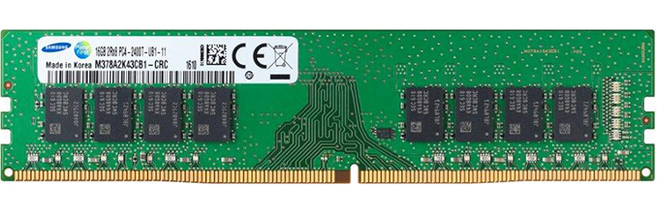
Putting it in a package

Slide 62
Other Memories
Static RAM
  Built from sequential circuits
    Takes 4-6 transistors to store 1 bit
    Fast access (< 1 ns access possible)‏
Dynamic RAM
  Built using a single transistor and a capacitor
    1’s must be refreshed often to retain value
    Slower access than static RAM
    Much more dense layout than static RAM
ROM, PROM, Flash memory, etc. Later

