Slide 1
Lecture 2
Verilog
  Structural constructs
  Describing combinational circuits
Additional references
  Tutorial and reference manual are found in ActiveHDL help
  “Starter’s Guide to Verilog 2001” by Michael Ciletti copies for borrowing in hardware lab

Slide 2
Combinational design
Step 1: Understand the problem
  Identify the inputs and outputs
  Draw a truth table
Step 2: Simplify the logic (we will get to this)
  Draw a K-map
  Write a simplified Boolean expression
    SOP or POS
    Use don’t cares
Step 3: Implement the design
  Logic gates and/or
  Verilog

Slide 3
Ways of specifying circuits
Schematics
  Structural description
  Describe circuit as interconnected elements
    Build complex circuits using hierarchy
      Large circuits are unreadable
Hardware description languages (HDLs)
  Not programming languages
    Parallel languages tailored to digital design
  Synthesize code to produce a circuit

Slide 4
Verilog versus VHDL
Both “IEEE standard” languages
Most tools support both
Verilog is “simpler”
  Less syntax, fewer constructs
VHDL is more structured
  Can be better for large, complex systems
  Better modularization

Slide 5
Simulation and synthesis
Simulation
  Models what a circuit does
    Multiply is “*”, ignoring implementation options
  Allows you to test design options
  “Execute” a design to verify correctness
Synthesis
  Converts your code to a "netlist"
    Can simulate synthesized design
  Tools map your netlist to hardware

Slide 6
Simulation and synthesis
HDL
Description
Synthesis
Gate or
Transistor
Description
Simulation and synthesis:
  We are using a simulator!
  The tool can be used to do synthesis.
Simulation
Simulation
Physical
Implementation
Functional
Validation
Functional/
Timing
Validation
Real
Chip!

Slide 7
Simulation
You provide an environment
  Using non-circuit constructs
    Active-HDL waveforms, read files, print
  Using Verilog simulation code
    A “test fixture”
Simulation
Circuit Description
(Synthesizable)
Test Fixture
(Specification)

Slide 8
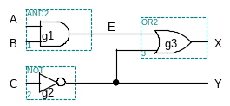
Specifying circuits in Verilog
Three major styles
  Instances and wires
  Continuous assignments
  “always” blocks
“Structural”
“Behavioral”
wire E;
and #2 g1(E,A,B);
not #1 g2(Y,C);
or #2 g3(X,E,Y);
wire E;
assign #2 E = A & B;
assign #1 Y = ~C;
assign #2 X = E | Y;
reg E, X, Y;
always @ (A or B or C)
begin
E = A & B;
Y = ~C;
X = E | Y;
end

Slide 9
Data types
Values on a wire
  0, 1, x (unknown or conflict), z (tristate or unconnected)
Vectors
  A[3:0] vector of 4 bits: A[3], A[2], A[1], A[0]
    Unsigned integer value
    Indices must be constants

Slide 10
Delays
Identified by the #<num>
  and #2 g1(E,A,B);
  Means it take 2 gate delays to assign E = A & B.
Used to determine the how long a circuit takes to saturate.

Slide 11
Manipulating vectors
Concatenating bits/vectors, use { }
  e.g. sign extend
    B[7:0] = {A[3], A[3], A[3], A[3], A[3:0]};
    B[7:0] = {4{A[3]}, A[3:0]};
Style: Use a[7:0] = b[7:0] + c[7:0] Not a = b + c;

Slide 12
Data types that do NOT exist
Structures
Pointers
Objects
Recursive types
Verilog is not C or Java or Lisp or …!

Slide 13
Numbers
Format: <sign><size><base><number>
14
  Decimal number
–4’b11
  4-bit 2’s complement binary of 0011 (is 1101)
12’b0000_0100_0110
  12 bit binary number (_ is ignored)
12’h046
  3-digit (12-bit) hexadecimal number

Slide 14
Numbers are unsigned
C[4:0] = A[3:0] + B[3:0];
  if A = 0110 (6) and B = 1010(–6), then C = 10000 (not 00000)
  B is zero-padded, not sign-extended

Slide 15
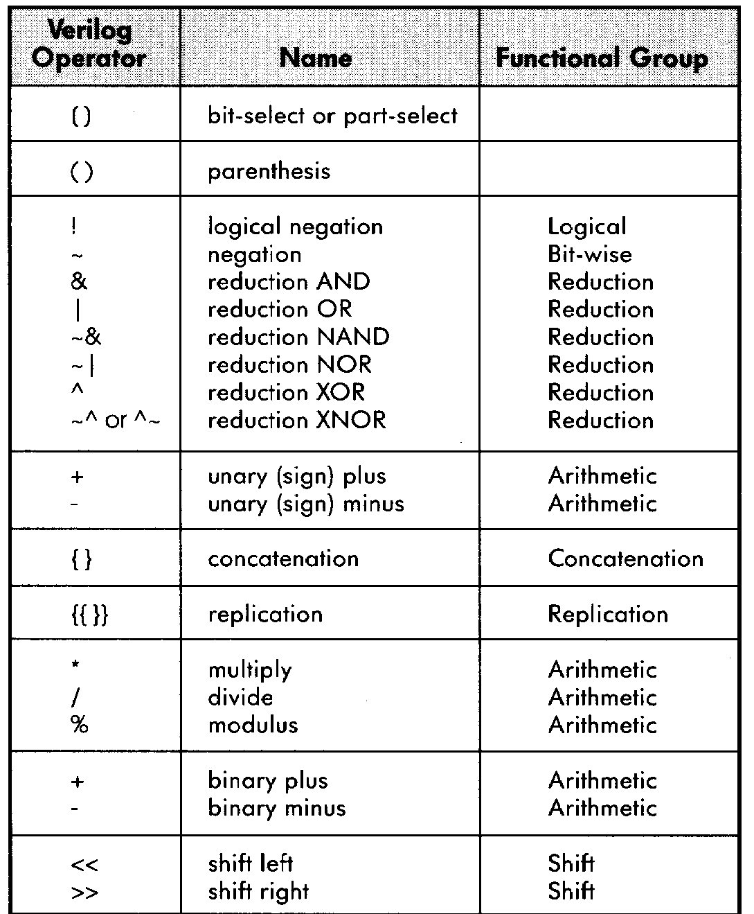
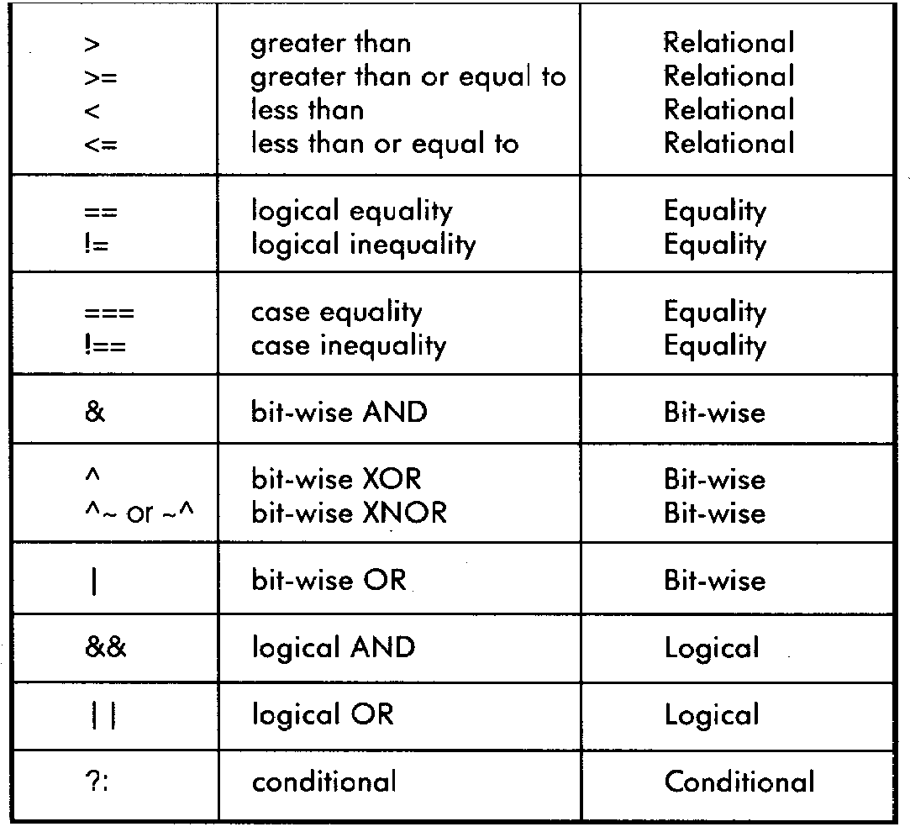
Operators
Similar to C operators

Slide 16
Two abstraction mechanisms
Modules
  More structural, but also behavioral
  Heavily used “real” Verilog code
Functions
  More behavioral
  Used to some extent in “real” Verilog

Slide 17
Basic building blocks: modules
// first simple example
module simple (A, B, C, X, Y);
input A, B, C;
output X, Y;
wire E;
and #2 g1(E, A, B);
not #1 g2(Y, C);
or #2 g3(X, E, Y);
endmodule

Slide 18
Basic building blocks: modules
Instanced into a design
  Never called
Use wires for connections
Modules execute in parallel
Gate declarations (and, or, etc)
  List outputs first
  Inputs second
Name can’t begin with a number
Names are case sensitive
Keywords are in lowercase
and, or, not are keywords
Illegal to nest module definitions
// for comments

Slide 19
Modules are circuit components
Module has ports
  External connections
  A,B,C,X,Y in example
Port types
  input
  output
  inout (tristate)
Use assign statements for Boolean expressions
  and ⇔ &
  or ⇔ |
  not ⇔ ~
// previous example as a
// Boolean expression
module simple2 (A,B,C,X,Y);
input A,B,C;
output X,Y;
assign #4 X = (A&B)|~C;
assign #1 Y = ~C;
endmodule

Slide 20
Testing your circuits
module simple_test();
reg in1, in2, in3;
wire X, Y;
simple DUT(in1, in2, in3, X, Y);
initial
begin
in1 <= 0;
in2 <= 0;
in3 <= 0;
#7
$display("X = %d, Y = %d", X, Y);
end
endmodule
Very important!
Create a test module!
  Separate file
  Compile both modules together
  Use print statements to debug.
  Common to use ‘DUT’ (Device Under Test)
  To name the module.
Use behavioral model to test
  For simplicity.

Slide 21
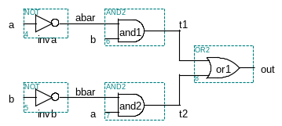
Structural Verilog
module xor_gate (a,b,out);
input a,b;
output out;
wire abar, bbar, t1, t2;
not #1 inva (abar,a);
not #1 invb (bbar,b);
and #2 and1 (t1,abar,b);
and #2 and2 (t2,bbar,a);
or #2 or1 (out,t1,t2);
endmodule
8 basic gates (keywords):
and, or, nand, nor
buf, not, xor, xnor

Slide 22
Behavioral Verilog
Describe circuit behavior
  Not implementation
A
Sum
B
Adder
Cout
Cin
module full_addr (Sum,Cout,A,B,Cin);
input A, B, Cin;
output Sum, Cout;
assign {Cout, Sum} = A + B + Cin;
endmodule
{Cout, Sum} is a concatenation

Slide 23
Behavioral 4-bit adder
module add4 (SUM, OVER, A, B);
input [3:0] A;
input [3:0] B;
output [3:0] SUM;
output OVER;
assign {OVER, SUM[3:0]} = A[3:0] + B[3:0];
endmodule
Buses are implicitly connected—
If you write BUS[3:2], BUS[1:0],
they become part of BUS[3:0]
“[3:0] A” is a 4-wire bus labeled “A”
Bit 3 is the MSB
Bit 0 is the LSB
Can also write “[0:3] A”
Bit 0 is the MSB
Bit 3 is the LSB

Slide 24
Continuous assignment
Assignment is continuously evaluated
  Corresponds to a logic gate
  Assignments execute in parallel
Boolean operators
(~ for bit-wise negation)
assign A = X | (Y & ~Z);
assign B[3:0] = 4'b01XX;
assign C[15:0] = 16'h00ff;
assign #3 {Cout, Sum[3:0]} = A[3:0] + B[3:0] + Cin;
bits can assume four values
(0, 1, X, Z)
variables can be n-bits wide
(MSB:LSB)
gate delay (used by simulator)

Slide 25
Invalid sequential assigns
assign A = X | (Y & ~Z);
assign B = W | A;
assign A = Y & Z;
“Reusing” a variable on the left
side of several assign statements
is not allowed
assign A = X | (Y & ~Z);
assign B = W | A;
assign X = B & Z;
Cyclic dependencies also are bad
A depends on X
which depends on B
which depends on A

Slide 26
Example: 4-bit comparator
module Compare1 (A, B, Equal, Alarger, Blarger);
input A, B;
output Equal, Alarger, Blarger;
wire notB, notA, AandB, NotAandB;
not #1 n1(notA, A);
not #1 n1(notB, B);
and #2 g1(AandB, A, B);
and #2 g2(NotAandB, notA, notB);
or #2 g3(Equal, AandB, NotAandB);
and #2 g4(Alarger, A, notB);
and #2 g5(Blarger, notA, B);
endmodule
Starting with 1-bit comparator
  Top-down design and bottom-up design are both okay
  Module ordering doesn’t matter because modules execute in parallel

Slide 27
4-bit comparator
// Make a 4-bit comparator from 4 1-bit comparators
module Compare4(A4, B4, Equal, Alarger, Blarger);
input [3:0] A4, B4;
output Equal, Alarger, Blarger;
wire e0, e1, e2, e3, Al0, Al1, Al2, Al3, B10, Bl1, Bl2, Bl3;
wire Al2ande3, Al1ande3ande2, Al0ande3ande2ande1;
wire NotAlarger, NotEqual;
Compare1 cp0(A4[0], B4[0], e0, Al0, Bl0);
Compare1 cp1(A4[1], B4[1], e1, Al1, Bl1);
Compare1 cp2(A4[2], B4[2], e2, Al2, Bl2);
Compare1 cp3(A4[3], B4[3], e3, Al3, Bl3);
and #4 (Equal, e0, e1, e2, e3);
not #1 (NotEqual, Equal);
and #2 (Al2ande3, Al2, e3);
and #4 (Al1ande3ande2, Al1, e3, e2);
and #4 (Al0ande3ande2ande1, Al0, e3, e2, e1);
or #4 (Alarger, Al3, Al2ande3, Al1ande3ande2, Al0ande3ande2ande1);
not #1 (NotAlarger, Alarger);
and #2 (Blarger, NotAlarger, NotEqual);
endmodule

Slide 28
Functions
Use functions for complex combinational logic
module and_gate (out, in1, in2);
input in1, in2;
output out;
assign out = myfunction(in1, in2);
function myfunction;
input in1, in2;
begin
myfunction = in1 & in2;
end
endfunction
endmodule
Benefit:
Functions force a result
⇒ Compiler will fail if function
does not generate a result

Slide 29
Always code blocks
Variables that appear on the left hand side in an always block must be declared as “reg”s
reg A, B, C;
always @ (W or X or Y or Z)
begin
A = X | (Y & ~Z);
B = W | A;
A = Y & Z;
if (A & B) begin
B = Z;
C = W | Y;
end
end
Sensitivity list:
block is executed
each time one of
them changes value
Statements in an always block are executed in sequence
BAD: All variables must be assigned on every control path!!!

Slide 30
Assignments
Blocking assignments (Q = A)
  Variable is assigned immediately
    New value is used by subsequent statements
Non-blocking assignments (Q <= A)
  Variable is assigned after all scheduled statements are executed
    Value to be assigned is computed but saved for later parallel assignment
  Usual use: Register assignment
    Registers simultaneously take new values after the clock edge

Slide 31
Blocking vs. non-blocking
Example: Swap
always @(posedge CLK)
begin
temp = B;
B = A;
A = temp;
end
always @(posedge CLK)
begin
A <= B;
B <= A;
end

Slide 32
Verilog tips
Do not write C-code
  Think hardware, not algorithms
    Verilog is inherently parallel
    Compilers don’t map algorithms to circuits well
Do describe hardware circuits
  **First draw a dataflow diagram!!!
  Then start coding

Slide 33
Verilog tips
always statement : Sequential Block
Sequential Block: All statements within the block are executed sequentially
When is it executed?
  Occurrence of an event in the sensitivity list
  Event: Change in the logical value
Statements with a Sequential Block: Procedural Assignments
Delay in Procedural Assignments
  Inter-Statement Delay
  Intra-Statement Delay

Slide 34
Verilog tips
Inter-Assignment Delay
  Example:
    Sum = A ^ B;
#2 Carry = A & B;
  Delayed execution
Intra-Assignment Delay
  Example:
Sum = A ^ B;
Carry = #2 A & B;
  Delayed assignment

Slide 35
Verilog tips
Two Procedural Constructs
initial Statement
always Statement
initial Statement : Executes only once
always Statement : Executes in a loop
Example:
  …
  always @(A or B) begin
  Sum = A ^ B;
  Carry = A & B;
  end
  …
  …
  initial begin
  Sum = 0;
  Carry = 0;
  end
  …

Slide 36
Verilog tips
always statement : Sequential Block
Sequential Block: All statements within the block are executed sequentially
When is it executed?
  Occurrence of an event in the sensitivity list
  Event: Change in the logical value
Statements with a Sequential Block: Procedural Assignments
Delay in Procedural Assignments
  Inter-Statement Delay
  Intra-Statement Delay

