Slide 1

Latches/Flip-Flops

Slide 2
Overview
We focuses on sequential circuits
  We add memory to the hardware that we’ve already seen
Our schedule will be very similar to before:
  We first show how primitive memory units are built
  Then we talk about analysis and design of sequential circuits
  We also see common sequential devices like registers and counters

Slide 3
Combinational circuits
Combinational
circuit
So far we’ve just worked with combinational circuits
  Applying the same inputs always produces the same outputs
This corresponds to a mathematical function, where every input has a
single, unique output
Inputs
Outputs

Slide 4
Sequential circuits
The outputs of a sequential circuit depend on
  inputs, and
  state (the current contents of some memory)
This makes things more difficult to understand, since the same inputs can
yield different outputs, depending on what’s stored in memory
The memory contents can also change as the circuit runs
We’ll some need new techniques for analyzing and designing sequential
circuits.
Inputs
Combinational
circuit
Outputs
Memory
(State)

Slide 5
What exactly is memory?
A memory should have at least three properties
  1. It should be able to hold a value.
  2. You should be able to read the value that was saved
  3. You should be able to change the value that’s saved
We’ll start with the simplest case, a one-bit bi-stable memory
  It should be able to hold a single bit, 0 or 1 (two possible stable states)
  2. You should be able to read the bit that was saved
  3. You should be able to change the value. Since there’s only a single bit,
  there are only two choices:
    Set the bit to 1
    Reset, or clear, the bit to 0

Slide 6
Bi-stable Binary Storage Elements
Simple Circuits with Feedback
  Primitive memory elements created from cascaded gates
  Simplest gate component: inverter
  Basis for commercial static RAM designs
  Cross-coupled NOR gates and NAND gates also possible
"1"
A
"0"
Z
Static Memory Cell
LD
A
1
s
v
Z
0

Slide 7
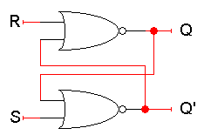
A really confusing circuit
The SR latch below has two inputs S and R, which will let us control the outputs Q and Q’
Here Q and Q’ feed back into the circuit. They’re not only outputs, they’re
also inputs!
To figure out how Q and Q’ change, we have to look at not only the inputs
S and R, but also the current values of Q and Q’:
Q_{next} = (R + Q’_{current})’
Q’_{next} = (S + Q_{current})’
Let’s see how different input values for S and R affect this thing
Q: 1-bit state variable

Slide 8
Storing a value: SR = 00
What if S = 0 and R = 0?
The equations on the right reduce to:
Q_{next} = (0 + Q’_{current})’ = Q_{current}
Q’_{next} = (0 + Q_{current})’ = Q’_{current}
So when SR = 00, then Q_{next} = Q_{current}.
Whatever value Q has, it keeps
This is exactly what we need to store values in the latch.
Q_{next} = (R + Q’_{current})’
Q’_{next} = (S + Q_{current})’

Slide 9
Setting the latch: SR = 10
What if S = 1 and R = 0?
Since S = 1, Q’_{next} is 0, regardless of Q_{current}:
Q’_{next} = (1 + Q_{current})’ = 0
Then, this new value of Q’ goes into the top
NOR gate, along with R = 0.
Q_{next} = (0 + 0)’ = 1
So when SR = 10, then Q’_{next} = 0 and Q_{next} = 1
This is how you set the latch to 1. The S input
stands for “set”
Notice that it can take up to two steps (two
gate delays) from the time S becomes 1 to the
time Q_{next} becomes 1
But once Q_{next} becomes 1, the outputs will stop
changing. This is a stable state
Q_{next} = (R + Q’_{current})’
Q’_{next} = (S + Q_{current})’

Slide 10
Resetting the latch: SR = 01
What if S = 0 and R = 1?
Since R = 1, Q_{next} is 0, regardless of Q_{current}:
Q_{next} = (1 + Q’_{current})’ = 0
Then, this new value of Q goes into the bottom NOR gate, where S = 0
Q’_{next} = (0 + 0)’ = 1
So when SR = 01, then Q_{next} = 0 and Q’_{next} = 1
This is how you reset, or clear, the latch to 0. The R input stands for “reset”
Again, it can take two gate delays before a change in R propagates to the output Q’_{next}
Q_{next} = (R + Q’_{current})’
Q’_{next} = (S + Q_{current})’

Slide 11
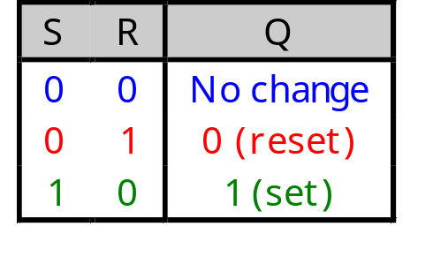
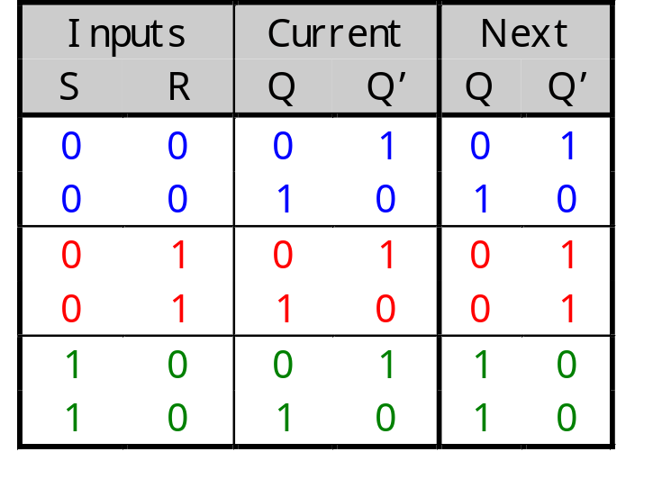
SR latches are memories!
This little table shows that our latch provides everything we need in a memory: we can set it, reset it, and remember the current value.
The output Q represents the data stored in the latch, which is called as the state of the latch.
We can expand the table above into a state table, which explicitly shows that the next values of Q and Q’ depend on their current values, as well as on the inputs S and R.

Slide 12
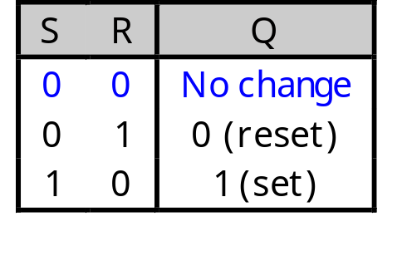
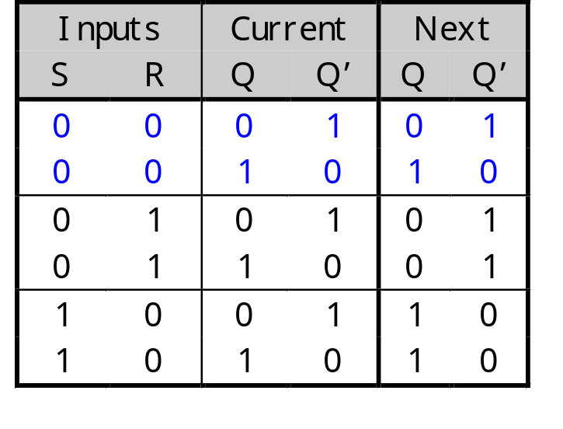
SR latches are sequential!
Notice that for inputs SR = 00, the next value of Q could be either 0 or 1, depending on the current value of Q
So the same inputs can yield different outputs, depending on whether the latch was previously set or reset
This is very different from the combinational circuits that we’ve seen so far, where the same inputs always yield the same outputs.

Slide 13
What about SR = 11?
Both Q_{next} and Q’_{next} will become 0
This contradicts the assumption that Q and Q’ are always complements
Another problem is what happens if we then make S = 0 and R = 0 together.
Q_{next} = (0 + 0)’ = 1
Q’_{next} = (0 + 0)’ = 1
But these new values go back into the NOR gates, and in the next step we get:
Q_{next} = (0 + 1)’ = 0
Q’_{next} = (0 + 1)’ = 0
The circuit enters an infinite loop, where Q and Q’ cycle between 0 and 1 forever
This is actually the worst case, but the moral is don’t ever set SR=11!
Q_{next} = (R + Q’_{current})’
Q’_{next} = (S + Q_{current})’
0
0
0
0
0
1
0
1

Slide 14

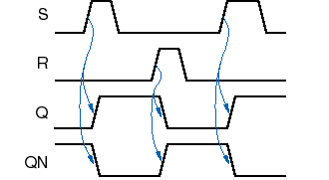
SR Latch Timing Diagram
Metastable
State

Slide 15
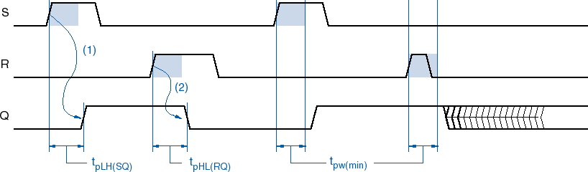
SR Latch Timing Parameters
Propagation delays – t_{pLH(SQ)}, t_{pHL(RQ)}
Minimum pulse width – t_{pw(min)}

Slide 16


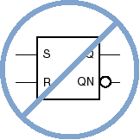

SR Latch Symbols

Slide 17
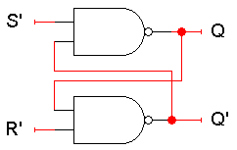

S’R’ latch
Q_{next} = (S’ . Q’_{current})’
Q’_{next} = (R’ . Q_{current})’
S’ | R’ | Q_{curr} | Q’_{curr} | (S’.Q’_{curr})’ | (R’.Q_{curr})’ | Q_{next}
1 | 1 | x | x’ | x | x’ | No change
1 | 0 | x | x’ | (1 . 1)’ | 1 | 0 (reset)
0 | 1 | x | x’ | 1 | (1 . 1)’ | 1 (set)
0 | 0 | Avoid

Slide 18
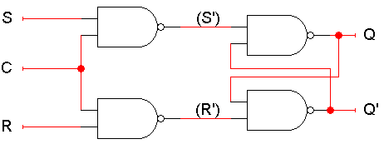
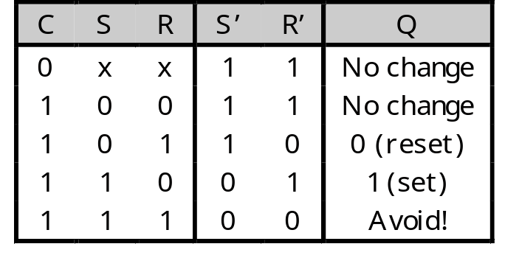
An SR latch with a control input
Here is an SR latch with a control input C
Notice the hierarchical design!
  The dotted blue box is the S’R’ latch from the previous slide
  The additional NAND gates are simply used to generate the correct inputs for the S’R’ latch
The control input acts just like an enable

Slide 19
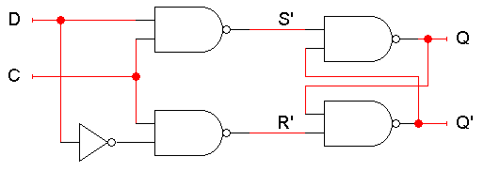
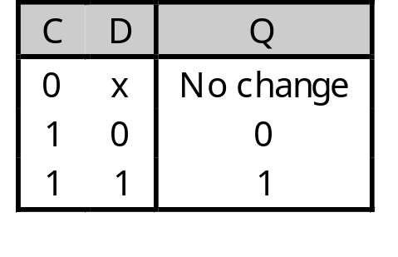
D latch
A D latch is based on an S’R’ latch.
The additional gates generate the S’ and R’ signals, based on inputs D (“data”) and C (“control”)
  When C = 0, S’ and R’ are both 1, so the state Q does not change
  When C = 1, the latch output Q will equal the input D
No more messing with one input for set and another input for reset!
Also, this latch has no “bad” input combinations to avoid. Any of the four possible assignments to C and D are valid.

Slide 20
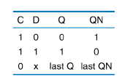
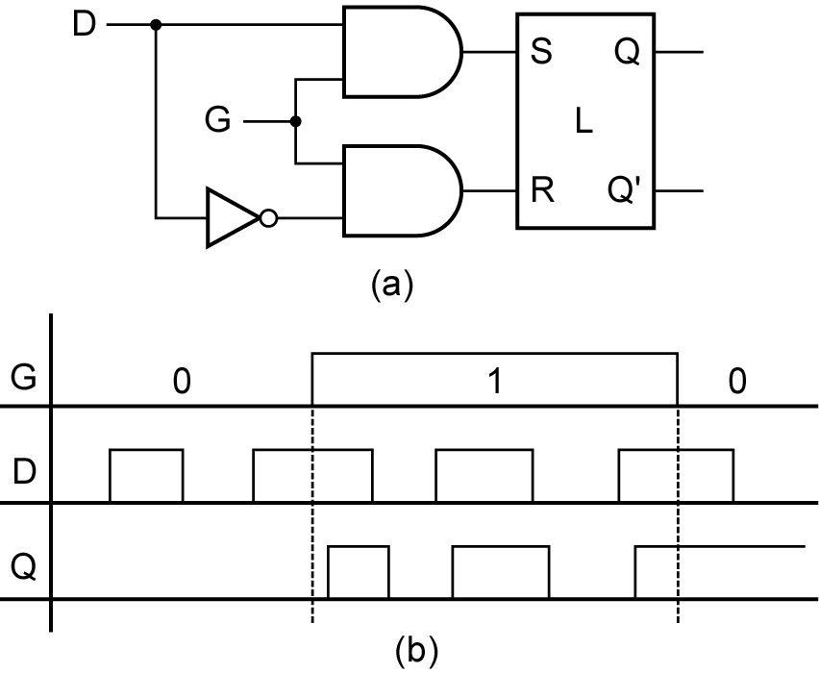
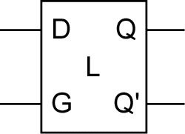
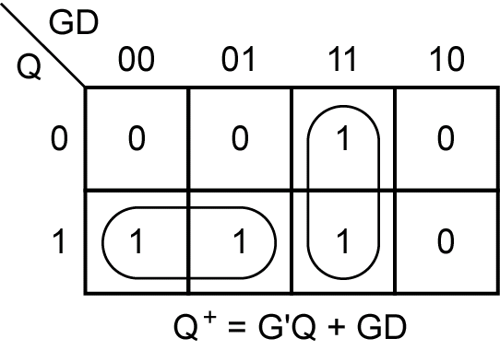
D-Latch with Gated SR-Latch
=

Slide 21
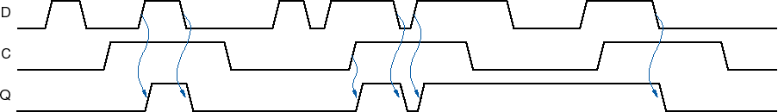
D latch Operation

Slide 22
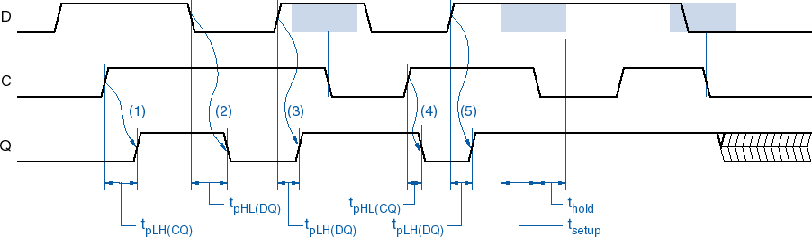
D-latch timing parameters
Propagation delay (from C or D) - t_{pLH(CQ)}, t_{pLH(DQ)}, t_{pHL(CQ)}, t_{pHL(DQ)}
Setup time (D before C edge) - t_{hold}
Hold time (D after C edge) - t_{setup}
Metastable
State

Slide 23
Summary
A sequential circuit has memory. It may respond differently to the same
inputs, depending on its current state
Memories can be created by making circuits with feedback
  Latches are the simplest memory units, storing individual bits
Next, we’ll improve upon latches with flip-flops.

Slide 24
Flip-Flops
A bistable memory device is the generic term for the elements we are studying
  Two possible states, 0 and 1
  Its state is readable
  Its state is changable
Bistable memory devices:
  Latch: Device with level sensitive triggering (no clock)
  Flip-flop: Device with edge-triggering (with clock)

Slide 25
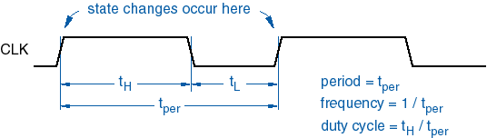
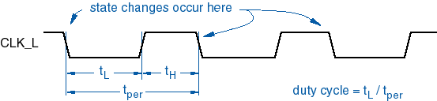
Clock signals
Very important with most sequential circuits
  State variables change state at clock edge
  Active high clock signal: State change occurs at the clock rising edge
  Active low clock signal: State change occurs at the clock falling edge

Slide 26
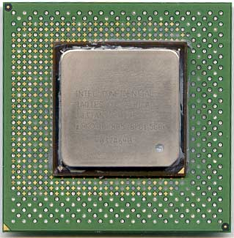
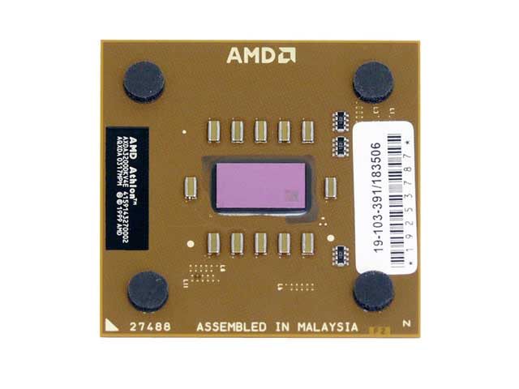
More about clocks
Clocks are used extensively in computer architecture
All processors run with an internal clock
  Modern chips run at frequencies up to 3.2 GHz.
  This works out to a cycle time as little as 0.31 ns!
Memory modules are often rated by their clock speeds
too—examples include “PC133” and “DDR400” memory
Be careful...higher frequencies do not always mean faster machines!
  You also have to consider how much work is actually being done during each clock cycle
  How much stuff can really get done in just 0.31 ns?

Slide 27
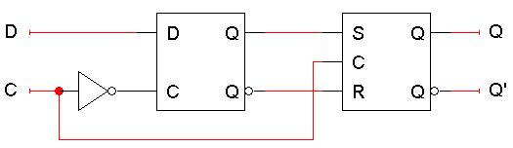
Positive-edge triggered D flip-flop
The flip-flop inputs are C and D, and the outputs are Q and Q
Master-slave structure:
  D latch on the left is the master,
  SR latch on the right is called the slave
Note the layout here
  The flip-flop input D is connected directly to the master latch
  The master latch output goes to the slave
  The flip-flop outputs come directly from the slave latch

Slide 28
D flip-flop when C=0
The D flip-flop’s control input C enables either the D latch or the SR latch, but not both
When C = 0:
  The master latch is enabled, and it monitors the flip-flop input D. Whenever D changes, the master’s output changes too
  The slave is disabled, so the D latch output has no effect on it. Thus, the slave just maintains the flip-flop’s current state

Slide 29
D flip-flop when C=1
As soon as C becomes 1, (i.e. on the rising edge of the clock)
  The master is disabled. Its output will be the last D input value seen just before C became 1
  Any subsequent changes to the D input while C = 1 have no effect on the master latch, which is now disabled
  The slave latch is enabled. Its state changes to reflect the master’s output, which again is the D input value from right when C became 1

Slide 30
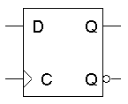
Positive edge triggering
This is called a positive edge-triggered flip-flop
  The flip-flop output Q changes only after the positive edge of C
  The change is based on the flip-flop input values that were present right at the positive edge of the clock signal
The D flip-flop’s behavior is similar to that of a D latch except for the positive edge-triggered nature, which is not explicit in this table
Edge-trigger
clock symbol
C
D
Q
0
x
No change
0
0 (reset)
1
1 (set)

Slide 31


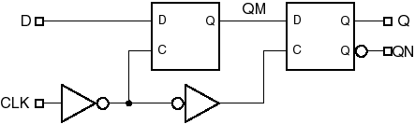
Edge-triggered D flip-flop behavior

Slide 32
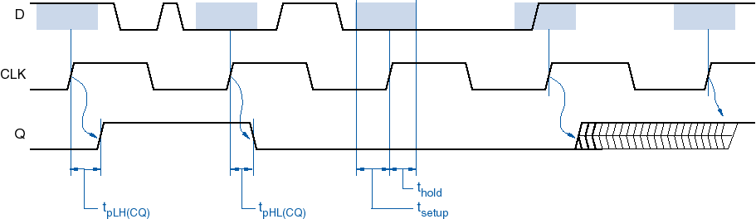
D flip-flop timing parameters
Propagation delay (from CLK) - t_{pLH(CQ)}, t_{pHL(CQ)}
Setup time (D before CLK) - t_{setup}
Hold time (D after CLK) - t_{hold}
Metastable
State

Slide 33
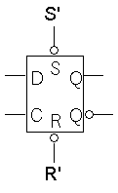
Direct inputs
One last thing to worry about… what is the starting value of Q?
We could set the initial value synchronously, at the next positive clock edge, but this actually makes circuit design more difficult
Instead, most flip-flops provide direct, or asynchronous, inputs that let you immediately set or clear the state
  You would “reset” the circuit once, to initialize the flip-flops
  The circuit would then begin its regular, synchronous operation
S’
R’
C
D
Q
0
0
x
x
Avoid!
0
1
x
x
1 (set)
Direct inputs to set or reset the flip-flop
1
0
x
x
0 (reset)
1
1
0
x
No change
S’R’ = 11 for “normal” operation of the D flip-flop
1
1
0
0 (reset)
1
1
1
1 (set)

Slide 34
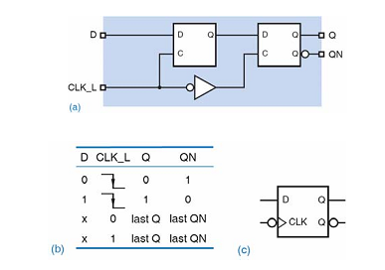
Negative-edge triggered D flip-flop

Slide 35
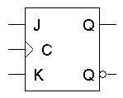
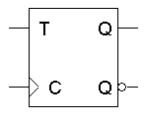
Flip-flop variations
We can make different versions of flip-flops based on the D flip-flop,
just like we made different latches based on the S’R’ latch
A JK flip-flop has inputs that act like S and R, but the inputs JK=11 are used to complement the flip-flop’s current state
A T flip-flop can only maintain or complement its current state.
C
J
K
Q
next
0
x
x
No change
0
0
No change
0
1
0 (reset)
1
0
1 (set)
1
1
Q’
current
C
T
Q
next
0
x
No change
0
No change
1
Q’
current

Slide 36
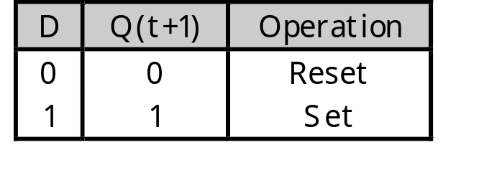
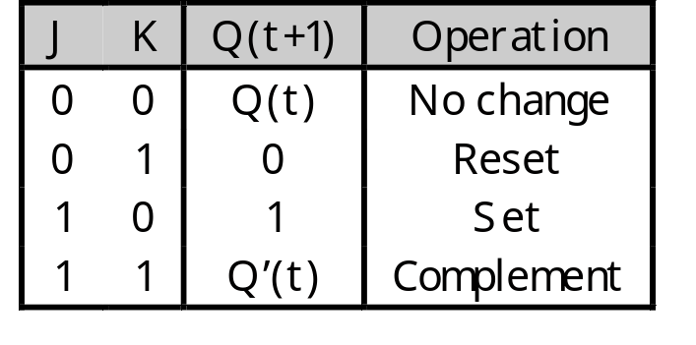
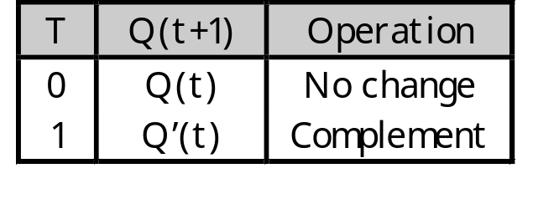
Characteristic tables
The tables that we’ve made so far are called characteristic tables
  Q(t+1) = f(Q(t), inputs)
    Current state: Q(t)
    Next state: Q(t+1)
  For simplicity, the control input C is not usually listed.
  Again, these tables don’t indicate the positive edge-triggered behavior of the flip-flops that we’ll be using.

Slide 37
Characteristic equations
We can also write characteristic equations, where the next state Q(t+1) is defined in terms of the current state Q(t) and inputs
Q(t+1) = D
Q(t+1) = K’Q(t) + JQ’(t)
Q(t+1) = T’Q(t) + TQ’(t)
= T ⊕ Q(t)

Slide 38
Flip flop timing diagrams
“Present state” and “next state” are relative terms
In the example JK flip-flop timing diagram on the left, you can see that at the first positive clock edge, J=1, K=1 and Q(1) = 1
We can use this information to find the “next” state, Q(2) = Q(1)’
Q(2) appears right after the first positive clock edge, as shown on the right. It will not change again until after the second clock edge
1 2 3 4
1 2 3 4
C
J
K
Q
C
J
K
Q
These values at clock cycle 1...
… determine the “next” Q

Slide 39
“Present” and “next” are relative
Similarly, the values of J, K and Q at the second positive clock edge can be used to find the value of Q during the third clock cycle
When we do this, Q(2) is now referred to as the “present” state, and Q(3) is now the “next” state
1 2 3 4
1 2 3 4
C
J
K
Q
C
J
K
Q

