Slide 1

330 Computer Architecture
Basic Processor Design:
Finite State Machines

Slide 2
Processors
General purpose processors
  Good for most tasks, maybe overkill for some, too slow for others
  Programmable control (defined by machine instructions in memory)
Special purpose processors
  Necessary for applications with non-standard requirements
    Very high performance, regular tasks (graphics)
    Very low power and/or cost (watch)
  Special purpose may or may not be programmable

Slide 3
Special Purpose Controller
This lecture:
  Design a non-programmable controller
  Implement it using the components from last lecture
Next lecture:
  Design a general purpose processor
  Implement it using the components from last lecture

Slide 4
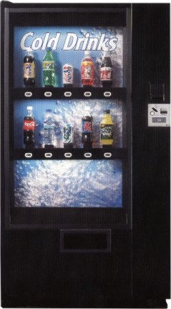
A simple device
Build a custom controller
for a vending machine.
We could use a general
purpose processor, but
we might save money
with a custom controller.
Take coins, give drinks

Slide 5
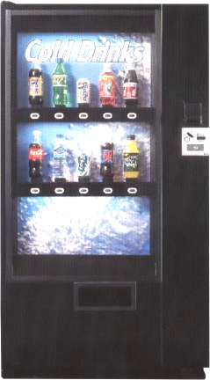
Input and Output
Inputs:
coin trigger
refund button
10 drink selectors
10 pressure sensors
Outputs:
10 drink release latches
Coin refund latch

Slide 6
Operation of Machine
Accepts quarters only
All drinks are $0.75
Once we get the money,
they can select a drink.
If they want a refund,
release any coins inserted
No free drinks!
No stealing money!

Slide 7
Building the controller
Finite State
  Remember how many coins have been put in the machine and what inputs are acceptable
Read-Only Memory (ROM)
  Define the outputs and state transitions
Custom combinational circuits
  Reduce the size (and therefore cost) of the controller

Slide 8
Finite State Machines
A Finite State Machine (FSM) consists of:
  K states: S = {s₁, s₂, … ,s_{k}}, s₁ is initial state
  N inputs: I = {i₁, i₂, … ,i_{n}}
  M outputs: O = {o₁, o₂, … ,o_{m}}
  Transition function T(S,I) mapping each current state and input to next state
  Output Function P(S) [or P(S,I)] specifies output

Slide 9
Two common state machines
Moore machine
output function based on current state only
Mealy machine
output function based on current state and current input

Slide 10
FSM for vending machine
0 coins
1 coin
3 coins
2 coins
Ran out of specific drink selection
Coin trigger
Refund button
Drink Select

Slide 11
Implementing FSM
Outputs
Implement
transition
functions
(using a ROM and
combinational circuits)
Inputs
Current state
D
Q
Next state
D
Q
2-bit state

Slide 12
ROMs and PROMs
Read Only Memory
  Array of memory values that are constant
  Non-volatile
Programmable Read Only Memory
  Array of memory values that can be written exactly once (destructive writes)
You can use ROMs to implement FSM transition functions
  ROM inputs: ROM address ; current state + primary inputs
  ROM outputs: ROM data ; next state + primary outputs

Slide 13
Some of the ROM contents
Current state | Coin trigger | Drink select | Refund button
0 0 | 0 | 0 | 0
0 0 | 0 | 0 | 1
0 0 | 0 | 1 | 0
0 0 | 1 | 0 | 0
0 1 | 1 | 0 | 0
1 0 | 1 | 0 | 0
1 1 | 0 | 1 | 0
1 1 | 1 | 0 | 0
24 more entries (fill em in?)
Next state | Coin release | Drink release
0 0 | 0 | 0
0 0 | 1 | 0
0 0 | 0 | 0
0 1 | 0 | 0
1 0 | 0 | 0
1 1 | 0 | 0
0 0 | 0 | 1
0 0 | 1 | 0
24 more entries
ROM address (current state + inputs)
ROM contents (next state + outputs)

Slide 14
8-entry 4-bit ROM
address
3x8
Decoder
0
1
A₀
1
A₁
0
diode
A₂
3
7
D₀
1
D₁
0
D₂
0
D₃
1
data

Slide 15
ROM for vending machine controller
Use current state and inputs as address
  2 state bits + 22 inputs = 24 bits (address)
Read next state and outputs from ROM
  2 state bits + 11 outputs = 13 bit (memory)
We need 2²⁴ entry 13 bit ROM memories
  218,103,808 bits! of ROM seems excessive for our cheap controller

Slide 16
Reducing the ROM needed
Replace 10 selector inputs and 10 pressure inputs with a single bit input (drink selected)
  Use drink selection input to specify which drink release latch to activate
  Only allow trigger if pressure sensor indicates that there is a bottle in that selection. (10 2-bit ANDs)
Now:
  2 current state bits + 3 input bits (5 bit ROM address)
  2 next state bits + 2 control trigger bits (4 bit memory)
  2⁵ × 4 = 128 bit ROM (good!)

Slide 17



Putting it all together
Drink selector
Pressure Sensor
Drink Release
10 input
OR gate
32
5×32 decoder
Drink
Release
Latches
refund
D Q
Coin release
D Q
coin
Clock/Event
2-bit state

Slide 18
Limitations of controller
What happens if we make the price $1.00?
  Must redesign the controller (more state)
  A programmable processor only needs a software upgrade.
What do we need to do to allow other coins?
What happens if someone hits two drink selections at once?
  How do we fix that?

