Slide 1
Combinational Logic Design-
Arithmetic Operation
(Slides taken from someone who didn’t put their name on it.)

Slide 2
Overview
Binary Addition
  Half Adder
  Full Adder
  Ripple Carry Adder(并行加法器)
  Carry Look ahead Adder(超前进位加法器)

Slide 3
1-bit Adder
Performs the addition of two binary bits.
Four possible operations:
  0+0=0
  0+1=1
  1+0=1
  1+1=10
Circuit implementation requires 2 outputs; one to indicate the sum and another to indicate the carry.

Slide 4
Half Adder
Performs 1-bit addition.
Inputs: A₀, B₀
Outputs: S₀, C₁
Index indicates significance,
0 is for LSB and 1 is for the
next higher significant bit.
Boolean equations:
  S₀ = A₀B₀’+A₀’B₀ = A₀ ⊕ B₀
  C₁ = A₀B₀
Truth Table
A₀
B₀
S₀
C₁
0
0
0
0
0
1
1
0
1
0
1
0
1
1
0
1

Slide 5
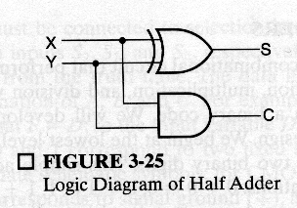
Half Adder (cont.)
S₀ = A₀B₀’+A₀’B₀ = A₀⊕ B₀
C₁ = A₀B₀
Block Diagram
Logic Diagram
A₀
B₀
A₀
S₀
1 bit
half adder
B₀
C₁
C₁
S₀

Slide 6
n-bit Addition
Design an n-bit binary adder which performs the addition of two n-bit binary numbers and generates a n-bit sum and a carry out.
Example: Let n=4
C_{out} C₃ C₂ C₁ C₀ 1 1 0 1 0
A₃ A₂ A₁ A₀ 1 1 0 1
+ B₃ B₂ B₁ B₀ +1 1 0 1
--------------------- ----------
S₃ S₂ S₁ S₀ 1 0 1 0

Slide 7
Full Adder
Full adder (for higher-order bit addition)
Combinational circuit that performs the additions of 3 bits (two bits and a carry-in bit)
A_{i}
B_{i}
1 bit
full adder
C_{i+1}
C_{i}
S_{i}

Slide 8
Full Adder (cont.)
The K-maps for
  C_{i+1}:
  S_{i}:
A_{i}
B_{i}
C_{i}
S_{i}
C_{i+1}
B_{i}C_{i}
A_{i}
0
0
0
0
0
0
0
1
0
0
0
1
1
0
0
1
1
1
0
1
0
1
0
0
1
1
0
1
1
0
0
1
0
B_{i}C_{i}
1
0
1
0
1
A_{i}
0
1
0
1
1
1
0
0
1
1
1
1
1
1
1
0
1
0

Slide 9
Full Adder (cont.)
Boolean equations:
  C_{i+1} = A_{i}B_{i} + A_{i}C_{i} + B_{i}C_{i}
  S_{i} = A_{i}B_{i}’ C_{i}’ + A_{i}’B_{i}’C_{i} + A_{i}’B_{i}C_{i}’ + A_{i}B_{i}C_{i}
  = A_{i} ⊕ B_{i} ⊕ C_{i}
You can design full adder circuit directly from the above equations (requires 3 ANDs and 1 OR for C_{i+1} and 2 XORs for S_{i})

Slide 10
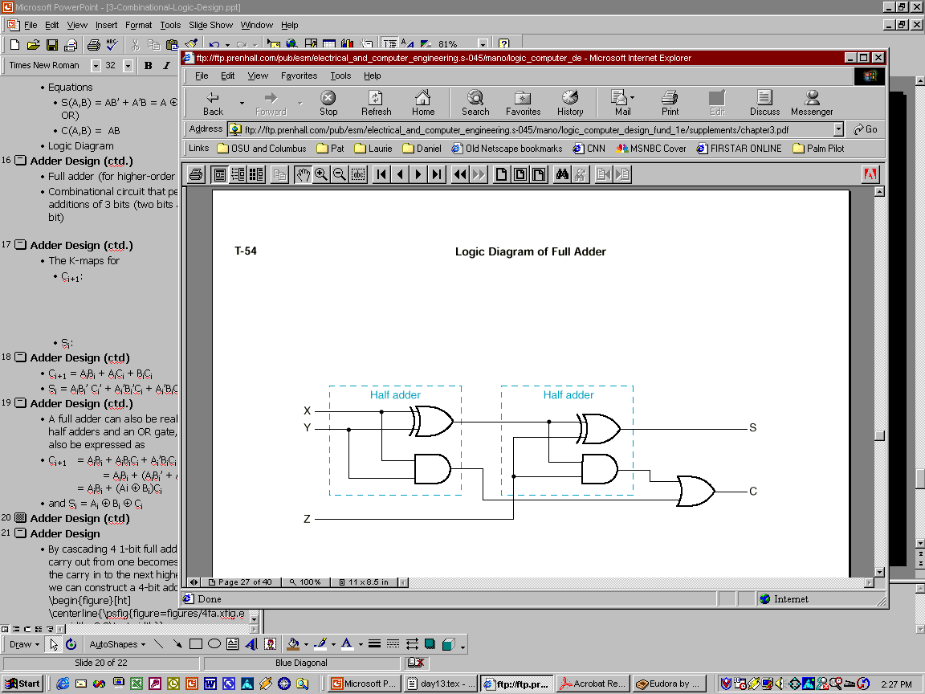
Full Adder using 2 Half Adders
A full adder can also be realized with two half adders and an OR gate, since C_{i+1} can also be expressed as:
C_{i+1} = A_{i}B_{i} + A_{i}B_{i}’C_{i} + A_{i}’B_{i}C_{i}
= A_{i}B_{i} + (A_{i}B_{i}’ + A_{i}’B_{i})C_{i}
= A_{i}B_{i} + (A_{i} ⊕ B_{i})C_{i}
and S_{i} = A_{i} ⊕ B_{i} ⊕ C_{i}
A_{i}
B_{i}
S_{i}
C_{i+1}
C_{i}

Slide 11
n-bit Combinational Adders
Perform parallel multi-bit addition
Ripple Carry Adder (并行加法器)
  Simple design
  Time consuming. Why? (you’ll see in a bit!)
Carry Look ahead Adder (超前进位加法器)
  More complex than ripple-carry adder
  Reduces circuit delay

Slide 12
n-bit Ripple Carry Adder
Constructed using n 1-bit full adder blocks in parallel.
Cascade the full adders so that the carry out from one becomes the carry in to the next higher bit position.

Slide 13
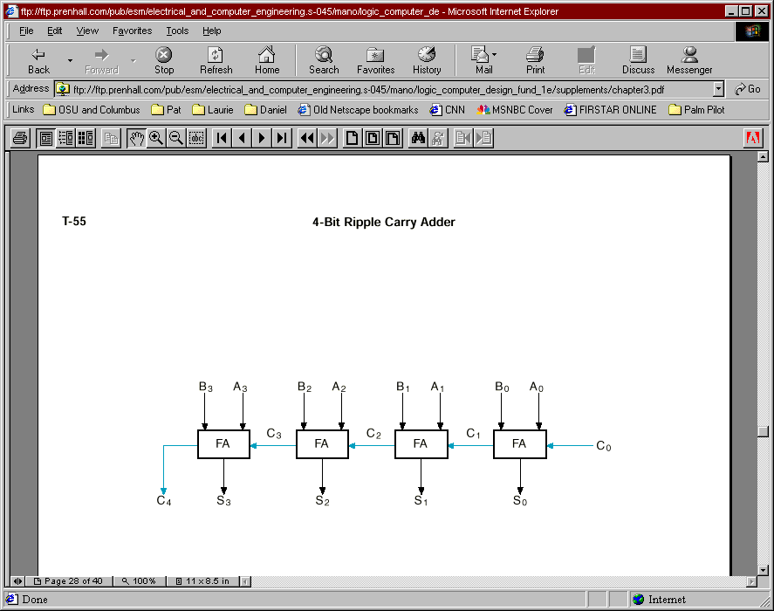
Example: 4-bit Ripple Carry Adder
C₄ C3 C2 C1 C0
A3 A2 A1 A0
+B3 B2 B1 B0
--------------
S3 S2 S1 S0

Slide 14
Ripple Carry Adder Delay
Circuit delay in an n-bit ripple carry adder is determined by the delay on the carry path from the LSB (C₀) to the MSB (C_{n}).
Let the delay in a 1-bit FA be Δ. Then, the delay of an n-bit ripple carry adder is nΔ.

Slide 15
Carry Look ahead Adder
Alternative design for a combinational n-bit adder.
Practical design with reduced delay at the expense of more complex hardware.
Derived from a transformation of the ripple carry adder design.

Slide 16
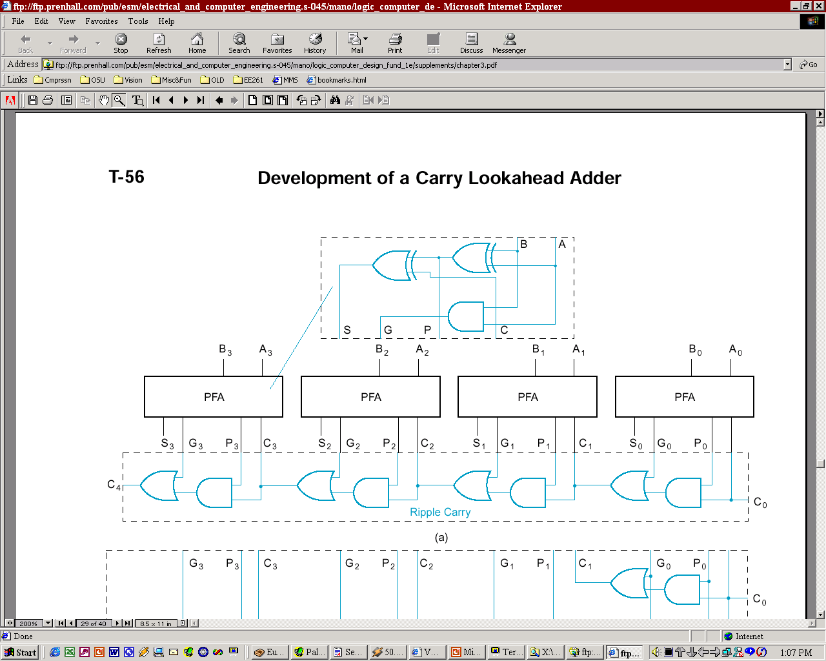
Carry Lookahead Adder Design
From a FA, separate between carry generation (a new carry signal is generated, i.e. C_{out}=1) and carry propagation (an existing C_{in} is propagated to C_{out})
Generate: G_{i} = A_{i}B_{i}: if 1, C_{i+1}=1
Propagate: P_{i} = A_{i} ⊕ B_{i}: if 1, C_{i+1} = C_{i}
Full Adder (FA)
Partial Full Adder (PFA)
B_{i}
A_{i}
A_{i}
B_{i}
S_{i}
C_{i+1}
C_{i}
S_{i}
G_{i}
P_{i}
C_{i}

Slide 17
Carry Lookahead Adder Design (cont.)
C_{i+1} = G_{i} + P_{i}C_{i}
PFA design breaks S functionality apart from G/P functionality

Slide 18
Carry Look ahead Adder (cont.)
Does this (design in previous slide) solve the long delay problem?
No, carry out still “ripples” !
Idea: use two levels of logic to generate carry out of any block C_{i} in terms of carry in C₀ and addend bits A_{i} and B_{i}

Slide 19
Block CLA
Implement:
  C₁ = G₀+P₀ C₀
  C₂ = G₁+P₁C₁ = G₁+P₁(G₀+P₀C₀) = G₁+P₁G₀+P₁P₀C₀
  C₃ = G₂ + P₂C₂ = G₂+P₂G₁+P₂P₁G₀+P₂P₁P₀C₀
  C₄ = G₃+P₃G₂+P₃P₂G₁+P₃P₂P₁G₀ + P₃P₂P₁P₀ C₀
  = G₀₋₃ + P₀₋₃C₀
Group carry generate
Group carry propagate

Slide 20
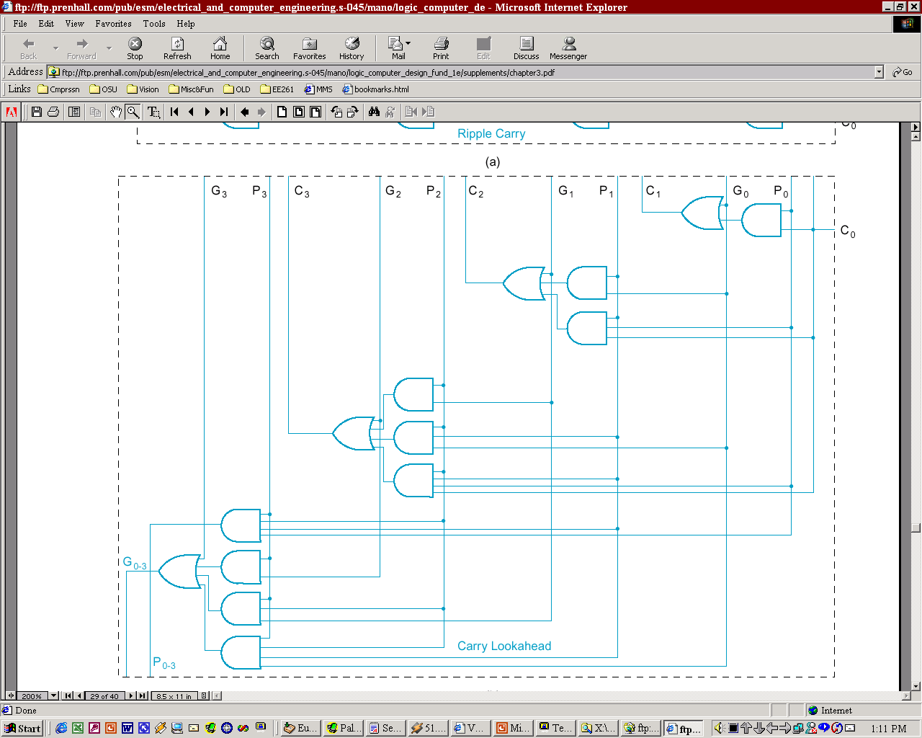
Generate/Propagate logic of a 4-bit CLA
-- C₀ … C_{n-1} have a
2-gates delay
-- C₄ = G₀₋₃+P₀₋₃C₀
has a 3-gates delay

