Slide 1
Introduction to X86 assembly
Dr. Paul West
Slides adapted from Istvan Haller

Slide 2
Whats next?
From previous (FSM) lecture, we need to be programmable.
How?
Numerous options
Instead of analysis, lets just learn what people chose to do.
Let watch what actually happens under to hood when we compile something.
Note: ALL languages do the following at some point.

Slide 3
Step 1: C Hello World Program
#include <stdio.h>
int main(int argc, char **argv)
{
printf("Hello world\n"); return 0;
}

Slide 4
Step 2: Compile to assembly
gcc -S -masm=intel -m32
-S : Generates assembly instead of object file
-masm=intel : Generate Intel syntax
-m32 : Generate legacy 32-bit version

Slide 5
Step 3: Look at assembly
.file "hello.c"
.text
.section .rodata
.LC0:
.string "Hello World!"
.text
.globl main
.type main, @function
main:
.LFB0:
.cfi_startproc
pushq %rbp
.cfi_def_cfa_offset 16
.cfi_offset 6, -16
movq %rsp, %rbp
.cfi_def_cfa_register
Confusing, right?

Slide 6
Step 4: Link it!
gcc hello.o
./hello

Slide 7
Take aways
The assembly is the interface between the programming language and the hardware.
The assembler (as/nasm) translates from assembly to machine code.
The linker (ld/gcc) packages the machine code so the OS can run your program.
Every language must assemble & link at some point.

Slide 8
Assembly syntax: AT&T vs Intel
MOV Reg1, Reg2
What is going on here?
Which is source, which is destination?

Slide 9
Identifying syntax
Intel: MOV dest, src
AT&T: MOV src, dest
How to find out by yourself?
Search for constants, read-only elements (arguments on the stack), match them as source
IdaPro, Windows uses Intel syntax
objdump and Unix systems prefer AT&T

Slide 10
Numerical representation
Binary (0, 1): 10011100
Prefix: 0b10011100 ← Unix (both Intel and AT&T)
Suffix: 10011100b ← Traditional Intel syntax
Hexadecimal (0 … F): “0x” vs “h”
Prefix: 0xABCD1234 ← Easy to notice
Suffix: ABCD1234h ← Is it a number or a literal?

Slide 11
Which syntax to use?
Don’t get stuck on any syntax, adapt
Quickly identify syntax from existing code
Every assembler has unique syntactic sugaring
Practice makes perfect
These lectures assume traditional Intel syntax
IdaPro + NASM

Slide 12
Hello World in NASM
section .text
global _start ;must be declared for linker (ld)
_start:
mov edx,len ;message length
mov ecx,msg ;message to write
mov ebx,1 ;file descriptor (stdout)
mov eax,4 ;system call number (sys_write)
int 0x80 ;call kernel
mov eax,1 ;system call number (sys_exit)
int 0x80 ;call kernel
section .data
msg db 'Hello, world!', 0xa ;our message to the world (string)
len equ $ - msg ;length of our string

Slide 13
Traditional Registers in X86
General Purpose Registers
AX, BX, CX, DX
Pseudo General Purpose Registers
Stack: SP (stack pointer), BP (base pointer)
Strings: SI (source index), DI (destination index)
Special Purpose Registers
IP (instruction pointer) and EFLAGS

Slide 14
GPR usage
Legacy structure: 16 bits
8 bit components: low and high bytes
Allow quick shifting and type enforcement
AX ← Accumulator (arithmetic)
BX ← Base (memory addressing)
CX ← Counter (loops)
DX ← Data (data manipulation)

Slide 15
Modern extensions
“E” prefix for 32 bit variants → EAX, ESP
“R” prefix for 64 bit variants → RAX, RSP
Additional GPRs in 64 bit: R8 →R15

Slide 16

Endianness
King of Lilliput ordered Little Endian.
Big Endians had to take refuge on the island of Blefuscu.
(satire) but we now have both on computers.

Slide 17
Endianness
Memory representation of multi-byte integers
For example the integer: 0A0B0C0Dh (hexa)
Big-endian↔highest order byte first (not math)
0A 0B 0C 0D
Little-endian↔lowest order byte first (X86, like math)
0D 0C 0B 0A
Important when manually interpreting memory
Bit-Endian is network byte order… =(

Slide 18
Endianness in pictures

Slide 19
Operands in X86
Register: MOV EAX, EBX
Copy content from one register to another
Immediate: MOV EAX, 10h
Copy constant to register
Memory: different addressing modes
Typically at most one memory operand
Complex address computation supported

Slide 20
Addressing modes
Direct: MOV EAX, [10h]
Copy value located at address 10h
Indirect: MOV EAX, [EBX]
Copy value pointed to by register BX
Indexed: MOV AL, [EBX + ECX * 4 + 10h]
Copy value from array (BX[4 * CX + 0x10])
Pointers can be associated to type
MOV AL, byte ptr [BX]

Slide 21
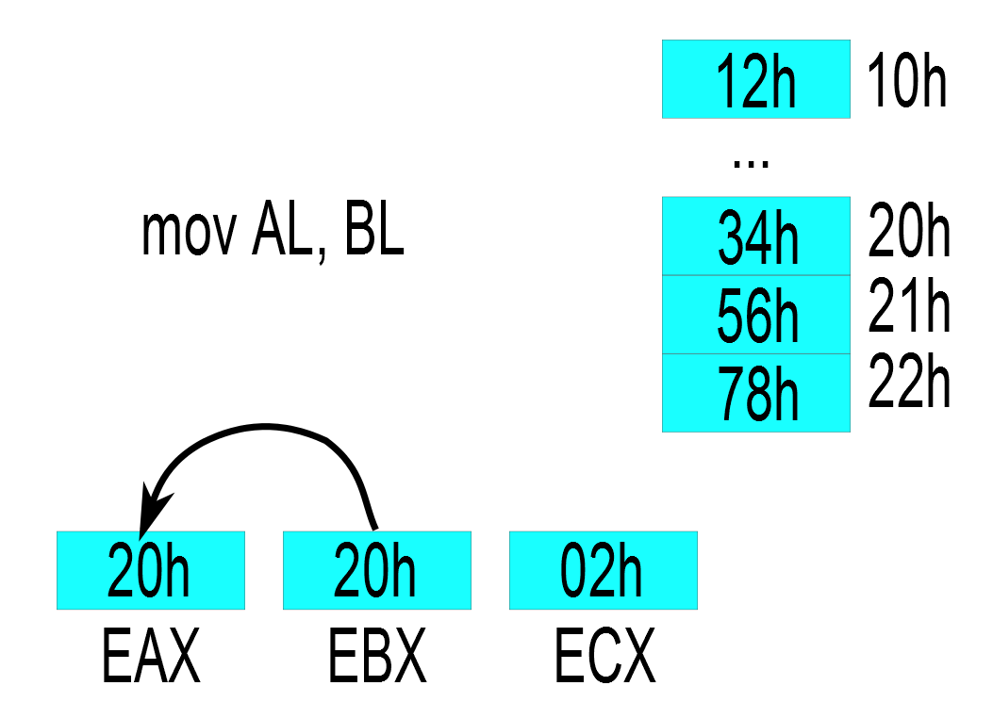
Operands and addressing modes: Register

Slide 22
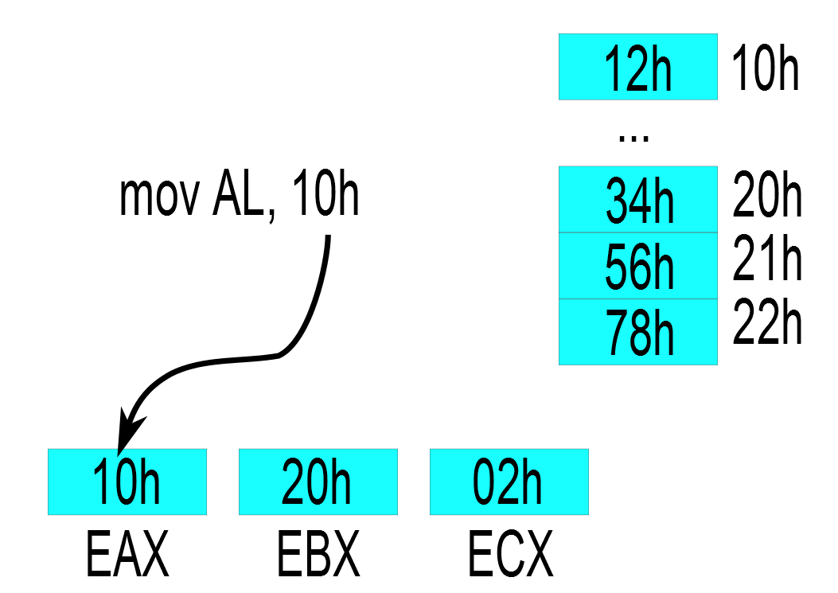
Operands and addressing modes: Immediate

Slide 23
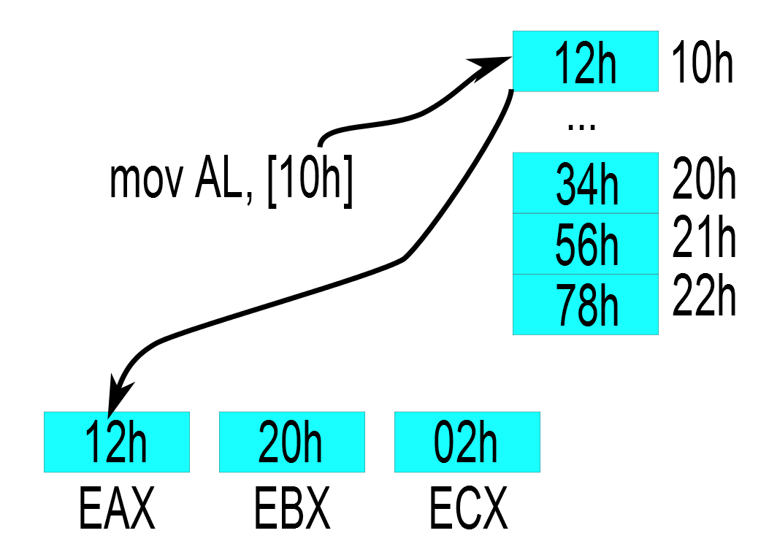
Operands and addressing modes: Direct

Slide 24
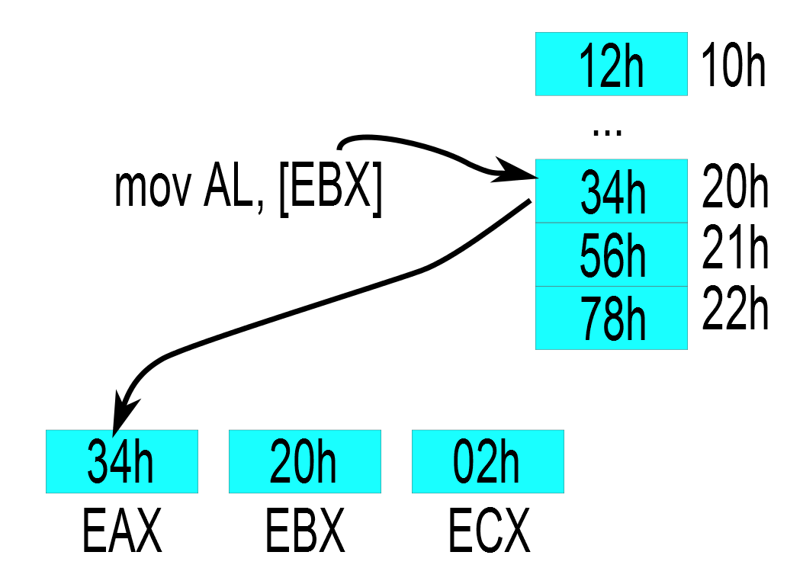
Operands and addressing modes: Indirect

Slide 25
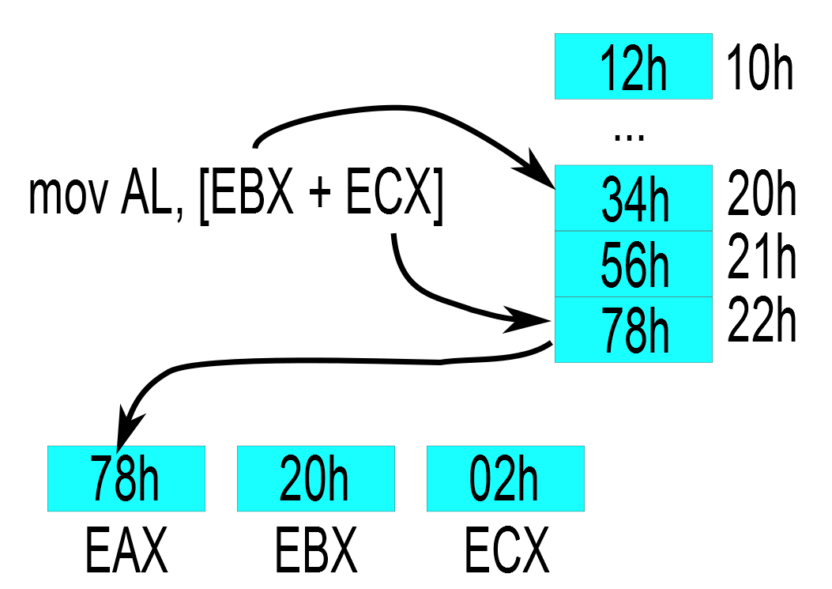
Operands and addressing modes: Indexed

Slide 26
Data movement in assembly
Basic instruction: MOV (from src to dst)
Alternatives
XCHG: Exchange values between src and dst
PUSH: Store src to stack
POP: Retrieve top of stack to dst
LEA: Same as MOV but does not dereference
Used to computer addresses
LEA EAX, [EBX + 10h] ↔ MOV EAX, EBX + 10h

Slide 27
Stack management
PUSH, POP manipulate top of stack
Operate on architecture words (4 bytes for 32 bit)
Stack Pointer can be freely manipulated
Stack can also be accessed by MOV
The stack grows “downwards”
Example: 0xc0000000 → 0

Slide 28
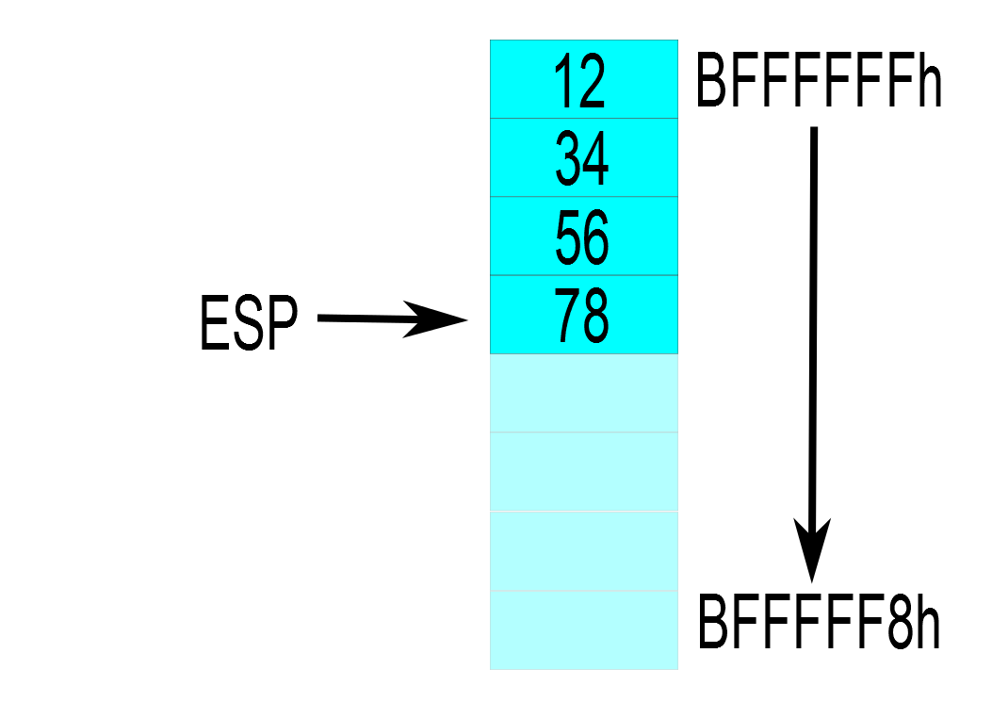
Manipulating the top of stack

Slide 29
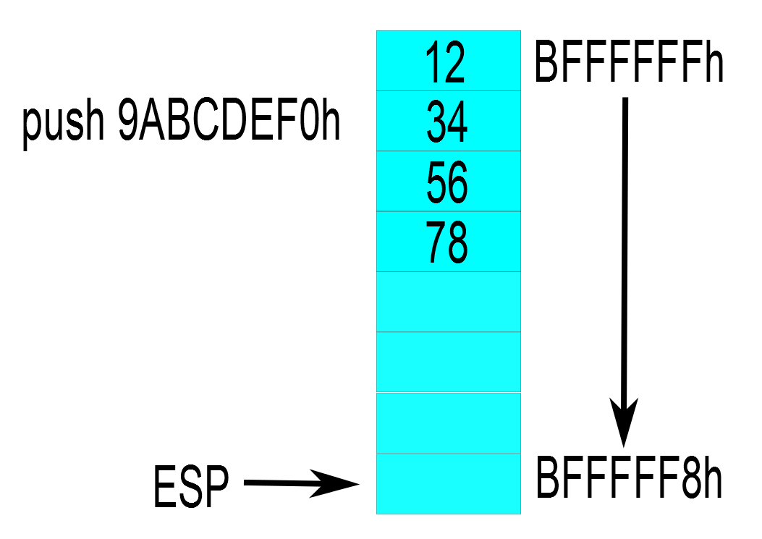
Manipulating the top of stack

Slide 30
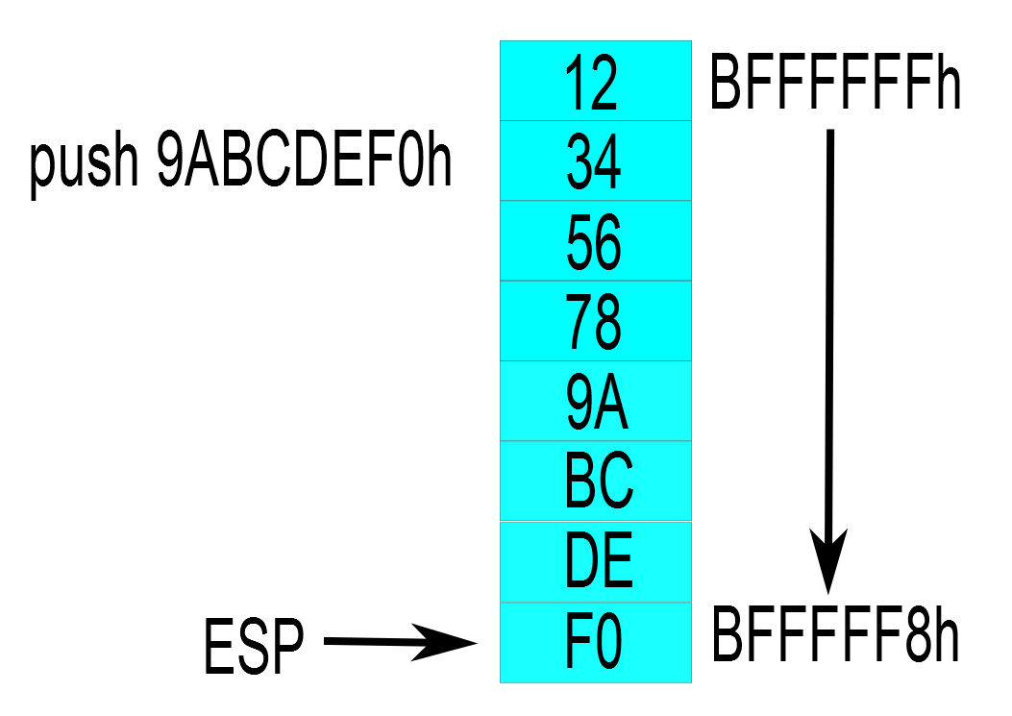
Manipulating the top of stack

Slide 31
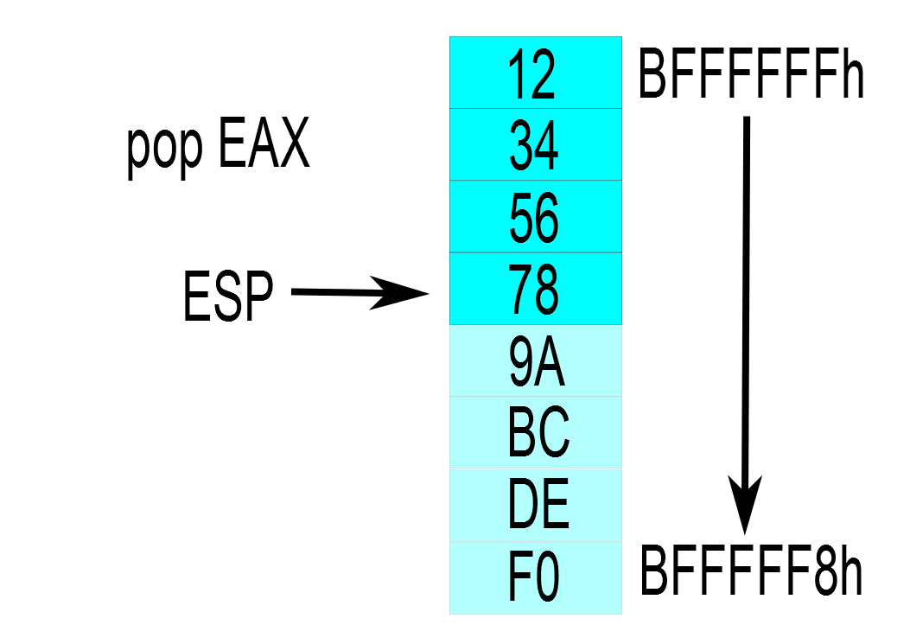
Manipulating the top of stack

Slide 32
Arithmetic and logic operations
ADD, SUB, AND, OR, XOR, …
MUL and DIV require specific registers
Shifting takes many forms:
Arithmetic shift right preserves sign
Logic shifting inserts 0s to front
Rotate can also include carry bit (RCL, RCR)
Shift, rotate and XOR tell-tale signs of crypto

Slide 33
Conditional statements
Two interacting instruction classes
Evaluators: evaluate the conditional expression generating a set of boolean flags
Conditional jumps: change the control flow based on boolean flags
Expression → Evaluator → EFLAGS → Jump

Slide 34
Conditional statements - Evaluators
TEST - logical AND between arguments
Does not perform operation itself, focus on Zero Flag
Detecting 0: TEST EAX, EAX
State of a bit: TEST AL, 00010000b (mask)
CMP – logical SUB between arguments
Compare two values: CMP EAX, EBX
Focus on Sign, Overflow and Zero Flags
All arithmetics influence flags

Slide 35
Conditional statements - Jumps
Conditional jumps based on status of flags
Conditional jumps related to CMP: JE (equal), JNE (not equal), JG (greater), JGE, JL (less), JLE
Conditional jumps related to TEST: JZ (same as JE), JNZ
Conditional jumps exist for every flag: JZ, JNZ, JO, JNO, JC, JNC, JS, JNC, ...

Slide 36
Unconditional jumps
Not necessary to have conditional for jumping to different code fragment, JMP instruction
Multiple types:
Relative jump: address relative to current IP
Short [-128; 127], Near, Far; Constant offset
Absolute jump: specific address
Direct vs Indirect
Static analysis may fail for indirect jump

Slide 37
Examples of control flow constructs
Single conditional if statement:
if (a == 0x1234) dummy();
cmp [a], 1234h
jnz short loc_8048437
call dummy
loc_8048437: ; CODE XREF: test

Slide 38
Examples of control flow constructs
Multiple conditional if statement:
if (a == 0x1234 && b == 0x5678) dummy();
cmp [a], 1234h
jnz short loc_8048443
cmp [b], 5678h
jnz short loc_8048443
call dummy
loc_8048443: ; CODE XREF: test+Dj

Slide 39
Examples of control flow constructs
While statement:
while (a == 0x1234) dummy();
jmp short loc_804844D
loc_8048448: ; CODE XREF: test+14j
call dummy
loc_804844D: ; CODE XREF: test+3j
cmp [a], 1234h
jz short loc_8048448

Slide 40
Examples of control flow constructs
For statement:
for (i = 0; i < a; i++) dummy();
mov [ebp+var_i], 0
jmp short loc_804843B
loc_8048432: ; CODE XREF: test+20j
call dummy
add [ebp+var_i], 1
loc_804843B: ; CODE XREF: test+Dj
cmp [ebp+var_i], [a]
jl short loc_8048432

Slide 41
Examples of control flow constructs
For statement after optimizing compiler:
mov eax, [a]
test eax, eax
jle short loc_8048460
xor ebx, ebx
loc_8048450: ; CODE XREF: test+1Ej
call dummy
add ebx, 1
cmp [a], ebx
jg short loc_8048450
loc_8048460: ; CODE XREF: test+8j
; Check if a <= 0, skip loop if yes

Slide 42
Practicing assembly
Generate assembly from C/C++ code
“gcc –S” (–masm=intel)
Disassemble existing programs
IdaPro or objdump (option for intel syntax)
Why not even start coding?

Slide 43
Writing your first assembly code
Object files generated using assembler (NASM)
Result can be linked like regular C code
First setup:
Link your object file with libc
Access to libc functions
Larger binaries ☹
Use GCC to manage linking

Slide 44
Content of assembly file
Divided into sections with different purpose
Executable section: TEXT
Code that will be executed
Initialized read/write data: DATA
Global variables
Initialized read only data: RODATA
Global constants, constant strings
Uninitialized read/write data: BSS

Slide 45
Allocating global data
Allocate individual data elements
DB: define bytes (8 bits), DW: define words (16 bits)
DD, DQ: define double/quad words (32/64 bits)
Initialize with value: DB 12, DB ‘c’, DB ‘abcd’
Repeat allocation with TIMES
100 byte array: TIMES 100 DB 0
Called DUP in some assemblers
Uninitialized allocation with RESB:
RESB size

Slide 46
Where are my variable names?
Any memory location can be named → Labels
Labels in data: Named variables
Labels in code: Jump targets, Functions
Label visibility is by default local to file
Define global labels using “global LabelName”

