Slide 1
Meltdown & Spectre
Slides adapted from
Mark D. Hill
Computer Sciences Dept.
Univ. of Wisconsin-Madison
Prepared while on a sabbatical visit to Google with public information only and representing the author’s views only, not necessarily Google’s.

Slide 2
Overview
Metldown and Spectre present multiple issues, at the core they are both privlege escalation vulnerabilities.
Namely, these two attacks allow a process to read information it is not authorized to read.
EX: Another user/process of the system can read the password you just typed in =(
To accomplish this goal the rogue processor takes advantage of:
Speculative Execution: In an Out of Order CPU (OOO) a branch mis-predict may execute instructions that shouldn’t.
Caching Architecture: Since a cache brings in multiple bytes (cache blocks), certain pieces of information (like passwords) may be brought in that shouldn’t.
We focus on Meltdown since it is easier to understand.

Slide 3

Executive Summary
Architecture 1.0: the timing-independent functional behavior of a computer Micro-architecture: the implementation techniques to improve performance
Question: What if a computer that is completely correct by Architecture 1.0 can be made to leak protected information via timing, a.k.a., Micro-Architecture?
Meltdown leaks kernel memory, but software & hardware fixes exist
Spectre leaks memory outside of bounds checks or sandboxes, and is scary
Implication: The definition of Architecture 1.0 is inadequate to protect information

Slide 4
Outline
Computer Architecture & Micro-Architecture Background
Timing Side-Channel Attack
Meltdown
Spectre
Wrap-Up

Slide 5
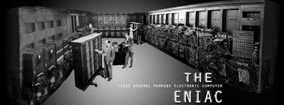
Computer Architecture 0.0 -- Pre-1964
Each Computer was New
Implemented machine (has mass) → hardware
Instructions for hardware (no mass) → software
Software Lagged Hardware
Each new machine design was different
Software needed to be rewritten in assembly/machine language
Unimaginable today
Going forward: Need to separate HW interface from implementation

Slide 6
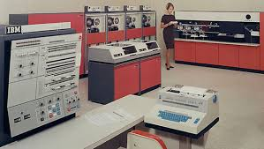
Computer Architecture 1.0 -- Born 1964
IBM System 360 defined an instruction set architecture
Stable interface across a family of implementations
Software did NOT have to be rewritten
branch (R1 >= bound) goto error
load R2 ← memory[train+R1]
and R3 ← R2 && 0xffff
load R4 ← memory[save+SIZE+R3]
Architecture 1.0: the timing-independent functional behavior of a computer Micro-architecture: implementation techniques that change timing to go fast
Note: The code is not IBM 360 assembly, but is the example used later.

Slide 7
Micro-architecture Harvested Moore’s Law Bounty
For decades, every ~2 years: 2x transistors, 1.4x faster & 1x chip power possible; 2300 transistors for Intel 4004 → millions per core & billions for caches
(Micro-)architects took this ever doubling budget to make each processor core execute > 100x than what it would otherwise.
Key techniques w/ tutorial next:
Instruction Speculation
Hardware Caching
Hidden by Architecture 1.0: timing-independent functional behavior unchanged

Slide 8
Meltdown Step 1: Caching Unauthorized Information
The First step of both Metldown is to copy unauthorized information into our cache. (Later we will try to read it.)
Naturally, our hardware has protection mechanisms that prevent us from reading that exact data or even data that is close to it.
How do we get around those protection schemes?
Take Advantage of Speculative Execution: Execute Instructions (loads) that will be squashed, but has the side effect of loading the unauthorized information into our cache (!!!)

Slide 9
Instruction Speculation Tutorial
Many steps (cycles) to execute one instruction; time flows left to right →
add
load
Go Faster: Pipelining, branch prediction, & instruction speculation
add
load
branch
Predict direction: target or fall thru
and
Speculate!
store
Speculate more!
Speculation correct: Commit architectural changes of and (register) & store (memory) go fast!
Mis-speculate: Abort architectural changes (registers, memory); go in other branch direction

Slide 10
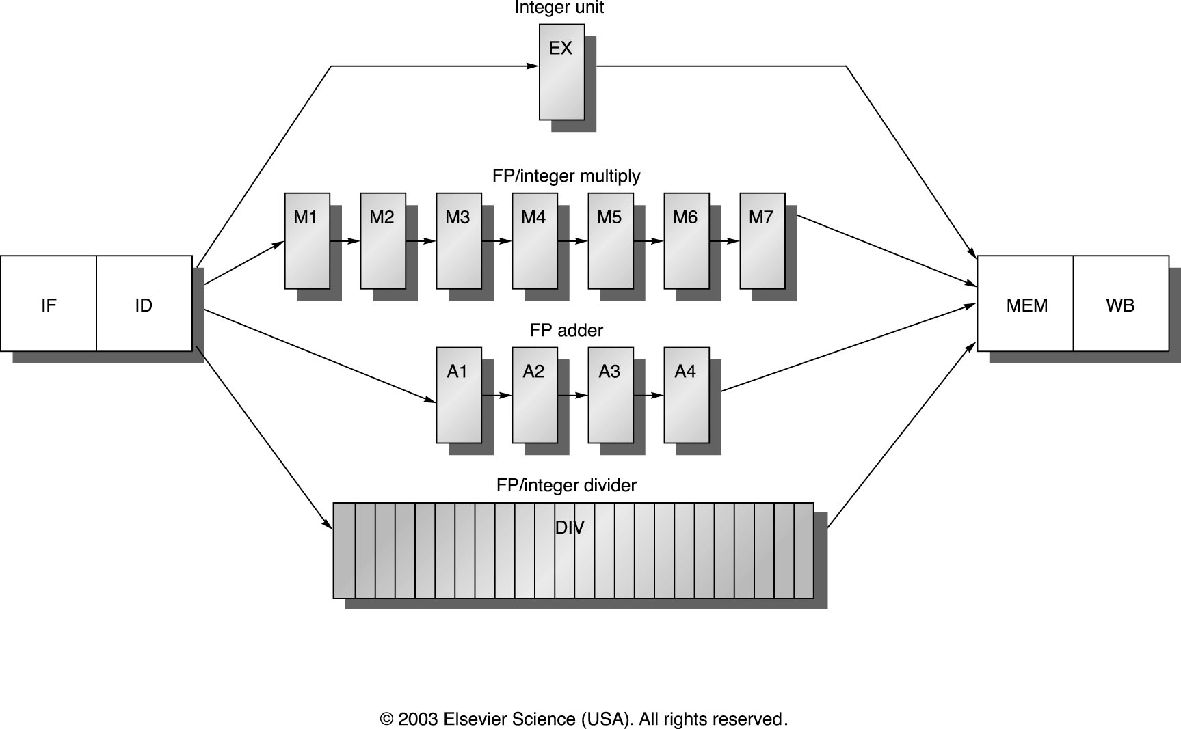
A More Realistic Out Of Order Pipeline (used since 1995)

Slide 11
Pentium Pro Architecture (Intel 1995 and onwards)
Any order
MEM
IF
ID
REN
Alloc
EX
CT
In-order
In-order
ROB
ARF
Instructions are Issued in order
Instruction execute in any order
The ReOrder Buffer (ROB) ensures instructions are committed in order

Slide 12
Taking Advantage of Speculative Execution
branch (R1 >= bound) goto error ; Speculate branch not taken
load R2 ← memory[train+R1] ; Speculate load & speculate cache hit
and R3 ← R2 && 0xffff ; Speculate AND
load R4 ← memory[save+SIZE+R3] ; Speculate load & speculate cache hit
What would happen if:
1) The branch predictor mis-predicted the branch as ‘not taken’.
2) And we set variable ‘train’ such that the load would be from an unauthorized area?
Result: The load would:
R1) Execute, bringing in the unauthorized information into the cache.
R2) The load would be flagged as segmentation error causing a fault.
R3) Instead of stopping the execution (as a fault usually does), the mis-predicted branch would squash the load AND the fault. (!!!)

Slide 13
Meltdown Step 2: Reading Unauthorized Information in the Cache
Now we have the unauthorized information in our cache. How do we read it?
If we do a load, that will cause a fault because our hardware has protection schemes to prevent us from reading where we shouldn’t.
Instead we are going to create a covert channel by using the Cache as a side channel.
Namely we are going to use the speed of our cache to determine the bits of our secret information.

Slide 14
Hardware Caching Tutorial
Main Memory (DRAM) 1000x too slow
Add Hardware Cache(s): small, transparent hardware memory
Like a software cache: speculate near-term reuse (locality) is common
Like a hash table: an item (block or line) can go in one or few slots
E.g., 4-entry cache w/ slot picked with address (key) modulo 4
0
--
12?
Miss
Insert 12
0
12
07?
Miss
Insert 07
0
12
12?
HIT!
No changes
0
12
16?
Miss
Victim 12
Insert 16
0
16
Note 12
victimized “early” due to “alias”
1
--
1
--
1
--
1
--
1
--
2
--
2
--
2
--
2
--
2
--
3
--
3
--
3
07
3
07
3
07

Slide 15
Timing is Important!
We use the cache as a side channel to determine which element of “data” is in the cache
Access both elements and time the difference in access (we previously flushed them)
ime = rdtsc();
maccess(&data[0x300]);
delta3 = rdtsc() - time;
time = rdtsc();
maccess(&data[0x200]);
delta2 = rdtsc() - time;
Execution time taken for
instruction is proportional
to whether it is in cache(s)

Slide 16
Timing Side Channel
Consider the following code, where ptr points to a secret (unauthorized) and data is within our cache (lets just say bit is 0):
if (spec_cond) {
unsigned char value = *(unsigned char *)ptr;
unsigned long index2 = (((value>>bit)&1)*0x100)+0x200;
maccess(&data[index2]);
}
What if:
spec_cond was mis-predicted ‘not-taken’
Before the if, memory at ptr was in the cache
Both memory at data+0x200 and data+0x300 are NOT in the cache
After the squashing the branch, would data+0x200 or data+300 be in the cache?

Slide 17
Side-Channel Attack: SAVE Secret in Micro-Arch
• When the right conditions exist, this branch of code will run speculatively
• The privilege check for “value” will fail, but only result in an entry tag in the ROB
• The access will occur although “value” will be discarded when speculation is undone
• The offset accessed in the “data” user array is dependent upon the value of privileged data
• We can use this as a 1 bit counter between several possible entries of the user data array
• Cache side channel timing analysis is used to measure which “data” location was accessed
• Time access to “data” locations 0x200 and 0x300 to infer value of desired bit

Slide 18

Side-Channel Attack: RECALL Secret from Micro-Arch
4: Probe time to access each element of save[]--micro-architectural property; If accessing save[foo] slow due to cache miss, then SECRET is foo. A leak! 5: Repeat many times to obtain secret information at some bandwidth. (More shifting/masking needed to get all SECRET bits victimizing 64B cache lines)
Well-known in 1983/85 DoD “Orange Book” Covert timing channels include all vehicles that would allow one process to signal information to another process by modulating its own use of system resources in such a way that the change in response time observed by the second process would provide information. --TRUSTED COMPUTER SYSTEM EVALUATION CRITERIA
With roots back to 1974 TENEX password attack But seemed fanciful
Spy vs. Spy, Mad Magazine, 1960

Slide 19
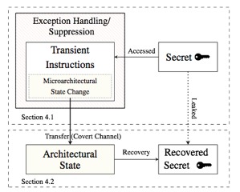
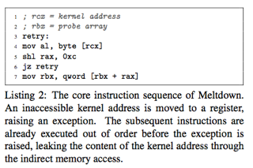
Meltdown (https://meltdownattack.com/meltdown.pdf)
Can leak the contents of kernel memory at up to 500KB/s
TRAP!! (not branch)
Under mis-speculation

Slide 20
Meltdown & Hardware
Demonstrated for many Intel x86-64 cores; NOT demonstrated for AMD
Key: When to suppress load with protection violation (user load to kernel memory)
EARLY: AMD appears to suppress early, e.g., at TLB access
LATE: Intel appears to suppress at end after micro-arch state changes
Why? A Guess:
Performance shouldn’t matter as this case is supposed to be rare
Do what’s easiest & have luck that is good (AMD) or bad (Intel)

Slide 21
Meltdown & Software
Bad: Meltdown operates with bug-free OS software
Good: Major commercial OSs patched for Meltdown ~January 2018
Idea: Don’t map (much) of protected kernel address space in user process
Offending load now fails address translation & does nothing
Patches quickly derived from KAISER developed for side-channel attacks of Kernel Address Space Layout Randomization (KASLR)
Performance impact 0-30% syscall frequency & core model.
Future hardware can fix Meltdown (like AMD) so maybe we dodged a bullet

Slide 22
Spectre (https://spectreattack.com/spectre.pdf)
Classic side-channel attack w/ deep micro-arch info
1. Attacker primes micro-architecture
E.g, branch predictor or branch target buffer for saving secret
E.g., cache for recalling secret
2: Victim loads secret under mis-speculation utilizing existing library code
Instead of performing the load directly. Hence we need understanding the target code.
Note: The code could be another user’s browser—where the password is stored.
3: Victim saves secret in micro-arch state, e.g., cache
4: Attacker recalls secret from micro-arch state; 4: repeat.
In other words, Meltdown is like Spectre, except that it must know what branch to poison inside of the target code base.

Slide 23
Spectre Applicability (Paper Sections 4, 5, & 6)
4. Exploit branch mis-prediction to let Javascript steal from Chrome browser
Demonstrated Intel Haswell/Skylake, AMD Ryzen, & several ARM cores
Many other existing designs vulnerable
5. Used indirect branches & return-oriented programming to mis-train branch target buffer to obtain information from different hyper-thread on same core
6. Many other known timing-channel exist, e.g., register file contention, functional unit occupancy, but what about unknown timing channels?

Slide 24
Spectre Mitigation (Section 7)
Branch prediction
SW: Suppress branch prediction “when important” with mfence, etc.
Not defined to work but appears to work--at a performance cost
HW could auto-magically suppress branch prediction when appropriate (???)
Branch Target Buffer
SW: Not clear. Disable hyper-threading, etc.?
HW: Make micro-architecture state private to thread (not core or processor)
More generally: Hard to mitigate threats NOT YET DEFINED.

Slide 25

Need Computer Architecture 2.0?
With Meltdown & Spectre, Architecture 1.0 is inadequate to protect information
Augment Architecture 1.0 with Architecture 2.0 specification of
(Abstraction of) time-visible micro-architecture?
Bandwidth of known (unknown?) timing channels?
Enforced limits on user software behavior? (c.f., KAISER)
Change Microarchitecture to mitigate timing channel bandwidth
Suppress some speculation
Undo most changes on mis-speculation
Can this be (formally) solved or must it be managed like crime?

Slide 26
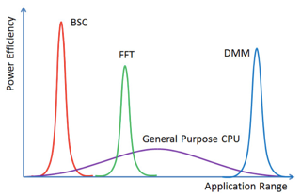
Need Computer Architecture 2.0?
More generally, can we reduce our dependence on SPECULATION?
Accelerators!! GPU, DSP, IPU, TPU, ... [Hennessy & Patterson 2018 Taxonomy]
Dedicated Memories
More ALUs
Easy Parallelism
Lower precision data
Domain Specific Language
Yavits et al. MultiAmdahl, 2017
Speculation NOT a first-order feature!
In 2005, Arvind said Speculation (w/ von Neumann model) killed Dataflow
After 2018, Dataflow-like Renaissance w/ Sea of Accelerators?

Slide 27
Executive Summary
Architecture 1.0: the timing-independent functional behavior of a computer Micro-architecture: the implementation techniques to improve performance
Question: What if a computer that is completely correct by Architecture 1.0 can be made to leak protected information via timing, a.k.a., Micro-Architecture?
Implication: The definition of Architecture 1.0 is inadequate to protect information
Meltdown leaks kernel memory, but software & hardware fixes exist
Spectre leaks memory outside of bounds checks or sandboxes, and is scary

Slide 28
Some References
New York Times: https://www.nytimes.com/2018/01/03/business/computer-flaws.html Meltdown paper: https://meltdownattack.com/meltdown.pdf Spectre paper: https://spectreattack.com/spectre.pdf A blog separating the two bugs: https://danielmiessler.com/blog/simple-explanation-difference-meltdown-spectre/ Google Blog: https://security.googleblog.com/2018/01/todays-cpu-vulnerability-what-you-need.html and https://googleprojectzero.blogspot.com/2018/01/reading-privileged-memory-with-side.html Industry News Sources: https://arstechnica.com/gadgets/2018/01/whats-behind-the-intel-design-flaw-forcing-numerous-patches/ and https://www.theregister.co.uk/2018/01/02/intel_cpu_design_flaw/

Slide 29
Backup Slides

Slide 30
Spectre Code Example
Listing 2: Exploiting Speculative Execution via JavaScript
1 if (index < simpleByteArray.length) {
2 index = simpleByteArray[index | 0];
3 index = (((index * TABLE1_STRIDE)|0) & (TABLE1_BYTES-1))|0;
4 localJunk ^= probeTable[index|0]|0;
5}
Listing 3: Disassembly of Speculative Execution in Listing 2 JavaScript
1 cmpl r15,[rbp-0xe0] ; Compare index (r15) against simpleByteArray.length
2 jnc 0x24dd099bb870 ; If index >= length, branch to instruction after move below
3 REX.W leaq rsi,[r12+rdx*1] ; Set rsi=r12+rdx=addr of first byte in simpleByteArray
4 movzxbl rsi,[rsi+r15*1] ; Read byte from address rsi+r15 (= base address+index)
5 shll rsi, 12 ; Multiply rsi by 4096 by shifting left 12 bits}\%\
6 andl rsi,0x1ffffff ; AND reassures JIT that next operation is in-bounds
7 movzxbl rsi,[rsi+r8*1] ; Read from probeTable
8 xorl rsi,rdi ; XOR the read result onto localJunk
9 REX.W movq rdi,rsi ; Copy localJunk into rdi

Slide 31
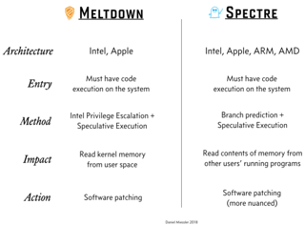
Meltdown v. Spectre
Miessler Blog (https://danielmiessler.com/blog/simple-explanation-difference-meltdown-spectre/ )

