Slide 1
Using HPC.MNSU.EDU with
Message Passing Interface (MPI)
Slides by David J. Haglin http://www.mnsu.edu/hpc/tutorials/Using-HPC.ppt
Presented by Dr. West

Slide 2
Outline
Machine Description
Background
  The message-passing model
  What is MPI?
Using MPI on HPC.MNSU.EDU
  Example C/C++/Fortran programs
  Using the Torque Job Queue

Slide 3
Specifications
35 nodes, 1 Master (head), 34 Worker
  Two, dual-core AMD Opteron CPUs
  4 logical Processing Entities (PEs)
  8 GB of RAM
  80 GB of local disk
Head node has 7.4TB of disk

Slide 4
Specifications
Operating System: RedHat Linux
Remote Access using SSH
  SSH Secure Shell or Putty
  Cygwin (for X11 Server)
Software to coordinate operation as a single machine:
  OpenPBS/Torque for “Queue of Jobs” model
Libraries such as ScaLaPack

Slide 5
The Message-Passing Model
A process is (traditionally) a program counter and address space.
Processes may have multiple threads (program counters and associated stacks) sharing a single address space. MPI is for communication among processes, which have separate address spaces.

Slide 6
The Message-Passing Model
Interprocess communication consists of
  Synchronization
  Movement of data from one process’s address space to another’s.
  On HPC.MNSU.EDU this means coordinating and communicating between the 29 worker nodes.

Slide 7
Cooperative Operations for Communication
The message-passing approach makes the exchange of data cooperative.
Data is explicitly sent by one process and received by another.
An advantage is that any change in the receiving process’s memory is made with the receiver’s explicit participation.
Communication and synchronization are combined.
Process 0
Process 1
Send(data)
Receive(data)

Slide 8
One-Sided Operations for Communication
One-sided operations between processes include remote memory reads and writes
Only one process needs to explicitly participate.
An advantage is that communication and synchronization are decoupled
One-sided operations are part of MPI-2.
Process 0
Process 1
Put(data)
(memory)
(memory)
Get(data)

Slide 9
What is MPI?
A message-passing library specification
  extended message-passing model
  not a language or compiler specification
  not a specific implementation or product
For parallel computers, clusters, and heterogeneous networks
Full-featured
Available for C, C++, Fortran

Slide 10
What is MPI?
Designed to provide access to advanced parallel hardware for
  end users
  library writers
  tool developers
Designed to be somewhat portable
MPI was explicitly designed to enable libraries …
… which may eliminate the need for many users to learn (much of) MPI

Slide 11
A Minimal MPI Program (C)
#include "mpi.h"
#include <stdio.h>
int main( int argc, char *argv[] )
{
MPI_Init( &argc, &argv );
printf( "Hello, world!\n" );
MPI_Finalize();
return 0;
}

Slide 12
A Minimal MPI Program (Fortran)
program main
use MPI
integer ierr
call MPI_INIT( ierr )
print *, 'Hello, world!'
call MPI_FINALIZE( ierr )
end

Slide 13
Notes on C and Fortran
C and Fortran bindings correspond closely
In C:
  mpi.h must be #included
  MPI functions return error codes or MPI_SUCCESS
In Fortran:
  mpif.h must be included, or use MPI module (MPI-2)
  All MPI calls are to subroutines, with a place for the return code in the last argument.
C++ bindings, and Fortran-90 issues, are part of MPI-2.

Slide 14
Error Handling
By default, an error causes all processes to abort.
The user can cause routines to return (with an error code) instead.
  In C++, exceptions are thrown (MPI-2)
A user can also write and install custom error handlers.
Libraries might want to handle errors differently from applications.

Slide 15
Compiling MPI Programs
C: mpicc –O3 –o myProg myProg.c
C++: mpicxx –O3 –o myProg myProg.cc
Fortran: mpif –o myProg myProg.f

Slide 16
Running MPI Programs
In general, starting an MPI program is dependent on the implementation of MPI you are using, and might require various scripts, program arguments, and/or environment variables.
mpiexec <args> is part of MPI-2, as a recommendation, but not a requirement
  You can use mpiexec for MPICH and mpirun for SGI’s MPI in this class

Slide 17
Running MPI Programs
Examples:
  mpiexec –np 3 a.out
  mpirun –np 4 myExecutable –option1=5
  mpiexec –np 2 myProg /net/master/data/raid0/data
The above examples run on the head node
To use worker nodes requires a “script”
  qsub myScript
  We’ll see example scripts later

Slide 18
Finding Out About the Environment
Two important questions that arise early in a parallel program are:
  How many processes are participating in this computation?
  Which one am I?
MPI provides functions to answer these questions:
  MPI_Comm_size reports the number of processes.
  MPI_Comm_rank reports the rank, a number between 0 and size-1, identifying the calling process

Slide 19
Better Hello (C)
#include "mpi.h"
#include <stdio.h>
int main( int argc, char *argv[] )
{
int rank, size;
MPI_Init( &argc, &argv );
MPI_Comm_rank( MPI_COMM_WORLD, &rank );
MPI_Comm_size( MPI_COMM_WORLD, &size );
printf( "I am %d of %d\n", rank, size );
MPI_Finalize();
return 0;
}

Slide 20
Better Hello (C++)
#include "mpi.h"
#include <iostream>
int main( int argc, char *argv[] )
{
MPI::Init(argc, argv);
int rank = MPI::COMM_WORLD.Get_rank();
int size = MPI::COMM_WORLD.Get_size();
std::cout << "I am " << rank << " of "
<< size << std::endl;
MPI::Finalize();
return 0;
}

Slide 21
Better Hello (Fortran)
program main
use MPI
integer ierr, rank, size
call MPI_INIT( ierr )
call MPI_COMM_RANK( MPI_COMM_WORLD, rank, ierr )
call MPI_COMM_SIZE( MPI_COMM_WORLD, size, ierr )
print *, 'I am ', rank, ' of ', size
call MPI_FINALIZE( ierr )
end

Slide 22
MPI is Simple
Many parallel programs can be written using just these six functions, only two of which are non-trivial:
  MPI_INIT
  MPI_FINALIZE
  MPI_COMM_SIZE
  MPI_COMM_RANK
  MPI_SEND
  MPI_RECV
Point-to-point (send/recv) isn’t the only way...

Slide 23
Group Communication Overview
All processes in a group participate in communication, by calling the same function with matching arguments.
Types of collective operations:
  Synchronization: MPI_Barrier
  Data movement: MPI_Bcast, MPI_Scatter, MPI_Gather, MPI_Allgather, MPI_Alltoall
  Collective computation: MPI_Reduce, MPI_Allreduce, MPI_Scan
Collective routines are blocking:
  Completion of call means the communication buffer can be accessed
  No indication on other processes’ status of completion
  May or may not have effect of synchronization among processes.

Slide 24
Group Communication Overview
Can use same communicators as PtP communications
  MPI guarantees messages from collective communications will not be confused with PtP communications.
Key is a group of processes participating in communication
  If you want only a sub-group of processes involved in collective communication, need to create a sub-group/sub-communicator from MPI_COMM_WORLD

Slide 25
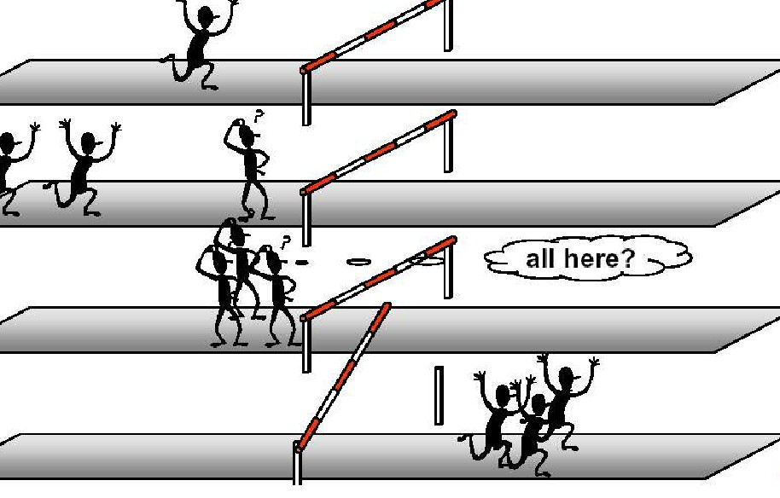
Barrier
int MPI_Barrier(MPI_Comm comm)
MPI_BARRIER(COMM,IERROR)
integer COMM, IERROR
Blocks the calling process until all group members have called it.
Affect performance. Refrain from using it.
…
MPI_Barrier(MPI_COMM_WORLD); // synchronization point
…

Slide 26
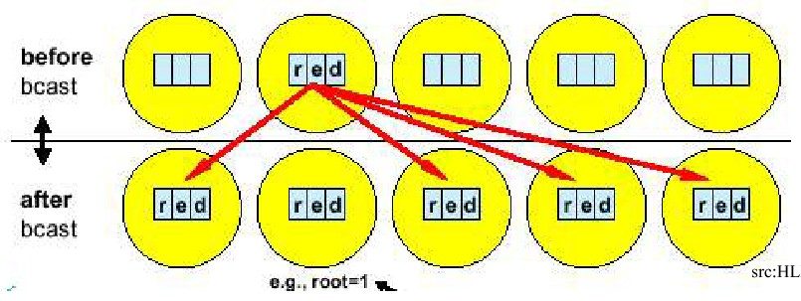
Broadcast
int MPI_Bcast(void *buffer, int count, MPI_Datatype datatype,int root,
MPI_Comm comm)
MPI_BCAST(BUFFER, COUNT, DATATYPE, ROOT, COMM)
integer BUFFER, COUNT, DATATYPE, ROOT, COMM
Broadcasts a message from process with rank root to all processes in group, including itself.
comm, root must be the same in all processes
The amount of data sent must be equal to amount of data received, pairwise between each process and the root
  For now, means count and datatype must be the same for all processes; may be different when generalized datatypes are involved.
int num=-1;
If(my_rank==0) num=100;
…
MPI_Bcast(&num, 1, MPI_INT, 0, MPI_COMM_WORLD);
…

Slide 27
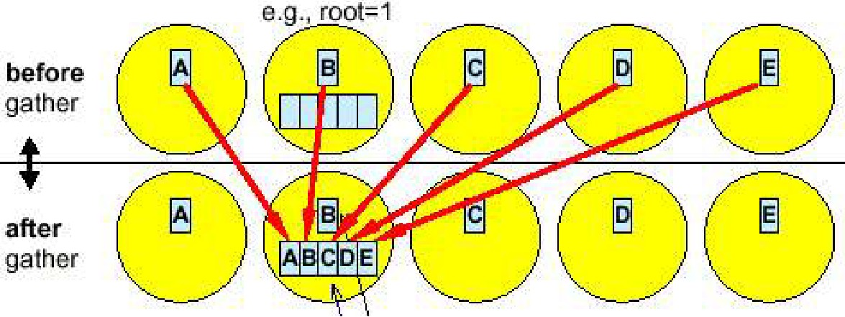
Gather
Int MPI_Gather(void *sendbuf, int sendcount, MPI_Datatype sendtype,
void *recvbuf, int recvcount, MPI_Datatype recvtype,
int root, MPI_Comm comm)
MPI_Gather(SENDBUF,SENDCOUNT,SENDTYPE,RECVBUF,RECVCOUNT,RECVTYPE,ROOT,COMM,
IERROR)
<type> SENDBUF(*), RECVBUF(*)
integer SENDCOUNT,SENDTYPE,RECVCOUNT,RECVTYPE,ROOT,COMM
Gathers message to root; concatenated based on rank order at root process
Recvbuf, recvcount, recvtype are only important at root; ignored in other processes.
root and comm must be identical on all processes.
recvbuf and sendbuf cannot be the same on root process.
Amount of data sent from a process must be equal to amount of data received at root
  For now, recvcount=sendcount, recvtype=sendtype.
  recvcount is the number of items received from each process, not the total number of items received, not the size of receive buffer!

Slide 28
Gather Example
int rank, ncous;
int root = 0;
int *data_received=NULL, data_send[100];
// assume running with 10 cpus
MPI_Comm_rank(MPI_COMM_WORLD, &rank);
MPI_Comm_size(MPI_COMM_WORLD, &ncpus);
if(rank==root)
data_received = new int[100*ncpus]; // 100*10
MPI_Gather(data_send, 100, MPI_INT, data_received, 100, MPI_INT, root,
MPI_COMM_WORLD); // ok
// MPI_Gather(data_send,100,MPI_INT,data_received, 100*ncpus, MPI_INT, root,
MPI_COMM_WORLD); ← wrong

Slide 29
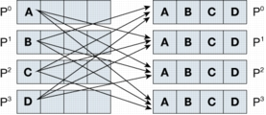
Gather to All
Int MPI_Allgather(void *sendbuf, int sendcount, MPI_Datatype *sendtype,
void *recvbuf, int recvcount, MPI_Datatype *recvtype,
MPI_Comm comm)
Concatenated messages according to rank order received by all processes
recvcount is the number of items from each process, not the total number of items received.
For now, sendcount=recvcount,sendtype=recvtype
int A[100], B[1000];
// assume 10 processors
MPI_Allgather(A, 100, MPI_INT, B, 100, MPI_INT, MPI_COMM_WORLD); // ok?
...
MPI_Allgather(A, 100, MPI_INT, B, 1000, MPI_INT, MPI_COMM_WORLD); // ok?

Slide 30
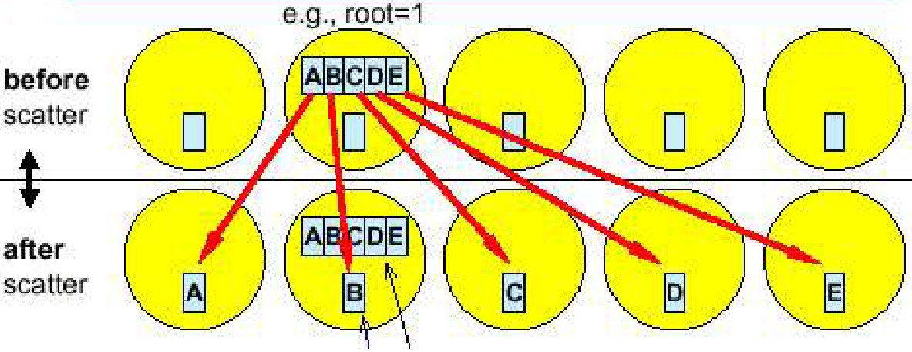
Scatter
Int MPI_Scatter(void *sendbuf, int sendcount, MPI_Datatype *sendtype,
void *recvbuf, int recvcount, MPI_Datatype *recvtype,
int root, MPI_Comm comm)
Inverse to MPI_Gather
Split message into ncpus equal segments; n-th segment to n-th process.
sendbuf, sendcount, sendtype important only at root, ignored in other processes.
sendcount is the number of items sent to each process, not the total number of items in sendbuf.

Slide 31
Scatter Example
int A[1000], B[100];
... // initializa A etc
// assume 10 processors
MPI_Scatter(A, 100, MPI_INT, B, 100, MPI_INT, 0,
MPI_COMM_WORLD); // ok?
...
MPI_Scatter(A, 1000, MPI_INT, B, 100, MPI_INT, 0,
MPI_COMM_WORLD); // ok?

Slide 32
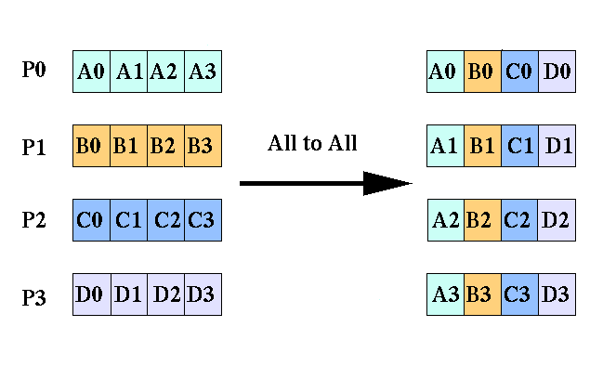
All-to-All
Int MPI_Alltoall(void *sendbuf, int sendcount, MPI_Datatype sendtype,
void *recvbuf, int recvcount, MPI_Datatype recvtype,
MPI_Comm comm)
Important for distributed matrix transposition; critical to FFT-based algorithms
Most stressful communication.
sendcount is the number of items sent to each process, not the total number of items in sendbuf.
recvcount is the number of items received from each process, not the total number of items received.
For now, sendcount=recvcount, sendtype=recvtype

Slide 33
All-to-All Example
double A[4], B[4];
...
// assume 4 cpus
for(i=0;i<4;i++) A[i] = my_rank + i;
MPI_Alltoall(A, 4, MPI_DOUBLE, B, 4, MPI_DOUBLE, MPI_COMM_WORLD); // ok?
MPI_Alltoall(A, 1, MPI_DOUBLE, B, 1, MPI_DOUBLE, MPI_COMM_WORLD); // ok?
Cpu 0
0 | 1 | 2 | 3
4 | 5 | 6 | 7
8 | 9 | 10 | 11
12 | 13 | 14 | 15
0 | 4 | 8 | 12
1 | 5 | 9 | 13
2 | 6 | 10 | 14
3 | 7 | 11 | 15
Cpu 1
Cpu 2
Cpu 3

Slide 34
Reduction
Perform global reduction operations (sum, max, min, and, etc) across processors.
MPI_Reduce – return result to one processor
MPI_Allreduce – return result to all processors
MPI_Reduce_scatter – scatter reduction result across processors
MPI_Scan – parallel prefix operation

Slide 35
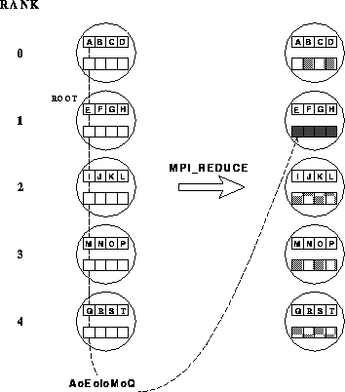
Reduction
Int MPI_Reduce(void *sendbuf, void *recvbuf, int count, MPI_Datatype datatype,
MPI_Op op, int root, MPI_Comm comm)
Element-wise combine data from input buffers across processors using operation op; store results in output buffer on processor root.
All processes must provide input/output buffers of the same length and data type.
Operation op must be associative:
  Pre-defined operations
  User can define own operations
int rank, res;
MPI_Comm_rank(MPI_COMM_WORLD, &rank);
MPI_Reduce(&rank,&res,1,MPI_INT,MPI_MAX,0,MPI_COMM_WORLD);

Slide 36
Pre-Defined Operations
MPI_MAX
MPI_MIN
MPI_SUM
MPI_PROD
MPI_LAND | Logical AND
MPI_LOR | Logical OR
MPI_BAND | Bitwise AND
MPI_BOR | Bitwise OR
MPI_LXOR
MPI_BXOR
MPI_MAXLOC | max + location
MPI_MINLOC | min + location

Slide 37
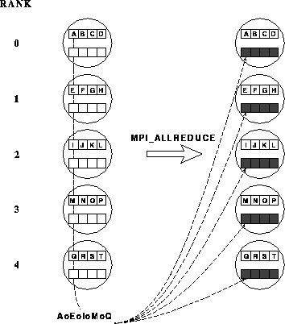
All Reduce
int MPI_Allreduce(void *sendbuf, void *recvbuf, int count,
MPI_Datatype datatype, MPI_Op op, MPI_Comm comm)
Reduction result stored on all processors.
int rank, res;
MPI_Comm_rank(MPI_COMM_WORLD, &rank);
MPI_Allreduce(&rank, &res, 1, MPI_INT, MPI_MAX,
MPI_COMM_WORLD);

Slide 38
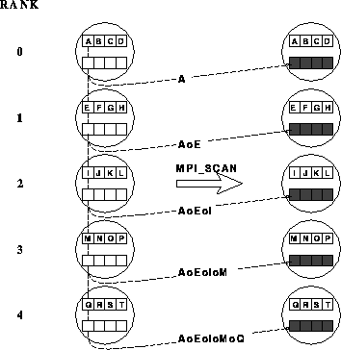
Scan
Int MPI_Scan(void *sendbuf, void *recvbuf, int count, MPI_Datatype datatype,
MPI_Op op, MPI_Comm comm)
Prefix reduction
To process j, return results of reduction on input buffers of processes 0, 1, …, j.

Slide 39
Example: Matrix Transpose
A
B
A – NxN matrix
Distributed on P cpus
Row-wise decomposition
B = A^{T}
B also distributed on P cpus
Rwo-wise decomposition
A_{ij} – (N/P)x(N/P) matrices
B_{ij}=A_{ji}^{T}
Input:
A[i]][j] = 2*i+j
A₁₁ | A₁₂ | A₁₃
A₂₁ | A₂₂ | A₂₃
A₃₁ | A₃₂ | A₃₃
A₁₁^{T} | A₂₁^{T} | A₃₁^{T}
A₁₂^{T} | A₂₂^{T} | A₃₂^{T}
A₁₃^{T} | A₂₃^{T} | A₃₃^{T}
Local transpose
A₁₁^{T} | A₁₂^{T} | A₁₃^{T}
A₂₁^{T} | A₂₂^{T} | A₂₃^{T}
A₃₁^{T} | A₃₂^{T} | A₃₃^{T}
All-to-all

Slide 40
Example: Matrix Transpose
0 | 1 | 2 | 3
4 | 5 | 6 | 7
0 | 1 | 2 | 3
4 | 5 | 6 | 7
0 | 4 | 0 | 4
1 | 5 | 1 | 5
2 | 6 | 2 | 6
3 | 7 | 3 | 7
Three steps:
Divide A into blocks;
Transpose each block locally;
All-to-all comm;
Merge blocks locally;
On each cpu, A is (N/P)xN matrix; First need to first re-write to P blocks of (N/P)x(N/P) matrices, then can do local transpose
After all-to-all comm, have P blocks of (N/P)x(N/P) matrices; Need to merge into a (N/P)xN matrix
A: 2x4
0 | 1 | 2 | 3 | 4 | 5 | 6 | 7
Two 2x2
blocks
0 | 1 | 4 | 5 | 2 | 3 | 6 | 7

Slide 41
Matrix Transposition
#include <stdio.h>
#include <string.h>
#include <mpi.h>
#include "dmath.h"
#define DIM 1000 // global A[DIM], B[DIM]
int main(int argc, char **argv)
{
int ncpus, my_rank, i, j, iblock;
int Nx, Ny; // Nx=DIM/ncpus, Ny=DIM, local array: A[Nx][Ny], B[Nx][Ny]
double **A, **B, *Ctmp, *Dtmp;
MPI_Init(&argc, &argv);
MPI_Comm_rank(MPI_COMM_WORLD, &my_rank);
MPI_Comm_size(MPI_COMM_WORLD, &ncpus);
if(DIM%ncpus != 0) { // make sure DIM can be divided by ncpus
if(my_rank==0)
printf("ERROR: DIM cannot be divided by ncpus!\n");
MPI_Finalize();
return -1;
}
Nx = DIM/ncpus;
Ny = DIM;
A = DMath::newD(Nx, Ny); // allocate memory
B = DMath::newD(Nx, Ny);
Ctmp = DMath::newD(Nx*Ny); // work space
Dtmp = DMath::newD(Nx*Ny); // work space
for(i=0;i<Nx;i++)
for(j=0;j<Ny;j++) A[i][j] = 2*(my_rank*Nx+i) + j;
memset(&B[0][0], '\0', sizeof(double)*Nx*Ny); // zero out B

Slide 42
// divide A into blocks --> Ctmp; A[i][iblock*Nx+j] → Ctmp[iblock][i][j]
for(i=0;i<Nx;i++)
for(iblock=0;iblock<ncpus;iblock++)
for(j=0;j<Nx;j++)
Ctmp[iblock*Nx*Nx+i*Nx+j] = A[i][iblock*Nx+j];
// local transpose of A --> Dtmp; Ctmp[iblock][i][j] → Dtmp[iblock][j][i]
for(iblock=0;iblock<ncpus;iblock++)
for(i=0;i<Nx;i++)
for(j=0;j<Nx;j++)
Dtmp[iblock*Nx*Nx+i*Nx+j] = Ctmp[iblock*Nx*Nx+j*Nx+i];
// All-to-all comm --> Ctmp
MPI_Alltoall(Dtmp, Nx*Nx, MPI_DOUBLE, Ctmp, Nx*Nx, MPI_DOUBLE,
MPI_COMM_WORLD);
// merge blocks --> B; Ctmp[iblock][i][j] → B[i][iblock*Nx+j]
for(i=0;i<Nx;i++)
for(iblock=0;iblock<ncpus;iblock++)
for(j=0;j<Nx;j++)
B[i][iblock*Nx+j] = Ctmp[iblock*Nx*Nx+i*Nx+j];
// clean up
DMath::del(A);
DMath::del(B);
DMath::del(Ctmp);
DMath::del(Dtmp);
MPI_Finalize();
return 0;
}

Slide 43
MPI Programs on Workers
#PBS –l nodes=4:ppn=4
#PBS –m abe
cd /home/haglin/tests/
mpiexec –np 16 /home/haglin/bin/myProg
There are many PBS options, see:
http://www.clusterresources.com/

