Slide 1
OpenCL Framework for Heterogeneous
CPU/GPU Programming
a very brief introduction to build excitement
NCCS User Forum, March 20, 2012
György (George) Fekete

Slide 2
What happened just two years ago?
Top 3 in 2010
SYSTEM | GFlop/s | PROCESSORS | GPU | POWER
Tianhe-1A | 4,701 | 14,336 Xeon | 7,168 Tesla M2050 | 4,040 kW
Jaguar | 1,759 | 224,256 Opteron |  | 6,950 kW
Nebulae | 1,271 | 9,280 Xeon | 4,640 Tesla | 2,580 kW
GPUs
Before 2009: novelty, experimental, gamers and hackers
Recently: demand serious attention in supercomputing
forw

Slide 3

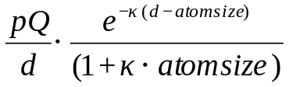
How are GPUs changing computation?
Example: compute field strength in the neighborhood of a molecule
field strength at each grid point depends on
distance from each atom
charge of each atom
sum all contributions
for each grid point p
for each atom a
d = dist(p, a)
val[p] += field(a, d)

Slide 4
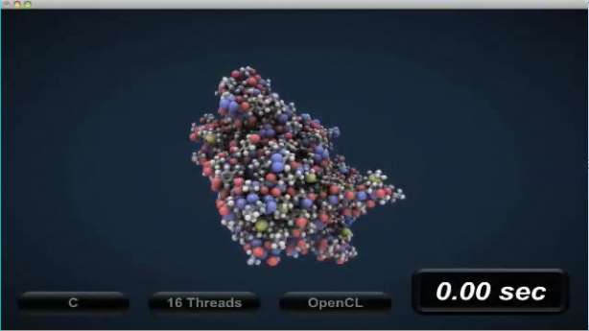
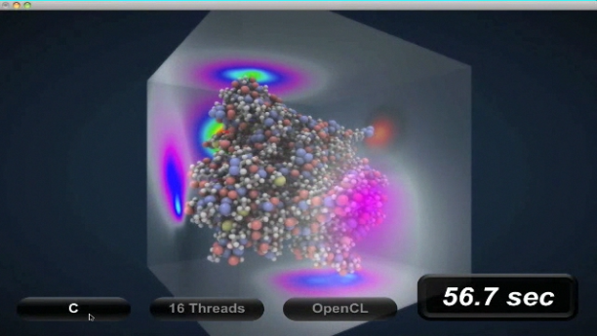
Run on CPU only
image credit: http://www.macresearch.org
Single core: about a minute

Slide 5
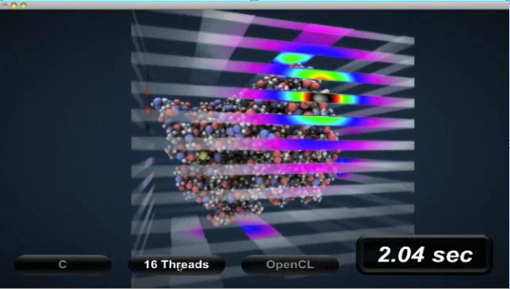
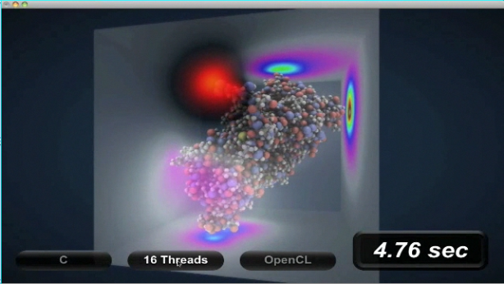
Run on 16 cores
image credit: http://www.macresearch.org
16 threads in 16 cores:
about 5 seconds

Slide 6
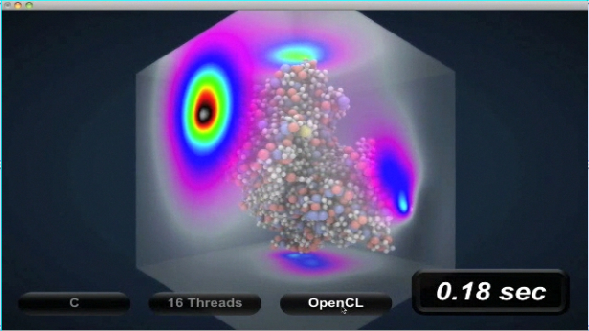
Run with OpenCL
clip credit: http://www.macresearch.org
With OpenCL and a GPU device:
a blink of an eye (< 0.2s)

Slide 7
Test run timings
 | Time | Speedup
CPU | 20.49 | 1
GPU not optimized | 0.15 | 136
GPU optimized | 0.07 | 292

Slide 8
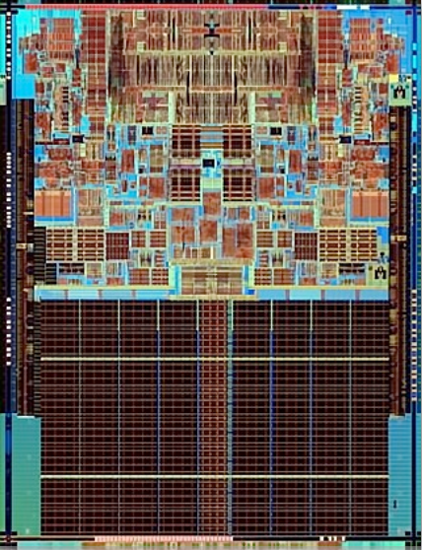
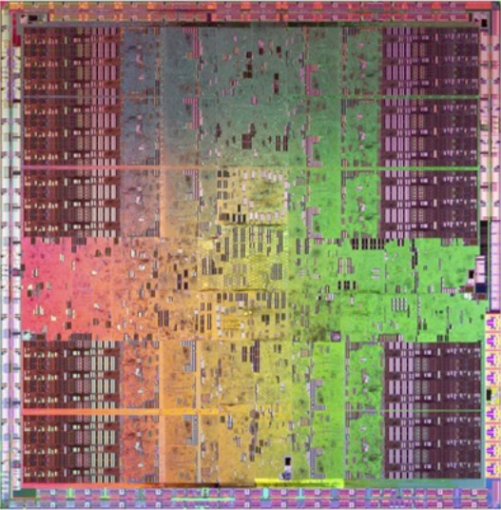
Why Is GPU so Fast?
GPU
CPU

Slide 9
GPU vs CPU (2008)
 | GTX 280 | Q9450
Bus | 512 bits | 128 bits
memory | 1GB GDDR3 dual port | 8GB single port
memory bandwidth | 141 GB/s | 12.1 GB/s
cache | 16kB + 16kB per block | 12 MB
cores | 240 | 4

Slide 10
Why should I care about heterogeneous computing?
rev
Increased computational power
  no longer comes from increased clock speeds
  does come from parallelism with multiple CPUs and programmable GPUs
CPU
multicore
computing
Heterogeneous
computing
GPU
data parallel
computing

Slide 11
What is OpenCL?
Open Computing Language
  standard for parallel programming of heterogeneous systems consisting of parallel processors like CPUs and GPUs
  specification developed by many companies
  maintained by the Khronos Group
    OpenGL and other open spec. technologies
Implemented by hardware vendors
  implementation is compliant if it conforms to the specifications

Slide 12
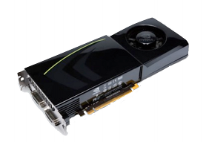
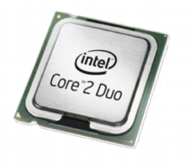
What is an OpenCL device?
Any piece of hardware that is OpenCL compliant
  device
    compute units
      processing elements
multicore CPU
many graphics adapters
Nvidia
AMD

Slide 13
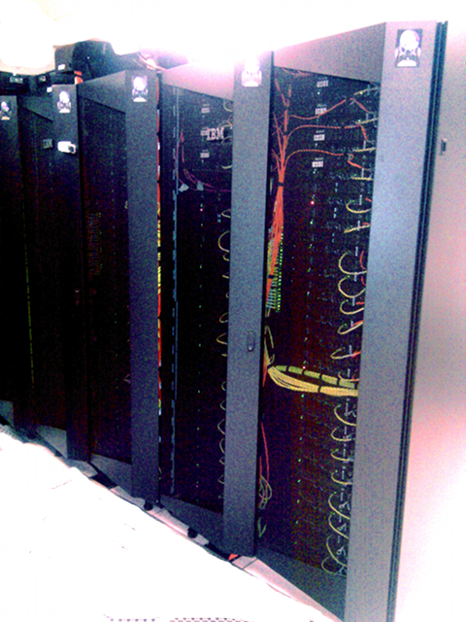
A Dali-gpu node is an OpenCL device

Slide 14
OpenCL features
Clean API
  ANSI-C99 language support
  additional data types, built-ins
Thread management framework
  application and thread-level synchronization
  easy to use, lightweight
Uses all resources in your computer
IEEE-754 compliant rounding behavior
Provide guidelines for future hardware designs

Slide 15

OpenCL's place in data parallel computing
Coarse grain
Fine grain
Grid
MPI
OpenMP/pthreads
SIMD/Vector engines

Slide 16
OpenCL ➔ the one big idea
remove one level of loops
each processing element has a global id
for i in 0...(n-1)
{
c[i] = f(a[i], b[i]);
}
then
id = get_global_id(0)
c[id] = f(a[id], b[id])
now

Slide 17
How are GPUs changing computation?
Example: compute field strength in the neighborhood of a molecule
for each atom a
d = dist(p, a)
val[p] += field(a, d)
for each grid point p
for each atom a
d = dist(p, a)
val[p] += field(a, d)

Slide 18
What kind of problems can OpenCL help?
Data Parallel Programming 101:
apply the same operation to each element of an array independently.
define F(x){...}
i = get_global_id(0); end = len(data)
while (i < end){ F(data[i]);
i = i + ncpus
}
F operates on one element of a data[ ] array
Each processor works on one element of the array at a time.
There are 4 processors in this example, and four colors...
(A real GPU has many more processors)
0
1
2
3
4
5
6
7
8
9
10
11
12

Slide 19


Is GPU a cure for everything?
Problems that map well
  separation of problem into independent parts
  linear algebra
  random number generation
  sorting (radix sort, bitonic sort)
  regular language parsing
Not so well
  inherently sequential problems
  non-local calculations
  anything with communication dependence
  device dependence
!
!!

Slide 20

How do I program them?
  C++
    Supported by Nvidia, AMD, ...
  Fortran
    FortranCL: an OpenCL Interfce to Fortran 90
    V0.1 alpha
    is coming up to speed
  Python
    PyOpenCL
  Libraries

Slide 21
OpenCL environments
Drivers
  Nvidia
  AMD
  Intel
  IBM
Libraries
  OpenCL toolbox for MATLAB
  OpenCLLink for Mathematica
  OpenCL Data Parallel Primitives Library (clpp)
  ViennaCL – linear algebra library

Slide 22
OpenCL environments
Other language bindings
  WebCL JavaScript Firefox and WebKit
  Python PyOpenCL
  The Open Toolkit library – C#, OpenGL, OpenAL, Mono/.NET
  Fortran
Tools
  gDEBugger
  clcc
  SHOC (Scalable Heterogeneous Computing Benchmark Suite)
  ImageMagick

Slide 23
Myths about GPUs
Hard to program
  just a different programming model.
  resembles MasPar more so than x86
  C, assembler and Fortran interface
Not accurate
  IEEE 754 FP operations
  Address generation

Slide 24
Possible Future Discussions
High-level GPU programming
  Easy learning curve
  Moderate accelaration
  GPU libraries, traditional problems
    Linear algebra problems
    FFT
    list is growing!
Close to the silicon
  Steep learning curve
  More impressive accelaration
Send me your problem

Slide 25
The time is now...
Andreas Klöckner et al, "PyCUDA and PyOpenCL: A scripting-based approach to GPU run-time code generation,"
Parallel Computing, V 38, 3, March 2012, pp 157-174.

