Slide 1
Chapter 16:
Linked Lists

Slide 2
Objectives
In this chapter, you will:
  Learn about linked lists
  Learn the basic properties of linked lists
  Explore insertion and deletion operations on linked lists
  Build and manipulate a linked list
  Construct a doubly linked list
C++ Programming: Program Design Including Data Structures, Sixth Edition

Slide 3
Introduction
Data can be organized and processed sequentially using an array, called a sequential list
Problems with an array
  Array size is fixed
  Unsorted array: searching for an item is slow
  Sorted array: insertion and deletion is slow because it requires data movement
C++ Programming: Program Design Including Data Structures, Sixth Edition

Slide 4

Linked Lists
Linked list: a collection of items (nodes) containing two components:
  Data
  Address (link) of the next node in the list
C++ Programming: Program Design Including Data Structures, Sixth Edition

Slide 5
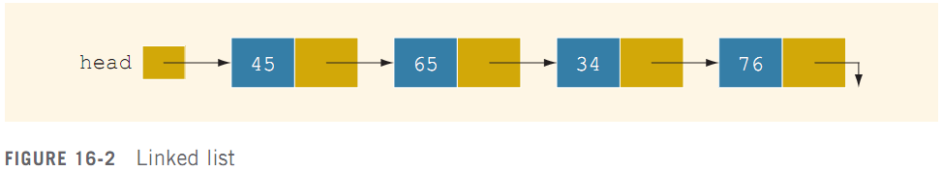

Linked Lists (cont’d.)
Example:
  Link field in the last node is null
C++ Programming: Program Design Including Data Structures, Sixth Edition

Slide 6
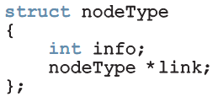
Linked Lists (cont’d.)
A node is declared as a class or struct
  Data type of a node depends on the specific application
  Link component of each node is a pointer
Variable declaration:
C++ Programming: Program Design Including Data Structures, Sixth Edition

Slide 7
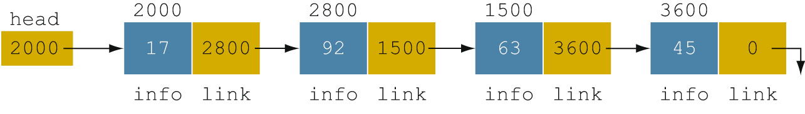
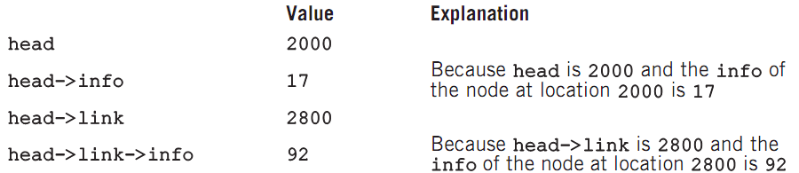
Linked Lists: Some Properties
Example: linked list with four nodes (Figure 16-4)
C++ Programming: Program Design Including Data Structures, Sixth Edition

Slide 8
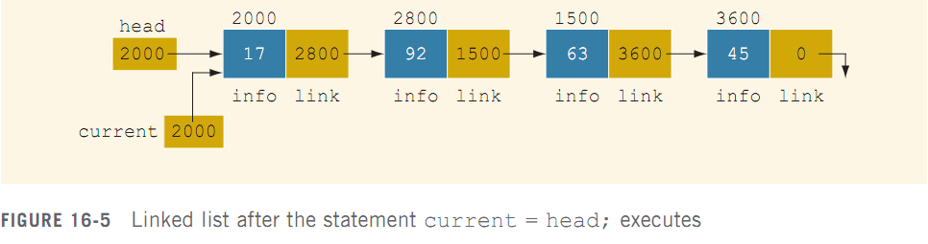
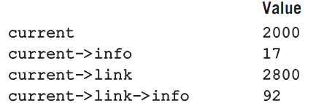
Linked Lists: Some Properties (cont’d.)
current = head;
  Copies value of head into current
C++ Programming: Program Design Including Data Structures, Sixth Edition

Slide 9
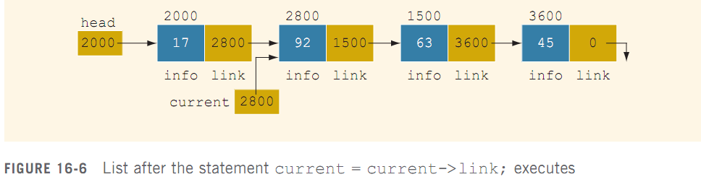
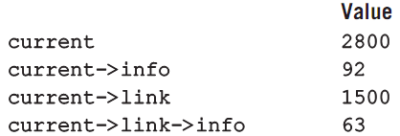
Linked Lists: Some Properties (cont’d.)
current = current->link;
C++ Programming: Program Design Including Data Structures, Sixth Edition

Slide 10
Traversing a Linked List
Basic operations of a linked list:
  Search for an item in the list
  Insert an item in the list
  Delete an item from the list
Traversal: given a pointer to the first node of the list, step through the nodes of the list
C++ Programming: Program Design Including Data Structures, Sixth Edition

Slide 11
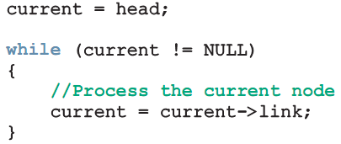
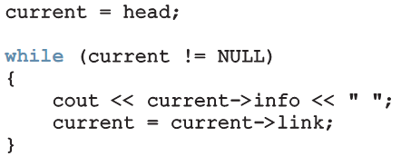
Traversing a Linked List (cont’d.)
To traverse a linked list:
Example:
C++ Programming: Program Design Including Data Structures, Sixth Edition

Slide 12
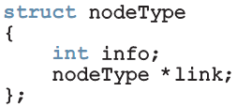
Item Insertion and Deletion
Definition of a node:
Variable declaration:
C++ Programming: Program Design Including Data Structures, Sixth Edition

Slide 13


Insertion
To insert a new node with info 50 after p in this list:
C++ Programming: Program Design Including Data Structures, Sixth Edition

Slide 14
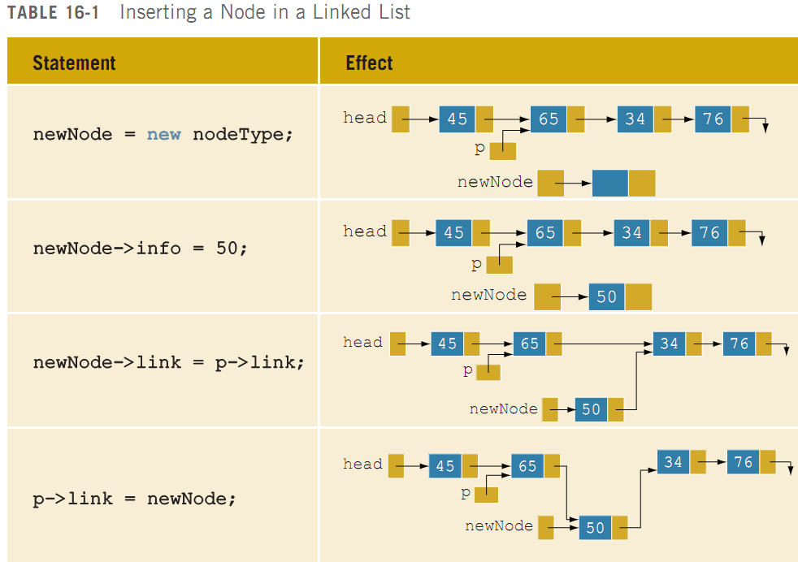
Insertion (cont’d.)
C++ Programming: Program Design Including Data Structures, Sixth Edition

Slide 15
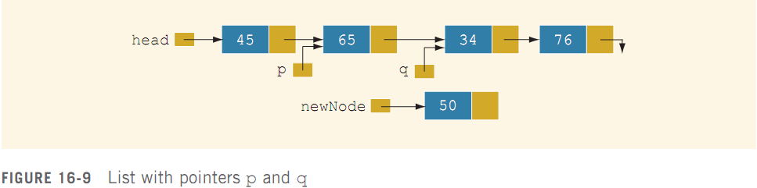

Insertion (cont’d.)
Can use two pointers to simplify the insertion code somewhat:
To insert newNode between p and q:
C++ Programming: Program Design Including Data Structures, Sixth Edition

Slide 16
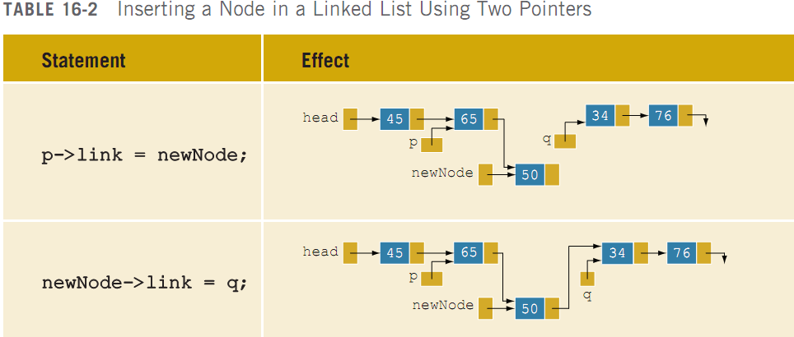
Insertion (cont’d.)
C++ Programming: Program Design Including Data Structures, Sixth Edition

Slide 17


Deletion
Node with info 34 is to be deleted:
C++ Programming: Program Design Including Data Structures, Sixth Edition

Slide 18

Deletion (cont’d.)
Node with info 34 is removed from the list, but memory is still occupied
  Node is dangling
  Must keep a pointer to the node to be able to deallocate its memory
C++ Programming: Program Design Including Data Structures, Sixth Edition

Slide 19
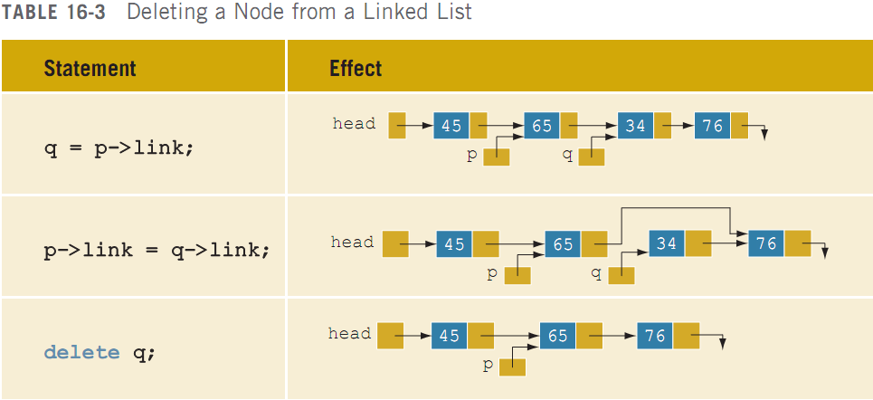
Deletion (cont’d.)
C++ Programming: Program Design Including Data Structures, Sixth Edition

Slide 20
Building a Linked List
If data is unsorted, the list will be unsorted
Can build a linked list forward or backward
  Forward: a new node is always inserted at the end of the linked list
  Backward: a new node is always inserted at the beginning of the list
C++ Programming: Program Design Including Data Structures, Sixth Edition

Slide 21
Building a Linked List Forward
Need three pointers to build the list:
  One to point to the first node in the list, which cannot be moved
  One to point to the last node in the list
  One to create the new node
Example:
  Data: 2 15 8 24 34
C++ Programming: Program Design Including Data Structures, Sixth Edition

Slide 22


Building a Linked List Forward (cont’d.)
C++ Programming: Program Design Including Data Structures, Sixth Edition

Slide 23
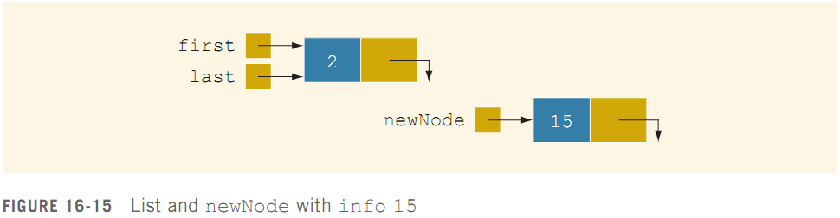

Building a Linked List Forward (cont’d.)
C++ Programming: Program Design Including Data Structures, Sixth Edition

Slide 24
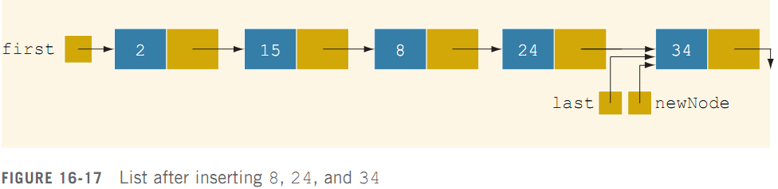
Building a Linked List Forward (cont’d.)
Now repeat this process three more times:
C++ Programming: Program Design Including Data Structures, Sixth Edition

Slide 25
Building a Linked List Backward
Algorithm to build a linked list backward:
  Initialize first to NULL
  For each item in the list
    Create the new node, newNode
    Store the data in newNode
    Insert newNode before first
    Update the value of the pointer first
C++ Programming: Program Design Including Data Structures, Sixth Edition

Slide 26
Linked List as an ADT
Basic operations on linked lists:
  Initialize the list
  Determine whether the list is empty
  Print the list
  Find the length of the list
  Destroy the list
  Retrieve info contained in the first or last node
  Search the list for a given item
C++ Programming: Program Design Including Data Structures, Sixth Edition

Slide 27
Linked List as an ADT (cont’d.)
Basic operations on linked lists (cont’d.):
  Insert an item in the list
  Delete an item from the list
  Make a copy of the linked list
C++ Programming: Program Design Including Data Structures, Sixth Edition

Slide 28
Linked List as an ADT (cont’d.)
Two general types of linked lists:
  Sorted and unsorted lists
Algorithms to implement the operations search, insert, and remove differ slightly for sorted and unsorted lists
abstract class linkedListType will implement basic linked list operations
  Derived classes: unorderedLinkedList and orderedLinkedList
C++ Programming: Program Design Including Data Structures, Sixth Edition

Slide 29
Linked List as an ADT (cont’d.)
For an unordered linked list, can insert a new item at either the end or the beginning
  buildListForward inserts item at the end
  buildListBackward inserts item at beginning
Will need two functions:
  insertFirst and insertLast
Will use two pointers in the list:
  first and last
C++ Programming: Program Design Including Data Structures, Sixth Edition
C++ Programming: From Problem Analysis to Program Design, Sixth Edition

Slide 30
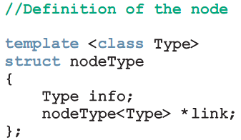
Structure of Linked List Nodes
Each node has two member variables
We implement the node of a linked list as a struct
Definition of the struct nodeType:
C++ Programming: Program Design Including Data Structures, Sixth Edition

Slide 31
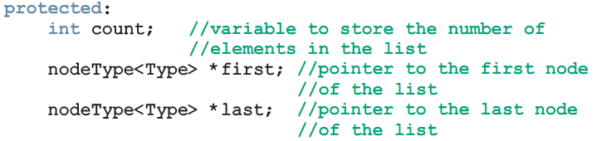
Member Variables of the class linkedListType
linkedListType has three member variables:
  Two pointers: first and last
  count: the number of nodes in the list
C++ Programming: Program Design Including Data Structures, Sixth Edition

Slide 32
Linked List Iterators
To process each node of the list
  List must be traversed, starting at first node
Iterator: object that produces each element of a container, one element at a time
  The two most common iterator operations:
    ++ (the increment operator)
    * (the dereferencing operator)
C++ Programming: Program Design Including Data Structures, Sixth Edition

Slide 33
Linked List Iterators (cont’d.)
An iterator is an object
  Need to define a class (linkedListIterator) to create iterators to objects of the class linkedListType
  Will have one member variable to refer to the current node
C++ Programming: Program Design Including Data Structures, Sixth Edition

Slide 34
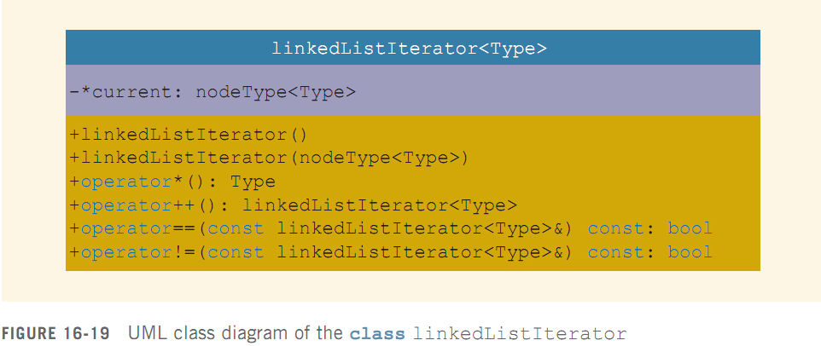
Linked List Iterators (cont’d.)
C++ Programming: Program Design Including Data Structures, Sixth Edition

Slide 35
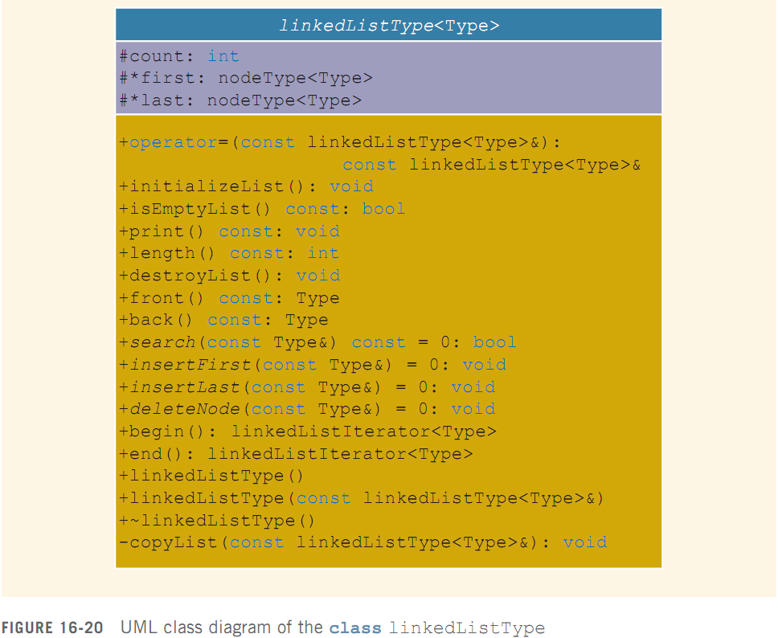
Linked List Iterators (cont’d.)
C++ Programming: Program Design Including Data Structures, Sixth Edition

Slide 36
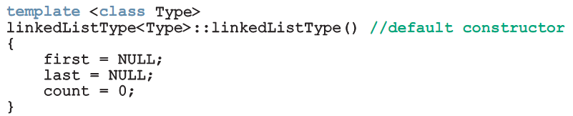
Default Constructor
Default constructor:
  Initializes the list to an empty state
C++ Programming: Program Design Including Data Structures, Sixth Edition

Slide 37
Destroy the List
Function destroyList:
  Traverses the list to deallocate memory occupied by each node
  Once list is destroyed, sets pointers first and last to NULL and count to 0
C++ Programming: Program Design Including Data Structures, Sixth Edition

Slide 38
Initialize the List
Function initializeList:
  Initializes list to an empty state
Since constructor already did this, initializeList is used to reinitialize an existing list
C++ Programming: Program Design Including Data Structures, Sixth Edition

Slide 39
Print the List
Function print:
  Prints data contained in each node
  Traverses the list using another pointer
C++ Programming: Program Design Including Data Structures, Sixth Edition

Slide 40
Length of a List
Function length:
  Returns the count of nodes in the list
  Uses the count variable
C++ Programming: Program Design Including Data Structures, Sixth Edition

Slide 41
Retrieve the Data of the First or Last Node
Function front:
  Returns the info contained in the first node
  If list is empty, program will be terminated
Function back:
  Returns the info contained in the last node
  If list is empty, program will be terminated
C++ Programming: Program Design Including Data Structures, Sixth Edition

Slide 42
Begin and End
Function begin:
  Returns an iterator to the first node in the list
Function end:
  Returns an iterator to one past the last node in the list
C++ Programming: Program Design Including Data Structures, Sixth Edition

Slide 43
Copy the List
Function copyList:
  Makes an identical copy of a linked list
Steps:
  Create a node called newNode
  Copy the info of the original node into newNode
  Insert newNode at the end of the list being created
C++ Programming: Program Design Including Data Structures, Sixth Edition

Slide 44
Destructor & Copy Constructor
Destructor:
  Deallocates memory occupied by nodes when the class object goes out of scope
  Calls destroyList to traverse the list and delete each node
Copy constructor:
  Makes an identical copy of the linked list
  Calls function copyList
C++ Programming: Program Design Including Data Structures, Sixth Edition

Slide 45
Overloading the Assignment Operator
Definition of the function to overload the assignment operator
  Similar to the copy constructor
C++ Programming: Program Design Including Data Structures, Sixth Edition

Slide 46
Unordered Linked Lists
class unorderedLinkedList
  Derived from the abstract class linkedListType
  Implements the operations search, insertFirst, insertLast, and deleteNode
C++ Programming: Program Design Including Data Structures, Sixth Edition

Slide 47
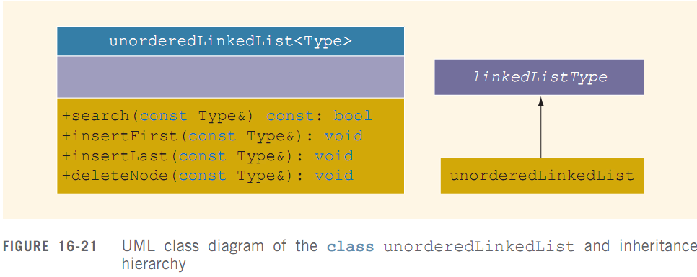
Unordered Linked Lists (cont’d.)
C++ Programming: Program Design Including Data Structures, Sixth Edition

Slide 48
Search the List
Function search:
  Searches the list for a given item
Steps:
  Compare search item with current node in the list
    If info of current node is the same as search item, stop the search
    Otherwise, make the next node the current node
  Repeat Step 1 until item is found or until no more data is left in the list
C++ Programming: Program Design Including Data Structures, Sixth Edition

Slide 49
Insert the First Node
Function insertFirst:
  Inserts a new item at the beginning of the list
Steps:
  Create a new node
  Store the new item in the new node
  Insert the node before first
  Increment count by 1
C++ Programming: Program Design Including Data Structures, Sixth Edition

Slide 50
Insert the Last Node
Function insertLast:
  Inserts a new node after last
  Similar to insertFirst function
C++ Programming: Program Design Including Data Structures, Sixth Edition

Slide 51
Delete a Node
Function deleteNode:
  Deletes a node with given info from the list
  Several possible cases to manage
Case 1: List is empty
  If the list is empty, output an error message
Case 2: Node to be deleted is the first node
  Adjust the pointer first and count
  If no other nodes, set first and last to NULL
C++ Programming: Program Design Including Data Structures, Sixth Edition

Slide 52
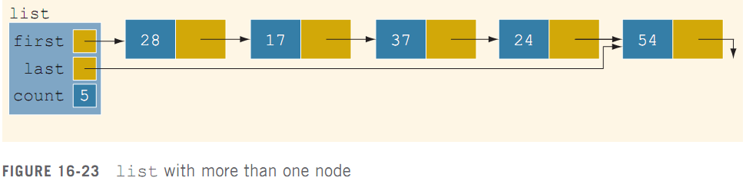
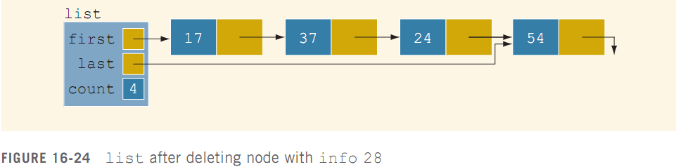
Delete a Node (cont’d.)
C++ Programming: Program Design Including Data Structures, Sixth Edition

Slide 53
Delete a Node (cont’d.)
Case 3: Node to be deleted is not the first one
  Case 3a: Node to be deleted is not last one
    Update link field of the previous node
  Case 3b: Node to be deleted is the last node
    Update link field of the previous node to null
    Update last pointer to point to previous node
C++ Programming: Program Design Including Data Structures, Sixth Edition

Slide 54
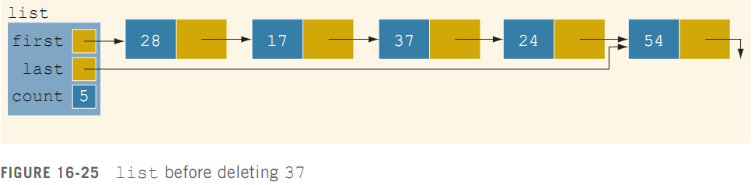
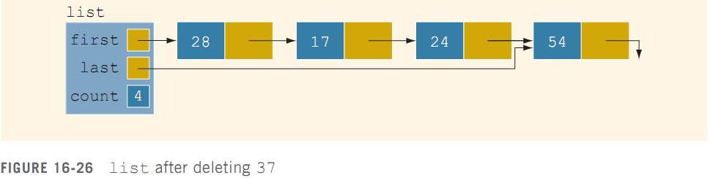
Delete a Node (cont’d.)
C++ Programming: Program Design Including Data Structures, Sixth Edition

Slide 55
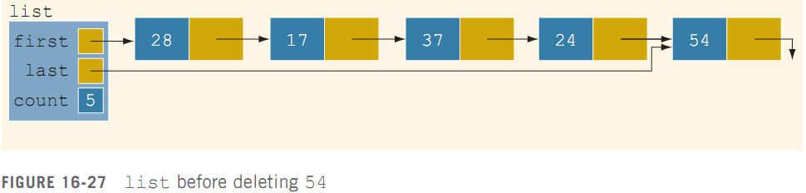
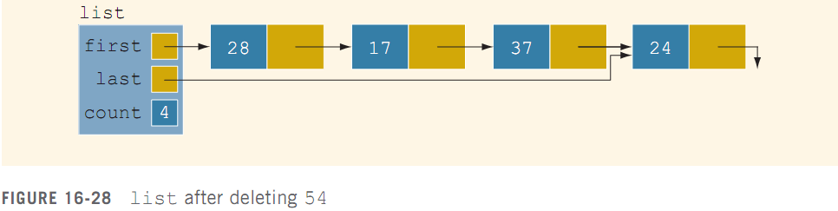
Delete a Node (cont’d.)
C++ Programming: Program Design Including Data Structures, Sixth Edition

Slide 56
Delete a Node (cont’d.)
Case 4: Node to be deleted is not in the list
  List requires no adjustment
  Simply output an error message
C++ Programming: Program Design Including Data Structures, Sixth Edition

Slide 57
Ordered Linked Lists
orderedLinkedList: derived from class linkedListType
  Provides definitions of the abstract functions insertFirst, insertLast, search, and deleteNode
Assume that elements of an ordered linked list are arranged in ascending order
Include the function insert to insert an element in an ordered list at its proper place
C++ Programming: Program Design Including Data Structures, Sixth Edition

Slide 58
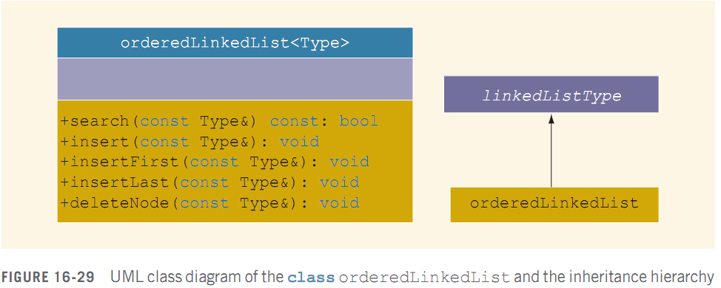
Ordered Linked Lists (cont’d.)
C++ Programming: Program Design Including Data Structures, Sixth Edition

Slide 59
Search the List
Steps:
  Compare the search item with the current node in the list
    If info of current node is >= to search item, stop search
    Otherwise, make the next node the current node
  Repeat Step 1 until an item in the list >= to search item is found, or no more data is left in the list
C++ Programming: Program Design Including Data Structures, Sixth Edition

Slide 60
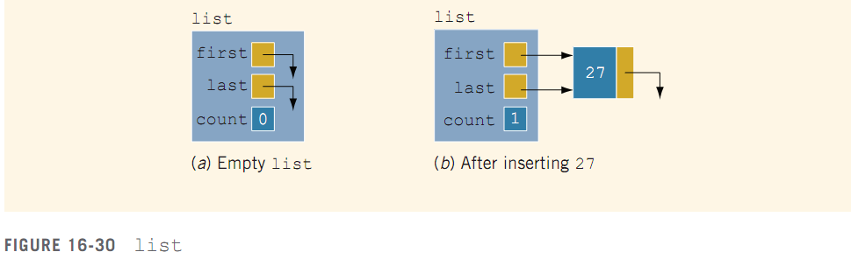
Insert a Node
Case 1: The list is empty
  New node becomes first node
C++ Programming: Program Design Including Data Structures, Sixth Edition

Slide 61
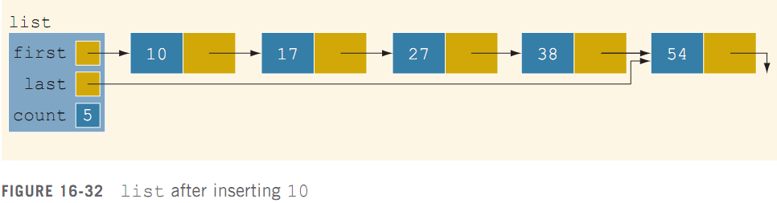
Insert a Node (cont’d.)
Case 2: List is not empty, and the item to be inserted is smaller than smallest item in list
  New node goes at beginning of list
C++ Programming: Program Design Including Data Structures, Sixth Edition

Slide 62
Insert a Node (cont’d.)
Case 3: New item to be inserted somewhere in list
  Case 3a: New item is larger than largest item
    New item is inserted at end of list
  Case 3b: Item to be inserted goes somewhere in the middle of the list
C++ Programming: Program Design Including Data Structures, Sixth Edition

Slide 63
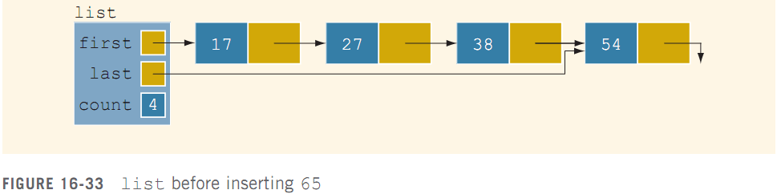
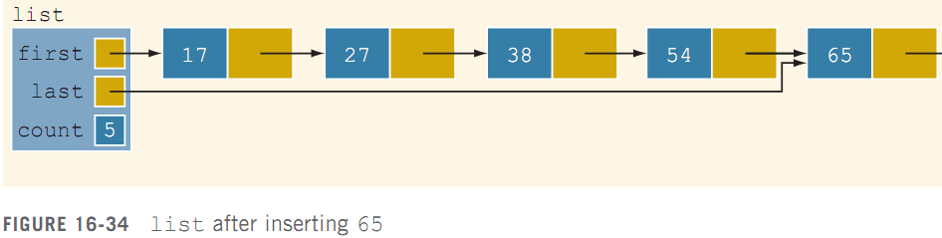
Insert a Node (cont’d.)
C++ Programming: Program Design Including Data Structures, Sixth Edition

Slide 64
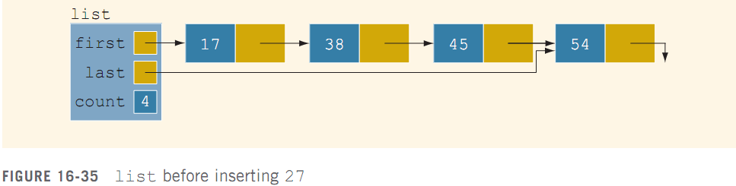
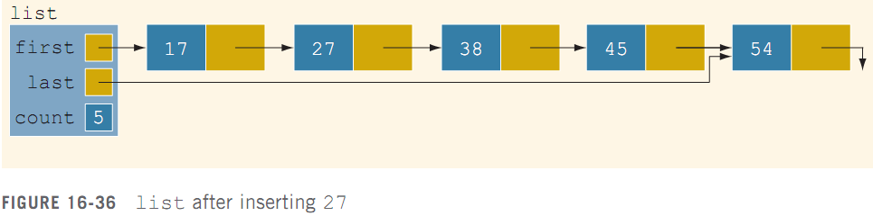
Insert a Node (cont’d.)
C++ Programming: Program Design Including Data Structures, Sixth Edition

Slide 65
Insert First and Insert Last
Functions insertFirst and insertLast
  Must insert new item at the proper place to ensure resulting list is still sorted
These functions are not actually used
  Definitions must be provided because they are declared as abstract in the parent class
Function insertNode is used to insert at the proper place
C++ Programming: Program Design Including Data Structures, Sixth Edition

Slide 66
Delete a Node
Case 1: List is initially empty → error
Case 2: Item to be deleted is first node in list
  Adjust the head (first) pointer
Case 3: Item is somewhere in the list
  current points to node with item to delete
  trailCurrent points to node previous to the one pointed to by current
Case 4: Item is not in the list →error
C++ Programming: Program Design Including Data Structures, Sixth Edition

Slide 67
Print a Linked List in Reverse Order (Recursion Revisited)
Links are only in forward direction
  Cannot traverse list backward using links
Can use recursion
  List is printed only if pointer to the list is not null
Recursive call is on the tail of the list
  When tail is empty, recursion stops
C++ Programming: Program Design Including Data Structures, Sixth Edition

Slide 68
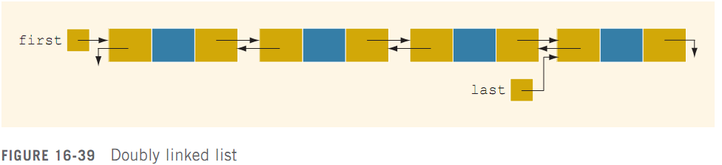
Doubly Linked Lists
Doubly linked list: every node has next and back pointers
  Can be traversed in either direction
C++ Programming: Program Design Including Data Structures, Sixth Edition

Slide 69
Doubly Linked Lists (cont’d.)
Operations:
  Initialize or destroy the list
  Determine whether the list is empty
  Search the list for a given item
  Retrieve the first or last element of the list
  Insert or delete an item
  Find the length of the list
  Print the list
  Make a copy of the list
C++ Programming: Program Design Including Data Structures, Sixth Edition

Slide 70
Default Constructor
Default constructor:
  Initializes doubly-linked list to empty state
  Sets first and last to null, and count to 0
isEmptyList:
  Returns true if list is empty, false otherwise
C++ Programming: Program Design Including Data Structures, Sixth Edition

Slide 71
Destroy the List & Initialize the List
Function destroy:
  Deletes all the nodes in the list, leaving list in an empty state
  Sets count to 0
Function initializeList:
  Reinitializes doubly linked list to an empty state
  Uses the destroy operation
C++ Programming: Program Design Including Data Structures, Sixth Edition

Slide 72
Length of the List & Print the List
Function length
  Returns the count of nodes in the list
Function print
  Traverses the list
  Outputs the info contained in each node
Function reversePrint
  Traverses list in reverse order using back links
  Outputs the info in each node
C++ Programming: Program Design Including Data Structures, Sixth Edition

Slide 73
Search the List
Function search:
  Returns true if search item is found, otherwise false
  Algorithm is same as that for an ordered linked list
C++ Programming: Program Design Including Data Structures, Sixth Edition

Slide 74
First and Last Elements
Function front
  Returns first element of the list
Function back
  Returns last element of the list
If list is empty, both functions will terminate the program
C++ Programming: Program Design Including Data Structures, Sixth Edition

Slide 75
Insert a Node
Four insertion cases:
  Case 1: Insertion in an empty list
  Case 2: Insertion at beginning of a nonempty list
  Case 3: Insertion at end of a nonempty list
  Case 4: Insertion somewhere in nonempty list
Cases 1 & 2 require update to pointer first
Cases 3 & 4 are similar:
  After inserting item, increment count by 1
C++ Programming: Program Design Including Data Structures, Sixth Edition

Slide 76
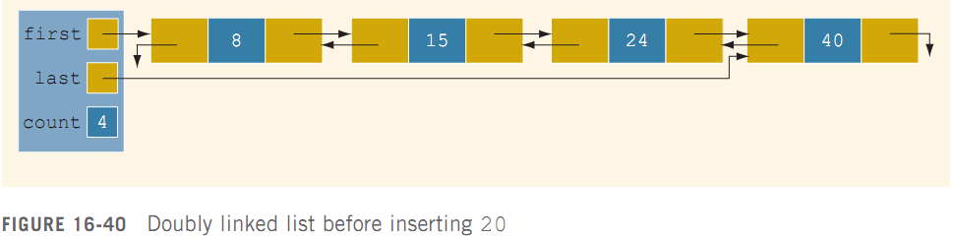
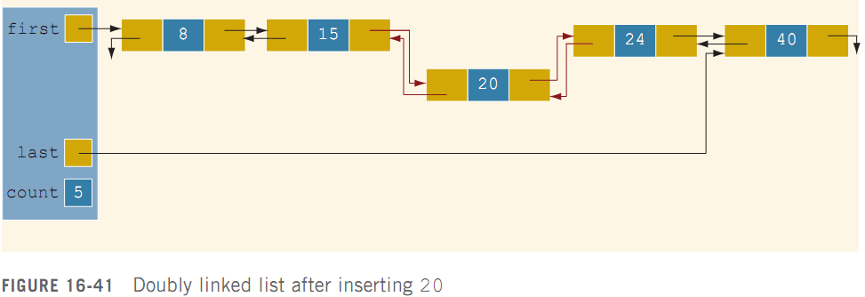
Insert a Node (cont’d.)
C++ Programming: Program Design Including Data Structures, Sixth Edition

Slide 77
Delete a Node
Case 1: The list is empty
Case 2: The item to be deleted is first node in list
  Must update the pointer first
Case 3: Item to be deleted is somewhere in the list
Case 4: Item to be deleted is not in the list
After deleting a node, count is decremented by 1
C++ Programming: Program Design Including Data Structures, Sixth Edition

Slide 78
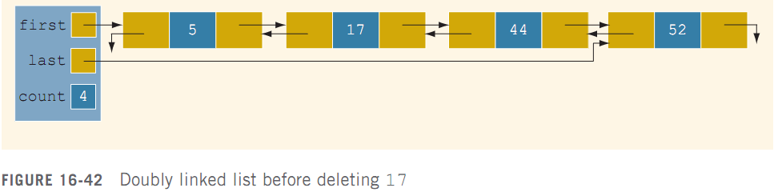
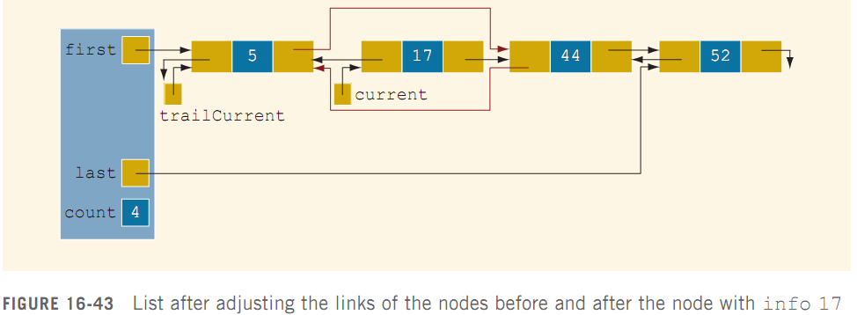
Delete a Node (cont’d.)
C++ Programming: Program Design Including Data Structures, Sixth Edition

Slide 79
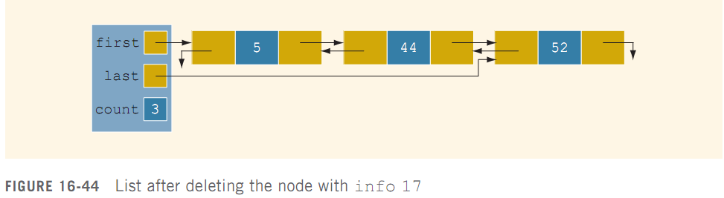
Delete a Node (cont’d.)
C++ Programming: Program Design Including Data Structures, Sixth Edition

Slide 80
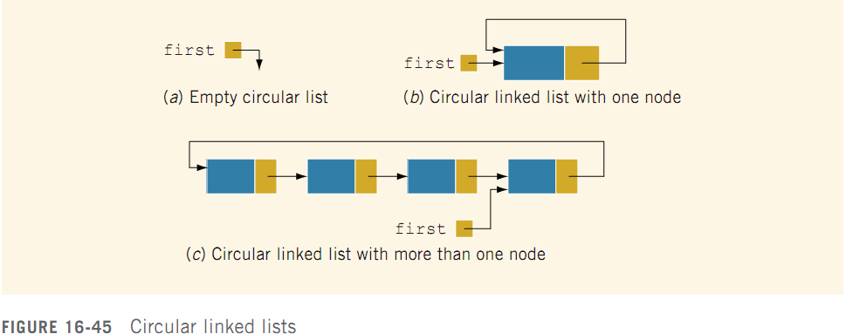
Circular Linked Lists
Circular linked list: a linked list in which the last node points to the first node
C++ Programming: Program Design Including Data Structures, Sixth Edition

Slide 81
Circular Linked Lists (cont’d.)
Operations on a circular list:
  Initialize the list (to an empty state)
  Determine if the list is empty
  Destroy the list
  Print the list
  Find the length of the list
  Search the list for a given item
  Insert or delete an item
  Copy the list
C++ Programming: Program Design Including Data Structures, Sixth Edition

Slide 82
Summary
A linked list is a list of items (nodes)
  Order of the nodes is determined by the address (link) stored in each node
Pointer to a linked list is called head or first
A linked list is a dynamic data structure
The list length is the number of nodes
C++ Programming: Program Design Including Data Structures, Sixth Edition

Slide 83
Summary (cont’d.)
Insertion and deletion does not require data movement
  Only the pointers are adjusted
A (single) linked list is traversed in only one direction
Search of a linked list is sequential
The head pointer is fixed on first node
Traverse: use a pointer other than head
C++ Programming: Program Design Including Data Structures, Sixth Edition

Slide 84
Summary (cont’d.)
Doubly linked list
  Every node has two links: next and previous
  Can be traversed in either direction
  Item insertion and deletion require the adjustment of two pointers in a node
A linked list in which the last node points to the first node is called a circular linked list
C++ Programming: Program Design Including Data Structures, Sixth Edition

