Slide 1
Chapter 19:
Binary Trees

Slide 2
Objectives
In this chapter, you will:
  Learn about binary trees
  Explore various binary tree traversal algorithms
  Organize data in a binary search tree
  Insert and delete items in a binary search tree
  Explore nonrecursive binary tree traversal algorithms
C++ Programming: Program Design Including Data Structures, Sixth Edition

Slide 3
Binary Trees
Definition: a binary tree T is either empty or has these properties:
  Has a root node
  Has two sets of nodes: left subtree L_{T} and right subtree R_{T}
  L_{T} and R_{T} are binary trees
C++ Programming: Program Design Including Data Structures, Sixth Edition

Slide 4
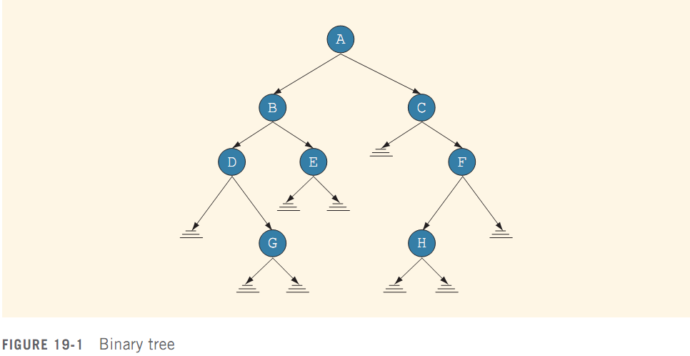
Binary Trees (cont’d.)
Root node, and
parent of B and C
Left child of A
Right child of A
Node
Directed edge,
directed branch, or
branch
Empty subtree
(F’s right subtree)
C++ Programming: Program Design Including Data Structures, Sixth Edition

Slide 5
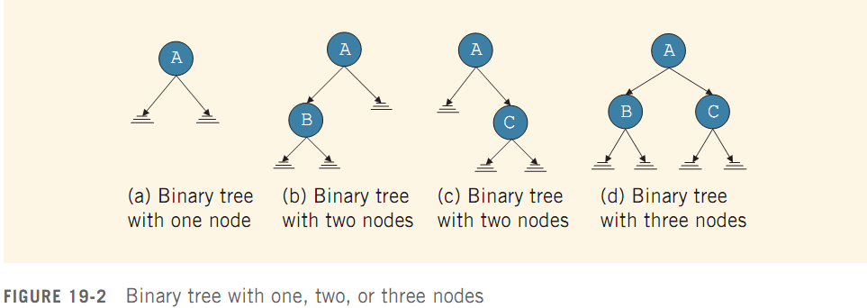
Binary Trees (cont’d.)
C++ Programming: Program Design Including Data Structures, Sixth Edition

Slide 6
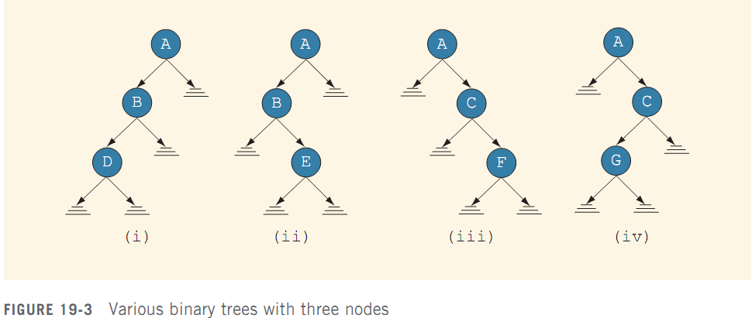
Binary Trees (cont’d.)
C++ Programming: Program Design Including Data Structures, Sixth Edition

Slide 7
Binary Trees (cont’d.)
Every node has at most two children
A node:
  Stores its own information
  Keeps track of its left subtree and right subtree using pointers
    lLink and rLink pointers
C++ Programming: Program Design Including Data Structures, Sixth Edition

Slide 8
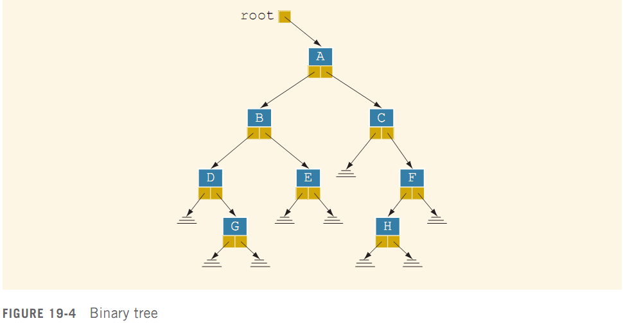
Binary Trees (cont’d.)
A pointer to the root node of the binary tree is stored outside the tree in a pointer variable
C++ Programming: Program Design Including Data Structures, Sixth Edition

Slide 9
Binary Trees (cont’d.)
Leaf: node that has no left and right children
U is parent of V if there is a branch from U to V
There is a unique path from root to every node
Length of a path: number of branches on path
Level of a node: number of branches on the path from the root to the node
  Root node level is 0
Height of a binary tree: number of nodes on the longest path from the root to a leaf
C++ Programming: Program Design Including Data Structures, Sixth Edition

Slide 10
Copy Tree
Binary tree is a dynamic data structure
  Memory is allocated/deallocated at runtime
Using just the value of the pointer of the root node makes a shallow copy of the data
To make an identical copy, must create as many nodes as are in the original tree
  Use a recursive algorithm
C++ Programming: Program Design Including Data Structures, Sixth Edition

Slide 11
Binary Tree Traversal
Insertion, deletion, and lookup operations require traversal of the tree
  Must start at the root node
Two choices for each node:
  Visit the node first
  Visit the node’s subtrees first
C++ Programming: Program Design Including Data Structures, Sixth Edition

Slide 12
Binary Tree Traversal (cont’d.)
Inorder traversal
  Traverse the left subtree
  Visit the node
  Traverse the right subtree
Preorder traversal
  Visit the node
  Traverse the left subtree
  Traverse the right subtree
C++ Programming: Program Design Including Data Structures, Sixth Edition

Slide 13
Binary Tree Traversal (cont’d.)
Postorder traversal
  Traverse the left subtree
  Traverse the right subtree
  Visit the node
Listing of nodes produced by traversal type is called:
  Inorder sequence
  Preorder sequence
  Postorder sequence
C++ Programming: Program Design Including Data Structures, Sixth Edition

Slide 14
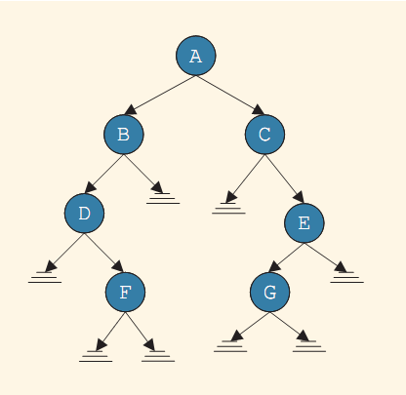
Binary Tree Traversal (cont’d.)
Inorder sequence:
  DFBACGE
Preorder sequence:
  ABDFCEG
Postorder sequence:
  FDBGECA
C++ Programming: Program Design Including Data Structures, Sixth Edition

Slide 15
Implementing Binary Trees
Typical operations:
  Determine whether the binary tree is empty
  Search the binary tree for a particular item
  Insert an item in the binary tree
  Delete an item from the binary tree
  Find the height of the binary tree
  Find the number of nodes in the binary tree
  Find the number of leaves in the binary tree
  Traverse the binary tree
  Copy the binary tree
C++ Programming: Program Design Including Data Structures, Sixth Edition

Slide 16
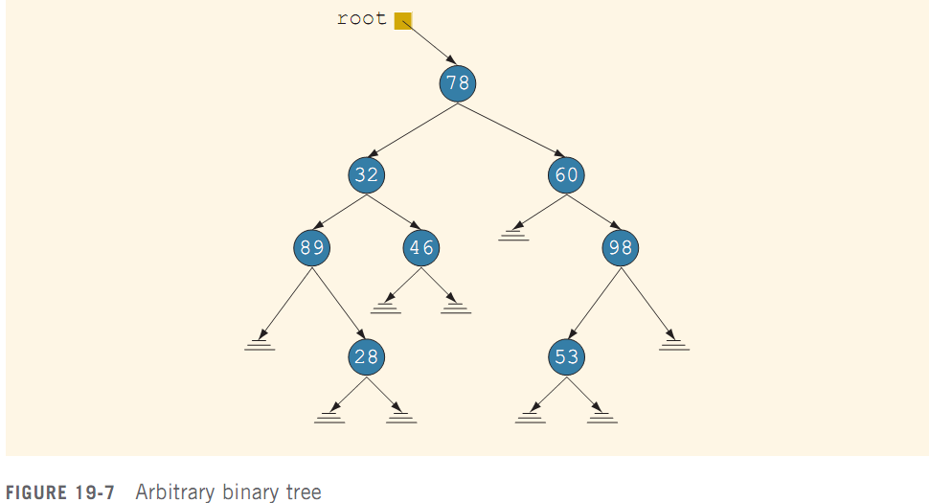
Binary Search Trees
Traverse the tree to determine whether 53 is in it - this is slow
C++ Programming: Program Design Including Data Structures, Sixth Edition

Slide 17
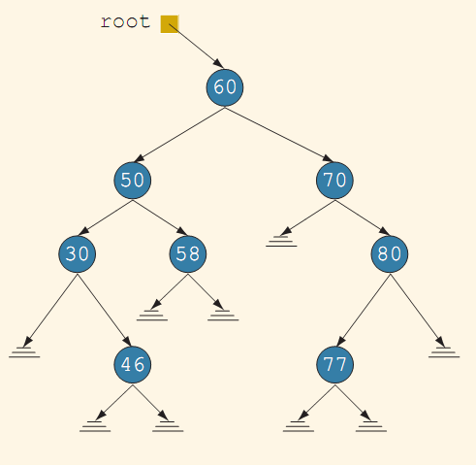
Binary Search Trees (cont’d.)
In this binary tree, data in each node is:
  Larger than data in its left child
  Smaller than data in its right child
C++ Programming: Program Design Including Data Structures, Sixth Edition

Slide 18
Binary Search Trees (cont’d.)
Definition: a binary search tree T is either empty or has these properties:
  Has a root node
  Has two sets of nodes: left subtree L_{T} and right subtree R_{T}
  Key in root node is larger than every key in left subtree, and smaller than every key in right subtree
  L_{T} and R_{T} are binary search trees
C++ Programming: Program Design Including Data Structures, Sixth Edition

Slide 19
Binary Search Trees (cont’d.)
Typical operations on a binary search tree:
  Determine if it is empty
  Search for a particular item
  Insert or delete an item
  Find the height of the tree
  Find the number of nodes and leaves in the tree
  Traverse the tree
  Copy the tree
C++ Programming: Program Design Including Data Structures, Sixth Edition

Slide 20
Search
Search steps:
  Start search at root node
  If no match, and search item is smaller than root node, follow lLink to left subtree
  Otherwise, follow rLink to right subtree
Continue these steps until item is found or search ends at an empty subtree
C++ Programming: Program Design Including Data Structures, Sixth Edition

Slide 21
Insert
After inserting a new item, resulting binary tree must be a binary search tree
Must find location where new item should be placed
  Must keep two pointers, current and parent of current, in order to insert
C++ Programming: Program Design Including Data Structures, Sixth Edition

Slide 22
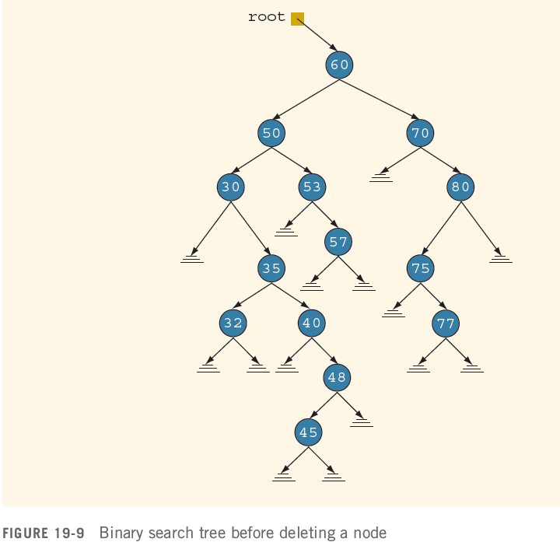
Delete
C++ Programming: Program Design Including Data Structures, Sixth Edition

Slide 23
Delete (cont’d.)
The delete operation has four cases:
  The node to be deleted is a leaf
  The node to be deleted has no left subtree
  The node to be deleted has no right subtree
  The node to be deleted has nonempty left and right subtrees
Must find the node containing the item (if any) to be deleted, then delete the node
C++ Programming: Program Design Including Data Structures, Sixth Edition

Slide 24
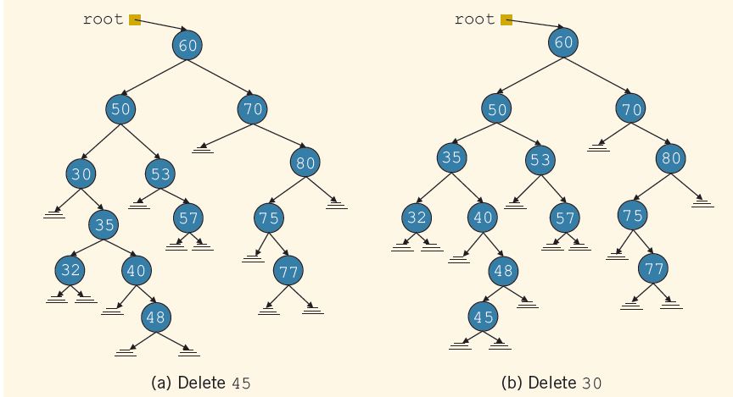
Delete (cont’d.)
C++ Programming: Program Design Including Data Structures, Sixth Edition

Slide 25
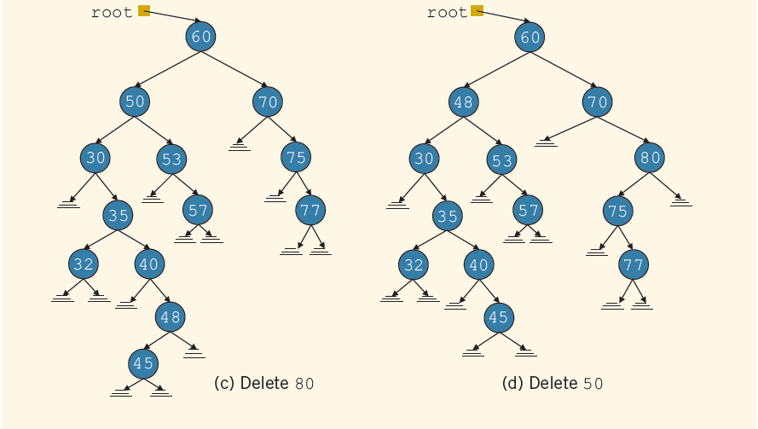
Delete (cont’d.)
(cont’d.)
C++ Programming: Program Design Including Data Structures, Sixth Edition

Slide 26
Binary Search Tree: Analysis
Let T be a binary search tree with n nodes, where n > 0
Suppose that we want to determine whether an item, x, is in T
The performance of the search algorithm depends on the shape of T
In the worst case, T is linear
C++ Programming: Program Design Including Data Structures, Sixth Edition

Slide 27
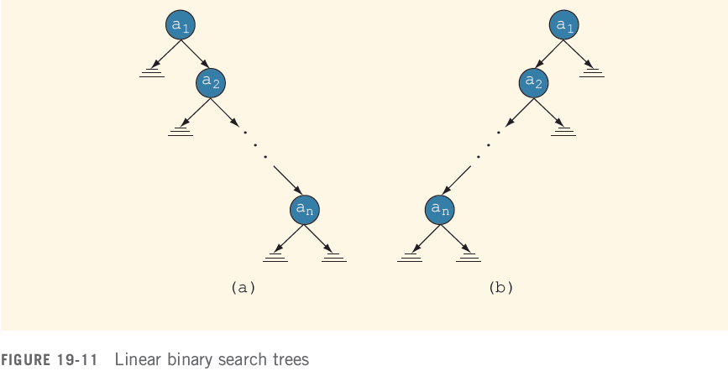
Binary Search Tree: Analysis (cont’d.)
Worst case behavior: T is linear
  O(n) key comparisons
C++ Programming: Program Design Including Data Structures, Sixth Edition

Slide 28


Binary Search Tree: Analysis (cont'd.)
Average-case behavior:
  There are n! possible orderings of the keys
    We assume that orderings are possible
  S(n) and U(n): number of comparisons in average successful and unsuccessful case, respectively
C++ Programming: Program Design Including Data Structures, Sixth Edition

Slide 29
Binary Search Tree: Analysis (cont’d.)
Theorem: Let T be a binary search tree with n nodes, where n > 0
  Average number of nodes visited in a search of T is approximately 1.39log₂n=O(log₂n)
  Number of key comparisons is approximately 2.77log₂n=O(log₂n)
C++ Programming: Program Design Including Data Structures, Sixth Edition

Slide 30
Nonrecursive Binary Tree Traversal Algorithms
The traversal algorithms discussed earlier are recursive
This section discusses the nonrecursive inorder, preorder, and postorder traversal algorithms
C++ Programming: Program Design Including Data Structures, Sixth Edition

Slide 31
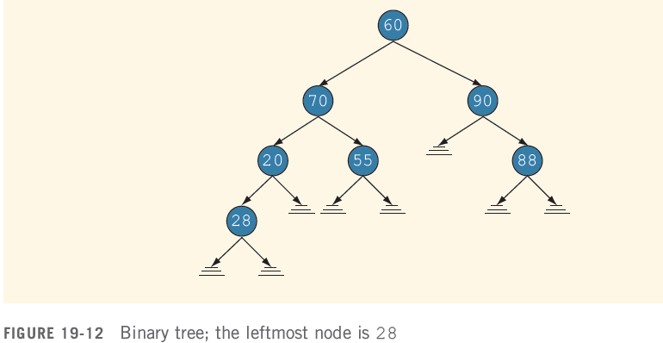
Nonrecursive Inorder Traversal
For each node, the left subtree is visited first, then the node, and then the right subtree
C++ Programming: Program Design Including Data Structures, Sixth Edition

Slide 32
Nonrecursive Preorder Traversal
For each node, first the node is visited, then the left subtree, and then the right subtree
Must save a pointer to a node before visiting the left subtree, in order to visit the right subtree later
C++ Programming: Program Design Including Data Structures, Sixth Edition

Slide 33
Nonrecursive Postorder Traversal
Visit order: left subtree, right subtree, node
Must track for the node whether the left and right subtrees have been visited
  Solution: Save a pointer to the node, and also save an integer value of 1 before moving to the left subtree and value of 2 before moving to the right subtree
  When the stack is popped, the integer value associated with that pointer is popped as well
C++ Programming: Program Design Including Data Structures, Sixth Edition

Slide 34
Binary Tree Traversal and Functions as Parameters
In a traversal algorithm, “visiting” may mean different things
  Example: output value; update value in some way
Problem:
  How do we write a generic traversal function?
  Writing a specific traversal function for each type of “visit” would be cumbersome
C++ Programming: Program Design Including Data Structures, Sixth Edition

Slide 35
Binary Tree Traversal and Functions as Parameters (cont’d.)
Solution:
  Pass a function as a parameter to the traversal function
  In C++, a function name without parentheses is considered a pointer to the function
C++ Programming: Program Design Including Data Structures, Sixth Edition

Slide 36
Binary Tree Traversal and Functions as Parameters (cont’d.)
To specify a function as a formal parameter to another function:
  Specify the function type, followed by name as a pointer, followed by the parameter types
C++ Programming: Program Design Including Data Structures, Sixth Edition

Slide 37
Summary
A binary tree is either empty or it has a special node called the root node
  If nonempty, root node has two sets of nodes (left and right subtrees), such that the left and right subtrees are also binary trees
The node of a binary tree has two links in it
A node in the binary tree is called a leaf if it has no left and right children
C++ Programming: Program Design Including Data Structures, Sixth Edition

Slide 38
Summary (cont’d.)
A node U is called the parent of a node V if there is a branch from U to V
Level of a node: number of branches on the path from the root to the node
  The level of the root node of a binary tree is 0
  The level of the children of the root is 1
Height of a binary tree: number of nodes on the longest path from the root to a leaf
C++ Programming: Program Design Including Data Structures, Sixth Edition

Slide 39
Summary (cont’d.)
Inorder traversal
  Traverse left, visit node, traverse right
Preorder traversal
  Visit node, traverse left, traverse right
Postorder traversal
  Traverse left, traverse right, visit node
In a binary search tree:
  Root node is larger than every node in left subtree
  Root node is less than every node in right subtree
C++ Programming: Program Design Including Data Structures, Sixth Edition

