Slide 1
Special Topic: Static, Stack, Heap, and Pointers
C++ vs Java

Slide 2
Three Categories of Memory
(for Data Store)
Static: storage requirements are known prior to run time; lifetime is the entire program execution
Run-time stack: memory associated with active functions
  Structured as stack frames (activation records)
Heap: dynamically allocated storage; the least organized and most dynamic storage area

Slide 3
Static Data Memory
Simplest type of memory to manage.
Consists of anything that can be completely determined at compile time; e.g., global variables, constants (perhaps), code.
Characteristics:
  Storage requirements known prior to execution
  Size of static storage area is constant throughout execution

Slide 4
Run-Time Stack
The stack is a contiguous memory region that grows and shrinks as a program runs.
Its purpose: to support method calls
It grows (storage is allocated) when the activation record (or stack frame) is pushed on the stack at the time a method is called (activated).
It shrinks when the method terminates and storage is de-allocated.

Slide 5
Run-Time Stack
The stack frame has storage for local variables, parameters, and return linkage.
The size and structure of a stack frame is known at compile time, but actual contents and time of allocation is unknown until runtime.
How is variable lifetime affected by stack management techniques?

Slide 6
Heap Memory
Heap objects are allocated/deallocated dynamically as the program runs (not associated with specific event such as function entry/exit).
The kind of data found on the heap depends on the language
  Strings, dynamic arrays, objects, and linked structures are typically located here.
  Java and C/C++ have different policies.

Slide 7
Heap Memory
Special operations (e.g., malloc, new) may be needed to allocate heap storage.
When a program deallocates storage (free, delete) the space is returned to the heap to be re-used.
Space is allocated in variable sized blocks, so deallocation may leave “holes” in the heap (fragmentation).
  Compare to deallocation of stack storage

Slide 8
Heap Management
Some languages (e.g. C, C++) leave heap storage deallocation to the programmer
  delete
Others (e.g., Java, Perl, Python, list-processing languages) employ garbage collection to reclaim unused heap space.

Slide 9
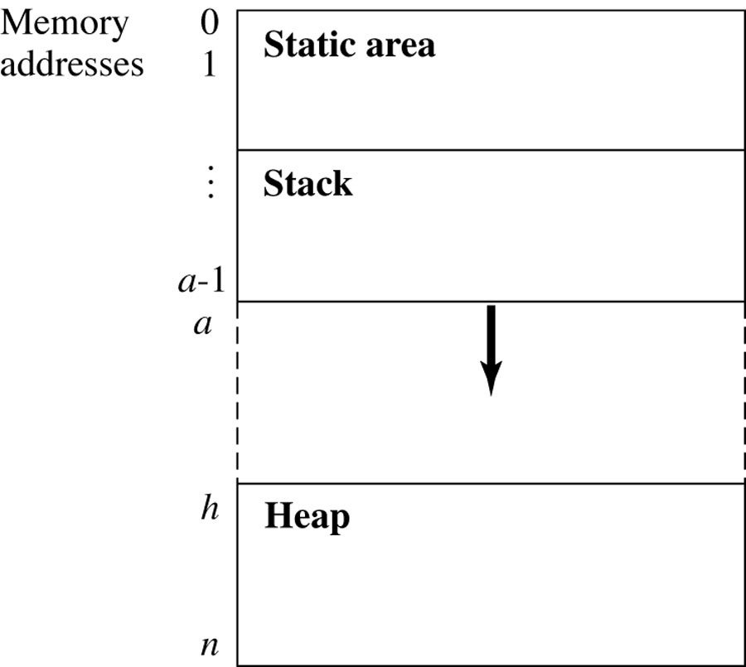
The Structure of Run-Time Memory
Figure 11.1
These two areas grow towards each other as program events require.

Slide 10
Stack Overflow
The following relation must hold:
0 ≤ a ≤ h ≤ n
In other words, if the stack top bumps into the heap, or if the beginning of the heap is greater than the end, there are problems!

Slide 11
Heap Management Functions
new returns the start address of a block of k words of unused heap storage and changes the state of the words from unused to undef.
  n ≤ k, where n is the number of words of storage needed; e.g., suppose a Java class Point has data members x,y,z which are floats.
  If floats require 4 bytes of storage, then
  Point firstCoord = new Point( )
  calls for 3 X 4 bytes (at least) to be allocated and initialized to some predetermined state.

Slide 12
Heap Overflow
Heap overflow occurs when a call to new occurs and the heap does not have a contiguous block of k unused words
So new either fails, in the case of heap overflow, or returns a pointer to the new block

Slide 13
Heap Management Functions
delete returns a block of storage to the heap
The status of the returned words are returned to unused, and are available to be allocated in response to a future new call.
One cause of heap overflow is a failure on the part of the program to return unused storage.

Slide 14
Pointers
Pointers are addresses; i.e., the value of a pointer variable is an address.
Memory that is accessed through a pointer is dynamically allocated in the heap
Java doesn’t have explicit pointers, but reference types are represented by their addresses and their storage is allocated on the heap (although the reference is on the stack).

Slide 15
Memory Allocation Java vs C++
JAVA | Stack Example | Heap Example
primitives | int a = 3; | int[] a = new int[1]; (Actually an Array Object.)
Classes | Does not exist! | String str = new String(“I am a string!”);
C++ | Stack Example | Heap Example
primitives | int a = 3; | int *a = new int;
Classes | String str(“I am a string!”) | String str = new String(“I am a string!”);
http://www.horstmann.com/ccj2/ccjapp3.html

Slide 16
Java versus C/C++/etc.
In Java, arrays are always allocated dynamically from heap memory.
In many other languages
  Globally defined arrays - static memory.
  Local (to a function) arrays are - stack storage.
  Dynamically allocated arrays - heap storage.
Dynamically allocated arrays also have storage on the stack – a reference (pointer) to the heap block that holds the array.

Slide 17
Declaring Arrays
Typical C/C++ array declarations
  int arr[5];
  float arr1[10][15];
  int *intPtr;
  intPtr = new int[5]
Typical Java array declarations:
  int[] arr = new int[5];
  float[][] arr1 = new float [10][5];
  Object[] arr2 = new Object[100];

Slide 18
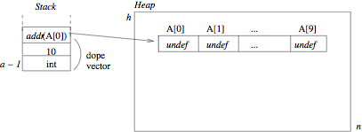
Allocation of Stack and Heap Space for Array A Figure 11.3

Slide 19
11.2.1 Memory Leaks and Garbage Collection
The increasing popularity of OO programming has meant more emphasis on heap storage management.
Active objects: can be accessed through a pointer or reference.
Inactive objects: blocks that cannot be accessed; no reference exists.
(Accessible and inaccessible may be more descriptive.)

Slide 20
Review
Three types of storage
  Static
  Stack
  Heap
Problems with heap storage:
  Memory leaks (garbage): failure to free storage when pointers (references) are reassigned
  Dangling pointers: when storage is freed, but references to the storage still exist.

Slide 21
Allocation of Stack and Heap Space for Array A Figure 11.3

Slide 22
Garbage
Garbage: any block of heap memory that cannot be accessed by the program; i.e., there is no stack pointer to the block; but which the runtime system thinks is in use.
Garbage is created in several ways:
  A function ends without returning the space allocated to a local array or other dynamic variable. The pointer (dope vector) is gone.
  A node is deleted from a linked data structure, but isn’t freed
  …

Slide 23
Another Problem
A second type of problem can occur when a program assigns more than one pointer to a block of heap memory
The block may be deleted and one of the pointers set to null, but the other pointers still exist.
If the runtime system reassigns the memory to another object, the original pointers pose a danger.

Slide 24
Terminology
A dangling pointer (or dangling reference, or widow) is a pointer (reference) that still contains the address of heap space that has been deallocated (returned to the free list).
An orphan (garbage) is a block of allocated heap memory that is no longer accessible through any pointer.
A memory leak is a gradual loss of available memory due to the creation of garbage.

Slide 25
11.3 Garbage Collection
All inaccessible blocks of storage are identified and returned to the free list.
The heap may also be compacted at this time: allocated space is compressed into one end of the heap, leaving all free space in a large block at the other end.

Slide 26
Garbage Collection
C & C++ leave it to the programmer – if an unused block of storage isn’t explicitly freed by the program, it becomes garbage.
  You can get C++ garbage collectors, but they aren’t standard
Java, Python, Perl, (and other scripting languages) are examples of languages with garbage collection
  Python, etc. also automatic allocation: no need for “new” statements
Garbage collection was pioneered by languages like Lisp, which constantly creates and destroys linked lists.

