Slide 1
Shockley-Haynes Experiment Minority Carrier Dynamics in Semiconductors
Sacha Barre & Clea Dronne

Slide 2

Introduction
Germanium group IV semiconductor
n-type Ge – group III impurities
p-types Ge – group V impurities
Minority carriers in semiconductors [1]
Mobility, $μ$
Diffusion constant, $D$
Lifetime, $τ$
[1] J. R. Haynes and W. Shockley, The Mobility and Life of Injected Holes and Electrons in Germanium, Mar 1951, Phys. Rev. 81, 835
Notes:
Studying semiconductors and the behavior of minority carriers is important to be able to exploit semiconductor materials in electronic devices like diode that rely on the injection of minority carriers
An intrinsic semiconductor like Ge (group IV) can be doped in order to modify its electrical properties
Indeed, we can have two types of semiconductor
N-types => group III impurities
P-types => group V impurities
In this experiment, we measure the dynamical properties of the minority carriers (mu, D and tau) in an n-type semiconductor to understand how and how far the carriers move and for how long they exist
Mobility: how quickly charge carriers move through a material when under the effect of an electric field. This is motion due to the electric field applied on the carriers. Dependence on the temperature and different mobilities (lattice, impurities and defects)
Diffusion: random motion of the carriers. Motion that is independent from the applied field. Due to a region that has a higher local density than an other => reaching equilibrium
Lifetime: average time it take a carrier to recombine. Recombination can be due to different interactions (https://www.freiberginstruments.com/upcdmdp/technology/electrical-characterization/minority-carrier-lifetime.html). The lifetime we measure is a combination of the bulk lifetime and the surface lifetime

Slide 3
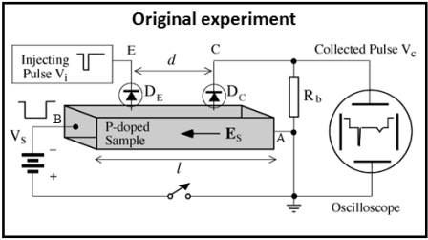
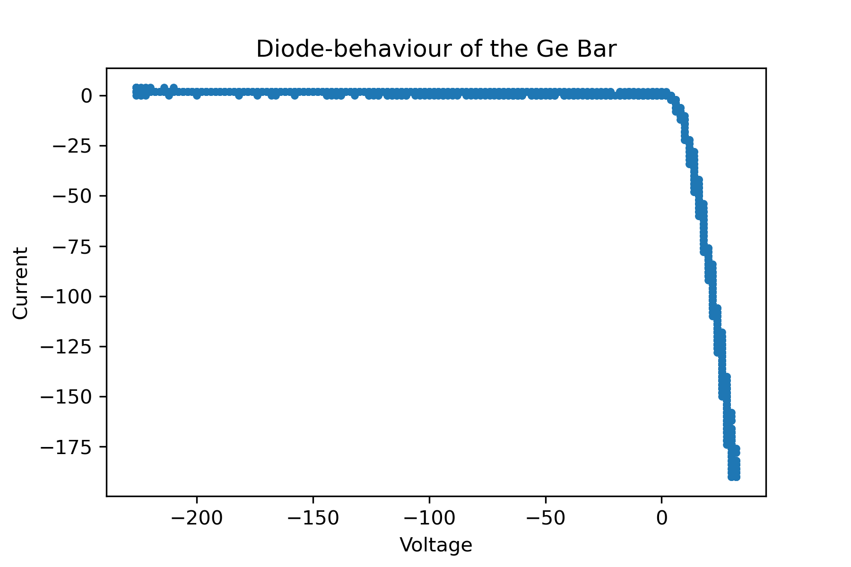
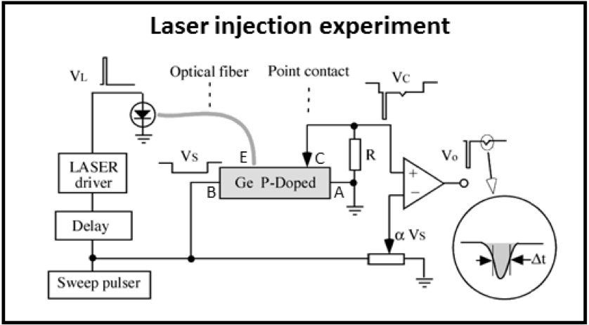
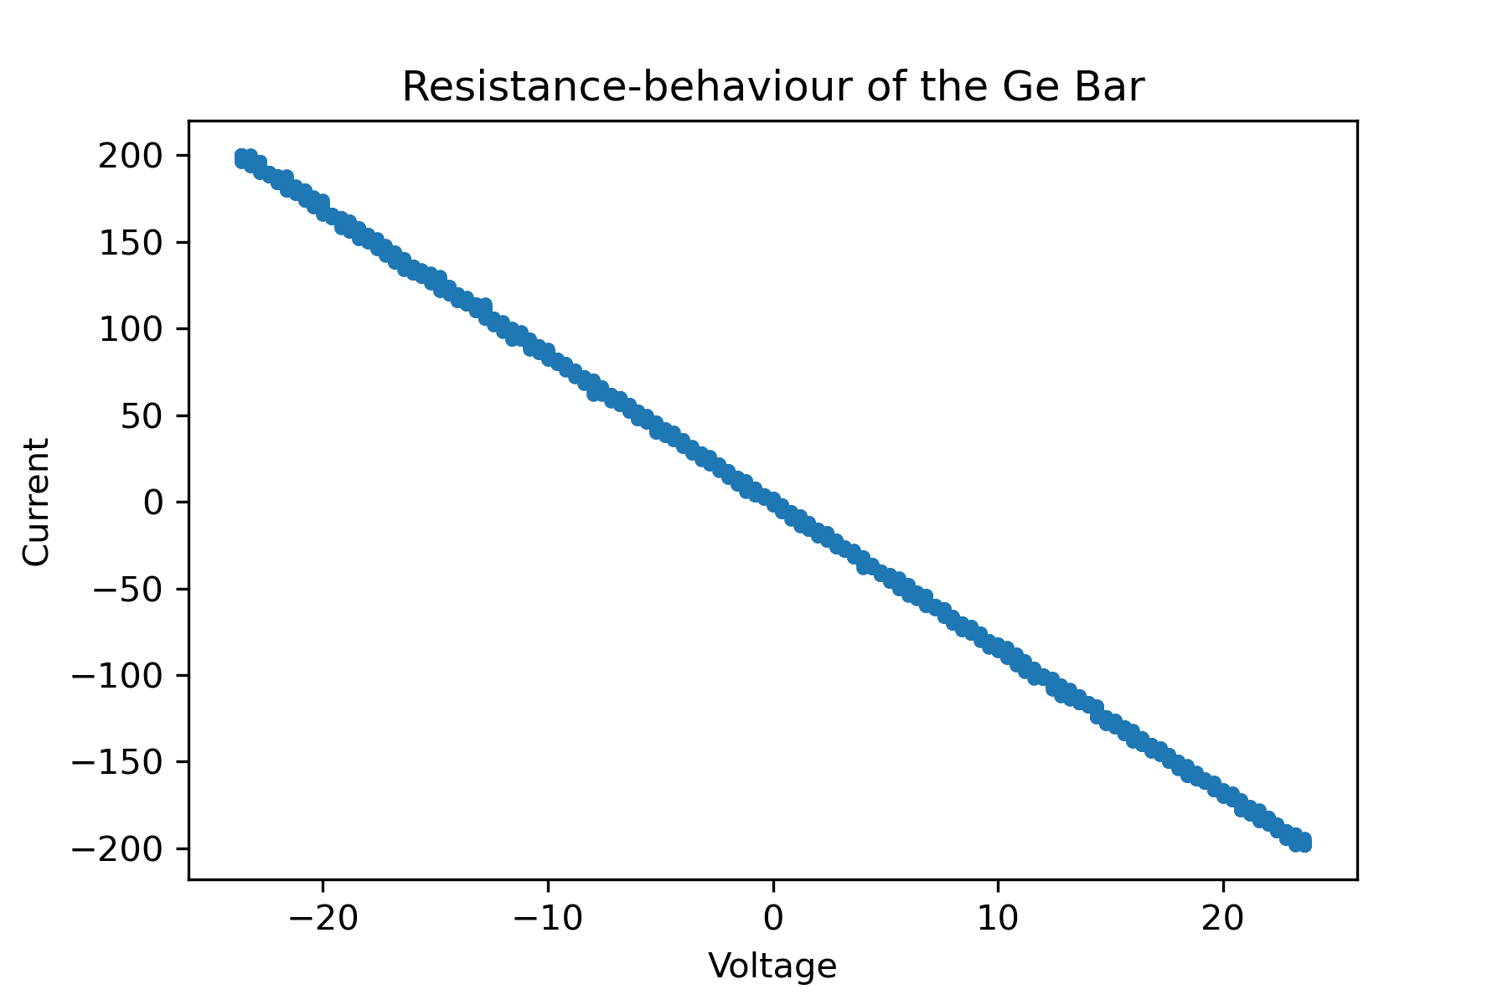
Experimental setup/detail
Diagrams taken from Lab Script
Notes:
Charge carriers are laser injected
This is the experimental setup that we used. Different from the original Shockley Haynes experiment as the charge carriers are laser injected -> limits Joule heating of the sample, pulses with low duty-cycle​
​
We also looked at the diode behaviour and resistance behaviour of the Ge bar and obtained the following Current vs. Voltage curves
This is what we expected to find as the Ge sample was an n-type semiconductor
Diode and resistance graphs are flipped with respect to conventional graphs -> we are measuring the minority charge carriers (not the majority)​
Graph confirms N-doped: diode has forward bias​

Slide 4

Theory
Dynamics of the excess minority carriers density is governed by
$$D\frac{∂^{2}n}{∂x^{2}}−μE\frac{∂n}{∂x}−\frac{n}{τ}=\frac{∂n}{∂τ}$$
Solution is
$$n\left(x,t\right)=\frac{A}{\sqrt{4πDt}}exp⁡(−\frac{{\left(x−μEt\right)}^{2}}{4Dt}−\frac{t}{τ})$$
(1)
(2)
Notes:
The dynamics of excess minority charge carriers is given by equation 1 where x is the distance down the bar and t is the time
Assuming the initial distribution is a delta function, the solution is given by equation 2
By assuming that the time at which the signal is received is small compared with the lifetime of the carriers and that the (diffusion distance is much less that the distance travelled)

Slide 5
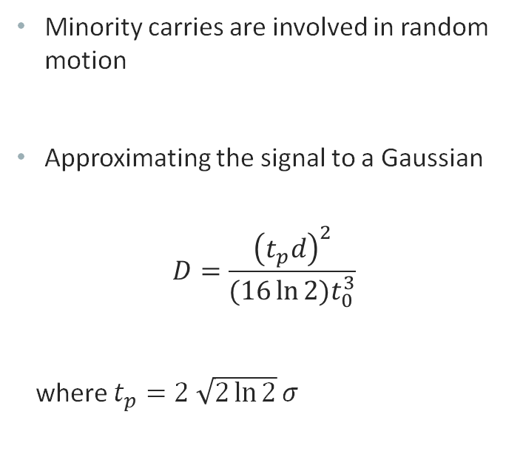
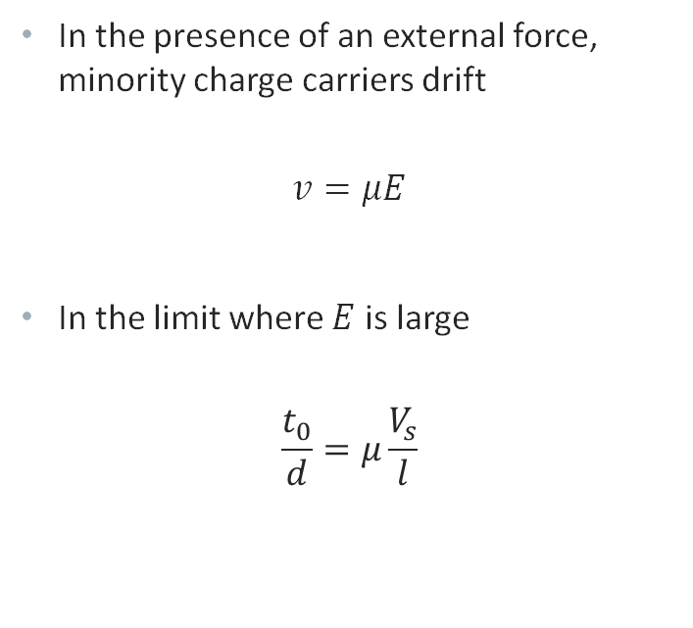
Mobility & Diffusion Constant
In the presence of an external force, minority charge carriers drift
$$v=μE$$
In the limit where $E$ is large
$$\frac{t_{0}}{d}=μ\frac{V_{s}}{l}$$
Minority carries are involved in random motion
Approximating the signal to a Gaussian
$$D=\frac{{\left(t_{p}d\right)}^{2}}{(16\ln{2}{)t}_{0}^{3}}$$
where $t_{p}=2 \sqrt{2\ln{2}}σ$
(3)
(5)
(4)

Slide 6
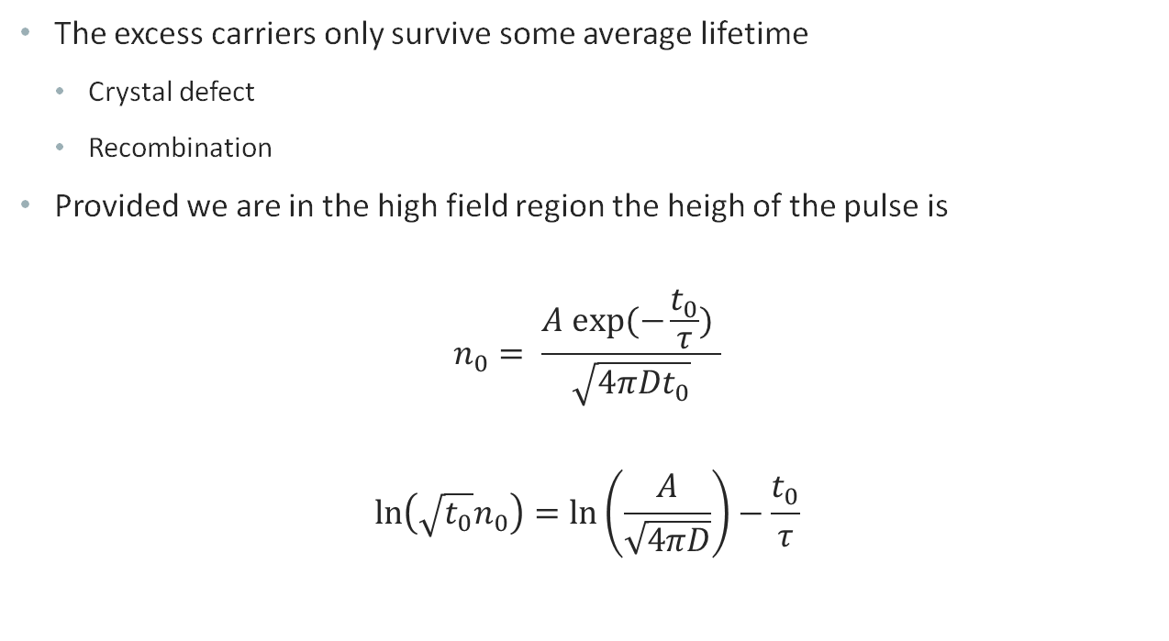
Lifetime
The excess carriers only survive some average lifetime
Crystal defect
Recombination
Provided we are in the high field region the heigh of the pulse is
$$n_{0}= \frac{A exp⁡(−\frac{t_{0}}{τ}) }{\sqrt{4πDt_{0}}}$$
$$\ln\left(\sqrt{t_{0}}n_{0}\right)=\ln\left(\frac{A}{\sqrt{4πD}}\right)−\frac{t_{0}}{τ}$$
(6)
(7)
Notes:
The excess carriers only survive some average lifetime before reaching a crystal defect or before recombination
The height of the pulse in the high field region is given by equation 6
This can be linearised to find the lifetime

Slide 7
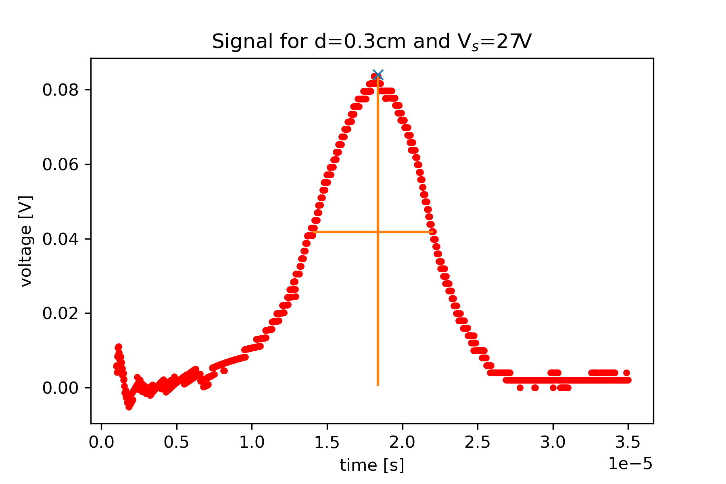
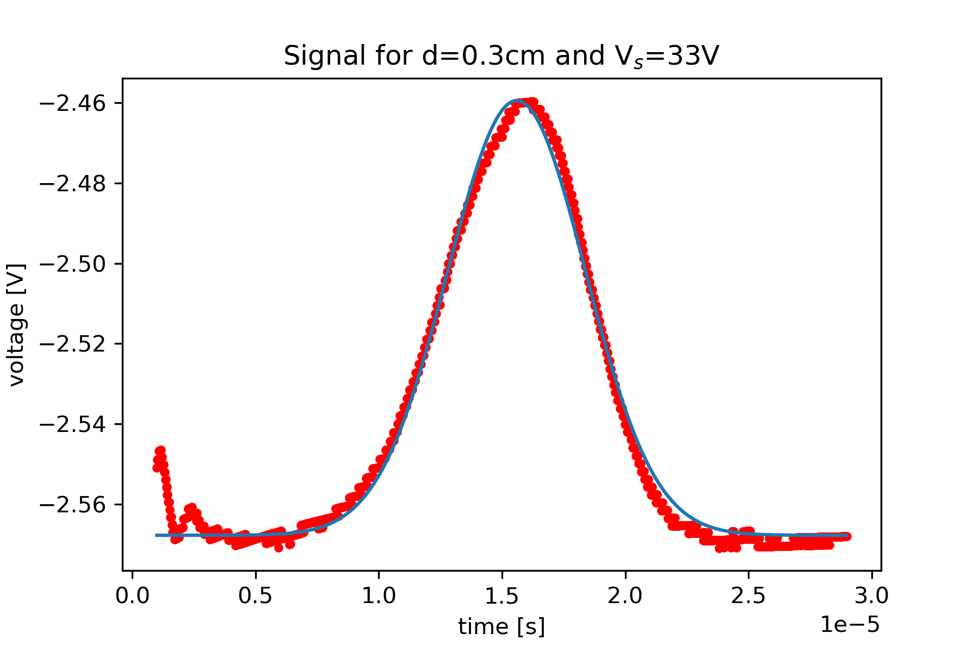
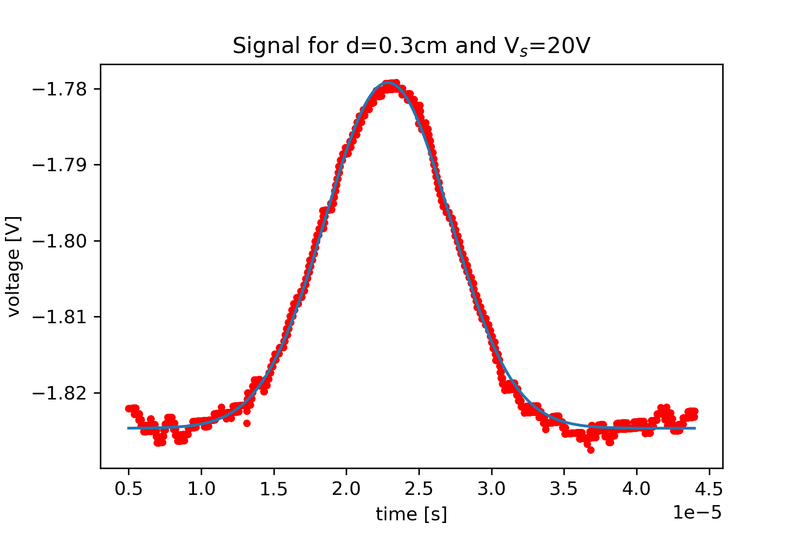
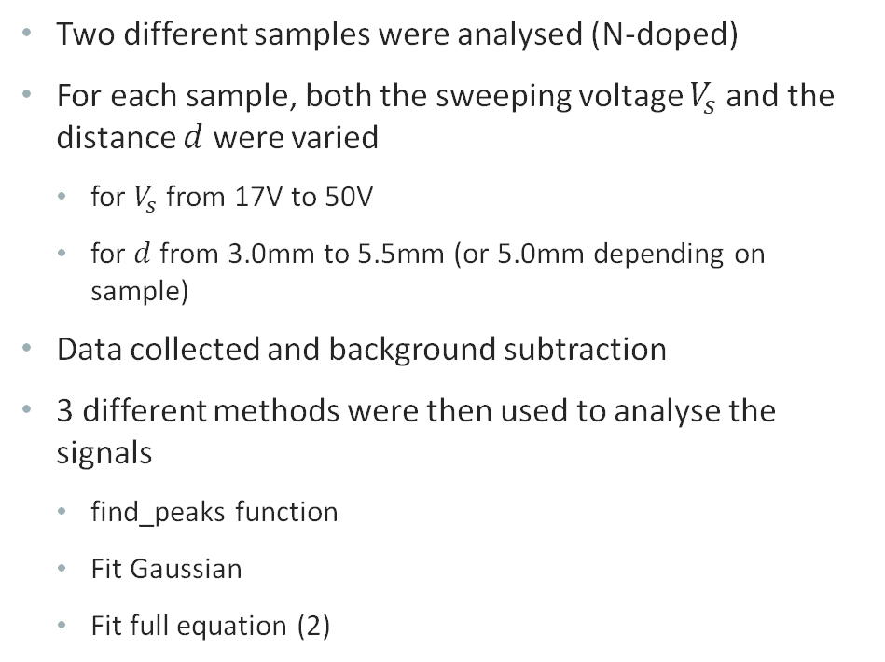
Experimental method
Two different samples were analysed (N-doped)
For each sample, both the sweeping voltage $V_{s}$ and the distance $d$ were varied
for $V_{s}$ from 17V to 50V
for $d$ from 3.0mm to 5.5mm (or 5.0mm depending on sample)
Data collected and background subtraction
3 different methods were then used to analyse the signals
find_peaks function
Fit Gaussian
Fit full equation (2)
find_peak
Gaussian fit
Full equation fit
Notes:
Two different samples were analysed
For each sample, both the sweeping voltage V_s and the distance d were varied
- for V_s from 17V to 50V
- for d from 3.0mm to 5.5mm (or 5.0mm depending on sample)
Data collected, first task was to subtract the background. Fitted an exponential background.
3 different methods were used to then analyse the signals
To get a first idea of the results, we used the find_peaks method from scipy library. This analysed the peaks and outputted the peak, width and height. From these we calculated the mobility, diffusion constant and lifetime.
Then we fitted gaussians (approximation to a Gaussian shape), used similar method to find the desired values
Then we attempted a fit of the full model (equation from previous slide). We obtained a very similar value for mobility for the one we tested.

Slide 8
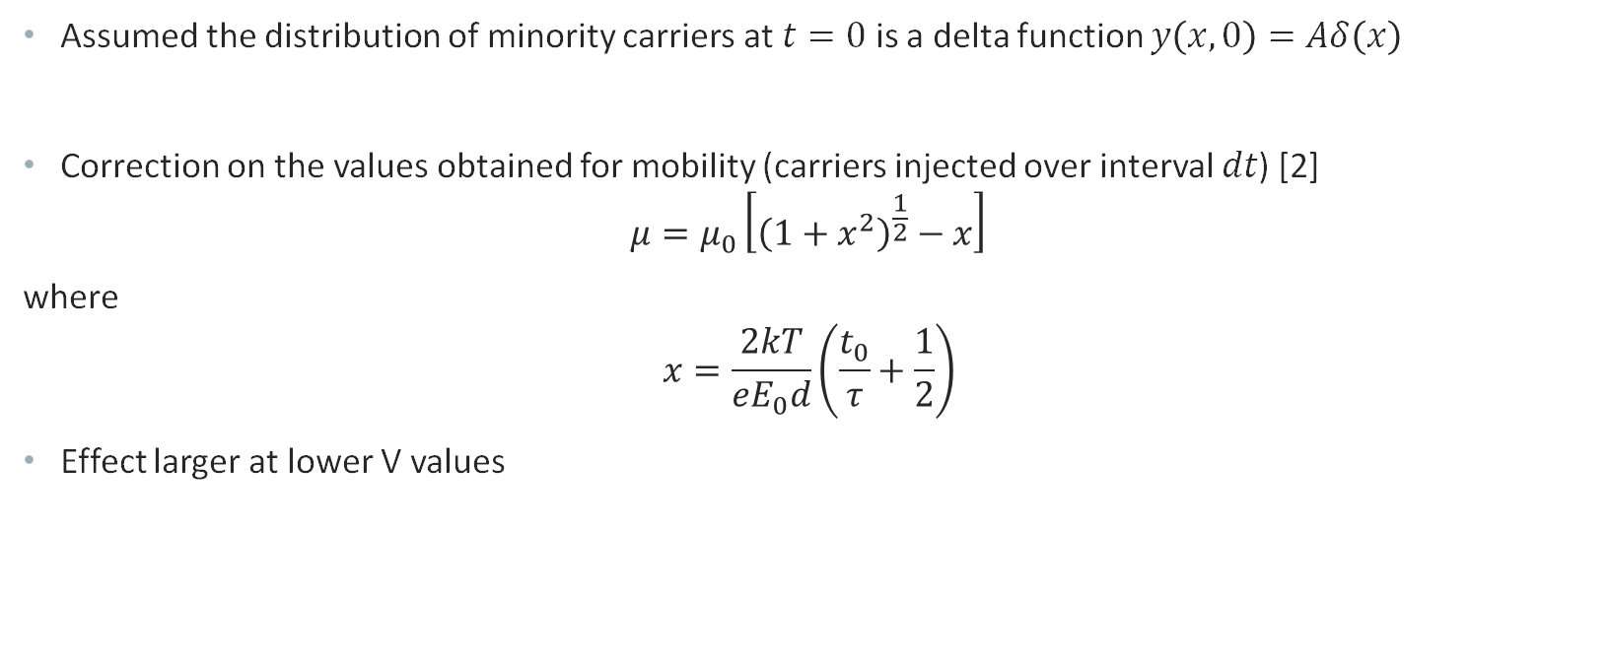
Correction on Mobility
Assumed the distribution of minority carriers at $t=0$ is a delta function $y\left(x,0\right)=Aδ\left(x\right)$
Correction on the values obtained for mobility (carriers injected over interval $dt$) [2]
$$μ=μ_{0}\left[{\left(1+x^{2}\right)}^{\frac{1}{2}}−x\right]$$
where
$$x=\frac{2kT}{eE_{0}d}\left(\frac{t_{0}}{τ}+\frac{1}{2}\right)$$
Effect larger at lower V values
[2] J. P. McKelvey, Diffusion Effects in Drift Mobility Measurements in Semiconductors, Apr 1956, Journal of Applied Physics 27, 341
Notes:
Assumed the distribution of minority carriers at $t=0$ is a delta function $y\left(x,0\right)=Aδ\left(x\right)$
However in reality carriers injected over time interval $dt$
Correction on the values obtained for mobility
Systematic dependence on the sweep field is larger at smaller V, where the peaks are broader
Explained by the diffusion and recombination of the excess charge carriers on the surface

Slide 9
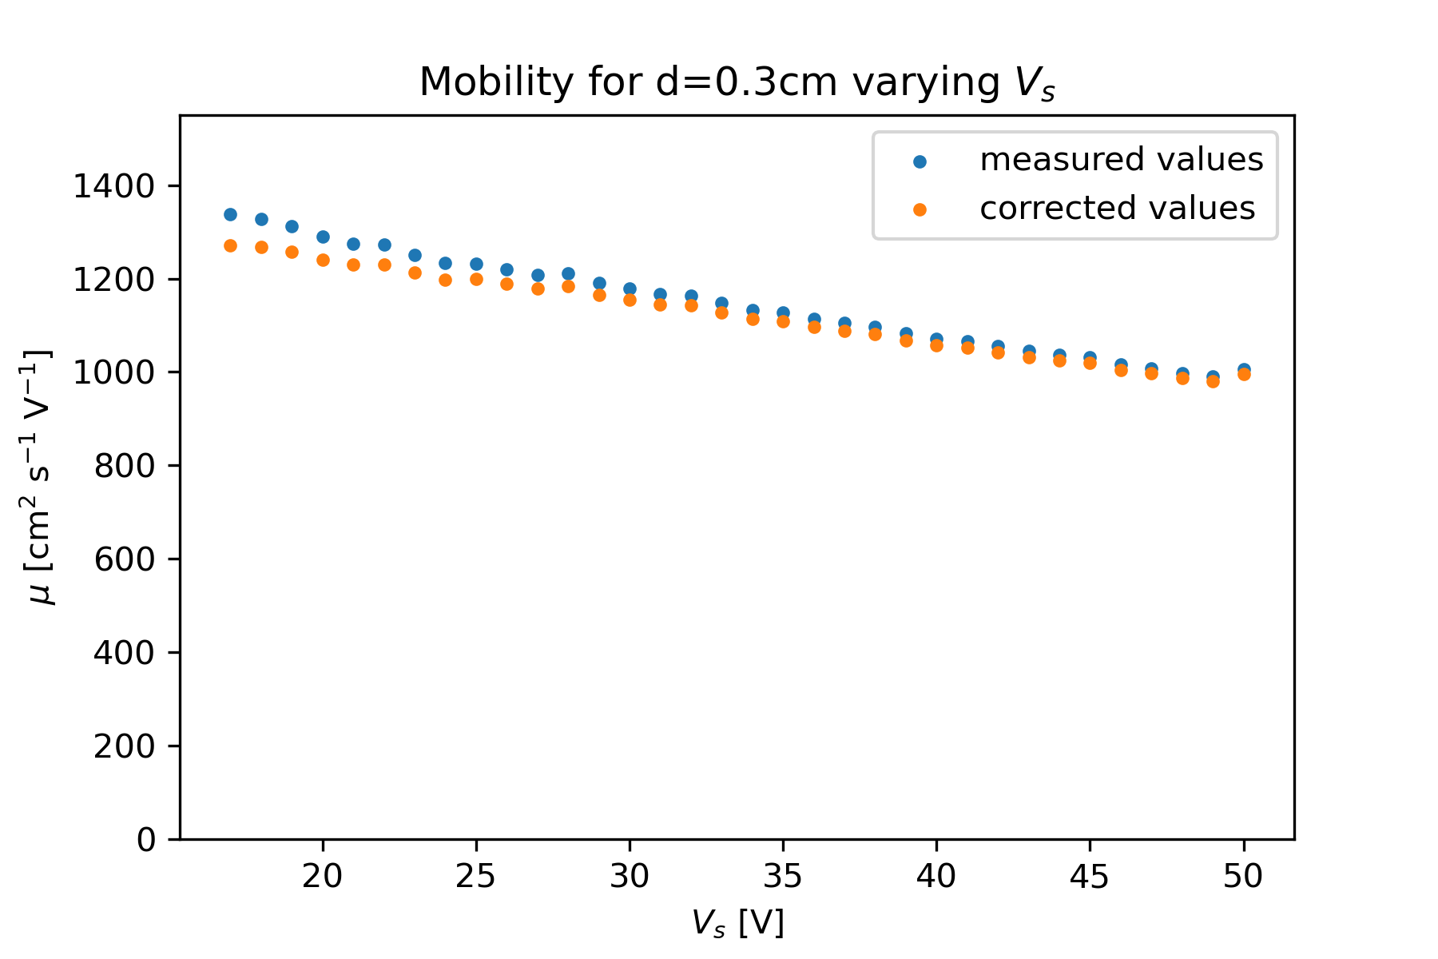
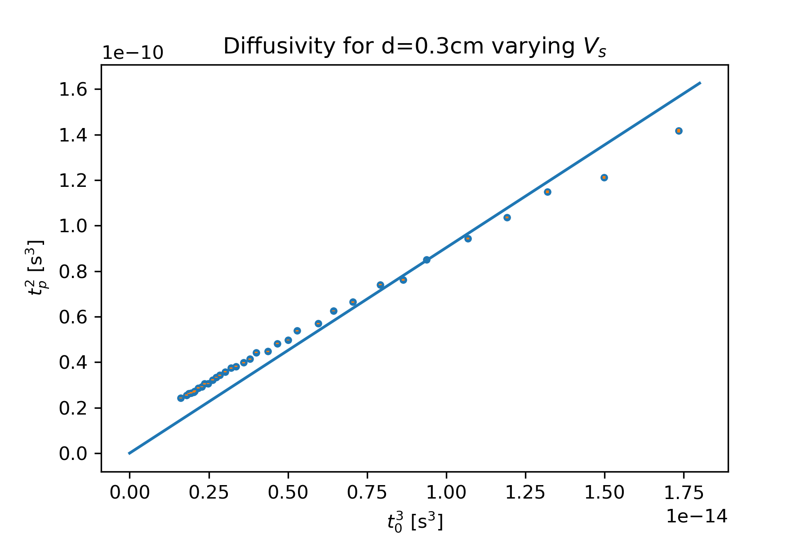
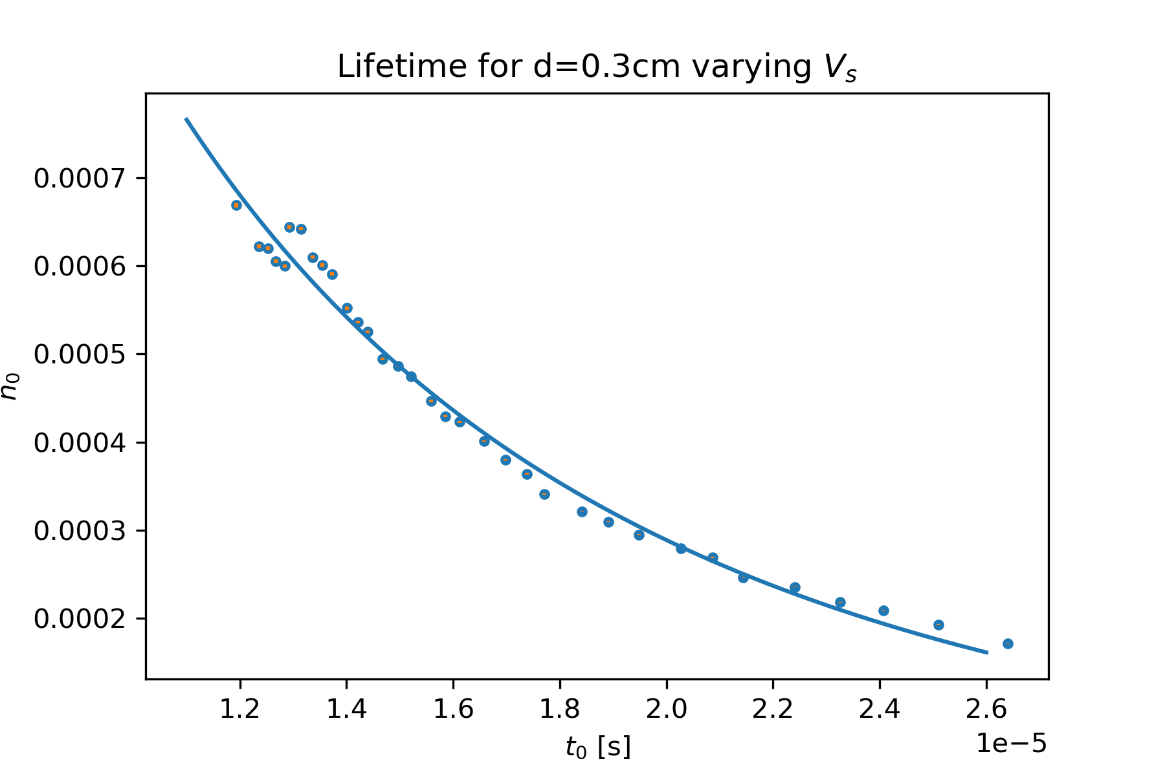
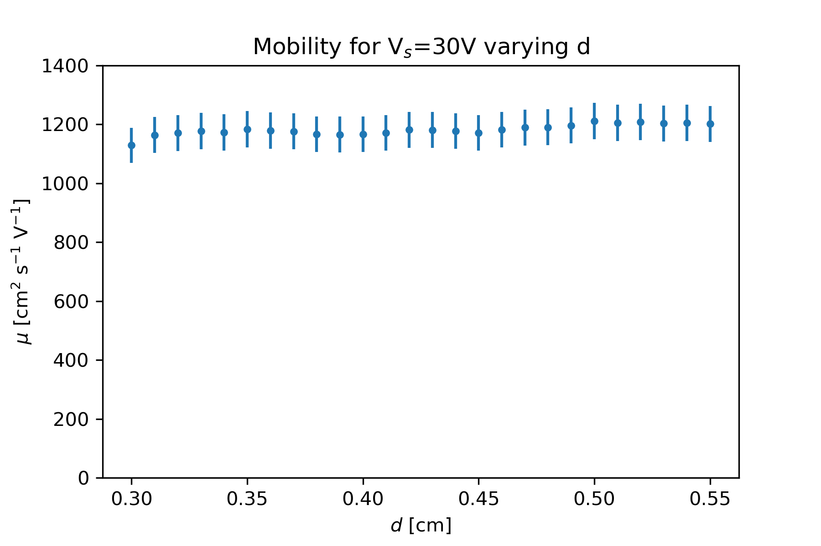
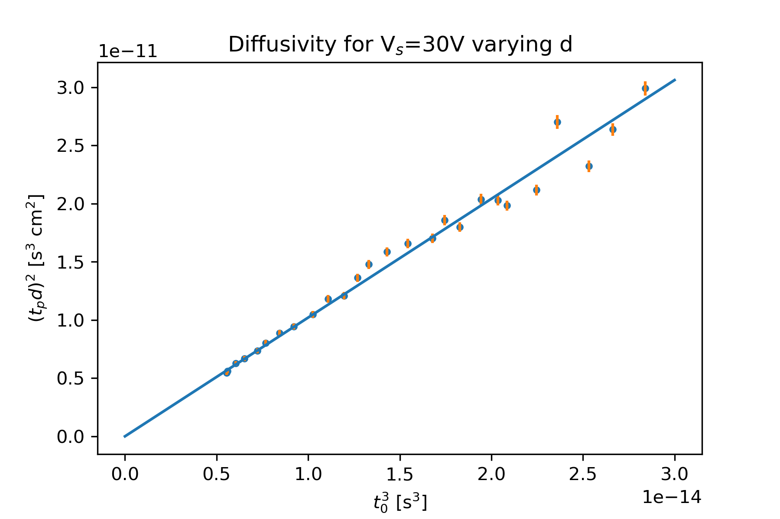
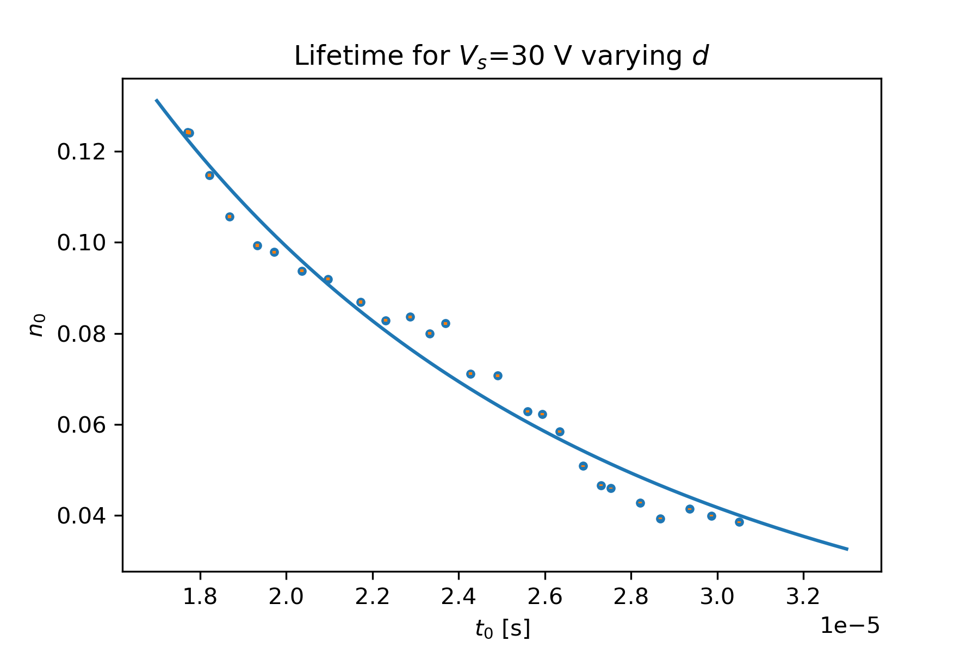
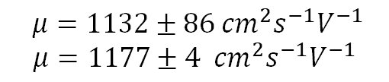
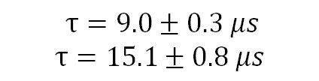
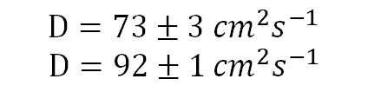
Results – Sample 1
$μ=1132±86{ cm}^{2}s^{−1}V^{−1}$
$μ=1177±4$ ${ cm}^{2}s^{−1}V^{−1}$
$D=73±3$ ${cm}^{2}s^{−1}$
$$D=92±1{ cm}^{2}s^{−1}$$
$τ=9.0±0.3$ $μs$
$$τ=15.1±0.8 μs$$

Slide 10
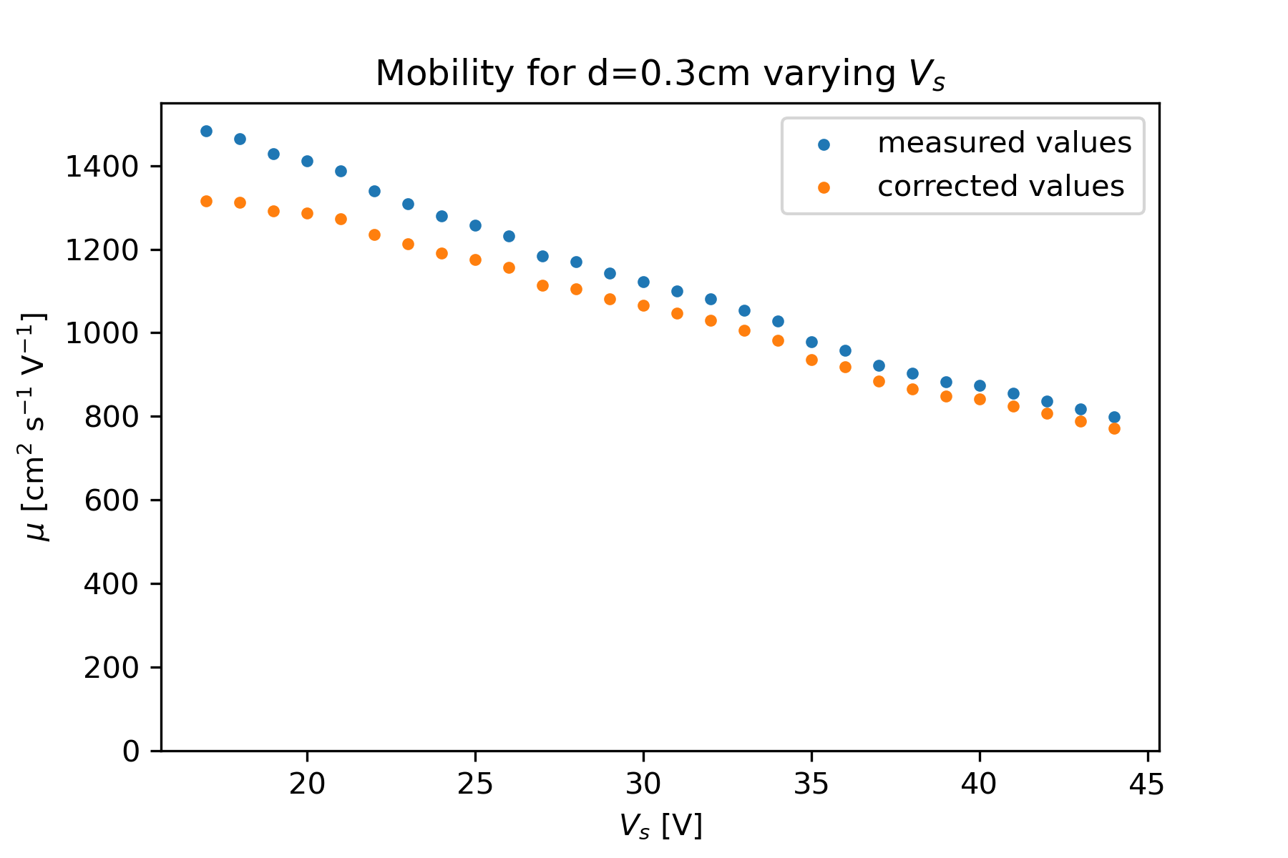
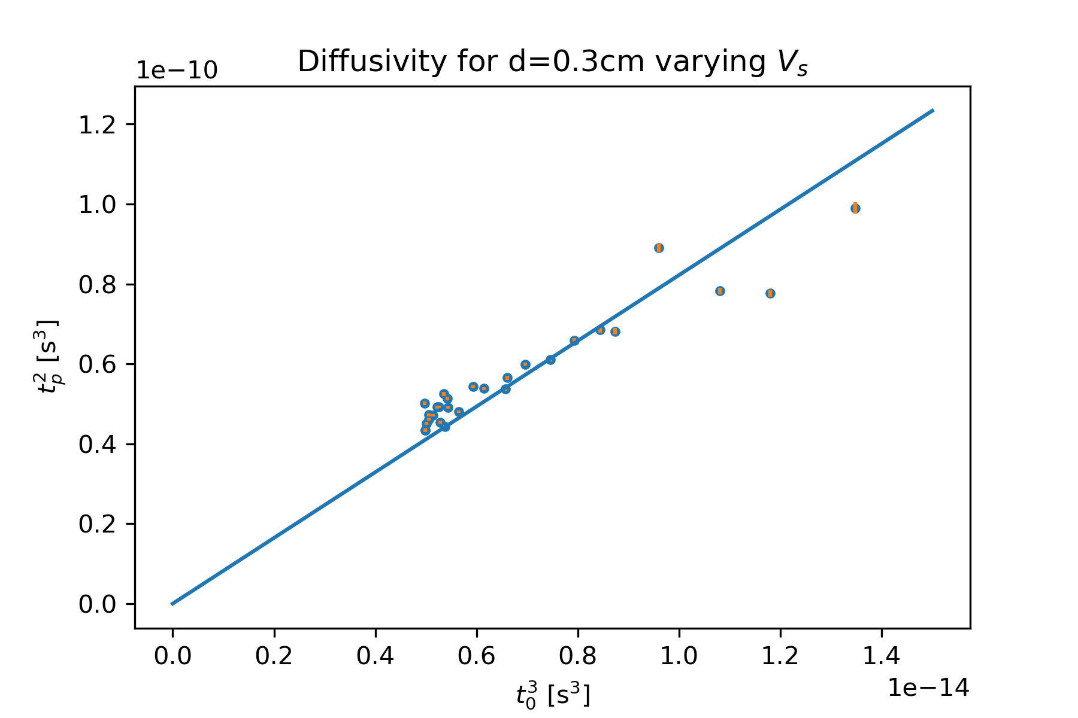
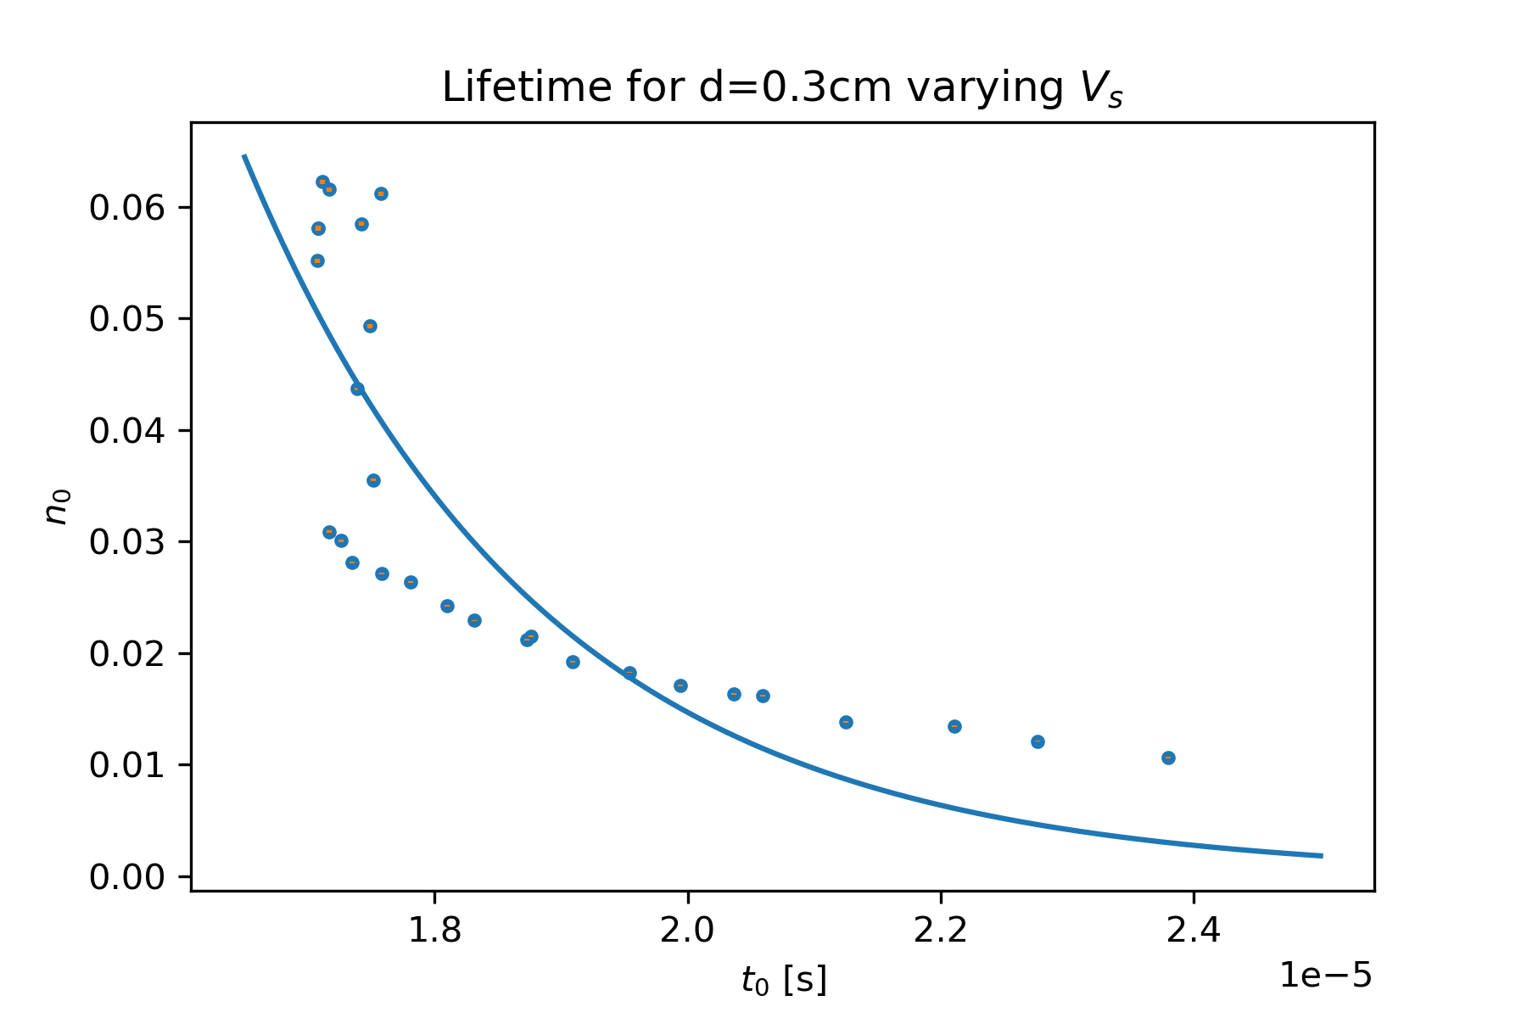
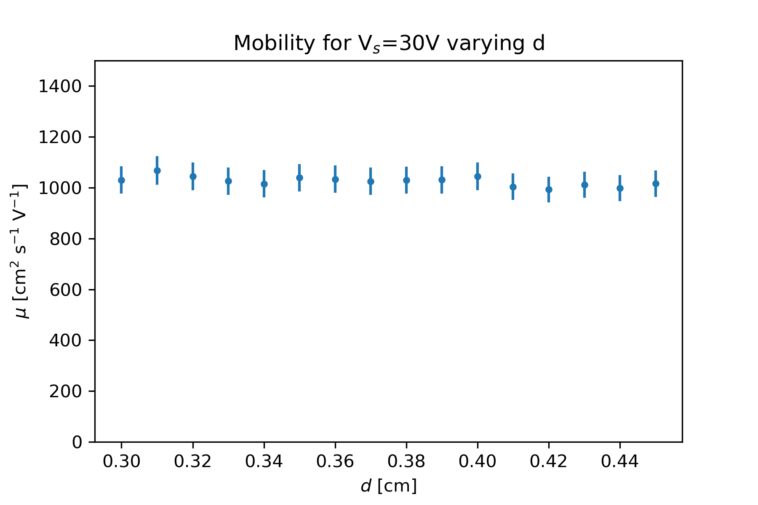
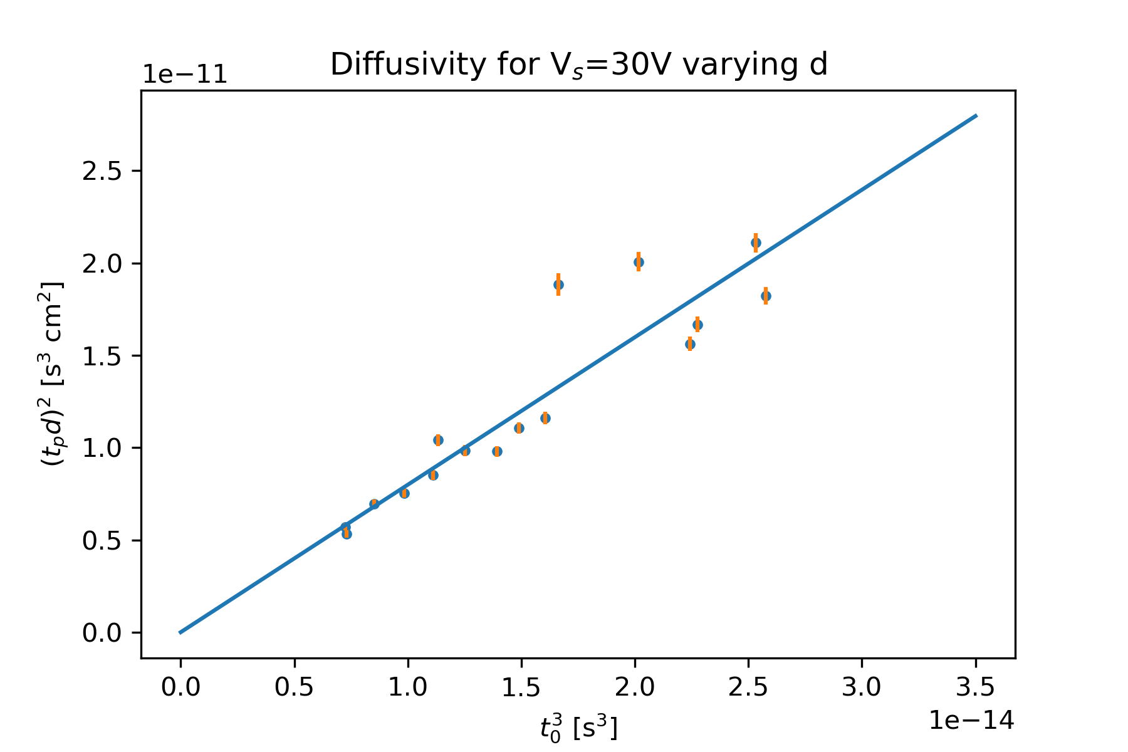
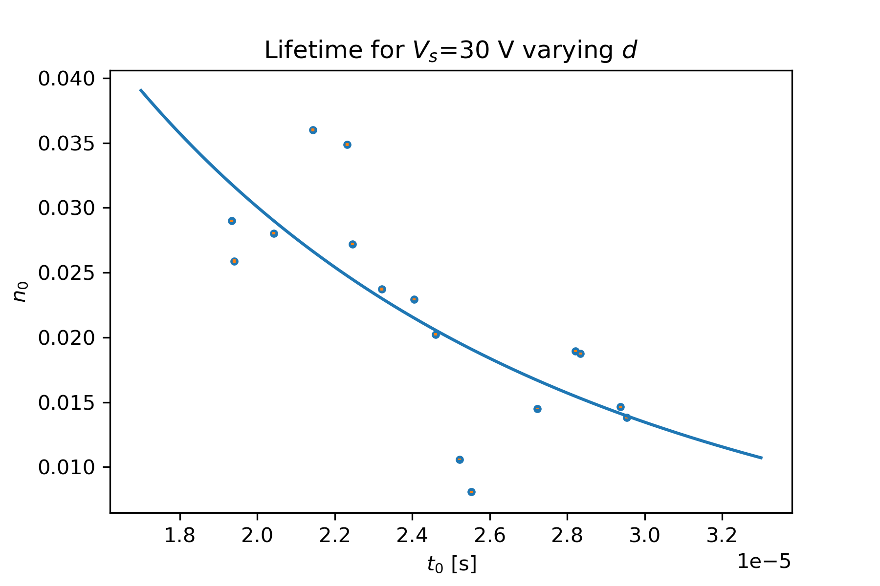
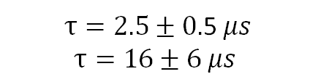
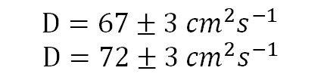
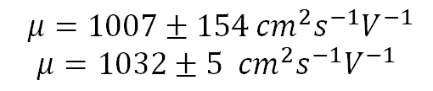
Results – Sample 2
$μ=1007±154{ cm}^{2}s^{−1}V^{−1}$
$μ=1032±5$ ${ cm}^{2}s^{−1}V^{−1}$
$D=67±3$ ${cm}^{2}s^{−1}$
$$D=72±3{ cm}^{2}s^{−1}$$
$τ=2.5±0.$5 $μs$
$$τ=16±6 μs$$

Slide 11

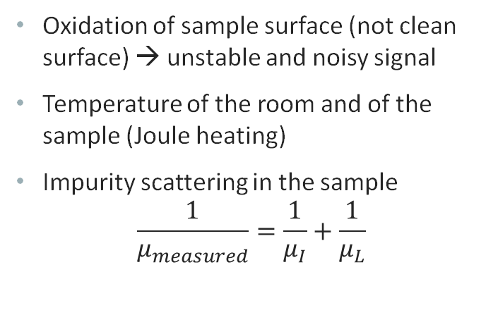
Sources of Error
Statistical Errors
Systematic Errors
Errors on measurements of $d$ and $l$
Statistical errors from the gaussian fittings of the peaks on $t_{0}$, $t_{p}$ and $n_{0}$
Oxidation of sample surface (not clean surface) → unstable and noisy signal
Temperature of the room and of the sample (Joule heating)
Impurity scattering in the sample
$$\frac{1}{μ_{measured}}=\frac{1}{μ_{I}}+\frac{1}{μ_{L}}$$
Notes:
Statistical Errors
- Errors on measurements of $d$ and $l$
- Statistical errors from the gaussian fittings of the peaks on $t_{0}$, $t_{p}$ and $n_{0}$
Systematic Errors
Temperature of the sample (Joule heating) – what does that?
Oxidation of sample surface (not clean surface) -> unstable and noisy signal
Impurity scattering in the sample (additional contribution to measured lifetime compared with lattice scattering)

Slide 12
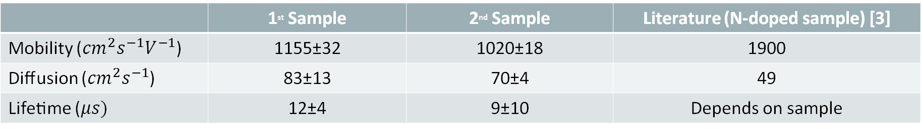
CONCLUSION
​ | 1st Sample​ | 2nd Sample​ | Literature (N-doped sample) [3]​
​Mobility (${cm}^{2}s^{−1}V^{−1}$) | ​1155±32 | ​1020±18 | ​1900
Diffusion (​${cm}^{2}s^{−1}$) | ​83±13 | ​70±4 | ​49
​Lifetime ($μs)$ | ​12±4 | ​9±10 | ​Depends on sample
[3] M. B. Prince, Drift Mobility in Semiconductors. I. Germanium, Nov 1953, Phys. Rev. 92, 681
Notes:
Our values in agreement with each other for the 2 samples
Difficulty to estimate the lifetime, especially on the worst quality 2nd sample
Values quite far from literature (but consistent with the other group)
-> systematic bias on sample/apparatus

