Slide 1
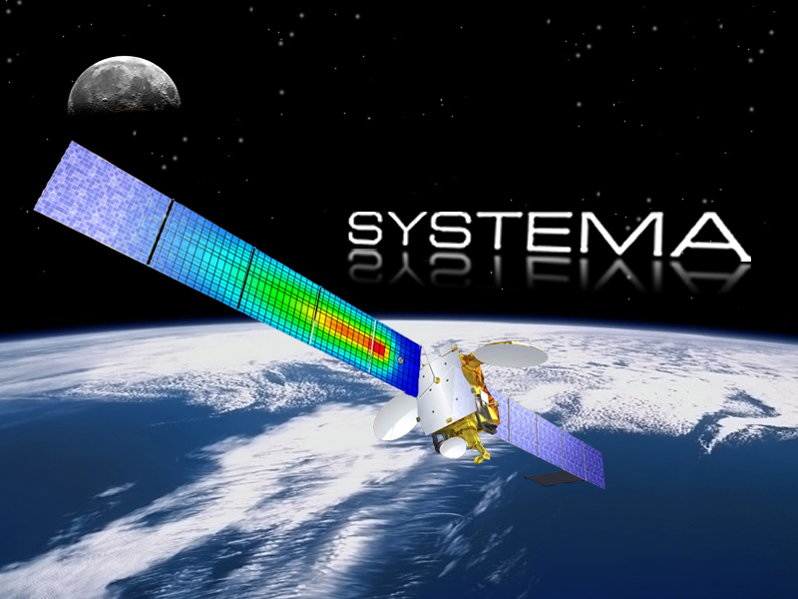
DOSRAD training course
Getting Started

Slide 2
Introduction
Overview
Welcome to DOSRAD Getting Started level course.
In this module, you will learn how to perform a radiation analysis.
The Getting Started describes the complete process to perform this analysis.

Slide 3

Introduction
In this chapter
1. DosratSat
Open an existing model
Explore the pre-processing options
Load the results
Perform post-processing operations
In a first stage, you will explore the Systema
platform and its functionalities:
2. MySat
Set the material references
Complete the geometrical model
Create the meshing
Create the mission
Create a process diagram and run the process
In a second stage, you will learn how to
perform the radiation dose analysis described
in this Getting Started:
For the preliminary steps (creation of geometry, material file, meshing and mission),
refer to the Systema Getting Started Manual.

Slide 4
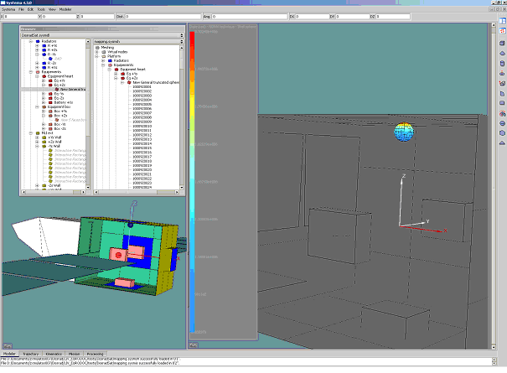
DosradSat
Introduction
In this chapter, you will start working
from an existing model to get familiar with
the DosradSat environment.
With the DosradSat model delivered with
the Dosrad software application,
you will be able to pre-process and post-process
data and loading existing results.
In the sections below, you will navigate through
Systema and identify the main
Functions of DOSRAD.

Slide 5
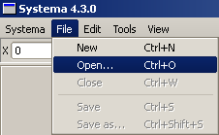
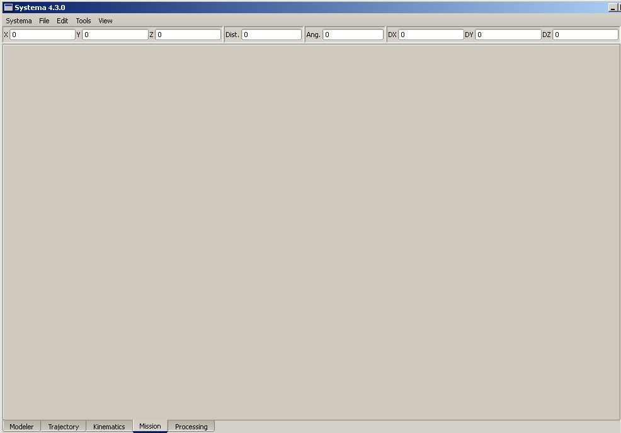
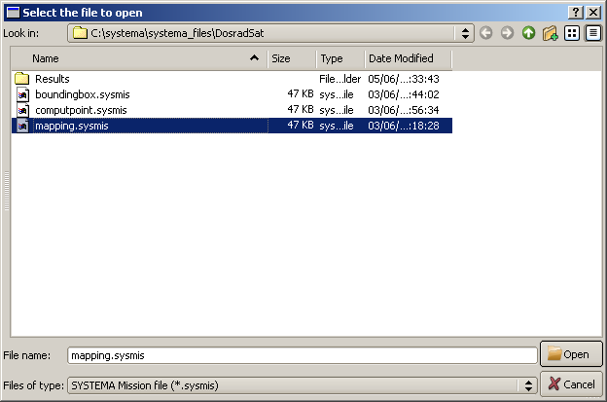
DosradSat
Opening an existing model
DosradSat
Open an existing model
Explore the pre-processing options
Load the results
Perform post-processing operations
MySat
Set the material references
Complete the geometrical model
Create the meshing
Create the mission
Create a process diagram
and run the process
When you open a file with the Mission tab, all the associated files
(geometrical model, meshing) open.

Slide 6
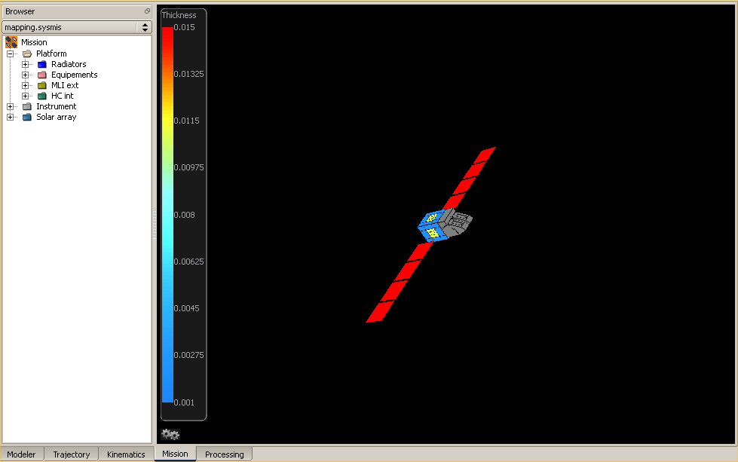
DosradSat
Opening an existing model (cont’d)
DosradSat
Open an existing model
Explore the pre-processing options
Load the results
Perform post-processing operations
MySat
Set the material references
Complete the geometrical model
Create the meshing
Create the mission
Create a process diagram
and run the process
All the elements of the satellite are graphically represented.

Slide 7
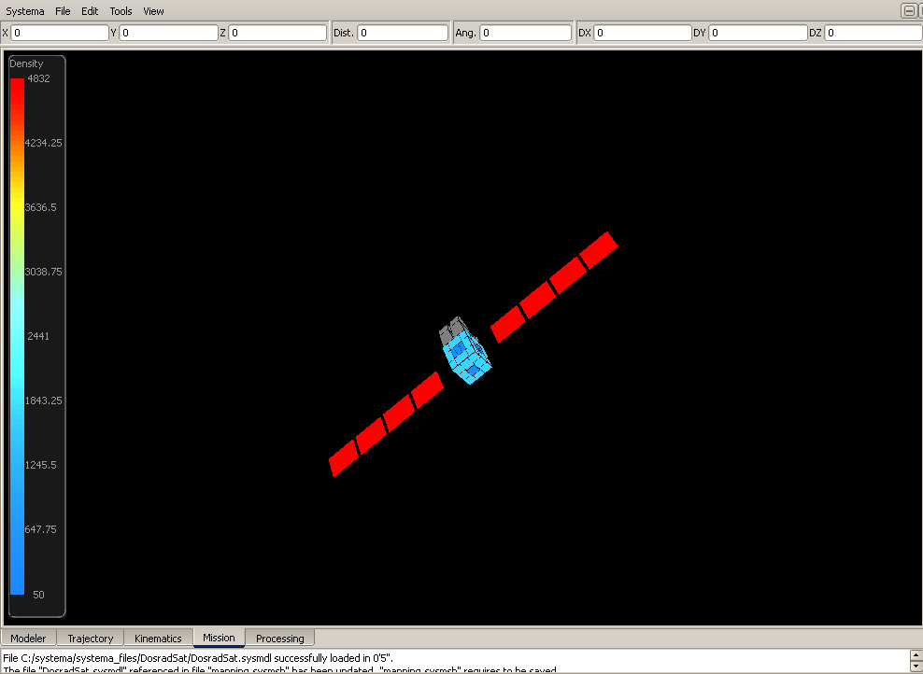
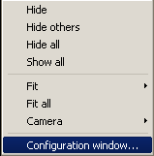

DosradSat
Pre-processing
DosradSat
Open an existing model
Explore the pre-processing options
Load the results
Perform post-processing operations
MySat
Set the material references
Complete the geometrical model
Create the meshing
Create the mission
Create a process diagram
and run the process
OR

Slide 8
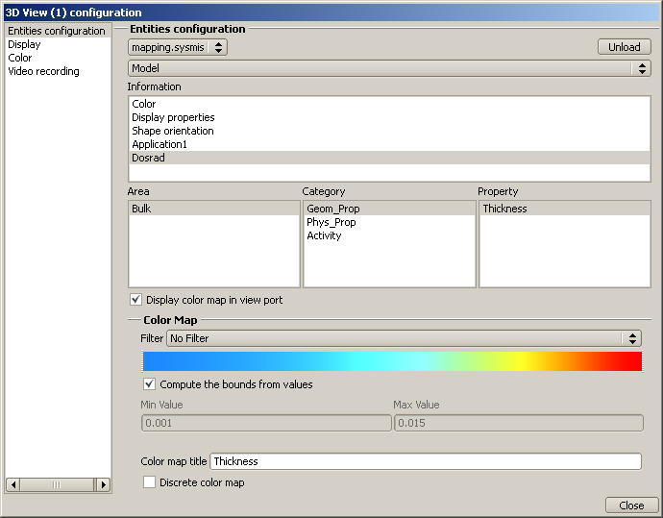
DosradSat
Pre-processing (cont’d)
DosradSat
Open an existing model
Explore the pre-processing options
Load the results
Perform post-processing operations
Refers to the color defined in the model
MySat
Refers to the orientation of the faces
Set the material references
Complete the geometrical model
Create the meshing
Create the mission
Create a process diagram
and run the process
Refers to the Dosrad properties
The applicative properties defined
in the mission are automatically
displayed at this stage.
The grey color in the view means that
the property has not been set.

Slide 9
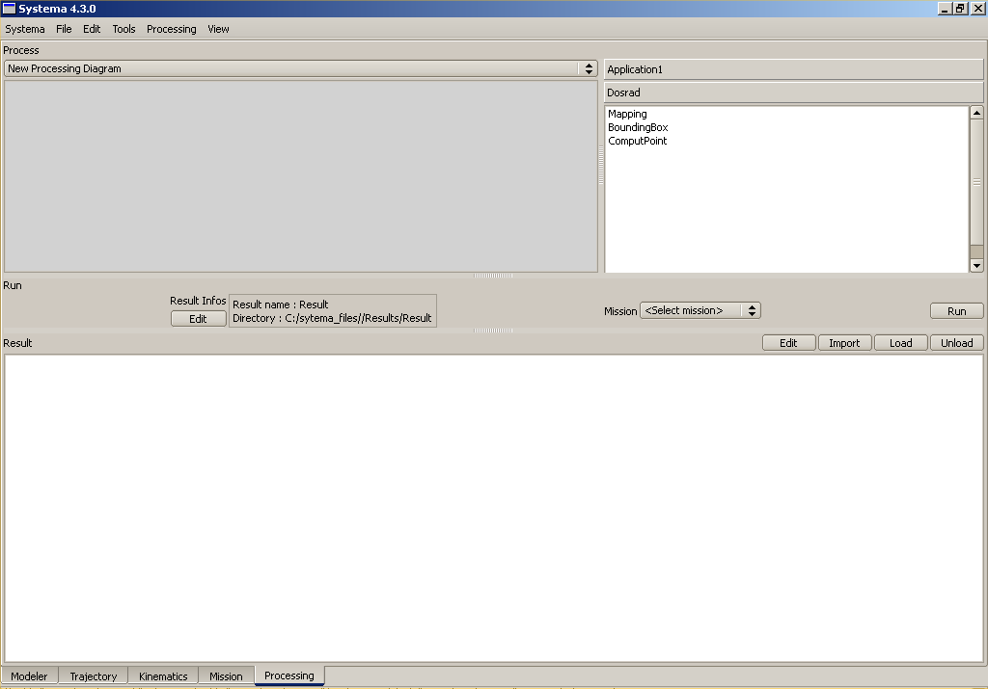
DosradSat
Loading results
DosradSat
Open an existing model
Explore the pre-processing options
Load the results
Perform post-processing operations
MySat
Set the material references
Complete the geometrical model
Create the meshing
Create the mission
Create a process diagram
and run the process
Used to edit a text file
Used to import any result file
Used to download a set of results
created upon a diagram execution
Used to unload the open files
These results are available in
the Modeler tab.

Slide 10
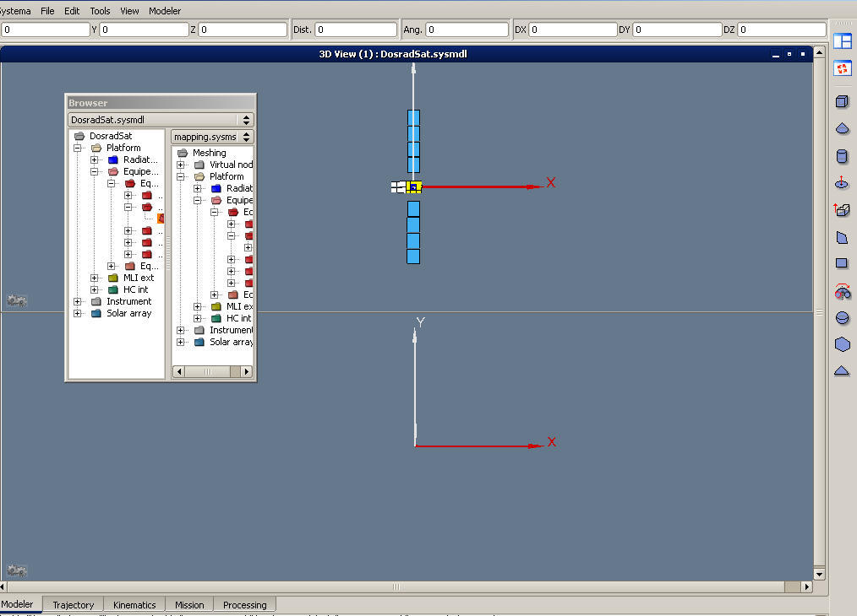
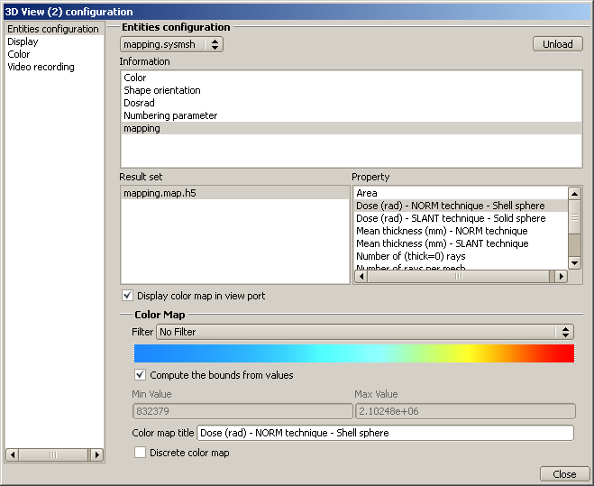
DosradSat
Post-processing
How to display results on the meshing
DosradSat
Open an existing model
Explore the pre-processing options
Load the results
Perform post-processing operations
MySat
Set the material references
Complete the geometrical model
Create the meshing
Create the mission
Create a process diagram
and run the process

Slide 11
DosradSat
Post-processing (cont’d)
3D view representation
DosradSat
Open an existing model
Explore the pre-processing options
Load the results
Perform post-processing operations
MySat
Set the material references
Complete the geometrical model
Create the meshing
Create the mission
Create a process diagram
and run the process
All the meshing results are graphically represented.

Slide 12
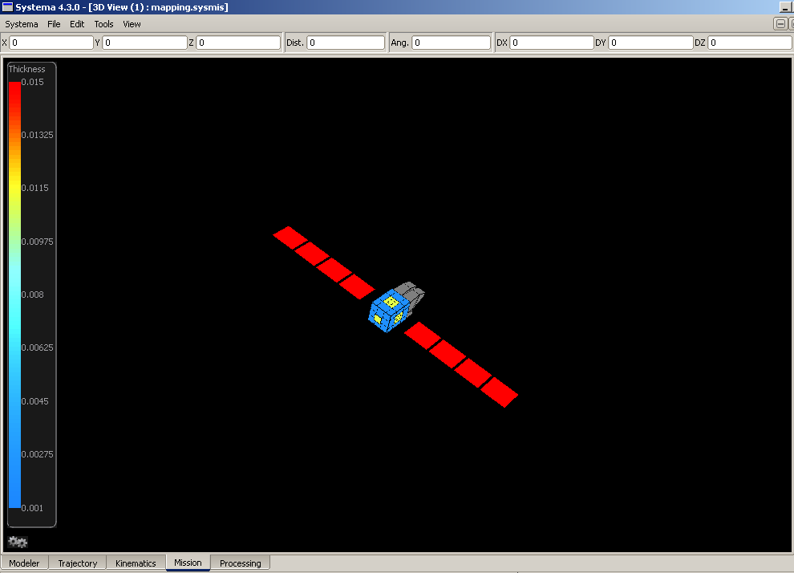
MySat
Introduction
With the DosradSat model delivered with the
functionalities of the DOSRAD environment,
let’s see how to create your own model.
To perform the radiation analysis, you must use
the “MySat” model.
The model is built in accordance with what you
want to model.
The MySat model is the model you will create
during this tutorial.
The DosradSat model is delivered with
Dosrad and can be used for result comparison.

Slide 13
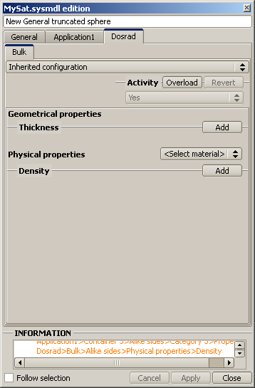
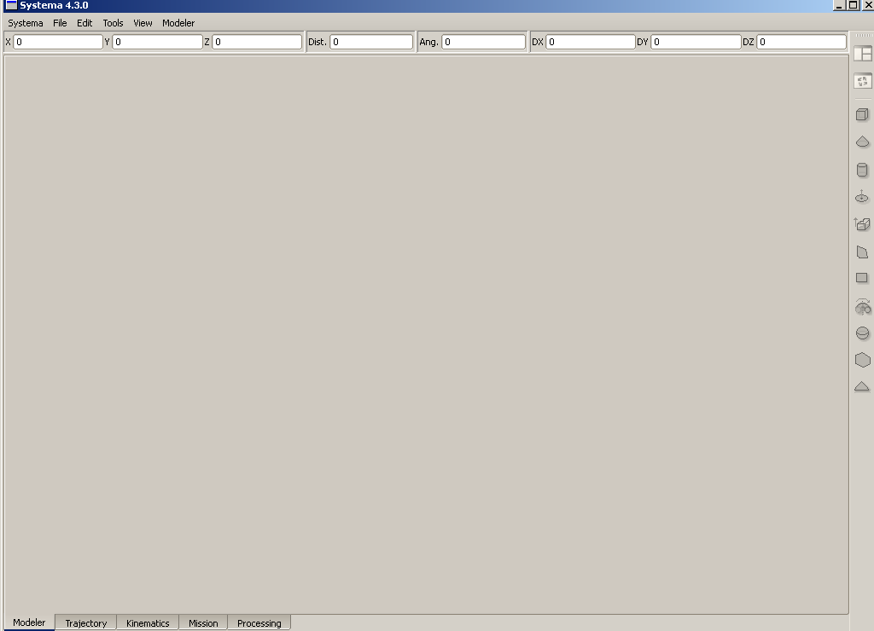
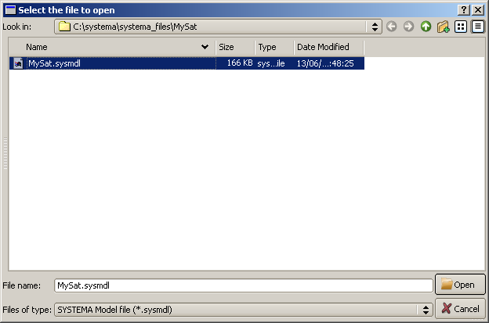
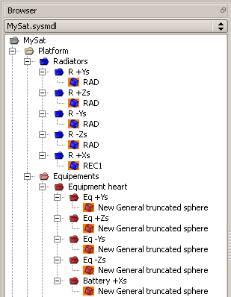
MySat
Introduction (Cont’d)
Starting with MySat
If you double-click a shape on
orange background, a warning
displays in the information area.

Slide 14
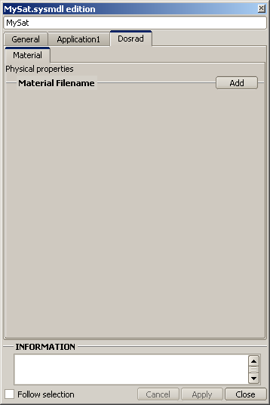
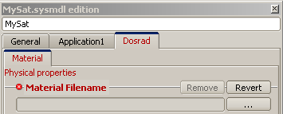
MySat
Setting the material references
DosradSat
Open an existing model
Explore the pre-processing options
Load the results
Perform post-processing operations
MySat
Set the material references
Complete the geometrical model
Create the meshing
Create the mission
Create a process diagram
and run the process

Slide 15
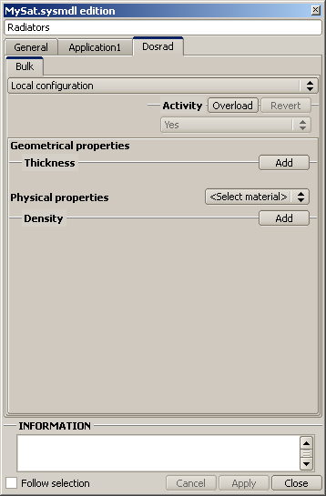

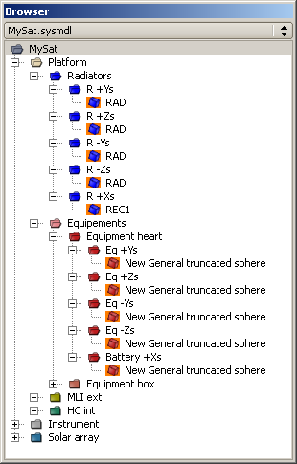
MySat
Completing the geometrical model
DosradSat
Open an existing model
Explore the pre-processing options
Load the results
Perform post-processing operations
MySat
Set the material references
Complete the geometrical model
Create the meshing
Create the mission
Create a process diagram
and run the process
At this stage, set the elements to
Local configuration. The next elements
will be set to Inherited configuration
To enter the bulk properties, refer to
the values given in the tables of chapter
“Getting Started” in the Dosrad User Manual.

Slide 16
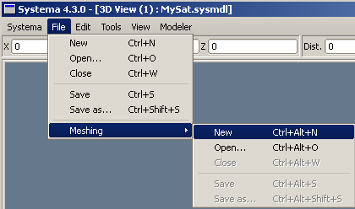
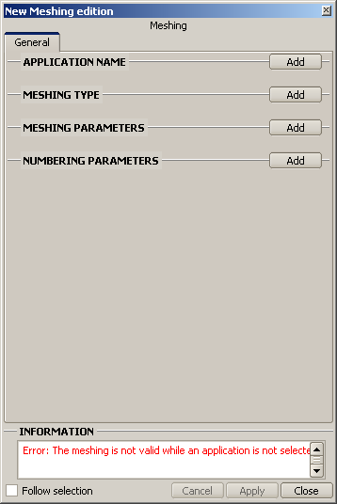
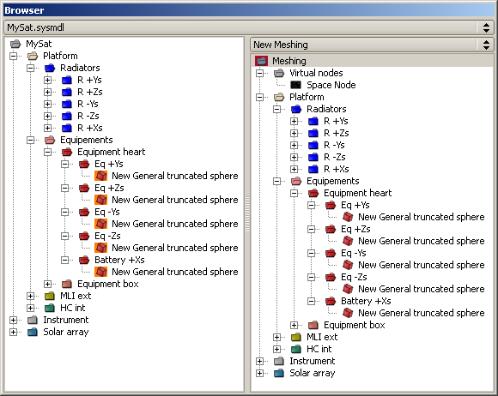


MySat
Creating the meshing
Initializing the meshing file
DosradSat
Open an existing model
Explore the pre-processing options
Load the results
Perform post-processing operations
MySat
Set the material references
Complete the geometrical model
Create the meshing
Create the mission
Create a process diagram
and run the process

Slide 17
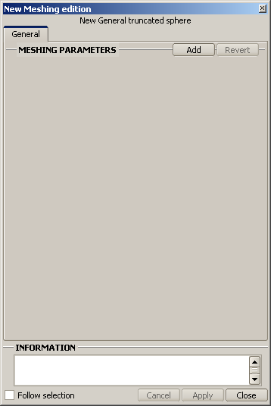
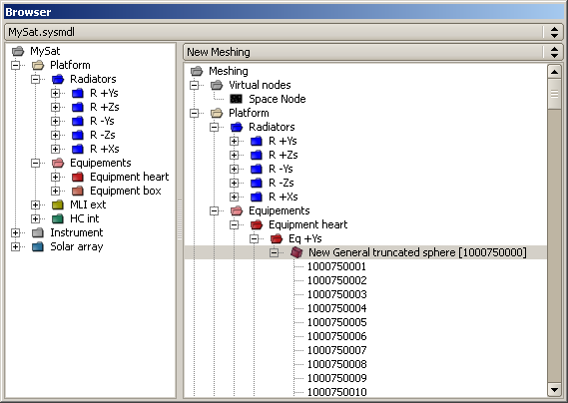
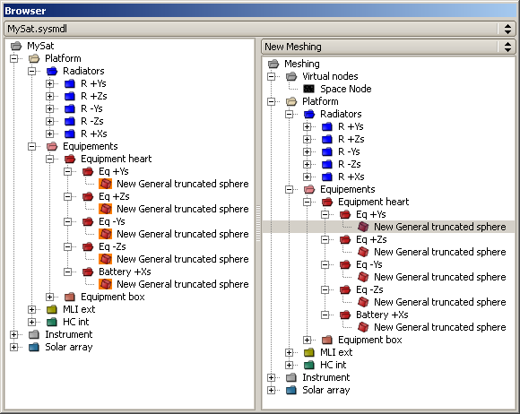
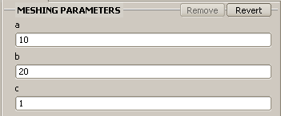
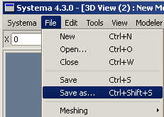
MySat
Creating the meshing (cont’d)
Dose cartography (or Mapping)
DosradSat
Open an existing model
Explore the pre-processing options
Load the results
Perform post-processing operations
MySat
Set the material references
Complete the geometrical model
Create the meshing
Create the mission
Create a process diagram
and run the process
Number corresponding
to the shapes
Number corresponding
to the meshes

Slide 18
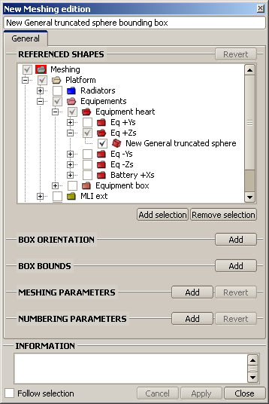
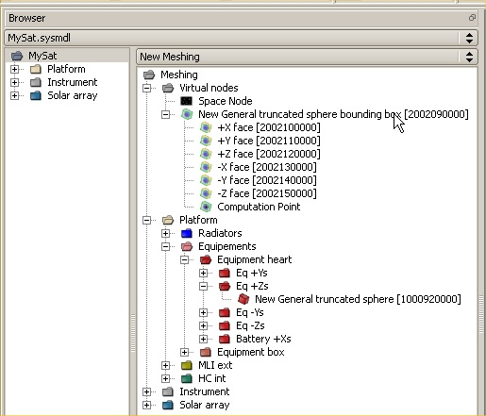
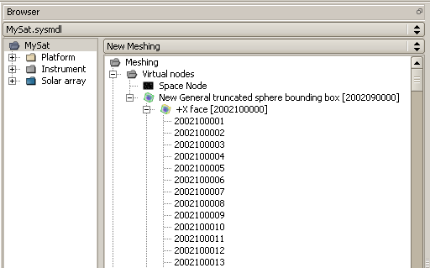
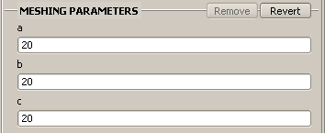
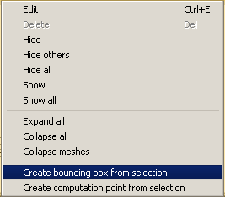

MySat
Creating the meshing (cont’d)
Bounding box
DosradSat
Open an existing model
Explore the pre-processing options
Load the results
Perform post-processing operations
MySat
Set the material references
Complete the geometrical model
Create the meshing
Create the mission
Create a process diagram
and run the process
Bounding box faces meshing
The bounding box is created under Virtual nodes
with an arbitrary numbering.
Do not enter the numbering parameters.

Slide 19
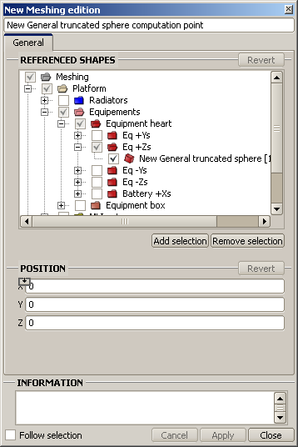
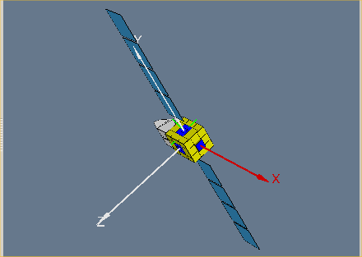
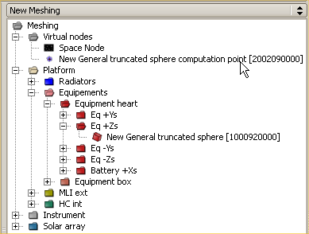
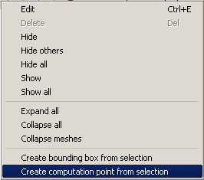

MySat
Creating the meshing (cont‘d)
Computation point
DosradSat
Open an existing model
Explore the pre-processing options
Load the results
Perform post-processing operations
SYSTEMA applies a default numbering sufficient
for radiation analyses. It is not necessary
to set numbering parameters.
MySat
Set the material references
Complete the geometrical model
Create the meshing
Create the mission
Create a process diagram
and run the process
Computation
point position
The computation point is created
under Virtual nodes
with an arbitrary numbering.
The surface meshing (used for dose cartography),
the bounding box and the computation point
can be created from the same meshing file.

Slide 20
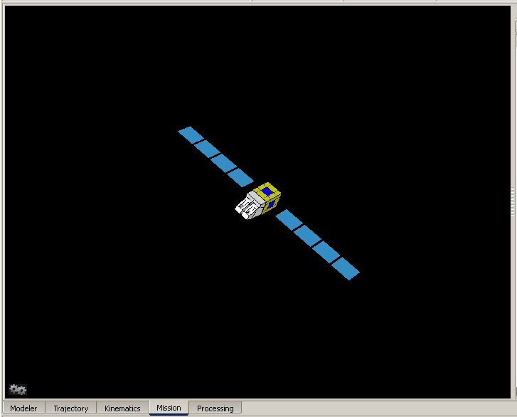
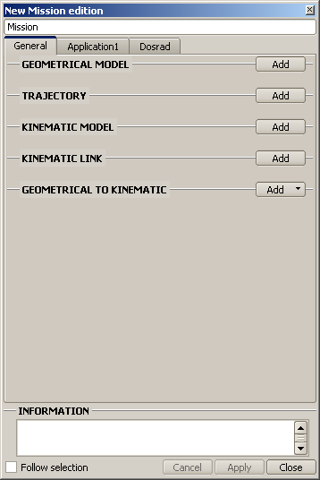
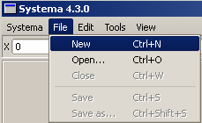
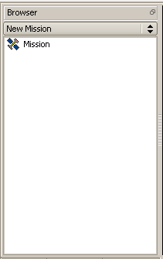
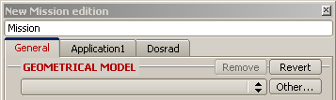
MySat
Creating the mission
Creating a new mission
DosradSat
Open an existing model
Explore the pre-processing options
Load the results
Perform post-processing operations
MySat
Set the material references
Complete the geometrical model
Create the meshing
Create the mission
Create a process diagram
and run the process
Now the satellite is displayed in the 3D view.

Slide 21
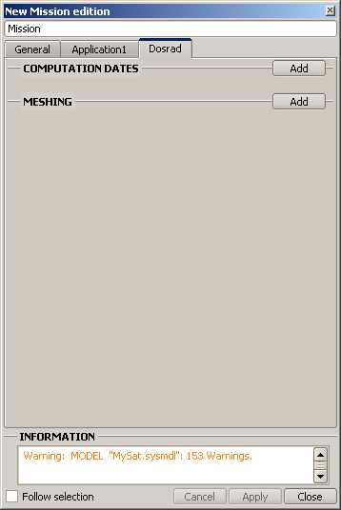
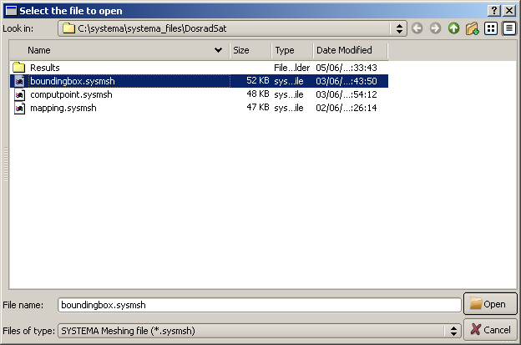

MySat
Creating the mission (cont’d)
Linking the meshing
DosradSat
Open an existing model
Explore the pre-processing options
Load the results
Perform post-processing operations
MySat
Set the material references
Complete the geometrical model
Create the meshing
Create the mission
Create a process diagram
and run the process
Select the previously created meshing file (mapping.sysmsh,
boundingbox.sysmsh or computpoint.sysmsh).
Do not enter the computation dates.
Do not forget to
save the mission file.

Slide 22
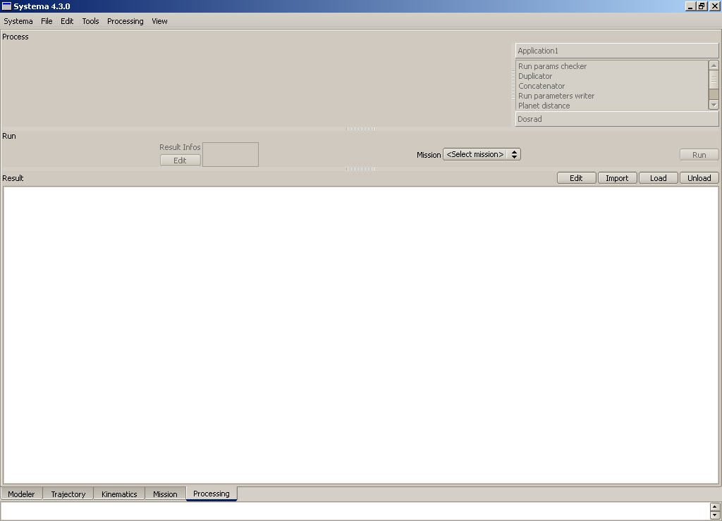
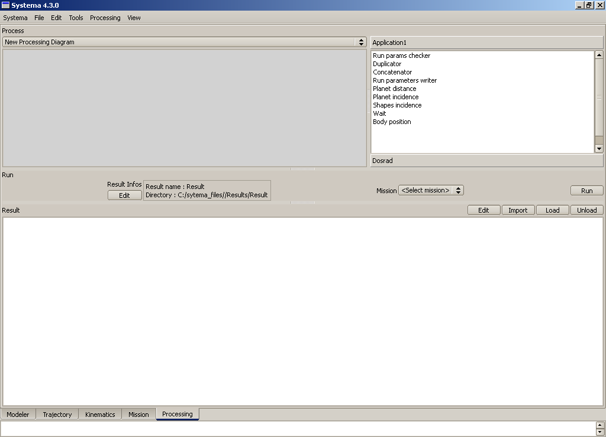
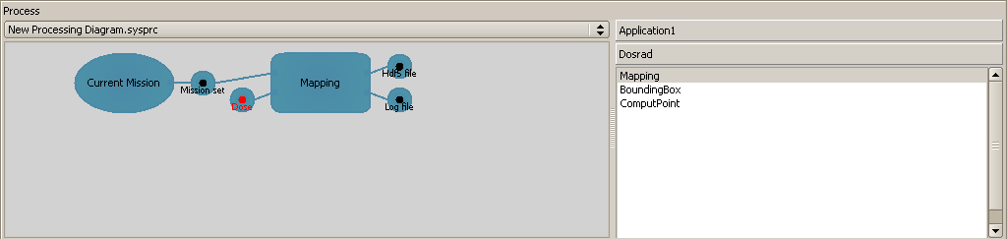
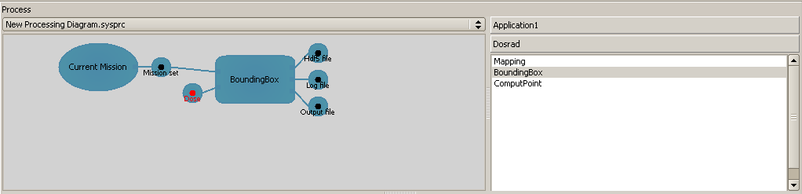
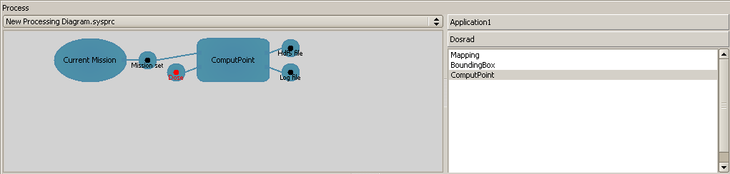
MySat
Defining a computation processing diagram
DosradSat
Creating a processing diagram
Open an existing model
Explore the pre-processing options
Load the results
Perform post-processing operations
MySat
Set the material references
Complete the geometrical model
Create the meshing
Create the mission
Create a process diagram
and run the process
Double click Mapping
Double click
BoundingBox
Double click ComputPoint

Slide 23



MySat
Defining a computation processing diagram (cont’d)
DosradSat
Activating the dose curve file
Open an existing model
Explore the pre-processing options
Load the results
Perform post-processing operations
MySat
Set the material references
Complete the geometrical model
Create the meshing
Create the mission
Create a process diagram
and run the process

Slide 24




MySat
Defining a computation processing diagram (cont’d)
DosradSat
Running the computing files
Open an existing model
Explore the pre-processing options
Load the results
Perform post-processing operations
MySat
Save the process diagram
Set the material references
Complete the geometrical model
Create the meshing
Create the mission
Create a process diagram
and run the process
Select the wished mission
The results are saved as per the information in the Result infos area.
The files created within these results are the result files generated from the
diagram and a .sysres file corresponding to the data displayed on the diagram.
If you want to display the results on different processes in the Result area,
be careful not to overwrite the sysres. file when you generate a result file.
We recommend to change the result file name for each process.
If you do not select the mission, a warning displays
and the results cannot be computed.
You have now created a complete
mission and generated the result files.

Slide 25


MySat
Defining a computation processing diagram (cont’d)
DosradSat
Displaying 3D results for a bounding box computation
Open an existing model
Explore the pre-processing options
Load the results
Perform post-processing operations
Now the results for a bounding box computation
are displayed in the 3D view.
MySat
Set the material references
Complete the geometrical model
Create the meshing
Create the mission
Create a process diagram
and run the process
In the 3D view, via the right click menu, select Configuration window
Select dose per face results, for instance
OR

Slide 26


MySat
Defining a computation processing diagram (cont’d)
DosradSat
Displaying 3D results - Available properties
Open an existing model
Explore the pre-processing options
Load the results
Perform post-processing operations
The names of the results in the Property list are followed by the technique and the type of geometry selected. For instance, SLANT technique – Solid sphere.
Among the available properties, you can select:
Area (information per bounding box mesh)
Number of (thick=0) rays per mesh
Number of launched rays per mesh
Number of void rays per mesh
Dose (result for each bounding box)
  Per mesh
  Per face
  Sub per face (if SLANT technique is chosen,
  results for Sub-contractors are also given)
  Total and total sub
Thickness (result for each bounding box)
  Per mesh
  Per face
  Sub per face
  Total and total sub
Mean thickness
MySat
Set the material references
Complete the geometrical model
Create the meshing
Create the mission
Create a process diagram
and run the process

Slide 27

Menu
Introduction
DosradSat
MySat
EXIT

