Slide 2
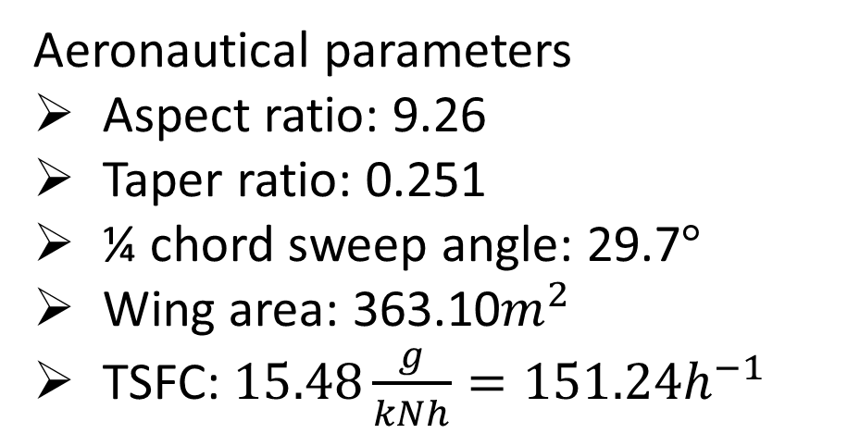
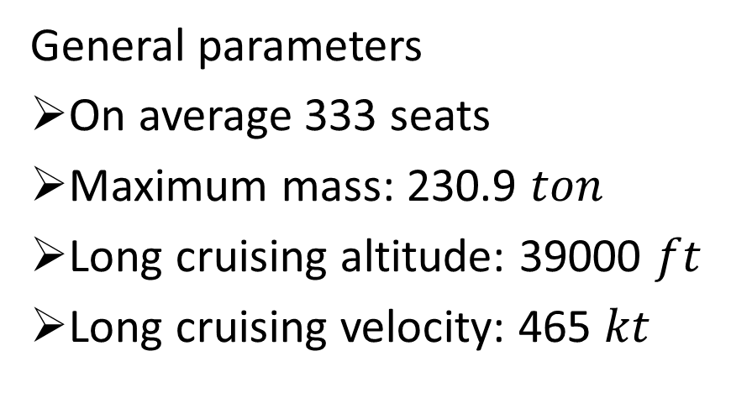
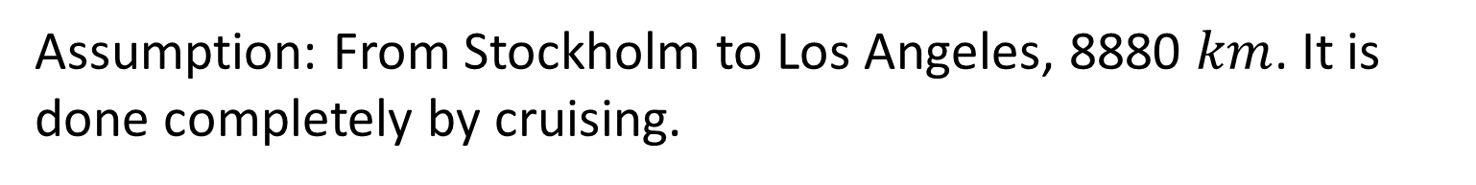
A330-300: Basic parameters and assumptions
General parameters
On average 333 seats
Maximum mass: 230.9 $ton$
Long cruising altitude: 39000 $ft$
Long cruising velocity: 465 $kt$
Aeronautical parameters
Aspect ratio: 9.26
Taper ratio: 0.251
¼ chord sweep angle: 29.7$°$
Wing area: 363.10$m^{2}$
TSFC: $15.48\frac{g}{kNh}=151.24h^{−1}$
Assumption: From Stockholm to Los Angeles, 8880 $km$. It is done completely by cruising.

Slide 3
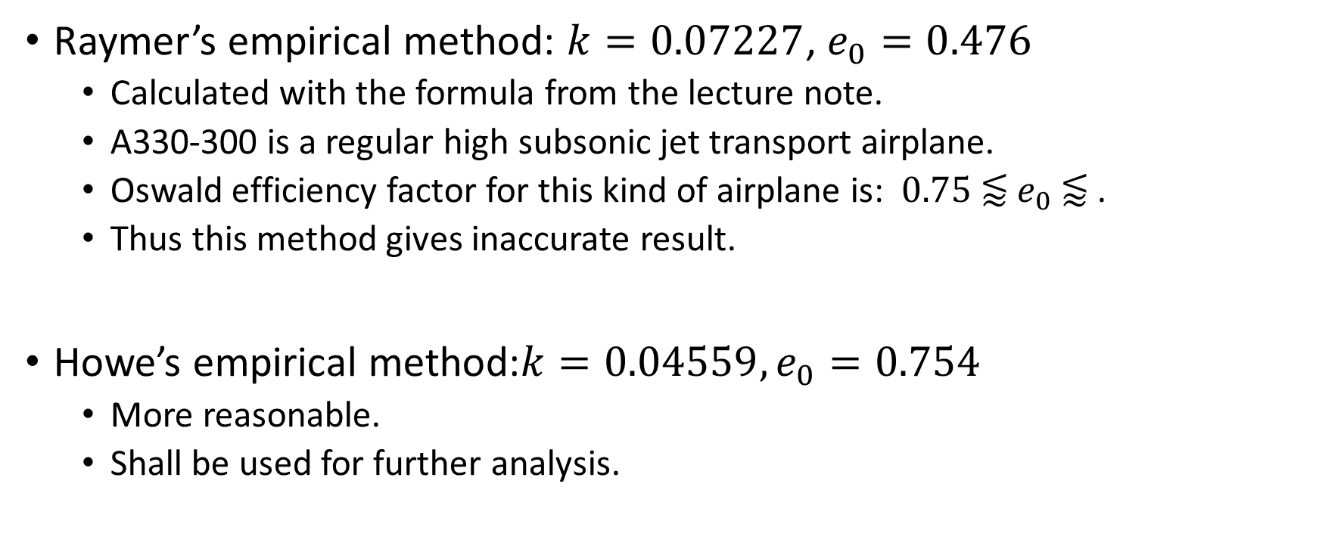
Calculation of K
Raymer’s empirical method: $k=0.07227$, $e_{0}=0.476$
Calculated with the formula from the lecture note.
A330-300 is a regular high subsonic jet transport airplane.
Oswald efficiency factor for this kind of airplane is: ${0.75 \text{⪅} e}_{0} \text{⪅}\text{ .}$
Thus this method gives inaccurate result.
Howe’s empirical method:$k=0.04559, e_{0}=0.754$
More reasonable.
Shall be used for further analysis.

Slide 4
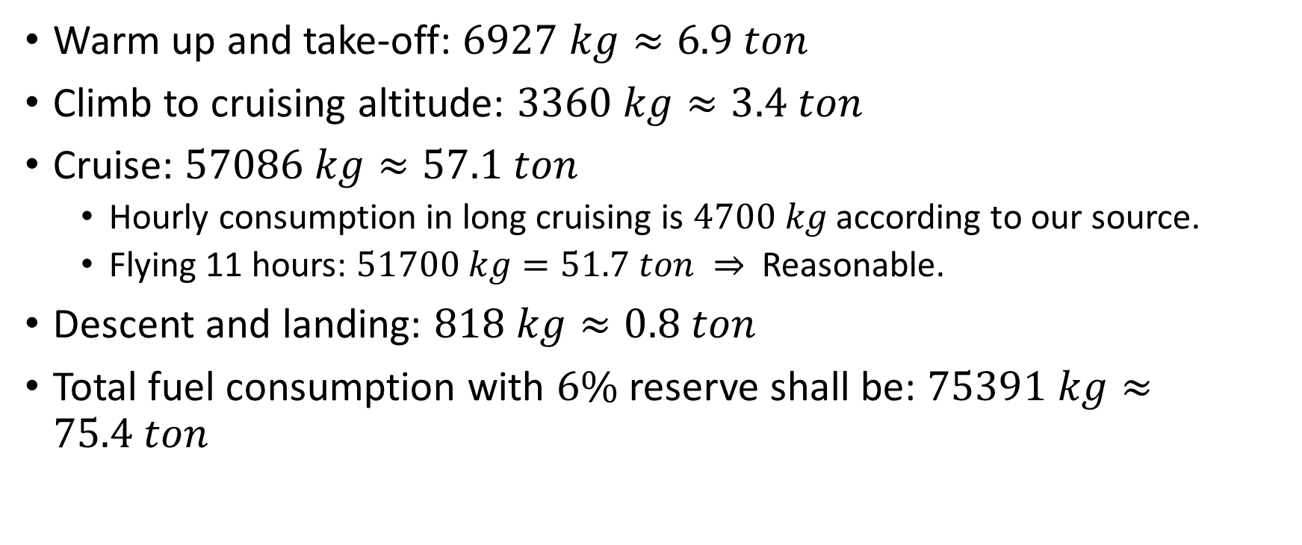
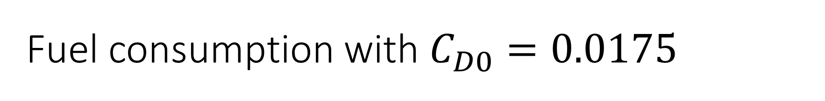
Fuel consumption with $C_{D0}=0.0175$
Warm up and take-off: $6927 kg≈6.9 ton$
Climb to cruising altitude: $3360 kg≈3.4 ton$
Cruise: $57086 kg≈57.1 ton$
Hourly consumption in long cruising is $4700 kg$ according to our source.
Flying 11 hours: $51700 kg=51.7 ton ⇒$Reasonable.
Descent and landing: $818 kg≈0.8 ton$
Total fuel consumption with $6\%$ reserve shall be: $75391 kg≈75.4 ton$

Slide 5
