Slide 1


One trusted path to
local home services
Bilingual coordination for customers, service providers, and a growing local network.
CLEANFIXHARISH.CO.IL
Notes:
[Sources]
- CleanFixHarish repository and product brief (user-owned, accessed 2026-08-23).
- Visuals: user-approved CleanFixHarish assets and OpenAI-generated documentary images created for this project.
[/Sources]

Slide 2

THE LOCAL FRICTION
Small jobs create outsized effort
Customers chase replies. Providers receive incomplete briefs. Everyone loses time resolving avoidable uncertainty.
01
Who is available?
02
What exactly is included?
03
Who keeps the job moving?
Notes:
[Sources]
- CleanFixHarish repository and product brief (user-owned, accessed 2026-08-23).
- Visuals: user-approved CleanFixHarish assets and OpenAI-generated documentary images created for this project.
[/Sources]

Slide 3

A managed journey,
not a directory
01
Request
02
Clarify
03
Match
04
Coordinate
05
Close
One accountable flow keeps scope, communication, and next steps visible.
Notes:
[Sources]
- CleanFixHarish repository and product brief (user-owned, accessed 2026-08-23).
- Visuals: user-approved CleanFixHarish assets and OpenAI-generated documentary images created for this project.
[/Sources]

Slide 4

VALUE FOR EVERY SIDE
Clarity improves the experience for everyone
CUSTOMERS
A simple request path, clearer expectations, and one place to follow progress.
SERVICE PROVIDERS
Better briefs, fewer surprises, and work that is easier to prepare for.
CleanFixHarish coordinates the space between them.
Notes:
[Sources]
- CleanFixHarish repository and product brief (user-owned, accessed 2026-08-23).
- Visuals: user-approved CleanFixHarish assets and OpenAI-generated documentary images created for this project.
[/Sources]

Slide 5

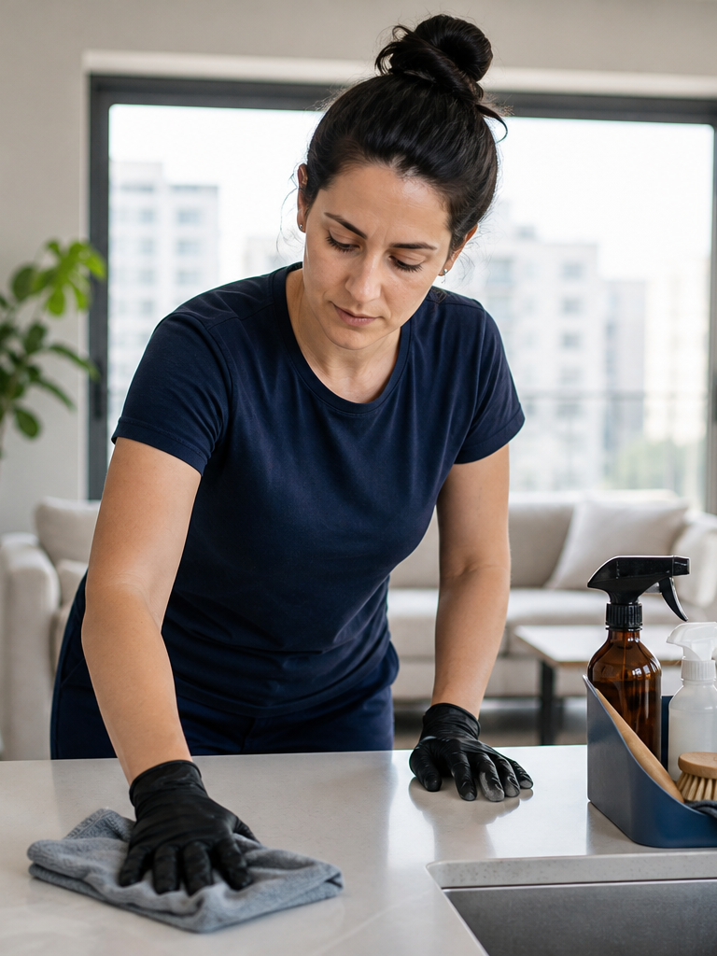


Focused services create repeatable trust
HANDYMAN
CLEANING
AC CARE
MOVE-IN
Start with frequent, understandable home needs—then learn where coordination creates the most value.
Notes:
[Sources]
- CleanFixHarish repository and product brief (user-owned, accessed 2026-08-23).
- Visuals: user-approved CleanFixHarish assets and OpenAI-generated documentary images created for this project.
[/Sources]

Slide 6

THE OPERATING LAYER
The platform turns requests into accountable work
Bilingual customer intake
Admin visibility and follow-up
Quote and service workflows
Installable mobile experience
Brand and content controls
Notes:
[Sources]
- CleanFixHarish repository and product brief (user-owned, accessed 2026-08-23).
- Visuals: user-approved CleanFixHarish assets and OpenAI-generated documentary images created for this project.
[/Sources]
Capabilities shown describe the product direction and implemented administrative/public-site foundations; they are not a claim of autonomous operation.

Slide 7

THE GROWTH LOOP
Every useful interaction can strengthen local discovery
Helpful bilingual content
Answers real local questions and earns search visibility.
Recognizable campaigns
One visual identity across social, groups, flyers, and referrals.
Measurable access
Trackable links and scan-safe QR assets connect attention to action.
Notes:
[Sources]
- CleanFixHarish repository and product brief (user-owned, accessed 2026-08-23).
- Visuals: user-approved CleanFixHarish assets and OpenAI-generated documentary images created for this project.
[/Sources]

Slide 8
Build local trust
into a repeatable system
CleanFixHarish combines a clear customer journey, provider-ready briefs, bilingual operations, and a distinctive local brand.
Explore the live experience
Notes:
[Sources]
- CleanFixHarish repository and product brief (user-owned, accessed 2026-08-23).
- Visuals: user-approved CleanFixHarish assets and OpenAI-generated documentary images created for this project.
[/Sources]

