Slide 1
Course Project
Evaluation
CS626 - Speech, Natural Language Processing, and the Web
Group Id - 4
Sarvesh Shashidhar, 24m2152, C-MINDS
Ritik, 24m2155, C-MINDS
Abhishek Mishra, 24m2156, C-MINDS
Nachiketa Patil, 24m2161, C-MINDS
Date: 04/11/24

Slide 2
Abstract
Emotional analysis/classification is an important NLP task (especially since the surge in popularity of chat bots).
This study focuses on text emotion analysis, specifically for the Hindi language.
We are taking inspiration from the paper Kumar, T., Mahrishi, M. & Sharma, G. Emotion recognition in Hindi text using multilingual BERT transformer. Multimed Tools Appl 82, 42373–42394 (2023). https://doi.org/10.1007/s11042-023-15150-1

Slide 3
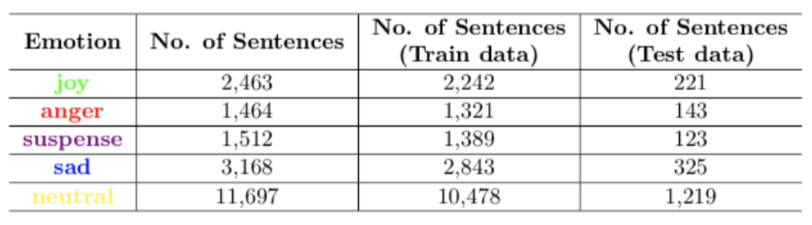
Dataset Used
Name – BHAAV
Developed by – MIDAS, IIIT Delhi
Size – 20,304 sentences from 230 different stories across 18 genres.
Emotion Labels – {Anger(0), Joy(1), Suspense(2), Sad(3), Neutral(4)}

Slide 4
Models to be Implemented
Logistic Regression
Naïve Bayes Classifier
SVC Classifier
Decision Tree Classifier
Boosted Tree Classifier
KNN Classifier
Random Forest Classifier
mBERT Classifier

Slide 5
Evaluation Metrics
Overall
  Precision
  Accuracy
  Recall
  F1 – score
Emotion Label-wise
  Precision
  Recall
  F1 – score
  F0.5 – score
  F2 – score

Slide 6
Our Contributions
BHAAV dataset has sentences labelled as “suspense” which can be either positive or negative depending on the context.
We propose to use models like VADER and TextBlob to get scores for the sentences and then classify them as either “positive suspense” or “negative suspense”.
We also shall manually annotate 1000 suspense sentences from the corpus and then evaluate our scoring scheme on its accuracy.

