Slide 1
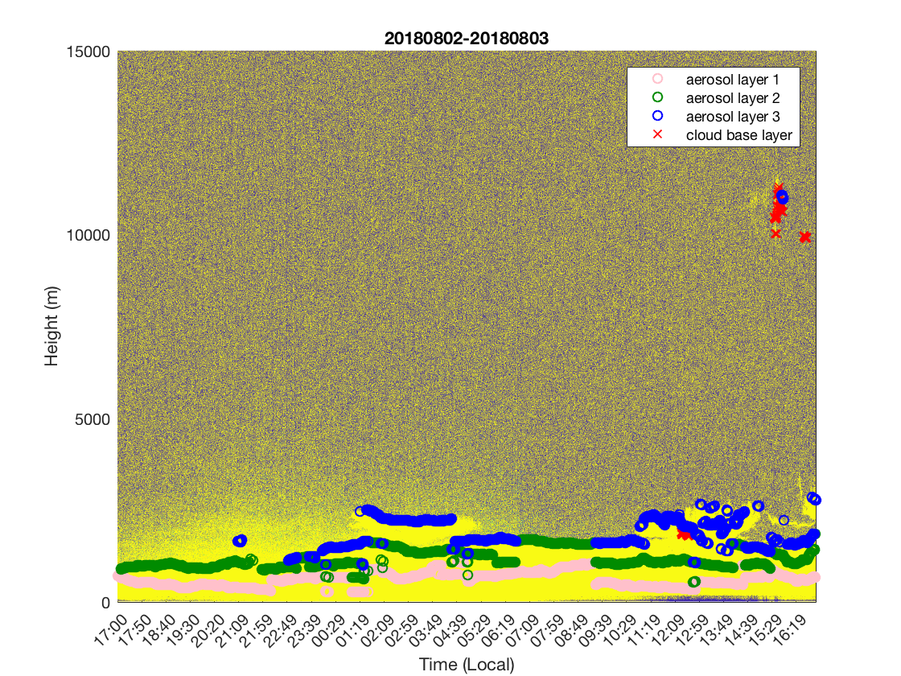
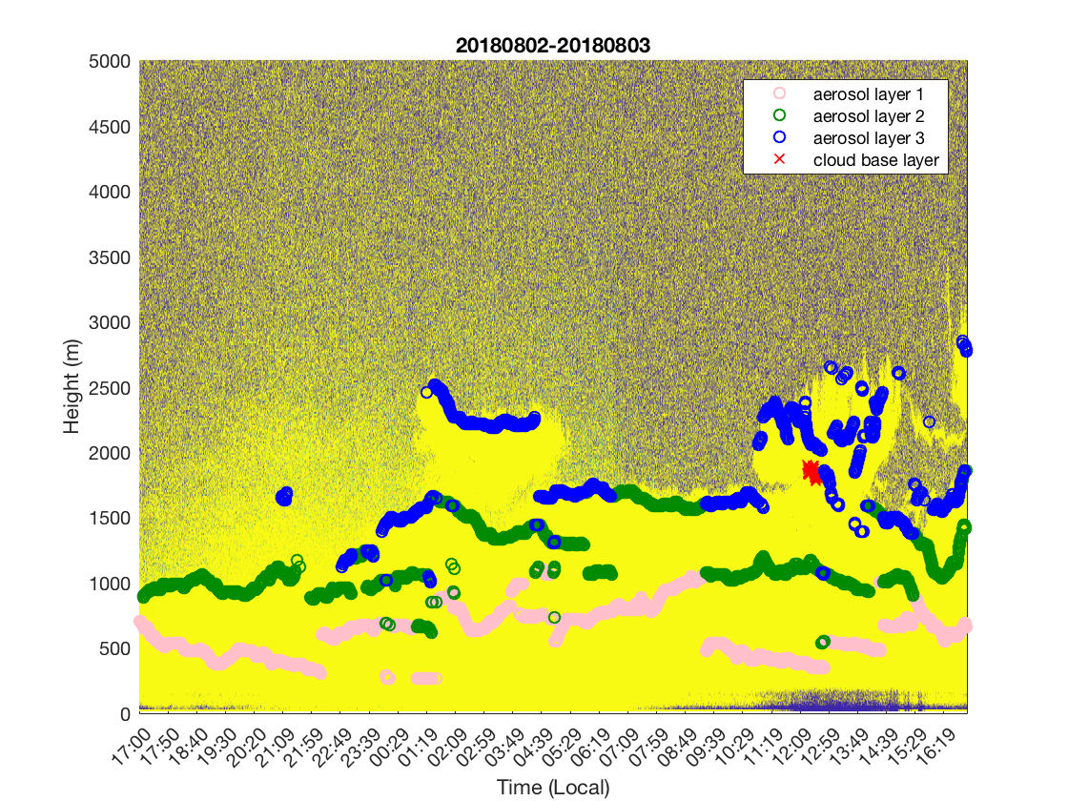
Daytime: aerosol layer 3 may represent pblh
Nighttime: aerosol layer 1 may represent nocturnal stable pblh
To confirm the pblh, we may need additional information, such as the vertical wind profile etc.

