Slide 1
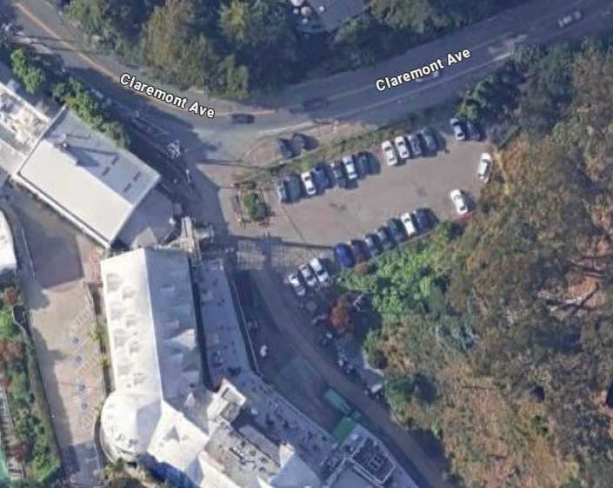




BATTERY ENERGY STORAGE SYSTEM PERMIT SET
GENERAL CONTRACTOR
ELECTRICAL ENGINEER
ER
BY
GENERAL NOTES
ALL CONSTRUCTION SHALL COMPLY WITH THE CODES ADOPTED BY CITY OF BERKELEY AS DESCRIBED IN THE OAKLAND MUNICIPAL CODE INCLUDING BUT NOT LIMITED TO 2022 CEC, CFC & CBC.
BEFORE INITIATING ANY WORK, THE CONTRACTOR SHALL NOTIFY ENGINEER OF RECORDS OF ANY DISCREPANCIES IDENTIFIED ON EXISTING CONDITIONS, STRUCTURE, ELECTRICAL, ETC.
CONTRACTOR SHALL BE RESPONSIBLE FOR ALL SAFETY PRECAUTIONS, OSHA REQUIREMENTS AND SAFETY MEASUREMENTS ON SITE.
CONTRACTOR IS RESPONSIBLE FOR INSTALLING ALL EQUIPMENT AND FOLLOWING ALL MANUFACTURER'S OR ENGINEER'S DIRECTIONS AND INSTRUCTIONS.
CONTRACTOR IS ADVISED THAT ALL DRAWINGS, COMPONENT MANUALS, ESPECIALLY INVERTER MANUALS, ARE TO BE READ AND UNDERSTOOD PRIOR TO INSTALLATION OR ENERGIZING OF ANY EQUIPMENT.
CONTRACTOR IS RESPONSIBLE FOR SELECTING AND PURCHASING EQUIPMENT DESIGNED TO LAST A MINIMUM OF 30 YEARS IN CONJUNCTION WITH THE BESS SYSTEM. ALL ENCLOSURES, CONDUITS, STRAPS, PAINTED METAL SURFACES, CONCRETE, GROUNDING EQUIPMENT AND OTHER EQUIPMENT AND OTHER PRODUCTS SHALL BE SELECTED TO LAST THE LIFECYCLE OF THE BESS SYSTEM.
BRIGHT POWER INC DBA BPI
PO BOX 10637
NAPA, CA 94581
info@bpi-power.com PHONE: (707) 252-9990
FAX: (707) 252-9992 WWW.BPI-POWER.COM LICENSE NUMBER: 930054
LICENSE CLASSIFICATION: A, C10
HIMANSHU BHARTIYA, ME, EE, FPE, LEED AP SACRAMENTO ENGINEERING CONSULTANTS 10555 OLD PLACERVILLE ROAD SACRAMENTO, CA 95827
himanshu@saceng.com
PHONE: (916) 368-4468 ext. 105
FAX: (916) 368-4490
STRUCTURAL ENGINEER
REX ARASHI
PROPERTY OWNER 10360 CAREY DR
APPLIED ENGINEERING CONSULTANTS, INC
CH PROPERTY OWNER LLC 401 CONGRESS AVE STE 2750
AUSTIN,TX 78701
GRASS VALLEY, CA 95945 RARASHI@APPLIEDEC.COM PHONE: (530) 838-5358
12/10/2025 UPDATED WITH LATEST AHJ COMMENTS
ALL CONTRACTORS ARE REQUIRED TO PROVIDE FULL SUBMITTALS OF INTENDED ORDERS TO BPI FOR REVIEW.
WHENEVER ANY SURFACE IMPROVEMENTS SUCH AS PAVEMENT, CURBING, PEDESTRIAN WALKS, FENCING, OR TURFING HAVE BEEN REMOVED, DAMAGED, OR OTHERWISE DISTURBED BY THE CONTRACTOR'S OPERATIONS; THEY SHALL BE REPAIRED OR REPLACED TO THE PRE-EXISTING CONDITION. THE REPAIRS ARE TO MEET THE OWNER'S SATISFACTION.
REFILL AND RESTORE THE WORK AS DIRECTED, DURING CONSTRUCTION AND PRIOR TO PROJECT COMPLETION, TO MAINTAIN ACCEPTABLE SURFACE CONDITIONS.
ALL ADDITIONAL MATERIALS REQUIRED SHALL BE FURNISHED WITHOUT ADDITIONAL COST TO THE OWNER.
ANY WORK BEGUN PRIOR TO ATTAINING APPROVAL AND SIGNATURES OF AHJ WILL BE AT CONTRACTOR'S RISK, AND WILL ONLY BE ALLOWED IF PRE-APPROVED BY PROJECT OWNER.
COORDINATE OPERATIONS WITH ALL REQUIRED MATERIALS TESTING SERVICES AS REQUIRED BY THESE DRAWINGS. EACH PHASE OF CONSTRUCTION SHALL BE TESTED AND APPROVED BY AHJ AS REQUIRED PRIOR TO PROCEEDING TO SUBSEQUENT PHASES.
NOTIFY ALL UTILITY COMPANIES INVOLVED IN THE DEVELOPMENT PRIOR TO BEGINNING OF WORK.
COMPLY WITH ALL CURRENTLY APPLICABLE SAFETY LAWS OF ALL JURISDICTIONAL BODIES. PROVIDE AND MAINTAIN ALL BARRICADES, SAFETY DEVICES, AND CONTROL OF TRAFFIC WITHIN AND AROUND THE CONSTRUCTION AREA. FOR ALL TRENCH EXCAVATION 5 FEET OR MORE IN DEPTH, OBTAIN PERMITS PRIOR TO BEGINNING ANY EXCAVATION.
MAINTAIN CONTINUOUS TEMPORARY TRAFFIC BARRICADES, WITH OPERABLE FLASHING DEVICES, SPACED AT INTERVALS OF NOT TO EXCEED 50 FEET WHENEVER THE WORK AREA IS ADJACENT TO AN EXISTING TRAFFIC LANE AND THERE IS A PAVEMENT CUT, TRENCH, OR DITCH WHICH IS OVER 2 INCHES IN DEPTH, OR IF THE TRAFFIC LANE USED BY VEHICLES IS NOT PAVED. IF THE CUT, TRENCH OR DITCH IS MORE THAN 10 FEET FROM A TRAFFIC LANE, THEN THE BARRICADE SPACING MAY BE GREATER, PROVIDED THAT IT DOES NOT EXCEED 200 FEET.
CONTRACTOR AGREES THAT, IN ACCORDANCE WITH GENERALLY ACCEPTED CONSTRUCTION PRACTICES, CONTRACTOR SHALL BE REQUIRED TO ASSUME SOLE AND COMPLETE RESPONSIBILITY FOR JOB SITE CONDITIONS DURING THE COURSE OF THE CONSTRUCTION OF THE PROJECT, INCLUDING SAFETY OF ALL PERSONS AND PROPERTY.
ALL PASIFIC GAS AND ELECTRIC COMPANY (PG&E)-REQUIRED EQUIPMENT SHALL BE INSTALLED IN ACCORDANCE WITH CURRENT PASIFIC GAS AND ELECTRIC COMPANY (PG&E) STANDARDS.
ALL CONSTRUCTION AND MATERIAL DELIVERY VEHICLES SHALL USE THE DESIGNATED ACCESS AND HAUL ROUTE(S) TO THE CONSTRUCTION SITE. ANY DEVIATION IN ROUTE(S) SHALL BE SUBJECT TO OWNER'S APPROVAL. THE ROUTE(S) SHALL BE MONITORED DURING THE PROJECT FOR ANY DAMAGE AND DEBRIS ATTRIBUTABLE TO THE PROJECT VEHICLES. ALL DAMAGE AND DEBRIS AS A RESULT OF THE PROJECT SHALL BE REPAIRED TO EXISTING STANDARDS.
CONDUCT OPERATION ENTIRELY WITHIN THE PROJECT AREAS INDICATED IN THESE DRAWINGS.
WHERE ANY WORK IS BEING DONE IN AN OFF-SITE EASEMENT, NOTIFY THE PROPERTY OWNER TWO WORKING DAYS PRIOR TO COMMENCING WORK WITHIN SAID EASEMENT.
DO NOT DISPOSE OF CHLORINATED OR OTHER CHEMICALLY TREATED OR POLLUTED WATER INTO ANY DRAINAGE SYSTEM OR TO AREA SOILS.
ALL FASTNERS SHALL BE TORQUED TO THE SPECIFICATION LISTED IN THE LATEST MANUFACTURERS MANUAL OR DATASHEET. WHERE POSSIBLE ALL FASTNERS SHALL BE TORQUE MARKED USING A BPI APPROVED METHOD.
SCOPE OF WORK
THE PROJECT IS TO INSTALL NEW BATTERY ENERGY STORAGE SYSTEMS (BESS) AND
ASSOCIATED ELECTRICAL EQUIPMENT.
ALL CONSTRUCTION SHALL COMPLY WITH THE CODES ADOPTED BY CITY OF BERKELEY AS DESCRIBED IN THE OAKLAND MUNICIPAL CODE INCLUDING BUT NOT LIMITED TO 2022 CEC, CFC, CBC & CGBSC.
REV. # REV. DATE
THE SYSTEM WILL BE INTERCONNECTED TO AND WILL BE OPERATING IN PARALLEL WITH THE ELECTRICAL UTILITY GRID PER THE REQUIREMENTS OF PASIFIC GAS AND ELECTRIC
1
COMPANY (PG&E) AND THE 2022 CEC.
ALL WORK SHALL COMPLY WITH THE CBC, CRC, CPC, CMC, CEC, AND OTHER APPLICABLE CODES AS AMENDED AND ADOPTED BY THE CITY OF OAKLAND IN EFFECT AT THE TIME OF
PO BOX 10637
NAPA, CA 94581
PH: (707)-252-9990
PERMIT APPLICATION
SHEET INDEX
B2600662
REVIEWED FOR COMPLIAN
CITY OF OAKLAND BUILDING SERVICES PLAN CHECK SECTION
For Substantial Compliance With Codes anSd2.0
SHEET | DESCRIPTION | REV
E0 | COVER SHEET | 00
E1.0 | PLOT PLAN | 01
E1.1 | ENLARGED PLOT PLAN | 01
^{C}E^{E}1.2 DEMOLITION PLAN 01
E2.0 | SINGLE LINE DIAGRAM | 00
E3.0 | SIGNAGE | 00
S1.1 | BESS PAD DETAILS | 01
S1.2 | GEAR PAD DETAILS | 00
SITE INFORMATION
SITE LATITUDE | 37.859399, -122.242405
ZONING DISTRICT | RH-4, RU-3
FLOOD ZONE | X
EXPOSURE CATEGORY | C
SEISMIC DESIGN CATEGORY | E
COLD DESIGN TEMPERATURE [°F] | 33,8
MAX OPERATING TEMPERATURE [°F] | 84,2
Ordinances
VISIONS NEED REVIEW
X6345
BUILDING CODE
Subject to CBC Sections 105.4, 107.3 and CRC R105.4 and R106.3
SURVEY (REVIEW ONLY) PLOT PLAN REVIEW PARKING/DRIVEWAY LAYOUT
GRADING & EROSION CONTROL SOILS REPORT ON FILE
S3.0
GROUNDING DETAILS FENCING DETAILS
00
01
SPECIAL INSPECTION LIST (checked items are required )
FOUNDATION
Piers and Caissons Grading and Drainage
Other
BESS INFO |  | BATTERY CABINET | BATTERY RACK | BATTERY INVERTER | RE
 | MANUFACTURER | GREAT POWER | GREAT POWER | By: DYNAPOWER
 | MODEL NUMBER | MAX-20HC-5000 | LIQRACK-280AH 1P416S | LLC CPS-1250 [480V]
 | COUNT | 1 | 12 | 1
 | BATTERY BANK CAPACITY [kWh] | 5 000 | 372.7
 | ROUND TRIP EFFICIENCY | 93.5% | N/A | 98%
 | VOLTAGE | 1 331.2 VDC | 1 331.2 VDC | 480 VAC
 | PHASE | N/A | N/A | 3
 | INVERTER RATING [kVA] | N/A | N/A | 802
 | WEIGHT [lbs] | 49 798 | 7054.8 | 1 980
 | ENCLOSURE TYPE | IP55 | N/A | IP54
 | RATED OUTPUT CURRENT | 193A (DC) | N/A | 964.6 A (AC) ELE
CONCRETE CONSTRUCTION
F'_{C} = 3,000 psi Reinf. Placement
Bolts in Concrete
STEEL CONSTRUCTION
Field/Shop Welding
Shotcrete or Masonry Concrete Placement
Other
Plan check engineer: Johnny Liu jliu2@oaklandca.gov
High Strength Bolting
PN - Claremont Resort & Club
41 Tunnel Road
Berkeley, CA 94705 APN: 048H-7670-027
Other
SEISMIC RESISTANCE
Structural Wood Structural Steel
Other
C/MECH/PLUMB NOT CHECKED
WIND RESISTANCE
Date:
04/08/2026
STRUCTURAL OBSERVATIONS (list below )
ELECTRICAL NOTES
THE LINE AND LOAD TERMINALS ON THE DC DISCONNECTS MAY BE ENERGIZED IN THE OPEN POSITION. SWITCH IS TO BE LABELED TO COMPLY WITH ARTICLE 690.17 OF THE NEC.
BATTERY ENERGY STORAGE SYSTEM (BESS) SHALL BE CLEARLY MARKED IN ACCORDANCE WITH THE NEC LABELING REQUIREMENTS ARTICLE 690.
GROUNDING OF THE BESS SHALL COMPLY WITH NEC 690.45 AND 690.47.
THE ELECTRICAL CONTRACTOR IS REQUIRED TO USE PERMANENTLY COLOR CODED INSULATION AND PROVIDE A COLOR CODE TO IDENTIFY DC AND AC CIRCUITS AND IN ACCORDANCE WITH NEC.
IN EVERY PULL BOX, TERMINAL BOX, AND AT ALL PLACES WHERE WIRES MAY NOT BE READILY IDENTIFIED BY NAMEPLATE MARKINGS ON THE EQUIPMENT TO WHICH THEY CONNECT, IDENTIFY EACH CIRCUIT WITH A PLASTIC LABEL OR TAG FOR NUMBER, POLARITY, OR PHASE.
FLEX CONDUIT SHALL ONLY BE USED WHEN SPECIFIED OR APPROVED BY BPI.
THIS ELECTRICAL INSTALLATION IS TO BE CONSIDERED AN OPTIONAL STANDBY SYSTEM PER CEC 702.
THE GREAT POWER MAX-20HC-5000 BATTERY STORAGE SYSTEMS ARE TO BE CONSIDERED PRE-ENGINEERED STATIONARY BATTERY STORAGE SYSTEMS.
SITE CLEARING NOTES (IF APPLICABLE)
Title 24 Energy - ECC Verification (PSR REQUIRED) Construction Formwork Certification
1. PROTECT FROM DAMAGE AND PRESERVE TREES, SHRUBS, AND OTHER PLANTS OUTSIDE THE LIMITS OF WORK AND WITHIN THE LIMIT OF THE WORK WHICH ARE DESIGNATED TO REMAIN UNDISTURBED.
Special Case
REMOVE OBSTRUCTIONS, TREES, SHRUBS, GRASS AND OTHER VEGETATION TO PERMIT INSTALLATION OF NEW CONSTRUCTION. REMOVAL INCLUDES DIGGING OUT STUMPS AND OBSTRUCTIONS AND GRUBBING ROOTS.
FILL DEPRESSIONS CAUSED BY CLEARING AND GRUBBING OPERATIONS WITH SOIL MATERIAL APPROVED BY OWNER, UNLESS FURTHER EXCAVATION OR EARTHWORK IS INDICATED.
STRIP TOPSOIL WHERE REQUIRED. STOCKPILE IN AREA APPROVED BY OWNER.
WITH OWNER'S APPROVAL, REMOVE EXISTING ABOVE AND BELOW GRADE IMPROVEMENTS AS INDICATED AND AS NECESSARY TO FACILITATE NEW CONSTRUCTION.
DISPOSE OF REMOVED TREES, BRUSH, STUMPS, ROOTS AND ORGANIC DEBRIS IN A LEGAL MANNER OFF THE SITE.
REVIEWED FOR COMPLIANCE SUBJECT TO FIELD INSPECTION
Oakland Fire Department Fire Prevention Bureau PCB
RECORD DRAWINGS
KEEP UP-TO-DATE AND ACCURATE A COMPLETE RECORD SET OF PRINTS FOR THE CONTRACT DRAWINGS SHOWING EVERY CHANGE FROM THE ORIGINAL DRAWINGS MADE DURING THE COURSE OF CONSTRUCTION INCLUDING FINAL LOCATION, ELEVATION, SIZES, MATERIALS, AND DESCRIPTION OF ALL WORK.
RECORDS SHALL BE "REDLINED" ON A SET OF CONSTRUCTION PLAN DRAWINGS AT THE SITE. A COMPLETE SET OF CORRECTED AND COMPLETED RECORD DRAWING PRINTS SHALL BE SUBMITTED TO OWNER PRIOR TO SUBSTANTIAL COMPLETION AT SITE.
Oakland, CA 94612
FDPR26-00369 04.13.26 41 Tunnel Rd. - B2600362
E0
COVER SHEET
OFD NOTES:
1.
Provide required minimum 5 feet setback with non-combustible vegetation or structure. Ref. CA Wildland Urban Interface Code.
FIRST ISSUE DATE:
11/20/2025
DESIGNED BY:
S.B.
EXP. 3/31/21
CHECKED BY:
W.V.D.W.
JOB NO.:
25-48

Slide 2







ESTIMATED TRENCHING | LENGTH (FT)
ASPHALT | 161'-9"
TOTAL | 161'-9"
1
NOTE:
REFER TO E1.1 FOR EQUIPMENT DIMMENSIONS.
SYSTEM | POI1
Inverter | 1 DYNA POWER COMPANY LLC CPS-1250 Gen5 [600V][SI1-SB] 982 kW ENERGY STORAGE INVERTER
Battery Cabinet | 1 Guangzhou Great Power Energy Storage Technology Co., Ltd MAX-20HC-5000 (5016kWh)
Battery Racks | 12 Guangzhou Great Power Energy Storage Technology Co., Ltd 1P416S (372.7kWh)
DC Size | 5016 kWh
AC Size | Derated to 802 kW
ER
BY
PRIVACY FENCE
(SEE E1.1 FOR PLACEMENT)
1
APN: 048H-7670-020
BESS INVERTER 1-1
Label text
BOLLARDS SPACED AROUND PAD (SEE E1.1 FOR SPACING)
APN: 048H-7672-013
BESS Container
28'-4"
Isolation XFMR
AC Disconnect 1-2
12/10/2025 UPDATED WITH LATEST AHJ COMMENTS
APN: 048H-7672-026
161'-9"
(E) Utility XFMR
APN: 048H-7670-021
PARCEL LINES
APN: 048H-7672-015
37'-1"
AC Disconnect 1-1
REV. # REV. DATE
CLAREMONT AVENUE
ARRAY 1 POINT OF INTERCONNECTION
41 Tunnel Road, Berkeley, CA 94705 2000A, 480Y/277, 3PH, 4W
APN: 048H-7673-001
150 KW UPS
1
PO BOX 10637
NAPA, CA 94581
PH: (707)-252-9990
APN: 048H-767-027
B2600662
REVIEWED FOR COMPLIANCE
CITY OF OAKLAND BUILDING SERVICES PLAN CHECK SECTION
For Substantial Compliance With Codes and Ordinances
REVISIONS NEED REVIEW
PN - Claremont Resort & Club
41 Tunnel Road
Berkeley, CA 94705 APN: 048H-7670-027
By:
X6345
BUILDING CODE
Subject to CBC Sections 105.4, 107.3 and CRC R105.4 and R106.3
SURVEY (REVIEW ONLY) PLOT PLAN REVIEW PARKING/DRIVEWAY LAYOUT
GRADING & EROSION CONTROL SOILS REPORT ON FILE
APN: 048H-7670-024
APN: 064-4225-003
APN: 048H-7670-017-01
CLAREMONT AVENUE
APN: 048H-7670-025
APN: 064-4225-005
ELEC/MECH/PLUMB NOT CHECKED
Date:
04/08/2026
APN: 064-4225-004
TUNNEL ROAD
DOMINGO AVENUE
REVIEWED FOR COMPLIANCE SUBJECT TO FIELD INSPECTION
Oakland Fire Department Fire Prevention Bureau PCB Oakland, CA 94612
FDPR26-00369 04.13.26 41 Tunnel Rd. - B2600362
E1.0
PLOT PLAN
OFD NOTES:
1.
Provide required minimum 5 feet setback with non-combustible vegetation or structure. Ref. CA Wildland Urban Interface Code.
FIRST ISSUE DATE:
1
PLOT PLAN
11/20/2025
E1.0
SCALE: 1'' = 50'
DESIGNED BY:
S.B.
EXP. 3/31/21
CHECKED BY:
W.V.D.W.
JOB NO.:
25-48

Slide 3

















 | BATTERY CABINET | BATTERY RACK | BATTERY INVERTER
MANUFACTURER | GREAT POWER | GREAT POWER | DYNAPOWER
ER
BY
MODEL NUMBER
MAX-20HC-5000
LIQRACK-280AH 1P416S
LLC CPS-1250 [480V]
BESS PAD
(REFER TO S1.2 FOR DETAILS)
COUNT
1
12
1
BESS INFO
BATTERY BANK CAPACITY [kWh]
5 000
372.7
PRIVACY FENCE BLOCKING VIEW FROM CLAREMONT AVENUE (ON TOP OF EQUIPMENT & BESS FOUNDATIONS) (REFER TO S3.0 FOR FENCE DETAILS)
3'-0" (TYP.)
1
ROUND TRIP EFFICIENCY
93.5%
N/A
98%
BOLLARD (TYP.) IN ACCORDANCE WITH
VOLTAGE
1 331.2 VDC
1 331.2 VDC
480 VAC
3"
CFC 2022, 1207.11.7.3 (1) SEE S1.1 FOR DIMENSIONS
PHASE
N/A
N/A
3
INVERTER RATING [kVA]
N/A
N/A
802
8'-0"
WEIGHT [lbs]
49 798
7054.8
1 980
8'-2"
ENCLOSURE TYPE
IP55
N/A
IP54
PARCEL LINE
RATED OUTPUT CURRENT
193A (DC)
N/A
964.6 A (AC)
12/10/2025 UPDATED WITH LATEST AHJ COMMENTS
LEGEND
BESS CONTAINER
SYMBOL | DESCRIPTION | TOTAL
 | BOLLARDS | 11
19'-10"
1
1
CONTAINER DIMENSIONS IN ACCORDANCE TO CFC 2022, 1207.5.6 (TYP.)
SPACING IN ACCORDANCE WITH
CFC 2022, 1207.11.7.3 (1)
5'-0" (TYP.)
2025 CFC 312 shall apply - typ.
REV. # REV. DATE
7'-1"
5'-5"
1
3'-7"
3'-0"
4'-0" (TYP.)
PO BOX 10637
NAPA, CA 94581
PH: (707)-252-9990
5'-1"
2'-11"
FENCE SETBACK FROM PROPERTY LINE
10'-6"
EQUIPMENT SETBACK FROM PROPERTY LINE
11'-3"
22'-9"
DYNA POWER COMPANY LLC CPS-1250
BATTERY INVERTER
2'-4" (TYP)
1200A AC DISCONNECT
ELECTRICAL EQUIPMENT PAD (REFER TO S1.1 FOR DETAILS)
1000KVA XFMR
CLAREMONT AVENUE
PN - Claremont Resort & Club
41 Tunnel Road
Berkeley, CA 94705 APN: 048H-7670-027
REVIEWED FOR COMPLIANCE SUBJECT TO FIELD INSPECTION
Oakland Fire Department Fire Prevention Bureau PCB Oakland, CA 94612
FDPR26-00369 04.13.26 41 Tunnel Rd. - B2600362
OFD NOTES:
1.
Provide required minimum 5 feet setback with non-combustible vegetation or structure. Ref. CA Wildland Urban Interface Code.
E1.1
ENLARGED PLOT PLAN
1
ENLARGED PLOT PLAN
FIRST ISSUE DATE:
11/20/2025
E1.1
SCALE: 1'' = 5'
DESIGNED BY:
S.B.
EXP. 3/31/21
CHECKED BY:
W.V.D.W.
JOB NO.:
25-48

Slide 4


















LEGEND
SYMBOL | DESCRIPTION | TOTAL
 | TREES/BUSHES | 1
 | MTRPSEE | 2
ER
BY
NTKREE
FTIRLEE (TTROIMMED
12'-4"
12/10/2025 UPDATED
STUMTRPEE
EN(HAS
REEV.
1
REV.
8'-3"
70P7H):-252-9990
06B3O7PXO A81 NAPA,
CLAREMONT
REVIEWED FOR COMPLIANCE SUBJECT TO FIELD INSPECTION
Oakland Fire Department Fire Prevention Bureau PCB Oakland, CA 94612
FDPR26-00369 04.13.26 41 Tunnel Rd. - B2600362
OFD NOTES:
1.
Provide required minimum 5 feet setback with non-combustible vegetation or structure. Ref. CA Wildland Urban Interface Code.
aPrNemont
u4n1nel Berkeley,
HA-7P6N7:0-027
1
E1.2
DEMOLITION
1
ENLARGED
UEFIRST
DATE:
11/20/2025
E1.1
SCALE:
DESIGNED
S.B.
31E/X2P1.
CHECKED
W.V.D.W.
.J:OB
25-48

Slide 5
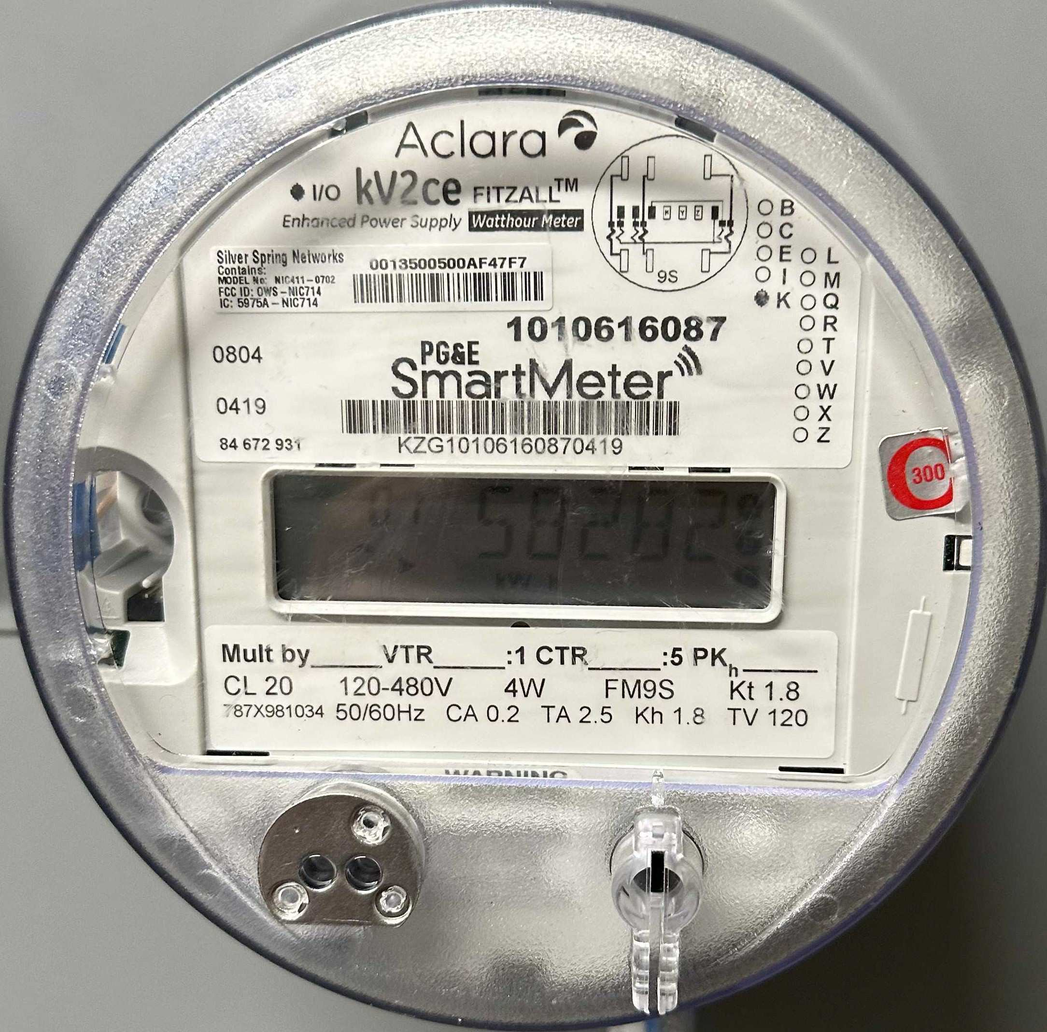


INTERCONNECTION iAscConnect OPONINNETCTION Terhters mSiantgicle raAsrngde determined ED1RYNA Photovoltaic aAnzlal rdous INVERTER OlaNb-eEleledc:trical IEEE-929-2000 G1uangzhou systems 2MSA1XR-82-0AH0C1-)5000 vtehreter _{STORAGE} u1a2ngzhou aIpfplicable, ^{PRODUCERS} RIQRACK-280AH-1P416S inverters ^{CAUSE} exclusively NORMAL U9A6NGZHOU eRnetsfer IESFINED LIQRACK-280AH-1P52S _{RPOEDWER} ESRYSSTEM WITHOUT S)T.ORAGE bMeer:ter AINRKING ELIENCTRICAL wn(Nge)r PT BE0EMkS(WNS)h) _{0V1000KVA} ^{Y/217270V0,A, Y/217270V0,A,} _{802kW ISOLATION} AWIC,3PH, AWIC,3PH, _{[480V] TRANSFORMER} 3R, NEMA ^{1, NEMA} HA(BEI)ONARD 5000kWh NON-FUSED ^{ES12(030)A} 27070V0,A, BESS ₊ _ _{A6 193A} 964.6A 964.6A 964.6A 964.6A TIMONAIN N CADBCLE N CAABCLE AABCLE N CAABCLE N CAABCLE ^{BATTERY} EBRATTERY METER ISACONNECT ISACONNECT SECTION M Grounding XoFfMRside CONTROL 75(NA) 8IA0(NRV)Y _{LUL.G} PANELOAD 0Y/220707AV, ^{SECTION TAODS} DISTRIBUTION XBILEITASOSRY _{SECTION} N CAABCLE (HVAC) ^{100A} 50(N) ... N CAABCLE ITASOSRY 50A N CAABCLE SUPPRESSION) INCOMING TFYROM N CAABCLE 10A EMS TESRITNEET N CAABCLE ^{Apparent ltMagaex ngRtuhn} oLlt-Lage Phases c. Neutral Material Current ^{mpaTcaibtyle} atiOngCP ^{Number Voltage itCode} Specification Ground ^{Conduit} [%V] D A] power %] drop [ft] ] Needed [#] Runs limit Moinr . Size ₁ ADBCLE 802,0 1,56 20 1300 1 dullNyot VnCAL 193,0 301,56 350 2 1#2 4/0 4/0 1# 1-1/2 0,02 REVIEWED FOR COMPLIANCE AABCLE 802,0 1,25 5 480 3 dullNyot VnCAL 964,6 1205,82 1200 4 1#0 cm5i0l 0 kcm5i0l 0 kcm3i5l 0 3-1/2 0,01 ^{SUBJECT TO FIELD INSPECTION} Oakland Fire Department AABCLE 802,0 1,25 5 480 3 dullNyot VnCAL 964,6 1205,82 1200 4 1#0 cm5i0l 0 kcm5i0l 0 kcm3i5l 0 3-1/2 0,01 Fire Prevention Bureau PCB AABCLE 802,0 1,25 160 480 3 dullNyot VnCAL 964,6 1205,82 1200 4 kcm2i5l 0 cm5i0l 0 kcm5i0l 0 kcm3i5l 0 3-1/2 0,59 ^{Oakland, CA 94612} FDPR26-00369 04.13.26 AABCLE 802,0 1,25 10 480 3 RateFdully TCU 964,6 1205,82 1200 4 1#0 cm3i5l 0 kcm3i5l 0 4/0 3 0,03 41 Tunnel Rd. - B2600362 AABCLE 145,4 1,25 10 480 3 RateFdully MnATL 174,0 218,75 225 1 8# cm3i0l 0 kcm3i0l 0 2# 2-1/2 0,04 _{OFD NOTES:} AABCLE 145,4 1,25 10 480 3 RateFdully MnATL 174,0 218,75 225 1 8# cm3i0l 0 kcm3i0l 0 2# 2-1/2 0,04 1. AABCLE 83,1 1,25 160 480 3 RateFdully MnATL 100,0 125,00 125 1 1/0 2/0 2/0 4# 2 0,92 Provide required minimum 5 feet setback with non-combustible vegetation or structure. Ref. AABCLE 41,5 1,25 160 480 3 RateFdully MnATL 50,0 62,50 70 1 3# 3# 3# 6# 1-1/4 1,15 CA Wildland Urban Interface Code. AABCLE 5,0 1,25 10 480 3 RateFdully MnATL 6,0 7,51 15 1 1#2 6# 6# 6# 1 0,01 31E/X2P1. | ER |  |  |  |  |  |  |  |  |  | BY
 | UPDATED
 | 12/10/2025 |  |  |  |  |  |  |  |  |  | REEV.
 | 1 |  |  |  |  |  |  |  |  |  | REV.
 |  |  |  |  |  |  | 06B3O7PXO A81 NAPA, 70P7H):-252-9990
 | aPrNemont u4n1nel Berkeley, HA-7P6N7:0-027
 | E2.0 POIS1LD
 | UEFIRST DATE: |  |  |  |  | 11/20/2025
 | DESIGNED |  |  |  |  | S.B.
 | CHECKED |  |  |  |  | W.V.D.W.
 | .J:OB |  |  |  |  | 25-48
2000A

Slide 6





LOCATION:
BESS
QUANTITY:
1
TEXT:
HEADER: 34 point (0.472")
SUB: 18 points (0.25")
BODY: 12 points (0.167")
LOCATION:
MSB
QUANTITY:
1
TEXT:
HEADER: 34 point (0.472")
SUB: 18 points (0.25")
BODY: 12 points (0.167")
ER
BY
CAUTION:
THIS SERVICE SUPPLIED BY ALTERNATIVE POWER SOURCES WITH DISCONNECTS LOCATED AS SHOWN
CAUTION:
THIS SERVICE SUPPLIED BY ALTERNATIVE POWER SOURCES WITH DISCONNECTS LOCATED AS SHOWN
BESS Container
YOU
BESS Container
12/10/2025 UPDATED WITH LATEST AHJ COMMENTS
ARE
BESS Inverter 1-1
Isolation XFMR
& AC Disconnect 1-2
BESS Inverter 1-1
HERE
Isolation XFMR
& AC Disconnect 1-2
(E) Utility XFMR
10"
(E) Utility XFMR
10"
REV. # REV. DATE
AC Disconnect 1-1
YOU
AC Disconnect 1-1
1
ARRAY 1 POINT OF INTERCONNECTION
41 Tunnel Road, Berkeley, CA 94705 2000A, 480Y/277, 3PH, 4W
ARE
ARRAY 1 POINT OF INTERCONNECTION
41 Tunnel Road, Berkeley, CA 94705 2000A, 480Y/277, 3PH, 4W
HERE
PO BOX 10637
NAPA, CA 94581
PH: (707)-252-9990
41 Tunnel Road
Berkeley, CA, 94705
TRUE NORTH
41 Tunnel Road
Berkeley, CA, 94705
TRUE NORTH
10"
10"
LOCATION:
QUANTITY:
TEXT:
BESS ENCLOSURE | 1 | 36 point (0.359") | LOCATION: | QUANTITY: | TEXT: | LOCATION: | QUANTITY: | TEXT:
(GREAT POWER) |  |  | BESS ENCLOSURE | 1 | 36 point (0.359") | BOLTSWITCH CABINET | 2 | 20 point (0.203")
ENERGY STORAGE SYSTEM DISCONNECT | 3"
5"
ENERGY STORAGE SYSTEM | 2"
5"
AC DISCONNECT BOLTSWITCH CABINET OPERATING CURRENT: 1200A OPERATING VOLTAGE: 480V | 2"
5"
PN - Claremont Resort & Club
41 Tunnel Road
Berkeley, CA 94705 APN: 048H-7670-027
LOCATION: BESS ENCLOSURE (DYNAPOWER)
QUANTITY:
1
TEXT:
36 point (0.359")
LOCATION:
BESS ENCLOSURE
QUANTITY:
1
TEXT:
28 point (0.281")
LOCATION: | QUANTITY: | TEXT:
XFMR | 1 | 20 point (0.203")
ENERGY STORAGE SYSTEM INVERTER | 3"
5"
LITHIUM IRON PHOSPHATE TECHNOLOGY | 2"
5"
ISOLATION XFMR XFMR SIZE: 1000KVA OPERATING VOLTAGE: 480/480V | 2"
5"
REVIEWED FOR COMPLIANCE SUBJECT TO FIELD INSPECTION
Oakland Fire Department Fire Prevention Bureau PCB Oakland, CA 94612
FDPR26-00369 04.13.26 41 Tunnel Rd. - B2600362
E4.0
POI1 SIGNAGE
OFD NOTES:
1.
Provide required minimum 5 feet setback with non-combustible vegetation or structure. Ref. CA Wildland Urban Interface Code.
FIRST ISSUE DATE:
11/20/2025
DESIGNED BY:
S.B.
EXP. 3/31/21
CHECKED BY:
W.V.D.W.
JOB NO.:
25-48

Slide 7

















26'-6"
1
 | FOR PAGES PV0.2 & PV0.3
 | GENERAL NOTES: STEM WALL SECTIONS WILL NEED TO BE FORMED AND POURED FIRST WITH A COLD JOINT WITH EXTENDED VERTICAL BARS TO TIE INTO THE SLAB. GRAVEL BACKFILL WILL FOLLOW AFTER THE STEM WALLS ARE SET. THE SLAB WILL BE PLACED AFTER THE BACKFILL.
 | Design Criteria: 2025 CBC, ASCE 7-22, ACI 318-19, ANSI/AWC NDS - 2024 Risk Category 1 Wind speed = 87 mph, Exposure B Seismic Design Category D, Sds = 1.8 Soils capacities per IBC Chapter 18: Bearing = 1500 psf, lateral bearing = 200 pcf for drilled piers Concrete Notes: Use fc' = 3000 psi Use A615, Grade 60 rebar Break test are required at 7, 14 and 28 days Max w/c = 0.5 Engineering Notes: Installation of post-installed anchors (wedge anchors, epoxy anchors) require continuous special inspection. Install anchors in strict accordance with manufacturer's recommendations. Remove all top soil under perimeter of equipment pads. Compact native soil or remove any loose materials.
ER
BY
BESS CONTAINER FOOTPRINT
3'-7"
SIMPSON PAB8H W/ 9" EMBEDMENT
1/15/2026 UPDATED WITH LATEST AHJ COMMENTS
Great Power Energy MAX-20HC-5000 BESS
Max Wt = 86000 lbs
16'-6"
3'-8"
3'-8"
verify 4" minimum
required. 2025 CFC
312.
REV. # REV. DATE
BATTERY TRAY ACCESS SIDE
CONCRETE FILLED TO TOP OF
1
5'-5"
WOOD POSTS IN PIERS, RESTRAINED BY PAD
PO BOX 10637
NAPA, CA 94581
PH: (707)-252-9990
1
MAINTENANCE ACCESS & FIRE CLEARANCE PER CFC 1207.1-1207.9
BOLLARD
REVIEWED FOR COMPLIANCE SUBJECT TO FIELD INSPECTION
Oakland Fire Department Fire Prevention Bureau PCB Oakland, CA 94612
FDPR26-00369 04.13.26 41 Tunnel Rd. - B2600362
B2600662
REVIEWED FOR COMPLIANCE
CITY OF OAKLAND BUILDING SERVICES PLAN CHECK SECTION
For Substantial Compliance With Codes and Ordinances
REVISIONS NEED REVIEW
14" DIAMETER x 4'-6" LONG PIER, TYP.
1
BESS PAD DETAILS - TOP VIEW
1
3" SCHEDULE 80 STEEL PIPE
(IN ACCORDANCE TO CFC 2022, 1207.11.7.3(1))
OFD NOTES:
1.
Provide required minimum 5 feet setback with non-combustible vegetation or structure. Ref. CA Wildland Urban Interface Code.
S1.1
SCALE: 1" = 2'
36" MIN.
48" MAX.
FINISH GRADE
84" POST
By:
X6345
BESS CONTAINER
BUILDING CODE
Subject to CBC Sections 105.4, 107.3 and
1/15/2026, 1:10:52 PM
CRC R105.4 and R106.3
PN - Claremont Resort & Club
41 Tunnel Road
Berkeley, CA 94705 APN: 048H-7670-027
SURVEY (REVIEW ONLY) PLOT PLAN REVIEW PARKING/DRIVEWAY LAYOUT
GRADING & EROSION CONTROL SOILS REPORT ON FILE
36" MIN.
48" MAX.
8'-0"
12" THICK SLAB WITH #4 BAR AT 18" O.C. EACH WAY AT TOP AND BOTTOM
CONCRETE
ELEC/MECH/PLUMB NOT CHECKED
3" MIN.
Date:
04/08/2026
BEND VERTICAL BARS INTO SLAB BY 12" MINIMUM
GRAVEL BACKFILL UNDER SLAB, COMPACT WITH VIBRATORY
COMPACTOR IN 6" LIFTS
SIMPSON PAB8H W/ 9" EMBEDMENT
10"
1
2"
6"
GRADE
15" MIN.
2'-4"
1'-0"
3
TYPICAL 4" BOLLARD
2025 CFC 312 shall apply - typ.
GRADE
3"
4°
2'-10" EMBEDMENT
S1.1
SCALE: 1" : 1'
1'-0" EMBEDMENT
1'-0"
#4 BAR AT 9" O.C. VERTICAL AND HORIZONTAL
BOLLARD NOTES:
BOLLARDS IN REGULATION WITH CFC 312.2
REGULAR 84" POST - SCHEDULE 40 GALVANIZED STEEL PIPE.
DETAIL CONSIDERED MINIMUM FOR INSTALLATION. CARE WILL BE TAKEN TO CONFORM TO EXISTING BOLLARD AESTHETIC SUCH AS COLOR, END-CAP, OR REFLECTIVE VISIBILITY STRIPS.
REPAIRS, IF NECESSARY, SHALL BE MADE TO EXISTING FINISH GRADE AFTER BOLLARD INSTALLATION.
COLD JOINTS
1'-0"
1
STANDARD HOOK AT BOTTOM
S1.1
BESS Pad Detail
2
BESS PAD DETAILS - SIDE VIEW
FIRST ISSUE DATE:
11/20/2025
S1.1
SCALE: 1" = 2'
DESIGNED BY:
S.B.
EXP. 3/31/21
CHECKED BY:
W.V.D.W.
JOB NO.:
25-48

Slide 8









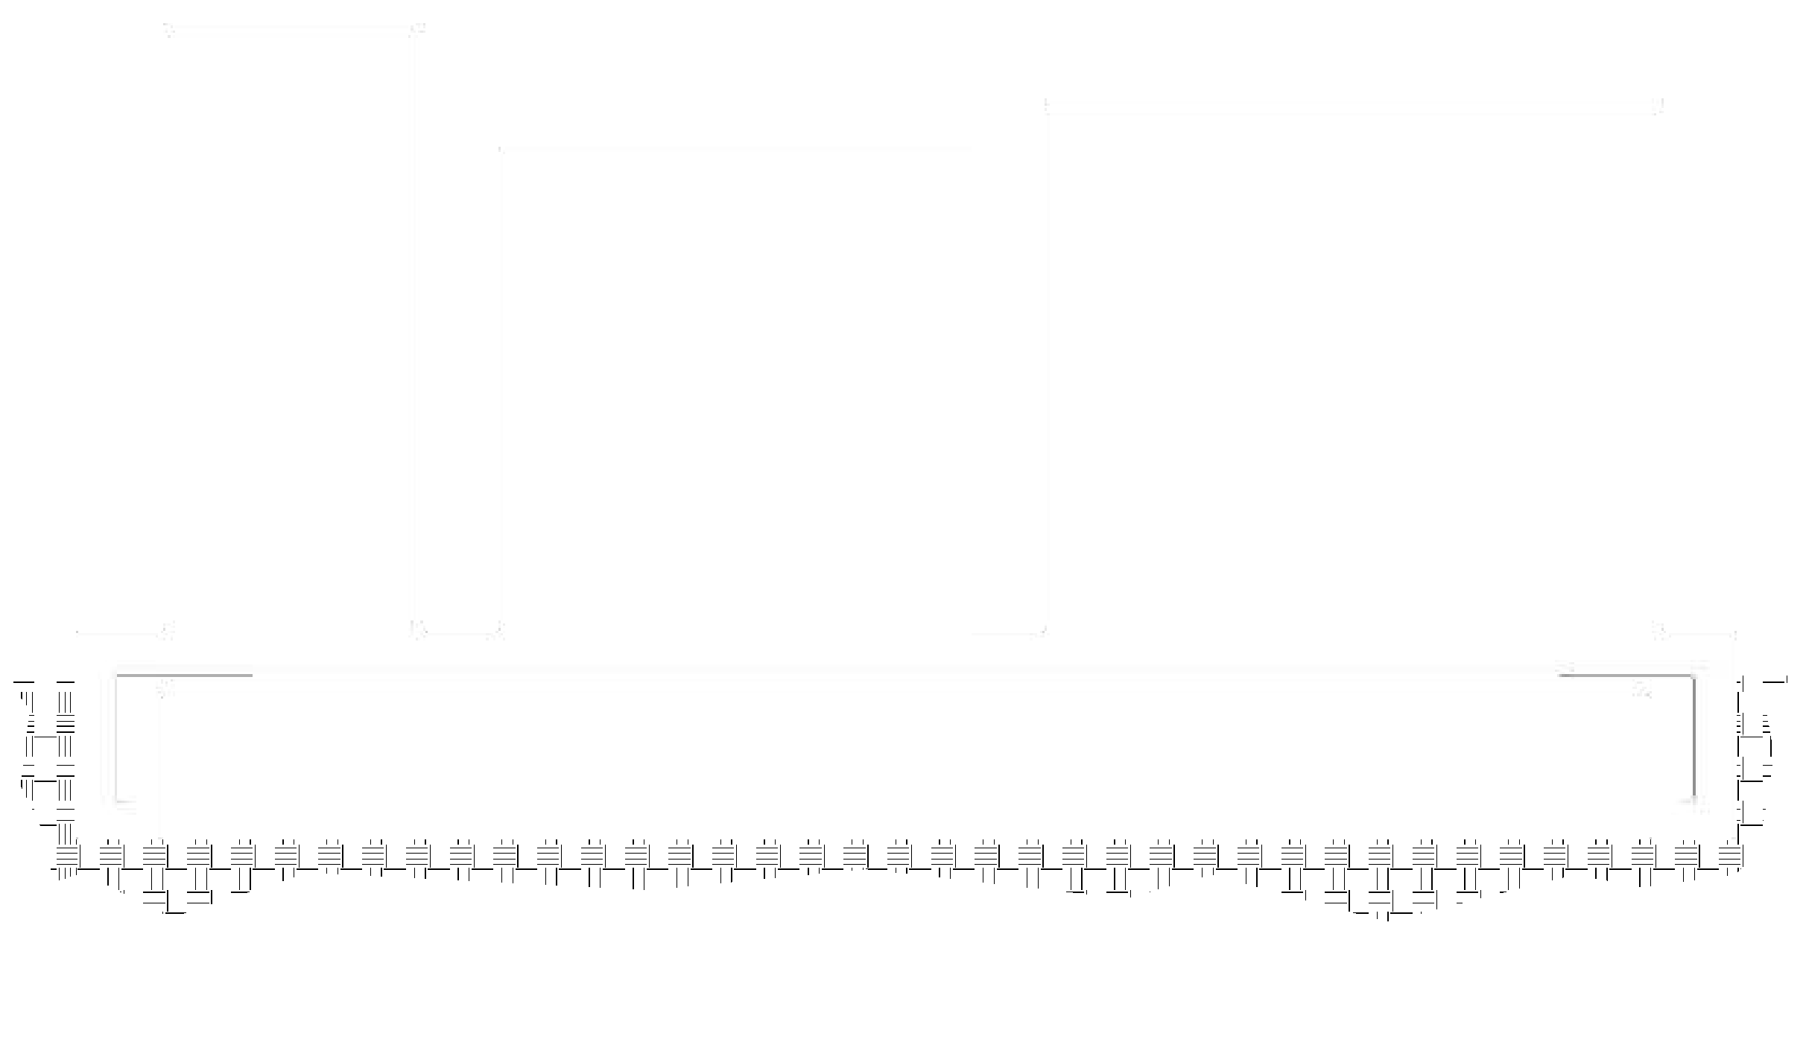







1
1'-2"
1'-9"
ER
BY
1'-11"
10"
1"
1'-7"
6'-3" OC MAX WOOD POST SPACING
AC DISCONNECT FOOTPRINT
TRANSFORMER FOOTPRINT
BATTERY INVERTER FOOTPRINT
1
4'-1"
CONCRETE PAD
6X6 PTDF WOOD POSTS
RATED FOR GROUND CONTACT
1
6" MIN
(4) 3/8" SIMPSON STONG-BOLT 2 SS W/ 2"
EMBEDMENT (TYP.)
1200A Disconnect
Max Wt = 710 lbs
7'-5"
3'-0" DEEP
WOOD POST
1/15/2026 UPDATED WITH LATEST AHJ COMMENTS
Dyna Power CPS-1250 Battery Inverter
Max Wt = 1980 lbs
4'-6" DEEP
Maddox 1000kVA XFMR
Max Wt = 8530 lbs
14" DIAMETER
WOOD POSTS IN PIERS, RESTRAINED BY PAD
14" DIAMETER
REV. # REV. DATE
4
PIER ELEVATION
5
PIER PLAN VIEW
10"
S1.2
SCALE: 1" = 2'
S1.2
SCALE: 1" = 2'
1
1'-0"
14" DIAMETER x 4'-6" LONG PIER, TYP.
B2600662
PO BOX 10637
NAPA, CA 94581
PH: (707)-252-9990
1
20'-1"
1
1
(4) 3/4" SIMPSON STRONG-BOLT 2 SS
W/ 4" EMBEDMENT (TYP.)
1
GEAR PAD DETAILS - TOP VIEW
(4) 3/4" SIMPSON STRONG-BOLT 2 SS
W/ 4" EMBEDMENT (TYP.)
REVIEWED FOR COMPLIANCE
CITY OF OAKLAND
BUILDING SERVICES
S1.2
SCALE: 1" = 1'
PLAN CHECK SECTION
For Substantial Compliance With Codes and Ordinances
REVISIONS NEED REVIEW
By:
X6345
BUILDING CODE
Subject to CBC Sections 105.4, 107.3 and CRC R105.4 and R106.3
SURVEY (REVIEW ONLY) PLOT PLAN REVIEW PARKING/DRIVEWAY LAYOUT
GRADING & EROSION CONTROL SOILS REPORT ON FILE
REVIEWED FOR COMPLIANCE SUBJECT TO FIELD INSPECTION
Oakland Fire Department Fire Prevention Bureau PCB Oakland, CA 94612
FDPR26-00369 04.13.26 41 Tunnel Rd. - B2600362
1/15/2026, 1:10:52 PM
OFD NOTES:
1.
Provide required minimum 5 feet setback with non-combustible vegetation or structure. Ref. CA Wildland Urban Interface Code.
PN - Claremont Resort & Club
41 Tunnel Road
Berkeley, CA 94705 APN: 048H-7670-027
6'-11"
ELEC/MECH/PLUMB NOT CHECKED
5'-6"
6'-1"
Date:
04/08/2026
1
3/4" SIMPSON STRONG-BOLT 2 SS W/ 4" EMBEDMENT
BEND VERTICAL BARS INTO SLAB BY 12" MINIMUM
GRAVEL BACKFILL UNDER SLAB, COMPACT WITH VIBRATORY COMPACTOR IN 6" LIFTS
9" THICK SLAB WITH #4 BAR AT 12" O.C. EACH WAY AT MID-DEPTH
6'-0"
9"
11"
4°
6"
GRADE
2'-4"
GRADE
COLD JOINTS
1'-6" EMBEDMENT
1'-10" EMBEDMENT
1
S1.2
Gear Pad DETAILS
#4 BAR AT 9" O.C. VERTICAL AND HORIZONTAL
1'-0"
STANDARD HOOK AT BOTTOM
1'-0"
FIRST ISSUE DATE:
11/20/2025
2
GEAR PAD DETAILS - FRONT VIEW
3
GEAR PAD DETAILS - SIDE VIEW
DESIGNED BY:
S.B.
S1.2
SCALE: 1" = 1'
S1.2
SCALE: 1" = 1'
EXP. 3/31/21
CHECKED BY:
W.V.D.W.
JOB NO.:
25-48

Slide 9


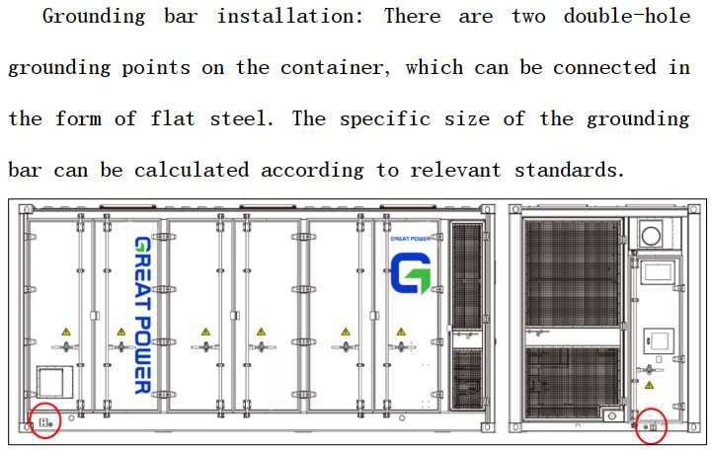
XFMR/ GREAT POWER GROUNDING ELECTRODE CONDUCTOR XFMR/ GREAT POWER GROUND TERMINAL _{NOTES:} GROUNDING CLAMP SIZE OF CONDUCTORS SHALL COMPLY WITH CEC 250.94 _{5/8"Ø x 8'-0" LONG COPPER CLAD} GROUND ROD OR OTHER ELECTRODE BOND TO SEPARATE CONDUCTORS FROM INVERTER TO METAL BUILDING FRAME _{AS SPECIFIED BY CEC 250.52} IF POSSIBLE (CEC 250.68) _{CONCRETE FOUNDATION PAD} INSTALLED WITHIN STUB-UP AREA GROUND TO METAL WATER PIPE EMBEDDED AT LEAST 10'-0" INTO THE SOIL IF _{SEE SHEETS S1.1 FOR LOCATION} AVAILABLE (CEC 250.68) ^{GRADE} CHECK RESISTANCE TO GROUND. IF RESISTANCE EXCEEDS 25 OHMS, INSTALL ADDITIONAL GROUND RODS WITH CONDUCTORS AS SHOWN SEPARATED AT LEAST 6'-0" UNTIL RESISTANCE IS REDUCED TO 25 OHMS OR LESS (CEC 250.52). PROVIDE THIRD PARTY GROUND RESISTANCE TEST. PROVIDE GAS AND WATER BOND (IF APPLICABLE). ₁ GROUNDING ELECTRODE DETAIL: XFMR/ BESS/ INVERER ^{S2.0} SCALE: NTS REVIEWED FOR COMPLIANCE SUBJECT TO FIELD INSPECTION Oakland Fire Department Fire Prevention Bureau PCB Oakland, CA 94612 FDPR26-00369 04.13.26 ₂ DIAGRAM OF GROUNDING POINTS 41 Tunnel Rd. - B2600362 S2.0 _{SCALE: NTS} OFD NOTES: 1. Provide required minimum 5 feet setback with non-combustible vegetation or structure. Ref. CA Wildland Urban Interface Code. EXP. 3/31/21 | ER |  |  |  |  |  |  |  |  |  | BY
 | UPDATED WITH LATEST AHJ COMMENTS
 | 1/15/2026 |  |  |  |  |  |  |  |  |  | REV. DATE
 | 1 |  |  |  |  |  |  |  |  |  | REV. #
 |  |  |  |  |  |  | PO BOX 10637 NAPA, CA 94581 PH: (707)-252-9990
 | PN - Claremont Resort & Club 41 Tunnel Road Berkeley, CA 94705 APN: 048H-7670-027
 | S2.0 GROUNDING DETAIL
 | FIRST ISSUE DATE: |  |  |  |  | 11/20/2025
 | DESIGNED BY: |  |  |  |  | S.B.
 | CHECKED BY: |  |  |  |  | W.V.D.W.
 | JOB NO.: |  |  |  |  | 25-48

Slide 10
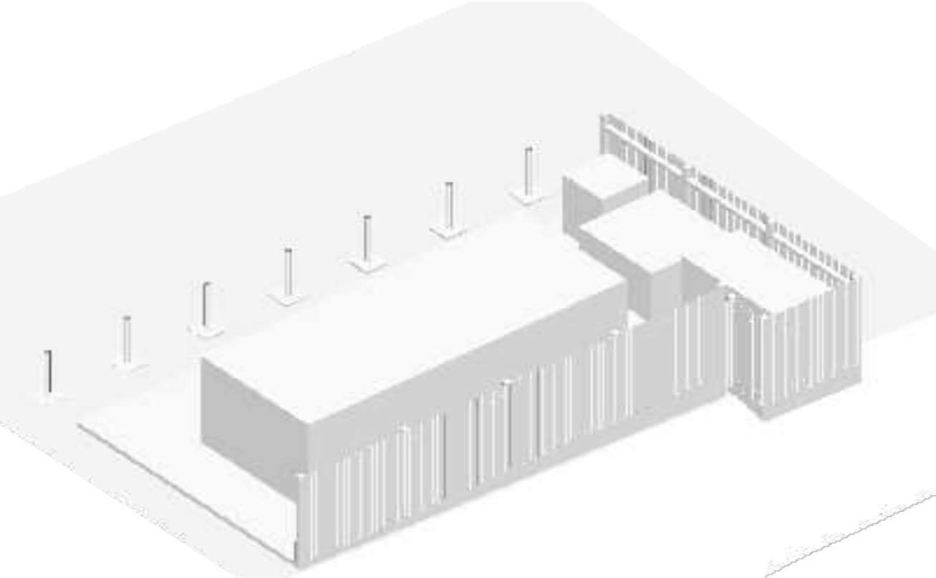
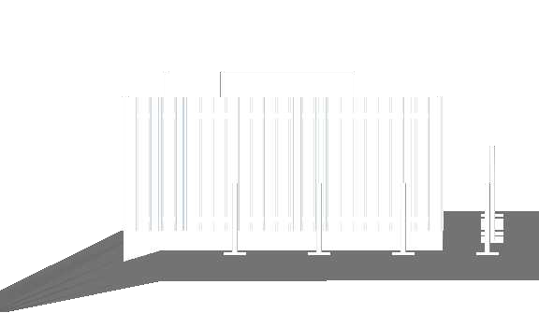
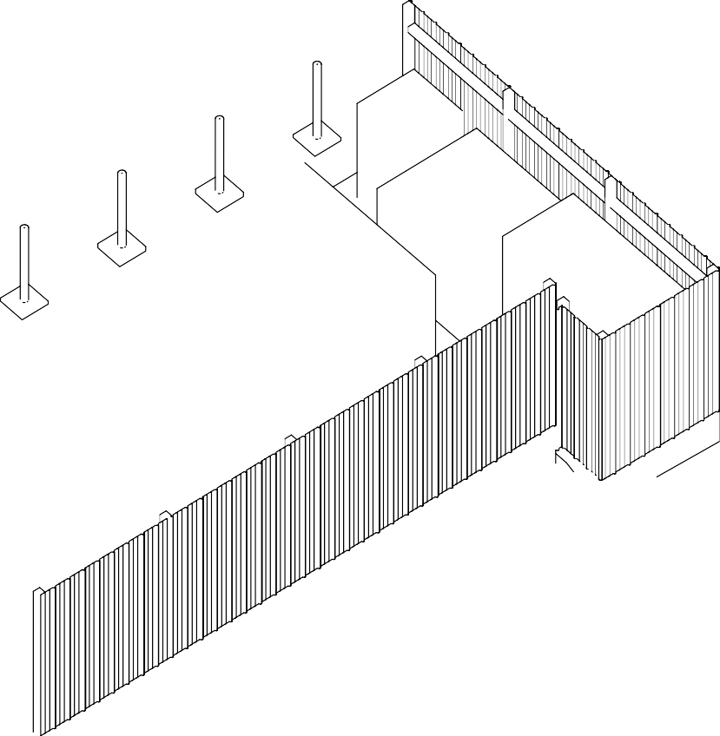


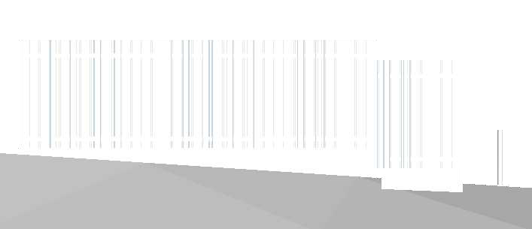


ER
BY
6X6 PTDF WOOD POSTS RATED FOR GROUND CONTACT PAINTED
TO MATCH SHEETING
8' HIGH PRIVACY FENCE
(ON TOP OF EQUIPMENT & BESS FOUNDATIONS)
1200A AC DISCONNECT
SIMPSON FB24Z BRACKET W/HZ10 COATING, TYP.
6'-3" OC MAX WOOD POST SPACING
1000KVA XFMR
1'-0"
DYNA POWER COMPANY LLC CPS-1250 BATTERY INVERTER
1/15/2026 UPDATED WITH LATEST AHJ COMMENTS
BESS CONTAINER
TOP AND BOTTOM RAILS (2x4 FLAT OR 2x4 STACKED)
.
8'-0"
REV. # REV. DATE
1'-0"
1
26 GAUGE MBCI PBR WALL PANEL, OR SIMILAR, 8', TAN PAINTED,#987665
PO BOX 10637
NAPA, CA 94581
PH: (707)-252-9990
1
FENCING DETAILS - ISOMETRIC VIEW
2
FENCING DETAILS - PARKING LOT VIEW
S3.0
SCALE: NTS
S3.0
SCALE: NTS
REVIEWED FOR COMPLIANCE SUBJECT TO FIELD INSPECTION
Oakland Fire Department Fire Prevention Bureau PCB Oakland, CA 94612
FDPR26-00369 04.13.26 41 Tunnel Rd. - B2600362
6'-3" OC MAX WOOD POST SPACING
SIMPSON FB24Z BRACKET W/HZ10 COATING, TYP.
OFD NOTES:
1.
Provide required minimum 5 feet setback with non-combustible vegetation or structure. Ref. CA Wildland Urban Interface Code.
1/15/2026, 1:10:52 PM
1'-0"
PN - Claremont Resort & Club
41 Tunnel Road
Berkeley, CA 94705 APN: 048H-7670-027
1'-0"
8'-0"
B2600662
REVIEWED FOR COMPLIANCE
CITY OF OAKLAND BUILDING SERVICES PLAN CHECK SECTION
For Substantial Compliance With Codes and Ordinances
REVISIONS NEED REVIEW
8'-0"
1'-0"
1'-0"
By:
X6345
BUILDING CODE
Subject to CBC Sections 105.4, 107.3 and CRC R105.4 and R106.3
SURVEY (REVIEW ONLY) PLOT PLAN REVIEW PARKING/DRIVEWAY LAYOUT
GRADING & EROSION CONTROL SOILS REPORT ON FILE
1
S3.0
FENCING DETAIL
3
FENCING DETAILS - CLAREMONT AVE. STREET VIEW
ELEC/MECH/PLUMB NOT CHECKED
FIRST ISSUE DATE:
11/20/2025
S3.0
SCALE: NTS
DESIGNED BY:
S.B.
Date:
04/08/2026
EXP. 3/31/21
CHECKED BY:
W.V.D.W.
JOB NO.:
25-48

