Slide 1

DISTRIBUTED ENERGY RESOURCE · GENERATION AND STORAGE ANALYSIS
1901 Convention Ctr Dr, Miami Beach, FL
25.79500°, -80.14000° · 1.26 MW-DC across 2 arrays · 1.00 MW / 4 MWh storage
Offline estimate — no site weather data was reached
NextNRG · August 27, 2026

Slide 2
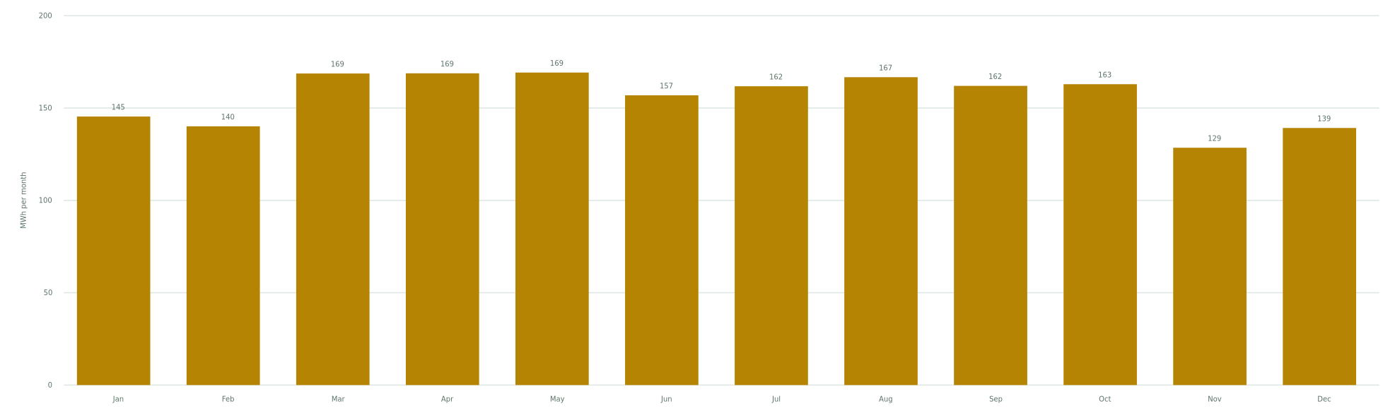
RESULT
Annual generation
ANNUAL OUTPUT
SPECIFIC YIELD
CAPACITY FACTOR
PEAK OUTPUT
1.87 GWh
1,484 kWh/kW
21.2%
1.01 MW
2 arrays at 1.26 MW-DC
per kW-DC installed, per year
against 1.01 MW-AC · 16.9% on DC
highest modelled hour
May is the strongest month at 169 MWh; Nov is the weakest at 128 MWh — a ratio of 1.3 to 1. Anything sized on an annual average will be wrong at both ends of that.
NextNRG · 1901 Convention Ctr Dr, Miami Beach, FL · 8/27/2026
1

Slide 3
INPUTS
What is on the ground
Array | kW-DC | Racking | Tilt | Azimuth | GCR | kWh/kW-yr | Share
South field | 900 | Fixed-tilt ground mount | 22° | 180° | 0.40 | 1,495 | 72%
Roof | 360 | Fixed-tilt ground mount | 8° | 180° | 0.40 | 1,459 | 28%
Where each orientation came from
South field — tilt: array properties; azimuth: derived from row angle 90°.
Roof — tilt: array properties; azimuth: derived from row angle 90°.
NextNRG · 1901 Convention Ctr Dr, Miami Beach, FL · 8/27/2026
2

Slide 4
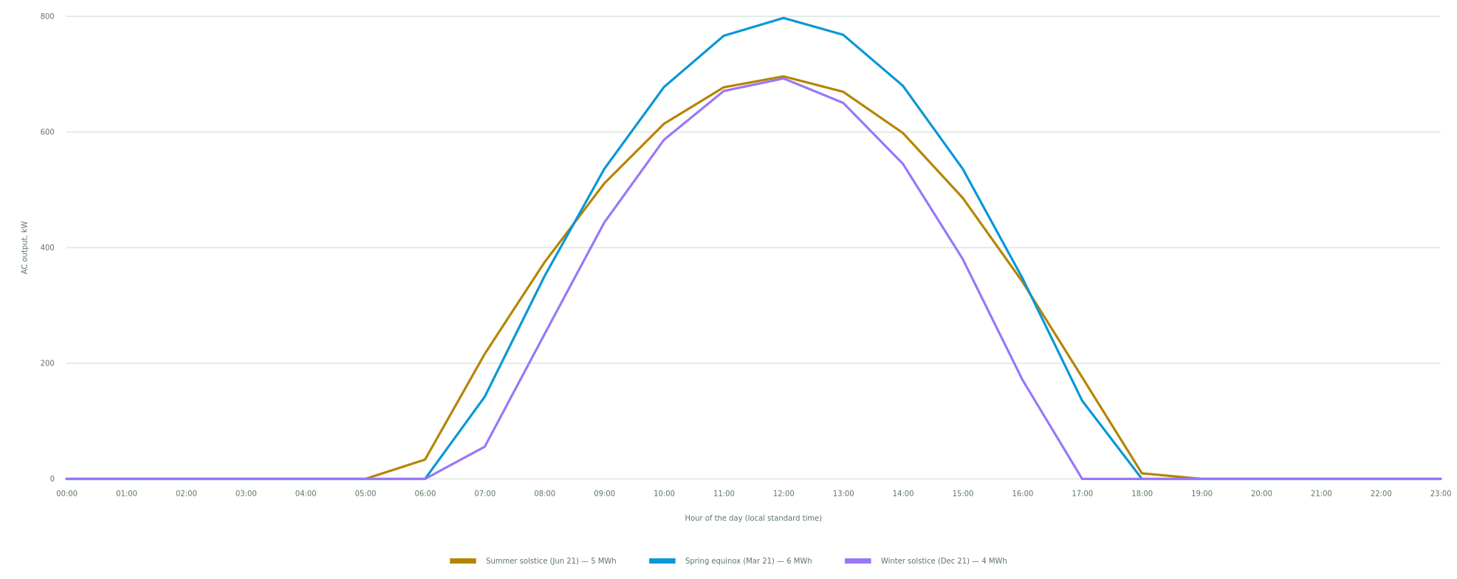
DAILY PROFILE
One day, hour by hour
Solar noon is set by longitude and the equation of time, not by the clock — which is why the peak does not sit at 12:00. Midsummer delivers 5 MWh and peaks at 696 kW; midwinter delivers 4 MWh and peaks at 693 kW. Anything that has to ride through a winter evening is sized on the lower of those, not the average.
NextNRG · 1901 Convention Ctr Dr, Miami Beach, FL · 8/27/2026
3

Slide 5
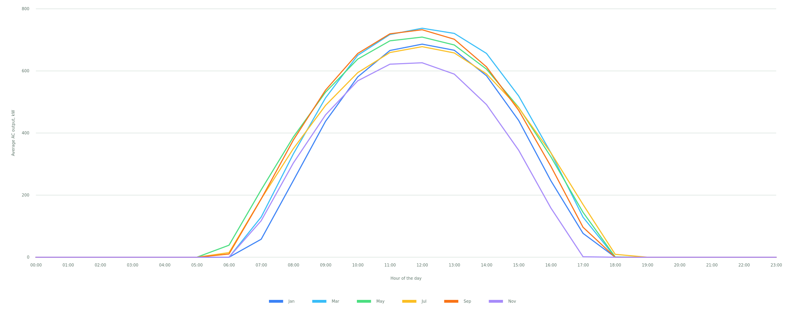
SEASONAL SHAPE
The same day, month by month
Each line is the average day for that month across the modelled year, so it already contains the cloudy days as well as the clear ones. The window of useful output narrows by roughly five hours between midsummer and midwinter at this latitude.
NextNRG · 1901 Convention Ctr Dr, Miami Beach, FL · 8/27/2026
4

Slide 6
LOSS CHAIN
From sunlight to the meter
Step | Effect | What it is
Plane-of-array irradiation | 1,796 kWh/m² | Sunlight actually striking the modules at this tilt and azimuth, after transposition.
Soiling | −2.0% | Dust and dirt on the glass between washes.
Mismatch | −2.0% | Modules in a string never perform identically.
Wiring | −2.0% | Resistive loss in DC and AC conductors.
Connections | −0.5% | Contact resistance across connectors and terminals.
Lid | −1.5% | Light-induced degradation in the first weeks of operation.
Nameplate | −1.0% | Manufacturing tolerance against the nameplate rating.
Availability | −3.0% | Time the plant is out for maintenance or faults.
Shading | −3.0% | Row-to-row and object shading.
Temperature | varies hourly | Cell temperature from the Sandia model; output falls about 0.35% per °C above 25°C.
Inverter | part-load curve | Efficiency falls away sharply below about 15% of rating — most of an hour near sunrise.
Clipping | −8,451 kWh | DC above the inverter AC limit at a 1.25:1 ratio — 0.4% of gross, computed hour by hour.
Delivered to the meter | 1.87 GWh | What the array actually sends out over the year.
Every loss is listed separately rather than rolled into one blanket percentage, because a single figure hides which assumption is doing the work. Each one is editable in the model.
NextNRG · 1901 Convention Ctr Dr, Miami Beach, FL · 8/27/2026
5

Slide 7
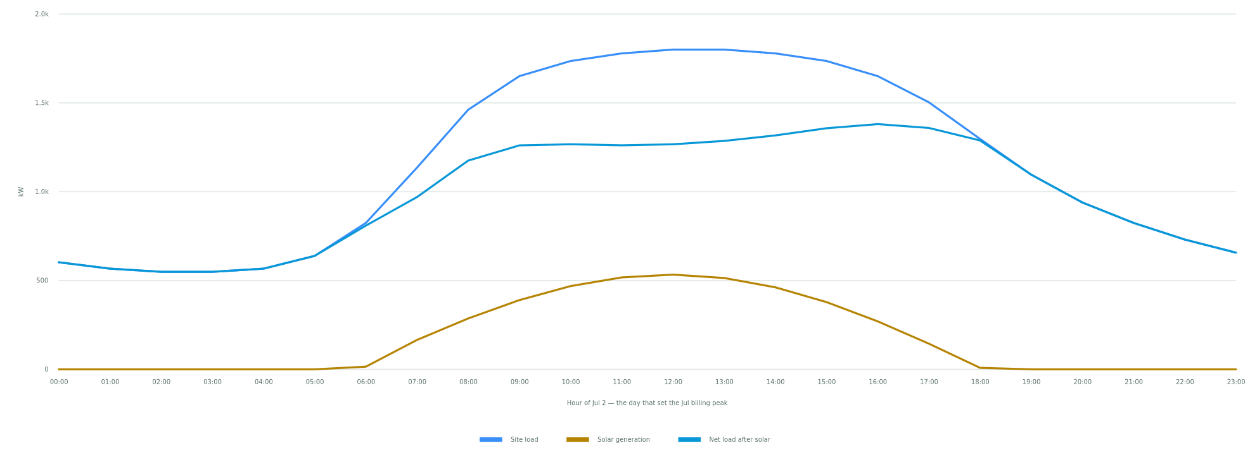
COINCIDENCE
Load against generation on the worst day
Solar carries energy, not demand. Across the year the array supplies 1.86 GWh of the site’s 8.20 GWh — 23% of consumption — but it takes only 288 kW off the Jul billing peak of 1.80 MW, which is 16%. Billing demand is set by one interval, and that interval does not wait for a clear sky.
NextNRG · 1901 Convention Ctr Dr, Miami Beach, FL · 8/27/2026
6

Slide 8
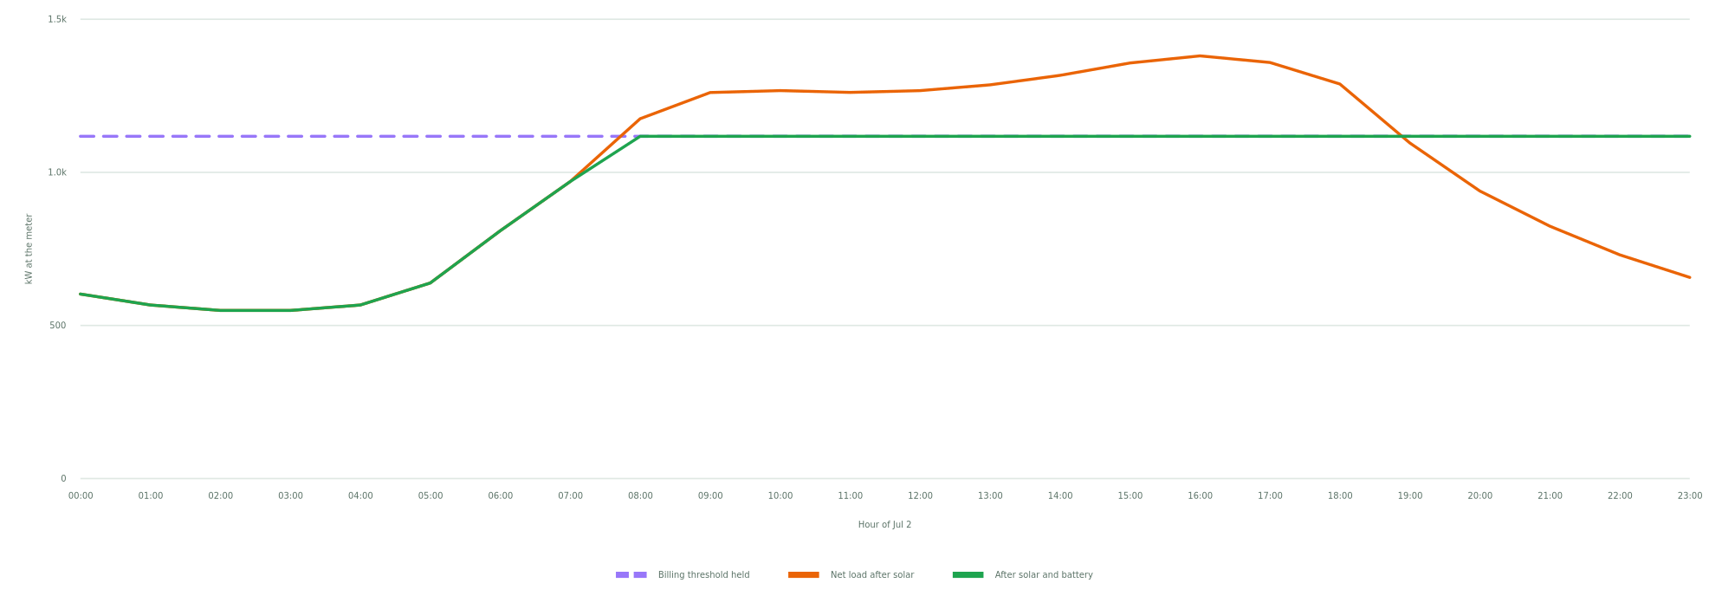
DEMAND SHAVING
What the battery takes off the peak
The battery is charged only into the headroom beneath the threshold, so charging can never set a new peak.
PEAK BEFORE
AFTER SOLAR
AFTER BATTERY
TOTAL CUT
1.80 MW
1.51 MW
1.12 MW
682 kW
Jul billing demand
−288 kW from the array
−394 kW more from storage
38% of the peak
NextNRG · 1901 Convention Ctr Dr, Miami Beach, FL · 8/27/2026
7

Slide 9
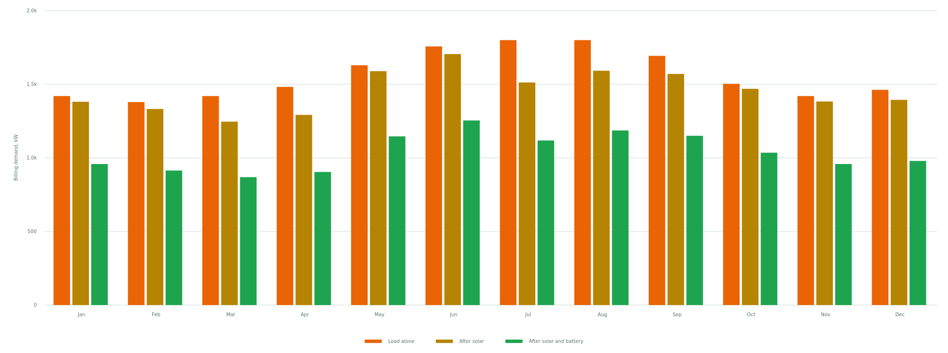
TWELVE BILLING PERIODS
Billing demand, month by month
Demand is billed on the single highest interval in each month, so each bar is one interval, not an average. Over twelve months the array removes $21,473 of demand charges and the battery a further $82,418.
⚠ Load shape is synthesised, not measured. Shape synthesised from a 1,800 kW peak and a 52% load factor. A synthesised shape cannot tell you when your real peak falls, which is the thing demand shaving turns on — import interval data before relying on these figures.
NextNRG · 1901 Convention Ctr Dr, Miami Beach, FL · 8/27/2026
8

Slide 10
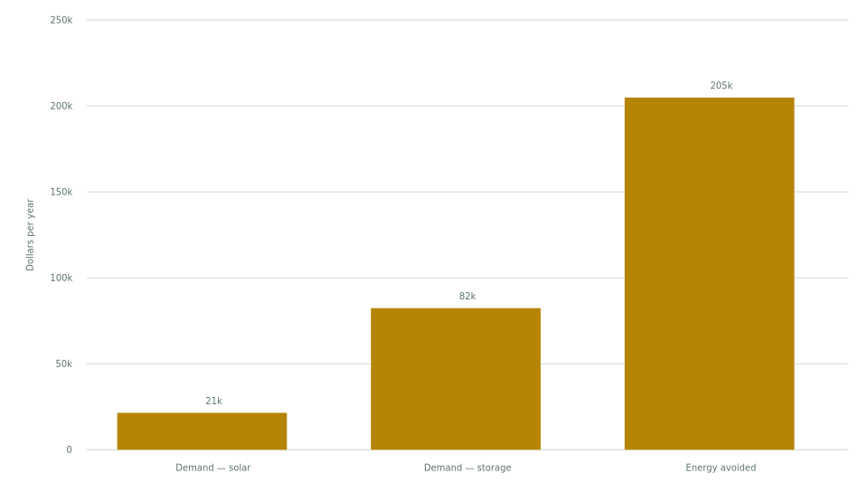
ANNUAL VALUE
What it is worth in a year
DEMAND CHARGES TODAY
SAVED BY SOLAR
SAVED BY STORAGE
TOTAL ANNUAL SAVING
$309,644
$21,473
$82,418
$308,827
at $16.50/kW-month
demand only — energy is counted separately
58 full cycles a year
demand plus avoided energy
Energy flow | Per year
Site consumption | 8.20 GWh
Solar generated | 1.87 GWh
Solar used on site | 1.86 GWh (100%)
Exported to the grid | 7 MWh
Still imported | 6.34 GWh
Share of load met by solar | 23%
Battery discharged | 219 MWh
Battery charged | 249 MWh
Full equivalent cycles | 58 / yr
Demand-charge value only. Capacity payments, ancillary services and energy arbitrage are modelled separately in the Value Stack, and are not added here to avoid counting the same kW twice.
NextNRG · 1901 Convention Ctr Dr, Miami Beach, FL · 8/27/2026
9

Slide 11
METHOD AND ASSUMPTIONS
How this number was arrived at
Input | Basis | Detail
Irradiance | assumed | Offline estimate: annual GHI interpolated from published station normals, nearest 6 km away, then split across the months by sun angle. No site-specific weather was reached. Add a free NREL key under Settings › API Keys for a measured answer.
Weather variability | modelled | Daily clearness sampled from the Hollands-Huget distribution about each month’s mean, seeded from the site coordinates so the same site returns the same year.
Sky model | modelled | HDKR anisotropic transposition with ASHRAE incidence-angle modifier. Ground albedo 0.20.
Ambient temperature | assumed | Latitude climatology with an 11 °C diurnal swing. Cell temperature by the Sandia model. This affects the shape more than the total; where PVWatts calibration is applied, the total is corrected.
DC/AC ratio and clipping | modelled | DC/AC 1.25:1. Clipping computed hour by hour: 8,451 kWh/yr, 0.4% of gross.
System losses | assumed | soiling 2.0%, mismatch 2.0%, wiring 2.0%, connections 0.5%, lid 1.5%, nameplate 1.0%, availability 3.0%, shading 3.0%. Each is separate and editable — a single blanket figure hides which one is doing the work.
Array 1 orientation | measured | Tilt 22° — array properties. Azimuth 180° — derived from row angle 90°.
NextNRG · 1901 Convention Ctr Dr, Miami Beach, FL · 8/27/2026
10

Slide 12
METHOD AND ASSUMPTIONS
How this number was arrived at (continued)
Input | Basis | Detail
Array 2 orientation | measured | Tilt 8° — array properties. Azimuth 180° — derived from row angle 90°.
Load profile | assumed | Shape synthesised from a 1,800 kW peak and a 52% load factor. A synthesised shape cannot tell you when your real peak falls, which is the thing demand shaving turns on. Import interval data before relying on the savings figure.
Demand charge | measured | $16.50/kW-month — imported bill.
Battery dispatch | modelled | Lowest holdable monthly threshold found by bisection with state of charge tracked hour by hour. Round-trip 88%, depth of discharge 95%. Charging is confined to the headroom below the threshold so it cannot set a new peak.
What this is not | note | A planning model, not a bankable energy assessment. Degradation, curtailment, snow, and interconnection limits are not modelled. An independent engineer’s P50/P90 study is what a lender will ask for.
NextNRG · 1901 Convention Ctr Dr, Miami Beach, FL · 8/27/2026
11

