Slide 1

BATTERY ENERGY STORAGE SYSTEM
PERMIT SET
GENERAL NOTES
ELECTRICAL ENGINEER
PO BOX {{GC_PO_BOX}}
{{CITY_SHORT}}, {{STATE}} {{ZIP}}
PH: {{GC_PHONE}}
ALL CONSTRUCTION SHALL COMPLY WITH THE CODES ADOPTED BY {{AHJ_CITY}} AS DESCRIBED IN THE {{MUNICIPAL_CODE}} INCLUDING BUT NOT LIMITED TO {{CODE_YEAR}} CEC, CFC & CBC.
{{EE_NAME}}
{{EE_FIRM}}
{{SITE_ADDR}}
{{EE_CITY_STATE_ZIP}}
PHONE: {{GC_PHONE}}
FAX: {{EE_FAX}} EXT. {{EE_EXT}}
{{EE_EMAIL}}
BEFORE INITIATING ANY WORK, THE CONTRACTOR SHALL NOTIFY ENGINEER OF RECORDS OF ANY DISCREPANCIES IDENTIFIED ON EXISTING CONDITIONS, STRUCTURE, ELECTRICAL, ETC.
CONTRACTOR SHALL BE RESPONSIBLE FOR ALL SAFETY PRECAUTIONS, OSHA REQUIREMENTS AND SAFETY MEASUREMENTS ON SITE.
CONTRACTOR IS RESPONSIBLE FOR INSTALLING ALL EQUIPMENT AND FOLLOWING ALL MANUFACTURER'S OR ENGINEER'S DIRECTIONS AND INSTRUCTIONS.
CONTRACTOR IS ADVISED THAT ALL DRAWINGS, COMPONENT MANUALS, ESPECIALLY INVERTER MANUALS, ARE TO BE READ AND UNDERSTOOD PRIOR TO INSTALLATION OR ENERGIZING OF ANY EQUIPMENT.
STRUCTURAL ENGINEER
CONTRACTOR IS RESPONSIBLE FOR SELECTING AND PURCHASING EQUIPMENT DESIGNED TO LAST A MIN. OF 30 YEARS IN CONJUNCTION WITH THE BESS SYSTEM. ALL ENCLOSURES, CONDUITS, STRAPS, PAINTED METAL SURFACES, CONCRETE, GROUNDING EQUIPMENT AND OTHER EQUIPMENT AND OTHER PRODUCTS SHALL BE SELECTED TO LAST THE LIFECYCLE OF THE BESS SYSTEM.
{{EE_NAME}}
{{EE_FIRM}}
{{SITE_ADDR}}
{{EE_CITY_STATE_ZIP}}
PHONE: {{GC_PHONE}}
{{EE_EMAIL}}
ALL CONTRACTORS ARE REQUIRED TO PROVIDE FULL SUBMITTALS OF INTENDED ORDERS TO CSB FOR REVIEW.
PN - {{PROJECT_NAME}}
WHENEVER ANY SURFACE IMPROVEMENTS SUCH AS PAVEMENT, CURBING, PEDESTRIAN WALKS, FENCING, OR TURFING HAVE BEEN REMOVED, DAMAGED, OR OTHERWISE DISTURBED BY THE CONTRACTOR'S OPERATIONS, THEY SHALL BE REPAIRED OR REPLACED TO THE PRE-EXISTING CONDITION. THE REPAIRS ARE TO MEET THE OWNER'S SATISFACTION.
SCOPE OF WORK
REFILL AND RESTORE THE WORK AS DIRECTED, DURING CONSTRUCTION AND PRIOR TO PROJECT COMPLETION, TO MAINTAIN ACCEPTABLE SURFACE CONDITIONS.
THE PROJECT IS TO INSTALL NEW BATTERY ENERGY STORAGE SYSTEMS (BESS) AND ASSOCIATED ELECTRICAL EQUIPMENT.
ALL CONSTRUCTION SHALL COMPLY WITH THE CODES ADOPTED BY {{AHJ_CITY}} AS DESCRIBED IN THE {{MUNICIPAL_CODE}} INCLUDING BUT NOT LIMITED TO {{CODE_YEAR}} {{STATE_CODE}}, CFC, CBC & OSHA.
THE SYSTEM WILL BE INTERCONNECTED TO AND WILL BE OPERATING IN PARALLEL WITH THE ELECTRICAL UTILITY UNDER THE REQUIREMENTS OF {{UTILITY}} BY {{AHJ_CITY}} AT THE TIME OF PERMIT APPLICATION.
{{SITE_ADDR}}
APN: {{APN}}
ALL ADDITIONAL MATERIALS REQUIRED SHALL BE FURNISHED WITHOUT ADDITIONAL COST TO THE OWNER.
{{CITY_SHORT}}, {{STATE}} {{ZIP}}
ANY WORK BEGUN PRIOR TO ATTAINING APPROVAL AND SIGNATURES OF {{AHJ_CITY}} WILL BE AT CONTRACTOR'S RISK, AND WILL BE STOPPED IF PRE-APPROVED BY PROJECT OWNER.
SHEET INDEX
SITE INFORMATION
COORDINATE OPERATIONS WITH ALL REQUIRED MATERIALS TESTING SERVICES AS REQUIRED BY THESE DRAWINGS. EACH PHASE OF CONSTRUCTION SHALL BE TESTED AND APPROVED BY {{AHJ_CITY}} AS REQUIRED PRIOR TO PROCEEDING TO SUBSEQUENT PHASES.
SHEET | DESCRIPTION
E0 | COVER SHEET
E1.0 | PLOT PLAN
E1.1 | ENLARGED PLOT PLAN
E1.2 | DEMOLITION PLAN
E2.0 | SINGLE LINE DIAGRAM
E4.0 | SIGNAGE
S1.1 | BESS PAD DETAILS
S1.2 | GEAR PAD DETAILS
S2.0 | GROUNDING DETAILS
S3.0 | FENCING DETAILS
SITE LATITUDE | {{LAT}}
ZONING DISTRICT | {{ZONING}}
FLOOD ZONE | {{FLOOD_ZONE}}
EXPOSURE CATEGORY | {{EXPOSURE}}
SEISMIC DESIGN CATEGORY | {{SDC}}
RISK CATEGORY | {{RISK_CAT}}
WIND SPEED | {{WIND_SPEED}}
SNOW LOAD | {{SNOW_LOAD}}
NOTIFY ALL UTILITY COMPANIES INVOLVED IN THE DEVELOPMENT PRIOR TO BEGINNING ANY EXCAVATION.
COMPLY WITH ALL CURRENTLY APPLICABLE SAFETY LAWS OF ALL JURISDICTIONAL BODIES. PROVIDE AND MAINTAIN ALL BARRICADES, SAFETY DEVICES, AND CONTROL OF TRAFFIC WITHIN AND AROUND THE CONSTRUCTION AREA. FOR ALL TRENCH EXCAVATION 5 FEET OR MORE IN DEPTH, OBTAIN PERMITS PRIOR TO BEGINNING ANY EXCAVATION.
MAINTAIN CONTINUOUS TEMPORARY TRAFFIC BARRICADES, WITH OPERABLE FLASHING DEVICES, SPACED AT INTERVALS OF NOT TO EXCEED 50 FEET WHENEVER THE WORK AREA IS ADJACENT TO AN EXISTING TRAFFIC LANE AND THERE IS A PAVEMENT CUT, TRENCH, OR DITCH WHICH IS OVER 2 INCHES IN DEPTH, OR IF THE TRAFFIC LANE USED BY VEHICLES IS NOT PAVED.
{{PERMIT_NO}}
SPECIAL INSPECTION LIST (checked items as required)
☐ FOUNDATION
☐ Grading and Drainage
REVIEWED FOR COMPLIANCE
☐ Piers and Caissons
☐ Shotcrete or Masonry
DATE | REV | COMMENTS
{{ISSUE_DATE}} | 00 | ISSUE FOR PERMIT
{{AHJ_CITY}}
☐ CONCRETE
☐ Concrete Placement
{{AHJ_DEPT}}
☐ f'c = ___ psi
☐ Welding
☐ Reinf. Placement
☐ High Strength Bolting
For {{PROJECT_NAME}} Subject to Code Compliance.
☐ Bolts in Concrete
☐ Field/Shop Welding
REVISIONS NEED REVIEW
☐ STEEL CONSTRUCTION
☐ SEISMIC
☐ BUILDING CODE ☐ ELECTRICAL CODE
☐ MECHANICAL CODE ☐ PLUMBING CODE
☐ GRADING/DRAINAGE ☐ STRUCTURAL DESIGN
☐ Field/Shop Welding
☐ Structural Wood
ELECTRICAL NOTES
☐ FIRE RESISTANCE
☐ Structural Steel
THE LINE AND LOAD TERMINALS ON THE AC DISCONNECTS MAY BE ENERGIZED IN THE OPEN POSITION. SWITCH IS TO BE LABELED TO COMPLY WITH ARTICLE 690.17 OF THE NEC.
☐ STRUCTURAL OBSERVATIONS (list below)
ALL WIRING SHALL CONFORM WITH THE LATEST EDITION OF THE NEC. ALL WIRING IS ASSUMED IN ACCORDANCE WITH THE NEC, UNLESS OTHERWISE LABELED.
BESS EQUIPMENT SUMMARY
GROUNDING OF THE BESS SHALL COMPLY WITH NEC 690.45 AND 690.47.
PARAMETER | BATTERY CABINET | BATTERY INVERTER | BATTERY SNAPSHOT
MANUFACTURER | {{BAT_MFR}} | {{BAT_MFR}} | {{BAT_MFR}}
MODEL NUMBER | {{BAT_MODEL}} | {{BAT_MODEL}} | {{BAT_MODEL}}
QUANTITY | {{BAT_QTY}} | {{BAT_QTY}} | {{BAT_QTY}}
BATTERY BANK CAPACITY (kWh) | {{KWH}} | N/A | {{KWH}}
RATED VOLTAGE (V) | {{DCV}} | {{INV_AC}} | {{VOLTAGE}}
ENCLOSURE TYPE | {{NEMA_RATING}} | {{NEMA_RATING}} | {{NEMA_RATING}}
RATED OUTPUT CURRENT (A) | {{ACDIS}} | {{ACDIS}} | {{ACDIS}}
THE ESTIMATED EXISTING ELECTRICAL SERVICE FROM UTILITY GRID IS ADEQUATE TO HANDLE ENERGY GENERATION AND PROVIDE A CLEAN POWER SUPPLY TO IDENTIFY ANY OBSTACLES IN THE WIRING.
IN EVERY PULL, BOX, TERMINAL BOX, AND AT ALL PLACES WHERE WIRES MAY NOT BE ALREADY IDENTIFIED BY MANUFACTURER MARKINGS ON CONDUCTORS WITH OUTER FINISH WHITE, IT SHALL BE THE NEUTRAL ON A POLY-PHASE CIRCUIT, AS WELL AS THE GROUNDED CONDUCTOR ON A SINGLE-PHASE CIRCUIT.
E0
FUSE CONDUIT SHALL ONLY BE USED WHERE SPECIFIED OR APPROVED IN WRITING.
THE GROUP-WIRING PROVISIONS OF THE NEC SHALL BE FOLLOWED FOR ALL CONDUCTORS PRE-ENGINEERED EXTENDED BATTERY ENERGY STORAGE.
COVER SHEET
ISSUE DATE | {{ISSUE_DATE}}
REVISION DATE | {{ISSUE_DATE}}
DESIGNED BY | {{DESIGNED_BY}}
CHECKED BY | {{DESIGNED_BY}}
JOB NO. | {{JOB_NO}}

Slide 2
ESTIMATED TRENCHING
ASPHALT | {{FENCE_LEN}} | {{BAT_QTY}}
SET OF {{NUM}} | {{FENCE_LEN}} | {{BAT_QTY}}
SYSTEM
INVERTERS | ({{BAT_QTY}}) {{BAT_MFR}} {{BAT_MODEL}}
BATTERY MODULES | ({{BAT_QTY}}) {{BAT_MFR}} LFP — Lithium Iron Phosphate
RATED CAPACITY | {{KW}} | {{KWH}}
LEGEND
▬▬ | BOUNDARY LINE | {{BAT_QTY}}
▭ | BESS ENCLOSURE FOOTPRINT | {{BAT_QTY}}
⊙ | POINT OF INTERCONNECTION | {{BAT_QTY}}
PO BOX {{GC_PO_BOX}}
{{CITY_SHORT}}, {{STATE}} {{ZIP}}
PH: {{GC_PHONE}}
Image
SITE
{{PROJECT_NAME}}
{{SITE_ADDR}}
{{CITY_SHORT}}, {{STATE}} {{ZIP}} · APN: {{PIN_NO}}
{{PERMIT_NO}}
PN - {{PROJECT_NAME}}
REVIEWED FOR COMPLIANCE
{{AHJ_FIRE_DEPT}}
{{SITE_ADDR}}
APN: {{APN}}
Subject to Plan Check & Field Inspection
REVISIONS NEED REVIEW
{{CITY_SHORT}}, {{STATE}} {{ZIP}}
DATE | REV | COMMENTS
{{ISSUE_DATE}} | 00 | ISSUE FOR PERMIT
E1.0
PLOT PLAN
ISSUE DATE | {{ISSUE_DATE}}
REVISION DATE | {{ISSUE_DATE}}
DESIGNED BY | {{DESIGNED_BY}}
CHECKED BY | {{DESIGNED_BY}}
JOB NO. | {{JOB_NO}}
1 — PLOT PLAN · SCALE: 1" = {{NUM}}'

Slide 3
MANUFACTURER | BATTERY CABINET | BATTERY INVERTER | BATTERY SNAPSHOT
MODEL NUMBER | {{BAT_MODEL}} | {{BAT_MODEL}} | {{BAT_MODEL}}
COUNT | {{BAT_QTY}} | {{BAT_QTY}} | {{BAT_QTY}}
BATTERY BANK CAPACITY | {{KWH}} | N/A | {{KWH}}
RATED VOLTAGE | {{DCV}} | {{INV_AC}} | {{VOLTAGE}}
INVERTER RATING (kW) | N/A | {{KW}} | {{KW}}
ENCLOSURE TYPE | {{NEMA_RATING}} | {{NEMA_RATING}} | {{NEMA_RATING}}
RATED OUTPUT CURRENT | {{ACDIS}} | {{ACDIS}} | {{ACDIS}}
Image
PO BOX {{GC_PO_BOX}}
{{CITY_SHORT}}, {{STATE}} {{ZIP}}
PH: {{GC_PHONE}}
LEGEND
SYMBOL | DESCRIPTION | TOTAL
▭ | BESS CONTAINER | {{BAT_QTY}}
PN - {{PROJECT_NAME}}
{{SITE_ADDR}}
APN: {{APN}}
{{CITY_SHORT}}, {{STATE}} {{ZIP}}
DATE | REV | COMMENTS
{{ISSUE_DATE}} | 00 | ISSUE FOR PERMIT
{{PERMIT_NO}}
REVIEWED FOR COMPLIANCE
{{AHJ_FIRE_DEPT}}
Subject to Plan Check & Field Inspection
REVISIONS NEED REVIEW
E1.1
ENLARGED PLOT PLAN
ISSUE DATE | {{ISSUE_DATE}}
REVISION DATE | {{ISSUE_DATE}}
DESIGNED BY | {{DESIGNED_BY}}
CHECKED BY | {{DESIGNED_BY}}
JOB NO. | {{JOB_NO}}
1 — ENLARGED PLOT PLAN · SCALE: 1" = {{NUM}}'

Slide 4
LEGEND
SYMBOL
DESCRIPTION
TOTAL
Image
TREE TO BE REMOVED
{{BAT_QTY}}
TREE TO BE PROTECTED
{{BAT_QTY}}
PO BOX {{GC_PO_BOX}}
{{CITY_SHORT}}, {{STATE}} {{ZIP}}
PH: {{GC_PHONE}}
PN - {{PROJECT_NAME}}
{{SITE_ADDR}}
APN: {{APN}}
{{CITY_SHORT}}, {{STATE}} {{ZIP}}
DATE | REV | COMMENTS
{{ISSUE_DATE}} | 00 | ISSUE FOR PERMIT
DEMOLITION NOTES
TREE / VEGETATION SCHEDULE
CONTRACTOR SHALL VERIFY ALL EXISTING CONDITIONS AND DIMENSIONS PRIOR TO BEGINNING WORK. ANY DISCREPANCIES SHALL BE REPORTED TO THE ENGINEER OF RECORD.
TAG | COMMON NAME | BOTANICAL NAME | DBH | HEIGHT | CANOPY | ACTION | PERMIT REF
T1 | {{SE_NAME}} | [Genus species] | {{DIM_IN}} | {{FENCE_LEN}} | {{FENCE_LEN}} | REMOVE | {{GC_PO_BOX}}
T2 | {{SE_NAME}} | [Genus species] | {{DIM_IN}} | {{FENCE_LEN}} | {{FENCE_LEN}} | PROTECT | —
T3 | {{SE_NAME}} | [Genus species] | {{DIM_IN}} | {{FENCE_LEN}} | {{FENCE_LEN}} | PROTECT | —
T4 | {{SE_NAME}} | [Genus species] | {{DIM_IN}} | {{FENCE_LEN}} | {{FENCE_LEN}} | PROTECT | —
PROTECT ALL TREES TO REMAIN PER LOCAL TREE PROTECTION ORDINANCE. INSTALL TREE PROTECTION FENCING AT THE DRIPLINE PRIOR TO ANY DEMOLITION.
REMOVE EXISTING TREE(S) AS INDICATED ON PLAN; STUMPS SHALL BE GROUND TO [DEPTH]" BELOW FINISH GRADE.
REMOVE ALL EXISTING PARKING SIGNAGE / PAINTED MARKINGS INTERFERING WITH BESS ENCLOSURE FOOTPRINT, FENCING, AND WORKING CLEARANCES PER NEC ART. 110.26.
E1.2
SAW-CUT EXISTING ASPHALT/CONCRETE TO NEAT EDGES ALONG TRENCHING ROUTES. RESTORE TO EQUAL OR BETTER CONDITION AFTER INSTALLATION.
RELOCATE ANY EXISTING UTILITIES IN CONFLICT WITH PROPOSED BESS FOOTPRINT — COORDINATE WITH UTILITY ({{UTILITY}}) AND OWNER.
HAUL ALL DEMOLITION DEBRIS OFF-SITE TO AN APPROVED DISPOSAL FACILITY. RECYCLE WHERE PRACTICAL.
DEMOLITION PLAN
NOTIFY {{AHJ_CITY}} AND OWNER 48 HOURS PRIOR TO COMMENCING ANY DEMOLITION OPERATIONS.
ISSUE DATE | {{ISSUE_DATE}}
REVISION DATE | {{ISSUE_DATE}}
DESIGNED BY | {{DESIGNED_BY}}
CHECKED BY | {{DESIGNED_BY}}
JOB NO. | {{JOB_NO}}
1 — DEMOLITION PLAN · SCALE: 1" = {{NUM}}'

Slide 5
SLD GENERAL NOTES
METER / SERVICE
STORAGE NOTES
POINT OF INTERCONNECTION (POI) PER UTILITY REQUIREMENTS. SEE INTERCONNECTION AGREEMENT.
PROPOSED STORAGE DEVICE(S) WILL NOT EXPORT TO THE UTILITY GRID. SYSTEM IS CONFIGURED AS A NON-EXPORT, BEHIND-THE-METER ENERGY STORAGE SYSTEM USING UL-LISTED INVERTERS WITH NON-EXPORT CONTROLS. SYSTEM OPERATION SHALL COMPLY WITH UTILITY INTERCONNECTION AGREEMENT AND ALL APPLICABLE STANDARDS.
ALL EQUIPMENT TO BE LISTED PER UL STANDARDS APPLICABLE; BESS PER UL 9540, BATTERY MODULES PER UL 1973, INVERTERS PER UL 1741 / IEEE 1547.
Utility: {{UTILITY}}
Meter Number: {{METER_NO}}
Service Voltage: {{VOLTAGE}} / {{PHASE}} / {{FREQ}}
Service Rating: {{ACDIS}} AT MAIN
Existing AIC: {{KAIC}}
ALL FIELD WIRING TO COMPLY WITH NEC 2023 (OR ADOPTED EDITION) — ART. 690, 705, & 706.
CONDUCTORS SIZED PER ATTACHED CABLE / VOLTAGE-DROP SCHEDULE. INSTALLATION METHODS PER NEC TABLE 310.16.
ANTI-ISLANDING / RAPID SHUTDOWN PER UL 1741 SA / IEEE 1547-2018.
PO BOX {{GC_PO_BOX}}
{{CITY_SHORT}}, {{STATE}} {{ZIP}}
PH: {{GC_PHONE}}
Image
PN - {{PROJECT_NAME}}
{{SITE_ADDR}}
APN: {{APN}}
{{CITY_SHORT}}, {{STATE}} {{ZIP}}
DATE | REV | COMMENTS
{{ISSUE_DATE}} | 00 | ISSUE FOR PERMIT
CABLE SCHEDULE / VOLTAGE-DROP CALCULATIONS
CIRCUIT | FROM | TO | PHASES | VOLTAGE | CURRENT (A) | RUN (FT) | CONDUCTORS | GROUND | CONDUIT | VD % | METHOD
C1 | BESS BANK 1 | INVERTER 1 | DC | {{DCV}} | {{ACDIS}} | {{FENCE_LEN}} | {{WIRE_AWG}} | {{WIRE_AWG}} | {{CONDUIT_SIZE}} EMT | {{PCT}} | NEC 310.16
C2 | INVERTER 1 | AC DISCO 1 | 3-PH | {{INV_AC}} | {{ACDIS}} | {{FENCE_LEN}} | {{WIRE_AWG}} | {{WIRE_AWG}} | {{CONDUIT_SIZE}} EMT | {{PCT}} | NEC 310.16
C3 | BESS BANK 2 | INVERTER 2 | DC | {{DCV}} | {{ACDIS}} | {{FENCE_LEN}} | {{WIRE_AWG}} | {{WIRE_AWG}} | {{CONDUIT_SIZE}} EMT | {{PCT}} | NEC 310.16
C4 | INVERTER 2 | AC DISCO 1 | 3-PH | {{INV_AC}} | {{ACDIS}} | {{FENCE_LEN}} | {{WIRE_AWG}} | {{WIRE_AWG}} | {{CONDUIT_SIZE}} EMT | {{PCT}} | NEC 310.16
C5 | AC DISCO 1 | (N) SWITCHGEAR | 3-PH | {{INV_AC}} | {{ACDIS}} | {{FENCE_LEN}} | {{WIRE_AWG}} | {{WIRE_AWG}} | {{CONDUIT_SIZE}} EMT | {{PCT}} | NEC 310.16
C6 | XFMR SEC | AUX DISCO | 3-PH | {{INV_AC}} | {{ACDIS}} | {{FENCE_LEN}} | {{WIRE_AWG}} | {{WIRE_AWG}} | {{CONDUIT_SIZE}} EMT | {{PCT}} | NEC 310.16
C7 | AUX DISCO | AUX LOADS | 3-PH | {{INV_AC}} | {{ACDIS}} | {{FENCE_LEN}} | {{WIRE_AWG}} | {{WIRE_AWG}} | {{CONDUIT_SIZE}} EMT | {{PCT}} | NEC 310.16
E2.0
SINGLE LINE DIAGRAM
ISSUE DATE | {{ISSUE_DATE}}
REVISION DATE | {{ISSUE_DATE}}
DESIGNED BY | {{DESIGNED_BY}}
CHECKED BY | {{DESIGNED_BY}}
JOB NO. | {{JOB_NO}}
1 — SINGLE LINE DIAGRAM · NOT TO SCALE

Slide 6
LOCATION: [LOCATION 1] QUANTITY: {{BAT_QTY}}
LOCATION: [LOCATION 2] QUANTITY: {{BAT_QTY}}
TEXT: HEADER: 36 point (4.475"); SUB: 28 points (3.25"); BODY: 26 points (3.135")
TEXT: HEADER: 36 point (4.475"); SUB: 28 points (3.25"); BODY: 26 points (3.135")
CAUTION:
THIS SERVICE SUPPLIED BY ALTERNATIVE POWER SOURCES WITH DISCONNECTS LOCATED AS SHOWN
CAUTION:
THIS SERVICE SUPPLIED BY ALTERNATIVE POWER SOURCES WITH DISCONNECTS LOCATED AS SHOWN
PO BOX {{GC_PO_BOX}}
{{CITY_SHORT}}, {{STATE}} {{ZIP}}
PH: {{GC_PHONE}}
Image
Image
PN - {{PROJECT_NAME}}
{{SITE_ADDR}}
APN: {{APN}}
LOCATION: [BESS Enclosure / Cabinet Panel]
LOCATION: [BESS Enclosure]
LOCATION: [BESS Cabinet, Each Module]
LOCATION: [AC Disconnect Enclosure]
{{CITY_SHORT}}, {{STATE}} {{ZIP}}
QUANTITY: {{BAT_QTY}}
QUANTITY: {{BAT_QTY}}
QUANTITY: {{BAT_QTY}}
QUANTITY: {{BAT_QTY}}
TEXT: 36 point (2.875")
TEXT: 36 point (2.875")
TEXT: 36 point (2.667")
TEXT: 28 point (2.000")
SIZE: 5"
SIZE: 5"
SIZE: 5"
SIZE: 5"
AC DISCONNECT
BOLT-SWITCH CABINET
OPERATING CURRENT: {{ACDIS}}
OPERATING VOLTAGE: {{INV_AC}}
ENERGY
STORAGE
SYSTEM
DISCONNECT
ENERGY
STORAGE
SYSTEM
INVERTER
LITHIUM IRON
PHOSPHATE
LOCATION: [Isolation Transformer Enclosure] QUANTITY: {{BAT_QTY}}
SIGNAGE SCHEDULE
TEXT: 28 point
TAG | SIGN DESCRIPTION | LOCATION | SIZE | MATERIAL | QTY | CODE REF
S-1 | CAUTION — Alt. power source w/ map | Site entrance / utility room | 10" × 10" | Reflective Vinyl on Aluminum | {{BAT_QTY}} | NEC 706.15
S-2 | ENERGY STORAGE SYSTEM DISCONNECT | ESS disconnect enclosure | 5" | Engraved Phenolic, white on black | {{BAT_QTY}} | NEC 706.15(C)
S-3 | ENERGY STORAGE SYSTEM INVERTER | Inverter enclosure | 5" | Engraved Phenolic | {{BAT_QTY}} | NEC 706.15
S-4 | LITHIUM IRON PHOSPHATE | Each BESS cabinet / module | 5" | Reflective Vinyl on Aluminum | {{BAT_QTY}} | IFC 1207
S-5 | AC DISCONNECT — Spec Label | AC Disconnect enclosure | 5" | Engraved Phenolic | {{BAT_QTY}} | NEC 110.21
S-6 | ISOLATION XFMR — Spec Label | XFMR enclosure | 5" | Engraved Phenolic | {{BAT_QTY}} | NEC 450
S-7 | DANGER — HIGH VOLTAGE | Each electrical access point | 7" × 10" | Reflective Vinyl on Aluminum | {{BAT_QTY}} | NEC 110.27
S-8 | ARC FLASH HAZARD — Spec Label | Switchgear / Inverter | {{CONDUIT_SIZE}} | Per NFPA 70E format | {{BAT_QTY}} | NEC 110.16
S-9 | EMERGENCY CONTACT | Site entrance / fence gate | {{CONDUIT_SIZE}} | Reflective Vinyl on Aluminum | {{BAT_QTY}} | IFC 1207.6
ISOLATION XFMR
XFMR SIZE: {{XFMR_SIZE}}
OPERATING VOLTAGE: {{V_PRI}}/{{V_SEC}}
DATE | REV | COMMENTS
{{ISSUE_DATE}} | 00 | ISSUE FOR PERMIT
E4.0
SIGNAGE
ISSUE DATE | {{ISSUE_DATE}}
REVISION DATE | {{ISSUE_DATE}}
DESIGNED BY | {{DESIGNED_BY}}
CHECKED BY | {{DESIGNED_BY}}
JOB NO. | {{JOB_NO}}
1 — SIGNAGE DETAILS & SCHEDULE · NOT TO SCALE

Slide 7
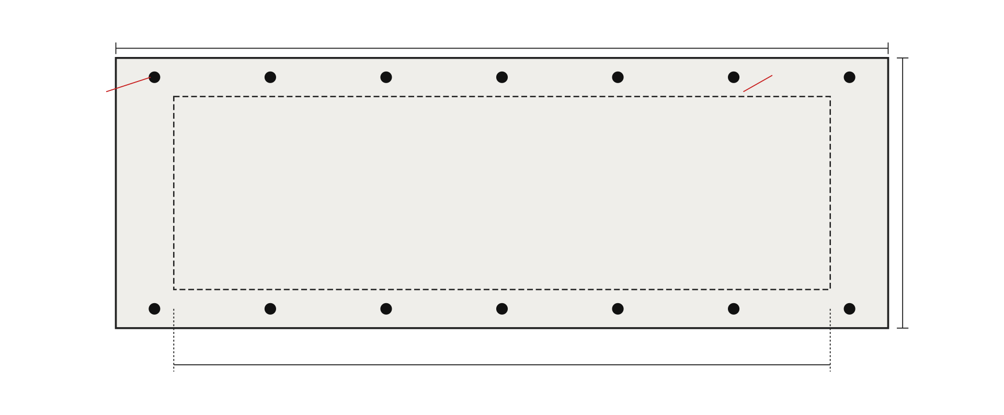
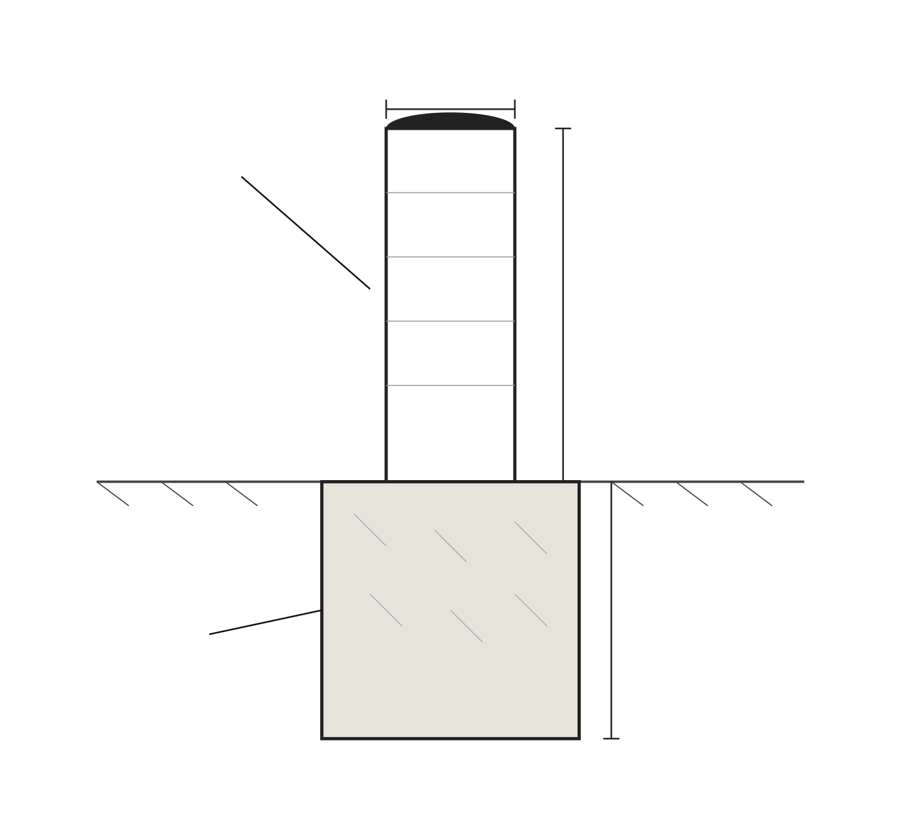
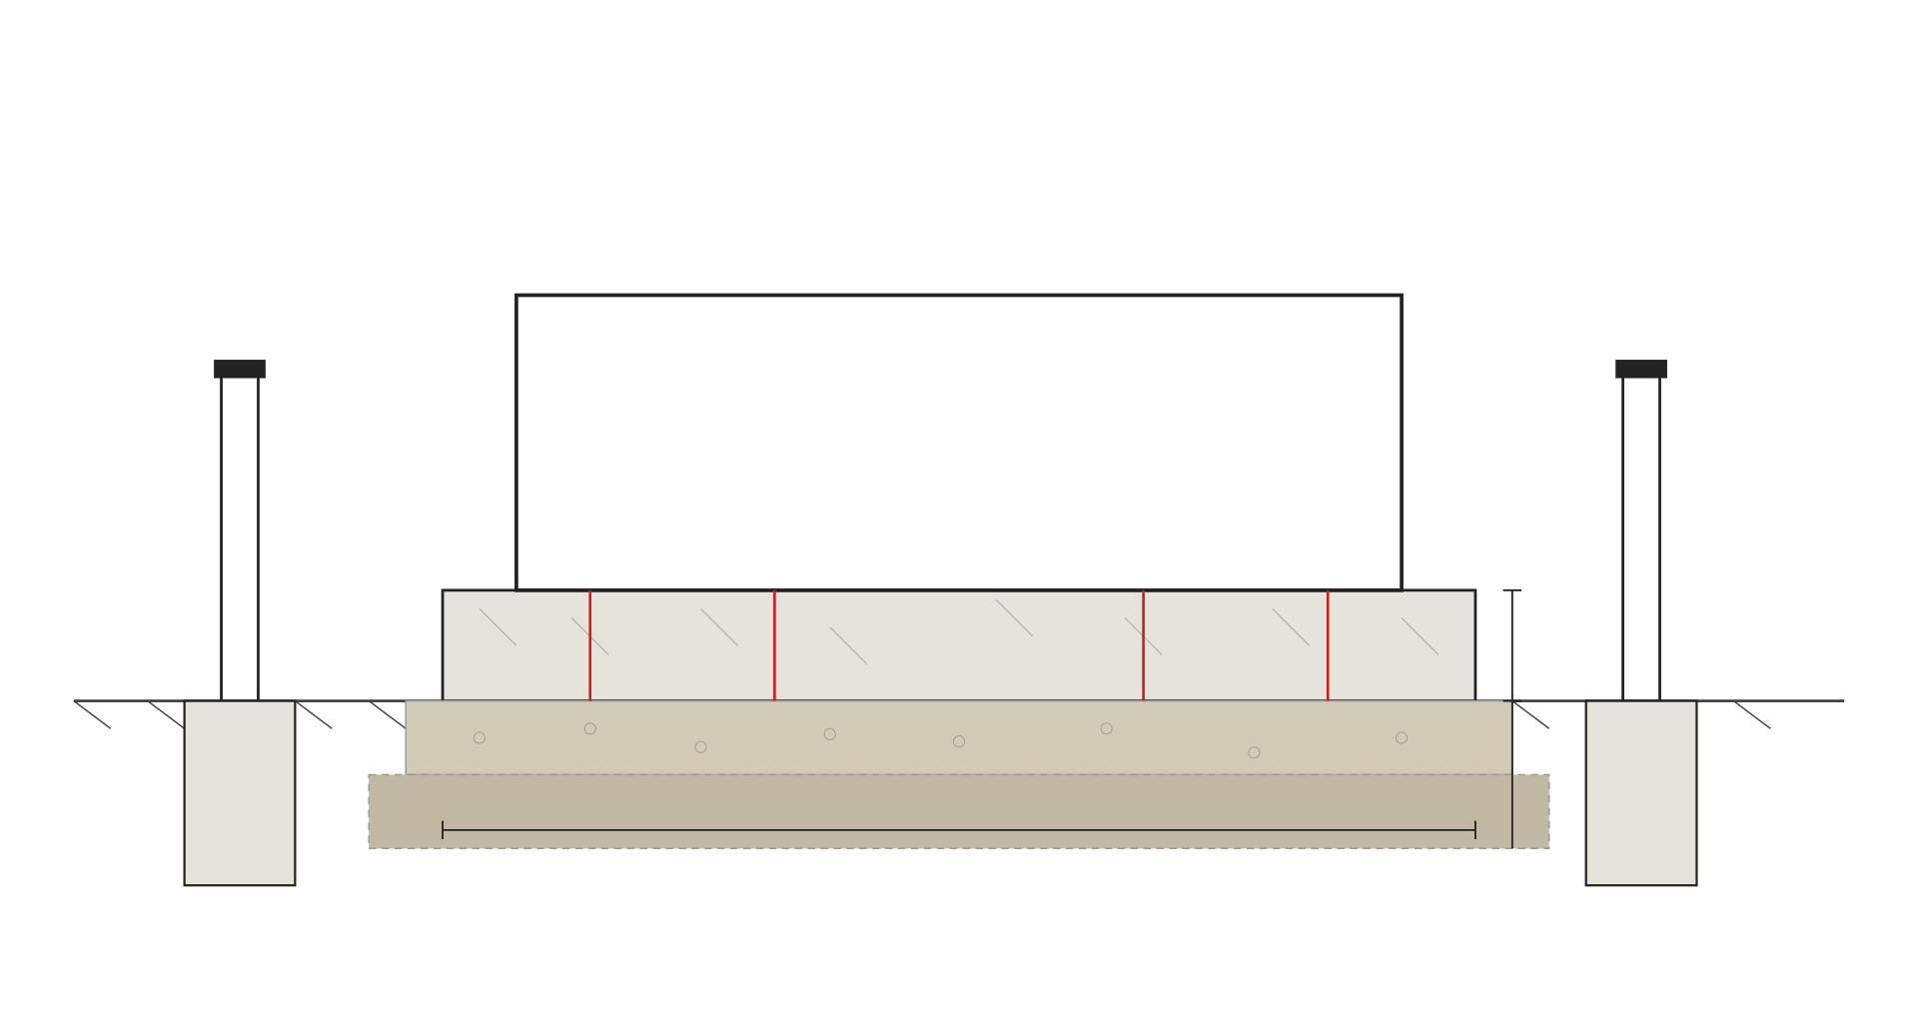
PO BOX {{GC_PO_BOX}}
{{CITY_SHORT}}, {{STATE}} {{ZIP}}
PH: {{GC_PHONE}}
PN - {{PROJECT_NAME}}
{{SITE_ADDR}}
APN: {{APN}}
{{CITY_SHORT}}, {{STATE}} {{ZIP}}
1
BESS PAD — TOP VIEW · SCALE: 1/4" = 1'-0"
3
BOLLARD DETAIL · SCALE: 1" = 1'-0"
PAD & BOLLARD NOTES
FOR PAD & PULLBOX: Coordinate routing of all conduits prior to pour. Provide sleeves and stub-ups per single-line diagram (see E2.0).
CONCRETE: Min. f'c = [3,000] psi at 28 days. Air-entrained per ACI 318. Slump 4" ±1".
REINFORCEMENT: #4 rebar @ 12" o.c.e.w. top & bottom, 2-mat construction. Min. cover 3" from earth, 2" from formed surfaces.
SUB-BASE: [6"] compacted crushed aggregate base course (CAB), 95% Std. Proctor.
SUBGRADE: Compacted native or imported select fill to 95% Std. Proctor; geotechnical report required for [≥ XX]-ton equipment.
ANCHOR BOLTS: 3/4" Ø Simpson Strong-Bolt 2 or equal, [8"] embedment, [12"] OC max. PER MFR ANCHORAGE DETAIL.
BOLLARDS: 6" Ø Sch. 40 hot-dip galvanized steel pipe, concrete-filled. Set [36"] above grade, [36"] below grade in [18" Ø × 36" D] concrete footing.
DATE | REV | COMMENTS
{{ISSUE_DATE}} | 00 | ISSUE FOR PERMIT
BOLLARD SPACING: Max. 4'-0" o.c., placed to protect equipment per local AHJ.
FINISH: Bollards painted safety yellow (OSHA 1910.144). Top capped or domed concrete.
DRAINAGE: Pad sloped [1/4"/ft] minimum away from BESS enclosure.
SPECIAL INSPECTION: Required per [IBC Ch. 17] for concrete placement and anchor installation.
VERIFY GRADE: Where necessary, regrade to existing finish elevations after pour.
S1.1
2
BESS PAD — SECTION A-A · SCALE: 3/4" = 1'-0"
BESS PAD DETAILS
ISSUE DATE | {{ISSUE_DATE}}
REVISION DATE | {{ISSUE_DATE}}
DESIGNED BY | {{DESIGNED_BY}}
CHECKED BY | {{DESIGNED_BY}}
JOB NO. | {{JOB_NO}}
BESS PAD DETAILS · SEE STRUCTURAL CALCULATIONS BY EOR

Slide 8
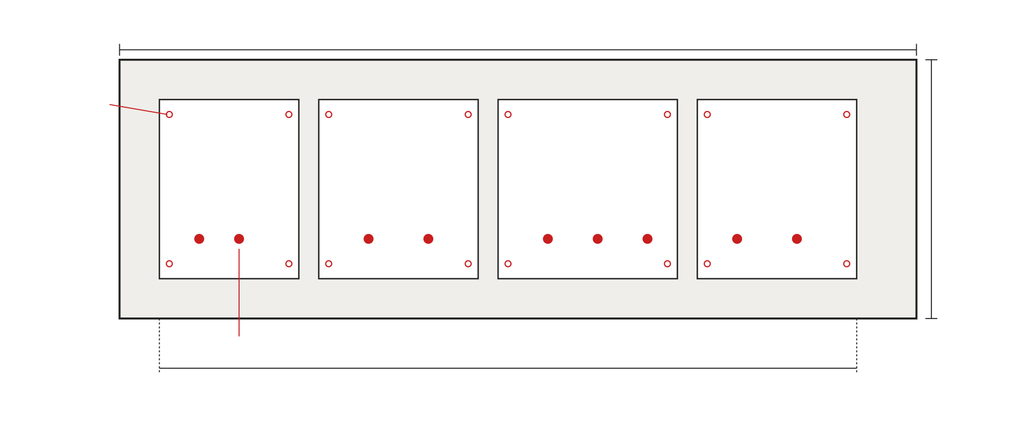
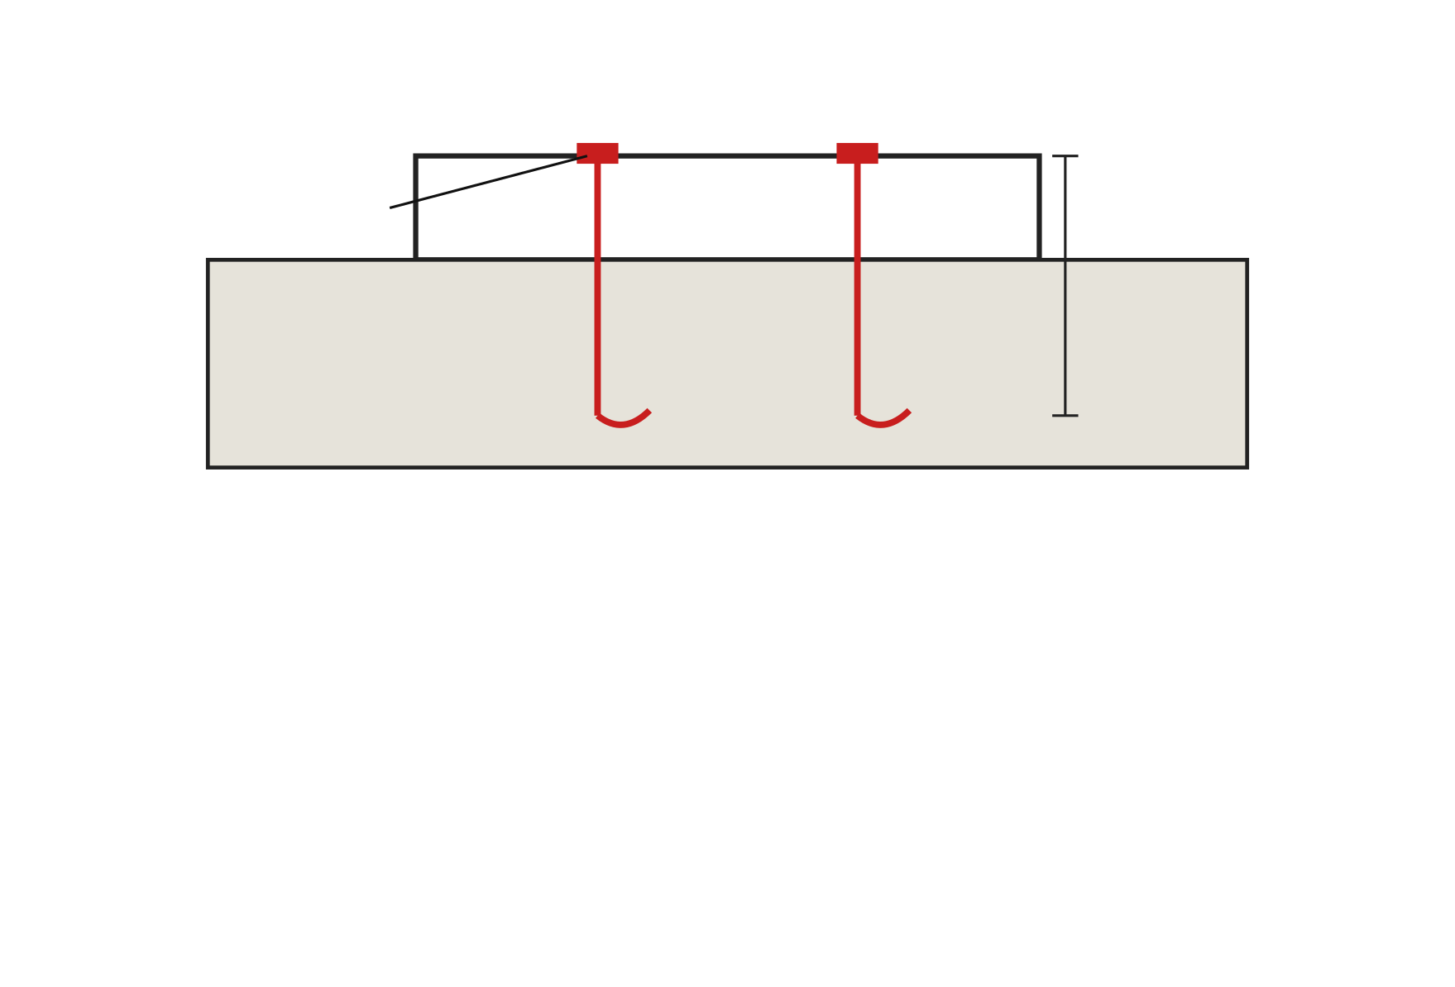
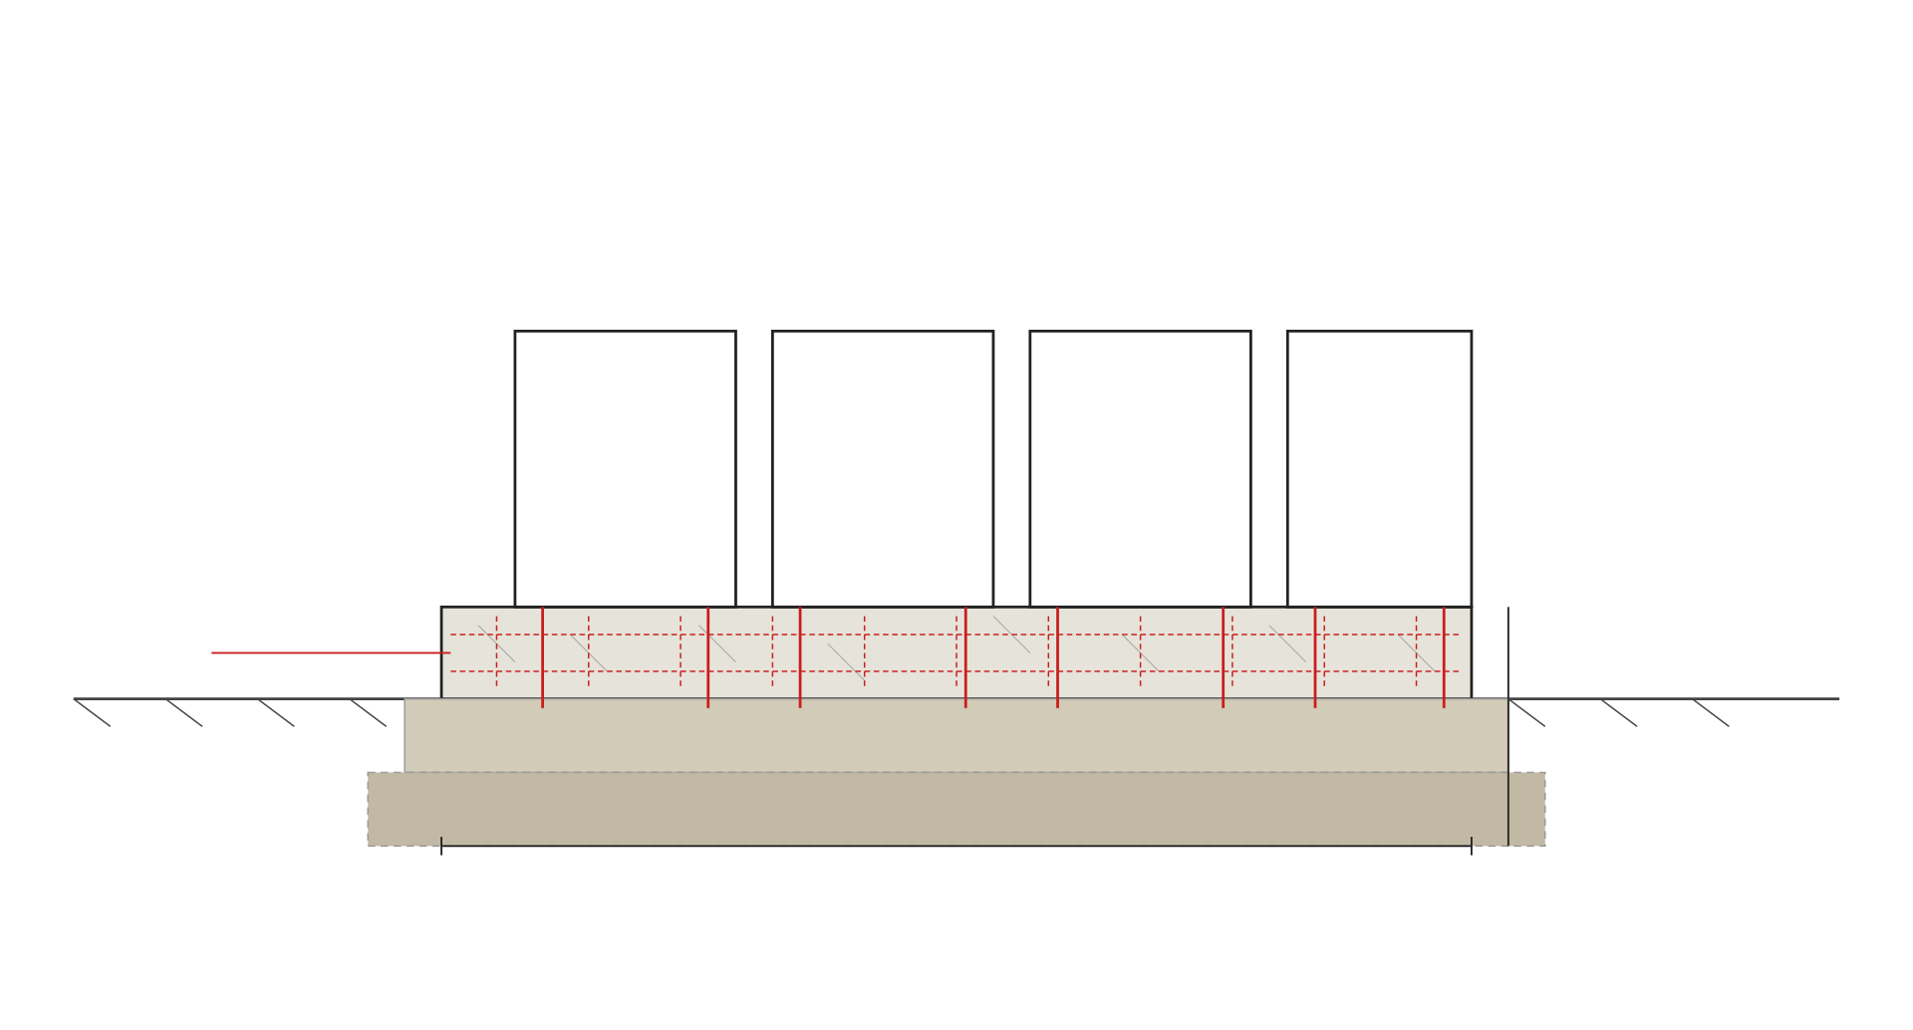
PO BOX {{GC_PO_BOX}}
{{CITY_SHORT}}, {{STATE}} {{ZIP}}
PH: {{GC_PHONE}}
PN - {{PROJECT_NAME}}
3
ANCHOR BOLT DETAIL · SCALE: 1-1/2" = 1'-0"
{{SITE_ADDR}}
APN: {{APN}}
{{CITY_SHORT}}, {{STATE}} {{ZIP}}
1
GEAR PAD — TOP VIEW · SCALE: 1/4" = 1'-0"
GEAR PAD NOTES
CONCRETE: Min. f'c = [3,000] psi at 28 days. ACI 318. Air-entrained, slump 4" ±1".
REINFORCEMENT: #4 rebar @ 12" o.c.e.w. top and bottom, 2-mat. 3" cover from earth, 2" from formed surfaces. Grade 60.
SUB-BASE: [6"] compacted crushed aggregate base course (CAB) at 95% Std. Proctor.
SUBGRADE: Compacted native or imported select fill at 95% Std. Proctor. Geotechnical report required where [BEARING] uncertain.
ANCHOR BOLTS: See Detail 3 — 3/4" Ø Simpson Strong-Bolt 2 or equal. Embedment [8"] minimum. Edge distance and spacing per ACI 318-19 Ch. 17.
SLAB EDGES: Chamfer 3/4" at all exposed top edges.
CONDUIT PENETRATIONS: Install sleeves prior to pour. Seal annular space with non-shrink grout after wire-pull.
WORKING CLEARANCE: Provide minimum [3'-0"] working space in front of all gear per NEC 110.26.
DRAINAGE: Slope pad [1/4"/ft] minimum away from equipment.
CONTROL JOINTS: Saw-cut control joints at [10'-0"] o.c. max., depth = 1/4 slab thickness.
FINISH: Hard-troweled smooth finish under equipment; broom finish elsewhere for non-slip walkway.
CURING: Wet-cure 7 days minimum, or membrane-cure per ACI 308.
EQUIPMENT GROUTING: Where equipment requires grouted base, use non-shrink, non-metallic grout to fill any voids between base and pad.
BACKFILL: All trenches around pad shall be backfilled with compacted [native / sand], in 8" lifts, to grade after rough installation. Verify with geotech where applicable.
SPECIAL INSPECTION: Per IBC Ch. 17 for concrete and post-installed anchors.
DATE | REV | COMMENTS
{{ISSUE_DATE}} | 00 | ISSUE FOR PERMIT
S1.2
2
GEAR PAD — SECTION B-B · SCALE: 3/4" = 1'-0"
GEAR PAD DETAILS
ISSUE DATE | {{ISSUE_DATE}}
REVISION DATE | {{ISSUE_DATE}}
DESIGNED BY | {{DESIGNED_BY}}
CHECKED BY | {{DESIGNED_BY}}
JOB NO. | {{JOB_NO}}
GEAR PAD DETAILS · SEE STRUCTURAL CALCULATIONS BY EOR

Slide 9
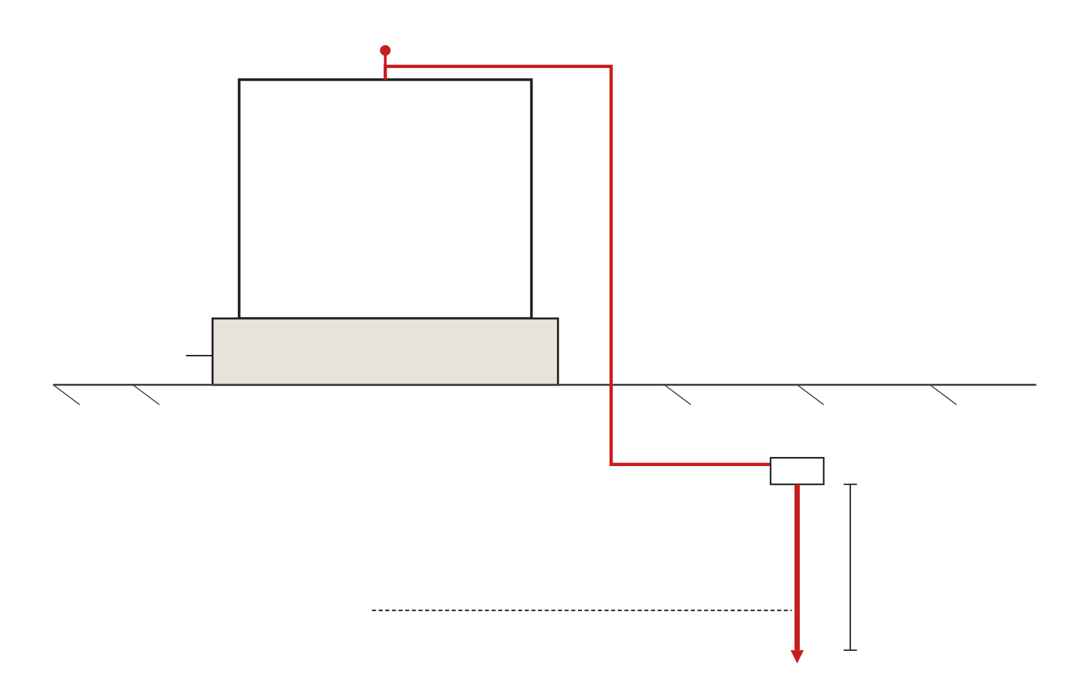
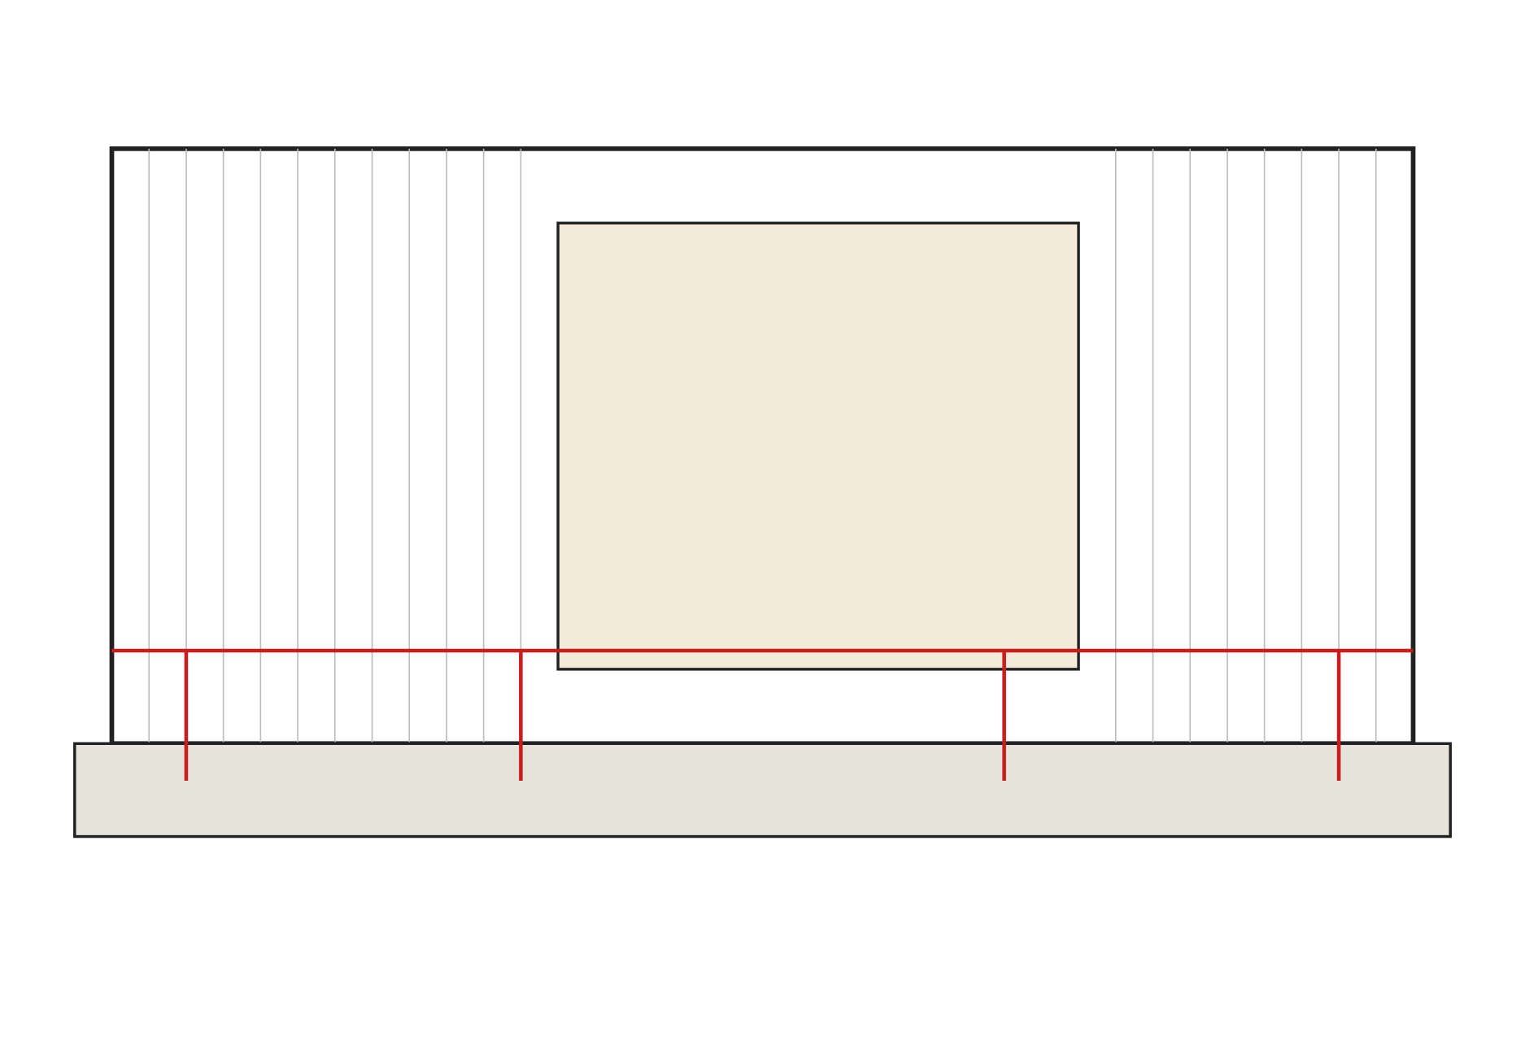
GROUNDING NOTES
SIZE OF CONDUCTORS SHALL COMPLY WITH NEC 250.66 AND 250.122.
BOND TO SEPARATE CONDUCTORS FROM INVERTER TO METAL BUILDING FRAME IF POSSIBLE (NEC 250.92).
GROUND TO METAL WATER PIPE EMBEDDED AT LEAST 10'-0" INTO THE SOIL, IF AVAILABLE (NEC 250.52).
CHECK RESISTANCE TO GROUND. IF RESISTANCE EXCEEDS 25 OHMS, INSTALL ADDITIONAL GROUND RODS WITH CONDUCTORS AS SHOWN, SEPARATED AT LEAST 6'-0" UNTIL RESISTANCE IS REDUCED TO 25 OHMS OR LESS (NEC 250.52). PROVIDE 3RD-PARTY GROUND RESISTANCE TEST REPORT.
PO BOX {{GC_PO_BOX}}
{{CITY_SHORT}}, {{STATE}} {{ZIP}}
PH: {{GC_PHONE}}
PROVIDE GAS AND WATER BOND IF APPLICABLE.
ALL GROUNDING CONNECTIONS BELOW GRADE TO BE EXOTHERMIC WELDED (CADWELD OR EQUAL).
ALL ABOVE-GRADE LUG CONNECTIONS TO BE LISTED MECHANICAL CONNECTORS, NEMA-RATED FOR APPLICATION.
EQUIPMENT GROUNDING CONDUCTOR (EGC) SHALL BE INSTALLED IN ALL RACEWAYS PER NEC 250.118 AND SIZED PER TABLE 250.122.
GROUNDING ELECTRODE SYSTEM SHALL BE BONDED PER NEC 250.50 AND 250.53.
ALL EQUIPMENT METAL ENCLOSURES, CONDUITS, AND CABLE TRAYS SHALL BE BONDED.
PN - {{PROJECT_NAME}}
{{SITE_ADDR}}
APN: {{APN}}
{{CITY_SHORT}}, {{STATE}} {{ZIP}}
GROUNDING CONDUCTOR SCHEDULE
CIRCUIT / EQUIPMENT | PHASE COND. SIZE | EGC / GEC SIZE | MATERIAL | NEC TABLE
XFMR SECONDARY → GES | {{WIRE_AWG}} | {{WIRE_AWG}} | Cu | 250.66
SVC PNL → GEC TO GROUND ROD | — | #6 AWG Cu min. | Cu | 250.66(A)
INVERTER → AC DISCO | {{WIRE_AWG}} | {{WIRE_AWG}} | Cu | 250.122
BESS CABINET BOND | — | {{WIRE_AWG}} | Cu | 250.118
FENCE BONDING JUMPER (TYP) | — | #6 AWG Cu min. | Cu (Bare) | IEEE 80
GROUND ROD (TYP) | — | 5/8" Ø × 8'-0" | Cu-clad Steel | 250.52(A)(5)
GROUND RING (IF REQ'D) | — | #2 AWG Cu min. | Cu (Bare) | 250.52(A)(4)
1
GROUNDING ELECTRODE DETAIL · NOT TO SCALE
DATE | REV | COMMENTS
{{ISSUE_DATE}} | 00 | ISSUE FOR PERMIT
GROUND RESISTANCE TEST RECORD (FIELD)
TEST ID | LOCATION | METHOD | RESULT (Ω) | PASS / FAIL | DATE | TECH
GR-1 | XFMR Pad | 3-Pt Fall of Potential | [ ] | [ ] | [ ] | [ ]
GR-2 | BESS Pad | 3-Pt Fall of Potential | [ ] | [ ] | [ ] | [ ]
GR-3 | Fence Gate | Clamp-on | [ ] | [ ] | [ ] | [ ]
S2.0
Note: All readings must be ≤25 Ω per NEC 250.53(A)(2), or a supplemental electrode must be installed.
GROUNDING DETAILS
ISSUE DATE | {{ISSUE_DATE}}
REVISION DATE | {{ISSUE_DATE}}
DESIGNED BY | {{DESIGNED_BY}}
CHECKED BY | {{DESIGNED_BY}}
JOB NO. | {{JOB_NO}}
2
DIAGRAM OF GROUNDING POINTS · NOT TO SCALE
GROUNDING DETAILS, SCHEDULE & TEST RECORD

Slide 10
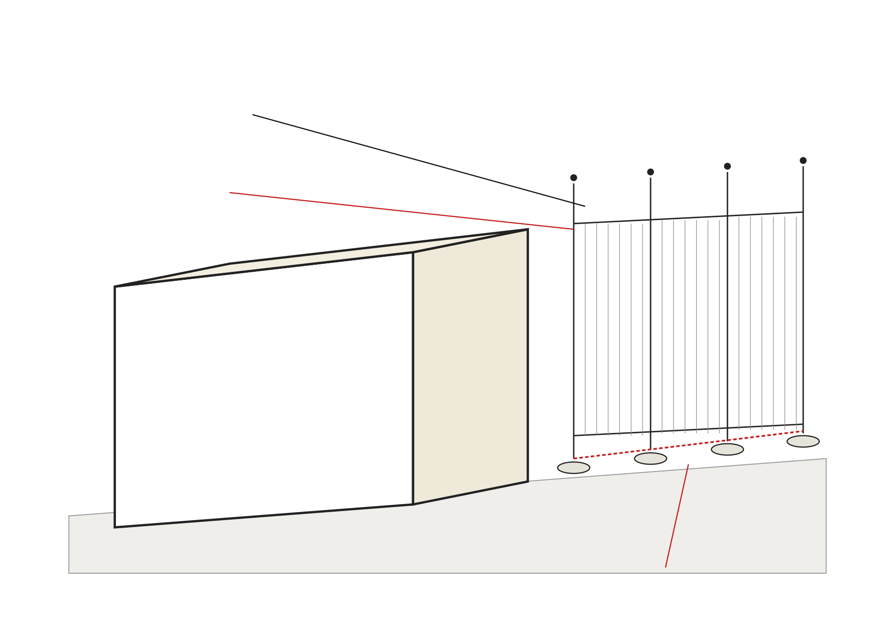
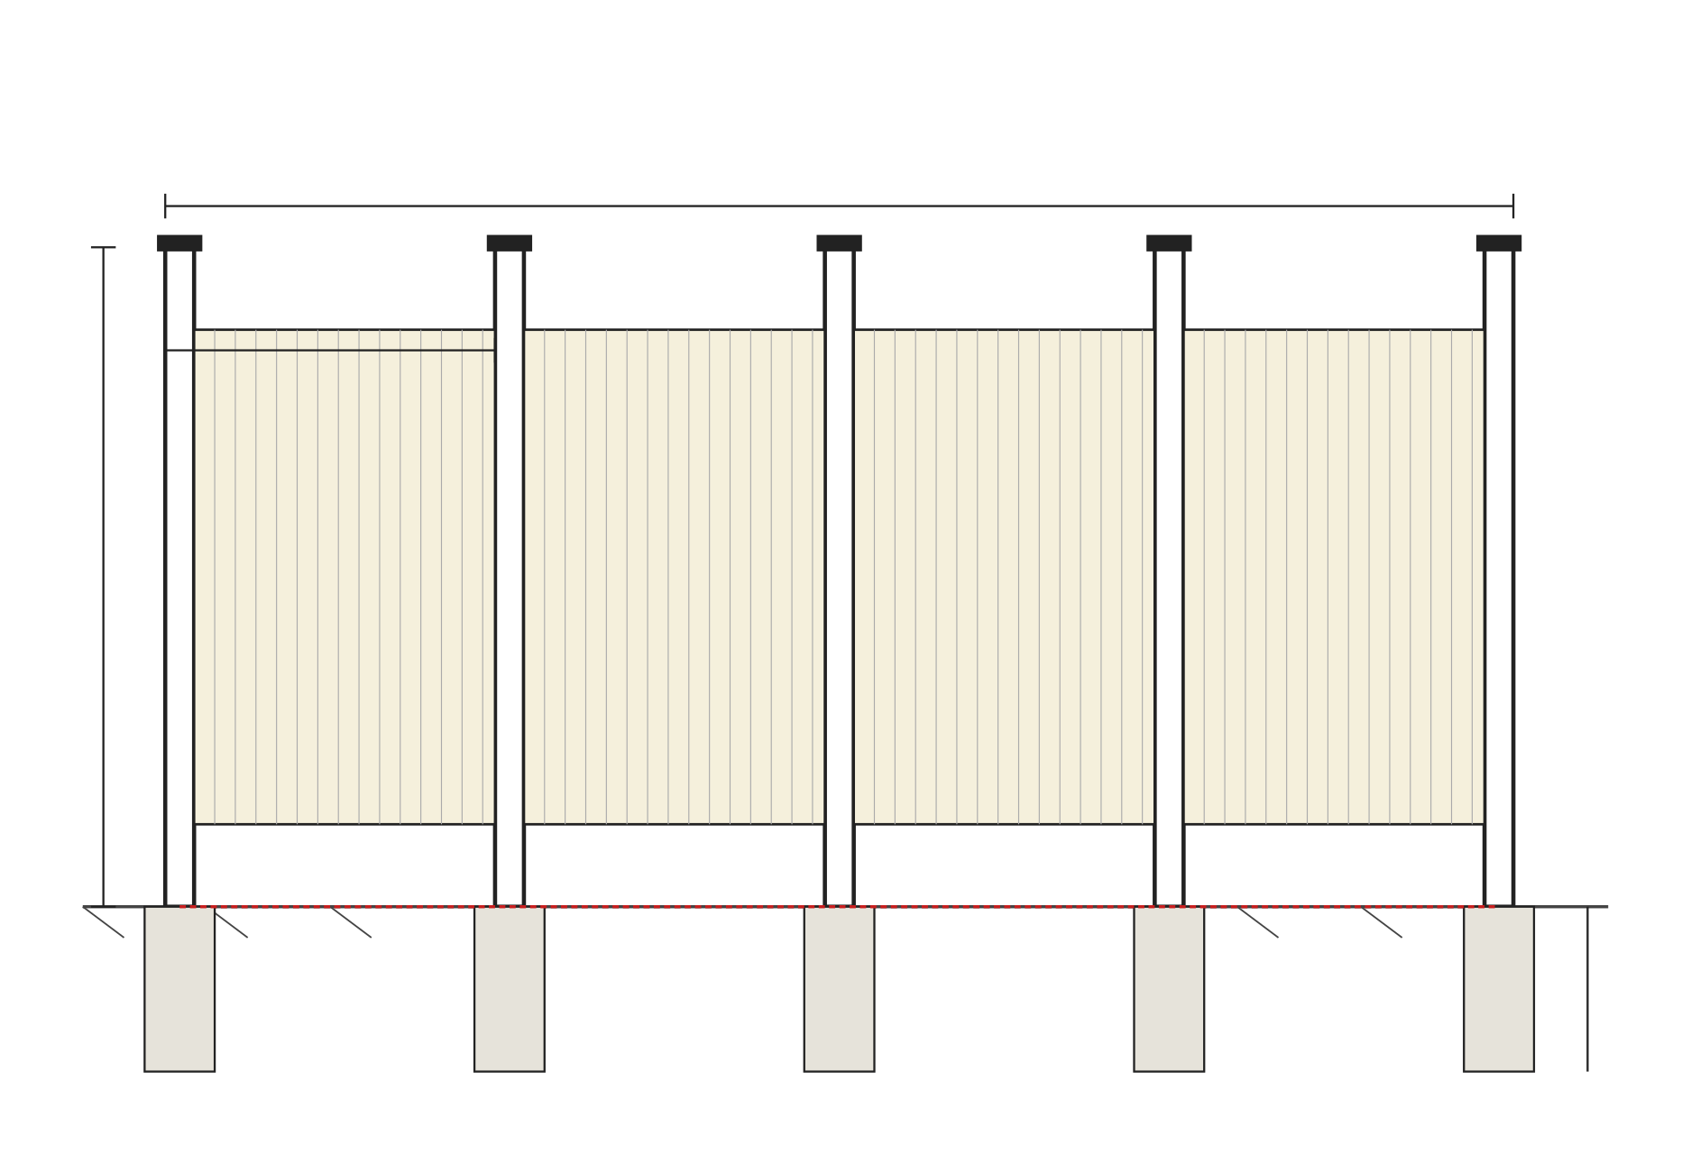
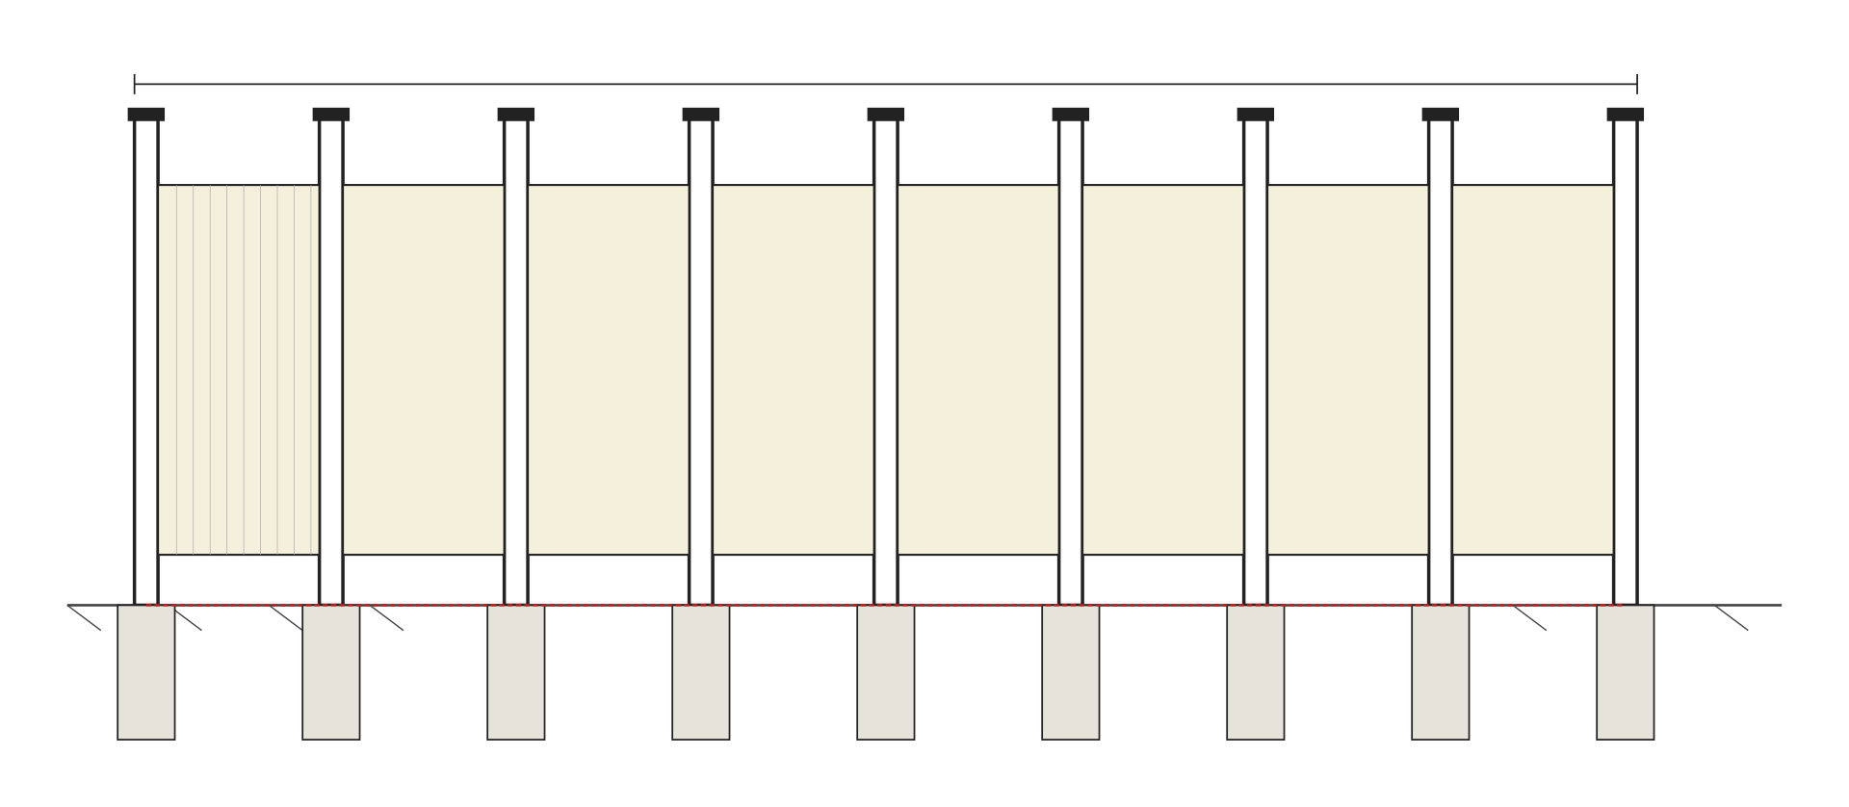
FENCING NOTES
Fence height: 8'-0" minimum measured from finish grade. Coordinate with local zoning and AHJ if greater height is required.
Fence panels and posts to be of materials & finish per AHJ / Owner spec; HDG steel, aluminum, or composite acceptable.
Posts: [2" × 2"] HDG steel tube, painted to match panels. Set in [12" Ø] concrete footing, [36"] minimum depth below grade.
PO BOX {{GC_PO_BOX}}
{{CITY_SHORT}}, {{STATE}} {{ZIP}}
PH: {{GC_PHONE}}
Post spacing: [8'-0" o.c. typical], max [10'-0" o.c.]; reduce as required at gates and panel transitions.
Concrete footing: f'c = [3,000] psi, crown above grade to shed water.
Provide ground bonding jumper #6 AWG Cu between adjacent fence posts and to grounding electrode system per IEEE 80 and NEC 250.
Gates: Provide one [double-swing 12'-0" wide] vehicle gate and one [pedestrian 4'-0"] gate. Gates to be self-closing & lockable per AHJ / IFC 1207.
Gate hardware to be heavy-duty, rated for exterior use, with weather-resistant finish.
Signage on fence per E4.0 (Caution / Energy Storage / Emergency Contact).
Maintain minimum [3'-0"] clearance from BESS enclosure to inside face of fence for working clearance per NEC 110.26.
Provide vegetation-free perimeter of [3'-0"] on both sides of fence; coordinate with landscape per local fire department requirements.
All exposed fasteners: stainless or HDG. Tamper-resistant where accessible from public side.
Fence to be installed plumb & level; max deviation 1/4" in 8'-0" run.
PN - {{PROJECT_NAME}}
Coordinate fence location with property line survey and easements. Maintain {{SETBACK}} per local code.
{{SITE_ADDR}}
APN: {{APN}}
{{CITY_SHORT}}, {{STATE}} {{ZIP}}
1
FENCING — ISOMETRIC VIEW · NOT TO SCALE
2
FENCING DETAIL — PARKING LOT SIDE VIEW · SCALE: 3/8" = 1'-0"
FENCING SCHEDULE
RUN | SIDE | LENGTH | HEIGHT | PANEL TYPE
A | Parking Lot | {{FENCE_LEN}} | 8'-0" | {{FENCE_TYPE}}
B | Cross Street | {{FENCE_LEN}} | 8'-0" | {{FENCE_TYPE}}
C | Property Line | {{FENCE_LEN}} | 8'-0" | {{FENCE_TYPE}}
D | Gate | {{FENCE_LEN}} | 8'-0" | Double Swing
DATE | REV | COMMENTS
{{ISSUE_DATE}} | 00 | ISSUE FOR PERMIT
{{PERMIT_NO}}
REVIEWED FOR COMPLIANCE
{{AHJ_FIRE_DEPT}}
For Continued Compliance Subject to Code
REVISIONS NEED REVIEW
S3.0
☐ BUILDING CODE ☐ ELECTRICAL CODE
☐ MECHANICAL CODE ☐ PLUMBING CODE
☐ GRADING/DRAINAGE ☐ STRUCTURAL DESIGN
FENCING DETAILS
ISSUE DATE | {{ISSUE_DATE}}
REVISION DATE | {{ISSUE_DATE}}
DESIGNED BY | {{DESIGNED_BY}}
CHECKED BY | {{DESIGNED_BY}}
JOB NO. | {{JOB_NO}}
3
FENCING DETAILS — CROSS STREET ELEVATION · SCALE: 3/8" = 1'-0"

