Slide 1
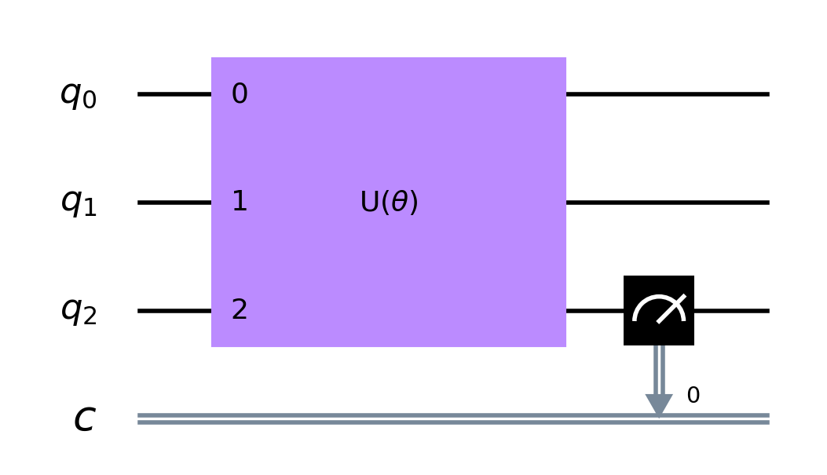
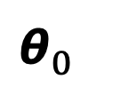

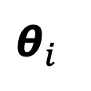
Quantum Computer
Classical Computer
Cost
Function
Cost < Tolerance?
No Yes
$$\text{θ}$$
$${\text{θ}}_{0}$$
$${\text{θ}}_{i}$$

