Slide 1



IW:LEARN 7 Years of Plone
In 1997 the Global Environment Facility (GEF)
initiated the International Waters: Learning
Exchange and Resource Network (IW:LEARN) as a knowledge management project to enhance the delivery of results by GEF IW projects.

Slide 2
IW:LEARN 7 Years of Plone
IW:LEARN is a joint UNEP/UNDP project which works with GEF (Global Environment Facility) International Waters projects to improve online sharing of data and information relevant to managing international waters, including marine, coastal and freshwater ecosystems.

Slide 3
IW:LEARN 7 Years of Plone
The IW:LEARN Team is spread around the globe (Bratislava, Nairobi, Bangkok and formerly Washington DC).

Slide 4
IW:LEARN 7 Years of Plone
Website: http://iwlearn.net
Training
Hosting: http://project-name.iwlearn.org
Archive

Slide 5
IW:LEARN 7 Years of Plone
The website serves as:
Information and News Hub
Document clearinghouse
Central repository for learning Materials
Portfolio visualization tool

Slide 6
IW:LEARN 7 Years of Plone
Short Term contract with the UN in Nairobi
Date: 2005-05-16
We are looking for Plone Developers to help us deploy the CMS for a number of distributed applications.
We are seeking plone experts with demonstrated skills for short term consultancies (6-12 months) with possibilities of extension.

Slide 7
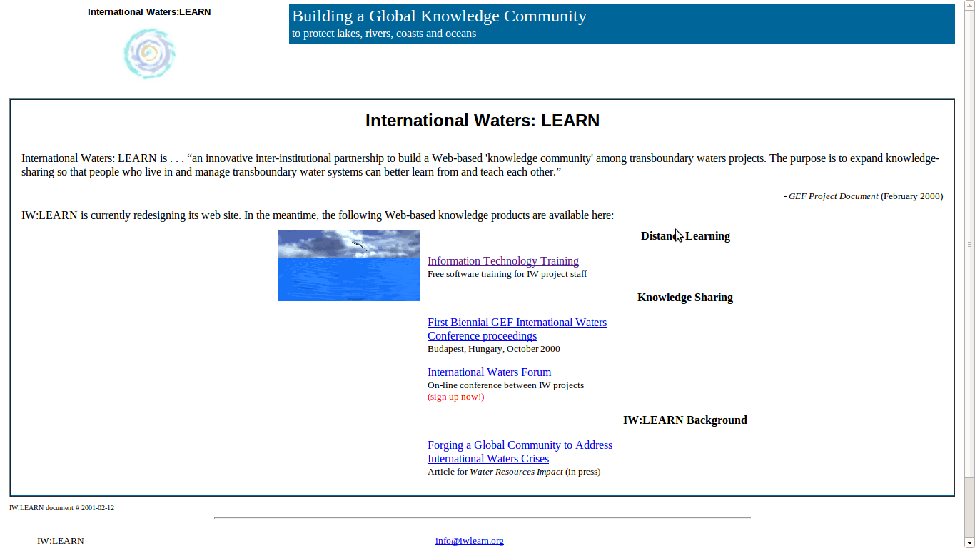
IW:LEARN 7 Years of Plone

Slide 8
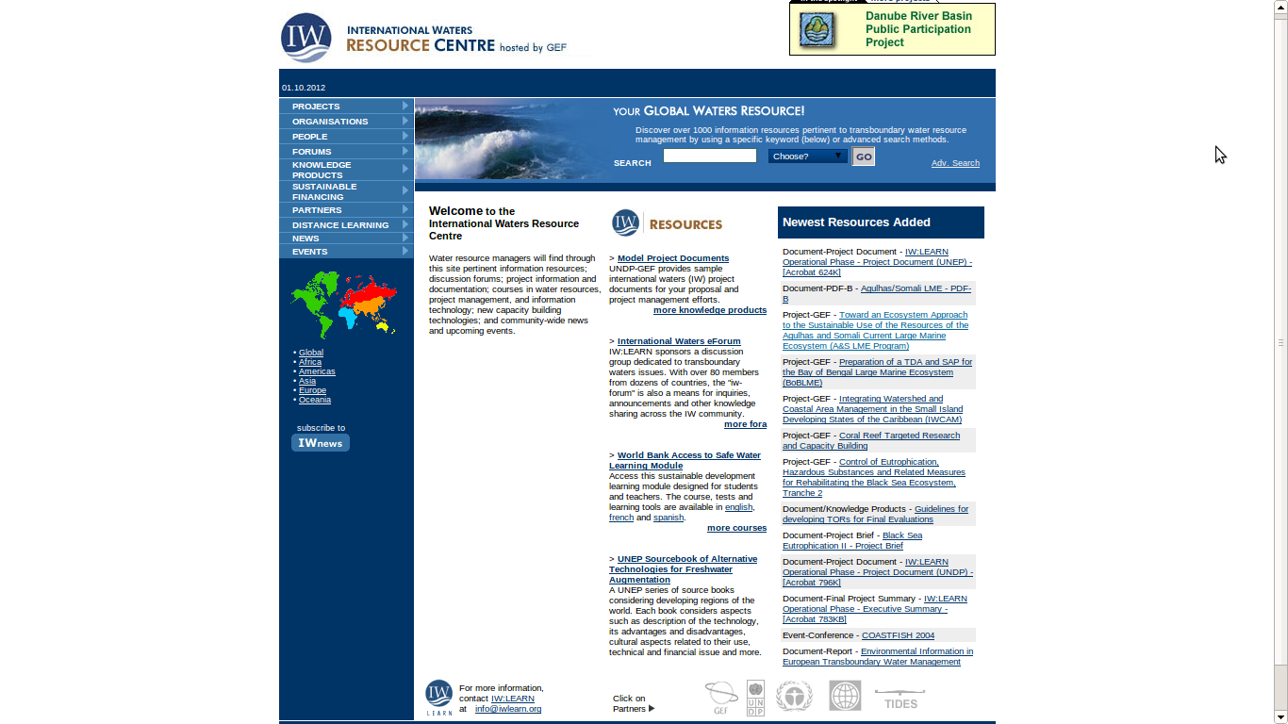
IW:LEARN 7 Years of Plone

Slide 9
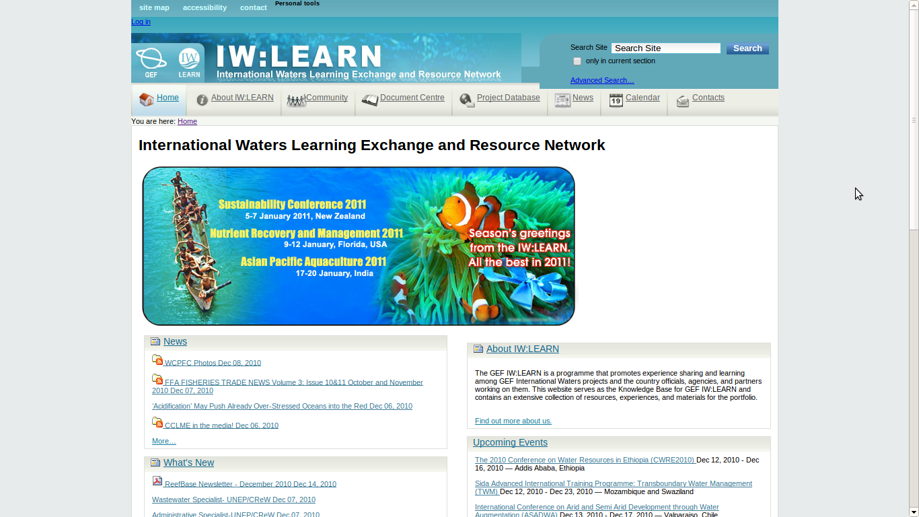
IW:LEARN 7 Years of Plone

Slide 10
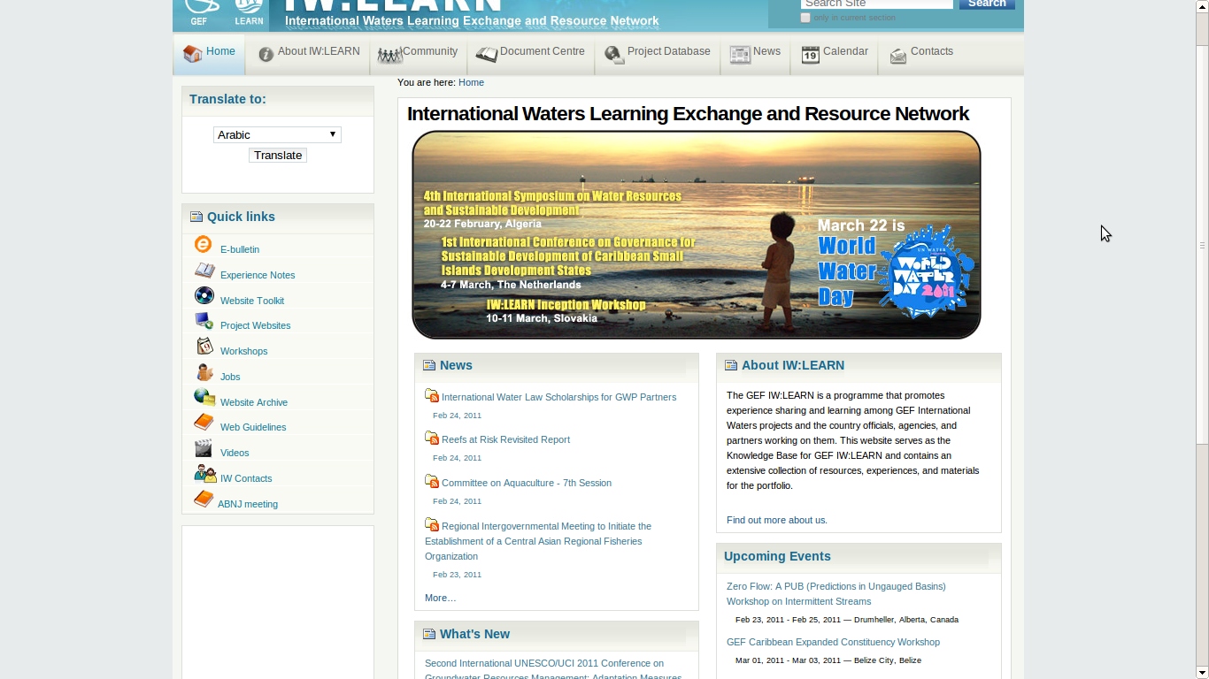
IW:LEARN 7 Years of Plone

Slide 11
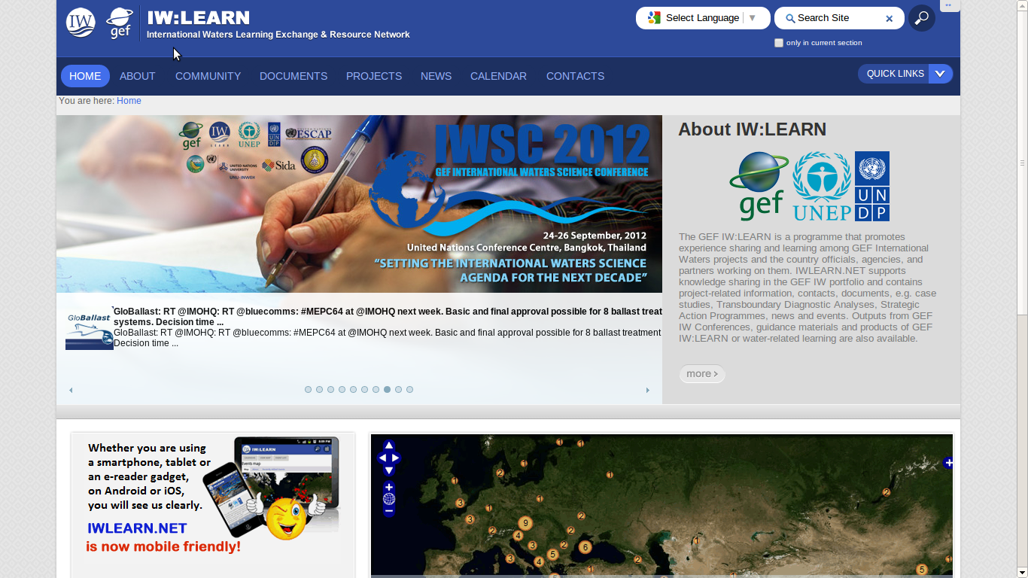
IW:LEARN 7 Years of Plone

Slide 12
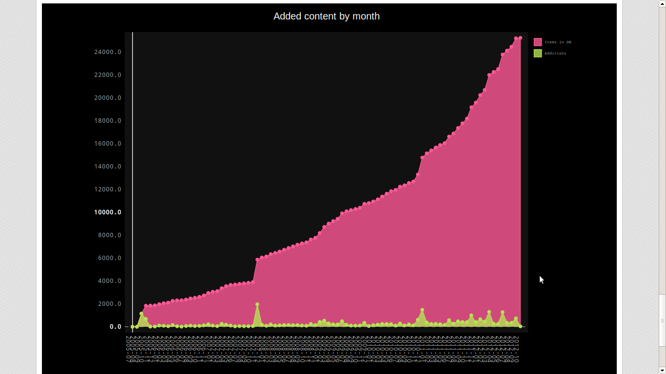
IW:LEARN 7 Years of Plone

Slide 13
IW:LEARN 7 Years of Plone

Slide 14

IW:LEARN 7 Years of Plone
Cost (free to download and install)
Avoids dependence on vendors (vendor lock-in) for support and services
Avoid costly upgrades and dropping of support of older software versions
Security – with many eyes all bugs are shallow
“Control over the use of one's ideas really constitutes control over other people's lives; and it is usually used to make their lives more difficult.”

Slide 15
IW:LEARN 7 Years of Plone
Adoption of open standards (avoid non-standard formats and compatibility issues in proprietary software)
Software can be readily customized (source code can be viewed and edited by anyone)
Distribution to stakeholders is not restricted
Any translation possible – investment may be too great for proprietary software developer
Fast development cycle, rapid response time to bug reports

Slide 16
IW:LEARN 7 Years of Plone
Engaging Stakeholders:
Events Calendar
News Federation (feedfeeder)
Newsletter (EasyNewsletter)

Slide 17
IW:LEARN 7 Years of Plone
Metadata
Everybody loves it but it is a challenge to get good metadata
Title
Description
Language
Related items
Keywords

Slide 18
IW:LEARN 7 Years of Plone
Description:
collective.ots
Extracts a meaningful abstract out of long documents.
The output is not perfect but a good starting point.

Slide 19
IW:LEARN 7 Years of Plone
Language
collective.langdet
Guess the language with ngram statistical methods
ar: 1, bg: 1, cy: 2, en: 24200, es: 278, et: 1, fr: 204, hr: 6, id: 52, it: 246, pt: 66, ro: 17, ru: 42, sk: 2, sq: 3, sr: 1, sv: 3, tl: 2,tn: 24, uk: 2, zh: 1

Slide 20
IW:LEARN 7 Years of Plone
Related Items
A powerful way to improve UX and Page Rank
Hard to do manually
collective.simserver

Slide 21
IW:LEARN 7 Years of Plone
What is a document similarity service?
Conceptually, a service that lets you :
train a semantic model from a corpus of plain texts (no manual annotation and mark-up needed)
index arbitrary documents using this semantic model
query the index for similar documents (the query can be either an uid of a document already in the index, or an arbitrary text)

Slide 22
IW:LEARN 7 Years of Plone
Simserver is built on Gensim. Gensim is a free Python framework designed to automatically extract semantic topics from documents, as efficiently (computer-wise) and painlessly (human-wise) as possible.

Slide 23
IW:LEARN 7 Years of Plone
Gensim aims at processing raw, unstructured digital texts (“plain text”). The algorithms in gensim, such as Latent Semantic Analysis, Latent Dirichlet Allocation or Random Projections, discover semantic structure of documents, by examining word statistical co-occurrence patterns within a corpus of training documents. These algorithms are unsupervised, which means no human input is necessary – you only need a corpus of plain text documents.

Slide 24
IW:LEARN 7 Years of Plone
Demo

Slide 25
IW:LEARN 7 Years of Plone
Visualizations
Maps built on top of collective.geo
Charts with pygal (SVG)

Slide 26
IW:LEARN 7 Years of Plone

Slide 27
IW:LEARN 7 Years of Plone
Maps of:
Events
Contact Locations
Project Basins (Choropleth)
Project Countries (Choropleth)
Project Management Units (Cluster)
Project Details

Slide 28
IW:LEARN 7 Years of Plone
Dynamic Charts
Project ratings
Regions
Agencies

Slide 29
IW:LEARN 7 Years of Plone

Slide 30
IW:LEARN 7 Years of Plone
Apart from Plone:
KARL Knowledge Management System
Geonode share spatial data

Slide 31
IW:LEARN 7 Years of Plone
Thank You
Questions?

Slide 32
IW:LEARN 7 Years of Plone

Slide 33
IW:LEARN 7 Years of Plone

Slide 34
IW:LEARN 7 Years of Plone

Slide 35
IW:LEARN 7 Years of Plone

Slide 36
IW:LEARN 7 Years of Plone

Slide 37
IW:LEARN 7 Years of Plone

Slide 38
IW:LEARN 7 Years of Plone

Slide 39
IW:LEARN 7 Years of Plone

Slide 40
IW:LEARN 7 Years of Plone

Slide 41
IW:LEARN 7 Years of Plone

Slide 42
IW:LEARN 7 Years of Plone

