Slide 1
Cover page
August 2005
At the Money Swaptions– Sajiv Shrivastva
AT THE MONEY SWAPTIONS

Slide 2
Product Background
Swaption
A swaption is the right, but not the obligation to enter into an interest rate swap. As with all options a premium is paid to obtain this right.
A receiver (call) swaption: the right to receive fixed in the underlying swap
A payer (put) swaption: the right to pay fixed in the underlying swap

Slide 3
Product Background
Optionality on Swaptions
  A European Swaption can only be exercised on the expiration date.
      Given only one exercise date and a known underlying swap maturity, European swaptions are often referred to as “1 into 2” whereby the first number refers to the length of the option period and the second to the length of the underlying swap. E.g. A 1 into 2 yr swaption translates into an option into entering a 2 year swap in one year.
A Bermudan Swaption has periodic exercise dates.
      In this type of option, the tenor of the underlying swap depends when/if the option is exercised. A “5NC1” refers to a final maturity date on the underlying of 5 years and no call dates on the option for the first year
      After 1 year, the owner may exercise periodically (lets assume quarterly). If the owner exercises periodically (let’s assume quarterly). If the owner exercises after 2 years(1 year after the no-call period), the swap tenor would be 3 years.

Slide 4
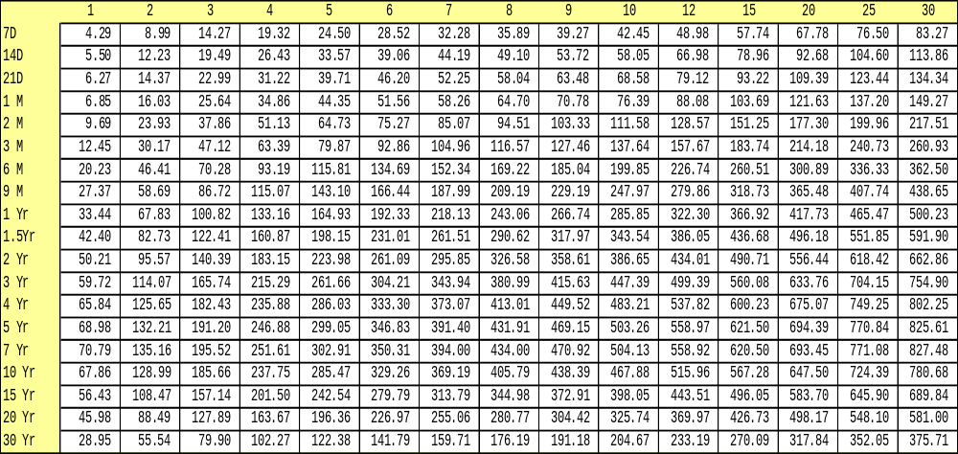
Product Background
At the Money (ATM) Swaptions
  The scope of this presentation will now focus on At the Money Swapations
      These options will be European and will be right at the money. (Current Forward price = Strike Price, The option on the swap is currently at the expiration date)
  All price testing positions and prices are tested in the following grid format.
Swap Tenors
Option
Expiry

Slide 5
Swaption At The Money (ATM) pricing
Pricing Parameters
  Forwards Surface (JPM)
  Forward Yield Volatility (JPM/Broker)
  Break Even Volatility (JPM/Broker)
      Volatility described as the basis point move in the underlying needed per business day over the life of the option for return to offset time decay. Implicit is the assumption that yield moves affect volatility
  Vega Surface (JPM)
      The change in present value of the trade for a one percent up movement in forward percent yield volatility
  Option premium (Broker)
      Price of the Option

Slide 6
Swaption At The Money (ATM) pricing
Pricing Methodology
    Obtain premiums from various brokers
    Reduce noise from broker premiums using standard outlier adjustment methodology
    Convert outlier adjusted premiums in to break even volatilities
    Using straight line interpolation to obtain break even points along the 2, 9 and 18 month tenors
    Convert interpolated break even volatilities back into premiums
    Similar to standard price testing, price test JPM premiums to broker premiums.

Slide 7
Copyright 2005 J.P. Morgan Chase & Co. All rights reserved. JPMorgan is the marketing name for J.P. Morgan Chase & Co., and its subsidiaries and affiliates worldwide. J.P. Morgan Securities Inc. is a member of NYSE and SIPC. JPMorgan Chase Bank is a member of FDIC. J.P. Morgan Futures Inc., is a member of the NFA. J.P. Morgan Securities Ltd. (JPMSL), J.P. Morgan Europe Limited and J.P. Morgan plc are authorized by the FSA. J.P. Morgan Equities Limited is a member of the Johannesburg Securities Exchange and is regulated by the FSB. J.P. Morgan Securities (Asia Pacific) Limited (CE number AAJ321) is regulated by the Hong Kong Monetary Authority. J.P. Morgan Securities Singapore Private Limited is a member of Singapore Exchange Securities Trading Limited and is regulated by the Monetary Authority of Singapore (“MAS”). J.P. Morgan Securities Asia Private Limited is regulated by the MAS and the Financial Services Agency in Japan. J.P.Morgan Australia Limited (ABN 52 002 888 011) is a licensed securities dealer.
Additional information is available upon request. Information herein is believed to be reliable but JPMorgan does not warrant its completeness or accuracy. Opinions and estimates constitute our judgment and are subject to change without notice. Past performance is not indicative of future results. The investments and strategies discussed here may not be suitable for all investors; if you have any doubts you should consult your investment advisor. The investments discussed may fluctuate in price or value. Changes in rates of exchange may have an adverse effect on the value of investments. This material is not intended as an offer or solicitation for the purchase or sale of any financial instrument. JPMorgan and/or its affiliates and employees may hold a position, may undertake or have already undertaken an own account transaction or act as market maker in the financial instruments of any issuer discussed herein or any related financial instruments, or act as underwriter, placement agent, advisor or lender to such issuer. Clients should contact analysts at and execute transactions through a JPMorgan entity in their home jurisdiction unless governing law permits otherwise. This report should not be distributed to others or replicated in any form without prior consent of JPMorgan. This report has been issued, in the U.K. only to persons of a kind described in Article 19 (5), 38, 47 and 49 of the Financial Services and Markets Act 2000 (Financial Promotion) Order 2001 (all such persons being referred to as “relevant persons”). This document must not be acted on or relied on by persons who are not relevant persons. Any investment or investment activity to which this document relates is only available to relevant persons and will be engaged in only with relevant persons. In other European Economic Area countries, the report has been issued to persons regarded as professional investors (or equivalent) in their home jurisdiction.
JPMorgan uses the following recommendation system: Overweight. Over the next six to twelve months, we expect this bond to outperform the average total return of the bonds in the analyst’s (or analyst’s team’s) coverage universe. Neutral. Over the next six to twelve months, we expect this bond to perform in line with the average total return of the bonds in the analyst’s (or analyst’s team’s) coverage universe. Underweight. Over the next six to twelve months, we expect this bond to underperform the average total return of the bonds in the analyst’s (or analyst’s team’s) coverage universe.
JPMorgan uses the following rating system: Improving (I) The issuer’s long-term credit rating likely improves over the next six to twelve months. Stable (S) The issuer’s long-term credit rating likely remains the same over the next six to twelve months. Deteriorating (D) The issuer’s long-term credit rating likely falls over the next six to twelve months. Deteriorating+ (D+) The issuer’s long-term credit rating likely falls to junk over the next six to twelve months. Defaulting (F) There is some likelihood that the issuer defaults over the next six to twelve months.
This report should not be distributed to others or replicated without prior consent of JPMorgan.

