Slide 1
Context-dependent effects of HP1 assessed in high throughput by thousands of integrated reporters
Laura Brueckner, NKI

Slide 2
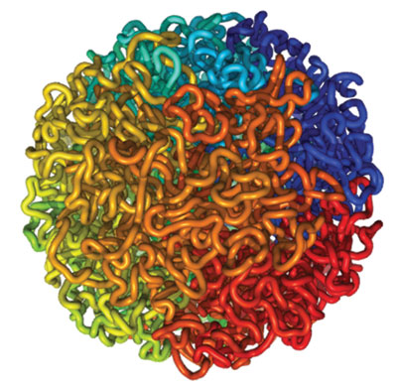
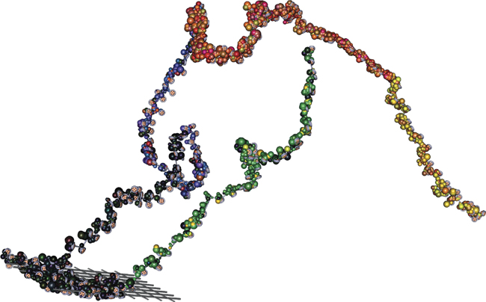
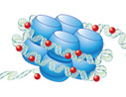

Multiple layers of genome organization
Associated chromatin proteins
3D organization
Nucleosome packaging and epigenetic modifications
DNA sequence

Slide 3
Chromatin effects on gene expression assayed by TRIP
Barcoded GFP reporter
Random integration in drosophila Kc167 cells
Locus A
Locus B
Locus C
TRIP pool
Mapping
reads
cDNA
reads
gDNA
reads

Slide 4
Chromatin effects on gene expression assayed by TRIP
Barcoded GFP reporter
Random integration in drosophila Kc167 cells
Locus A
Locus B
Locus C
TRIP pool
Mapping
reads
cDNA
reads
gDNA
reads

Slide 5
HP1a – a hallmark of heterochromatin
Nucleates and spreads a heterochromatin state that results in transcriptional silencing
Associated with euchromatic genes and activating role in their transcription (d. melanogaster, Piacentini 2003/2009)
How does HP1a function depend on chromatin context?

Slide 6
HP1a – a hallmark of heterochromatin
Gal4DBD + Protein of interest
Nucleates and spreads a heterochromatin state that results in transcriptional silencing
Associated with euchromatic genes and activating role in their transcription (d. melanogaster, Piacentini 2003/2009)
How does HP1a function depend on chromatin context?
HP1
Gal4
reporter gene
5x GAL4 UAS
pMT
GFP
Cu-Inducible promoter
Integration in multiple loci
Permissive chromatin state
GFP
Non-permissive chromatin state
GFP

Slide 7

TRIP assay - Assessing chromatin protein effects in multiple genomic contexts
D-2
D0
TRIP pool
(drosophila Kc167)
GFP induction
Transient transfection
Gal4-HP1
Gal4
HP1
D2
gDNA
Next-generation sequencing
cDNA
spike-in

Slide 8
HP1 effects on TRIP expression

Slide 9
HP1-induced repression is not correlated with expression

Slide 10
HP1-induced repression is modulated by chromatin environment

Slide 11
HP1-induced repression is enhanced in pericentromeric heterochromatin

Slide 12
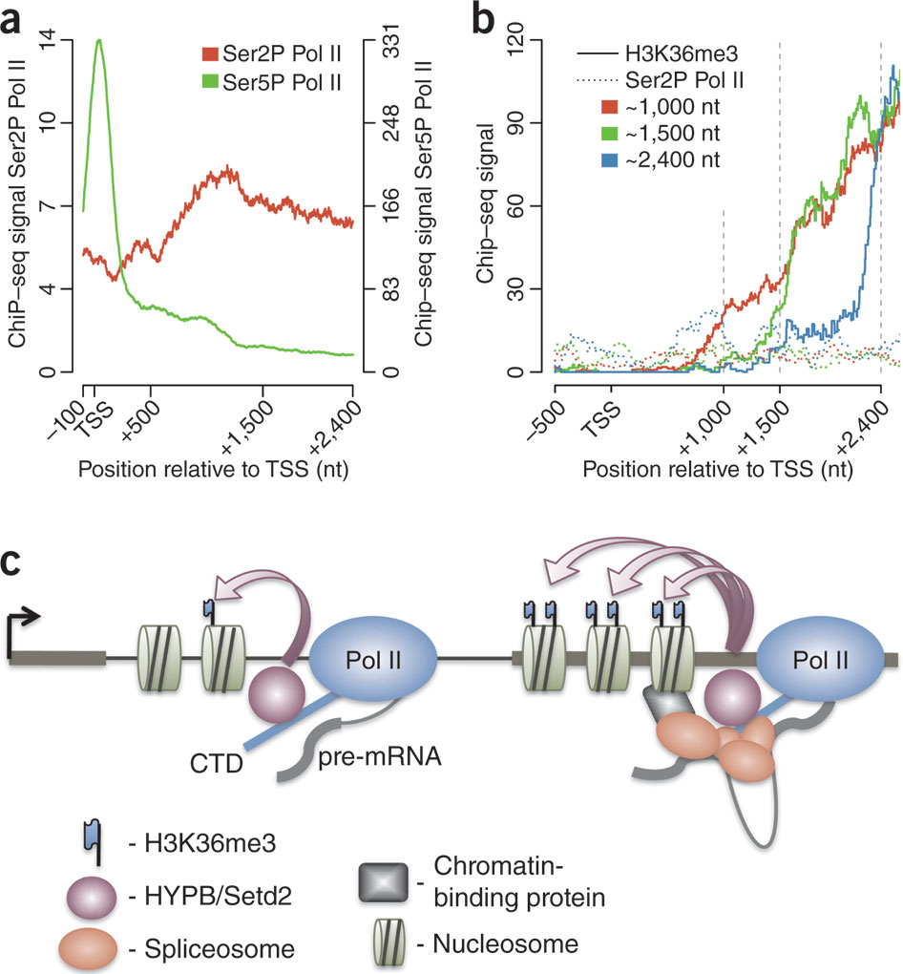
HP1-induced repression is diminished in H3K36me3-associated regions

Slide 13
HP1-induced repression is not permanent

Slide 14
Summary and conclusions
HP1 is a powerful repressor able to override even high levels of transcription
The local chromatin context modulates HP1 action
HP1-induced silencing is enhanced by 2-fold in pericentromeric heterochromatin
HP1 function is diminished in H3K36me3-associated regions
No stable memory of HP1-induced silencing

Slide 15

Thankyous
Van Steensel lab
Bas van Steensel
Joris van Arensbergen
Eva Brinkman
Jorge Omar Yanez-Cuna
Ludo Pagie
Tao Chen
Marcel de Haas
Sandra de Vries
Tom van Schaik
Christ Leemans
Van Lohuizen lab
Waseem Akhtar
Flow Cytometry facility
Genomics Core Facility

