Slide 1
Towards Graphical configuration inside the into-cps application

Slide 2
Agenda
Background
Contribution
Future Work
Conclusion

Slide 3
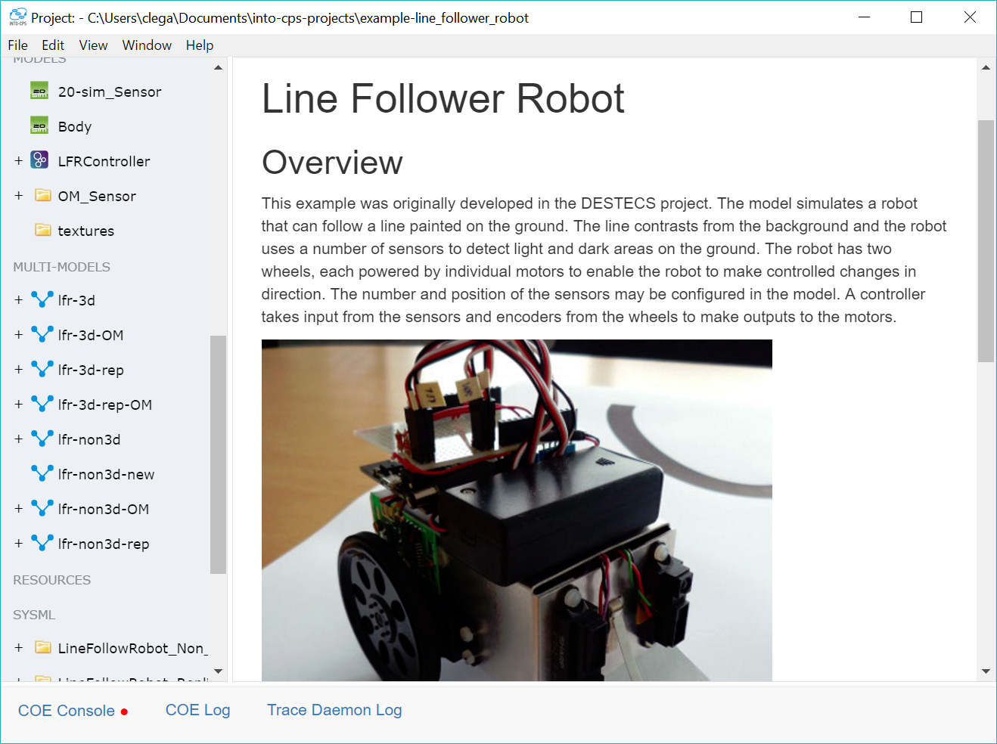
Background – motivation
System Engineering Course
Powerful tooling
Frustrating User interface

Slide 4
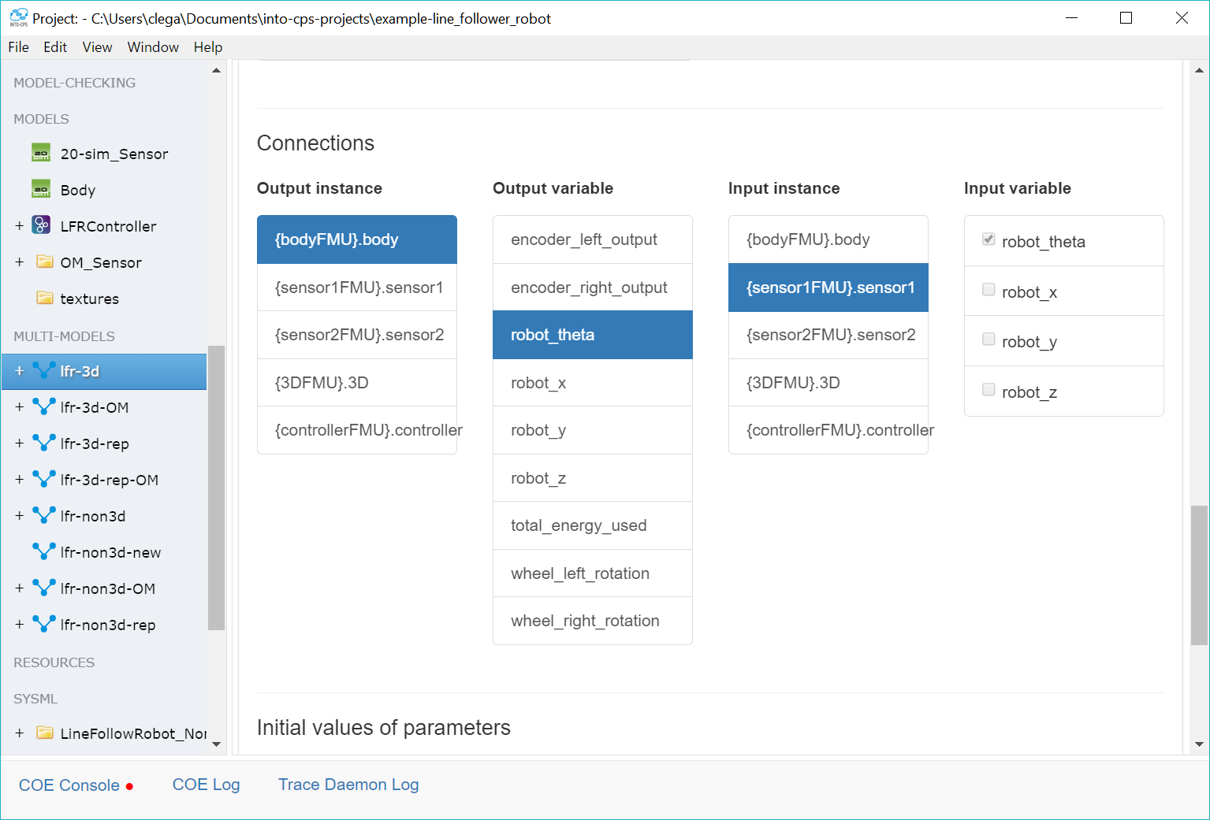
Background – connections inside application
Gets the job done
Limited overview
Find un-connected port?

Slide 5
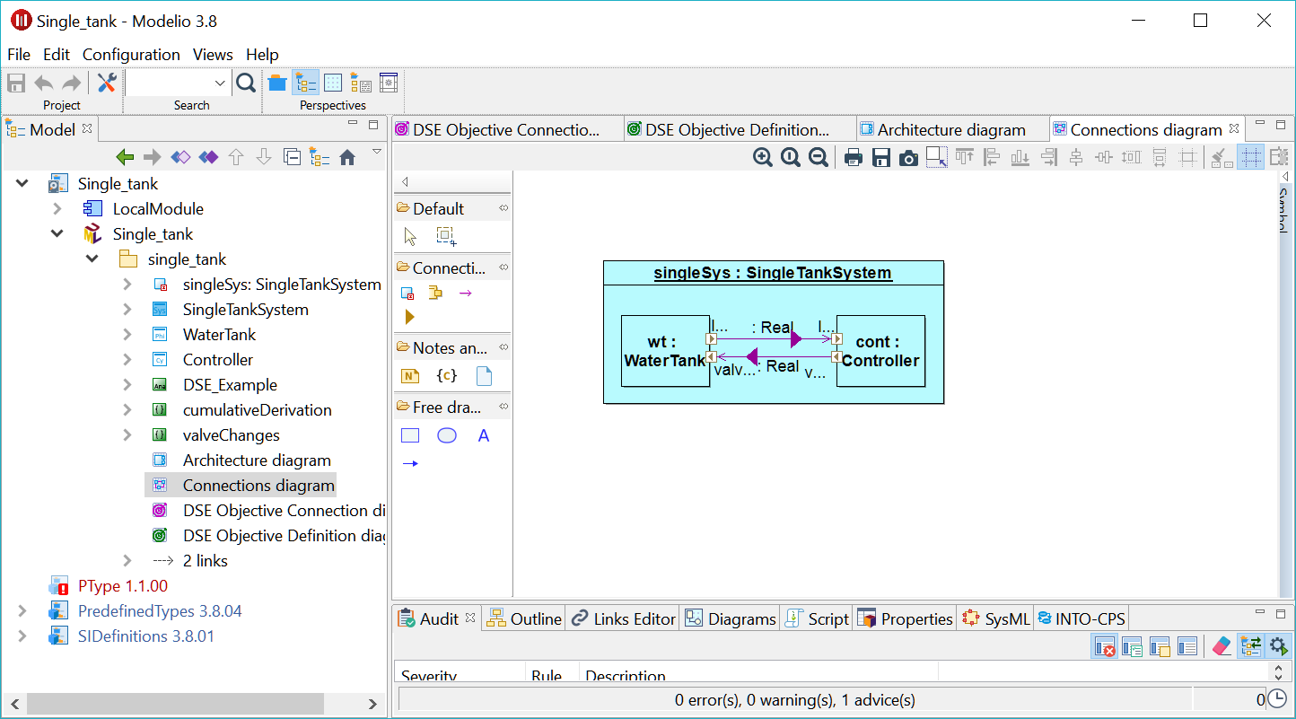
Background – sysML profile
Better overview
Familiar experience
Ease of use
Exchangeability

Slide 6
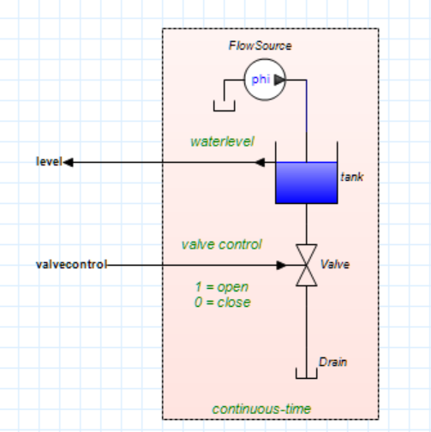
Background – Other tools
20Sim, OMEDIT, Matlab …
Integrated block-based design
Key difference to SysML profile?

Slide 7
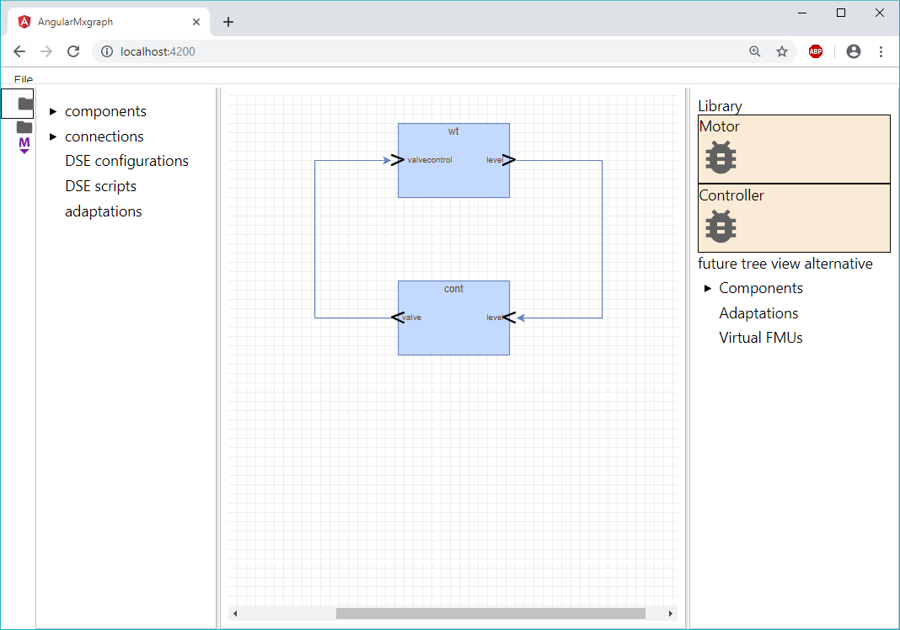
Contribution – Graphical Editor
Integrated Block-based editor
Faster development loop
Less error prone
Familiar experience

Slide 8
Contribution – Graphical editor
Project explorer
Canvas
Library

Slide 9
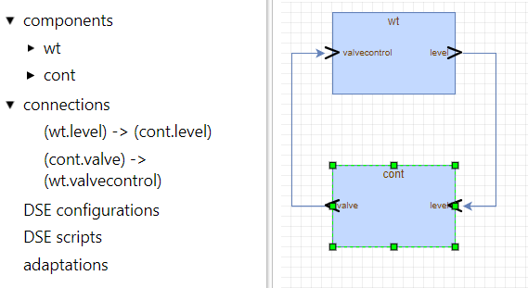
Graphical editor – Project Explorer
Abstract representation of system
Overview of hierarchy
Also shows artefacts not present in canvas

Slide 10
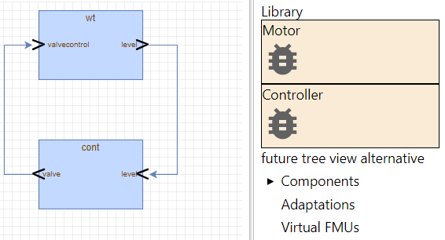
Graphical editor – Library
Drag and Drop
Categorised by type
Potential sources of items

Slide 11
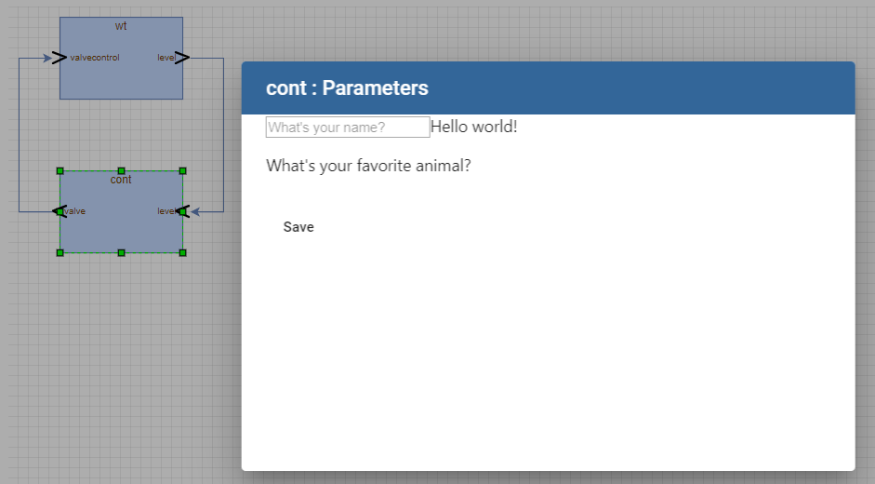
Graphical editor – Parameters
Configuration of system
Instance specific vs shared
Cooping with large number of parameters

Slide 12
Exchange format – Looking forward
Why is this relevant?
Current format
Future format

Slide 13
Exchange format – Current format
Simple JSON format
No geometry, shared parameters, hierarchy …
Requires drilling into the FMU archives

Slide 14
Exchange format – System Structure and Parametrization
TODO

Slide 15
Future Work
List most significant

Slide 16
Future Work – Semantic Adaptation
Describe SA

Slide 17
Future Work – Hierarchy
List most significant

Slide 18
Acknowledgements
poul due jensen

