Slide 1
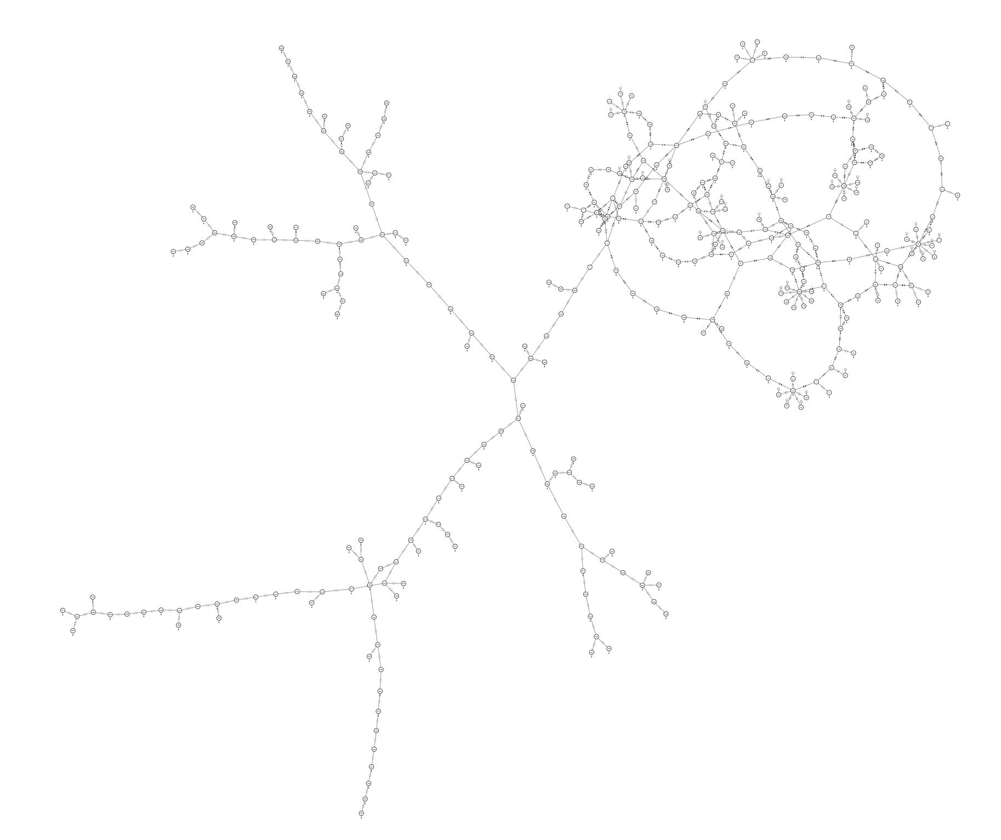
Test network
200-bus
Transmission
network
External area
141-bus
Distribution
network

Slide 2
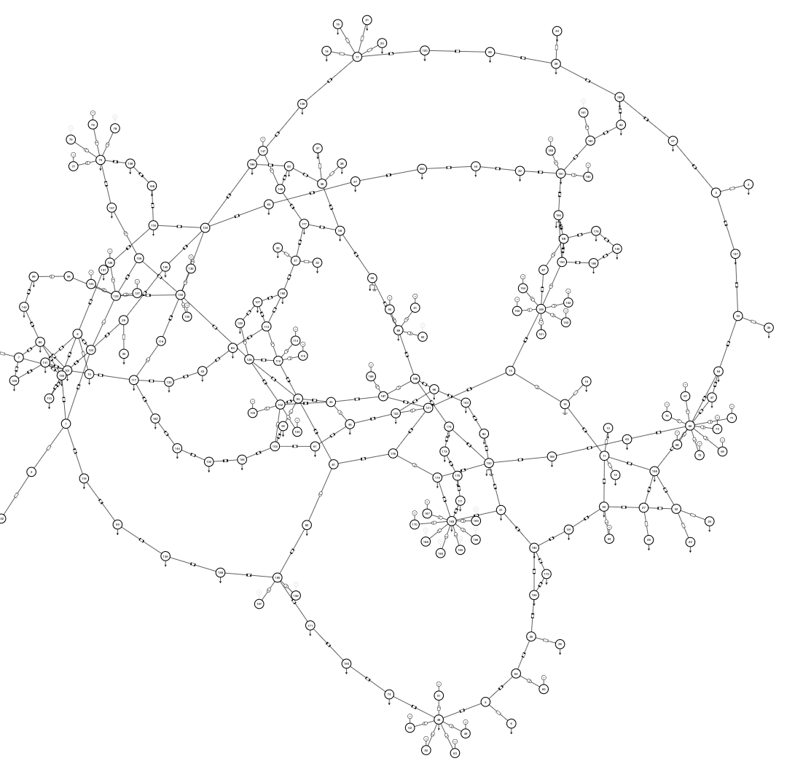
Goal
Create a surrogate model of external 141-bus distribution network.
200-bus
Transmission
network
141-bus
Surrogate model
141-bus
Distribution
network

Slide 3
Data
PSL branch – pg-9bus-dataset
Directory - psl/psl/datasets/ACTIVSg200_case141_data
Each file contains the boundary bus interaction for a fault (step function) in the 141-bus external area.
Measurements: Voltage at the boundary bus, Current flowing into the external area
Four measuements in each file. Data tags -
y1 – V
Y2 - \theta_V
y3 – I
Y4 - \theta_I
200-bus transmission network
141-bus
external
area
Boundary bus

