Slide 1
GSAM | QUANTITATIVE STRATEGIES | FIXED-INCOME RELATIVE VALUE
RESEARCH NOTE · APRIL 2026
Mean Reversion in OIS–Treasury Spreads
Evidence, Regime Dependence, and a Hidden Markov Model Trading Filter
1,890
162
+0.12
3×
Daily observations (2019–2026)
Parameter combinations (100% sign-stable)
Sharpe uplift from HMM regime gate
Larger reversion in rising-rate regimes
Chase Leibowitz · Dhruv Trivedi · Jose Maldonado · Felipe Sanchez-Noguera
Duke University · CS216 Everything Data · Spring 2026
VIDEO RECORDING https://duke.box.com/s/ois-treasury-mean-reversion-video
REPO github.com/crl65/COMPSCI216-Project

Slide 2
Executive Summary
GSAM
Quantitative Strategies
A structural, regime-contingent mispricing in U.S. rates — tradable with the right representation
INVESTMENT THESIS
FOUR RESEARCH PILLARS
OIS–Treasury spreads mean-revert
RQ1
Mean Reversion
Yes — 12 / 18 cells BH-significant
Do spreads snap back after ±2σ?
after ±2σ dislocations — a structural, parameter-stable feature of U.S. rates markets
RQ2
Robustness
No — stable across 162 parameter cells
• 100% of 162 (window × threshold × horizon) cells carry the predicted sign; 73% survive FDR correction
• Rate direction — not volatility — triples reversion magnitude (partial η² = 0.28 at 5Y)
• A 2-state HMM used as a binary trade gate raises OOS Sharpe from 0.39 → 0.51 and win-rate from 55% → 73%
Is it a tuning artifact?
RQ3
Regime Dependence
Rates matter (3× effect); vol does not
Does macro state matter?
EXT
HMM Trade Gate
Yes — Sharpe +0.12, DD flat
Can unsupervised regimes help?
BOTTOM LINE
Given scarce labels, imposing known regime structure (HMM) beats trying to learn it (Random Forest). Representation decides whether the same signal helps or hurts.
Thesis
Data
Evidence
Regimes
Extension
Risks
2 / 17

Slide 3
Motivation & Research Questions
GSAM
Quantitative Strategies
Why the gap between swaps and Treasuries matters — and what we test
MARKET CONTEXT
RESEARCH QUESTIONS
Interest-rate swaps and Treasury bonds price the same thing: where short-term rates are headed. Their yields should stay close.
The OIS–Treasury spread hovers around a long-run average — compressing in calm markets, widening under stress. When it drifts too far, a classic RV trade bets on the snap-back.
These spreads feed into pension funding ratios, corporate hedging costs, and Federal Reserve market-function assessments — broad practical and policy relevance.
RQ 1
Existence
Do OIS–Treasury spreads mean-revert after extreme ±2σ signals?
RQ 2
Robustness
Is this robust to the choice of rolling window, threshold, and forward horizon?
RQ 3
Regime Dependence
Does mean-reversion magnitude differ across rate-direction and volatility regimes?
Spread identity
s_{t,τ} = OIS_{t,τ} − DGS_{t,τ}
EXT
Applied Extension
Typical sign: negative (OIS < Treasury yield due to positive Treasury liquidity premium)
Can an unsupervised HMM detect those regimes in a way that improves out-of-sample trading performance more than a supervised classifier?
Mean reversion = the tendency of the spread to return to its average after a large deviation. The trading signal: 60-day rolling z-score with |z| > 2.
Thesis
Data
Evidence
Regimes
Extension
Risks
3 / 17

Slide 4
Data Sources & Panel Construction
GSAM
Quantitative Strategies
1,890 daily observations · Jan 2019 — Apr 2026 · 2Y, 5Y, 10Y maturities
INPUT SERIES
CLEANING & CONSTRUCTION
Source | Ticker / Series | Description | Role
FRED | DGS2 / DGS5 / DGS10 | Treasury CMT yields, 2/5/10Y | Benchmark yields
FRED | EFFR | Effective Fed Funds Rate | Rate-regime classifier
LSEG | USDOIS2/5/10Y=PYNY | SOFR OIS par rates, 2/5/10Y | Swap rates
LSEG | .MOVE | ICE BofA MOVE Index | Implied Treasury vol
Parse
FRED holiday sentinels (".") → NaN; LSEG multi-row headers located dynamically, mid-rate = (Bid+Ask)/2
1
2
Merge
Inner join FRED × LSEG by date; 5-business-day forward-fill covers federal holidays
3
Spread
sₜ,τ = OISₜ,τ − DGSₜ,τ for τ ∈ {2Y, 5Y, 10Y}
Summary Statistics (percentage points)
Column | Mean | Std | Min | Max | % Neg.
spread_2y | −0.093 | 0.258 | −0.352 | 2.149 | 82.3%
spread_5y | −0.247 | 0.100 | −0.470 | 0.463 | 99.9%
spread_10y | −0.336 | 0.133 | −0.745 | 0.131 | 99.9%
4
Signal
60-day rolling z-score zₜ = (sₜ − μ⁶⁰) / σ⁶⁰; event if |z| > 2 with ≥5-day gap
OIS trades below Treasuries ~100% of the time at 5Y/10Y — the positive Treasury liquidity premium at work.
5
Regimes
EFFR change (60d) → rising/falling; MOVE vs. 60-day median → high/low vol
DATA INTEGRITY NOTE
23 dates in 2Y show spread > 1.0 pp — LSEG quoting artifacts (OIS jumps ~200 bps while DGS2 stays flat then reverts). Retained in classical analysis (conservative) but excluded from all ML features.
Thesis
Data
Evidence
Regimes
Extension
Risks
4 / 17

Slide 5
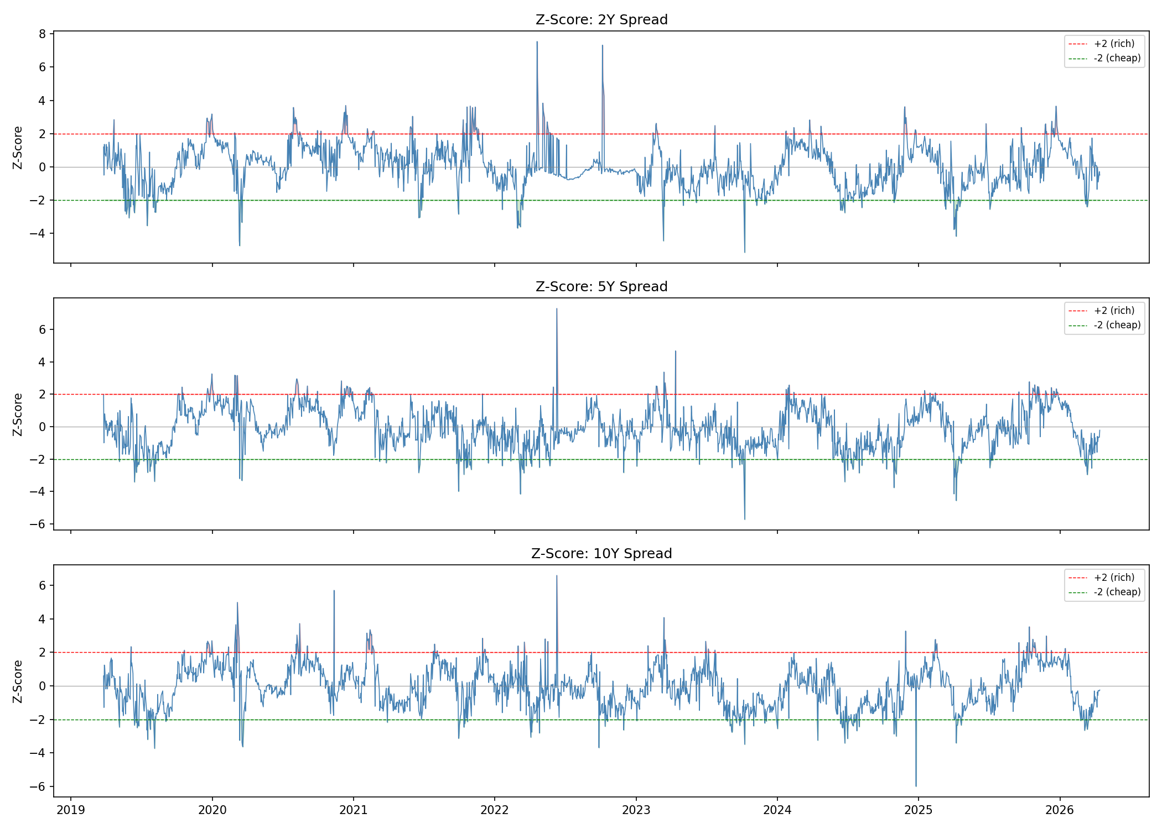
Defining the Dislocation: The 60-Day Z-Score Signal
GSAM
Quantitative Strategies
Extreme |z| > 2 events isolate the tails where mean reversion should be most visible
60-Day Rolling Z-Score — 5Y OIS–Treasury Spread
HOW TO READ THE SIGNAL
The rolling z-score standardizes each spread observation against its own 60-day history:
zₜ = (sₜ − μ⁶⁰ₜ) / σ⁶⁰ₜ
Breach rates are consistent with a mean-reverting series with moderately fat tails. Events are de-clustered with a minimum 5-business-day gap so one episode doesn't count multiple times.
NON-OVERLAPPING EVENTS
Maturity
z < −2
z > +2
2Y
33
40
5Y
48
37
10Y
44
37
Source: Authors' calculations · FRED (DGS) + LSEG (OIS) · ±2σ thresholds marked as horizontal dashes.
→ 239 non-overlapping events across the panel
Thesis
Data
Evidence
Regimes
Extension
Risks
5 / 17

Slide 6
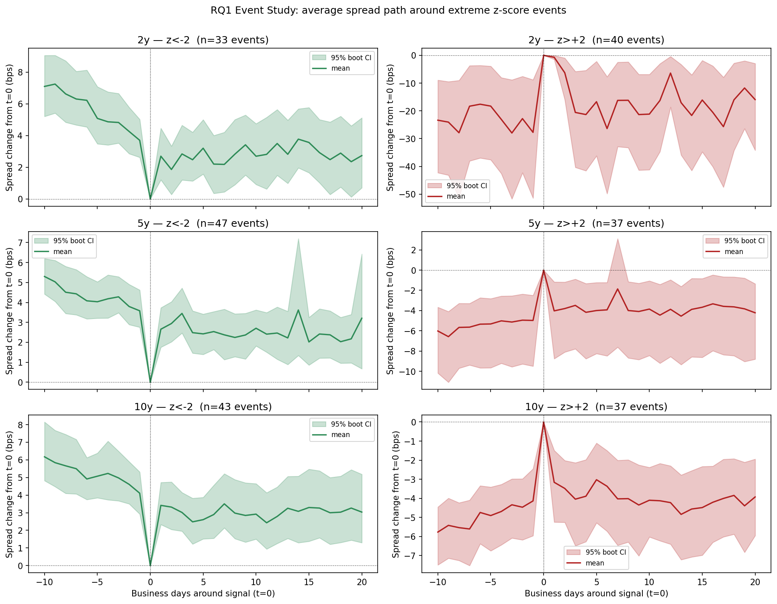
RQ1 — Does the Spread Snap Back?
GSAM
Quantitative Strategies
Average spread path in a 30-day window centered on each ±2σ event
Event Study — 3 maturities × 2 signal directions
INTERPRETATION
In every panel the spread drifts back toward zero — the expected mean-reversion shape, roughly half-complete by day 10.
The visual is consistent with tradable reversion: spreads compressed by ~half their dislocation within two weeks, with relatively stable post-event paths.
Headline stat · 5Y z<−2, 10-day
+2.68 bps
Cohen's d = 0.87 · 95% CI [+1.81, +3.61] → large, consistent, tradable effect (cost: 1 bp round-trip).
METHOD
t-tests + percentile-bootstrap CIs, supplemented with Wilcoxon signed-rank, Cohen's d, and Benjamini–Hochberg FDR correction across the 18-cell grid.
Each panel: average spread path normalized to zero at signal time · Rows = maturities (2Y, 5Y, 10Y) · Cols = signal direction (too-low / too-high).
Thesis
Data
Evidence
Regimes
Extension
Risks
6 / 17

Slide 7
RQ1 — Statistical Evidence
GSAM
Quantitative Strategies
10-day forward change after ±2σ events · all 6 cells carry the predicted sign
TABLE 1 · PRIMARY SPECIFICATION (10-DAY HORIZON)
RQ 1 · VERDICT
Maturity | Signal | n | Mean (bps) | Cohen's d | t-stat | p (BH) | Sig.
2Y | z < −2 | 33 | +2.69 | +0.48 | +2.76 | 0.019 | *
2Y | z > +2 | 40 | −21.17 | −0.37 | −2.35 | 0.039 | *
5Y | z < −2 | 48 | +2.68 | +0.87 | +6.02 | <0.001 | ***
5Y | z > +2 | 37 | −3.85 | −0.33 | −2.00 | 0.055 | .
10Y | z < −2 | 44 | +2.94 | +0.53 | +3.53 | 0.003 | **
10Y | z > +2 | 37 | −4.10 | −0.63 | −3.85 | 0.002 | **
Confirmed.
Mean reversion is present, practically meaningful, and statistically robust across maturities and signal directions.
18 / 18
cells with predicted sign
Sig. codes: *** p<0.001 ** p<0.01 * p<0.05 . p<0.10
12 / 18
KEY TAKEAWAYS
significant after BH-FDR
• All 18 cells (full grid, see Appendix) show the sign predicted by mean reversion.
• 12 of 18 survive Benjamini–Hochberg FDR correction at q < 0.05 — controls false positives across families.
• Largest, most consistent effect at 5Y z < −2 (Cohen's d = 0.87) — conventionally a large effect and economically actionable vs. a 1 bp round-trip cost.
• 2Y z > +2 shows a statistically significant −21 bps, but is dominated by LSEG 2022 quoting artifacts; 5Y and 10Y are the clean read.
d = 0.87
peak Cohen's d (5Y z<−2)
+2.68 bps
10-day mean reversion, 5Y
Thesis
Data
Evidence
Regimes
Extension
Risks
7 / 17

Slide 8
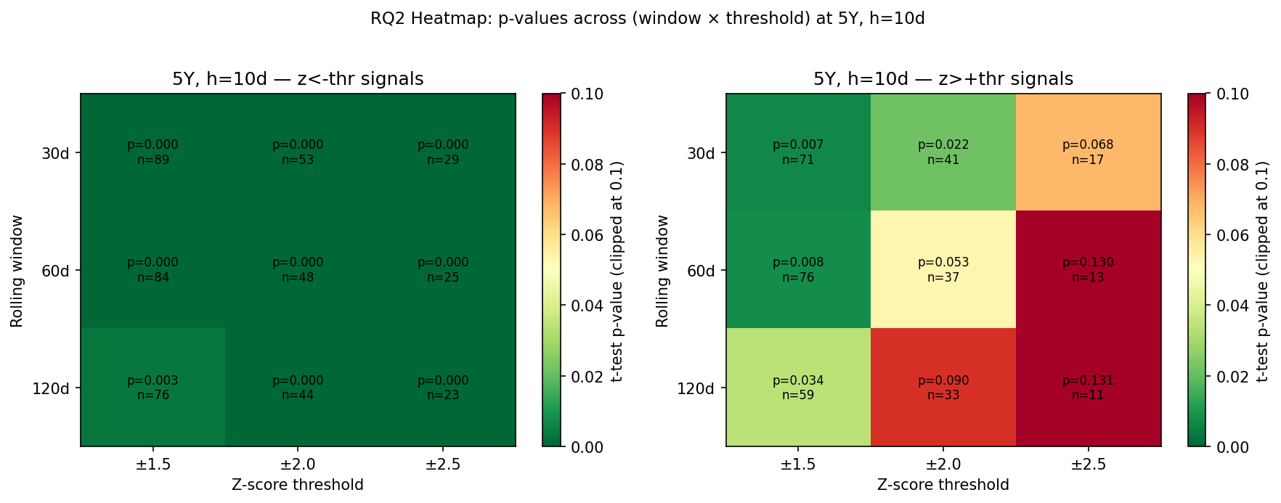
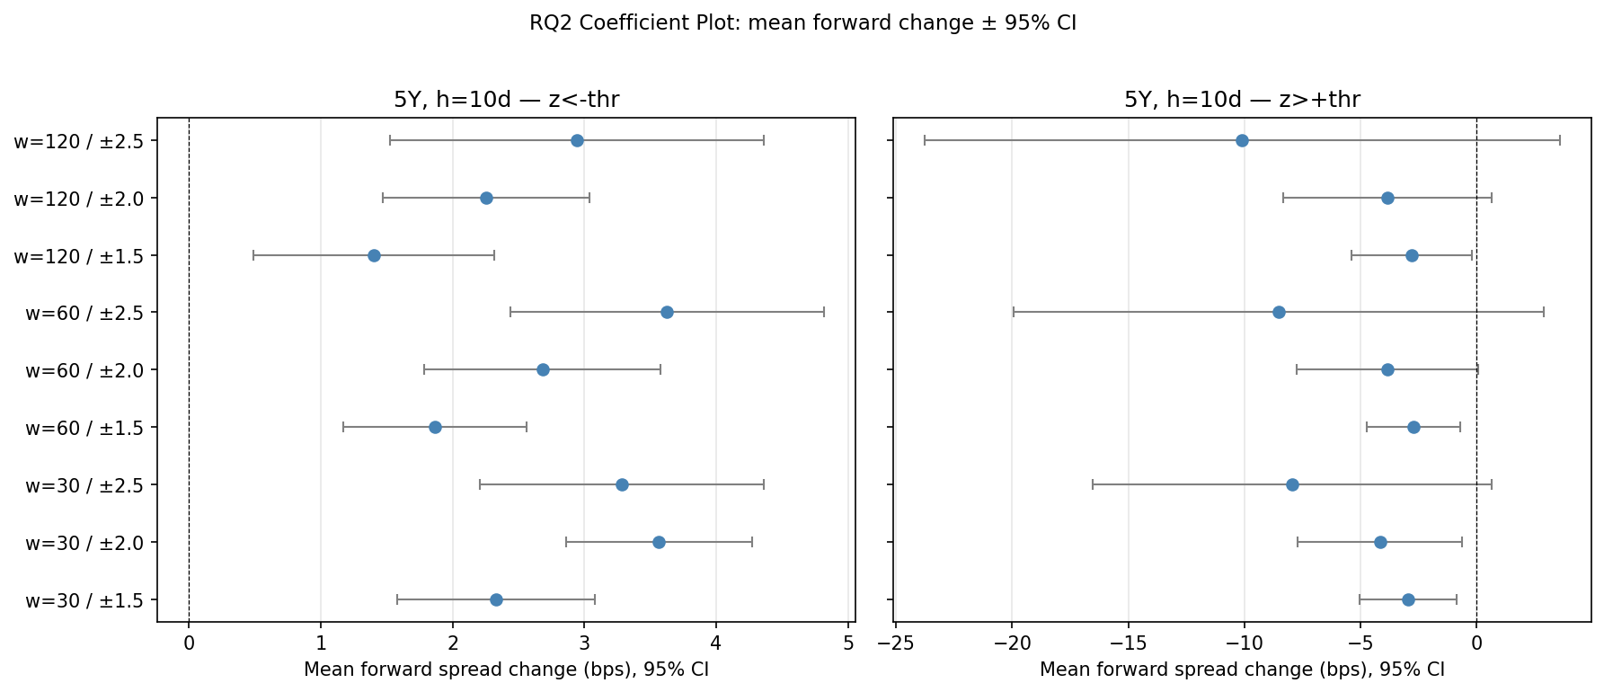
RQ2 — Is It a Parameter Tuning Artifact?
GSAM
Quantitative Strategies
162 combinations of rolling-window × z-threshold × forward horizon · with BH-FDR throughout
5Y × 10-day horizon — p-value heatmap across window (rows) × threshold (cols)
GRID STABILITY SUMMARY
Quantity | Value
Total combinations | 162
Sign predicted by reversion | 162 (100%)
Survive BH-FDR at q < 0.05 | 118 (73%)
Range across window levels | 2.83 bps
Range across threshold levels | 2.72 bps
Range across horizon levels | 0.64 bps
RQ 2 · VERDICT
Structural, not a tuning artifact.
Coefficient stability · mean forward change (bps) with 95% CIs across 9 (window, threshold) pairs
The sign never flips across any combination of rolling window, z-threshold, or forward horizon. Magnitude varies by ≤3 bps.
Thesis
Data
Evidence
Regimes
Extension
Risks
8 / 17

Slide 9
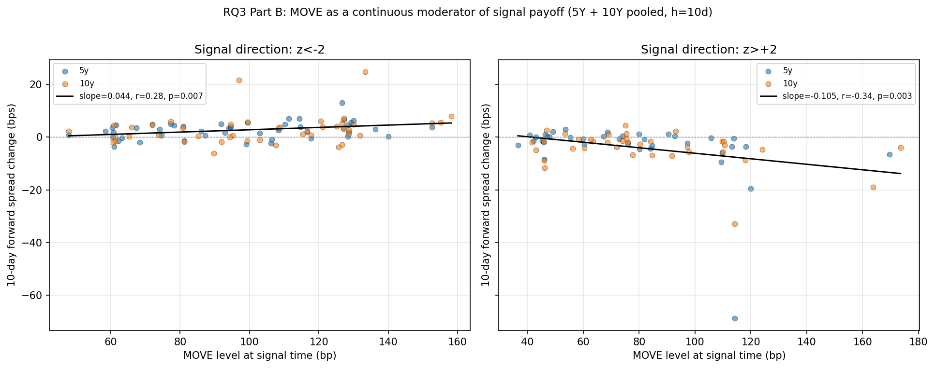
RQ3 — Regime Dependence: Which Macro Factor Matters?
GSAM
Quantitative Strategies
Two-way ANOVA decomposing reversion variance across rate regime × volatility regime
TWO-WAY ANOVA · 5Y SIGNALS
EFFECT DECOMPOSITION
Signal | Term | F | p | partial η²
z < −2 | rate_regime | 17.26 | < 0.001 | 0.282
z < −2 | vol_regime | 0.01 | 0.930 | 0.000
z < −2 | rate × vol | 0.78 | 0.383 | 0.017
z > +2 | rate_regime | 6.59 | 0.015 | 0.167
z > +2 | vol_regime | 0.42 | 0.521 | 0.013
z > +2 | rate × vol | 2.16 | 0.151 | 0.062
RATE REGIME
η² = 0.28
Large effect — spreads behave differently when the Fed is hiking vs. cutting.
VOLATILITY REGIME
η² ≈ 0.00
Green cells mark the statistically dominant driver — rate regime explains ≈28% of variance in 5Y reversion size.
No binary effect. Continuous MOVE level still matters (see scatter, r ≈ −0.34).
MOVE vs. 10-day forward change (5Y/10Y events pooled) — continuous relationship, negative slope
RQ 3 · VERDICT
Rates matter. Vol (binary) does not.
Rising-rate periods generate ~3× larger reversion (+5.40 vs +1.67 bps at 5Y z<−2) — the actionable conditioning variable.
Thesis
Data
Evidence
Regimes
Extension
Risks
9 / 17

Slide 10
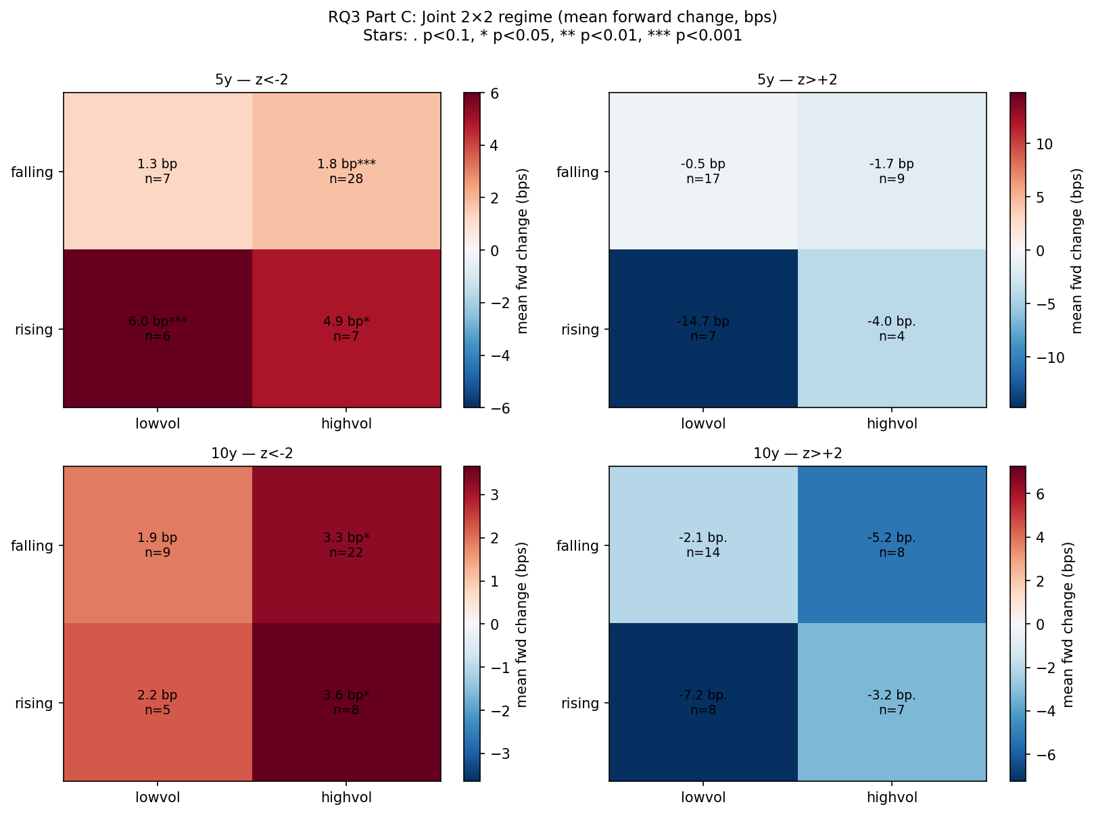
RQ3 — Rate Regime Is the Actionable Conditioning Variable
GSAM
Quantitative Strategies
Rising-rate environments amplify mean reversion by ~3× at 5Y
RATE-REGIME SPLIT · MEAN 10-DAY FORWARD CHANGE (BPS)
Joint regime heatmap (mean 10-day Δ, bps)
Maturity | Signal | Rising rates | Falling rates | p (diff) | Cohen's d
5Y | z < −2 | +5.40 (n=13) | +1.67 (n=35) | 0.001 | 1.21
5Y | z > +2 | −10.84 (n=11) | −0.89 (n=26) | 0.131 | −0.85
10Y | z < −2 | +3.11 (n=13) | +2.86 (n=31) | 0.869 | 0.04
10Y | z > +2 | −5.37 (n=15) | −3.23 (n=22) | 0.371 | −0.33
5Y z < −2 · Rising-rate reversion is +5.40 bps vs +1.67 bps in falling-rate periods → 3.2× larger.
Cohen's d = 1.21 (very large). p < 0.001 for the between-regime difference. Tight confidence intervals support trading on this split.
WHY RISING RATES AMPLIFY REVERSION
• Balance-sheet constraints intensify when short-rate funding costs climb, forcing dealers to close stale RV positions.
• Swap-spread narrowing on hikes brings OIS and Treasuries back toward their long-run offset faster than in cut cycles.
• Consistent with RQ3 Part B: at the continuous level, higher MOVE is also associated with larger snap-back for positive-z signals.
Thesis
Data
Evidence
Regimes
Extension
Risks
10 / 17

Slide 11
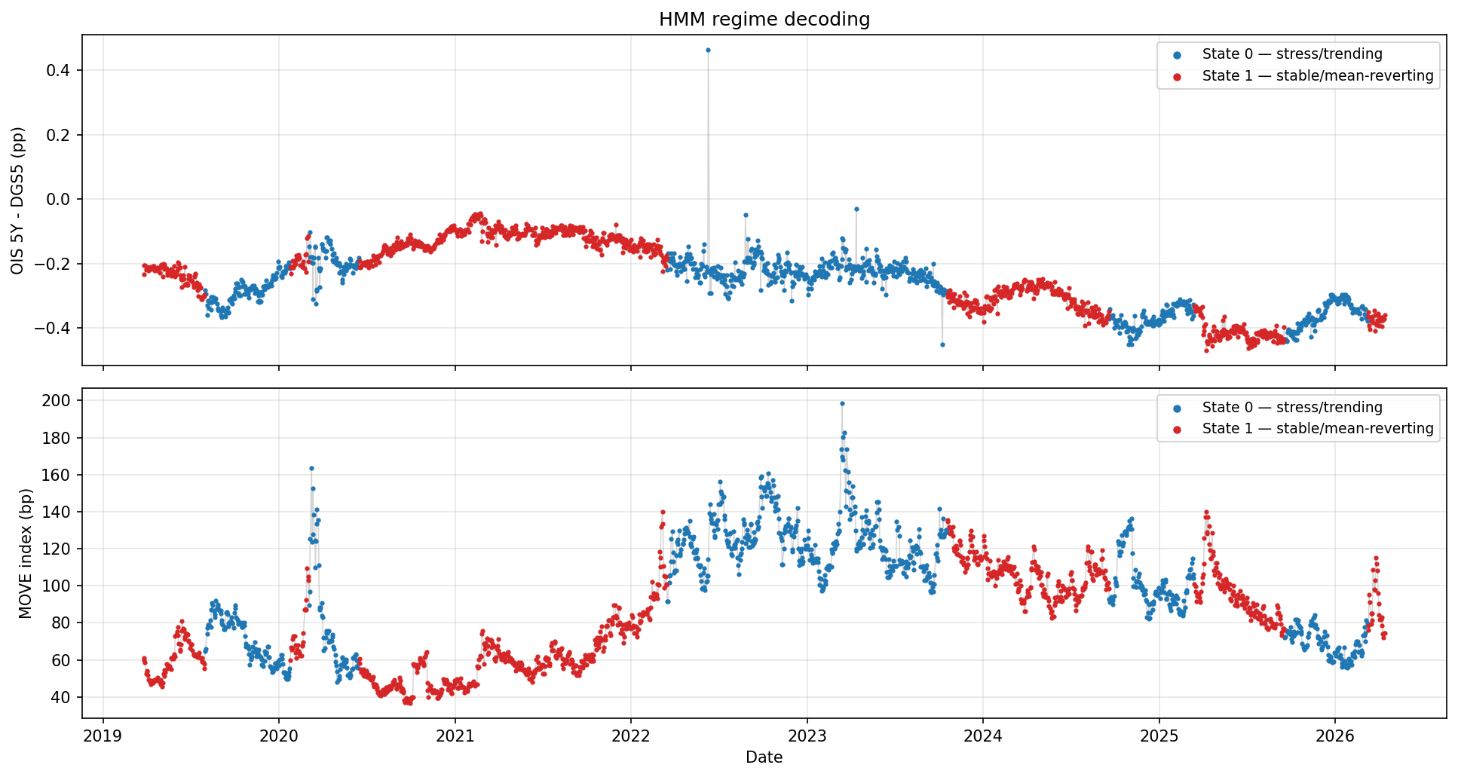
Applied Extension — Unsupervised Regime Detection via HMM
GSAM
Quantitative Strategies
2-state Gaussian HMM on (spread_5y, 60-day EFFR change) · Baum–Welch fit, Viterbi decoding
Viterbi-decoded states aligned with 5Y spread (top) and MOVE (bottom)
STATE DIAGNOSTICS
State | n | % Rising | Mean MOVE | Mean 5Y sp.
0 · Stress | 856 | 48.1% | 101.3 | −0.269
1 · Stable | 973 | 18.3% | 77.6 | −0.229
TRANSITION MATRIX
 | to S0 | to S1
from S0 | 0.994 | 0.006
from S1 | 0.005 | 0.995
Expected dwell ≈ 171 / 194 days → slow, structural shifts a fixed-income desk can condition on.
LOOK-AHEAD CHECK
100%
OOS state agreement between full-sample and pre-2024-only fits (n = 591 days) — no look-ahead bias.
State 0 (stress/trending) concentrates in high-MOVE episodes; State 1 (stable/mean-reverting) in calm markets.
Thesis
Data
Evidence
Regimes
Extension
Risks
11 / 17

Slide 12
Same Signal, Two Representations — Why RF Hurts and HMM Helps
GSAM
Quantitative Strategies
Tree-splits on a continuous hmm_state feature destroy information; a binary trade-gate preserves it
RANDOM FOREST · continuous feature
HMM · binary trade gate (trade only in State 1)
AUC
ΔAUC from adding hmm_state
Sharpe (OOS)
Win-rate
0.544
−0.122
0.39 → 0.51
55% → 73%
barely above chance
regime signal actively hurts the classifier
+0.12 vs. rules-based baseline
trading 55% as many events
Feature set | Test AUC
Full (10 features) | 0.544
Full minus hmm_state | 0.667
Logistic Regression baseline | 0.400
Naïve majority class | 0.500
HMM state at entry | Trades | Win % | Mean (bps) | Total (bps)
State 1 · Stable | 11 | 72.7 | +1.55 | +17.1
State 0 · Stress | 9 | 33.3 | −0.08 | −0.7
Why it works
• HMM is fit to market dynamics (spread + rate change), not to scarce event labels.
• Binary gate ≡ skip State-0 trades. All 9 stress-state trades produced every dollar of drawdown and zero net P&L.
• Same underlying entry signal — no refitting of the trigger.
Why it fails
• Only 56 training events · 69% majority class
• Trees split at fixed thresholds — can't encode “regime-conditioned structure”
• SHAP: hmm_state contributes ≈ 0 signal relative to MOVE-based features
Thesis
Data
Evidence
Regimes
Extension
Risks
12 / 17

Slide 13
Out-of-Sample Backtest — Three Strategies, One Trigger
GSAM
Quantitative Strategies
2024-01-02 to 2026-03-24 · 29 events · 1 bp round-trip cost · exit at 10 days or z-crossing
PERIOD
EVENTS (OOS)
ROUND-TRIP COST
SHARPE UPLIFT
26 months
29
1 bp
+0.12
TABLE 4 · STRATEGY COMPARISON
Strategy | Trades | Win % | Mean (bps) | Total (bps) | Sharpe | Max DD (bps) | Calmar
1 · Rules-based | 20 | 55.0 | +0.82 | +16.4 | 0.39 | −9.6 | 0.73
2 · RF-filtered | 20 | 55.0 | +0.82 | +16.4 | 0.39 | −9.6 | 0.73
3 · HMM-filtered (S=1) | 11 | 72.7 | +1.55 | +17.1 | 0.51 | −9.4 | 0.78
Strategy 1 · Baseline
Strategy 2 · RF Filter — Inoperative
Strategy 3 · HMM Filter — Skips Drawdown
Fire every ±2σ event with no filter. 55% win rate, 0.39 Sharpe — a tradable but unimpressive rules-based signal.
28 of 29 events clear the RF probability threshold. In practice the filter is a no-op; performance is identical to Strategy 1.
All 9 stress-state trades produced zero net P&L and every bp of drawdown. Skipping them lifts Sharpe to 0.51 and win rate to 73%.
Thesis
Data
Evidence
Regimes
Extension
Risks
13 / 17

Slide 14
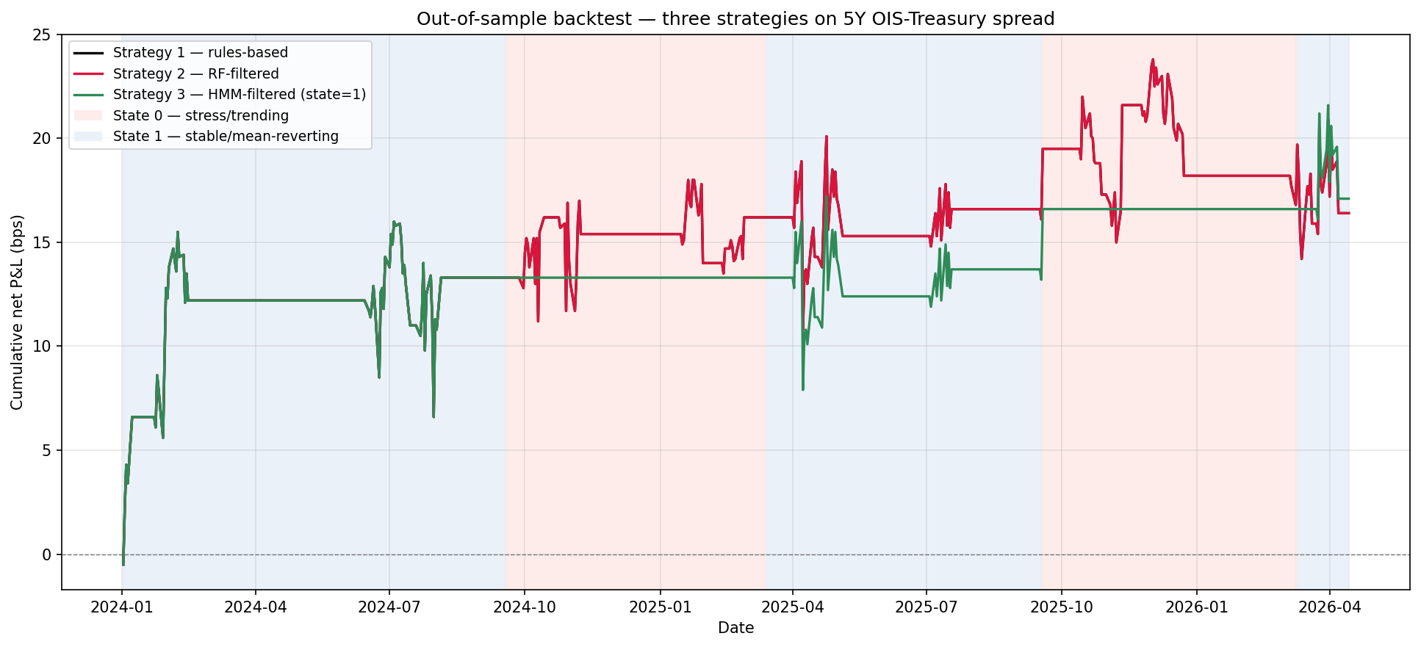
Out-of-Sample Cumulative P&L — The HMM Gate in Action
GSAM
Quantitative Strategies
Red shading = HMM State 0 (stress) · Blue shading = HMM State 1 (stable)
READ THE CURVE: The green line (HMM-filtered) tracks the gray baseline in stable periods and goes flat — not down — during red (stress) shading, avoiding essentially all drawdown while sacrificing 45% of trade count.
Thesis
Data
Evidence
Regimes
Extension
Risks
14 / 17

Slide 15
Central Finding
GSAM
Quantitative Strategies
Representation decides whether a regime signal helps or hurts
The same hmm_state signal that harmed the Random Forest as a continuous feature helped the backtest as a binary trade gate.
WHY THIS MATTERS
• Tree-splits on a continuous state probability destroy the structural prior — the RF can only memorize a 69% majority.
• A binary yes/no gate preserves the prior — regime → trade / no trade.
• When training data is scarce, imposing known structure beats trying to learn it. The HMM encodes the prior; the RF has to discover it from 56 labeled events and can't.
Thesis
Data
Evidence
Regimes
Extension
Risks
15 / 17

Slide 16
Limitations & Future Work
GSAM
Quantitative Strategies
What we can't yet conclude — and where to take this next
LIMITATIONS
FUTURE WORK
Short OOS window
Deeper history
27 months / 29 events is too thin for statistically conclusive strategy comparisons. Sharpe CIs are wide; +0.12 uplift is directional, not proven.
Splice SOFR with LIBOR-OIS pre-2018 to push the panel back to 2010 — adds two full rate cycles and a stress event (COVID).
Tight ML training set
Cross-currency replication
85 total supervised events for a 10-feature classifier — the RF has no choice but to memorize the 69% majority base rate.
Repeat in EUR (ESTR-OIS vs. Bunds) and GBP (SONIA-OIS vs. Gilts) to test whether the USD result generalizes.
2Y data artifacts
Real-time HMM
23 LSEG quoting artifacts in 2022 (spread_2y > 1.0 pp) persist in classical analysis. Kept conservatively; excluded from ML features.
Replace batch Baum-Welch with an online filter so the state assignment updates daily without a recompute over the full sample.
Stylized costs
Richer ML
1 bp flat round-trip assumes DV01-matched, no slippage, and ignores bid-ask widening in the exact stress periods the HMM filters out.
Pool events across maturities (≈150 obs), add non-linear kernels, or use gradient-boosted trees with monotonic constraints on MOVE.
Amplification risk
Production wrapper
At scale, systematic RV strategies can amplify the dislocations they trade — worth monitoring in any live deployment.
Add DV01-matched sizing, bid-ask aware cost modeling, and a capacity / amplification monitor before any live deployment.
Thesis
Data
Evidence
Regimes
Extension
Risks
16 / 17

Slide 17
Conclusion
GSAM
Quantitative Strategies
Four research questions, one consistent story
RQ 1
RQ 2
RQ 3
EXT
Confirmed
Robust
Rate-driven
HMM > RF
Mean reversion is present, large (d = 0.87 at 5Y), and survives BH-FDR.
Predicted sign holds across 100% of 162 parameter cells.
Rising rates triple reversion; volatility regime is a null finding.
Binary regime gate lifts Sharpe 0.39 → 0.51; continuous feature hurts.
CLOSING STATEMENT
We find robust mean reversion in OIS–Treasury spreads across 3 maturities, 1,890 daily observations, and 162 parameter combinations. Rate regime is the dominant moderator (partial η² = 0.28 at 5Y); binary volatility is not.
Applied: a 2-state HMM as a binary trade gate raises OOS Sharpe from 0.39 to 0.51 and win-rate from 55% to 73%, while the identical signal hurts a Random Forest. Given scarce labels, imposing known structure beats trying to learn it.
THANK YOU · QUESTIONS?
Chase Leibowitz · Dhruv Trivedi · Jose Maldonado · Felipe Sanchez-Noguera
github.com/crl65/COMPSCI216-Project · Duke CS216 Everything Data · Spring 2026
Thesis
Data
Evidence
Regimes
Extension
Risks
17 / 17

