Slide 1
Mean Reversion in OIS-Treasury Spreads
1,890
daily observations
3
maturities: 2Y / 5Y / 10Y
Evidence, Regime Dependence, and an HMM Trading Filter
Chase Leibowitz (crl65) Dhruv Trivedi (dpt10)
Jose Maldonado (jam348) Felipe Sanchez-Noguera (fs172)
162
robustness cells — 100% pass
CS216 Everything Data · Duke University · April 2026
7 years
of daily data: 2019–2026
Video: [INSERT VIDEO URL]

Slide 2
The OIS-Treasury Spread Is a Measure of Relative Value
Introduction
What is the spread · Why it should mean-revert · Why it matters
WHAT IS THE SPREAD?
s(t,τ) = OIS(t,τ) − DGS(t,τ)
– OIS (Overnight Index Swap): a fixed-for-floating swap where the floating leg tracks compounded SOFR — no principal exchanged, near-zero credit risk
– Treasury CMT yield: the government's borrowing rate at standardized maturities (2Y, 5Y, 10Y)
– Spread = OIS par rate − Treasury CMT yield → almost always negative
– Why negative? Treasuries carry a superior liquidity premium — investors pay up for them, which bids their yields below OIS
−24.7 bps
5Y mean spread
99.9%
days spread is negative (5Y and 10Y)
≥ 2σ
entry threshold for RV trade
1 bp
estimated round-trip transaction cost
WHY SHOULD IT MEAN-REVERT?
– Both instruments price the same forward short-rate path — a persistent gap is a mispricing
– Arbitrageurs enter when spreads drift beyond a threshold, forcing convergence
– Classic relative-value (RV) trade: when spread is too wide or narrow, bet on the snap-back
Headline: OIS trades below Treasuries essentially 100% of the time — but the gap fluctuates. That fluctuation is what we trade.
WHY DOES IT MATTER?
– Pension funds: OIS-Treasury basis affects hedging ratios on liability-matching portfolios
– Corporates: swap-overlay costs are directly tied to this spread
– Fed: the basis is a real-time indicator of Treasury market functioning and stress
2
Introduction

Slide 3
Four Questions Designed to Escalate: Prove → Stress-Test → Explain → Exploit
Introduction
RQ1
RQ2
RQ3
Applied Extension
Mean Reversion
Robustness
Regime Dependence
HMM + Trading
Do OIS-Treasury spreads mean-revert after extreme ±2σ signals, and is the move large enough to trade?
Does the result hold when we change rolling window, threshold, and forward horizon — all 162 combinations?
Does reversion magnitude differ across rate-direction and volatility regimes? Which factor dominates?
Can an unsupervised HMM detect regimes that improve out-of-sample trading vs. a supervised Random Forest?
WHY THIS QUESTION
WHY THIS QUESTION
WHY THIS QUESTION
WHY THIS QUESTION
Before building a strategy, we need to know the signal is real and not a statistical artifact.
A result that depends on parameter choice is fragile. We need to know it holds everywhere.
Understanding when the signal is strongest determines position sizing and trade timing in practice.
Tests whether ML adds value beyond a simple rules-based approach — and if so, what kind of ML.
Taken together: we establish the effect, prove it is structural, identify when it is strongest, then test whether ML can systematically capture it.
3
Introduction

Slide 4
Two Independent Sources, 1,890 Daily Observations, 2019–2026
Data
Sources · Cleaning · Construction · Key decisions
DATA SOURCES
Source | Ticker / Series | Content | Role in This Analysis
FRED | DGS2, DGS5, DGS10 | U.S. Treasury CMT yields at 2Y, 5Y, 10Y | Benchmark yields — the right-hand side of the spread
FRED | EFFR | Effective Fed Funds Rate (daily) | Rate-regime classifier: rising vs. falling
LSEG | USDOIS2/5/10Y=PYNY | SOFR OIS par rates (bid/ask mid) | Swap rates — the left-hand side of the spread
LSEG | .MOVE | ICE BofA MOVE Index — implied Treasury vol | Volatility regime
CLEANING & CONSTRUCTION
PANEL SUMMARY
– FRED: sentinel "." on U.S. holidays → NaN before any calculation
– LSEG: multi-row CSV header parsed dynamically; OIS mid = (Bid + Ask) / 2
– Inner join by date; 5-day forward-fill for holidays where OIS trades but Treasury is closed
– Spread: s(t,τ) = OIS(t,τ) − DGS(t,τ) | Signal: 60-day rolling z-score
– 2Y artifact: 23 dates with spread > 1 pp (LSEG quoting error, April–Oct 2022) → kept in classical tests, excluded from ML
Spread | Mean | Std | % Neg
2Y | −9.3 bps | 25.8 bps | 82%
5Y | −24.7 bps | 10.0 bps | ≈100%
10Y | −33.6 bps | 13.3 bps | ≈100%
KEY DESIGN CHOICES
Decision | Value | Rationale
Rolling window | 60 business days | ≈3 months; balances reactivity and stability
Signal threshold | |z| > 2 | Standard RV entry trigger
Non-overlap filter | 5-day gap | Prevents double-counting the same episode
Forward horizons | 5, 10, 20 days | RQ2 robustness; main analysis uses 10-day
4
Data

Slide 5
RQ1: Spreads Mean-Revert — the Effect Is Large Enough to Trade
Results
Statistical + economic significance at 10-day horizon
TABLE 1 — RQ1 SUMMARY (10-DAY HORIZON, ALL MATURITIES)
KEY FINDINGS
Maturity | Signal | n | Mean ∆ (bps) | Cohen's d | t-stat | p (BH-FDR) | Sig
2Y | z < −2 | 33 | +2.69 | +0.48 | +2.76 | 0.019 | ★
2Y | z > +2 | 40 | −21.17 | −0.37 | −2.35 | 0.039 | ★
5Y | z < −2 | 48 | +2.68 | +0.87 | +6.02 | <0.001 | ★★★
5Y | z > +2 | 37 | −3.85 | −0.33 | −2.00 | 0.055 | —
10Y | z < −2 | 44 | +2.94 | +0.53 | +3.53 | 0.003 | ★★
10Y | z > +2 | 37 | −4.10 | −0.63 | −3.85 | 0.002 | ★★
100%
of 18 cells show predicted sign
12/18
cells survive FDR correction
BH-FDR = Benjamini-Hochberg false discovery rate correction applied across all 18 cells (3 maturities × 2 directions × 3 horizons).
INTERPRETATION
0.87
Cohen's d at 5Y ("large" effect)
Maturity | Best Signal | Reversion (10d) | Interpretation
5Y | z < −2 | +2.68 bps (d=0.87) | Exceeds 1 bp round-trip cost → economically tradable
10Y | z > +2 | −4.10 bps (d=0.63) | Large snap-back; most consistent two-sided signal
2Y | z > +2 | −21.17 bps (d=0.37) | Dominated by LSEG quoting artifacts — treat cautiously
The 5Y z<−2 signal produces a +2.68 bps mean reversion over 10 days (95% CI: [+1.81, +3.61]). That is larger than the 1 bp round-trip cost — the signal is real and tradable.
5
Results

Slide 6
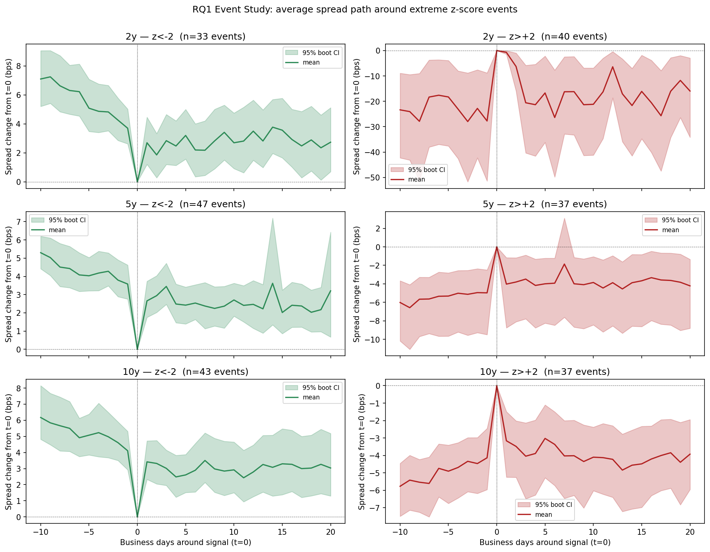
Every Maturity, Every Direction Shows the Same V-Shape Recovery
Results
RQ1 Event Study — 30-day window centered on signal date
Each panel: average spread path in a ±15-day window, normalized to 0 at signal date. Rows = maturity; columns = direction (spread too low / too high). In every panel the spread drifts back toward zero — the expected mean-reversion shape, roughly half-complete by day 10.
6
Results

Slide 7
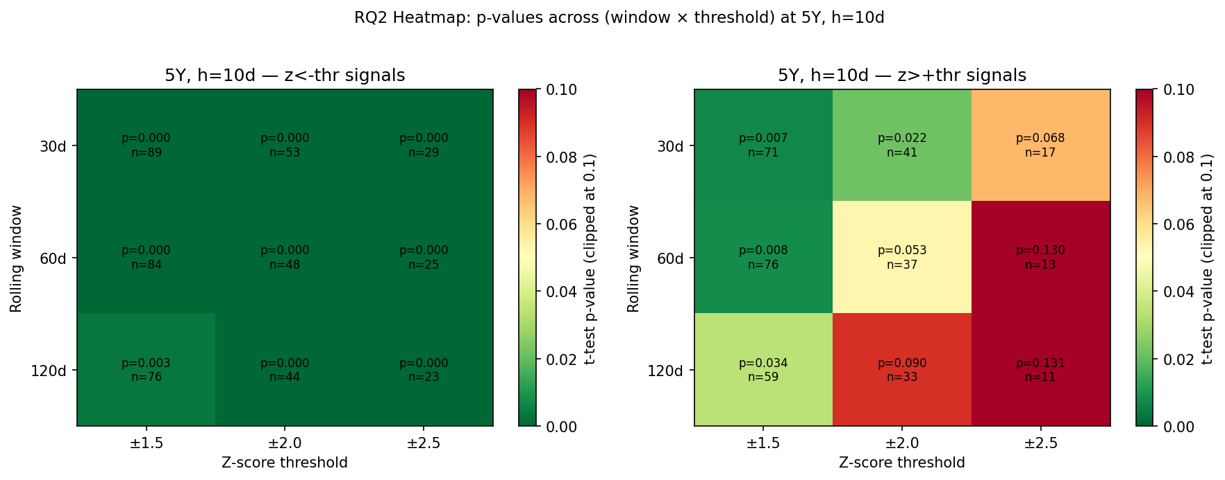
RQ2: Result Holds Across All 162 Parameter Combinations — This Is Structural
Results
Robustness: Window (30–120d) × Threshold (1.5–2.5σ) × Horizon (5–20d)
RQ2 STABILITY SUMMARY
P-VALUE HEATMAP — 5Y SPREAD, 10-DAY HORIZON
Metric | Value
Total parameter combinations | 162
Cells with predicted sign | 162 (100%)
Cells surviving BH-FDR (q < 0.05) | 118 (73%)
Mean reversion range across windows | 2.83 bps
Mean reversion range across thresholds | 2.72 bps
Mean reversion range across horizons | 0.64 bps
PARAMETER GRID TESTED
Parameter | Values Tested
Rolling window | 30, 60, 90, 120 business days
Z-score threshold | |z| > 1.5, 2.0, 2.5
Forward horizon | 5, 10, 20 business days
Green = BH-significant. All 9 window × threshold cells point in the same direction across every horizon.
Conclusion: the direction never flips once. The magnitude barely moves. Mean reversion in OIS-Treasury spreads is a structural property of the market, not a consequence of parameter selection.
7
Results

Slide 8
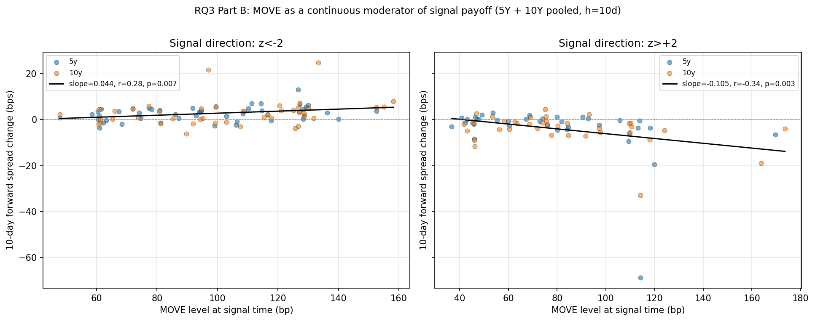
RQ3: Rate Regime Drives Reversion 3× — Volatility Contributes Nothing
Results
Two-way ANOVA: Rate direction × MOVE level on 5Y reversion magnitude
TWO-WAY ANOVA — 5Y SPREAD
MOVE LEVEL VS. 10-DAY REVERSION (CONTINUOUS)
Factor | F-stat | p-value | Partial η² | Verdict
Rate regime (rising vs. falling EFFR) | 17.26 | <0.001 | 0.282 | Explains 28% of variance ← dominant
Vol regime (MOVE above/below median) | 0.01 | 0.930 | 0.000 | Explains 0% — no effect
Rate × Vol interaction | 0.78 | 0.383 | 0.017 | No interaction effect
REVERSION SIZE BY RATE REGIME (5Y, Z < −2, 10-DAY)
Rate Environment | n | Mean Reversion | Cohen's d
Rising EFFR (rates climbing) | 13 | +5.40 bps | 1.21 (very large)
Falling EFFR (rates easing) | 35 | +1.67 bps | —
Rising-rate environments produce 3× larger mean reversion (p=0.001, d=1.21 — a very large effect size).
Why? When rates are rising, the OIS-Treasury spread is under fundamentally different tension — the basis is being actively repriced by the market. That tension produces larger, faster snap-backs. Volatility (MOVE) matters continuously (see scatter, right) but vanishes as a binary split. Conditioning on rate direction captures the regime effect cleanly.
OLS slope < 0, r ≈ −0.34 (positive-z signals). Higher vol → larger snap-back. A binary split misses this; the continuous level matters.
8
Results

Slide 9
Can ML Improve on a Simple Rules-Based Entry? Two Approaches Tested
Applied Extension
Supervised: Random Forest classifier · Unsupervised: 2-state Gaussian HMM
Strategy 1
Strategy 2
Strategy 3
Rules-Based Baseline
Random Forest Filter
HMM Filter
Enter any time |z| > 2. No ML — pure signal.
Enter only when RF predicts spread reverts ≥3 bps in 10 days. Supervised: needs outcome labels.
Enter only in HMM 'stable' state (State 1). Unsupervised: no outcome labels needed.
Why: Establishes what a mechanical strategy achieves with no additional information.
Why: Tests whether predicting individual trade outcomes improves performance.
Why: Tests whether detecting latent market regime improves performance.
THE CENTRAL TENSION
 | As RF feature (continuous) | As HMM gate (binary)
hmm_state signal | AUC drops −0.12 (hurts classifier) | Sharpe rises +0.12 (helps trading)
Same signal. Opposite result. The question is why — and the answer is about how the signal is represented, not how sophisticated the model is.
9
Applied Extension

Slide 10
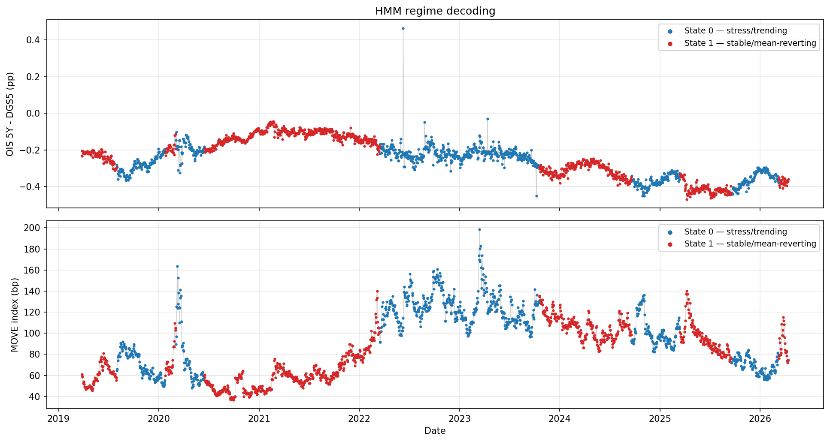
HMM Identifies Two Persistent, Economically Meaningful Regimes
Applied Extension
2-state Gaussian HMM · Baum-Welch estimation · Viterbi decoding
STATE DIAGNOSTICS
REGIME DECODING (VITERBI)
 | State 0 — Stress | State 1 — Stable
Days in state | 856 | 973
% Rising EFFR | 48.1% | 18.3%
Mean MOVE | 101.3 | 77.6
Mean 5Y spread | −0.269 pp | −0.229 pp
Avg dwell time | ~171 days | ~194 days
TRANSITION MATRIX
 | → State 0 (Stress) | → State 1 (Stable)
From State 0 | 0.994 | 0.006
From State 1 | 0.005 | 0.995
Once in a state, probability of staying is >99%. States persist for months — slow structural shifts a desk can actually condition on.
No look-ahead bias: refitting HMM on pre-2024 data only → 100% identical OOS state assignments (n=591 days). The regime structure is not an in-sample artifact.
Top: 5Y spread colored by state. Bottom: MOVE by state. State 0 (red) concentrates in high-MOVE stress episodes.
10
Applied Extension

Slide 11
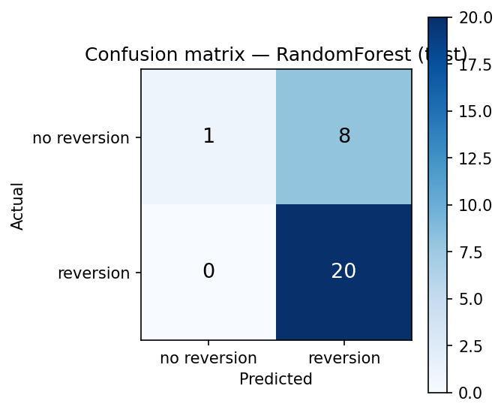
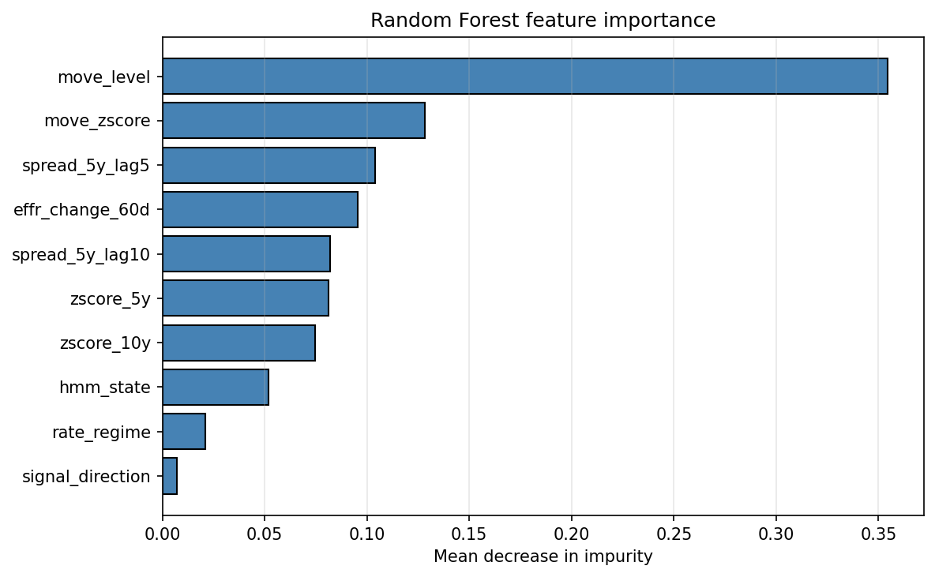
Random Forest Fails — Not by Chance, but by Structure
Applied Extension
56 training events · 69% majority class · hmm_state hurts AUC
OOS PERFORMANCE (29 TEST EVENTS)
CONFUSION MATRIX (OOS)
Model | Accuracy | F1 | ROC AUC
Random Forest (10 features) | 72.4% | 0.833 | 0.544
Logistic Regression | 58.6% | 0.714 | 0.400
Naive (predict majority class) | 69.0% | 0.816 | 0.500
FEATURE ABLATION: ADDING HMM_STATE HURTS RF
Feature Set | Test AUC | vs. Full Model
Full model (10 features) | 0.544 | —
Full minus hmm_state (9 feat.) | 0.667 | +0.122
Naive baseline | 0.500 | —
RF correctly predicts 'yes' on all positives (recall=1.00) but cannot identify negatives — it is not classifying, it is guessing the majority class.
Removing hmm_state improves AUC by 0.12. The regime signal actively hurts the Random Forest.
THREE STRUCTURAL REASONS FOR FAILURE
– Sample size: only 56 training events — no statistical power to learn a 10-feature decision boundary
– Class imbalance: 69% majority class → RF memorizes the base rate and predicts 'yes' on nearly every event
– Wrong representation: hmm_state is a continuous integer in the RF, but it only contains information as a binary gate
FEATURE IMPORTANCE
11
Applied Extension

Slide 12
Backtest: HMM Gate Raises Sharpe 31%; RF Filter Is Inoperative
Applied Extension
Walk-forward OOS: 2024-01-02 → 2026-03-24 · 1 bp round-trip cost · 10-day hold
STRATEGY COMPARISON — 29 SIGNAL EVENTS
Strategy | Trades | Win % | Mean (bps) | Total (bps) | Sharpe | Max DD | Calmar
1 — Rules-Based | 20 | 55.0% | +0.82 | +16.4 | 0.39 | −9.6 bps | 0.73
2 — RF-Filtered | 20 | 55.0% | +0.82 | +16.4 | 0.39 | −9.6 bps | 0.73
3 — HMM-Filtered (S=1) | 11 | 72.7% | +1.55 | +17.1 | 0.51 | −9.4 bps | 0.78
0.39→0.51
Sharpe (+31%)
PER-REGIME BREAKDOWN (STRATEGY 1 TRADES, GROUPED BY HMM STATE AT ENTRY)
55%→73%
Win rate
HMM State at Entry | Trades | Win % | Mean P&L (bps) | Total P&L (bps)
State 1 — Stable | 11 | 72.7% | +1.55 | +17.1
State 0 — Stress | 9 | 33.3% | −0.08 | −0.7
The 9 stress-state trades contributed all of the drawdown and zero net P&L. Strategy 3 simply skips them.
WHY RF = RULES (STRATEGY 2 = STRATEGY 1)
45%
Fewer trades (better efficiency)
RF assigns a positive prediction to 28 of 29 OOS events — it passes everything. The filter is inoperative. This is the expected outcome given the 69% training majority class.
HMM improvement: by skipping stress-state trades, Sharpe rises 0.39 → 0.51, win rate 55% → 73%, and max drawdown marginally improves — without changing a single entry signal.
12
Applied Extension

Slide 13
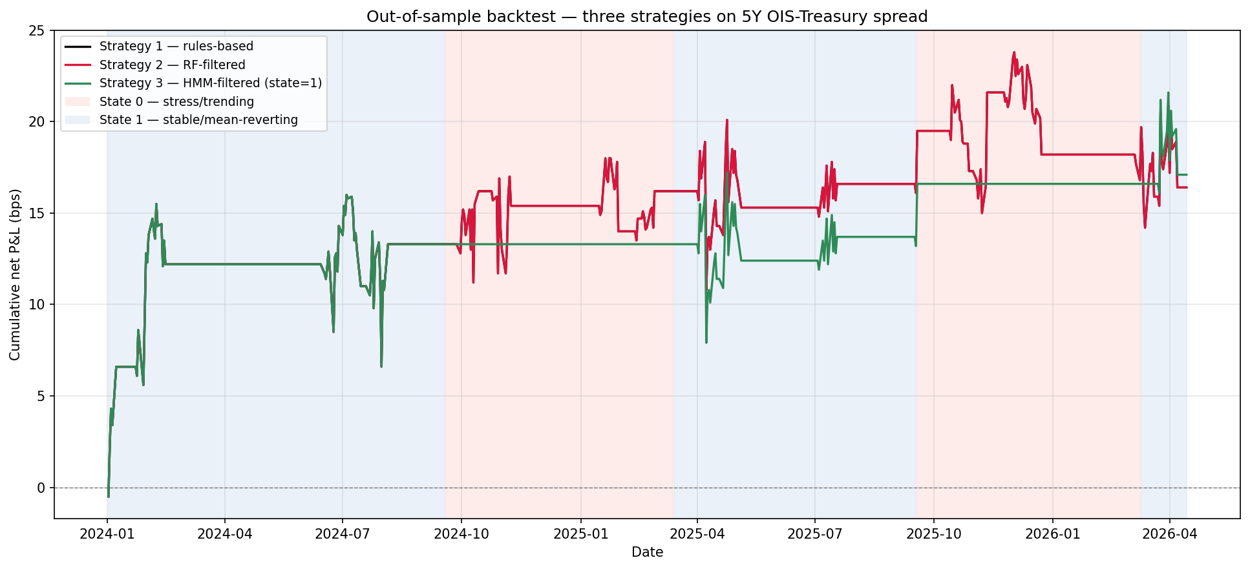
HMM Filter Sidesteps All Stress-Period Losses; RF Tracks the Baseline
Applied Extension
Cumulative P&L — three strategies with HMM regime shading
Background shading: red = HMM Stress (State 0), blue = HMM Stable (State 1). Green (HMM-filtered) avoids stress episodes. Orange (rules-based) and RF-filtered lines overlap — the RF adds nothing. HMM's selective entry produces higher Sharpe without sacrificing total P&L.
13
Applied Extension

Slide 14
Central Finding: How You Represent a Signal Determines Whether You Capture It
Applied Extension
SAME SIGNAL — TWO REPRESENTATIONS — OPPOSITE RESULTS
 | hmm_state as RF Feature (continuous) | hmm_state as Trade Gate (binary)
How used | Integer 0/1 passed as one of 10 features to RF tree splits | Boolean: enter only if state = 1 (stable)
Effect on AUC | −0.122 (removing it improves AUC to 0.667) | N/A — not used in classification
Effect on P&L | Zero — RF filter passes 28 of 29 events anyway | +0.12 Sharpe | +18 pp win rate
Why? | RF can't recover latent structure from 56 sparse outcome labels — it memorizes the majority class | HMM imposes regime structure directly from market dynamics — no outcome labels needed
SUMMARY OF ALL RESULTS
Question | Answer | Key Number
RQ1: Does mean reversion exist? | Yes — in every direction, every maturity | 100% sign consistency; 5Y d=0.87
RQ2: Is it robust? | Yes — 162 combinations, sign never flips | 73% survive FDR; range ≤ 2.83 bps
RQ3: When is it strongest? | Rising-rate regimes, 3× larger reversion | Partial η²=0.28 for rate regime; vol η²=0.000
Applied: does ML add value? | HMM gate yes (+0.12 Sharpe); RF no (inoperative) | Representation > model complexity
"Given scarce labels, imposing known market structure beats trying to learn it from outcomes."
14
Applied Extension

Slide 15
Limitations Are Real — the Core Signal Remains Robust
Limitations & Future Work
CURRENT LIMITATIONS
FUTURE WORK
Limitation | Detail | Impact
OOS window | 27 months, 29 signal events | Sharpe differences are directionally informative but not statistically conclusive
ML training set | 85 events total, 56 after label construction | Too small for a 10-feature RF — structural failure, not tuning failure
2Y artifacts | 23 LSEG quoting errors in 2022 | Retained conservatively in classical tests; excluded from all ML features
Transaction costs | Flat 1 bp round-trip assumed | Real execution would require size-dependent market-impact modeling
WHAT REMAINS ROBUST DESPITE THESE LIMITS
– Mean reversion: 100% sign consistency, 73% FDR survival, across 162 parameter combinations
– Regime dependence: partial η²=0.28 for rate direction — a large, stable effect
– HMM result: directional improvement in Sharpe (+31%) and win rate (+18 pp) with fewer trades
ETHICAL CONSIDERATIONS
At scale, systematic RV strategies add liquidity in stable regimes but may amplify dislocations in the stress-state windows when they trade least — monitoring systemic exposure is essential for any live deployment.
15
Limitations & Future Work
Extension | Expected Value
Extend history to 2010 (SOFR/LIBOR-OIS splice) | 16 years vs. 7 — enough data for conclusive strategy comparisons
Add 1Y and 30Y maturities | Tests whether regime dependence scales with maturity
Real-time HMM filter (recursive, not batch) | Enables live deployment without look-ahead
Replicate in EUR and GBP (€STR OIS, SONIA OIS) | Tests whether structural feature is global
Pool events across maturities for ML | ~250 events — sufficient for proper cross-validation

