Slide 1
HTML Crash-Course
Scope:
An overview for the Process Street Validation

Slide 2
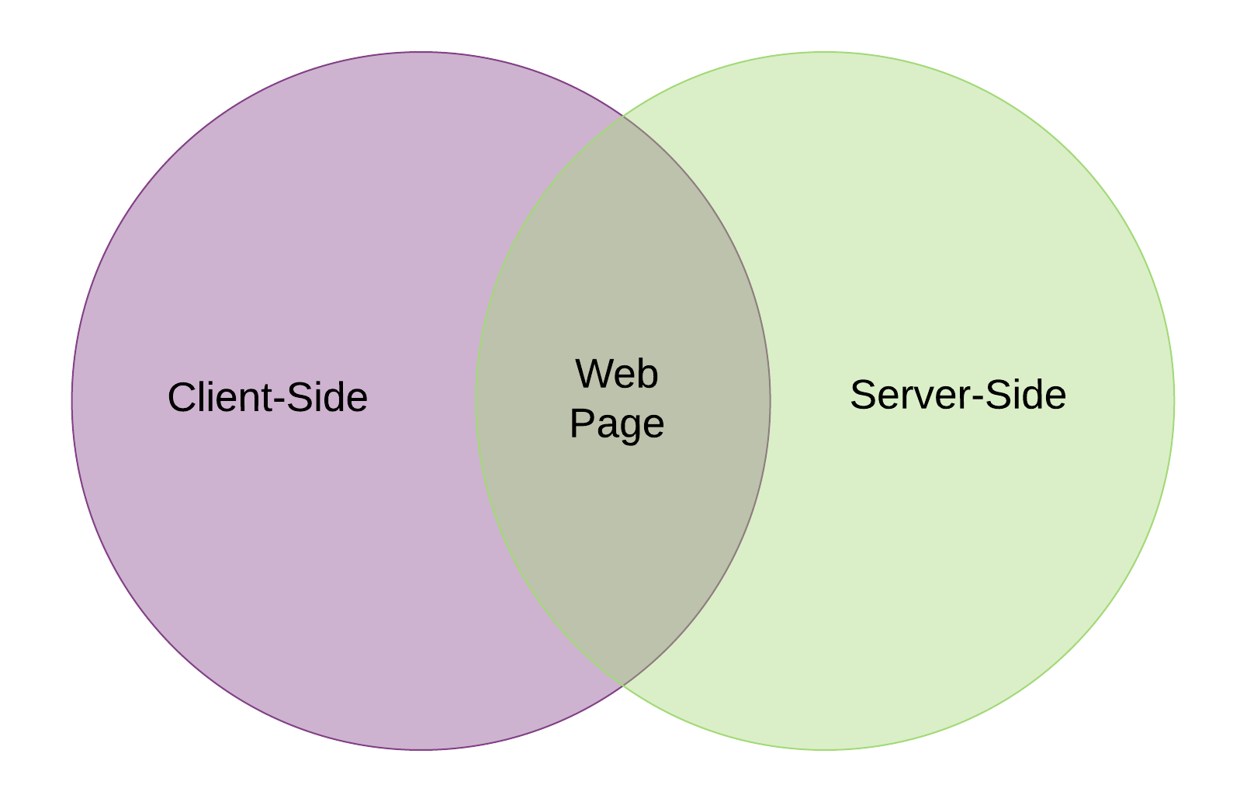
Client Side & Server Side
HTML
CSS
Javascript*
PHP
C#
Java

Slide 3
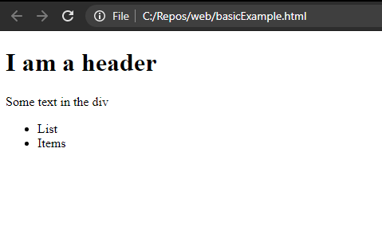
HTML (the content)
basicExample.html
<!DOCTYPE html>
<html>
<head>
<title>Hello World</title>
</head>
<body>
<div>
<h1>I am a header</h1>
Some text in the div
<ul>
<li>List</li>
<li>Items</li>
</ul>
</div>
</body>
</html>

Slide 4
CSS (the style)
style.css
body {
background: white;
font-family: Arial, Helvetica, sans-serif;
font-size: large;
}
h1 {
color:blue;
}
#noShow, .alsoHidden {
display:none;
}

Slide 5
Javascript (the function)
script.js
function showMessage() {
alert("Stop clicking me!");
}
function showText() {
var text = document.querySelectorAll("li");
alert(text);
}

