Slide 1

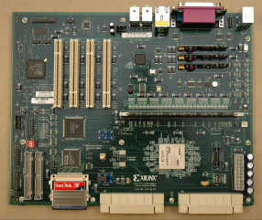
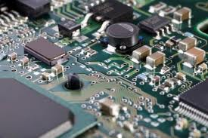
Digital Electronics :
Introduction to hardware design
Cédric Lemaître

Slide 2
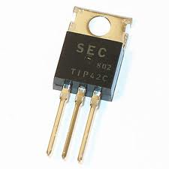
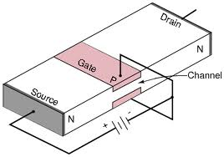
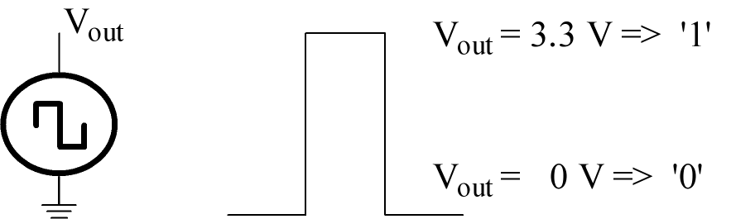
Why Digital Electronics exists ?
Binary representation of the information = Cheaper
 | logic 0 | Logic 1
Transistor n | Passing to ground | blocked
DRAM | decharged capacity | Charged capacity
Optical fiber | No light | light
CD | Raw surface | hole

Slide 3
Digital Electronics
Historic
1938: Digital electronics appears for telephony needs
related to Boole theory (1872) .
NB: Von Neumann have defined the baselines for computer design
1948 : 1st transistor
1962 : 1st integrated circuit (Noyce -> Fairchild)
1971 : 1st 4 bits µ-processor : Intel 4004 -> 2300 transistors
NB: Moore’s law (the transistor number doubles every 18 months)
NB: Moore, co-creator with Noyce of Intel society

Slide 4
Digital Electronics
Historic
1974 :
8080 8bits 2MHz 5000 Transistors (T)
1978 :
8086 16 bits 5MHz 29000 T
1989 :
80486 32 bits 25 MHz 1.18 millions T
2000 :
Pentium iV 256 bits 1.5 GHz 42 millions T
2003 :
  100 millions de T…
Intel Museum: www.intel.com/intel/intelis/museum

Slide 5
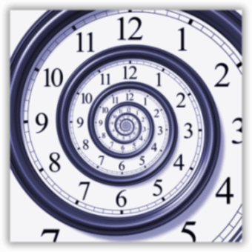
Digital representations & formats
Binary representation of the information
Weighted code (binary, hexadecimal, decimal…)
Non-weighted code (Gray, ASCII…)

Slide 6
Weighted code
B, a base
with b associated symboles {S₀, S₁, S₂, ..., S_{b-1}}
N, a number that can be defined as:
( a_{n} a_{n-1} a_{n-2} ... a₀ , a₋₁ ... a_{-m} ) with a_{i} in {S₀, S₁, S₂, ..., S_{b-1}}
N, polynomial value:
N = ( a_{n} a_{n-1} a_{n-2} ... a₀ , a₋₁ ... a_{-m} )_{b}

Slide 7
Weighted code
N = ( a_{n} a_{n-1} a_{n-2} ... a₀ , a₋₁ ... a_{-m} )_{b}
  a_{i} digit
  b_{i} weight associated with a_{i}
  a_{n} Higher rank digit or Most Significant Digit (MSD)
  a_{-m} Least Significant Digit (LSD)
  (a_{n} a_{n-1} a_{n-2} ... a₀ ) integer part
  (a₋₁ ... a_{-m}) fractional part (<1)

Slide 8
Weighted code
Most commun bases :
Base 2 (or binary) {0,1} digit = bit
(00110101)₂ => byte
Base 8 (or octal)
{0,1,2,3,4,5,6,7}
Base 10 (or decimal)
{0,1,2,3,4,5,6,7,8,9}
Base 16 (ou hexadecimal) {0,1,2,3,4,5,6,7,8,9,A,B,C,D,E,F}

Slide 9
Weighted code examples
(0,45)10 : (0,0111001…)2
For signed number: MSB => sign
(-35,626)10 (with 10 bits interger and fractional parts)
35,625 = 00 0010 0011, 1010 0000 00
-35,625 = 11 1101 1100, 0110 0000 00
Checking :
-2⁹ + 2⁸ + 2⁷ + 2⁶ + 2⁴ + 2³ + 2² + 2⁻² + 2⁻³ =
-512+256+128+64 + 16 +8 +4+0,25 +0125 = -35,625

Slide 10
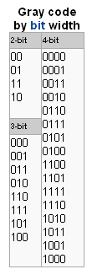
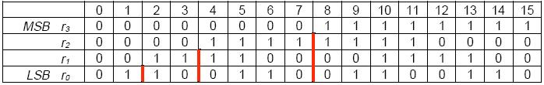
Digital representations & formats
Code de Gray :
ASCII :
American Standard Code for Information Interchange
  26 characters for minuscule letters
  26 characters for majuscule letters
  10 for decimal symbols
  30 for special characters (><%§+_-...

Slide 11
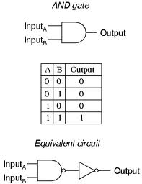
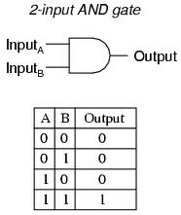
Logic operators
Historic
Binary representation of the information

Slide 12
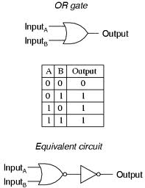
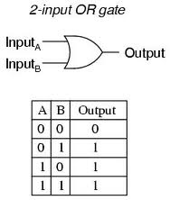
Logic operators
Historic
Binary representation of the information

Slide 13
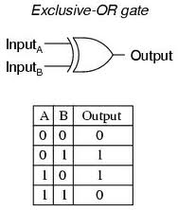
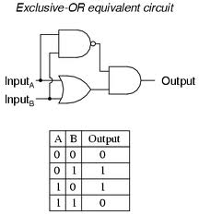
Logic operators
Historic
Binary representation of the information

Slide 14
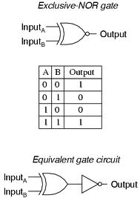
Logic operators
Historic
Binary representation of the information

Slide 15
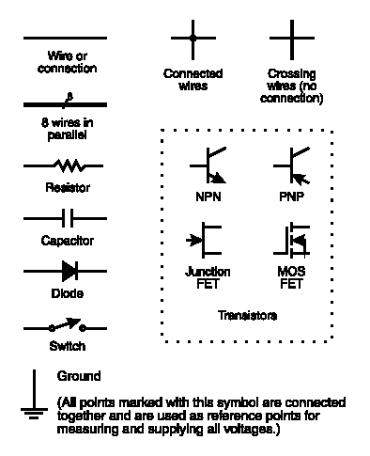
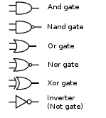
Conventions

Slide 16
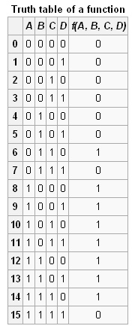

Thank you wikipedia
Logical synthesis
Truth table

Slide 17
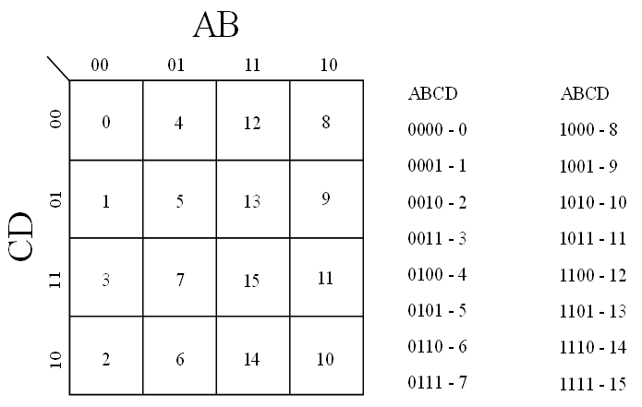
Thank you wikipedia
Logical synthesis
Truth table
Other representation: Karnaugh map

Slide 18
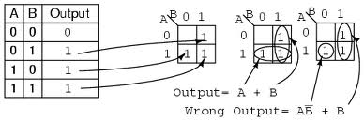
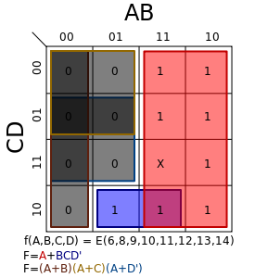
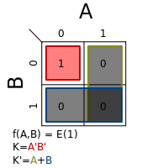
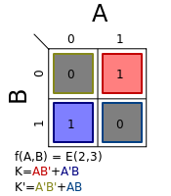
Thank you wikipedia
Logical synthesis
Karnaugh map

Slide 19
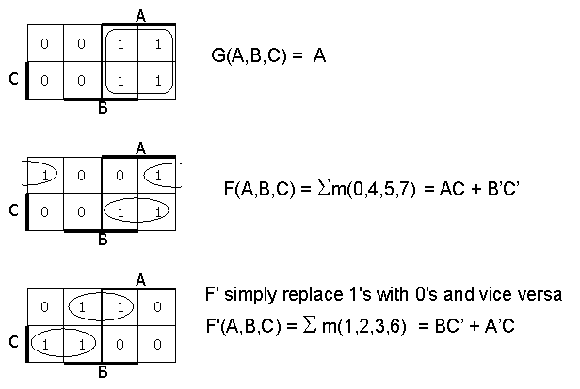
Logical synthesis
Karnaugh map

Slide 20
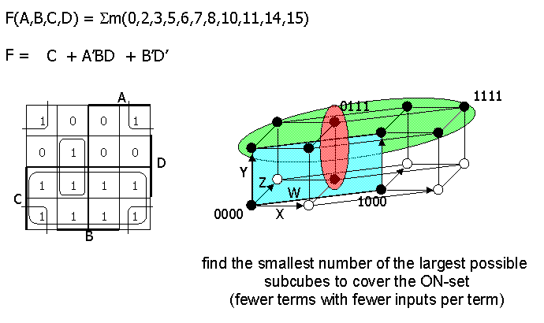
Logical synthesis
Karnaugh map

Slide 21
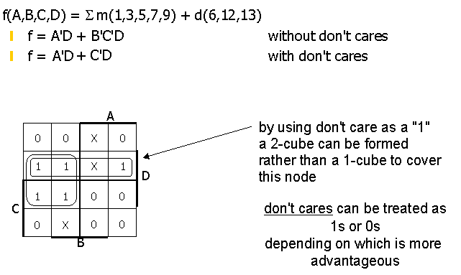
Logical synthesis
Karnaugh map

Slide 22
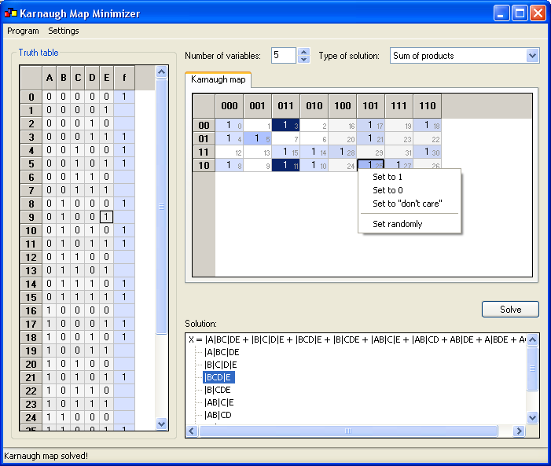
Logical synthesis
Karnaugh map solver
http://www.puz.com/sw/karnaugh/index.htm

Slide 23
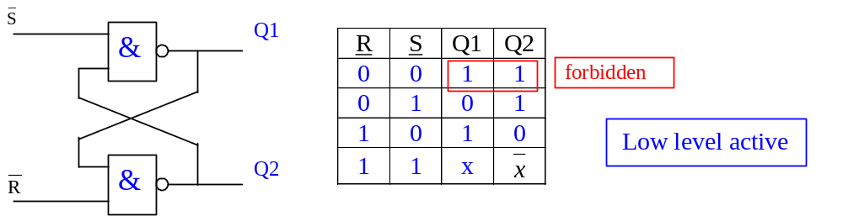
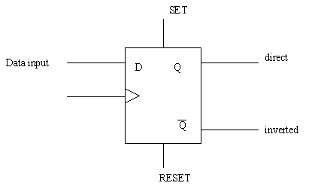
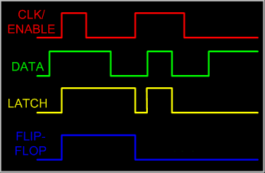
Sequential electronics
D flip-flop
D flip-flop Vs D latch

Slide 24
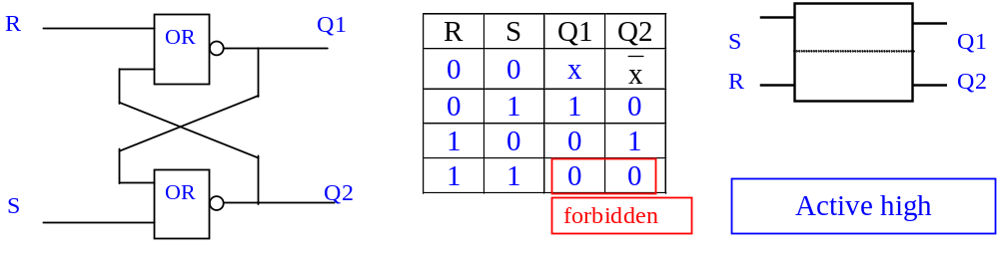
R-S latch

Slide 25
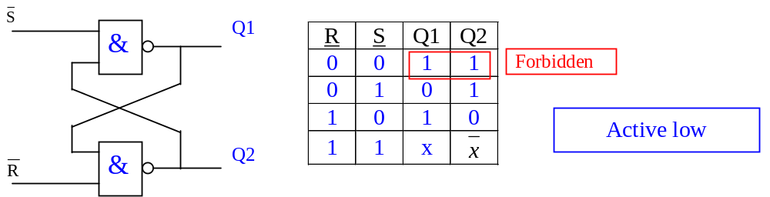
R – S latch

Slide 26
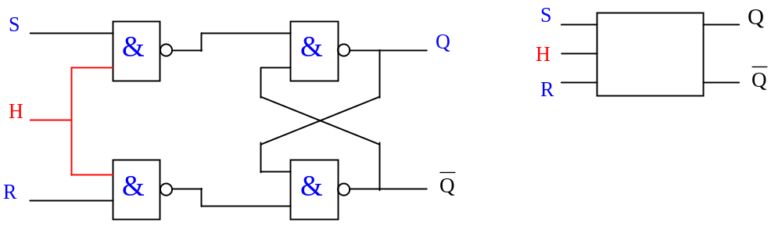
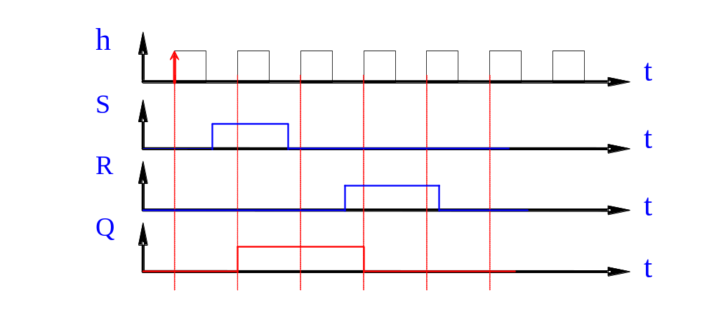


Validation input
R | S | Q
0 | 0 | x
0 | 1 | 1 | 0
1 | 0 | 0 | 1
1 | 1
Forbidden
H is validation input (an enable input) – it is not on front !

Slide 27
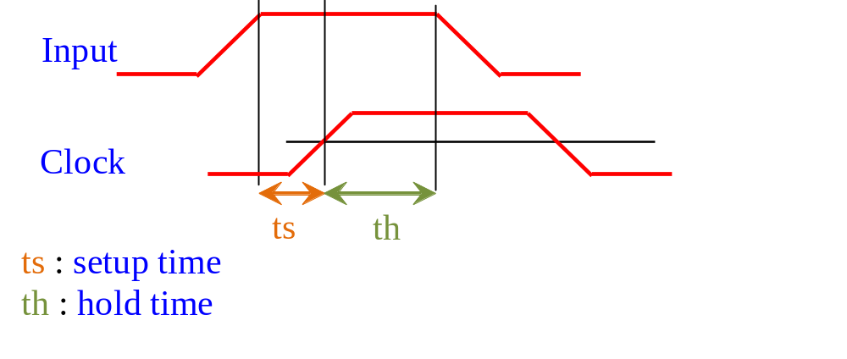
Setup – Hold time

Slide 28
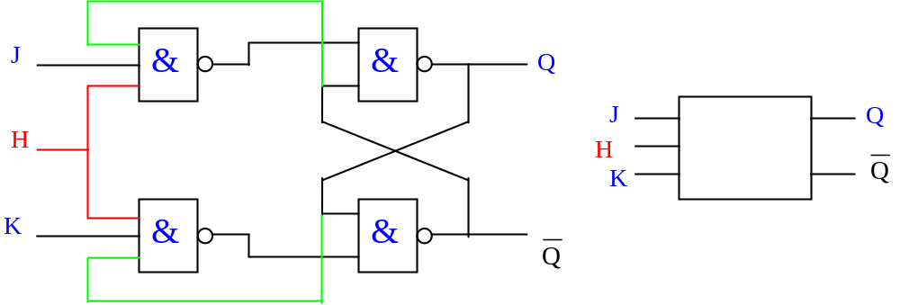
JKH latch

Slide 29
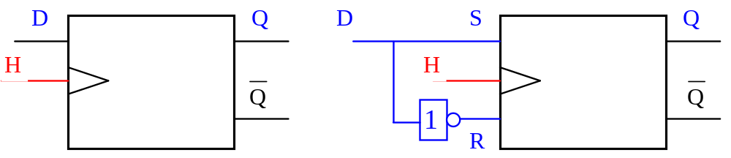
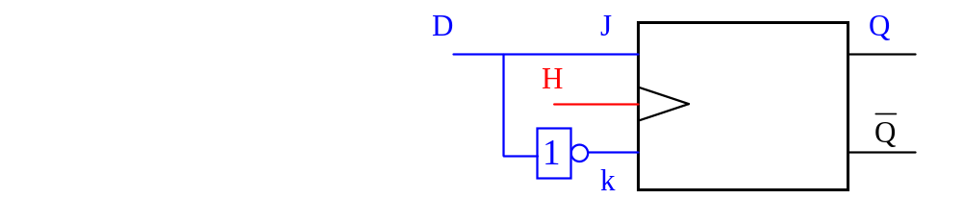
Flip-flop Vs Latch
D Flip-flop
H is a clock input of the D flip-flop
Q is only modified on clock edges

Slide 30
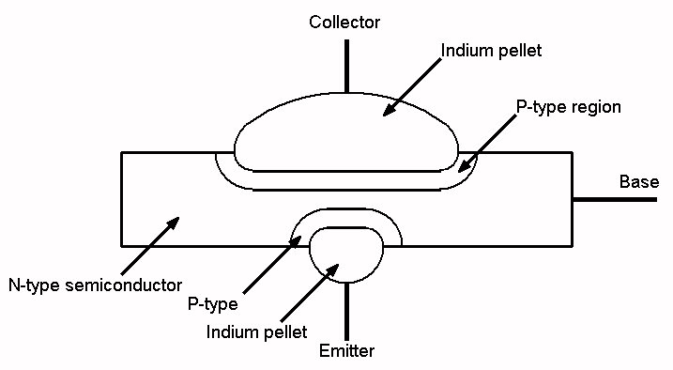
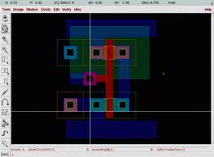
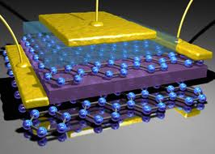
Digital components
PMOS transistors

Slide 31
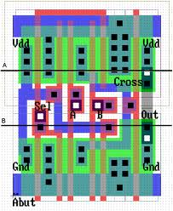

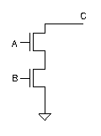
Digital components
Historic
Binary representation of the information

Slide 32
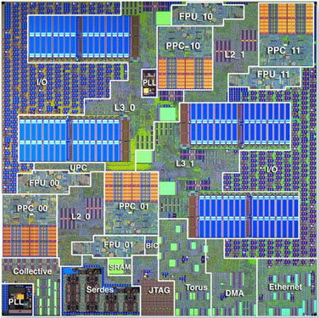
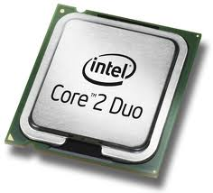
Digital components
Historic
Binary representation of the information

Slide 33
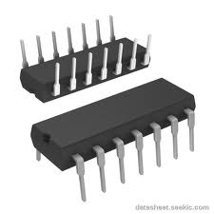
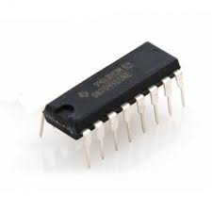
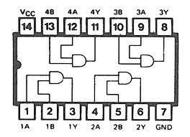
Digital components
Historic
Binary representation of the information
7408

Slide 34
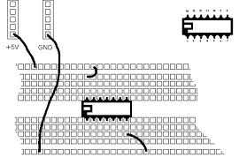
What is digital design?
Logical gate
7408
Digital components
How to associate them?

Slide 35
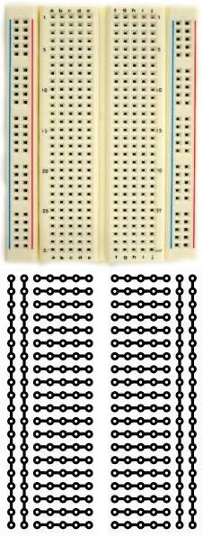


BreadBroad
(in french « plaquette labdec »

Slide 36


How to use a BreadBroad ?

Slide 37
How to connect Digital components ?
7408

Slide 38

Digital components

Slide 39


Digital components
Full Adder

Slide 40




Digital components
Tools for automatic translation to logical component

Slide 41

Loop unrolling (patial or totol)
Before: After:
for i range 0 to 100 do for i range 0 to 100 do
a(i) := a(i) + b(i) a(i) := a(i) + b(i)
i := i + 1 a(i+1) := a(i+1) + b(i+1)
end loop i := i + 2
end loop
Interesting with processing unit!!!

Slide 42



Multiple operators
Reuse operator

Slide 43



Slide 44







T
T+1
T+2
T+3

Slide 45



Slide 46



