Slide 1

WarungAI
Rekod jualan dalam beberapa saat.
A trilingual business workspace for Malaysian warung & hawker stalls — capture every sale in seconds, then turn the ledger into advice.
Hackathon 2026 · Live demo: one click, no signup
Notes:
WarungAI: bookkeeping that keeps up with a food stall. Trilingual, mobile-first. Everything you will see is running live — the Demo Stall loads five weeks of realistic data with one click and no account.

Slide 2



Rush hour doesn't wait for bookkeeping
Warung and hawker stalls run on speed and memory. Tools built for cafés and retail counters do not survive a nasi lemak rush.
Sales live in the head
Profit is a guess
Stock runs out mid-service
No time to write anything down mid-rush. By closing time, the day is a blur of plates and change.
Ingredient prices creep up quietly. A dish can sell below its own cost for weeks before anyone notices.
The first warning is an empty pot and a customer walking away. Restocking is reactive, not planned.
The result: owners work hard all day and still cannot answer "did I make money this week?"
Notes:
The pain is not laziness — it is physics. During a rush there is zero slack for admin. So records never exist, and every downstream decision (pricing, prep, restock) is a guess.

Slide 3



A workspace that keeps up with the stall
Three promises, one pipeline: however a sale is captured, it flows through the same review step into the same ledger.
Capture in seconds
→
Records you can trust
→
Advice you can act on
Type it, say it, tap it, or scan it — four entry modes that match how the stall actually works
Every draft is reviewed before saving. Sales sync stock automatically, and a 10-minute undo forgives rush-hour mistakes.
The ledger becomes weekly stories, profit-leak warnings and tomorrow-prep suggestions — computed on-device, no AI bill.
Notes:
Pillar 2 is the differentiator: capture speed is worthless if the records are wrong. Review-before-save plus undo means speed does not cost accuracy.

Slide 4




Four ways to record a sale
Type it
Say it
"jual 3 nasi lemak rm12" — natural language in BM or English, parsed into product, quantity and price.
Voice entry that follows the app language — ms-MY, en-US or zh-CN — into the same parser as typing.
Busy Mode
Scan it
A tap-grid for rush hour: tap products, pick Cash or QR, save. Stock counts shown on every tile.
Snap a paper receipt — on-device OCR extracts items, quantities and totals. Handwriting included.
One pipeline: every path ends at the same review-and-confirm step — nothing is saved unchecked.
Notes:
Four modes are not four features — they are one pipeline with four doors. Demo order: Busy Mode first (fastest wow), then scan the handwritten receipt.

Slide 5
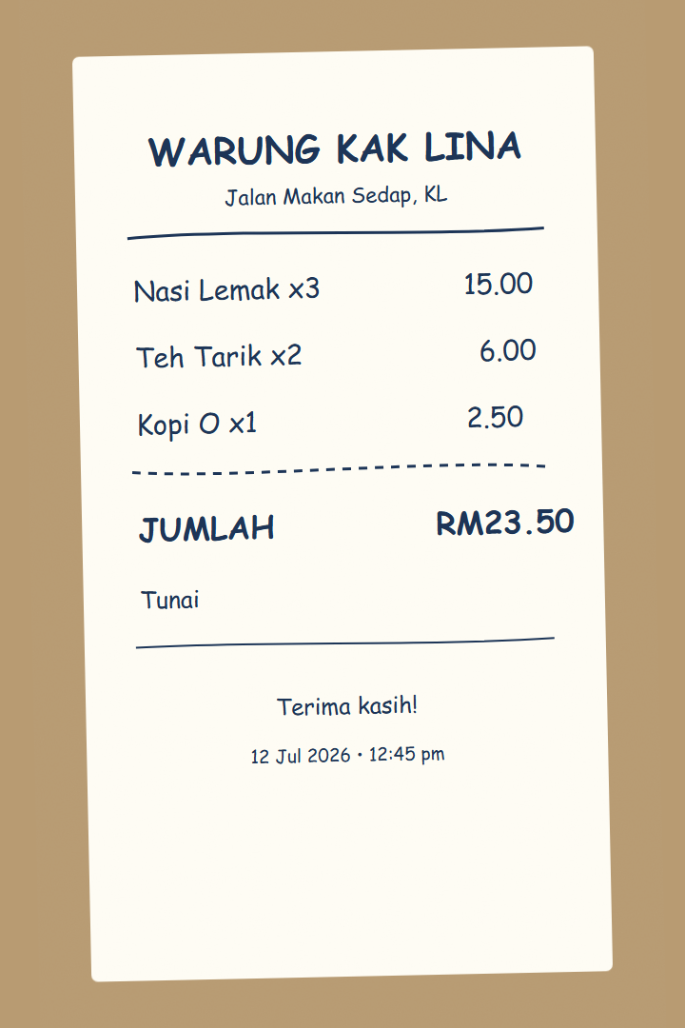




Fast, but never careless
Review before save
OCR and voice drafts are confirmed by the owner — never auto-committed to the ledger.
10-minute undo
Mis-tapped during the rush? One tap removes the sale and puts the stock back.
Inventory follows sales
Every sale decrements stock; deleting restores it; low-stock alerts fire before the pot is empty.
Private by design
Per-user data enforced by Postgres row-level security. Receipts are read on the phone — images never leave it.
The demo receipt — handwritten, scanned live, reviewed before saving.
Notes:
This exact handwritten receipt is scanned during the demo. Point out the review table: the owner corrects the OCR before anything is saved. Undo covers the remaining human error.

Slide 6





The ledger talks back
Week vs week — Margin, revenue and profit deltas — not just totals.
Daily net profit — Demo Stall (RM)
Profit leaks — Flags dishes selling below cost or under 15% margin.
Slow movers — Includes products with zero sales — the ones owners forget exist.
Tomorrow's prep — Weekday-aware suggestions from the same weekday in past weeks.
Business story — One sentence on why the week went the way it did.
Computed from records on-device — no AI API, no cost, works offline.
Notes:
Deliberate call: insights are computed, not LLM-generated. Instant, free, private, and works with zero connectivity. The "business story" is rule-based and translated like everything else.

Slide 7




Made for the warung, not the boardroom
Installs like an app
Weekly report
WhatsApp share
Progressive Web App (PWA) — add to home screen from the browser. No app store, no update friction.
A print-ready summary for the accountant — or the micro-loan application.
Daily closing summary straight to the family group chat.
Notes:
Language is not a checkbox: voice recognition, date formats and pluralization all follow the picker. A Chinese-speaking aunty and a Malay-speaking uncle can share one device.

Slide 8



Under the hood
React 18 + Vite, code-split
39
automated tests — parsers, insights, i18n parity, components
The OCR engine ships only when someone actually scans — the app stays light on cheap phones.
Supabase Postgres + RLS
3 × 360
UI strings, full parity across BM / EN / 中文 enforced by a test
Row-level security separates every vendor; sales are written through an atomic RPC.
On-device OCR (Tesseract.js)
4
capture modes feeding one reviewed pipeline
Receipt images are processed in the browser and never uploaded anywhere.
Structured-data i18n engine
0
secrets shipped to the client — and no per-use AI cost
Libraries return data, the UI owns the words — so every insight exists in all three languages by construction.
Notes:
Engineering judges: the i18n architecture is the deep cut — the insight engine returns typed data, never sentences, so nothing can exist in only one language. 39 tests run in CI fashion via npm test.

Slide 9
See it live — five stops, three minutes
Try the Demo Stall — one click on the login screen loads five weeks of realistic stall data. Browser-only, no account, no setup. An in-app guide follows this exact route.
1
2
3
4
5
Busy Mode
Receipt scan
Daily closing
Analytics
Weekly report
Tap products, pick Tunai or QR, save a rush-hour sale in seconds.
Scan the handwritten receipt; review and correct before saving.
Sales, profit, payment split and business health for today.
Winners, profit leaks, slow movers and tomorrow-prep.
Print or save as PDF — take the week to the accountant.
Undo safety net: any mis-tap during the demo is reversible for 10 minutes.
Notes:
If anything goes sideways mid-demo, use the undo — it is itself a feature. The walkthrough panel in-app shows these same five stops with a script per stop.

Slide 10
LANGUAGE 01 / 03
Mulakan dalam bahasa yang paling selesa.
warungAI
Bahasa Melayu
Selamat petang, Kak Lina
Jualan hari ini
RM 486.50
Dari salam hingga rekod jualan, WarungAI bercakap Bahasa Melayu dengan jelas dan pantas.
+12.8% dari semalam
Nasi lemak
RM 90.00
18 dijual hari ini
One tap changes every label, prompt and voice setting.
Rekod jualan
Ringkasan | Jualan | Stok
WarungAI Â· built for every shift

Slide 11
LANGUAGE 02 / 03
Switch once. Work naturally in English.
warungAI
English
Good afternoon, Kak Lina
Today's sales
RM 486.50
The same fast sale flow, with every label and prompt immediately ready for an English-speaking team.
+12.8% vs yesterday
Nasi lemak
RM 90.00
18 sold today
One tap changes every label, prompt and voice setting.
Record sale
Overview | Sales | Stock
WarungAI Â· built for every shift

Slide 12
LANGUAGE 03 / 03
一键切换，中文界面立即就绪。
warungAI
中文
下午好， Lina姐
今日销售
RM 486.50
从问候到销售记录，所有界面文字都切换为中文；语音输入也会跟着改变。
+12.8% 从昨天
Nasi lemak
RM 90.00
卖了18个
一键切换所有标签、提示和语音设置。
记录销售
总览 | 销售 | 库存
WarungAI Â· built for every shift

Slide 13
THEME 01 / 02
Light mode for the first prep of the day.
warungAI
Light mode
Good morning, Kak Lina
Today's sales
RM 486.50
A crisp, high-contrast workspace that keeps the busy morning flow easy to read.
+12.8% vs yesterday
Nasi lemak
RM 90.00
18 sold today
One tap changes every label, prompt and voice setting.
Record sale
Overview | Sales | Stock
WarungAI Â· built for every shift

Slide 14
THEME 02 / 02
Dark mode for the last close of the night.
warungAI
Dark mode
Good evening, Kak Lina
Today's sales
RM 486.50
The same dashboard, softened for late hours - without changing the sales workflow.
+12.8% vs yesterday
Nasi lemak
RM 90.00
18 sold today
One tap changes every label, prompt and voice setting.
Record sale
Overview | Sales | Stock
WarungAI Â· built for every shift

Slide 15



What's next
Smarter OCR
Atomic inventory
Owner requests
Gemini vision via Firebase AI Logic: structured JSON straight from crumpled, faded or handwritten receipts — and ~350 lines of regex parsing retired. App Check keeps the key out of the client.
Move stock math into Postgres functions so a sale and its stock change succeed or fail together — no drift under concurrent rush-hour devices.
Edit a sale in place, recurring expenses (sewa, utilities), and CSV export — the paperwork micro-lenders and accountants actually ask for.
Everything above builds on what already works today — nothing on this slide is required for the demo.
Notes:
Roadmap is deliberately small and concrete. The OCR migration is scoped, not aspirational: Firebase AI Logic solves the API-key problem client-side via App Check.

Slide 16
Terima kasih.
Record the rush. Understand the week.
The Demo Stall is one click away — no account needed.
Notes:
Close by inviting judges to try it themselves — the demo works on their own phones via the URL, one click, no signup.

