Slide 1
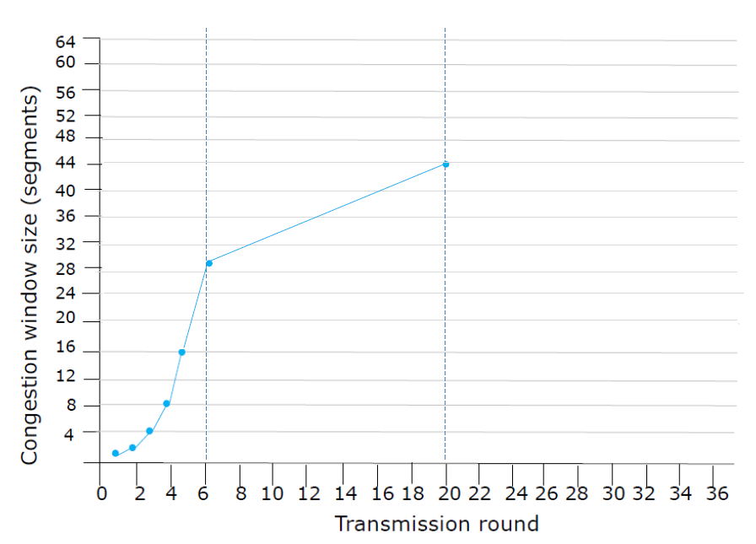
ssthresh
ssthresh

