Slide 1

Using D3.js to create data visualisations
30/08/2018

Slide 2
Contents
D3 in a nutshell
What does it look like?
A concept map of involved technologies
Basic operations
Example:
HTML / CSS vs D3
‘fun’ extensions of example 1
Hacking templates

Slide 3
D3.js in a nutshell
D3: Data-Driven Documents
D3.js is a JavaScript library for manipulating documents based on data
D3 helps you bring data to life using HTML, SVG, and CSS
D3’s emphasis on web standards gives you the full capabilities of modern browsers
Without tying yourself to a proprietary framework
combining powerful visualization components and a data-driven approach to DOM manipulation.

Slide 4
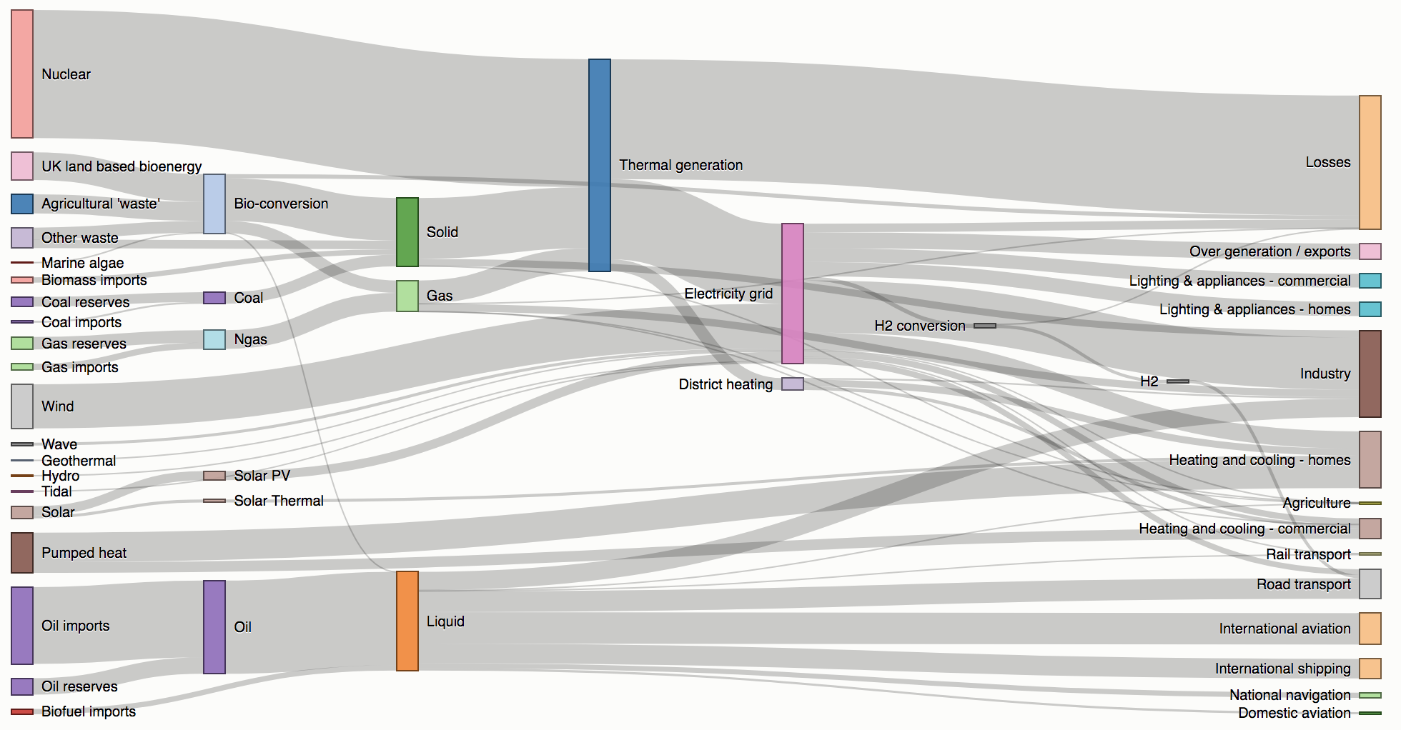
What does d3 look like?
Sankey Diagram

Slide 5
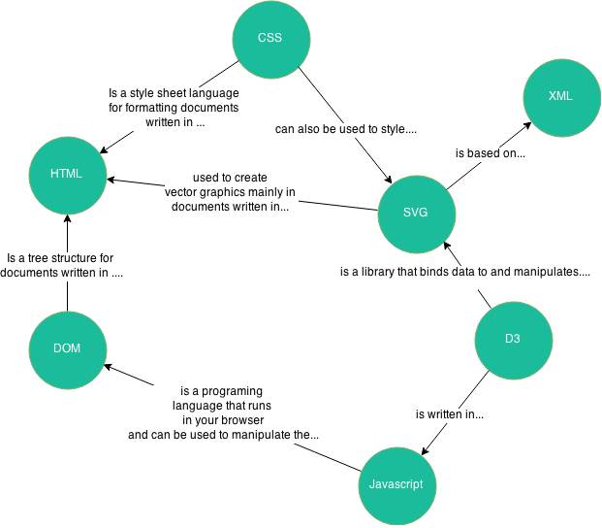
Concept diagram

Slide 6
4 basic operations
Selections
select() and selectAll() can be used to select one or all elements, e.g. “p”
Selections can be based on (a.o.) the tag, class, ID, attribute value,…
Enter and Exit
Can be used to create and remove nodes based on data
Append
Appends a new element for each data point
Transformation
D3 does not introduce new visual representations
Uses HTML, SVG, and CSS
Transitions
E.g. fading a colour from white to black, resize circles
Transitions gradually interpolate styles and attributes over time

Slide 7
Example HTML / CSS vs. D3

Slide 8
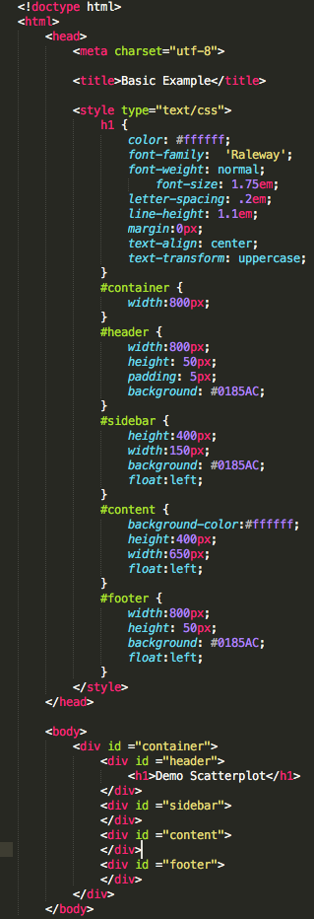
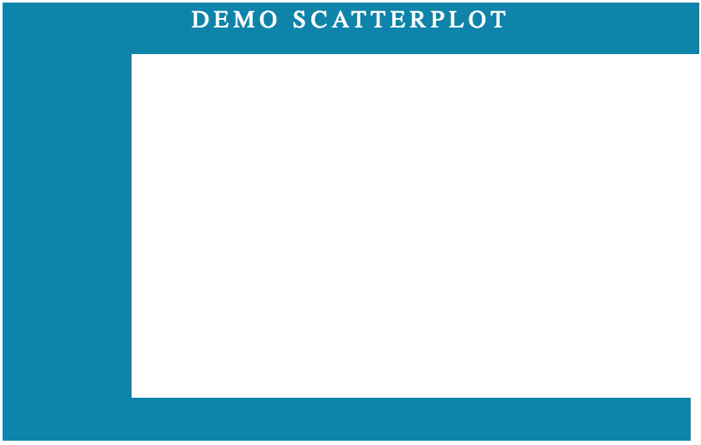
Basic HTML & CSS

Slide 9
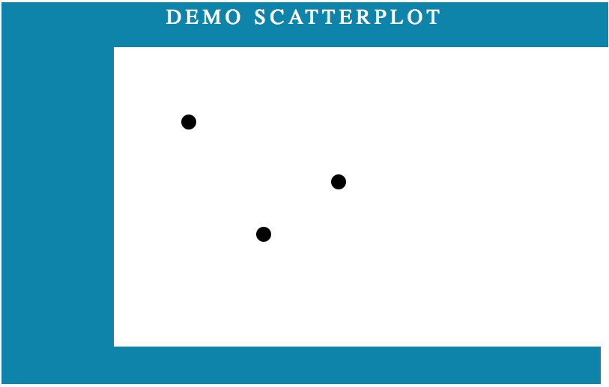

Adding SVGs and circles manually

Slide 10
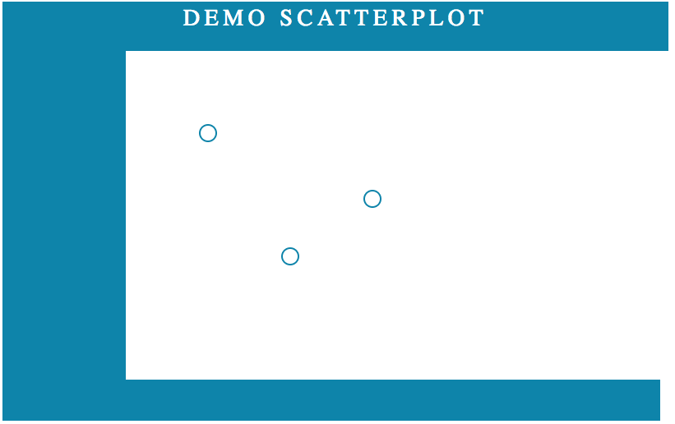

Changing the appearance of circles

Slide 11
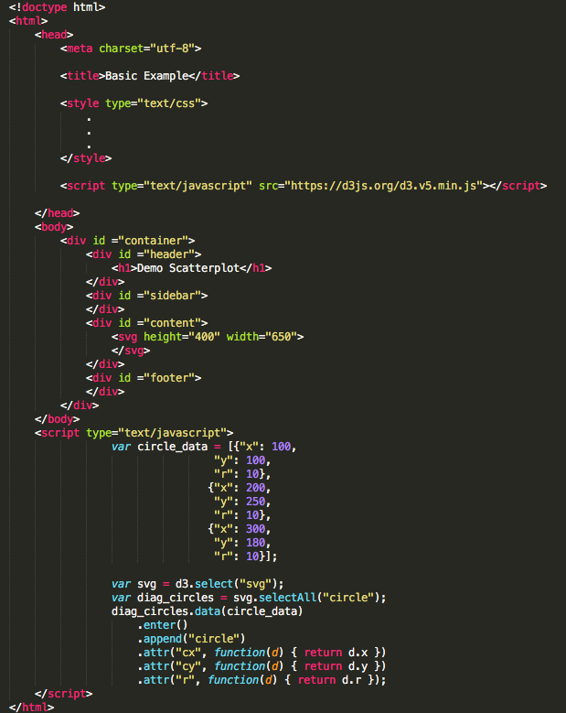
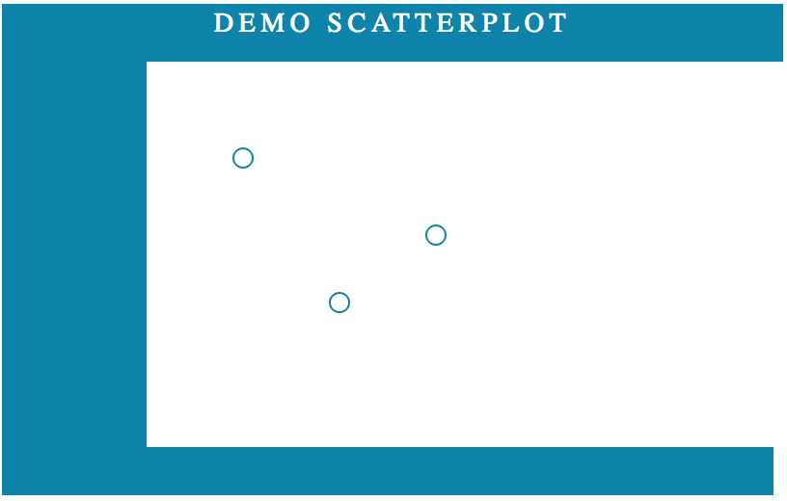
The d3 version

Slide 12
A bit of D3 ‘fun’

Slide 13
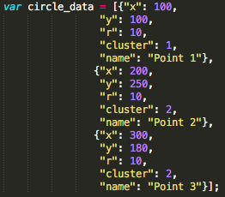
Adjusted data

Slide 14

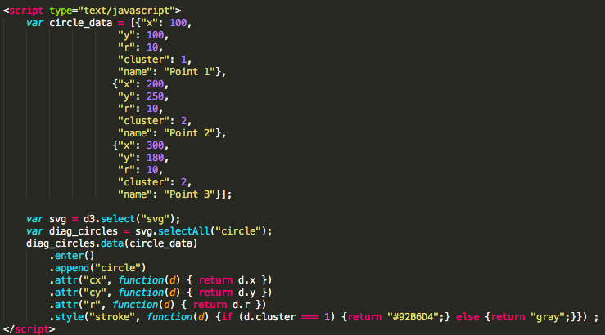
Conditionally changing the stroke colour

Slide 15
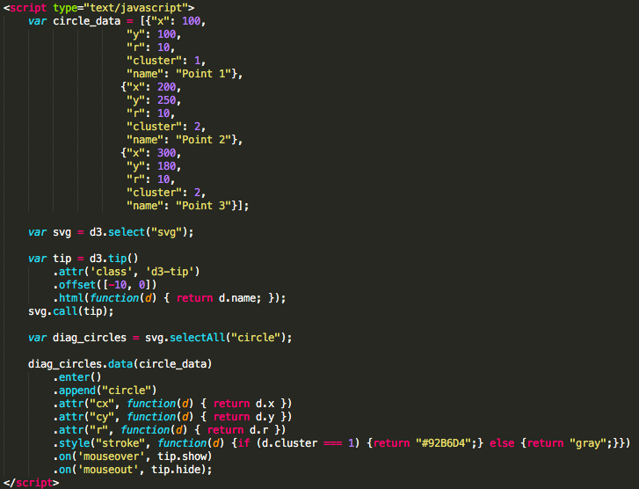
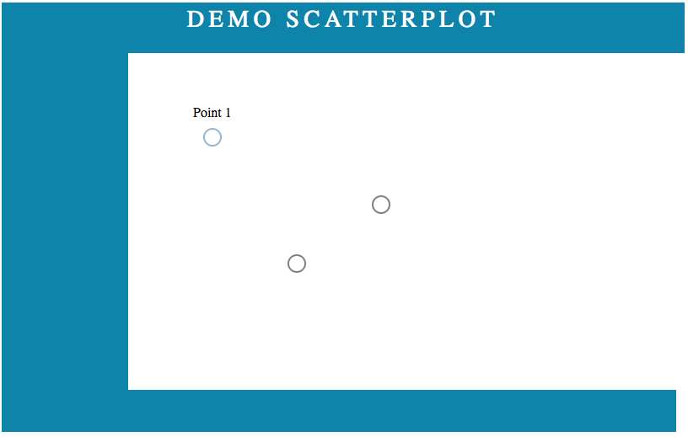
Adding tool tips

Slide 16
D3 axes
D3 axes have a
Domain
The values it is capable of representing
Range
Begin and end point of axis line within the svg

Slide 17
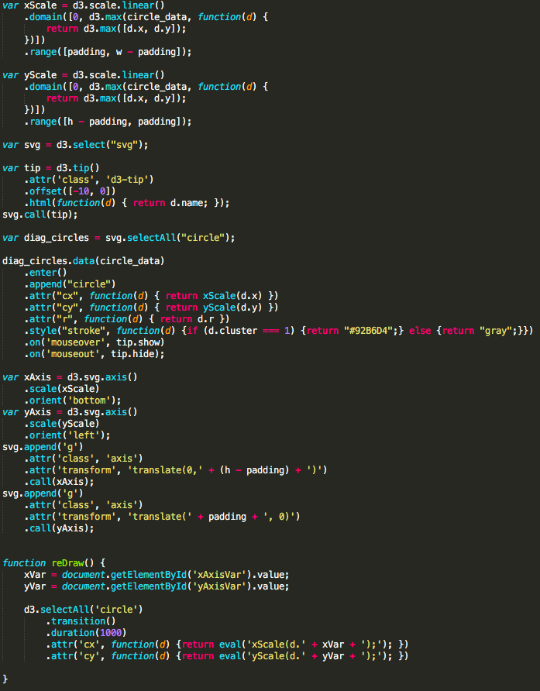
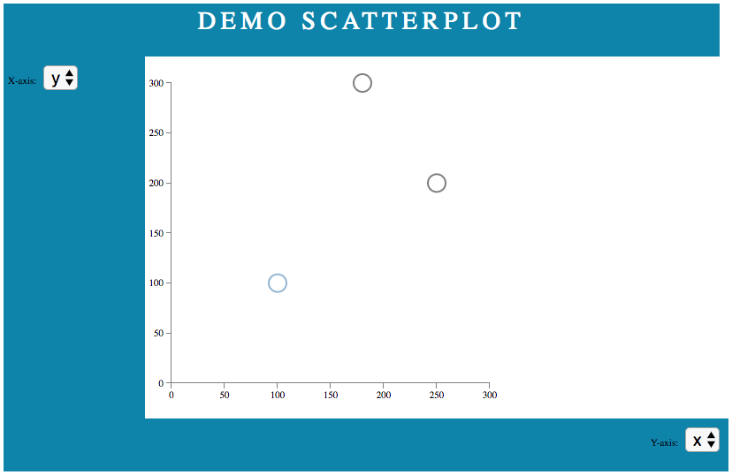
Transformations / Interactivity

Slide 18
Hacking D3 templates
Lot’s of templates available
https://bl.ocks.org/mbostock
Process:
Look for template that looks like something you want to achieve
https://bl.ocks.org/mbostock/4063269
Recreate original to rule out any errors
Check the input data, adjust yours as much as possible
Add additional features as necessary

Slide 19
Sources
https://d3js.org/
https://bl.ocks.org/mbostock
https://bost.ocks.org/mike/sankey/
http://www.coppelia.io/2016/01/from-zero-to-d3/

Slide 20
























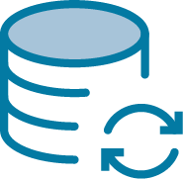










Pictures and icons
Logo
Standorte
Icons

