Slide 1


Project Presentation
Building a Journey Autopilot with BCG & DB
22.07.2026

Slide 2






The Team
Laurin Breuer
Martin Nikoljacic
Christian Sahler
Clemens Schädel
Hendrik Mehl
22.07.2026

Slide 3
RECAP & PLAN
01
22.07.2026

Slide 4
Our vision across 6 dimensions
“Turning every disruption into a solved problem for rail customers”
Disruption Monitoring
Predicts delay risk hours ahead from live operational data
Replanning & Rerouting
Ranks alternative DB routes against personal preferences
Calendar Integration
Preference profile and Outlook calendar reveal every travel constraint
Compensation
Detects passenger rights claims and files them automatically
Stakeholder Communication
Proactive updates via WhatsApp and e-mail – user keeps veto control
Booking & Ext. Options
Hotels, Flinkster, Call-a-Bike and taxis when trains cannot run
22.07.2026

Slide 5
Project Plan across 6 Feature Streams and 1 Tech Stream
Action Plan Record
Affected Agents
Importance
Ownership
🟢 Capture preference profile via onboarding (class, seat, speed vs. comfort, home base)
🟢 connect DB Account (mocked)
🟢 Connect Outlook Calender
🟢 Derive hard & soft travel constraints from calendar events
🟢 Provide user-friendly UI
Orchestrator
Onboarding & Calendar
Context
Essential
Persistence
🟢 Ingest live ops data from API
🟢 Score disruption risk hours ahead using historic delay patterns
🟡 Calculate Risk Score and Confidence
🔴 Wake the Orchestrator when the score crosses the configured threshold
🟡 Surface the live score & rationale to the user on demand
Monitoring
Disruption Monitoring
Risk-Modell
Essential
🟢 Generate alternative DB routes under user constraints
🟢 Rank options against the user's preference profile
🟢 Display alternative Route to User and ask to accept or decline
Planner
Replanning & Rerouting
Orchestrator
Essential
Feature Streams
🟢 Establish Connection to WhatsApp and Outlook
🟢 Present rerouting options and capture the user's veto
🟢 Deliver disruption updates via E-Mail to stakeholders
🟢 Confirm executed actions to the traveler and all impacted meeting participants
Stakeholder Comunication
Communicator
Essential
Veto-Gate
🟢 Load passenger rights via Web Scraping into a RAG store
🟢 Detect passenger rights eligibility
🟢 Automatically file claims with the required data (mocked)
🔴 Track claim status and communicate with user
Planner
Compensation
Executor
Essential
🔴 Book / modify train tickets if necessary
🟡 Search and book hotel if no train is running
🟡 Always ask User for Approval
🟡 Check Flinkster, Call-a-Bike Availability
🔴 Check and. book taxis if necessary
Executor
Booking & Ext. Options
Veto-Gate
Optional
Policy
🟢 Multi Agent Architecture
🟢 Clearly defined Tool Calls and implementation
🟡 Architectural Decision Records
🟡 Database with consistent storage
🟢 One-command Docker setup
Architecture
All Agents
Foundation
Tech
🟢 Done 🟡 WIP 🔴 Not started
22.07.2026

Slide 6
OUR Solution
02
22.07.2026

Slide 7











Our Architecture employs a Multi-Agent-Setup
Claude Sonnet 4.6
Memory
Chat Model
Memory
Send WhatsApp Message
Orchestrator
Agent
Orchestrator · ReAct
Reply in chat
On start of the autopilot
Tools
Monitoring
Agent
true
Planner
Agent
Communi-cator Agent
Executor
Agent
false
If risk of disruption
Passenger
Rights RAG
DB Live Data
Delay History
Risk Model
DB Reroutes
Calendar
Train Alternatives
Hotels
Outlook Mail
WhatsApp
Booking
Reschedule
Compensation
22.07.2026

Slide 8
Our Architecture employs a Multi-Agent-Setup
Claude Sonnet 4.6
Memory
Chat Model
Memory
Send WhatsApp Message
Orchestrator
Agent
Orchestrator · ReAct
Reply in chat
On start of the autopilot
Tools
Monitoring
Agent
true
Planner
Agent
Communi-cator Agent
Executor
Agent
false
If risk of disruption
Passenger
Rights RAG
DB Live Data
Delay History
Risk Model
DB Reroutes
Calendar
Train Alternatives
Hotels
Outlook Mail
Booking
Reschedule
Compensation
22.07.2026

Slide 9

Deep Dive Data Sources
Live DB Data
db-vendo-client
github.com/public-transport/db-vendo-client
Delay History
Deutsche Bahn Data Project
piebro.github.io/deutsche-bahn-data
Calendar & E-Mail
Microsoft Outlook
outlook.office.com
Hotels
OpenStreetMap
openstreetmap.org
WhatsApp Messaging
Twilio API
twilio.com
Passenger Rights
bahn.de passenger rights
bahn.de/service/informationen-buchung/fahrgastrechte
22.07.2026

Slide 10
DEMO
03
22.07.2026

Slide 11
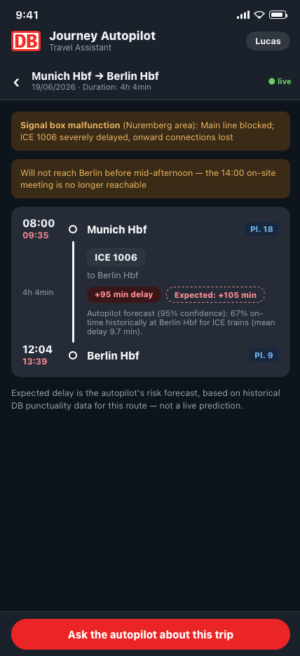
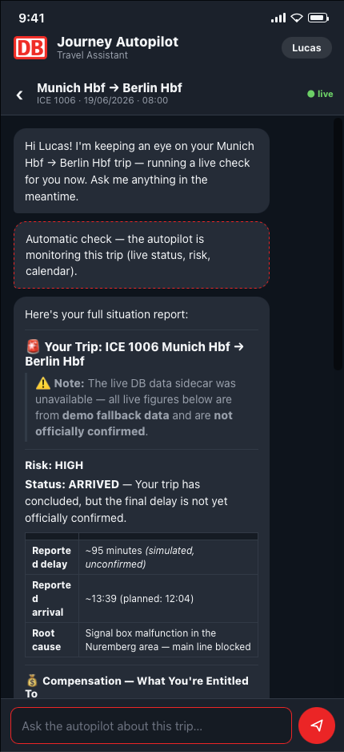
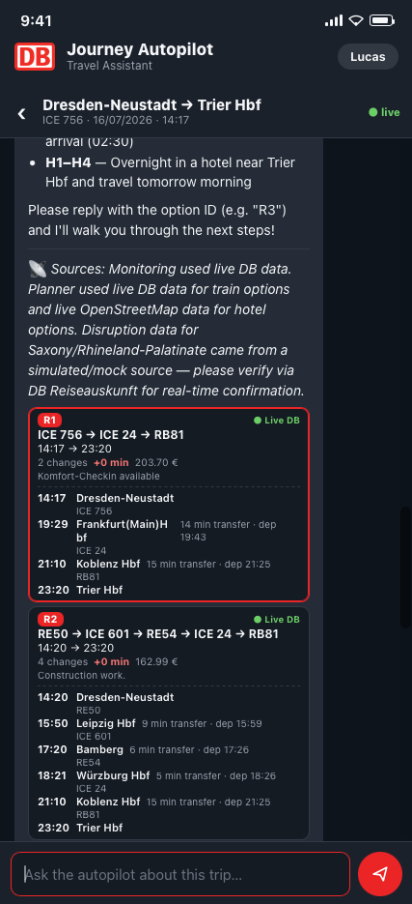
Demo
22.07.2026

Slide 12
OUTLOOK
04
22.07.2026

Slide 13
Outlook
Limitations
Next Steps
Mocked data – hotel booking and taxi are not yet live
Token usage – current tokenomics are inefficient
Risk score – based only on expected delay derived from historical train data
Build out open points
Taxi integration, risk score improvements, booking flow
Broaden what users can ask
Flexible requests, e.g. passenger-rights questions, hotel bookings
Improve performance & UX
Cut loading time, stream agent progress live
22.07.2026

Slide 14
Thank you!
22.07.2026

Slide 15
Backup
05
22.07.2026

Slide 16
Architectural Decisions
Google ADK
Why: Native multi-agent support, tool calling & session state out of the box
Trade-off: Framework lock-in vs. raw LLM APIs
Orchestrator Pattern
Why: Coordinates Monitoring, Planner & Communicator agents with context isolation
Trade-off: Single coordination point – must stay lightweight
ADR-01
ADR-02
Passenger rights RAG
Why: Claims grounded in official passenger rights rules – no hallucinated entitlements
Trade-off: Knowledge base must be kept up to date
SQLite Persistency Store
Why: Lightweight store for preferences, trips & agent state – zero-ops, file-based
Trade-off: Limited concurrency – fine for single-user scope
ADR-03
ADR-04
22.07.2026

Slide 17
Resolved Pain Points & Business Impact
Resolved pain points
Business impact
Arriving late to meetings
Predictive rerouting hours before disruptions hit
For DB
Turn stress into loyalty – every solved disruption becomes a BahnBonus engagement moment
Keep the top 1 % – BC100 & B2B frequent travelers stay instead of defecting to plane or car
Own the rescue – rebooking via Sprinter, Flinkster & partner hotels keeps every euro inside the DB ecosystem
Data flywheel – every trip sharpens prediction & preference profiles competitors can’t copy
Stress during delays & missed transfers
Autopilot replans proactively – traveler just confirms
Manual search & rebooking effort
Ranked alternatives booked across the DB ecosystem
Compensation requires manual claims
Passenger rights claims detected & filed automatically
22.07.2026

Slide 18
Naive Baseline Comparison
PROMPT
PROMPT
ANSWER — CLAUDE Sonnet 4.6
My ICE 1006 from Munich to Berlin is heavily delayed, and I have an important on-site meeting in Berlin at 14:00. Please assess the situation, find the best alternative, and tell me what I should do.
I can't actually help with this right now.
WHY — NO ACCESS TO
Real-time train data (delays, live schedules)
DB (Deutsche Bahn) live departures
Your location, or the delay length
WHAT TO DO NOW
Check now: DB Navigator / bahn.de for live connections; ask staff for the estimated arrival
Call DB: 0800 150 7090 (free, 24/7) to rebook the fastest route
Alternatives: earlier ICE or a flight (Munich→Berlin ~1h); alert your Berlin contact now
Compensation: delay >60min qualifies under EU rail rules
To plan properly: what time is it now, and how delayed is the train? Always verify with DB for live data.
22.07.2026
Notes:
Claude Sonnet 4.6 answer: I want to be genuinely helpful here, but I have to be straight with you:
## I Can't Actually Help With This Right Now
**Here's why:**
- I have **no access to real-time train data** (current delays, live schedules)
- I can't check **DB (Deutsche Bahn) live departures**
- I don't know your **current location, time, or how delayed** the train is
- I can't see **available alternatives** right now
## What You Should Do RIGHT NOW
**1. Check immediately:**
- **DB Navigator app** or **bahn.de** → real-time connections
- Ask **train staff** for the current estimated arrival
**2. Call DB Hotline:**
- 📞 **0800 150 7090** (free, 24/7)
- They can rebook you on the fastest alternative
**3. Consider alternatives if delay is severe:**
- Earlier/faster ICE on the same route
- **Flight** (Munich → Berlin ~1h, check Lufthansa/Ryanair)
- Inform your Berlin contact **now** so they can prepare a backup plan
**4. Protect yourself:**
- If delay >60min, you're entitled to **compensation under EU rail rules**
---
**The single most useful thing I'd need to help you plan:** What time is it now, and how delayed is the train? Even then, please verify with DB directly for live data.

