Slide 1
Food Volume & Calorie Estimation
VORGESTELLT VON
Lukas Lommer & Polina Kochmar
MODELL & PROJEKT
Clemens Dieterich , Jochen Lichtenscheidel , Nico Gergen

Slide 2
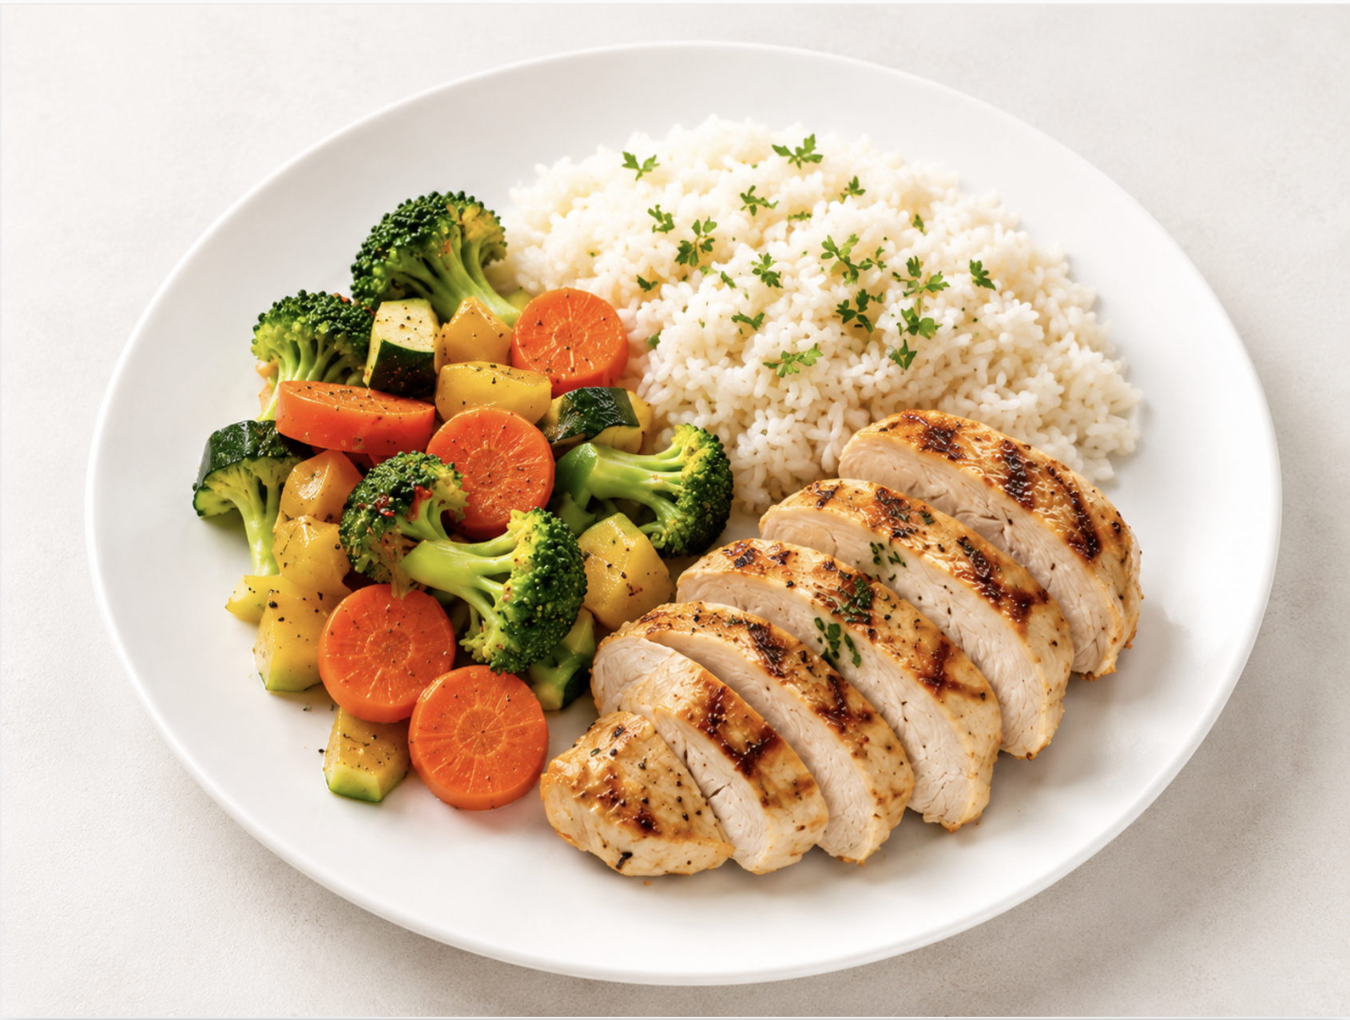
Food Volume & Calorie Estimation
How much food is on the plate?
?
?
How many grams?
?
How many calories?
Estimate food amount and calories from plate images
Volume | Grams | Kcal estimation

Slide 3



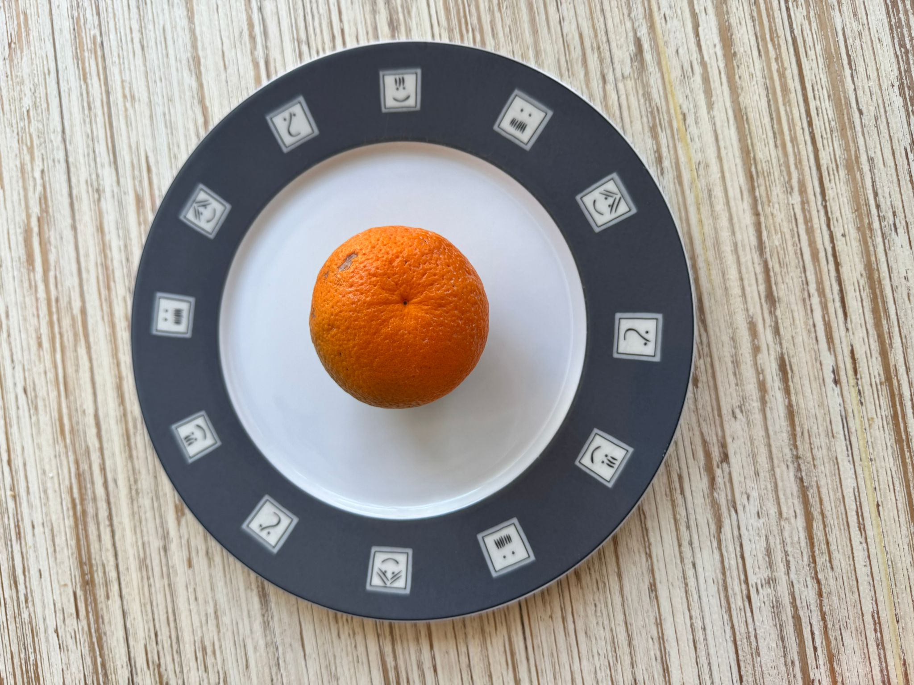
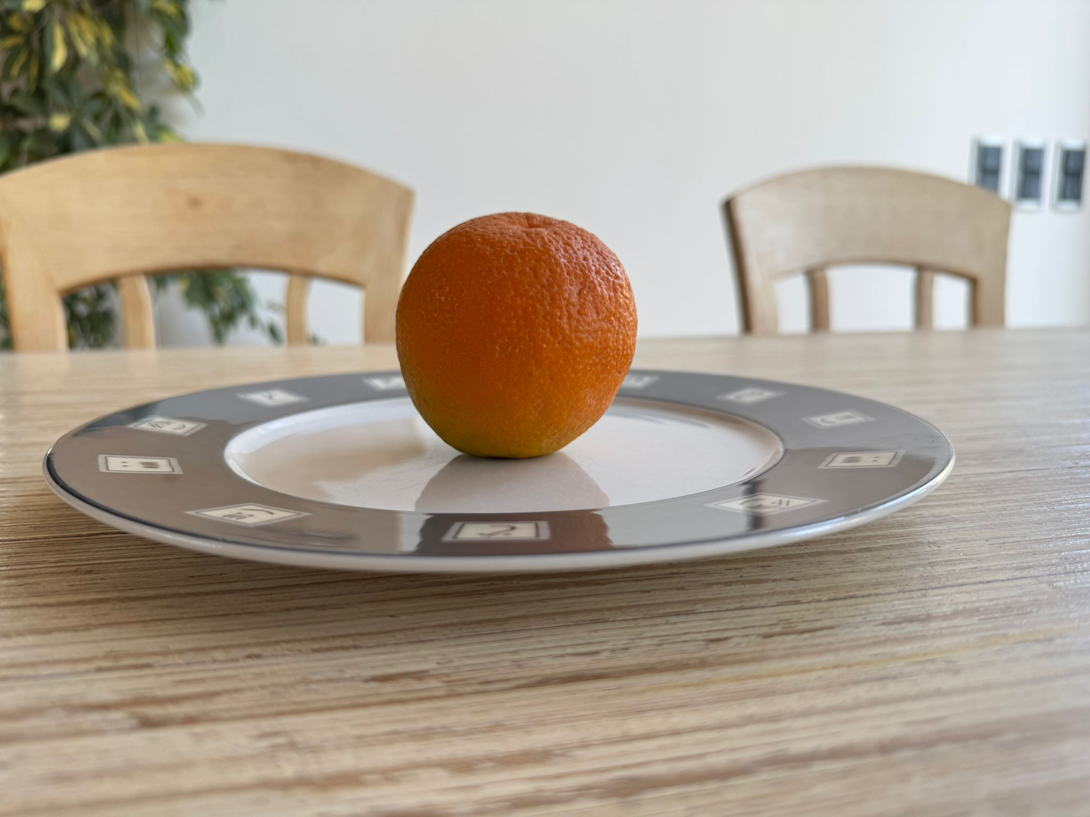

Input Data & Challenge
Reliable estimation depends on image perspective and available visual information.
Top Image
Side Image
Visible: food area on the plate — shape and footprint of each item.
Visible: food height and profile — key input for real 3D volume.
Without a side image: no reliable real volume — only a grams-based fallback is possible.
Top + Side
Only Top
Real volume estimation (ml)
Grams fallback — no real volume

Slide 4

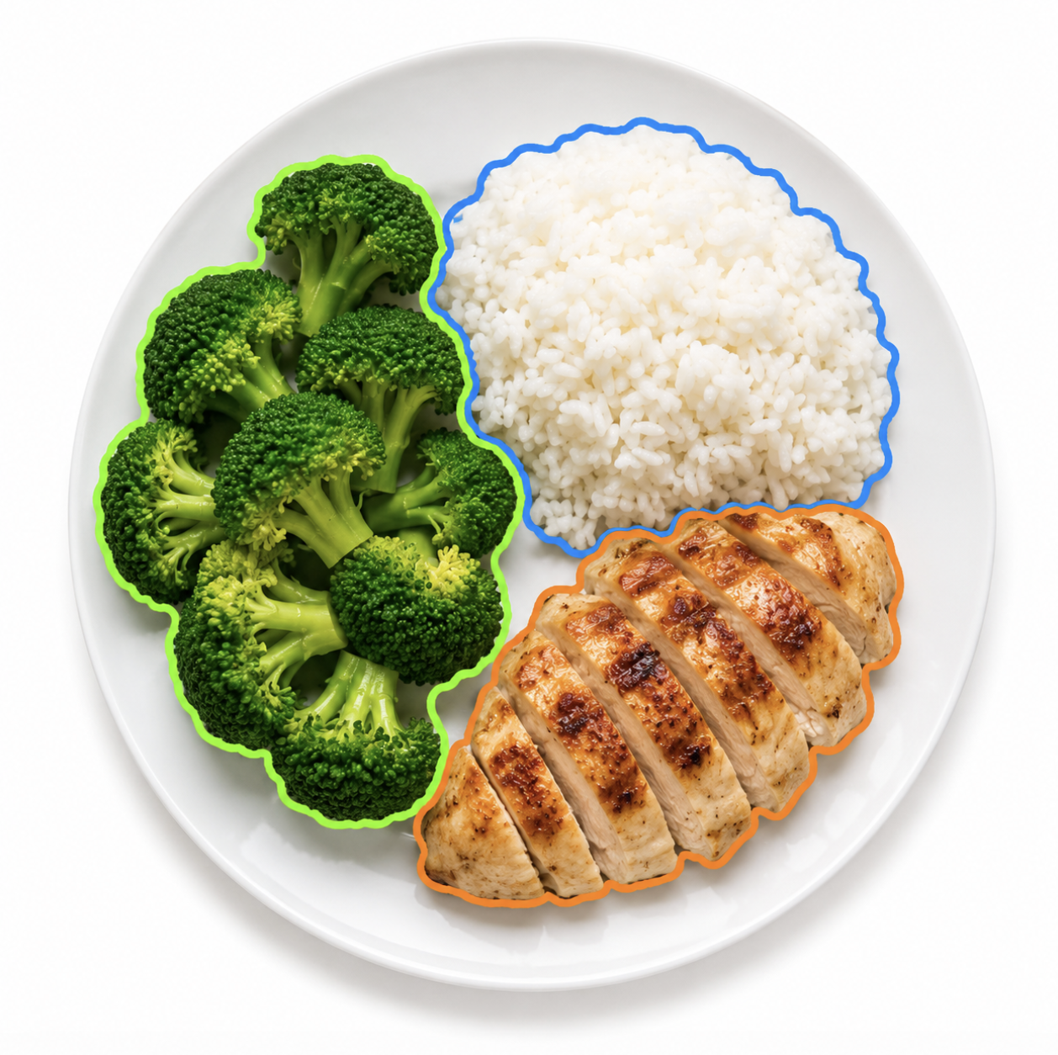







CRISP-DM Pipeline
Images are transformed into model-ready features before estimation.
Image
Segmentation
Food Recognition
Feature
Extraction
Volume / Grams
Calories
Pipeline Components
FastSAM
CLIP
Gradient Boosting Regressor
Segments individual food items on the plate.
Recognizes / filters food classes by semantic similarity.
Volume fallback using area_cm2, height_cm, area_x_height.

Slide 5



Evaluation Results
The model works, but performance depends strongly on image quality and viewpoint.
Evaluation
Limitations
MAPE by validation strategy
Photo quality
26.2%
Segmentation errors
19.1%
Scale estimation
KFold
GroupKFold
(by food type)
No reliable volume without side image

