Slide 1
Calling R from Matlab
C. Kreutz
28.2.19

Slide 2
Summary
This function implements the functionality of the R-DCOM Rlink in an alternative manner
The original R-DCOM link works only under windows and is not freely available any more. Moreover, getting it run was always tricky.
Calling R-functions from Matlab covers the following steps:
Initialization: openR
Pushing variables to R: putRdata(‚varname‘, value)
Evaluating R commands: evalR(‚r_command‘)
Picking result variables: getRdata(‚varname‘)
Cleaning up: closeR
Disadvantages:
R is run via command-line
Due to redundant initialization, loading of packages, reading and writing workspaces, executing commands is slower than directly doing it in R
Pusing and picking complex data-types are not yet implemented
Errors messages of errors occuring in R are not visible. Omit closeR and execute evalR.R directly to see error messages.

Slide 3
R
Matlab
putRdata.mat
putRdata
putRdata_cellstr.mat
evalR
evalR.R
global openR.cmd
evalR_execution.R
evalR.rData
calculated in R
getRdata.mat
getRdata

Slide 4
Basic example:
openR;
putRdata('cont',[10,3;5,5]);
evalR('p <- fisher.test(cont,alternative="two.sided")$p.value');
p = getRdata('p');
closeR;
Copy & paste from powerpoint might not work because the character for the quotation marks might be invalid/wrong.

Slide 5
Example with a specific package
Here, it is shown how linear discriminant analysis is executed from the MASS package:
Install the package in R
Run the R function in Matlab
Use only basic variable classes in putRdata and getRdata
global OPENR
OPENR.libraries{end+1} = 'MASS';
openR;
evalR('Iris <- data.frame(rbind(iris3[,,1], iris3[,,2], iris3[,,3]), Sp = rep(c("s","c","v"), rep(50,3))) ')
evalR('train <- sample(1:150, 75) ')
evalR('z <- lda(Sp ~ ., Iris, prior = c(1,1,1)/3, subset = train) ')
evalR('pred <- as.numeric(predict(z, Iris[-train, ])$class) ')
prediction = getRdata('pred');
closeR;

Slide 6
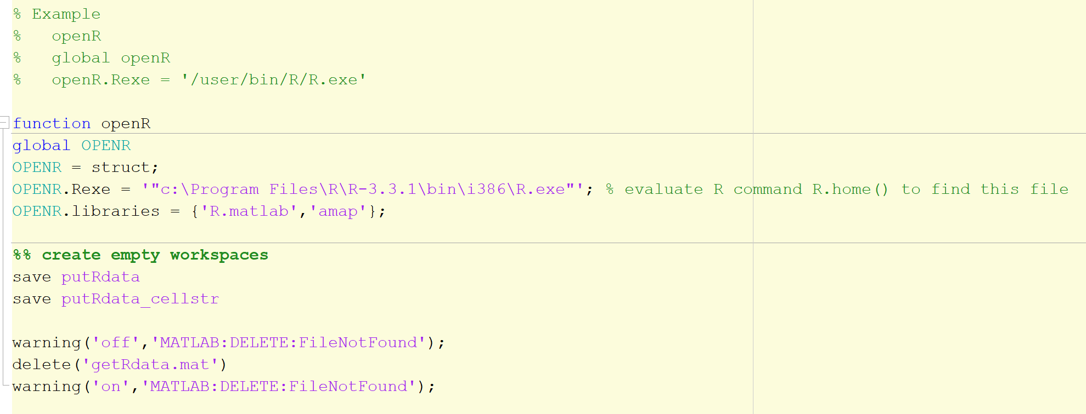
openR

Slide 7
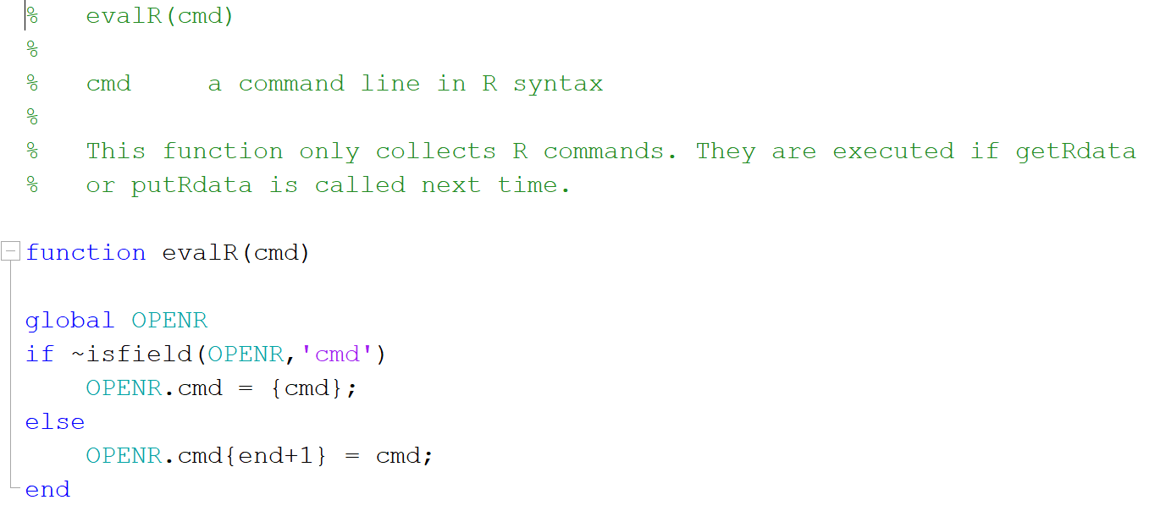
evalR

Slide 8
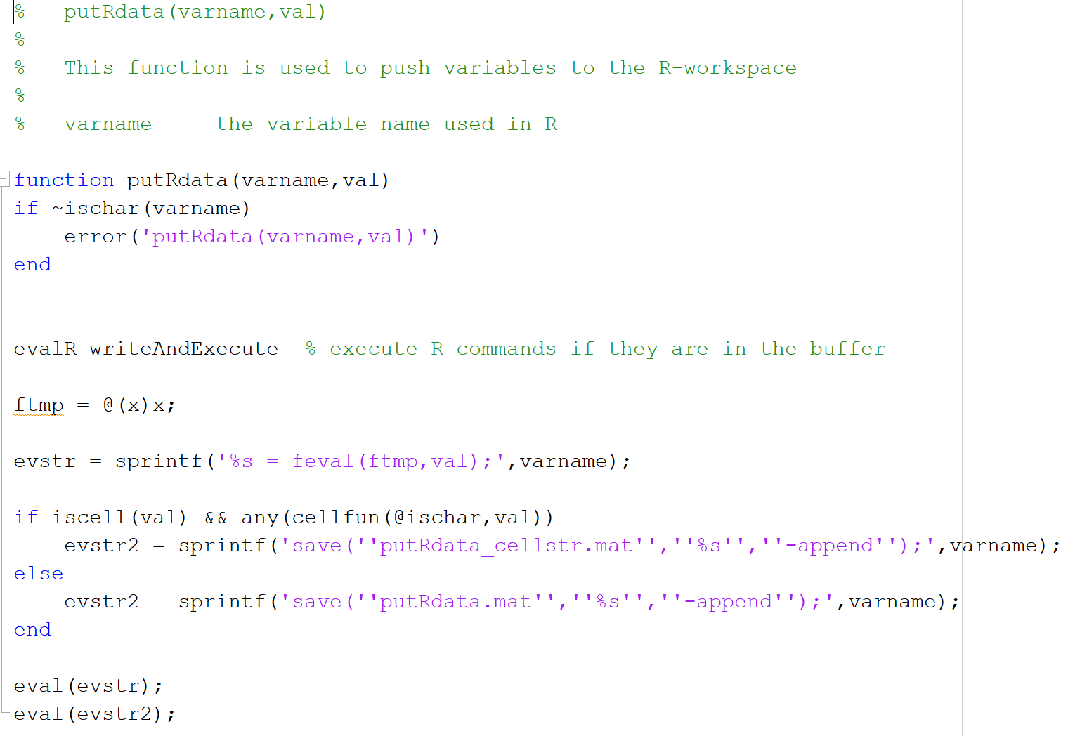
putRdata: saving variables as *.mat

Slide 9
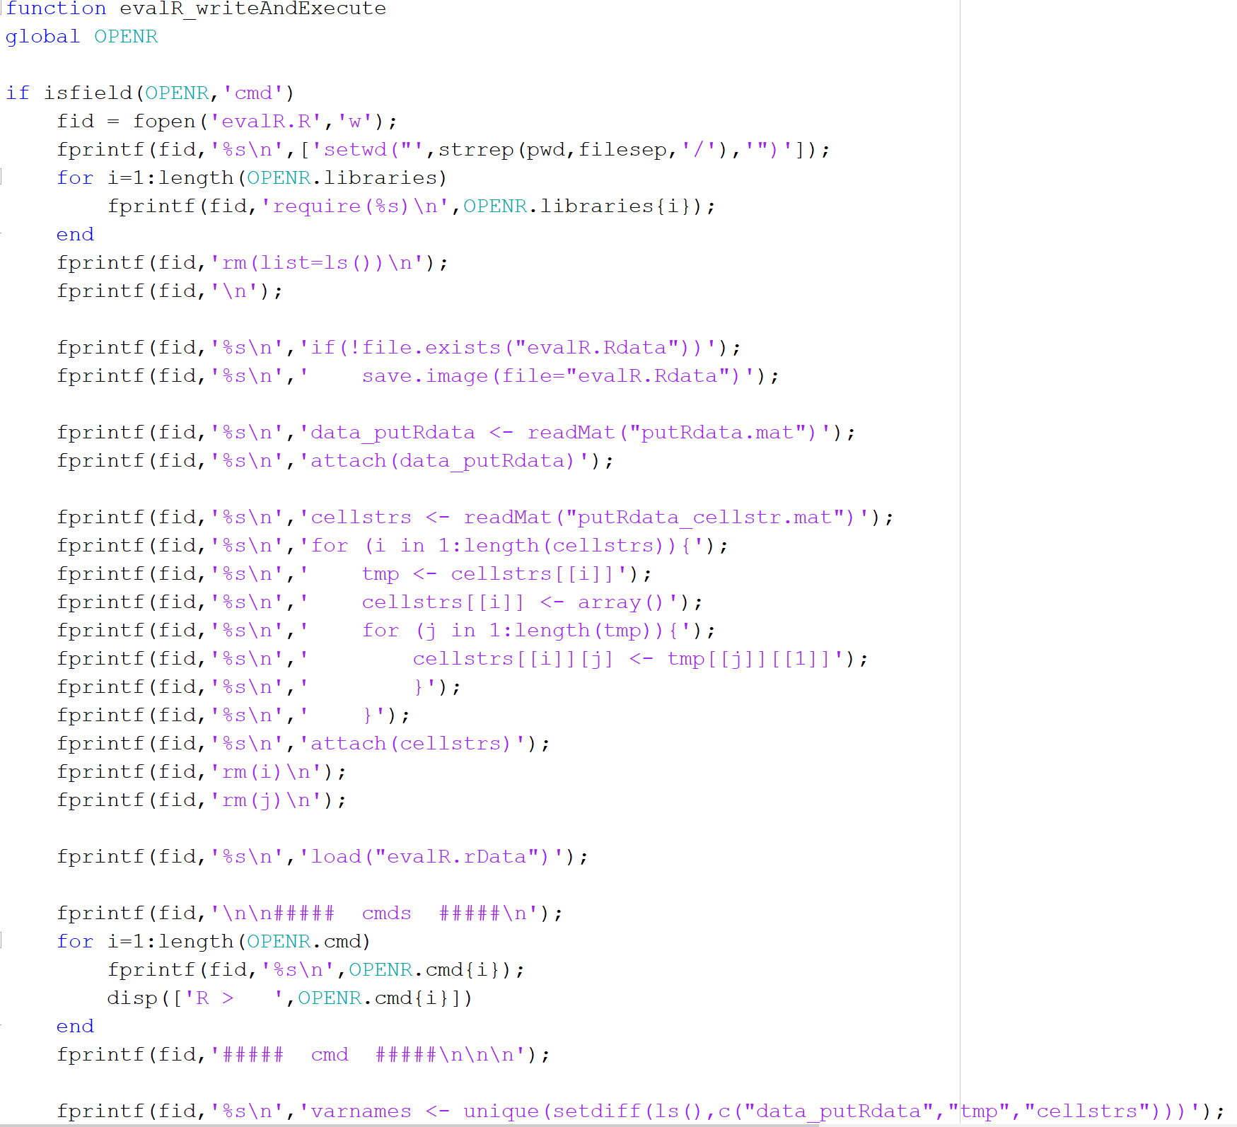
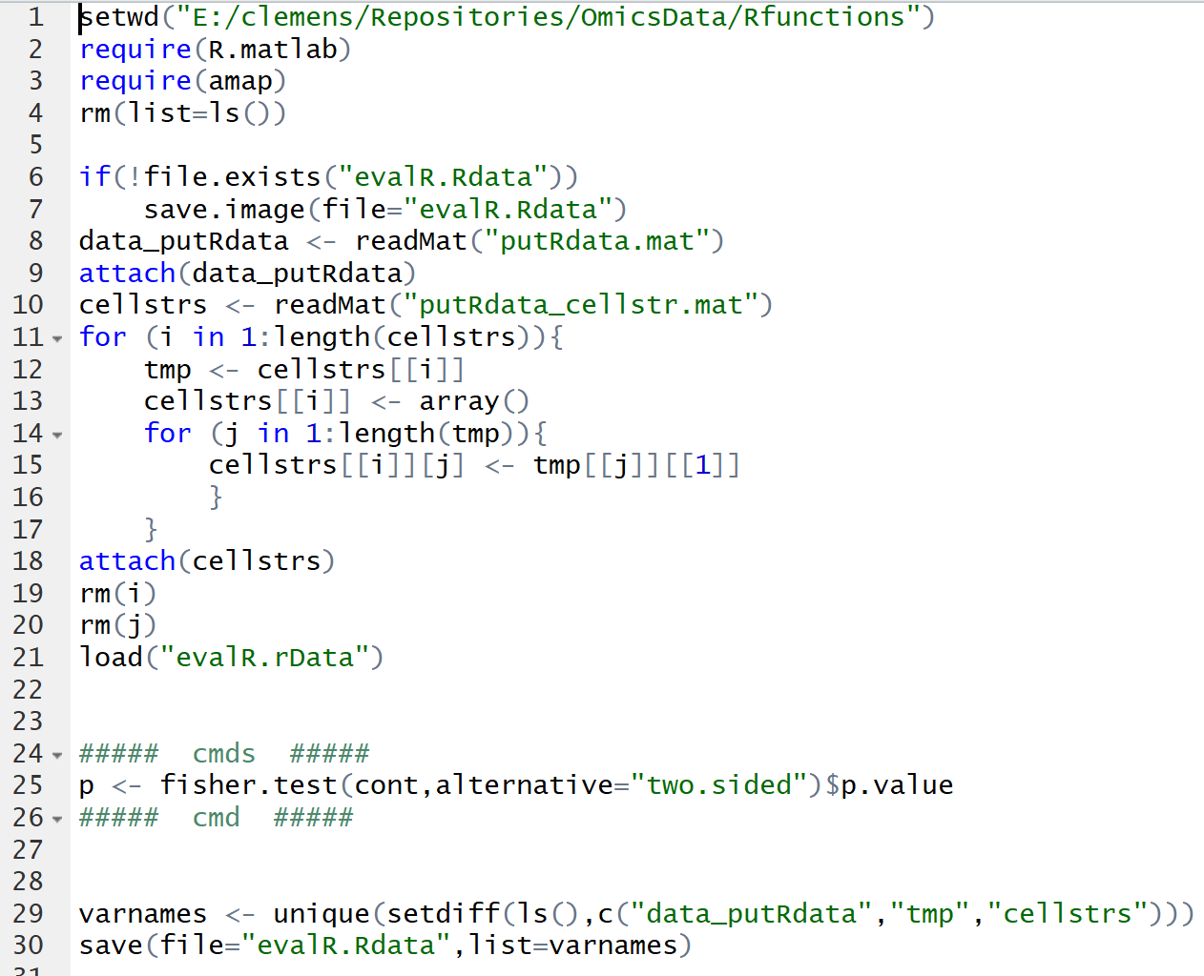
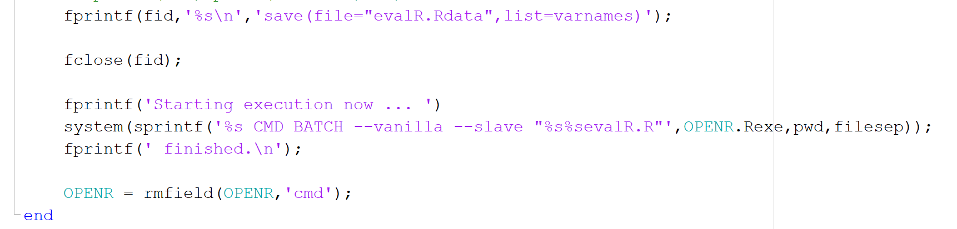
evalR_writeAndExecute: the core function

Slide 10
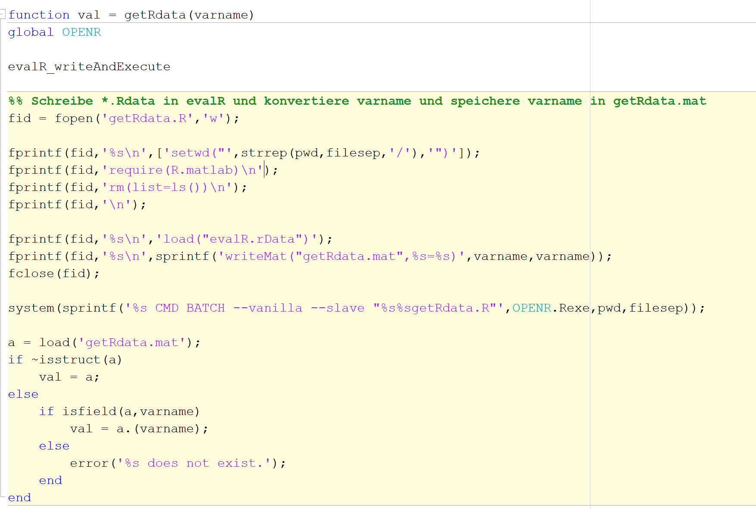
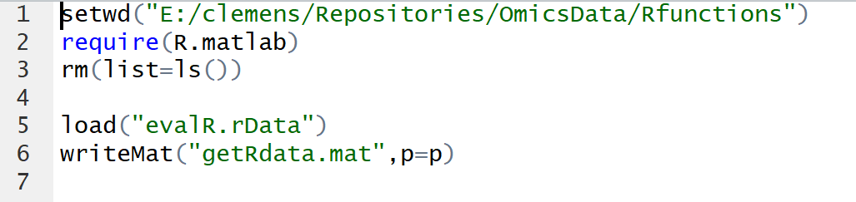
getRdata: picking results
This function is slow.

Slide 11
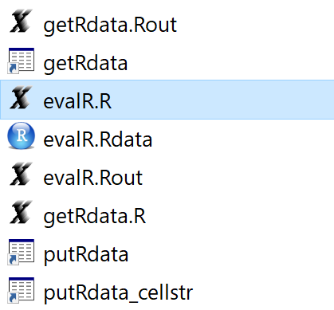
Error/debugging
If the code does not run, do the following:
Comment (or remove) closeR
Run the code again
Check execution of evalR.R in R (by hand via copy & paste)
Check execution of getRdata.R in R (by hand via copy & paste)

